Slide 1

Hebden Green School Coffee Morning
Clare Baker – Post 16 SEN Advisory Officer – CW&C
23rd November 2022

Slide 2
Agenda
Planning for Transitions
Transitions to FE
Supported Internships
Preparation to Adulthood
Conclusion

Slide 3
Planning for Transitions
Start early – as early as Year 7
Use your Annual Reviews to discuss options
We have support from agencies within the Local Authority.
Use the Local Offer and the information in there.
Communicate with your school.

Slide 4
Transition to FE
Annual Reviews take place in the Autumn Term- final plans completed by 31st March.
Use the Live Well site and the Prep for Adulthood Page
We have a transition map for parents and young people.
Home | Live Well Cheshire West (cheshirewestandchester.gov.uk)

Slide 5
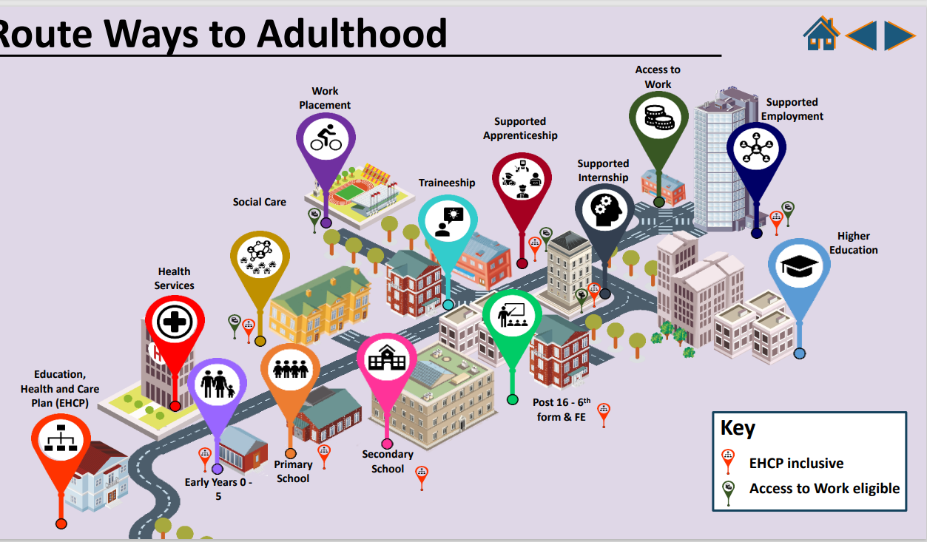

Slide 6

Notes:
Focus to improve employment oppotrunties for our up – focus SI 3rd – 50% into employment – supported into other positive outcomes.

Slide 7

What is a Supported Internship?
An SI is a full-time 1-year study programme that includes tailored employability training alongside an extended unpaid work placement for young people 16-24 years with special educational needs (SEN) in receipt of an education, health and care plan (EHCP).

Slide 8
What is a Supported Internship?
The aim for the programme is to give each learner the best opportunity of securing paid employment at the end of the programme.
Cheshire West and Chester Council’s Skills & Employment team launched its new Supported Internship programme in October 2020.

Slide 9

The Team
Darryl Jones – Supported Internship Co-Ordinator
Jackie Southern – SEN Tutor
Karina Zlocinska – Employment Support Officer
Clare Rolfe – Employment Support Officer

Slide 10
Preparation for Adulthood
Successes
Only LA provider directly delivering SIs
Annual Transition Event
Monthly Webinars
The Post 16 Pathway
Strong College Network

Slide 11
Conclusions
Conclusion
Transition as early as possible
Use support agencies and school
Supported Internship – more employment opportunities.
Remember help is available

