Slide 1

Whilst You Are At Home
We are going to stay in touch
19th January 2021

Slide 2


Slide 3

Positive Message of the Week
Hello Everyone, 2nd week of this 3rd lock down and we are, yet again very proud of you all, we are hearing really good things about how you are following all the safety rules and thinking about other peoples health, safety and well-being at the moment. Keep up the Great work.
A lot of you are working from home along with some of your parents, which means we all have to be patient with one another.
If you are worried about anything please remember to talk to someone you trust.

Slide 4
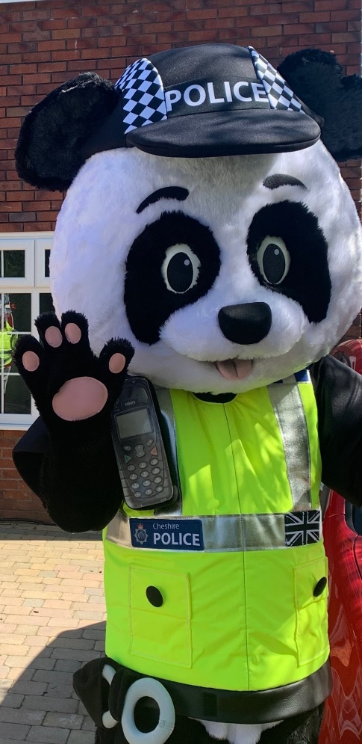



Messages from PC Panda
“Don’t trust anyone with your personal information or photo’s”.
“Remember no playing outside with your friends, just at the moment, this won’t be forever”.
“Think carefully about the pictures you share online!”
“Some of my PCSO friends have said they love the drawings you did of your Christmas presents”

Slide 5
Online Safety
You are all smart children and we want you to remember the Online Safety messages.
Lets follow our Golden Rules.
This week we are going to focus on what we should and should not share with people.
Share
Don’t Share
Kind thoughts
Your location
Personal photos
Creative ideas
Positive messages
Your Address
Gaming advice
Photos of your School uniform
What School
you go to
Happy memories
Holiday Info.
Cartoon Pic’s of your pets
Gaming Passwords

Slide 6


This weeks activities
We would like you to create a picture or poster telling your Parents and the wider community what you know about keeping yourselves safe while Online.
Internet Safety
Never send anything you wouldn’t say in real life.
Never give out your address, phone number, school or your parent’s names without permission.
Never share your passwords with friends.
Never install programs on your devices without permission.
Never agree to meet someone you’ve met online in person.
If you find something online that makes you feel uncomfortable, talk to someone you trust.
Maybe you could place your pictures and thoughts in your windows for passers-by to enjoy ☺

Slide 7













What are you going to share on your devices? Lets think about what is safe to share with everyone! And what is NOT!
Speak to someone you trust if you are not sure.
Personal pics &
School uniforms
Pics of Home
Kind words
Make & Do
How you are feeling
Exercise with Jo Wicks
Baking pics

Slide 8

Useful Links for you,
your Parents and Teachers.
The BBC are assisting with home schooling which those of you with school aged children may find useful. The link is below:
https://www.bbc.com/mediacentre/2020/bbc-launches-biggest-education-offer-ever?fbclid=IwAR0ifLYSI531vBMt9X8cVq5yDQn7hO2JIGee6uYs2G-wLAcZIkhHrLxxc4k
NSPCC Helpline
0808 800 5000
https://www.o2.co.uk/help/nspcc/helpline
Childline | Childline
https://www.childline.org.uk
Get help and advice about a wide range of issues, call us on 0800 1111, talk to a counsellor online, send Childline an email or post on the message boards
Twitter @CheshrieSSYP

Slide 9

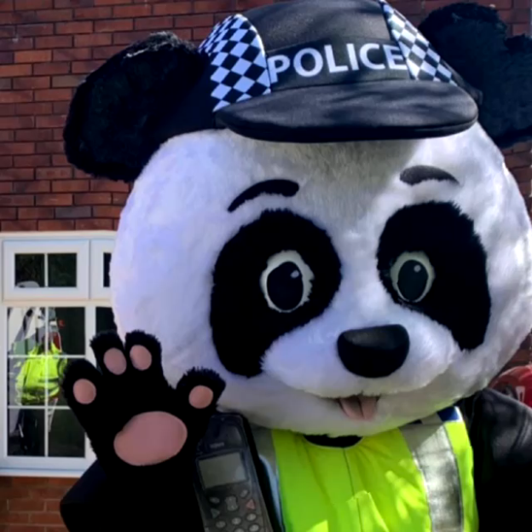
Until next Time 26th January 2021
Keep washing your hands, remember Hands, Face and Space.
Stay healthy, by doing a bit of exercise every day.
Keep positive, by reminding yourself, You are an Amazing Child.
Carry On Doing Your Bit for Great Britain and the NHS
Cheshire Police on Facebook
@CheshireSSYP on Twitter
www.cheshire.police.uk

