Slide 1


Year 3 & 4
Glan-Llyn 2019

Slide 2
Glan-llyn
Gwersyll Glan-llyn is an outdoor education centre located on the shores of Llyn Tegid near Bala.
It has been providing quality outdoor education courses since the 1950s!
The centre has been developed over the years and is now said to be one of the leading outdoor education centres in Wales.
Glan-Llyn has established its own curriculum with 4 main components; the Welsh language, being Welsh, the Urdd and Wales.
Notes:
(1) They organise courses for groups and organisations, educational courses for schools and colleges and adventure holidays for Urdd members.
(4) Within this curriculum lie aspects of PSE Earth Education.

Slide 3
NATIONAL CURRICULUM (ASPECTS OF pe, 2008)
Health, Fitness and Well being
Competitive Sports
Adventurous Activities
Creative Activities

Slide 4


Why go on a residential?
Purposes:
  To further develop the pupils independence.
  To provide elements of challenge and adventure.
  To acquire new and relevant skills and knowledge that are transferable.
  To provide new opportunities - future use of leisure time.
  To become fully immersed in the Welsh language and culture.
  For enjoyment!
‘The children haven’t stopped talking about it’
Headteacher
‘It was really brilliant, I wish I could still be there! ’
Pupil
‘The best few days of his life’
Junior School Parent

Slide 5

What else does Glan-Llyn offer?
Visits are organised away from school to enrich the Curriculum.
Whilst away from school, opportunities are offered to develop:
Responsibility
Self Reliance
Self Confidence
Care and regard for others and the environment

Slide 6


Glan-llyn 2019
At Glan-Llyn the following skills and attributes are enhanced through outdoor and adventurous activities:
Cognitive
Personal
& Social
- Listening
- Observing
- Communicating
- Planning,
performing and evaluating
- Thinking logically
- Decision making
- Problem solving
- Developing aesthetic and safety awareness
- Co-operation
- Competition
- Self discipline
- Sharing
- Self esteem
- Leadership
- Appreciation
- Perseverance
- Tolerance
- Respect
Physical
- Body management
- Endurance
- Strength
- Stamina
- Co-ordination

Slide 7
Glan-Llyn 2019
The three C’s:
C- Commitment
C- Consideration
C- Co-operation

Slide 8
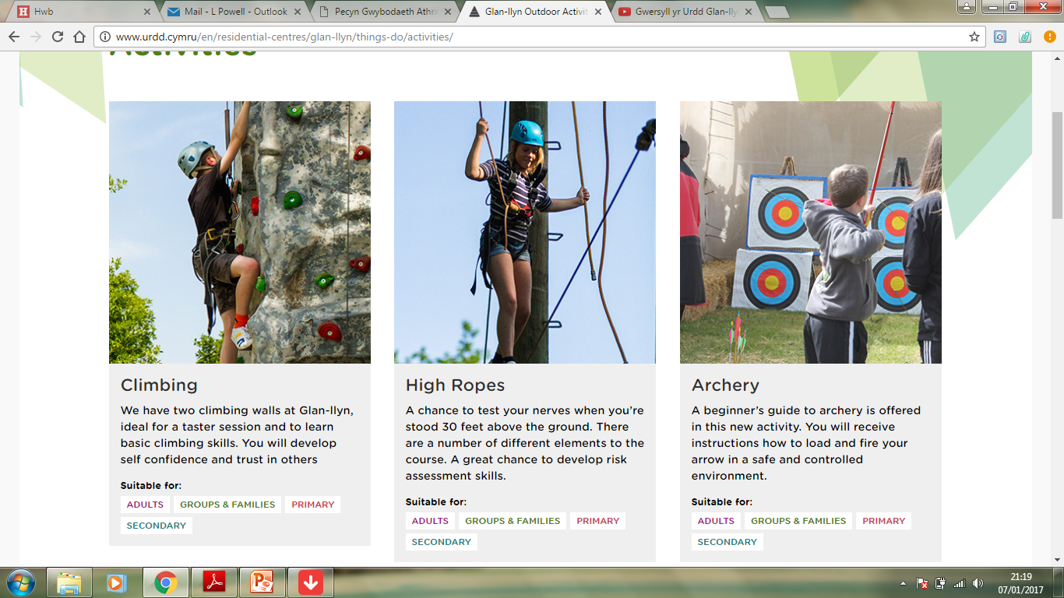
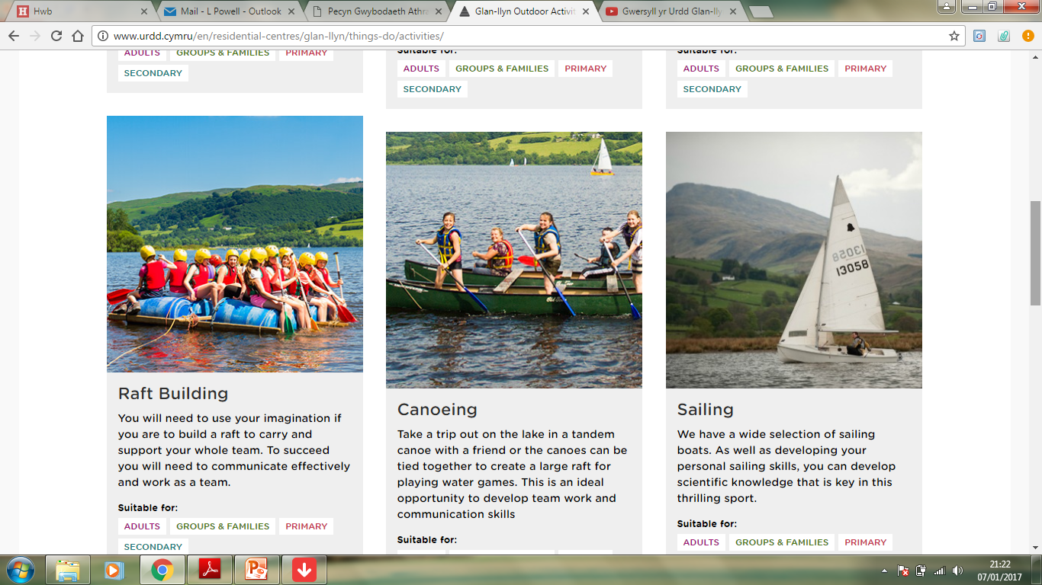
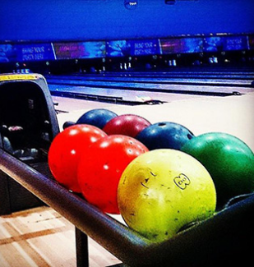
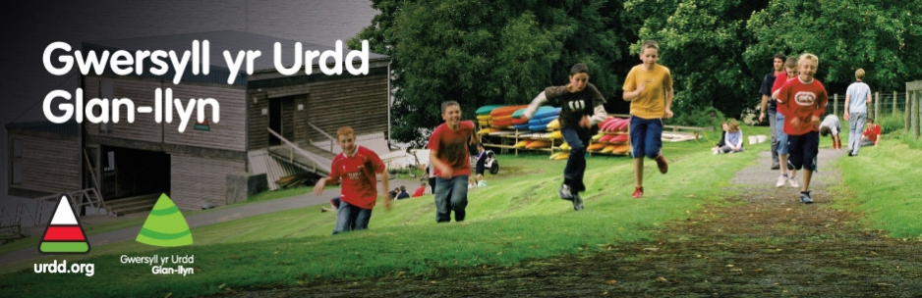
Possible Activities…
Raft Building
Canoeing
Ten pin bowling
Kayaking
High Ropes
Rock climbing
Archery

Slide 9

Glan-llyn 2019: Itinerary*
Day One
9:30 am: Leave school for Glan Llyn
10:45 am (approx): Arrive at Glan Llyn
11:00 – 12:00 pm : children allocated dormitories, beds made (by children!), unpacking, meet staff, fire drill, timetable given and ‘kit’ allocation.
12:30 – 1:00 pm : Lunch
1:30 – 4:30 pm : Afternoon activities
4:30 – 5:00 pm : Free Time
5:00 – 6:00 pm : Tea
6:00 – 9:00 pm : Evening Activities
9:30(ish!) pm : lights out!
Day Two
8:30 am : Breakfast
9:30 – 12.30 am : Morning activities.
12:30 – 1:00 pm : Lunch
1:30 pm (approx) : Leave Glan-Llyn
3:15 pm : Arrive back at school

Slide 10
What equipment do I need?
Everything included on the kit list
Old clothes!
Medication/inhalers labelled with dosage
No specialist equipment – all provided (you can bring walking shoes if you wish)
Spending money in a purse/wallet (£5-£10 max)
No mobile phones!
Sun cream/ insect repellent

Slide 11
What is expected of us?
Commitment - to every activity, making the most of every opportunity
Consideration - for others, including staff
Cooperation - work together, support your peers
Good manners - inside and outside the centre
Listen carefully to instructions and advice
Respect for the centre and its equipment
Maturity
Independence
Appropriate behaviour – essential
Enjoy ourselves, use your Welsh, and make the most of the opportunity! ☺

Slide 12
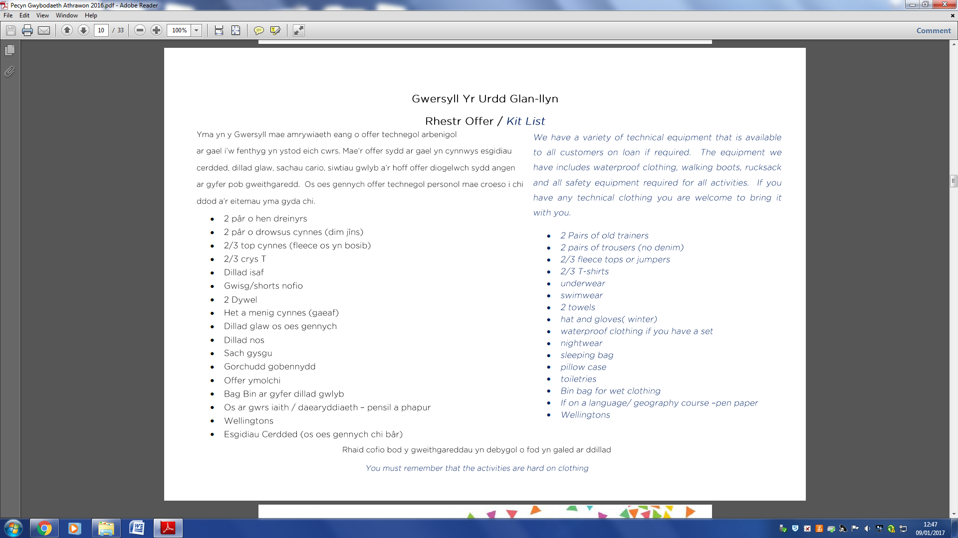

Slide 13
Continued…
PLEASE READ AND SIGN THE HOME SCHOOL AGREEMENT (given out in the New Year).
PLEASE COMPLETE THE HEALTH CERTIFICATE (given out in the New Year).
PLEASE HAND ANY LABELLED MEDICATION WITH WRITTEN INSTRUCTIONS TO STAFF (to be discussed closer to the date ofGlan-Llyn).

Slide 14
total price...
PRICES:
    £85
    £75 for children eligible for Free School meals.
    Deposits are needed ASAP and Full payment is needed by
    Monday 14th January 2019 to secure our booking at Glan-Llyn

Slide 15
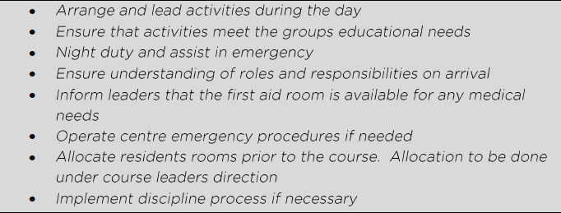
Roles and responsibilities
Glan-Llyn Staff

Slide 16
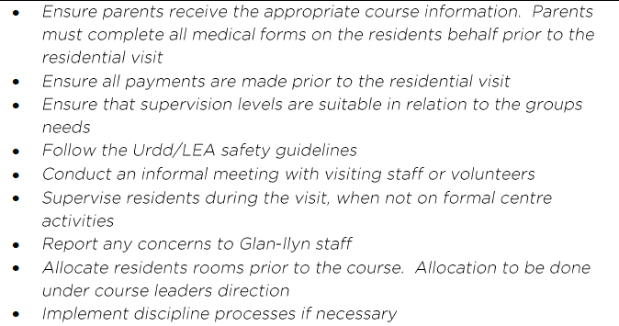
Roles and responsibilities
Course Leader/Director

Slide 17
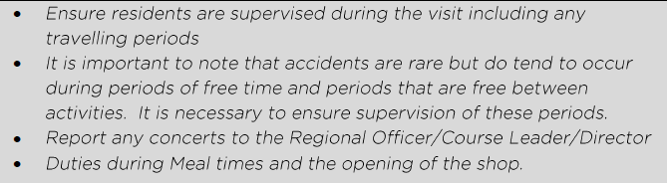
Roles and responsibilities
Visiting Staff and Volunteers

Slide 18


