Slide 1
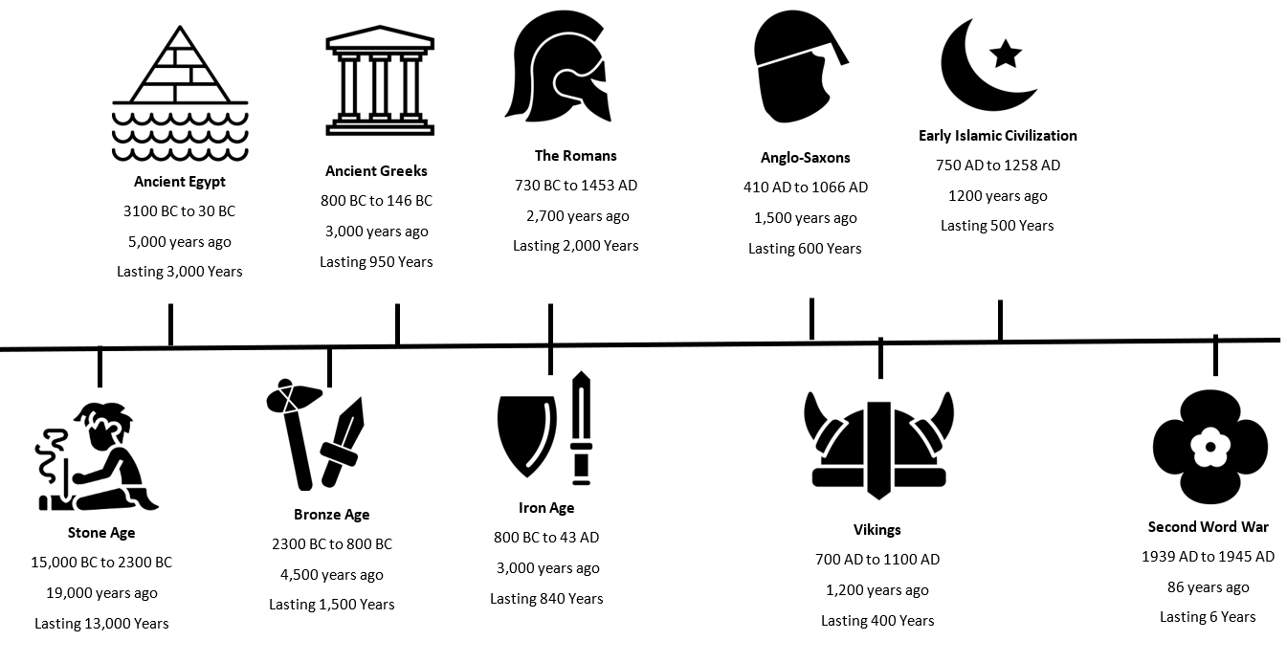
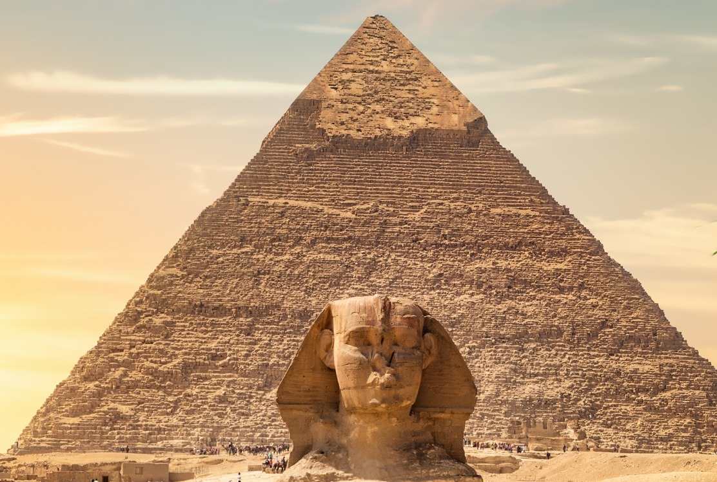
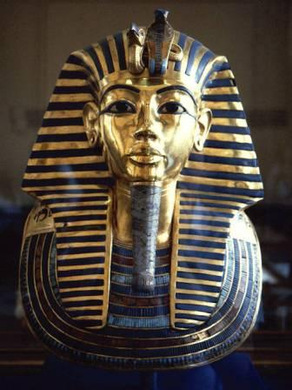
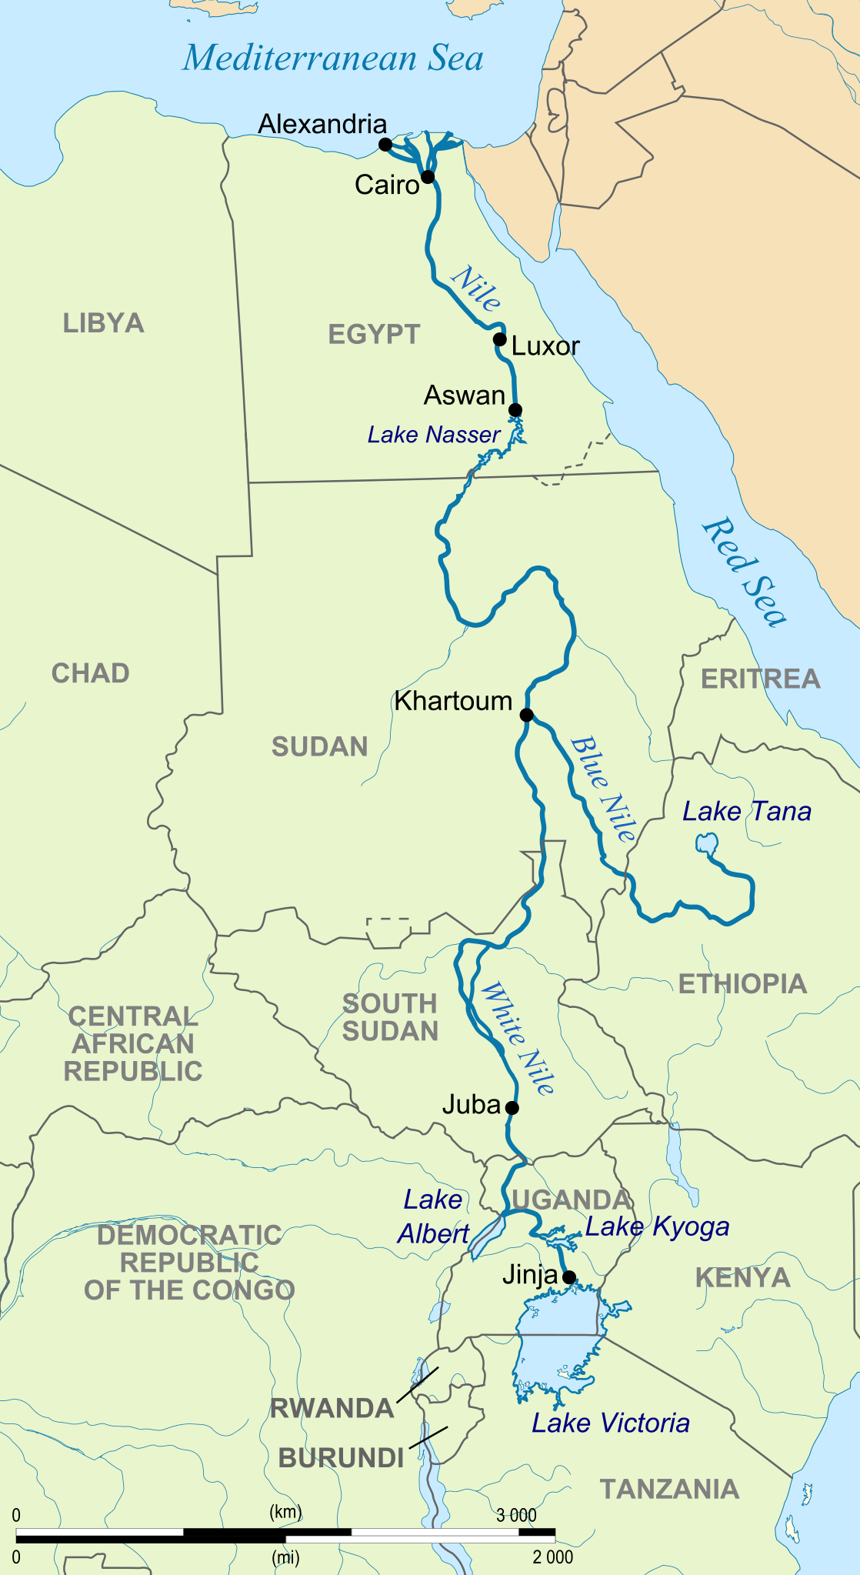

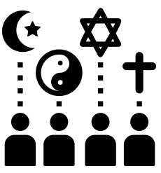
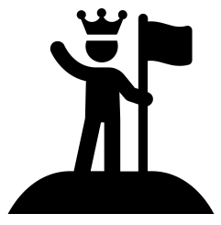

The ancient Egyptians lived over 5,000 years ago.
They built a strong and powerful empire.
They built large pyramids and temples which we can still see today.
The Ancient Egyptians believed in many gods and an afterlife.
They mummified bodies and gave pharaohs treasures for the afterlife.
Tutankhamun is a very famous pharaoh who was discovered with lots of treasures.
The River Nile was very important for the Ancient Egyptians and is still important today.
We know about the Ancient Egyptians because of their writing called hieroglyphs and the things they left behind.
Themes
Settlements and Buildings
Religion and Beliefs
Empire
Archaeology

