Slide 2
How Does It Move?
Look at this toy car. When you push it, how does it move??

Slide 3
How Does It Move?
When you push the toy car, the wheels turn, which is how the car can move. Do you think all the wheels turn at the same time and at the same speed?

Slide 4
Wheels and Axles
The wheels on the toy car move at the same time and speed because each pair of wheels is attached to a pole called an axle. Real vehicles, such as cars and vans, also have axles.

Slide 5
Wheels and Axles
On toy cars, if a wheel isn’t directly attached to an axle, it will need to be secured in place so it doesn’t move from side to side.
If you are making your own toy car, wheels can be secured with a washer on either side. You could even use small pieces of modelling clay either side of the wheel if you don’t have any washers.
washers
washers

Slide 6
Wheels, Axles and Chassis
An axle needs to be attached to the chassis (said ‘shah-see’). A chassis is the frame upon which the rest of the vehicle is built.
In this picture, the chassis is an upside down shoebox lid. Holes have been made on each side of the box and the axles have been threaded through.

Slide 7
Wheels
If you were creating your own toy vehicle, what could you use for your wheels?
Here are some ideas:
wooden wheels
wheels from plastic brick toys
cotton reels

Slide 8
Axles
If you were creating your own toy vehicle, what could you use for your axles?
Here are some ideas:
wooden dowel
straw
cotton bud

Slide 9
Chassis
If you were creating your own toy vehicle, how could you attach the axles to the chassis?

Slide 10



Purpose of a Vehicle
The materials you use and the design of your vehicle will depend on what the vehicle needs to do and where it will be travelling.
Will it be transporting people or something else? Will it need to travel at high speeds? What kind of ground will it travel on?

Slide 11
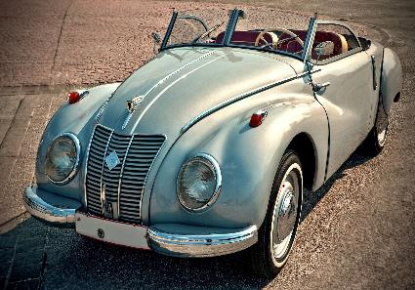
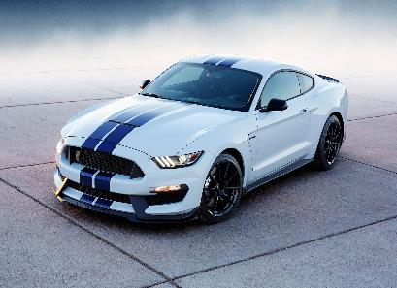
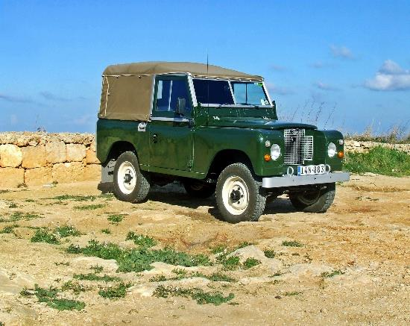
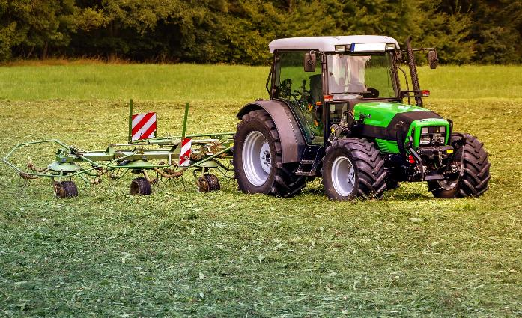
What Will Your Vehicle Look Like?
Once you’ve designed the wheels, axle and chassis, it is then time to think about what your vehicle will look like.

