Slide 1

Welcome to Year 1's Parent Information Meeting!

Slide 2

Our School Values!

Slide 3


http://www.naturalhydrationcouncil.org.uk/hydration-facts/hydration-and-water-facts-for-kids-2/
http://www.water-for-health.co.uk/our-blog/2015/05/children-found-to-have-improved-memory-and-attention-when-hydrated/

Slide 4


http://www.nhs.uk/livewell/childrenssleep/Pages/childrenssleephome.aspx
In bed by 7.30!
11 hours every night!

Slide 5





Limit technology especially near to bed-time and on week-ends
Supervise children at all times

Slide 6



Slide 7
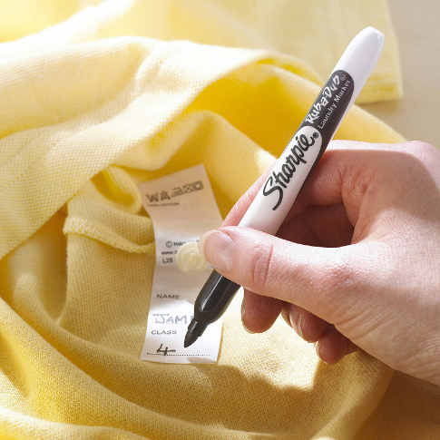





Please label EVERYTHING!

Slide 8
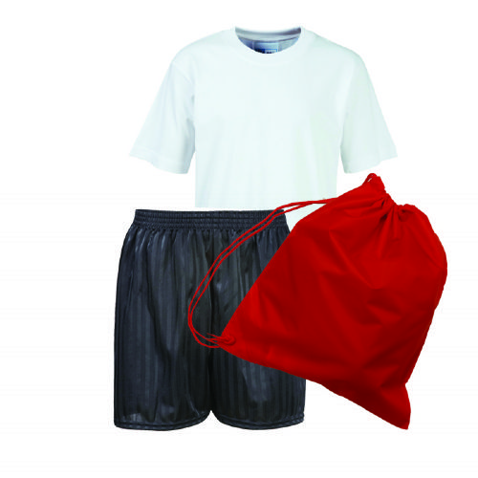
PE
Tuesday and Friday
Children can come to school wearing their PE kit.

Slide 9

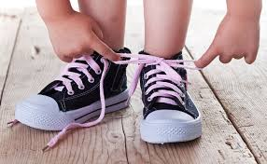

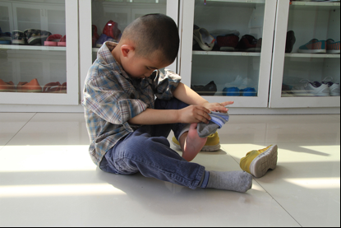
Building Independence
Please help your child to be independent. Give them time to do it for themselves.
Velcro is better!

Slide 10
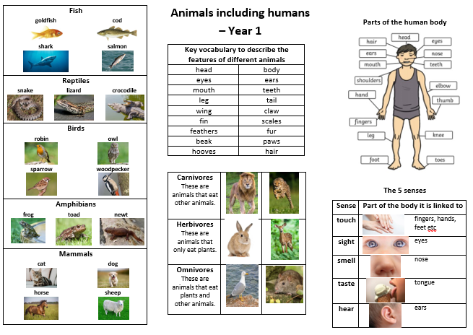
Knowledge Organiser - Science

Slide 11
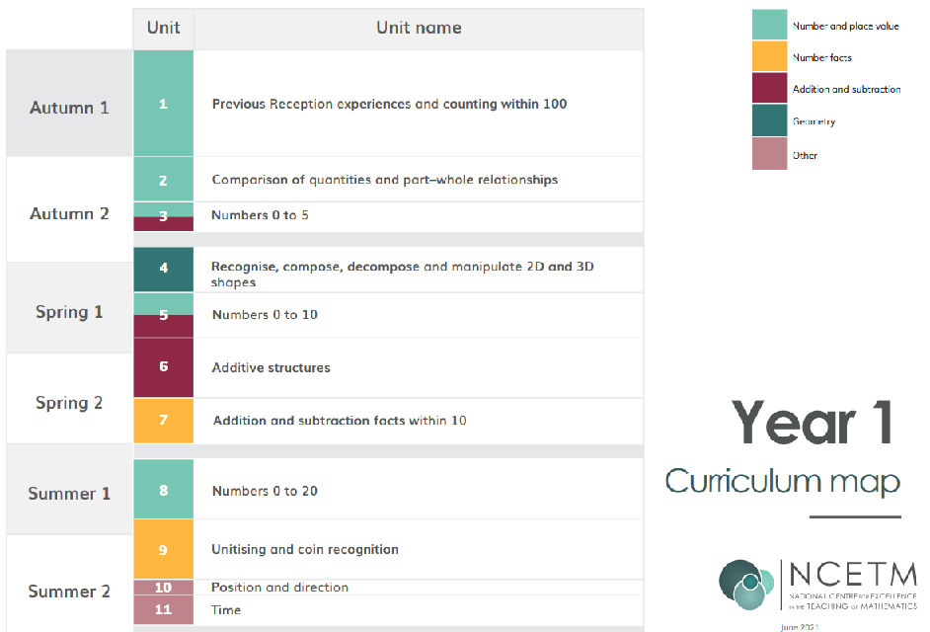
Maths in Year 1
Please practise counting everyday. Children should be able to count to and within 100 forwards and backwards.

Slide 12

English – Reading in Year 1
Phonics and Reading sessions are EVERYDAY!

Slide 13

English
Reading at home:

Slide 14
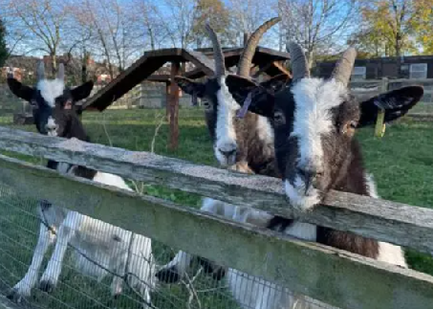
Trip to Heeley City Farm

Slide 15

Keep checking the school website, especially the Y1 pages including phonics resources.
Select your language!

Slide 16



Letterjoin and Letter Formation – see our school website
https://www.letterjoin.co.uk/log-in.html

Slide 17

Homework!
Homework is given out on Fridays - return all homework to school by Thursday the following week, or any day before this.

Slide 18




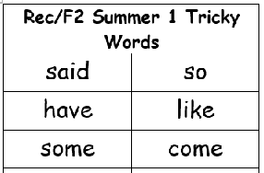

Reading
Every day if you can…
Letter Formation
Tricky Words
Counting

Slide 19

Communication.
Parent consultations will be after October half-term.
I work Tuesday to Friday and Mrs Dawson teaches Y1 on Mondays.

Slide 20

Thank you for your support!

