Slide 1

Welcome to Year 1's Parent Information Morning!

Slide 2


http://www.nhs.uk/livewell/childrenssleep/Pages/childrenssleephome.aspx
In bed by 7.30!
11 hours every night!

Slide 3
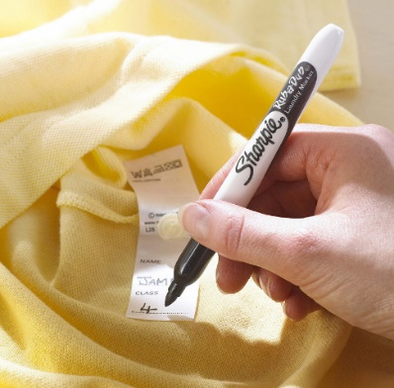
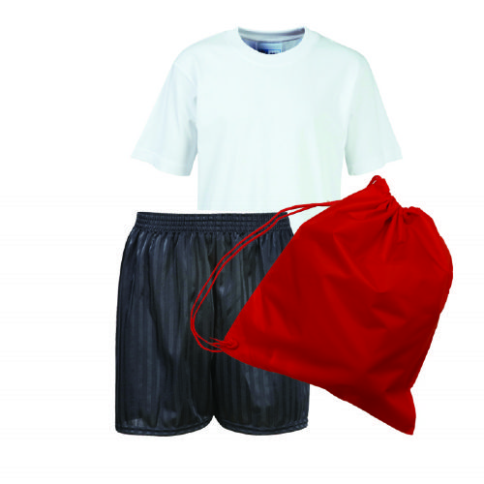

PE Wednesday and Friday
Labelled PE kit

Slide 4
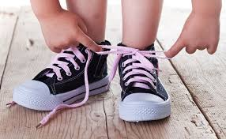

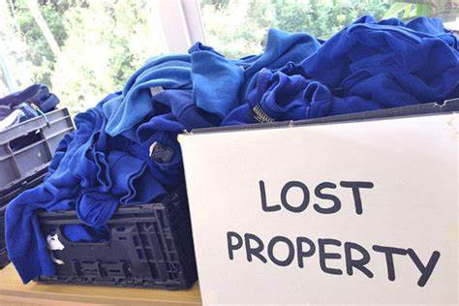
Building Independence Please help your child to be independent. Give them time to do it for themselves.
But also…being responsible for their own belongings!
Where is my hat?

Slide 5


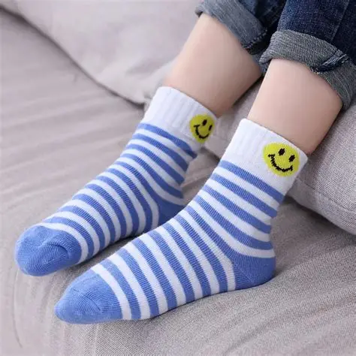
Rainy Weather

Slide 6

Notes:
Netherthorpe1234!

Slide 7
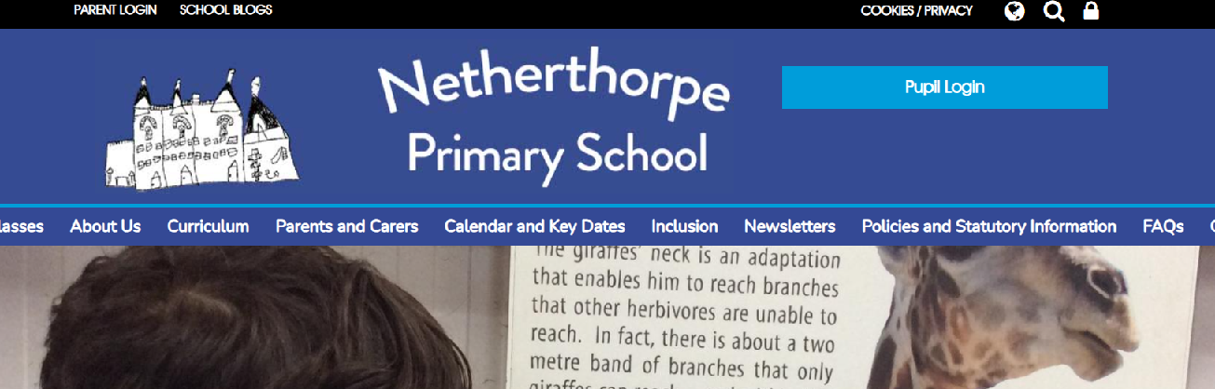

Slide 8

Language and Communication
Tiny Happy People - Key talking tips for any age
Supporting children's early communication skills - Speech and Language UK: Changing young lives

Slide 9

Phonics How to say pure sounds.
https://www.littlewandlelettersandsounds.org.uk/resources/for-parents/

Slide 10
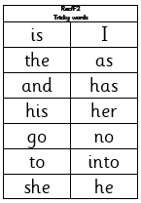
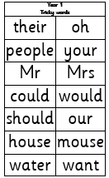
Tricky Words – These are on the school website in the Y1pages.
Try to practice everyday!

Slide 11

Knowledge Organisers
How to use them at home!

Slide 12
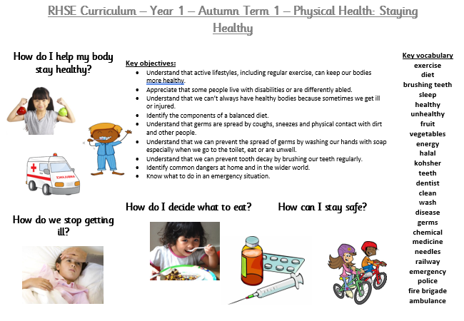
Knowledge Organiser – RHSE – Physical Health

Slide 13

Maths
Maths home learning | Home learning | White Rose Education

Slide 14
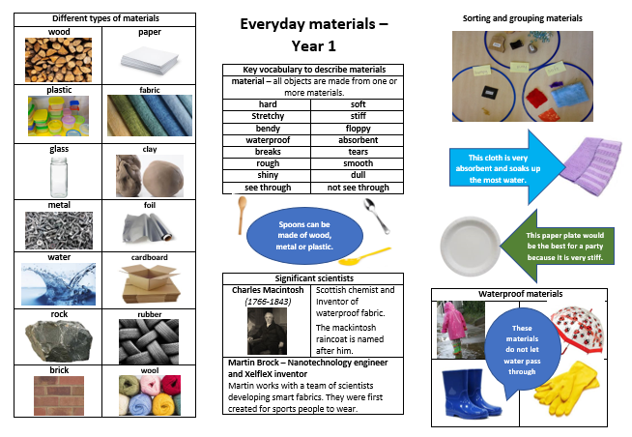
Science

Slide 15

Letterjoin
https://www.letterjoin.co.uk/log-in.html

Slide 16

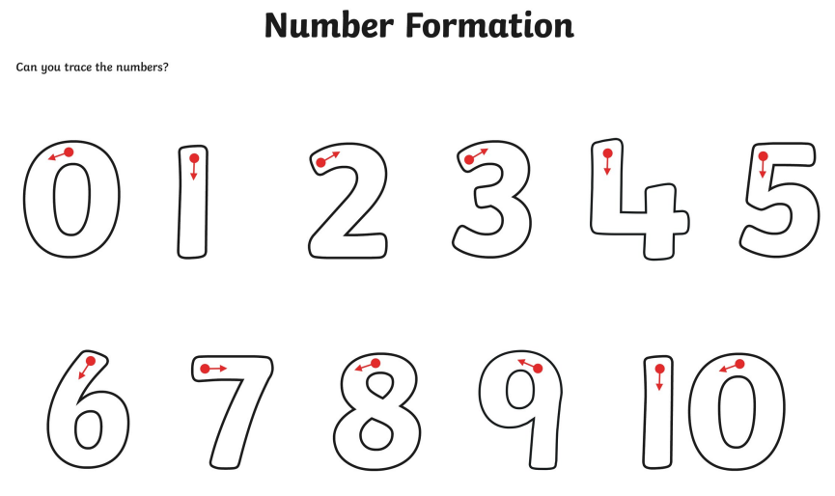
Letter and number formation

Slide 17





Reading
At Home -
Every day if you can…
Counting in 1s,2s,5s,10s and especially backwards!
Letter and number formation
Tricky words

Slide 18

Homework!
Homework is given out on Fridays - return all homework to school by Thursday the following week, or any day before this.

Slide 19


Slide 20

Thank you for your support!

