Slide 1
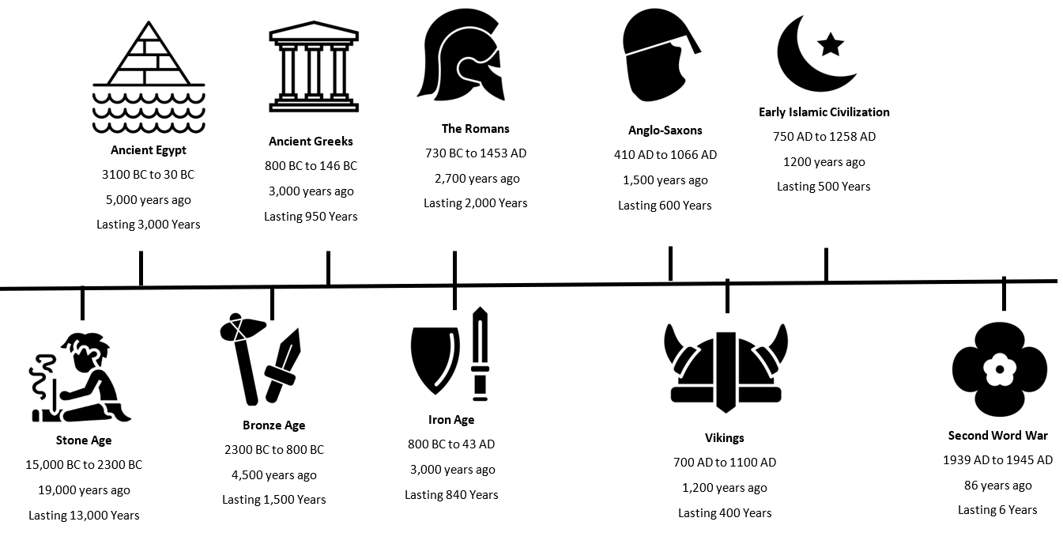
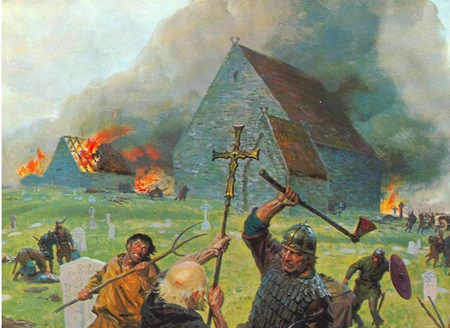
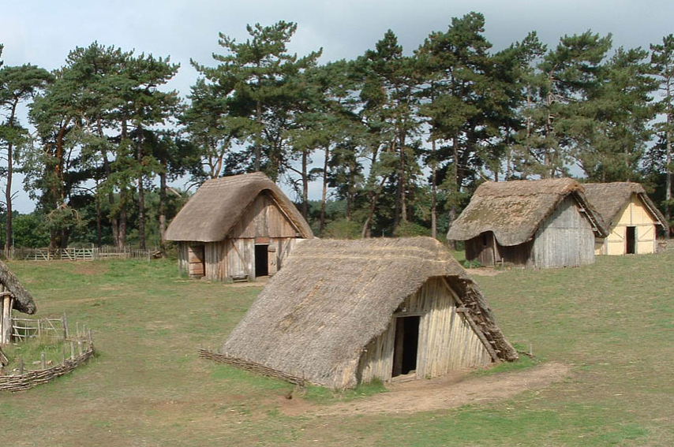
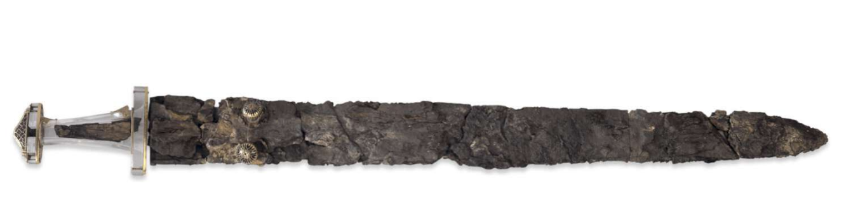
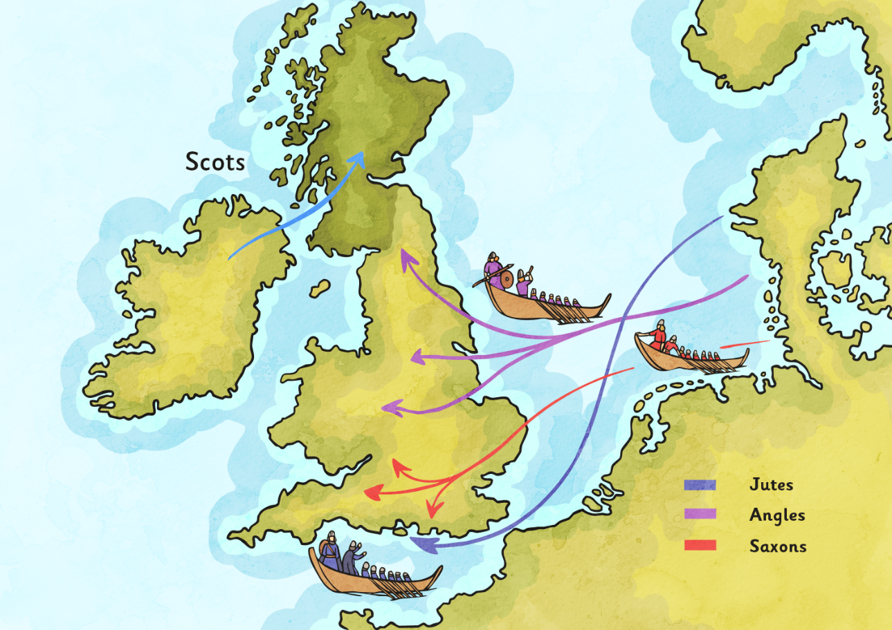


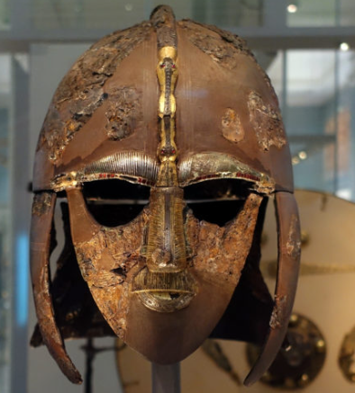



The Anglo-Saxons came from modern day Denmark, Netherlands and Germany.
They settle in Britain after the Romans had left.
They lived in wooden houses in small villages.
The Scots came from Ireland and settled in Scotland.
The Scots and Anglo-Saxons did not get on.
They had different languages and believed in different religions.
Both the Anglo-Saxons and Scots ended up being largely Christian.
We can learn about this time from Anglo-Saxon writing called Runes.
Themes
Change and Development
Religion and Beliefs
Settlements and Buildings
Invasion
Archaeology

