Slide 1

Welcome to Year 1's Parent Information Meeting!

Slide 2

Our School Values!

Slide 3


Slide 4


http://www.naturalhydrationcouncil.org.uk/hydration-facts/hydration-and-water-facts-for-kids-2/
http://www.water-for-health.co.uk/our-blog/2015/05/children-found-to-have-improved-memory-and-attention-when-hydrated/

Slide 5
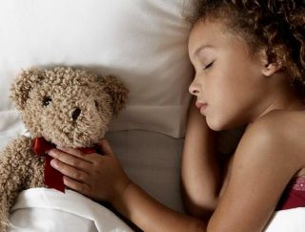

http://www.nhs.uk/livewell/childrenssleep/Pages/childrenssleephome.aspx
In bed by 7.30!
11 hours every night!

Slide 6
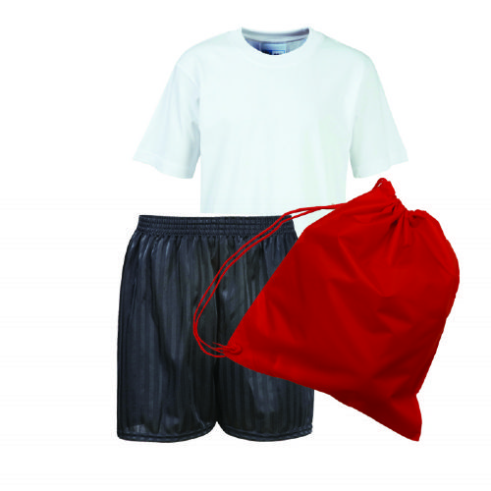
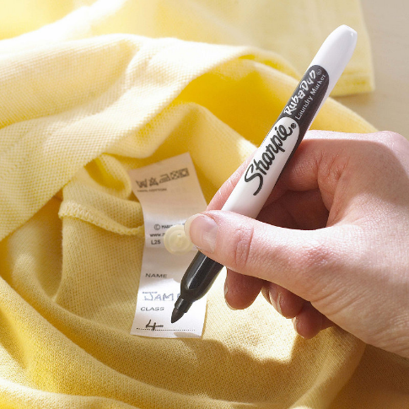

PE
Thursday and Friday
PLEASE practise getting changed and dressed for PE.
Labelled PE kit

Slide 7

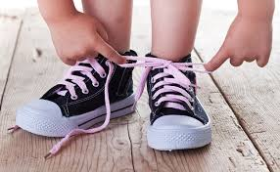

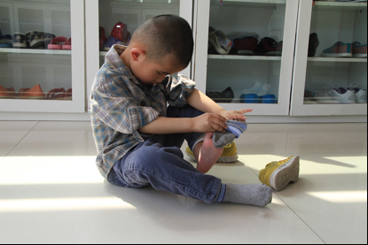
Building Independence
Please help your child to be independent. Give them time to do it for themselves.
Velcro is better!

Slide 8
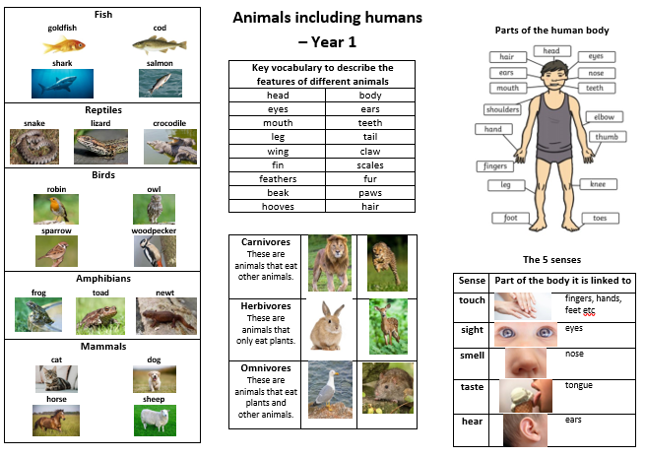
Knowledge Organiser - Science

Slide 9
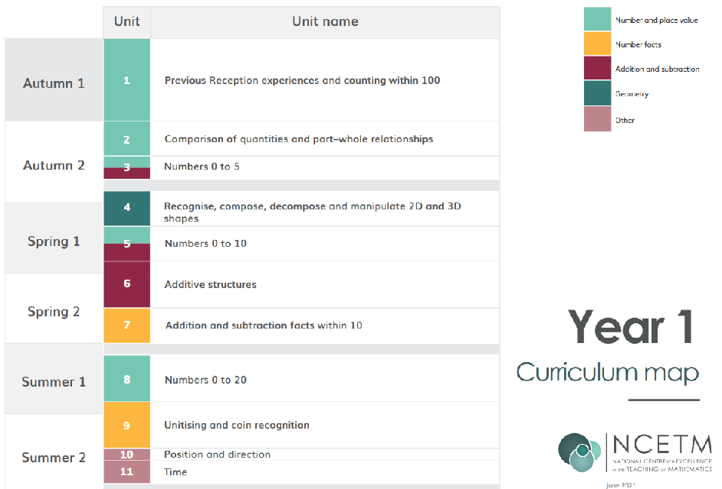
Maths in Year 1
Please practise counting everyday. Children should be able to count to and within 100 forwards and backwards.

Slide 10

English – Reading in Year 1
Phonics and Reading sessions are EVERYDAY!

Slide 11

English
Reading at home:

Slide 12

English in Year 1
Writing
Alphabet – letter names and sounds, capital and lower-case letters
Consonants and vowels
Labelling
Sentences – capital letters, full-stops and finger spaces
Using adjectives

Slide 13


Trip to Graves Park or Tropical Butterfly House
Tuesday 14th October 2025
Trips can be paid for weekly!
(provisional date)

Slide 14
Other trips in Y1:
Zoolab visit in March 2026
English Institute of Sport in May 2026
Local History Walks in June/July 2025
Weston Park July 2026

Slide 15
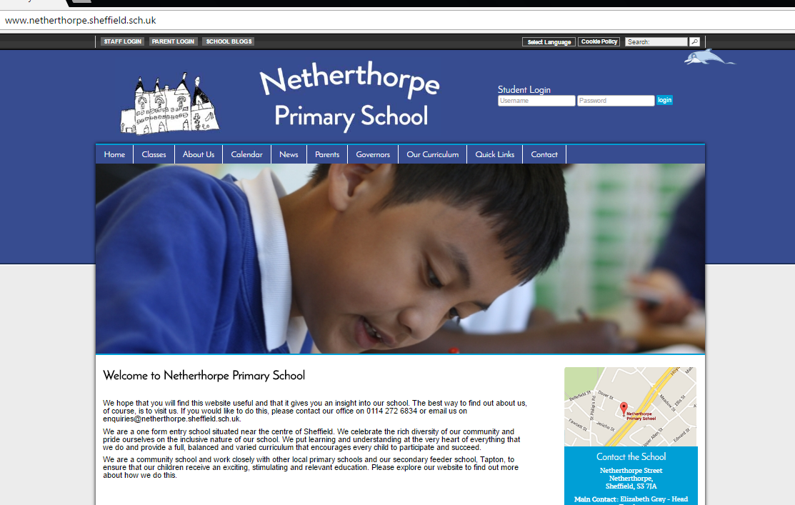
Keep checking the school website, especially the Y1 pages including phonics resources.
Select your language!

Slide 16





Limit technology especially near to bed-time and on week-ends
Supervise children at all times

Slide 17
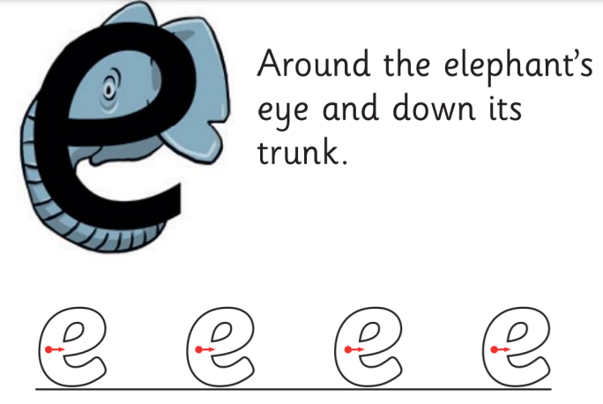

Letterjoin and Letter Formation – see our school website
https://www.letterjoin.co.uk/log-in.html

Slide 18

Homework!
Homework is given out on Fridays - return all homework to school by Thursday the following week, or any day before this.

Slide 19

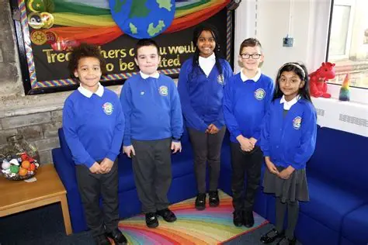
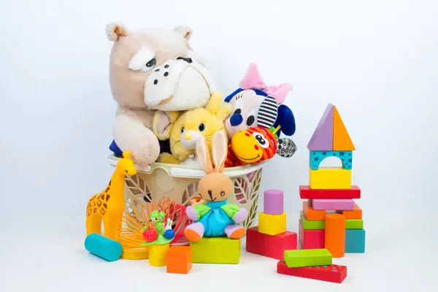
School Uniform

Slide 20
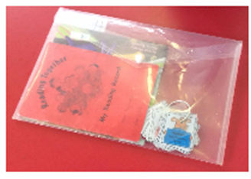


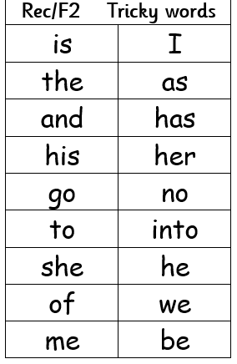

Reading
Every day if you can…
Tricky Words
Counting

Slide 21

Communication.
Parent consultations will be after October half-term.
I work Tuesday to Friday and Mrs Zafar teaches Y1 on Mondays.

Slide 22

Thank you for your support!

