Slide 1
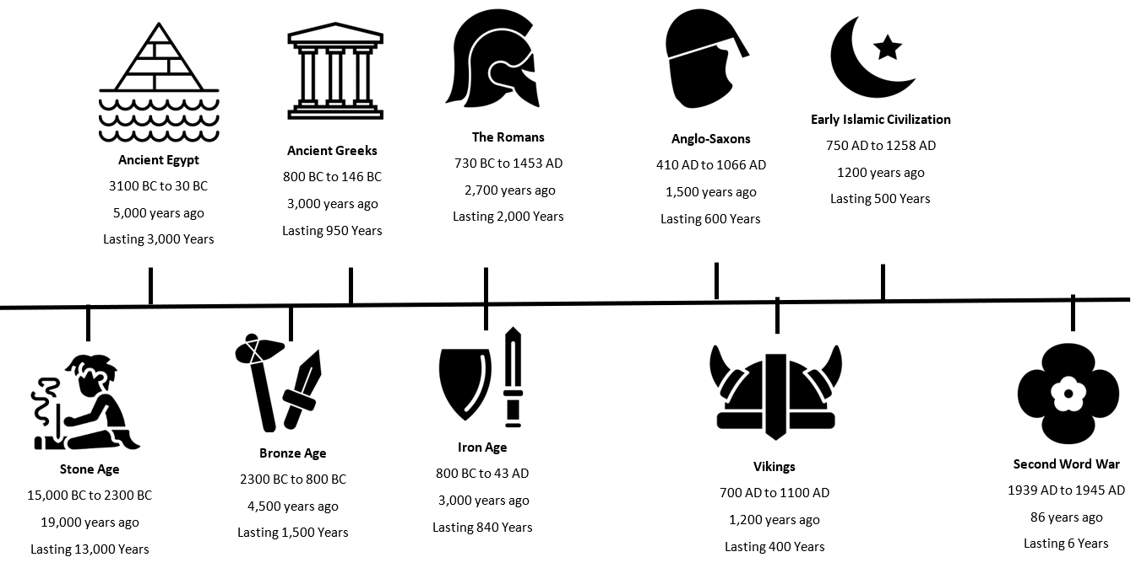
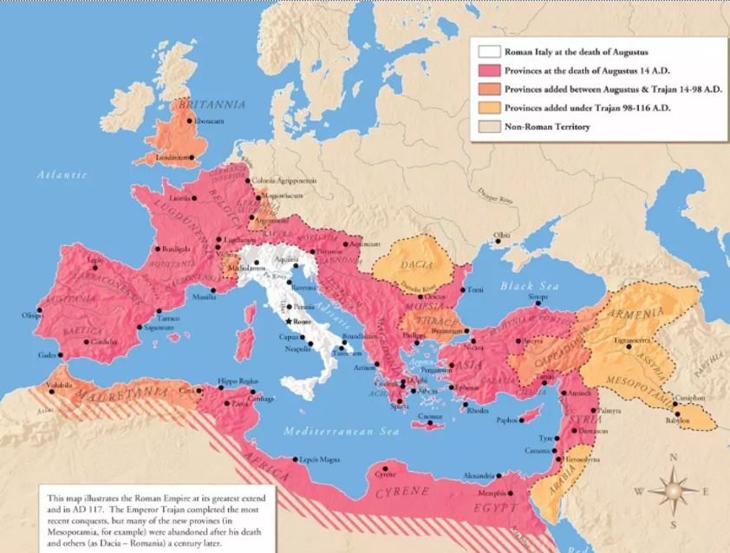
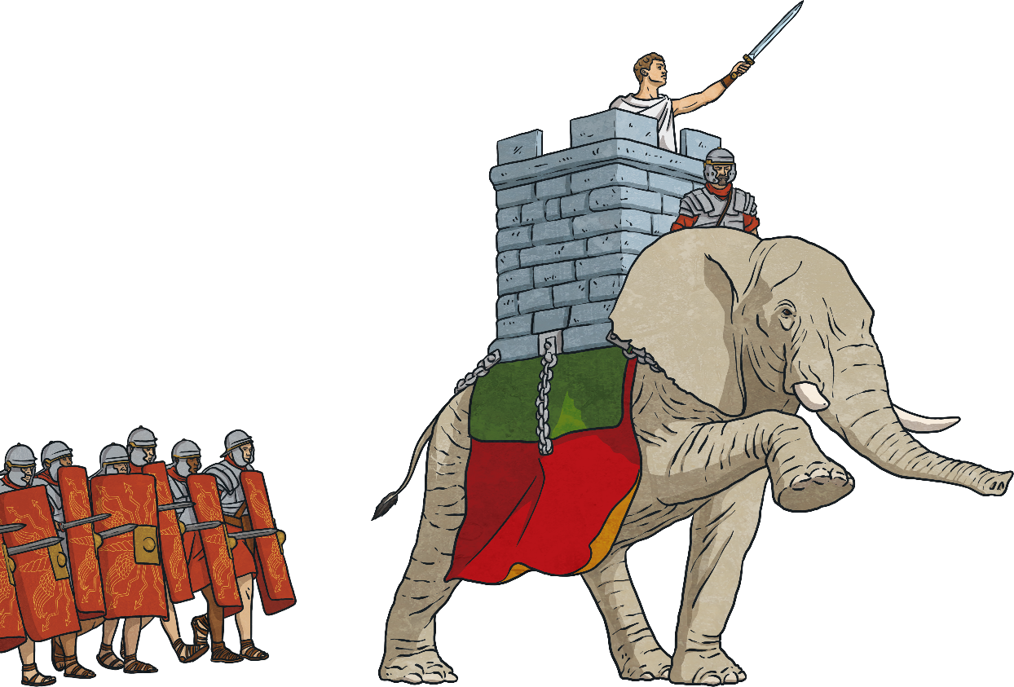
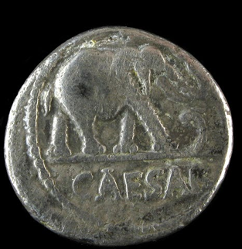






The Romans had a large empire.
They invaded and settled in Britain in 43 AD under Emperor Claudius.
The Romans believed in many Gods but then became Christians.
The Romans changed life in Britain in many ways.
They brought new buildings, laws, money and the Christian faith to Britain.
The Romans left Britain in the early 400s AD.
The Empire was attacked by lots of different people and started to collapse.
After the Romans left Britain, the Anglo-Saxons invaded and settled.
We can find out lots about the Romans because of the buildings, writing and artefacts they left behind.
Themes
Change and Development
Settlements and Buildings
Religion and Beliefs
Invasion
Empire
Archaeology

