Slide 1
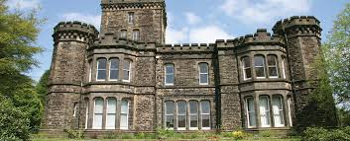
Robinwood 2025
Mon 28th – Wed 30th April

Slide 2

No need to make notes this evening!
This presentation will be available on the Robinwood 2025 page of the school website.

Slide 3

On the day
We will leave school at approximately 0930, so there’s no need to be at school earlier than normal. Children will not need to bring any lunch.
Bring your bags to the Art Room when you arrive.
We will register, organise luggage, go to the toilet etc before setting off.
The journey takes about 90 minutes.

Slide 4

Staffing
Mrs Towers (Y3/4 Phase Leader)
Mr MacDonald (Y4 teacher)
Mrs Fallon (Y4 teacher)
Miss Jones (Teaching assistant)
Miss Pepler (HLTA)
Miss Collingwood (Teaching assistant)
Mr Croft (Teaching assistant)

Slide 5
What will the children be doing?
Children will take part in a range of indoor and outdoor activities, including crate stacking, obstacle/problem solving courses, trapeze, archery, climbing wall, canoeing, indoor caving, the giant swing, zip wire, night line….. plus some team games and challenges in the evenings. They won’t get bored!
All activities are led by qualified instructors.
Each activity group will also have a Marlcliffe staff member with them.
Canoeing and raft building are obviously water-based activities. Non-swimmers can easily take part, and the water (a man-made lake) is about a metre deep.
No-one will be forced to do an activity but will be given every encouragement to do so. Marlcliffe staff will be on hand to do the activity with them, if this helps.

Slide 6

Meal times
The meals are hearty and nutritious.
Each day, the children will get a cooked breakfast and cooked evening meal. The evening meal will typically be something like fish fingers, pizza, pasta bolognaise or jacket potatoes.
There will always be a choice - children will be asked at the start of the visit to choose what they’d like for each meal.
Sandwiches, wraps, fruit, crisps and biscuits will be given at lunch time.
Water and fresh fruit are available throughout the day.
Dietary requirements are catered for (you will have given details on the personal information form you completed).

Slide 7
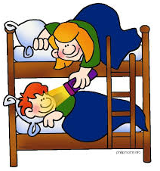
Night time
All dormitories have dedicated night time staff, who are on duty (awake) all evening, and the Marlcliffe staff will be on call at all times.
The bedtime routine is fairly strict; children are in bed by 2130 and the lights are turned out at 2200.
Any children with medical needs will be attended to by a member of the Marlcliffe staff (Miss Collingwood or Miss Pepler).
All children will be in a dormitory with a few friends, and the girls and boys will be separate.

Slide 8
What to bring…
Robinwood’s suggested kit list will be added to the website.
In summary, bring warm, hard-wearing clothing that it wouldn’t be a disaster to lose!
Some of it may/will get wet so please pack a black bin bag or two!
The centre has drying and laundry facilities and the turnaround is very organised…but there’s always a pile that belong to ‘Mr Nobody’ when we leave.
Name as much of your clothing as possible (unfortunately we can’t guarantee that everything will get back to you).
You don’t need any specialist equipment; this is all provided by the centre.
Shower time is scheduled after the wet/muddy activities.

Slide 9

What NOT to bring
Mobile phones
Electrical equipment – iPods, hand-held games, expensive watches etc.
Aerosols
The centre doesn’t allow children to use a camera of any sort. Marlcliffe staff will take plenty of photographs, which will be used in line with school policy and with your consent.
Food/sweets - no midnight feasts!

Slide 10
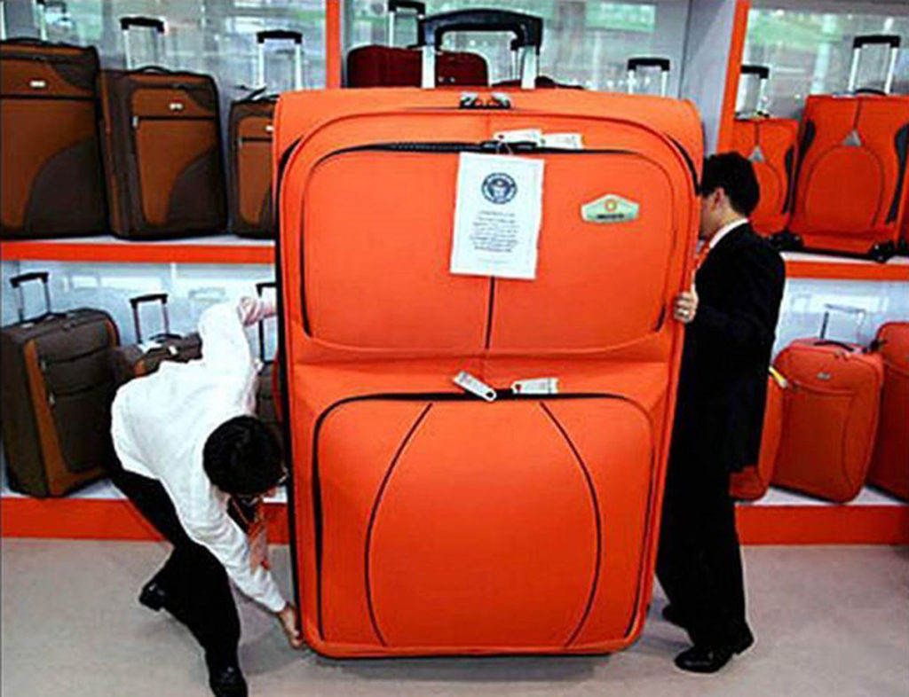
Please pack a case/bag that your child can carry on their own (including up some stairs). Some accommodation is on the upper floor. It does need to be able to fasten securely please!

Slide 11

Medication
Pupils with asthma must bring 2 inhalers.
  One will be kept by staff in a medication box
  One will be carried by the group leader or pupil at all times
Calpol / Travel Sickness forms to be completed
All medications must be labelled clearly with the child’s name and the dose to be administered.
On the Monday morning, all medication must be given to Miss Collingwood or Miss Pepler in the art room, with appropriate paperwork. Please try to bring them in earlier than this if possible!
Children must not have any form of medication in their bags.
ALL medication must be in date and named.
Notes:
CC & AA

Slide 12
Travel Sickness Tablets
If you have said that your child suffers from travel sickness that requires medication, please ensure that you have completed Form 3B and are able to provide this medication for your child.
It would be useful if any medications could be brought to the school office by Friday 25th April.
All medication (travel sickness or otherwise) must labelled clearly and in the original packaging, be in date and have a 3B form completed.
If in doubt regarding medication, or if you have any questions, please let us know in the chat or get in contact with us at school.

Slide 13

Money and Valuables
The children don’t need to bring any money with them.
There is not a shop at Robinwood.
If your child brings money or valuables we cannot take responsibility for them.
Please do not send tablets / kindles / phones / smart watches / gaming devices.

Slide 14

Contacts
There will be no direct contact between pupils and parents.
Any birthdays whilst we’re there? We know about one!
The Robinwood 2025 Blog will have daily updates
Contact school: 0114 2344329
Notes:
JB

Slide 15
Robinwood Blog
We have created a blog to give you photos and updates throughout the trip (link will be on website)
We will only post photographs of children for whom we have parental consent – most of you have already given consent on the annual permission form. If you wish to include your child for just this trip then permission forms are available…please ask a member of staff after the meeting. If you can’t remember whether you have given permission, then we are happy to check for you.

Slide 16
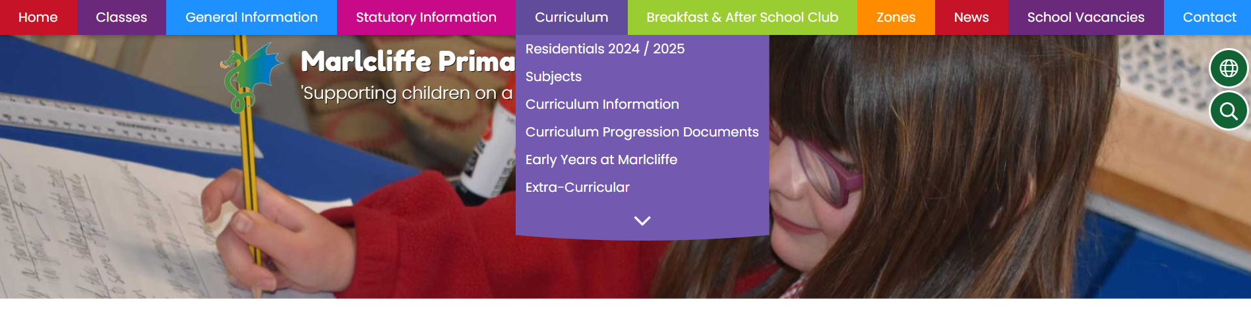
Robinwood Blog
Click on the Curriculum tab, then click Residentials 2024/2025

Slide 17
Robinwood Blog Information
The blog will only be in use for the duration of our visit
Posting to the blog is limited by a number of factors e.g. data/wifi signals, availability of devices etc.
Please be patient with us! Your child's wellbeing is our first priority before updating any blogs – we cannot guarantee that all children will be featured on the blog but we will try to include as many children as possible.

Slide 18

Returning
We will be leaving Robinwood at around 1400.
A member of staff will telephone school with regular updates as to our progress, so you will know if we’ve been delayed.
We will also update the Blog during the journey.
Last year we arrived back at school at 1630. This will depend on traffic.

Slide 19
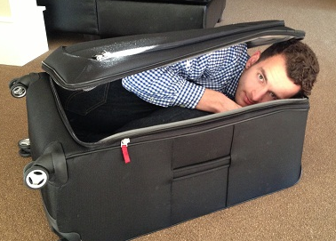
Any Questions?
Before you ask…I’m afraid you can’t come with us!

