Slide 1
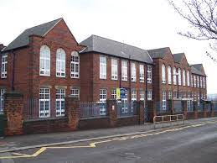
Welcome To FS2
Parents’ Information Evening

Slide 2
General Information
Medication – If your child requires any medication, please complete a form at the office.
Jewellery – Children are allowed to wear earrings, but these must be removed for PE days. Other jewellery is not permitted in school for health and safety.
Children are given a piece of fruit or vegetable each day, they can bring their own
Water bottles should only have water in them
Uniform – Please ensure all uniform is named, including coats, shoes if possible and bags.
Before and after school – children must not play on the school equipment before or after school for health and safety.
If you need to speak to a teacher at the end of the day could you please wait at the end of the line, so that we can ensure children are handed back to parents quickly.

Slide 3
Daily Phonics Lessons

Slide 4
Teach reading: change lives
Parent workshop: Phonics and early reading in Reception, Phase 2
(Autumn 1)
Notes:
For this presentation, you will need to download and print out the following resources and information for parents:
Phase 2 grapheme information sheet – Autumn 1
the parent handout ‘Your child’s reading journey – Reception Autumn term’
the Phase 2 and 3 grapheme mat
the Little Wandle Progression overview
‘Phase 2 tricky words: Reception Autumn term – Information for parents and carers’ – or parents can access this in the ‘For parents’ area of the Little Wandle website.
You will need a flipchart and access to the Little Wandle and Collins websites.
You may also wish to have a copy of the Little Wandle Glossary to hand (in Getting started/Teaching).

Slide 5

Little Wandle Letters and Sounds Revised
Our school has chosen
Little Wandle Letters and Sounds Revised as our Systematic Synthetic Phonics (SSP) programme to teach early reading and spelling.
Notes:
Slide purpose:
To inform parents that all schools must teach phonics in Reception, but explain your school's choice of SSP
Suggested script:
The National Curriculum specifies that all schools must teach children to read using phonics in Reception.
Read the slide.

Slide 6
Phonics is:
making connections between the sounds of our spoken words and the letters that are used to write them down.
Notes:
Slide purpose:
To provide a simple definition of phonics
Suggested script:
So what is phonics?
Read the slide.
It sounds complicated but it really isn’t!
Let's learn some important words that will help you understand phonics ...

Slide 7
Terminology
Phoneme
Blend
Grapheme
Segment
Digraph
Trigraph
Notes:
Slide purpose:
To give simple definitions of key terminology
Notes:
Explain what each word means – use the Glossary to help.

Slide 8
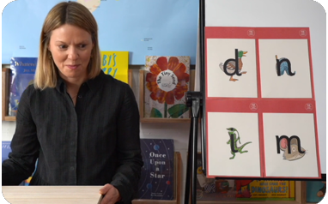
This term we are teaching Phase 2
These are the first group of letters and sounds your child will learn.
We start teaching from week 3 of Reception.
The lessons are fun, interactive, engaging and have been designed to gradually build over time.
Notes:
Slide purpose:
To introduce Phase 2
Notes
Read the slide.

Slide 9


We teach Phase 2 in this order
Notes:
Slide purpose:
To provide an overview of the Phase 2 sounds
Suggested script:
We usually teach four new sounds a week and have a review lesson on a Friday.
You will get a list of the sounds that we are learning to have at home. This will help you with letter formation (handwriting) and pronunciation.
Give the Phase 2 grapheme information sheet for Autumn 1 to parents.

Slide 10
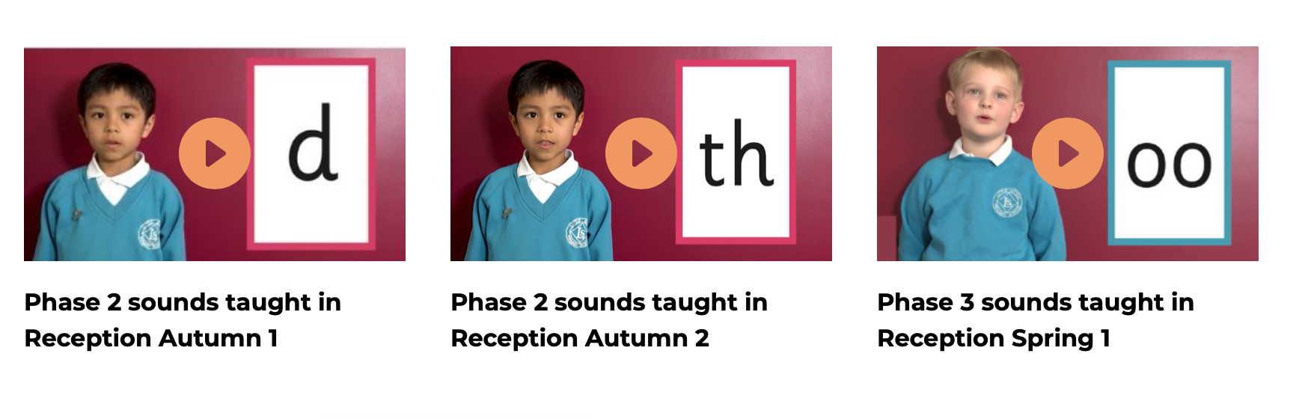
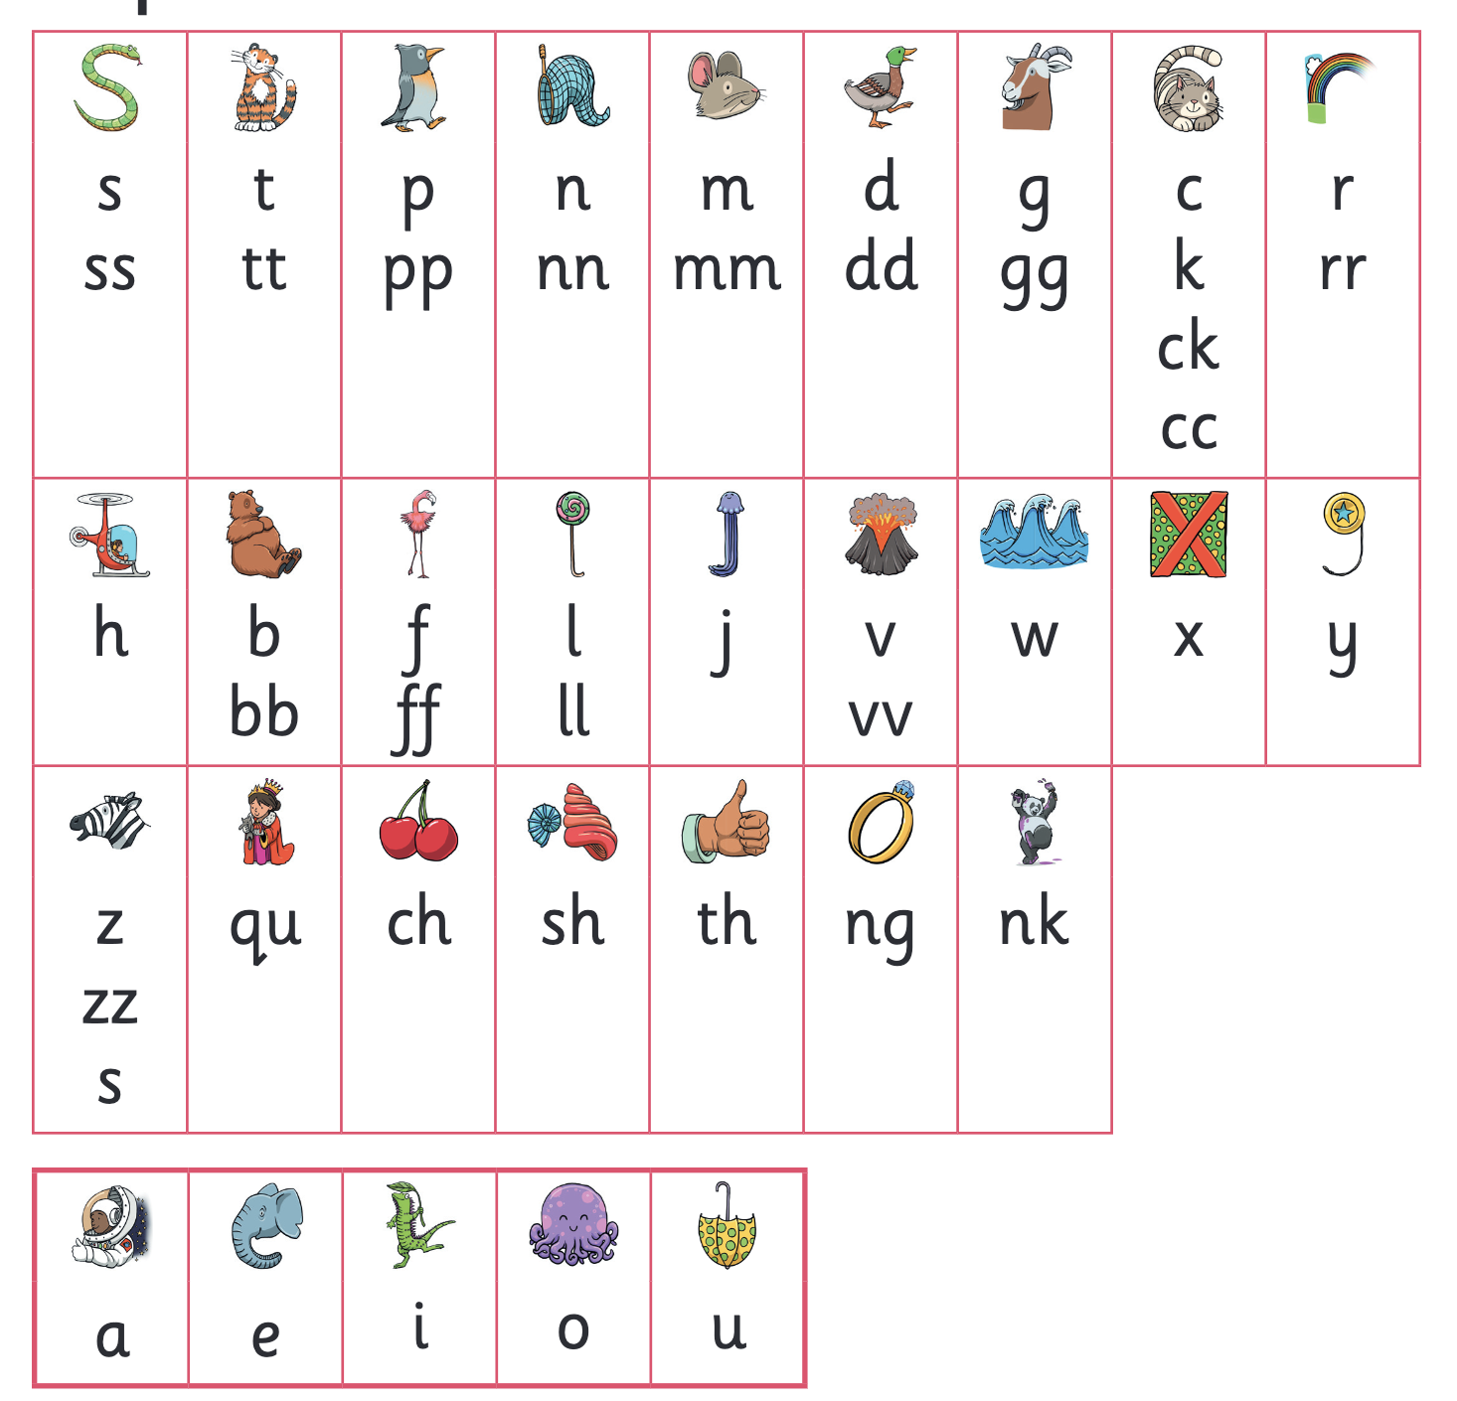
Let’s say the Phase 2 sounds
Notes:
Slide purpose:
To practise the Phase 2 sounds
Notes
Give out the parent handout and the Phase 2 and 3 grapheme mat.
Play the videos/teach the parents to say the Phase 2 sounds: https://www.littlewandlelettersandsounds.org.uk/resources/for-parents/
Show parents where to access these videos in the ‘For parents’ area of the Little Wandle website.

Slide 11
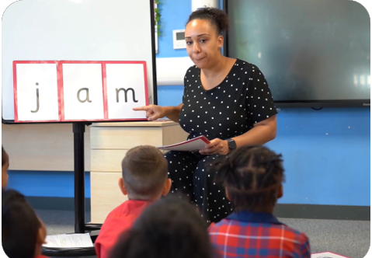
We teach blending so your child learns to read
Teacher-led blending is taught throughout Phase 2.
Our aim to is to teach every child to blend by Christmas.
We will inform you if your child needs additional practice.
Notes:
Slide purpose:
To introduce blending
Suggested script:
Teacher-led blending is teaching children how to blend, directed and demonstrated by the teacher.
It is repeated daily in the Autumn term.

Slide 12

Blending to read words
Notes:
Slide purpose:
To provide an overview of blending
Suggested script:
Some children learn to blend really quickly, and others take a little longer.
If your child is finding it difficult, ask your child’s teacher for ways to help at home – playing blending games at home is so helpful!
Show parents the ‘How we teach blending’ video from ‘For parents’ area of the website: https://www.littlewandlelettersandsounds.org.uk/resources/for-parents/

Slide 13
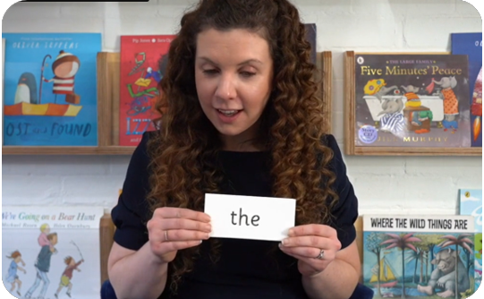
Tricky words
These words have unusual spellings e.g. he, the, was.
They are taught in a systematic way.
Children are now learning to read the Phase 2 tricky words: is, I, the, put, pull, full, as, and, has, his, her, go, no, to, into, she, push, he, of, we, me, be.
Notes:
Slide purpose:
To introduce tricky words
Notes:
Read the slide.
You may wish to give parents a copy of the document ‘Phase 2 tricky words: Reception Autumn term – Information for parents and carers'.

Slide 14
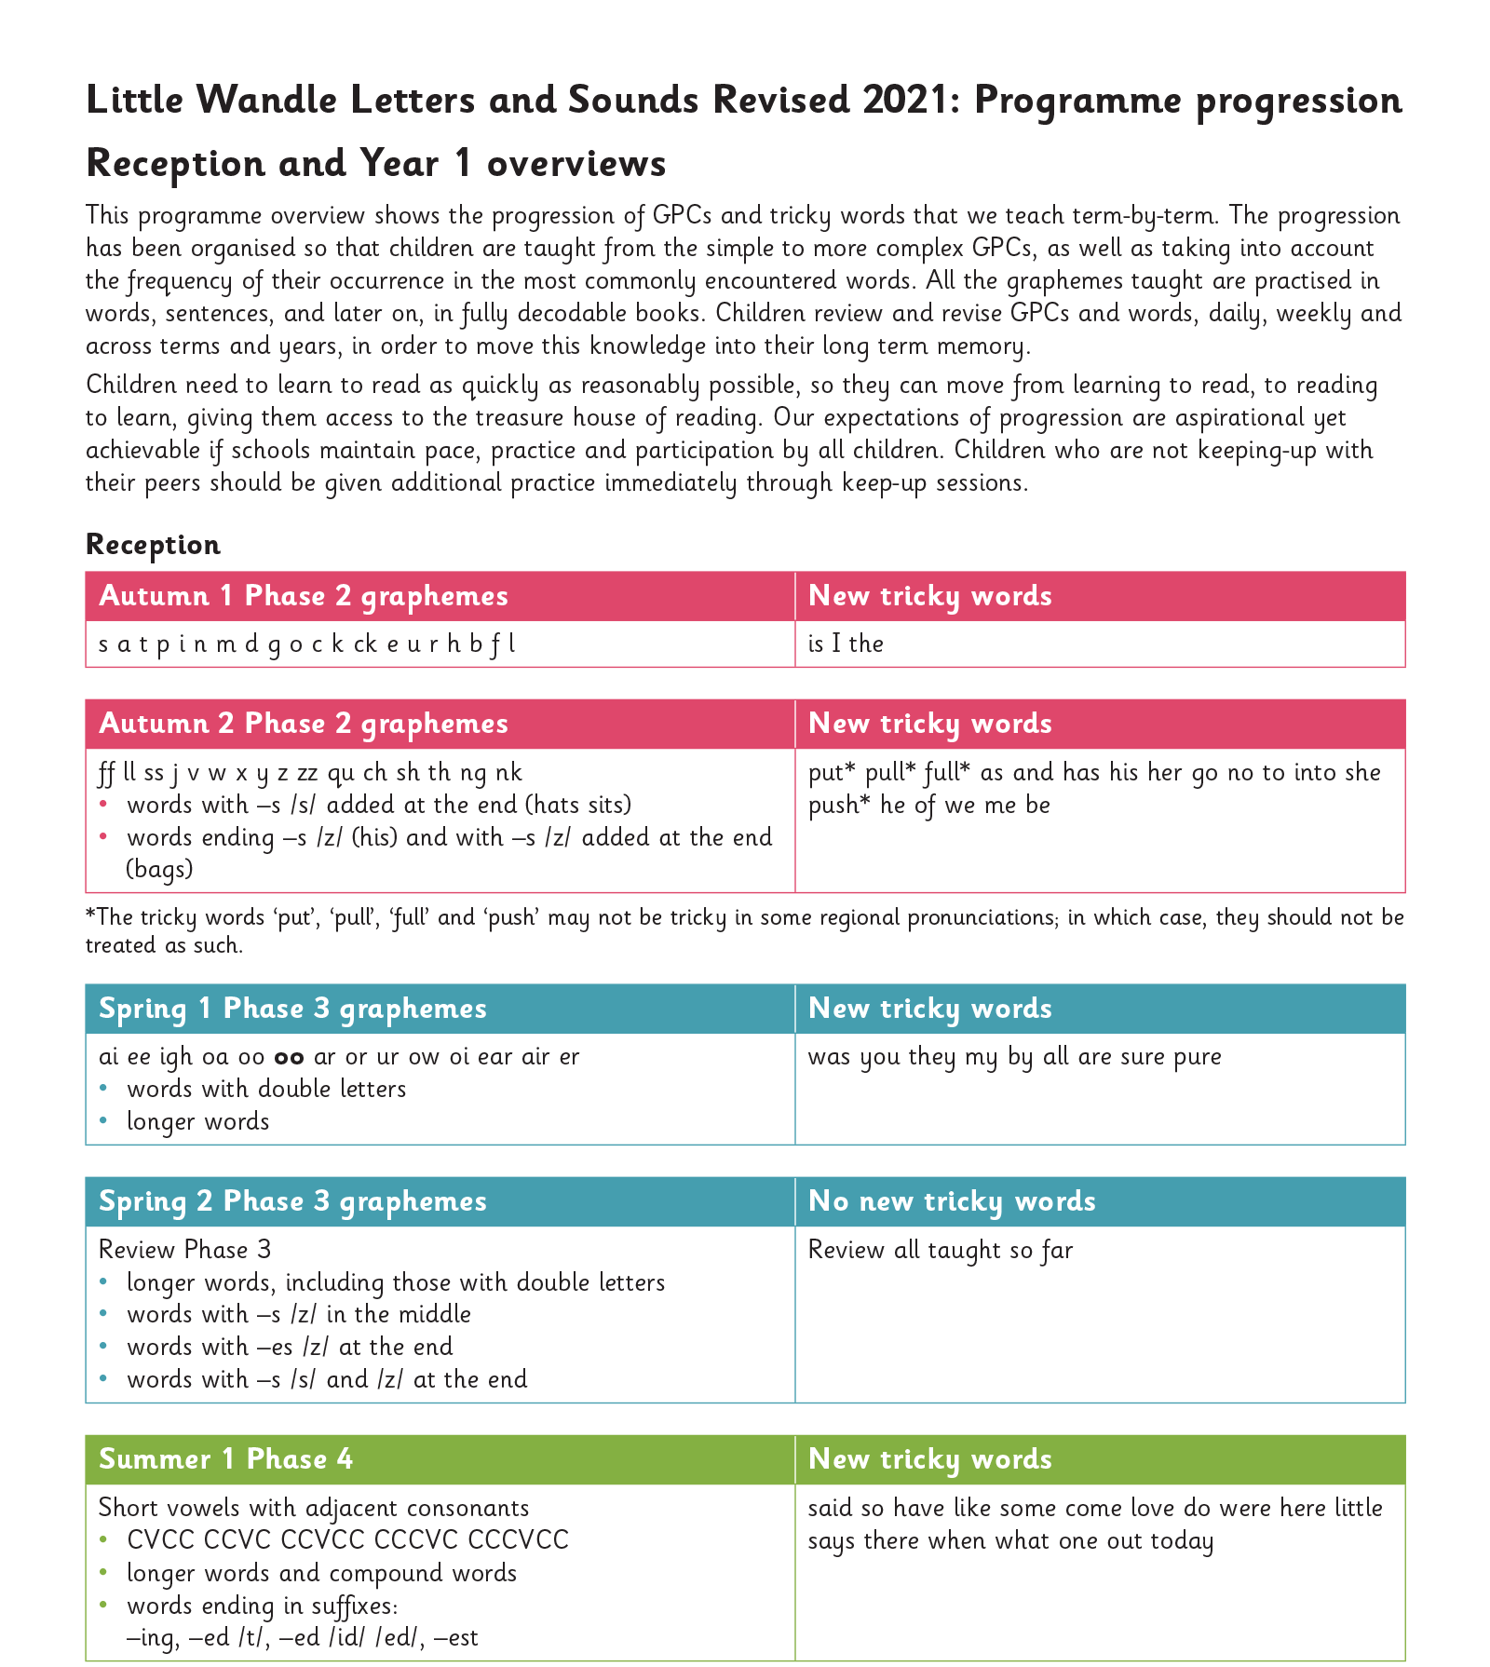
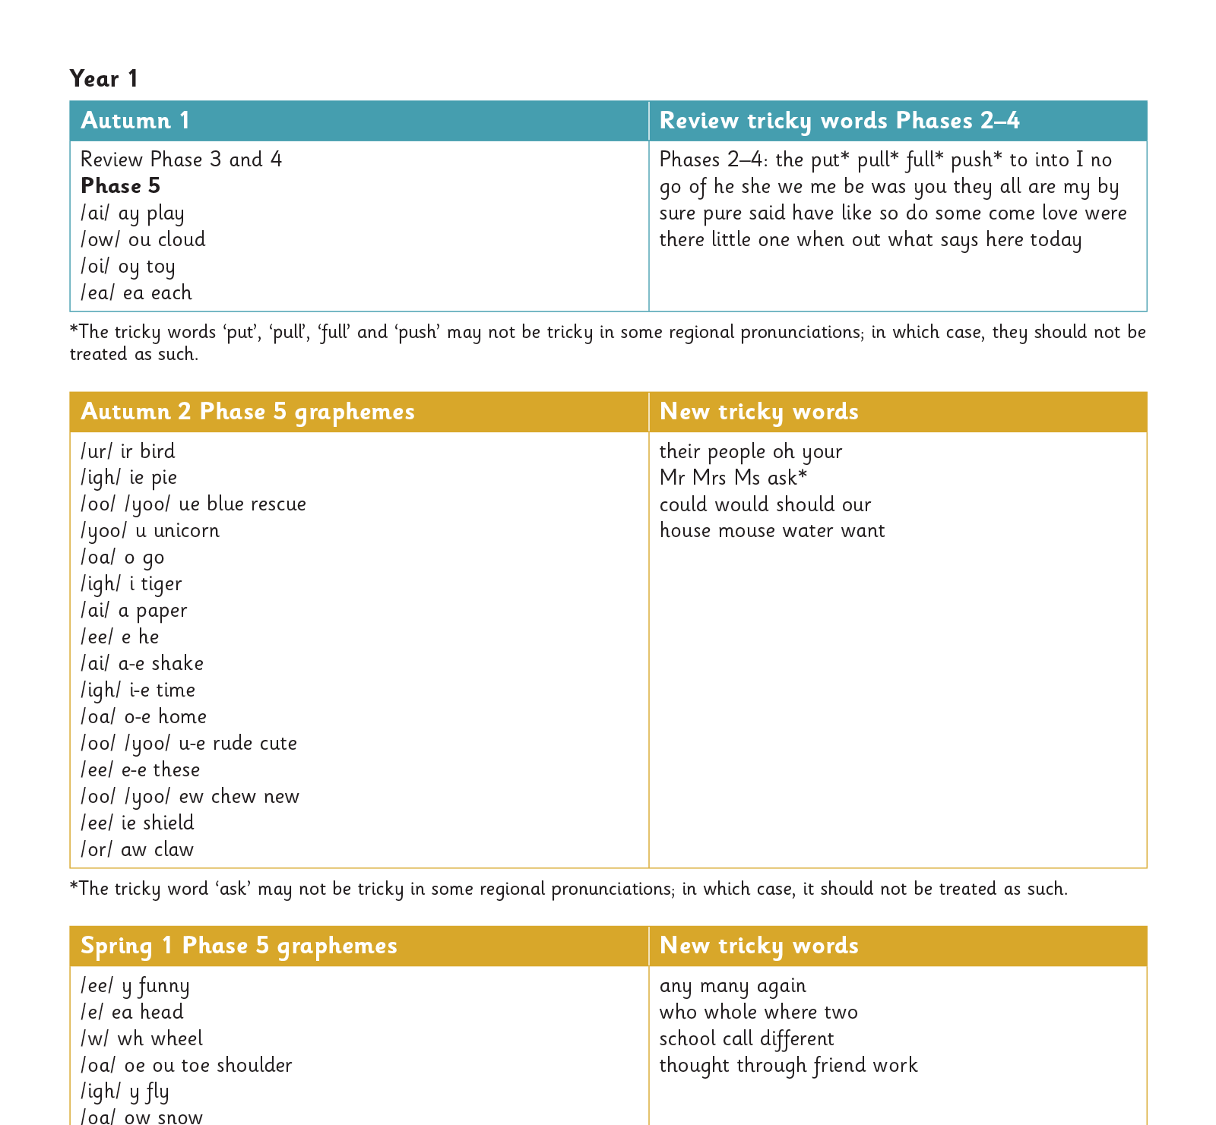
Our progression
Notes:
Slide purpose:
To provide an overview of the whole programme’s progression
Suggested script:
We will work our way through the whole Little Wandle Programme until your child can read fluently.

Slide 15
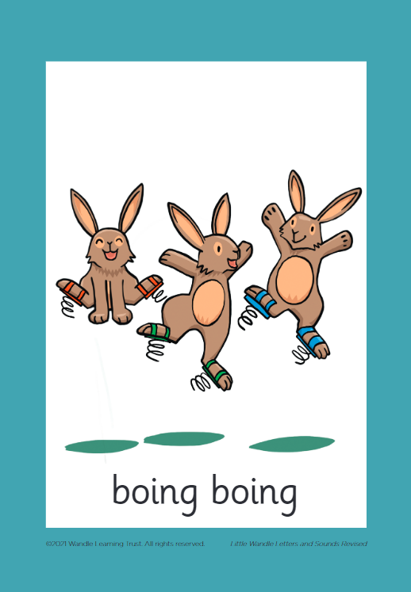



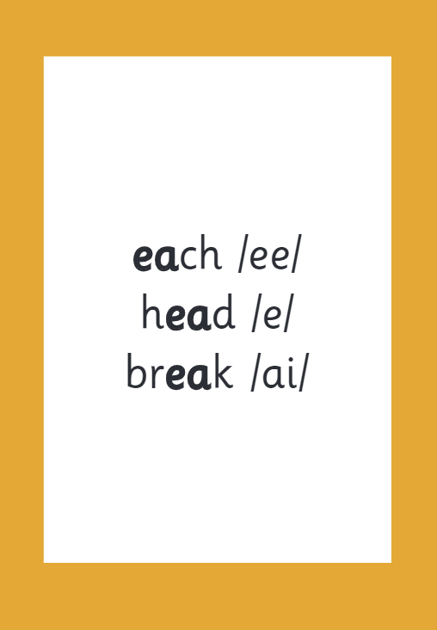

How we make learning stick
Notes:
Slide purpose:
To provide an overview of the programme’s efficacy
Suggested script:
There are specific resources for the Little Wandle Programme which the children will be very familiar with.
Each sound that we teach to begin with has either a mnemonic (like the astronaut that you can see here) or a phrase like boing-boing for ‘oi’. This helps the children recognise and remember the graphemes.
Every time we teach a new sound, we also read words during the phonics lesson that contain that new sound so that the children practise what they have learned.
We then go on to reading a sentence containing some of those words.
We have displays in the classroom and on the tables to support the children throughout the day.

Slide 16
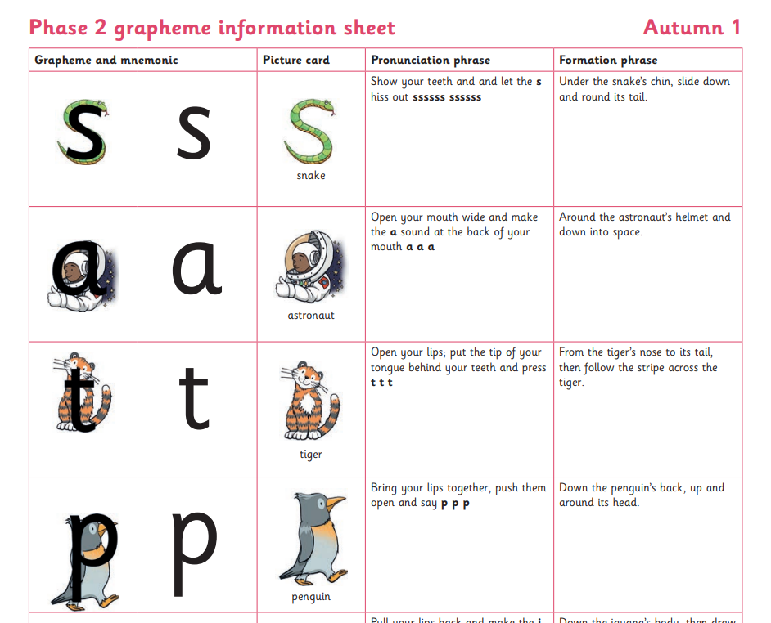

Spelling
Your child will be taught how to spell simple words, using the graphemes they have been taught.
They will practise the correct formation of letters. They will also have handwriting lessons.
Notes:
Slide purpose:
To introduce spelling
Notes:
Read the slide.
Hand out the Phase 2 grapheme information sheet for Autumn 1, which includes the formation phrases.

Slide 17

How do we teach spelling?
Say the word.
Segment the sounds.
Count the sounds.
Write them down.
Notes:
Slide purpose:
To provide an overview of spelling
Notes:
Model the process above on a flipchart for the parents to see.
Show the process with a Phase 2 word, e.g. pin, dig, hug.

Slide 18
How do we practise reading in books?
Reading practice sessions are:
timetabled three times a week
taught by a trained teacher/teaching assistant
taught in small groups
children in Reception will bring a book home by week 4 of the first half-term.
Notes:
Slide purpose:
To introduce decodable books
Suggested script:
The children read the same book three times in a week.
The first time we work on decoding (sounding out) the words, the second time we work on prosody which is reading with expression – making the book sound more interesting with our story-teller voice or our David Attenborough voice – and the third time we look at comprehension.
We read the books three times at school because we want to develop the fluency.
The more children see words, the more they begin to read them automatically without having to sound them out.

Slide 19

How do we find the right book for your child?
Notes:
Slide purpose:
To introduce book matching
Suggested script:
We assess your child every six weeks to check progress.
Any child who needs extra support has Daily Keep-up sessions planned for them.

Slide 20



Books going home
Notes:
Slide purpose:
To introduce the process and format for reading at home
Suggested script:
As well as the ‘learning to read’ book that your child will bring home they will also bring home a book for sharing with you.
This shared book is SO important. This is how we are going to give them the WILL to read.
Please read with your child as often as you can – at least once a day if possible.

Slide 21
Listening to your child read their phonics book
Your child should be able to read their book without your help.
They might sound out words and blend them before they read them fluently.
If they can’t read a word, read it to them.
Talk about the book and celebrate their success.
Notes:
Slide purpose:
To give guidance on reading the decodable book at home
Notes
Read the slide.

Slide 22
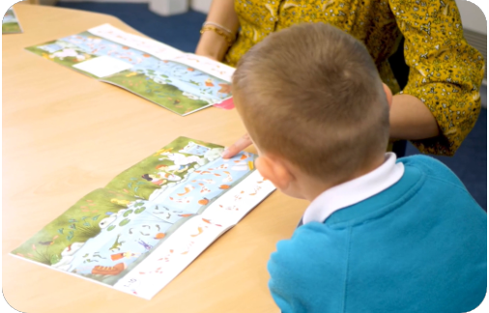
Reading a wordless books
Wordless books are invaluable as they teach reading behaviours and early reading skills to children who are not blending – yet!
Talk about the pictures.
Point to the images in the circles and find them on the page.
Encourage your child to make links from the book to their experiences.
Notes:
Slide purpose:
To give guidance on reading wordless books at home
Notes:
Read the slide.

Slide 23

Read to your child
The shared book is for YOU to read:
Make the story sound as exciting as you can by changing your voice.
Talk with your child as much as you can:
  Introduce new and exciting language.
  Encourage your child to use new vocabulary.
  Make up sentences together.
  Find different words to use.
  Describe things you see.
Notes:
Slide purpose:
To give guidance on reading the shared book at home
Notes:
Read the slide.

Slide 24
Maths Mastery in the EYFS

Slide 25
EARLY LEARNING GOALS
Number
Children at the expected level of development will
-Have a deep understanding of number to 10, including the composition of each number
- Subitise (recognise quantities without counting) up to 5
Automatically recall (without reference to rhymes, counting or other aids) number bonds up to 5 (including subtraction facts) and some number bonds to 10, including double facts

Slide 26
EARLY LEARNING GOALS
Number Pattern
Children at the expected level of development will
-Have a deep understanding of number to 10, including the composition of each number
-Compare quantities up to 10 in different contexts, recognising when one quantity is greater than, less than or the same as the other quantity
-Explore and represent patterns within numbers up to 10, including evens and odds, double facts and how quantities can be distributed equally

Slide 27
Main aims of Maths Mastery
Problem solving- Pupils are encouraged to identify, understand and apply relevant mathematical principles and make connections between different ideas. This builds the skills needed to tackle new problems, rather than simply repeating routines without a secure understanding.
Reasoning-They should be able to say not just what the answer is, but how they know it’s right.
Fluency- Children should be able to recall and apply mathematical knowledge both rapidly and accurately. However, it is important to stress that fluency often gets confused for just memorisation – it is far more than this. As well as fluency of facts and procedures, children should be able to move confidently between contexts and representations, recognise relationships and make connections in mathematics.

Slide 28
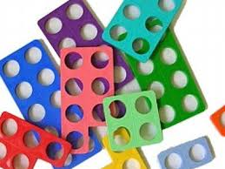
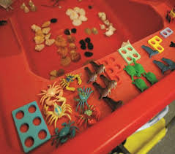
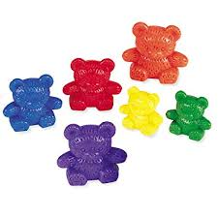
How is Maths Mastery taught?
The first stage in every new concept is ‘concrete’- manipulate objects themselves to help them understand what they are doing

Slide 29

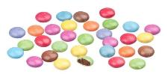
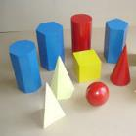


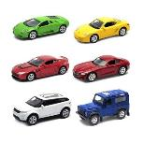
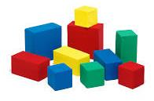

Alternatives to maths resources
Counters or you could use…… Smarties
3D shapes or you could use…… groceries
Counting Bears or you could use…… anything you have a lot of!
Notes:
Maths dictionary for parents is really useful!

Slide 30
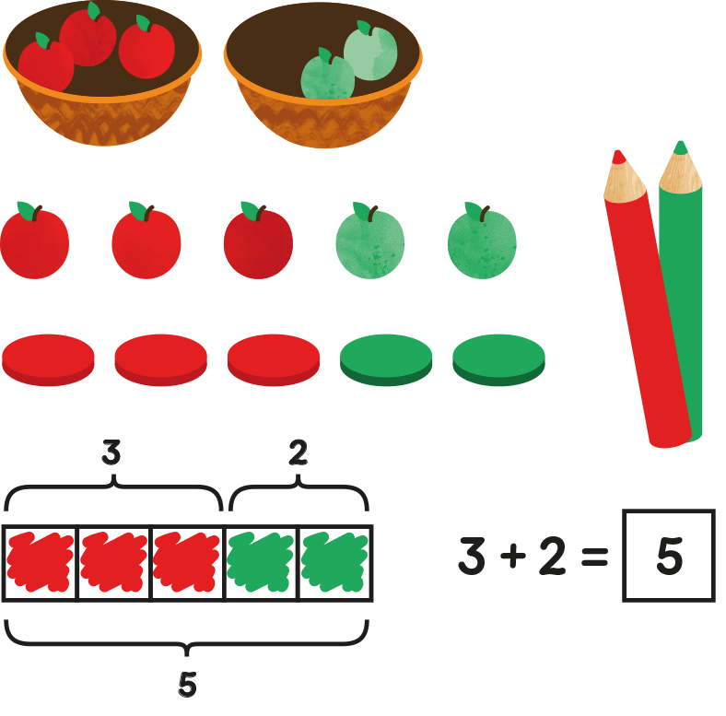
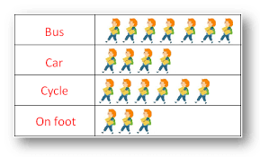
How is Maths Mastery taught?
The second stage is ‘Pictorial’- build on the concrete approach by using pictorial representations (these can then be used to reason and problem solve)
The children will not be able to move to the pictorial stage until they have grasped the concrete stage.

Slide 31
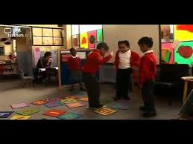
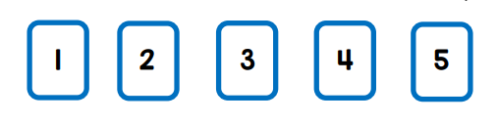
How is Maths Mastery taught?
The last stage is ‘Abstract’- With the foundations firmly laid, children should be able to move to an abstract approach using numerals and key concepts with confidence
The children will not be able to move to the abstract stage until they have grasped the pictorial stage.

Slide 32

Subitising
Notes:
Young children have powerful visual memories and some may find it easier to remember images than words. Subitising can help children to build images for numbers, to visualise and to learn number facts. For instance, most four-year-olds readily learn to recognise five dots on a dice, which helps them to understand the cardinal value or 'howmanyness' of five, which they can link to the word and symbol for 5. Structured images like this also help children to begin to see numbers inside numbers, for instance seeing four and one within five.

Slide 33
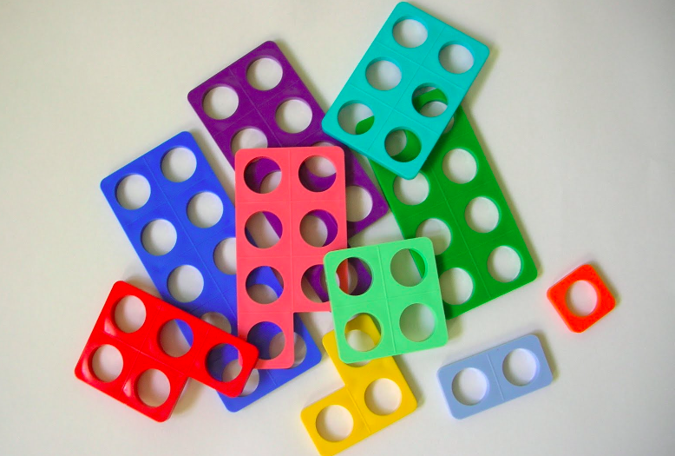
Subitising
Subitising
Subitising
Subitising
Subitising
concrete

Slide 34
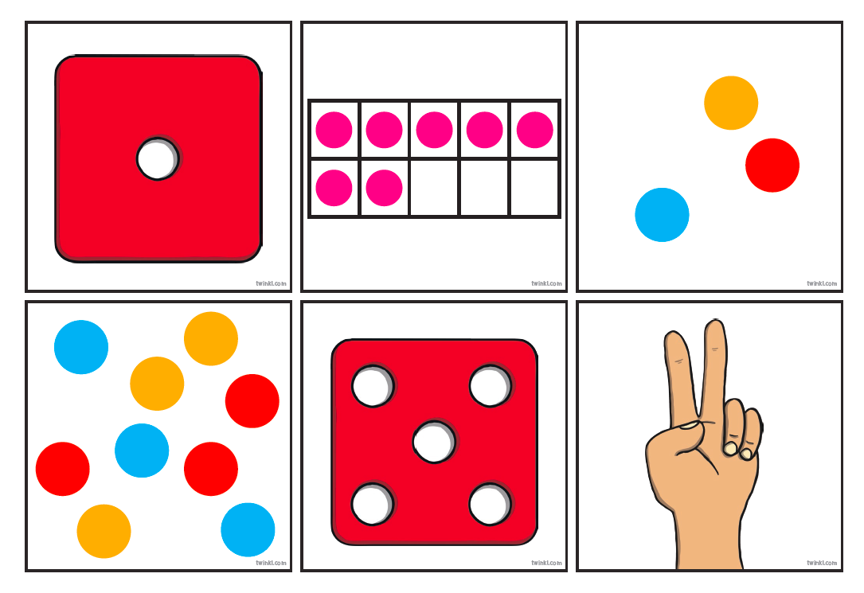
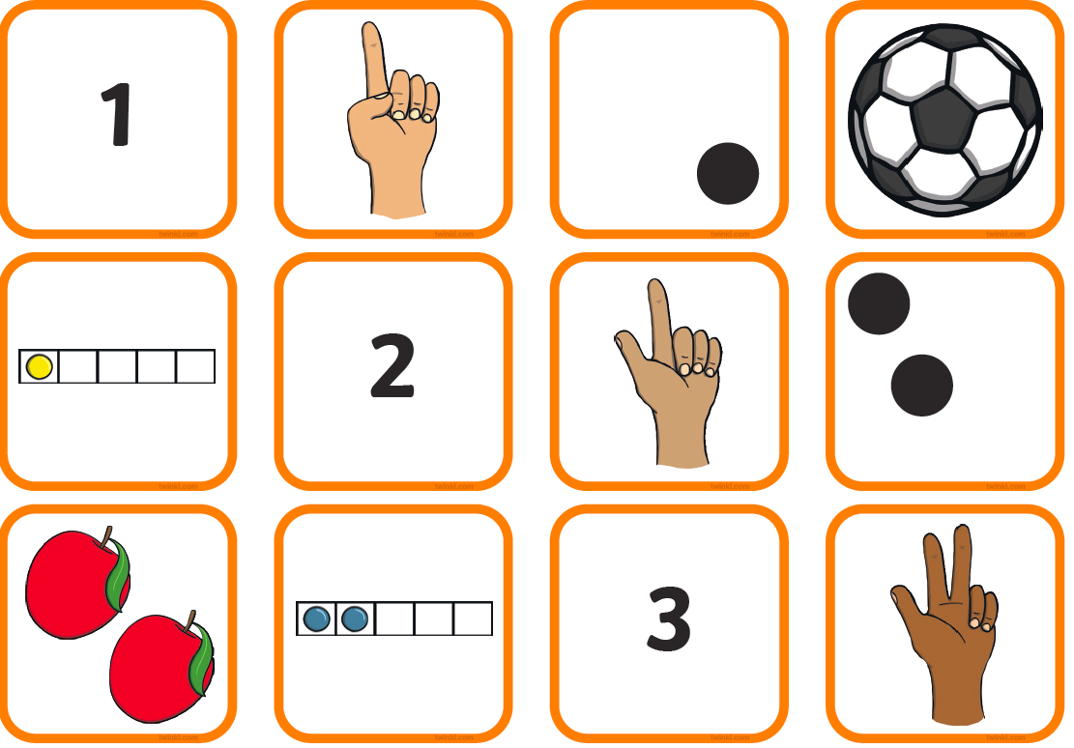
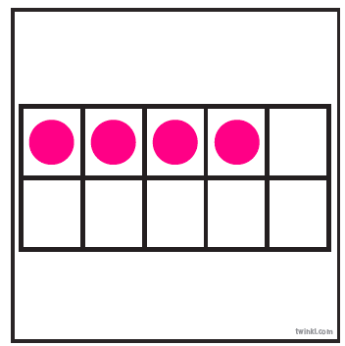
Subitising
Notes:
We need to show children different arrangements as numbers can be seen in different ways – it’s not always uniform like a dice.

Slide 35
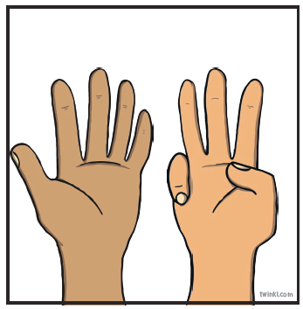
Subitising

Slide 36

Five frame
concrete

Slide 37

Ten frame
concrete

Slide 38
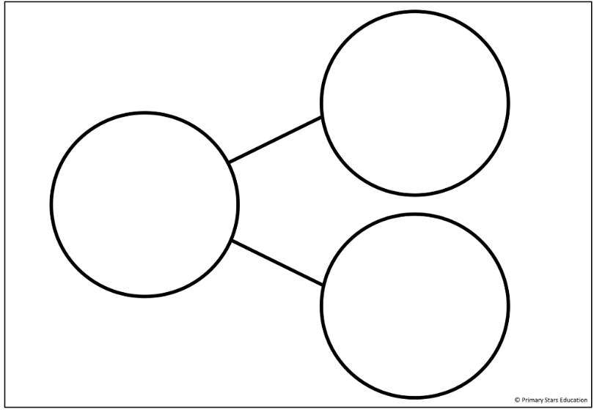
Part, part, whole Method
concrete

Slide 39
Pictorial
4
Notes:
Four is 4+0 = 4
4 is also 1 less than 5

Slide 40
Pictorial
4
Notes:
Four is 1 plus 3 or 3 plus 1 is 4
If I took 3 away I would be left with 1
1 less than 4 is 3

Slide 41
Pictorial
4
Notes:
Four is 1 plus 3 or 3 plus 1 is 4
If I took 3 away I would be left with 1
1 less than 4 is 3

Slide 42
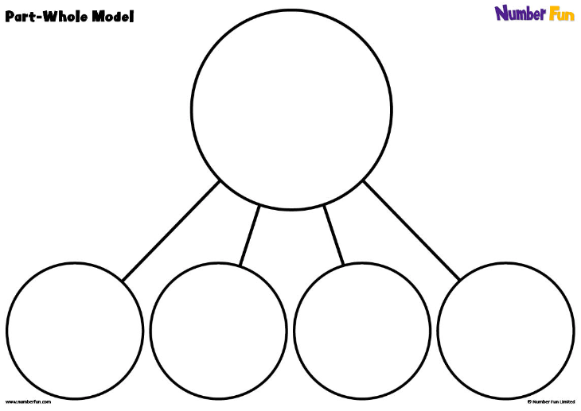
Pictorial

Slide 43
Ten frame
concrete

Slide 44
Ten frame
concrete

Slide 45


Websites to support children’s Maths skills
CBeebies have lots of fun and interactive games and activities to help get our younger children excited about Maths
I See Maths – a useful site with a plethora of ideas for fun games that all the family
Primary Games Arena - It is a free website that encourages children to play online maths games linked to their home learning. It breaks the games down into concepts which is really helpful.
Hit the Button – children love this game as it helps to increase confidence through practising times tables and number bonds.
Maths Zone – this site is jam-packed with fun ways to learn more about maths.
BBC Bitesize – lots of information alongside short videos help to make the learning enjoyable and accessible for all children.

Slide 46
How can you help?
Homework- links to the learning that week.
Keep it fun using concrete objects (objects they can move)
Let them make mistakes and problem solve (talk to them about what went wrong)
Encourage children to speak in full sentences (not just the answer, e.g. “three plus two altogether makes five”)
“Don’t tell me show me”- sometimes children will say “I just know” when you ask them how they got to an answer
Don’t worry about abstract (writing the answer) encourage mark making such as dots, lines etc don’t worry about the numeral this early in the year
Find links in their own experiences of mathematics (can you set the table? How many forks will we need?)
Be positive (let’s work this out together)

Slide 47
How can you help your child with Maths at home?
Deliberately make mistakes. Children need to understand mistakes are normal and everyone makes them e.g. get mixed up when counting, muddle two numbers when ordering them.
Watch Numberblocks on Cbeebies. This programme is written by maths specialists to model maths concepts and represents number brilliantly. Also, Numberjacks is excellent for solving problems.
Hide numbers around the house or garden for children to find.
Play outdoor maths games like hopscotch and skittles. Even better, let children make up their own games and decide how to score points.
Read books with maths concepts e.g. The Very Hungry Caterpillar, One is a snail, ten is a crab, What’s the time, Mr Wolf? The doorbell rang.
Draw attention to more and less.

Slide 48
How can you help your child with Maths at home?
Count - steps up the stairs, money into a money box etc. Ask children to say how many without counting (5 or fewer)
Play games using dice/dominoes and encourage child to say how many spots without counting
Ask children to set the table with enough knives, forks and plates for everyone
Spot numbers in the environment – on phones, microwaves, clocks, registration plates, doors
Ask children to think of their own representations for numbers eg one of them, two hands, three bears, four wheels on a car, five toes, six sides on a dice, seven dwarves, eight legs on an octopus etc.

Slide 49
Homework
Homework will be given out every Friday.
The children will be given a math challenge based on what that they have been learning in their math sessions that week.
These challenges are practical tasks that should be fun. You can record your child’s learning in a variety of ways.
Photographs, drawings or a comment. If you upload your child’s homework onto Seesaw please write a note in their homework book to inform the teacher.

Slide 50
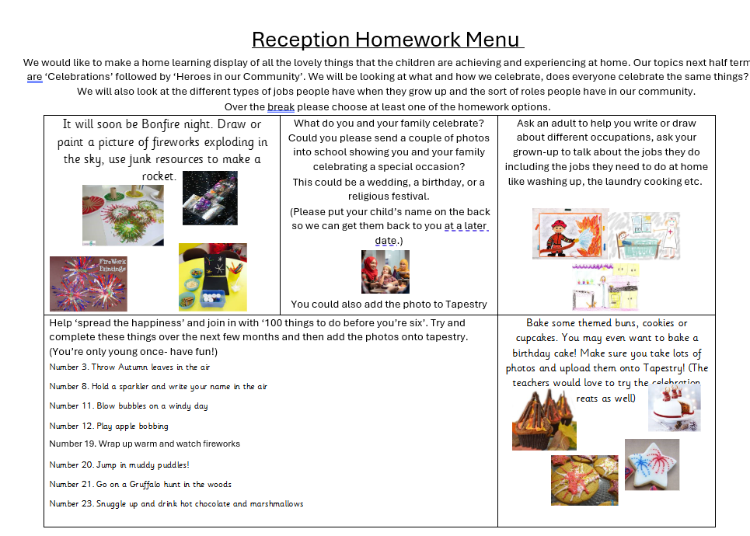
Topic Homework
This will be given each half term in the form of a homework menu
This needs returning the first couple of weeks of term

Slide 51
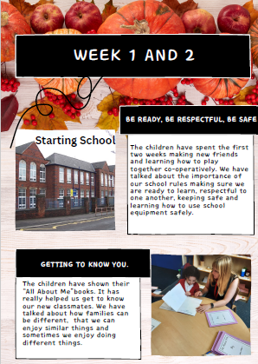
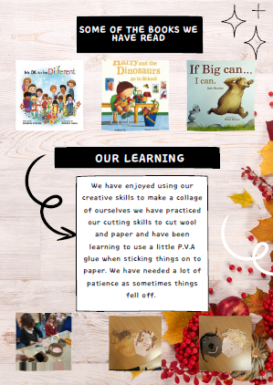
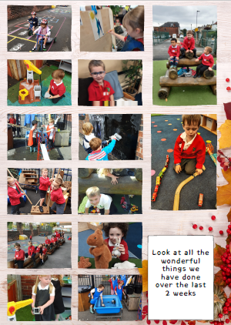
Communication

Slide 52

Any Questions?
enquiries@marlcliffe.sheffield.sch.uk

