Slide 1



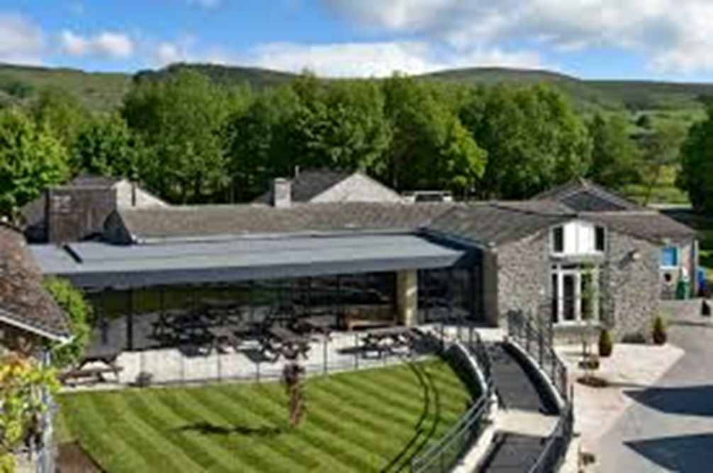


CASTLETON RESIDENTIAL
Monday 23rd - Wednesday 25th March 2026

Slide 2



No need to make notes this evening...
This presentation will be available on the Residentials page of the school website.

Slide 3

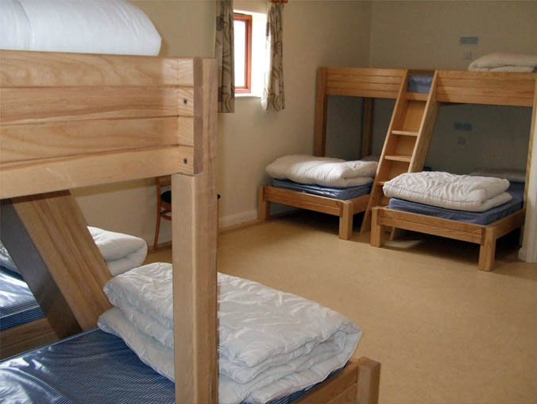
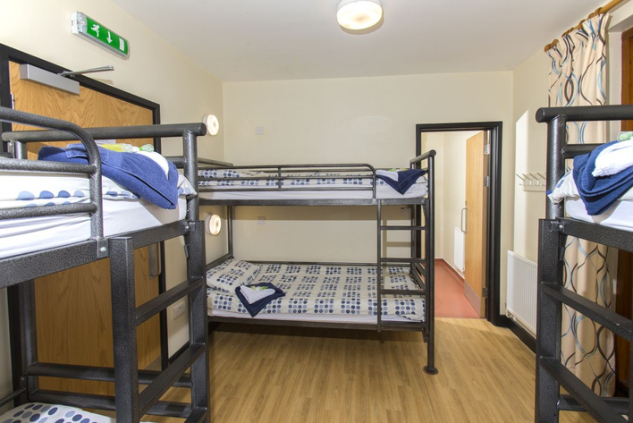
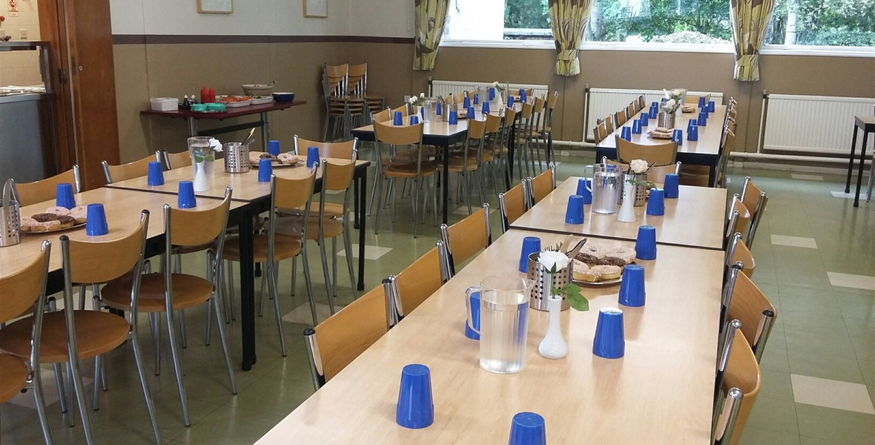
The Hollowford Centre
The Hollowford centre has over 50 years experience in delivering outdoor and adventurous activities for school.
Please see their website for more details: https://www.lindleyeducationaltrust.org/

Slide 4



Staffing
Mrs Towers (Lead teacher)
Mrs Fallon
Mr MacDonald
Miss Pepler
Mrs Hayes
Mr Croft
Mr Kenworthy

Slide 5


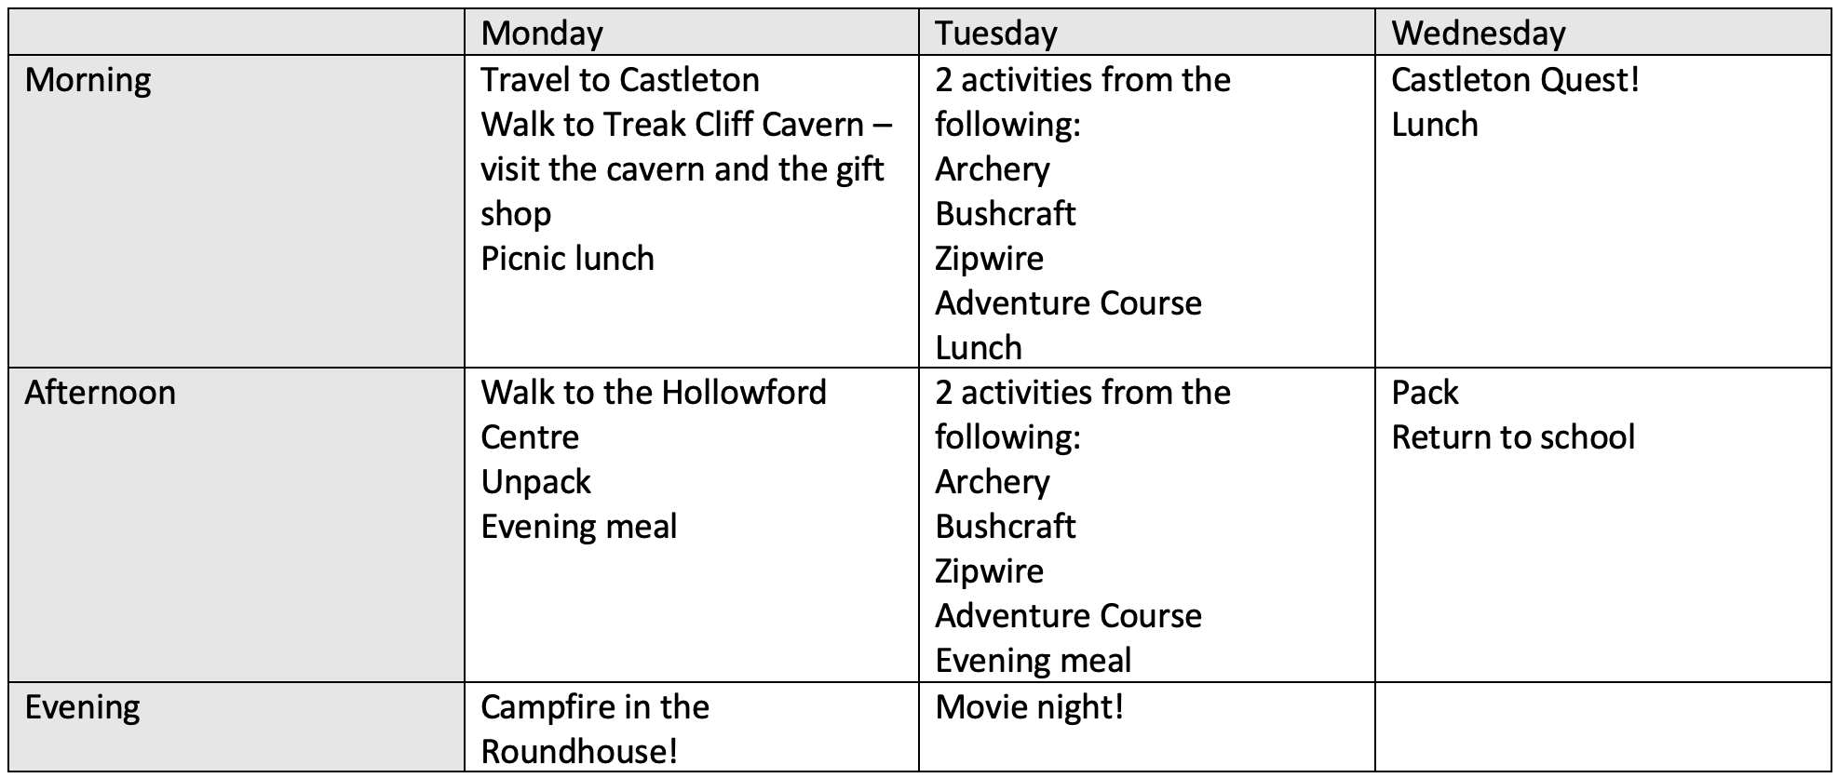


Programme of Activities

Slide 6

What to Bring
Kit lists are available to take home with you after the meeting.
•You will be given Hollowford’s suggested kit list - this will also be added to the website.
•In summary, bring warm, hard-wearing clothing that it wouldn’t be a disaster to lose!
•Some of it may/will get wet or muddy so please pack a black bin bag or two!
•Name as much of your clothing as possible (unfortunately we can’t guarantee that everything will get back to you but it is much more likely too if it is named!).
•You don’t need any specialist equipment; this is all provided by the centre.

Slide 7

Spending Money
The children will have the opportunity to visit the Treak Cliff Cavern gift shop. The Hollowford Centre also has it’s own gift shop selling small souvenirs and snacks.
If you wish for your child to bring spending money, please send no more than £10 in a named purse/wallet.
Your child will be expected to be responsible for their own money.
Please make sure this is packed with their lunch as their luggage will go to the Hollowford Centre while we are at the cavern.

Slide 8

What Not to Bring!
•Mobile phones
Electrical equipment – iPods, hand-held games, expensive watches etc.
The centre doesn’t allow children to use a camera of any sort. Marlcliffe staff will take plenty of photographs, which will be shared on our Residential Blog in line with school policy and with your consent.
Food/sweets - no midnight feasts!
Anything valuable!

Slide 9

Medication
•Pupils with asthma must bring 2 inhalers. One will be kept by staff in a medication box and one will be carried by the group leader or pupil at all times.
•Calpol / Travel Sickness permission to be given on medical forms.
•All medications must be labelled clearly with the child’s name and the dose to be administered.
•On the Monday morning, all medication must be given to Miss Pepler in the art room, with appropriate paperwork. Please try to bring them in earlier than this if possible!
•Children must not have any form of medication in their bags.
•ALL medication must be in date and named.

Slide 10

On The Day...
On the day of the residential, please bring your child’s bags to the art room. There is no need to be at school earlier than normal - we will be leaving school at approximately 10am.
Children will need a packed lunch for Monday lunchtime.
On arrival at Castleton, the Hollowford Centre staff will take our bags to the centre while we walk to Treak Cliff Cavern, where we will visit the cavern and the gift shop and have our packed lunch.
We will then walk to the Hollowford Centre and settle into our rooms before having our evening meal and evening activity.

Slide 11



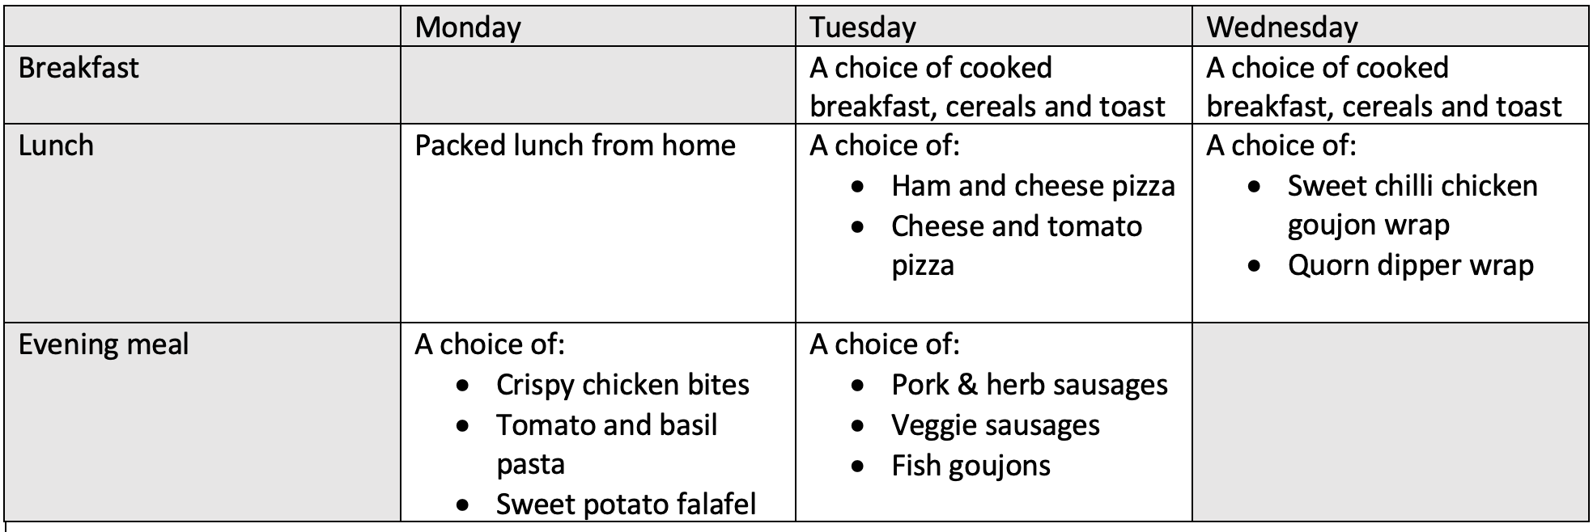


Meal Times
Children have already chosen their meal options for the visit from the menu below. All dietary needs will be passed on to the Hollowford Centre and will be catered for.

Slide 12

Night Time
Dormitories sleep between 4-6 people. There is a combination of bunk beds and single beds. All rooms have en suite bathrooms.
Marlcliffe staff will be staying on each corridor and will be on call throughout the night if needed.
Children have listed a choice of friends that they would like to be with and we will ensure everyone is with at least one friend. Girls and boys will be in separate dormitories.
Children with medical needs will be attended to by a member of Marlcliffe staff.

Slide 13
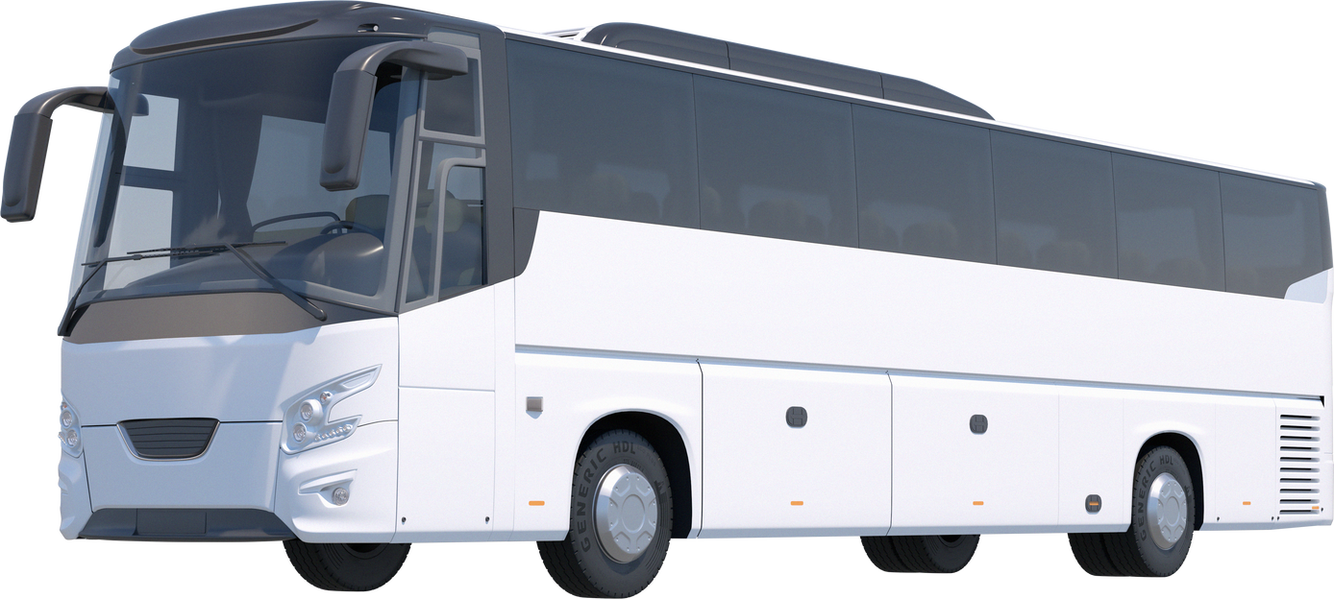
Return to School
We will be setting off back to school at approximately 2pm and expect to arrive at around 3pm so children can be collected at the normal time.
Any delays will be communicated through the school office and will also be posted on the Blog.

Slide 14
Castleton Blog
We have created a blog to give you photos and updates throughout the trip (link will be on website)
We will only post photographs of children for whom we have parental consent – most of you have already given consent on the annual permission form. If you wish to include your child for just this trip then permission forms are available…please ask a member of staff after the meeting. If you can’t remember whether you have given permission, then we are happy to check for you.

Slide 15




ANY QUESTIONS?

