Slide 1

Lower KS2
Parents’ Information Slides
How can I help my child?
What
is expected in school?
What is my child expected to do at home?
Notes:
Jon

Slide 2
Questions
If you have any questions, please ask at the end.
If you prefer, you can email questions to enquiries@marlcliffe.sheffield.sch.uk, marked for the attention of your child’s teacher.
We will also be available at the end of the meeting to have a chat with you.
Notes:
Jon

Slide 3

The team:
Mrs Towers – Phase leader
Mrs Neale
Mrs Mowforth
Mrs Cooper
Mr MacDonald
Mrs Fallon
Mrs Barber
Mrs Packham
Miss Collingwood
Miss Pepler
Mr Croft
Notes:
Jon

Slide 4
Welcome to KS2!
A few differences:
Milk and fruit/healthy snacks are available from the tuck shop at breaktimes – no more than £1.
Children have breaktime on the back playground.
School dinners – £2.95 per day. Pay on SchoolComms
Children may bring a healthy snack – no nuts please.
Notes:
Jon

Slide 5

Attendance at Marlcliffe

Slide 6
Attendance Roles
SLT Attendance Champion- Clare Hayes
Attendance Officer- Charlotte Codd
Learning Mentor- Sherren Barrett

Slide 7


OUR SCHOOL TARGET THIS YEAR IS
96%

Slide 8


Slide 9
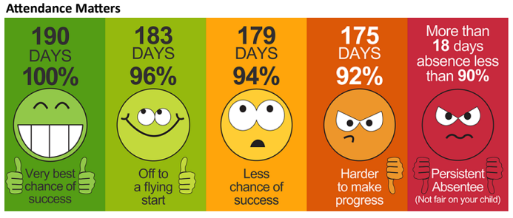

Slide 10
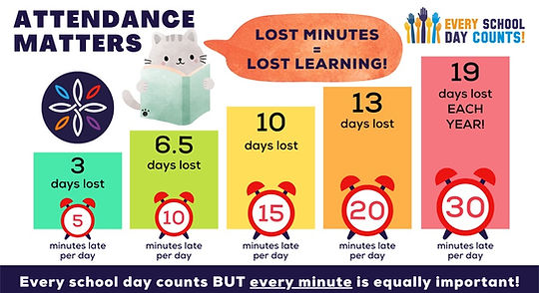

Slide 11
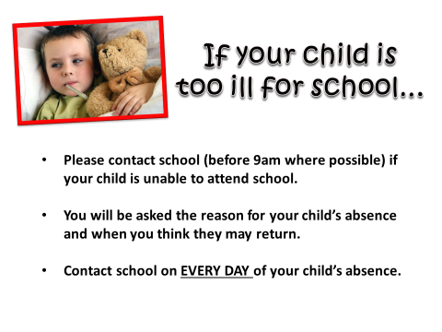

Slide 12
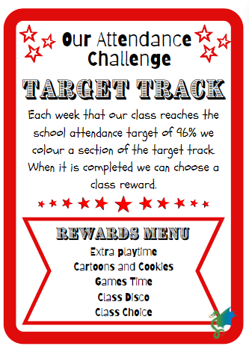
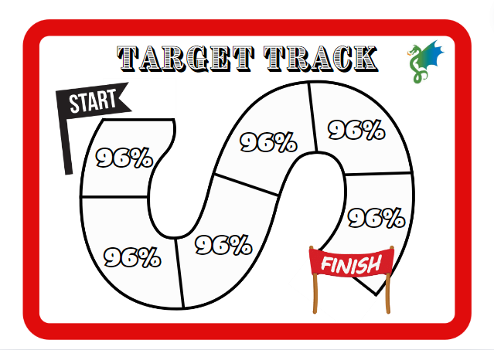



Attendance Rewards at Marlcliffe

Slide 13

Homework
Maths homework will be set on Seesaw every Friday. It should be completed and submitted to Seesaw by the following Wednesday. Children who do not complete this will be asked to complete it at homework club. One activity from the homework menu – 20-30 mins. Activities from the homework grid can be done in books or uploaded to SeeSaw where appropriate. Homework club available on Thursday lunchtime for anyone who needs support completing homework/children who have not handed homework in.
Notes:
Jon

Slide 14

Reading:
We would like children to read out loud, at home, with an adult, for around 10 minutes at least 3 times a week. This will be rewarded with reading raffle tickets.
Please record book title, page numbers and initial your child's reading record each time.
Notes:
Roanne

Slide 15
Reading Records
Need to be in school everyday
Children need to bring their reading book every day too
Each time your child reads at home they will receive a raffle ticket to enter a weekly prize draw. The Reading Record must be signed/initialled by you/grown up.
Notes:
Roanne

Slide 16

Reading Strategies
These are some useful strategies that you could try with your child when reading with them at home.

Slide 17
Spellings:
Spellings will be tested every week.
New lists will be given out each week to learn for the following week.
Please practise spellings at home.
Notes:
Roanne

Slide 18
PE kits
Please ensure your child has the following PE kit at all times:
Black or navy shorts
Plain white t-shirt (no football shirts)
Plimsolls or trainers
Socks
Bobble/scrunchie for long hair
Tracksuits for outdoor lessons in winter (optional)
No jewellery/fitbits
Notes:
Ruth

Slide 19
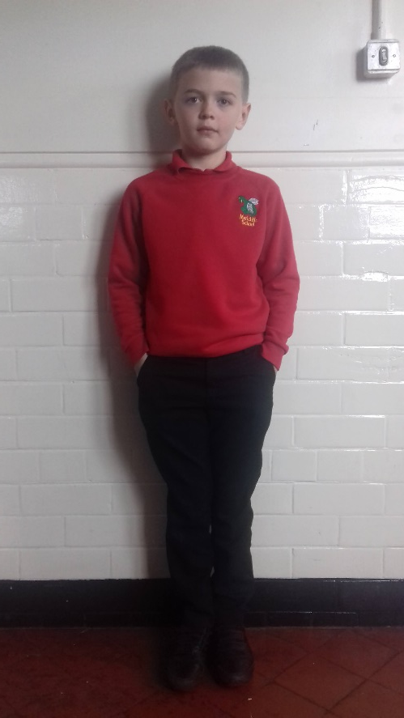
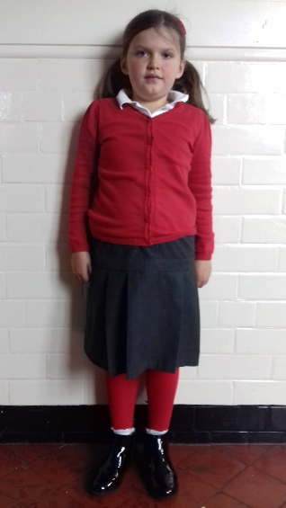
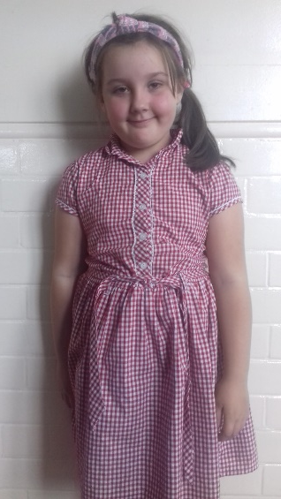
Uniform
We do have a set uniform in place that we expect the children to be wearing at all times, unless it is non-school uniform day.
Please ensure all clothing including PE kit is labelled with your child’s name.
The children always look very smart in their uniforms!
Notes:
Chloe

Slide 20

Rewards and Sanctions
Dojos
Certificates
Marlcliffe All Star
Hot Chocolate with the head
Red box – Timeout
Sanctions
Notes:
Liz

Slide 21
This Year’s Learning
Autumn 1 – The Anglo Saxons
Autumn 2 – The Vikings
Spring 1 – Extreme Environments
Spring 2 – Sheffield Flood
Summer 1 – Africa
Summer 2 – Coasts
Notes:
Chloe

Slide 22
This Year’s Learning
Y4s will learn to play recorder with Mrs Towers.
Y4 swimming will commence in February – further details to be sent out after Christmas.
Notes:
Chloe

Slide 23
English Curriculum
Continue to develop accuracy of spelling and punctuation in writing.
Learn a wider range of sentence structures.
Combination of group reading activities and whole class book study.
Notes:
Chloe

Slide 24
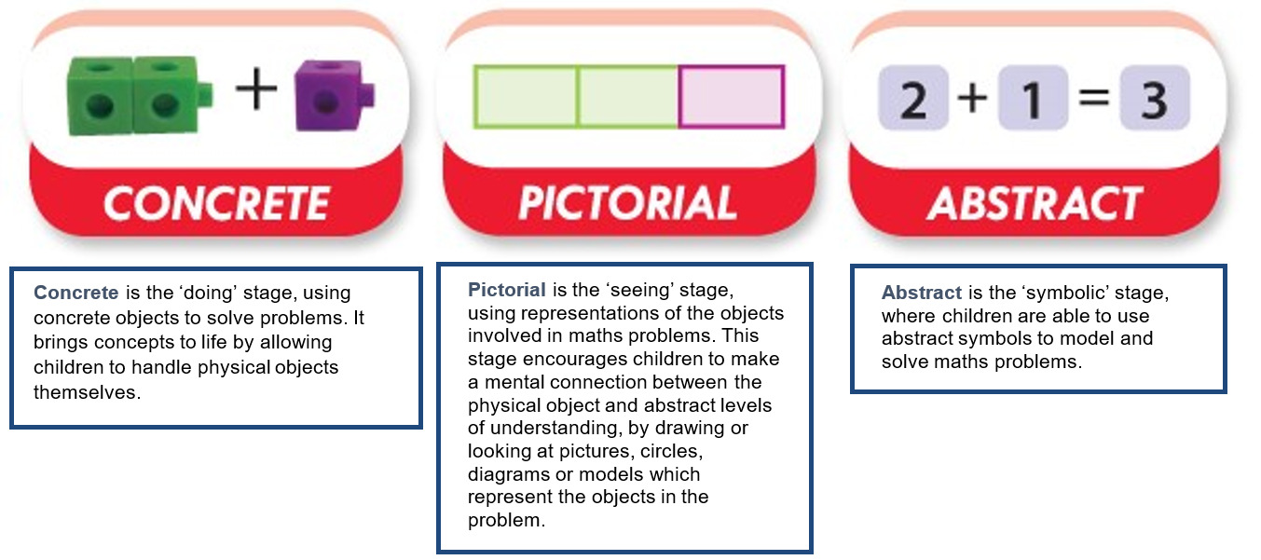
Maths Curriculum
White Rose Maths programme of study.
Concrete, Pictorial, Abstract
White Rose Maths programme of study.
Concrete, Pictorial, Abstract
Notes:
Chloe

Slide 25
Y4 Multiplication Tables Check
Statutory test for all Y4s in June.
Children answer 25 questions on times tables from 2 to 12.
6 seconds to answer each question.
No pass mark – children are expected to get 25/25!
Times Tables Rockstars Soundcheck mode.
Notes:
Chloe

Slide 26
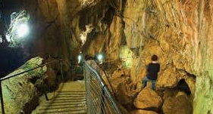
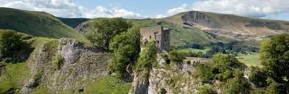
Y4 Castleton Trip
23rd – 25th March 2026
Initial letters to go home next week.
Information meeting dates to follow.
Notes:
Chloe

Slide 27
Website/ Class blogs
Curriculum newsletters and homework menus will be posted, together with any other useful information.
We will only post photographs of children with consent from parents/carers. If you are unsure whether or not you have given this consent, please speak to the office.
Links to individual class blogs are available on the website.
Notes:
Liz

Slide 28
Staying in contact
In the morning, short messages can be passed on to the teacher via email or the office.
Teachers will be dismissing the children at the end of the day and will be available to receive messages.
If a longer discussion is required, please contact the school office or email enquiries@marlcliffe.sheffield.sch.uk.
Notes:
Liz

Slide 29
Dates for your diary
Y3/4 Halle Orchestra Trip - 3rd or 4th October
Christmas Fayre – 3rd December
Carols around the tree – 12th and 15th December
3/4 Christmas Party – 16th December
Year 4 Castleton – 23rd – 25th March
Y3/4 Filey Seaside trip - 8th or 10th June
Year 4 MTC – 1st – 11th June

