Slide 1

Year 1 meet the teacher
Miss smith (1s) miss walsh
(1w)

Slide 2
In this meeting we will cover:
Phonics
Reading
Homework
Classroom environment

Slide 3
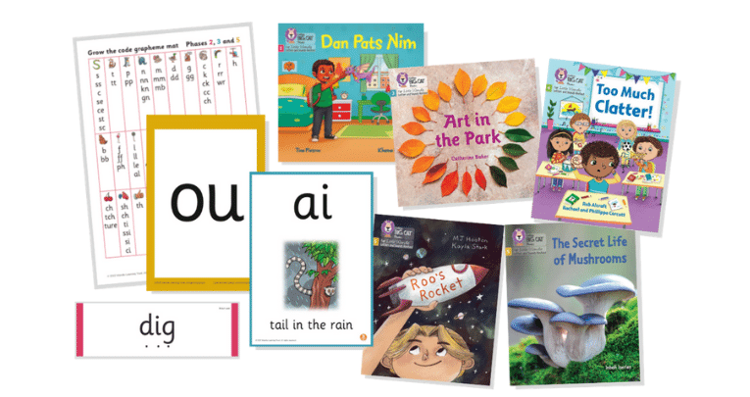

Phonics at Ashbury Meadow
In Nursery, Reception, Year 1, and Year 2, children have daily phonics lessons in which they follow the 'Little Wandle, Letters and Sounds' programme. This is an approach to teaching phonics in which individual sounds (phonemes) are blended together to form words.
Little Wandle, Letters and Sounds is divided into
5 stages, known as 'phases'. Each phase builds on knowledge and skills from previous learning.
During each lesson the children also learn the grapheme (written sound) along with the phoneme (letter sound). As the programme progresses the children also learn diagraphs (two letters making one sound) and trigraphs (three letters making one sound).

Slide 4
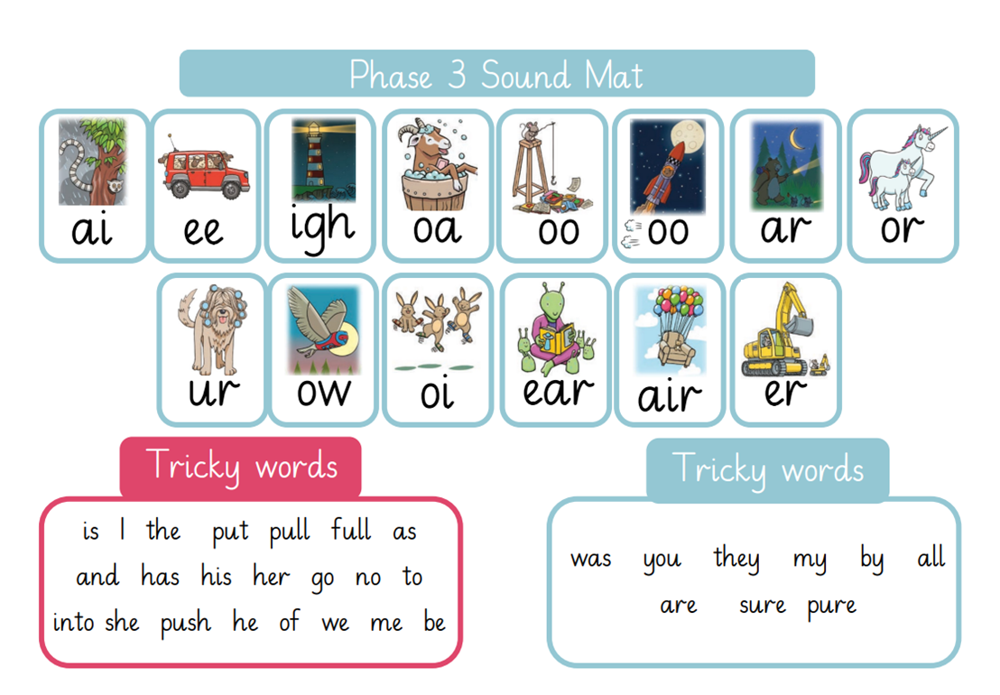
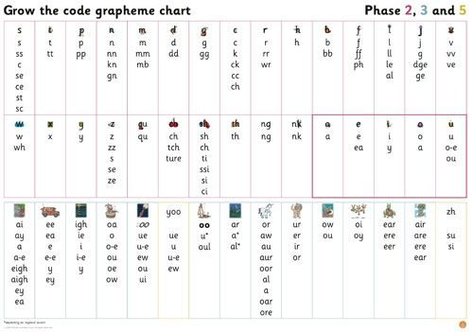
Phonics in Year 1
Autumn 1
Revisit and review the graphemes and phonemes taught in phase 3 and 4.
Autumn 2- Summer 2
Throughout the school year the children focus on
phase 5 and are taught diagraphs, trigraphs and split diagraphs, along with tricky words. The children’s knowledge of phonemes is expanded through the understanding that both phonemes, diagraphs and trigraphs can have alternative sounds.
e.g.
ee: ea, e, e-e, ie, ey, y, ee
Where children need additional support within phonics, they will receive daily catch-up and keep-up phonics sessions.

Slide 5
Phonics in Year 1
Autumn 1
Revisit and review the graphemes and phonemes taught in phase 3 and 4.
Autumn 2- Summer 2
Throughout the school year the children focus on
phase 5 and are taught diagraphs, trigraphs and split diagraphs, along with tricky words. The children’s knowledge of phonemes is expanded through the understanding that both phonemes, diagraphs and trigraphs can have alternative sounds.
e.g.
ee: ea, e, e-e, ie, ey, y, ee
Where children need additional support within phonics, they will receive daily catch-up and keep-up phonics sessions.

Slide 6
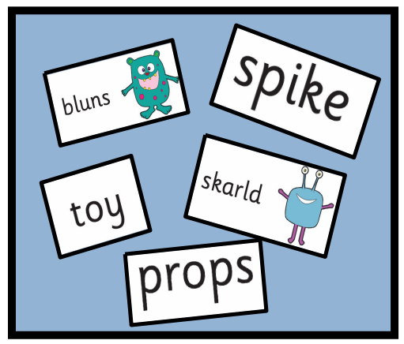
Phonics Screening Check
June 2027
What is the Phonics Screening Check?
It is a quick check of your child’s phonics knowledge.
It is not designed to create any stress or anxiety for your child.
It assesses decoding skills using phonics.
It consists of 40 words (20 real words,
20 ‘alien words’).
If children do not achieve the required score in Year 1, they will retake the screening at the end of Year 2.
The pass mark in 2026 was 31.
Your child will complete 3 practice papers throughout the year, these will be sent home for you to be kept fully up to date in your child’s progress.

Slide 7

Phonics – Parent/Carer Support
The ‘For Parents’ section of the Little Wandle website is extremely helpful in supporting your child.
The resources on this page will help you support your child with saying their sounds and writing their letters. There are also some useful videos so you can see how they are taught at school and feel confident about supporting their reading at home.
You can buy the Little Wandle Phase 5 flashcards on Amazon.

Slide 8
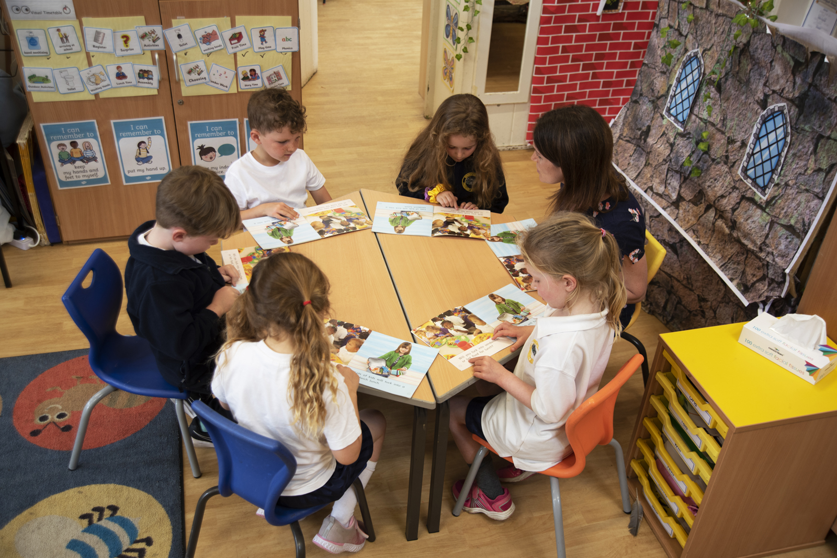
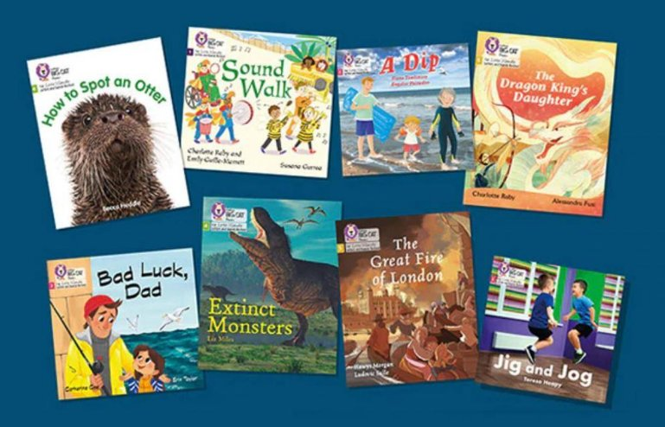
Reading Year 1
Early Reading is taught through reading practice sessions 3 times a week.
Books are used which match children’s secure phonic knowledge.
The reading practice sessions have been designed to focus on 3 key reading skills:
decoding (applying strategies to read)
prosody (reading with expression)
comprehension (understanding the text)
On the 3rd read, an adult will stamp in your child’s reading record and write their next steps. Please look at this to support your child’s reading.
Where children need additional support within reading, students will receive additional 1:1 reading sessions.

Slide 9

Homework- Reading
Children will be given one decodable book to read to an adult and a physical book to be read to by an adult.
The first book will be matched to their phonic ability and will be sent home every Friday.
You must listen to your child read and record your child’s reading three times a week.

Slide 10
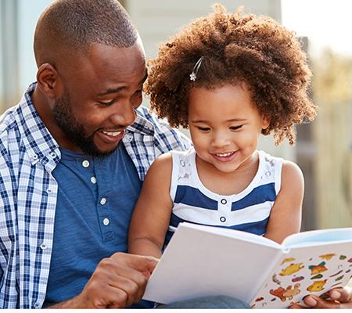


Homework- Reading
Book read by adult
The second book will be a sharing book. This is a library book which has been chosen by your child which an adult reads to encourage them to develop a love for reading.
Book bags should be brought in every day. This is important so that:
Letters can be stored
Reading records can be commented in
Sharing books can be changed.
Children will have a slot each week to change their library book. Please ensure library books stay in book bags so books can be changed.

Slide 11
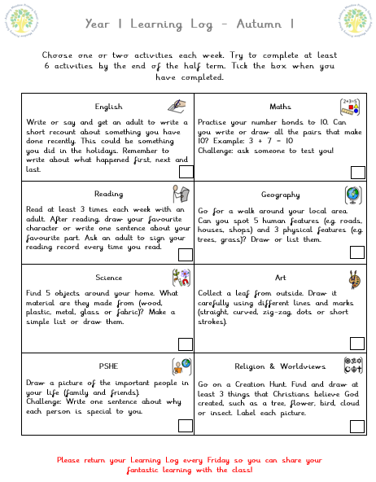
Homework – Learning Logs
Each half term, your child will receive a new ‘Learning Log’ inside their Learning Log books.
Please support your child in choosing one or two activities each week. Encourage them to complete at least 6 activities by the end of the half term. Written work to be completed in their learning log books. Please feel free to write in their learning logs if you are scribing for them/add any pictures! Children are to tick the box when they have completed a learning task.
Learning Logs are to be returned every Friday for the children to share their learning with their peers.

Slide 12
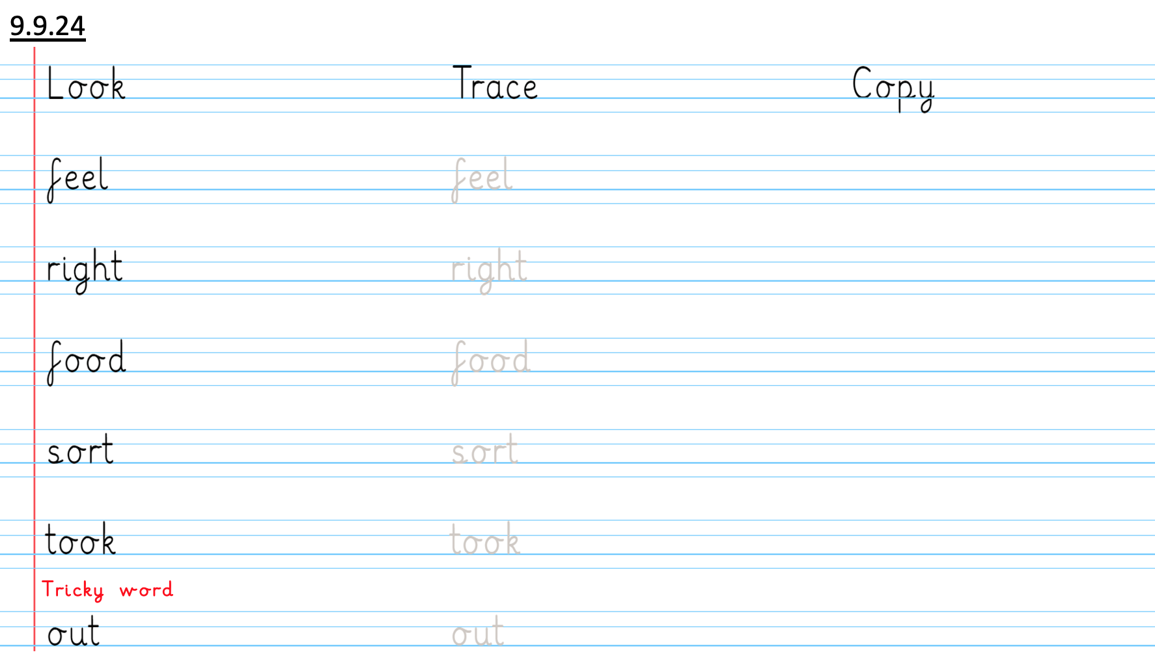
Homework- Spelling
Every Friday, children will be given words to practice that match the current phase they are working on.
5 words and 1 tricky word.
All words will have been shown and practised with the children in previous phonics lessons.
Every Friday, children will have a spelling test.
Please ensure your child has practised these before Friday.

Slide 13
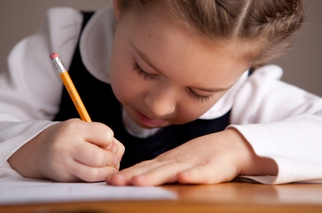
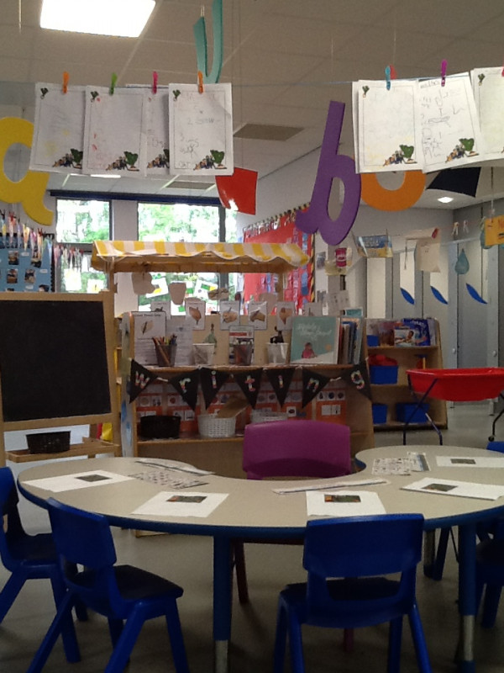
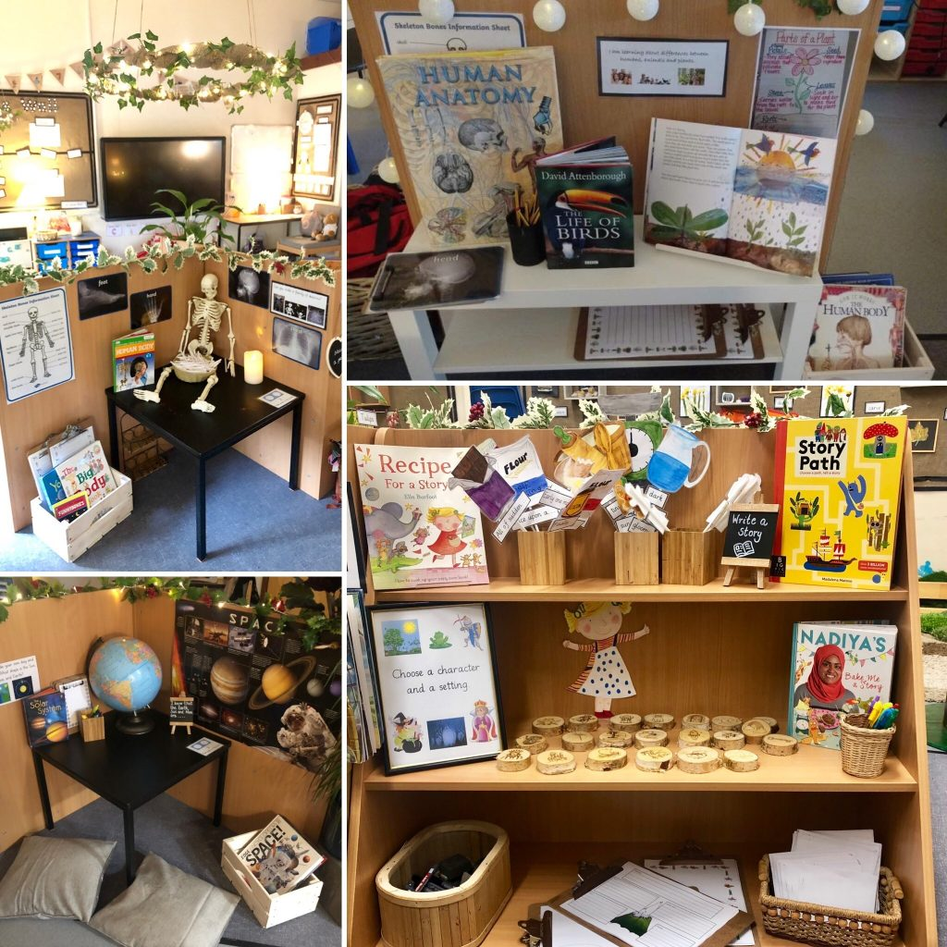
Classroom Environment
One of the biggest changes that children will need to get accustomed to is playing in the provisional areas less and being required to complete more work at tables.
They will be introduced to new topics such as Science, History, Geography Art, DT, RE and worldviews, and PSHE.
Children will still have many opportunities throughout the day to learn through play.

Slide 14

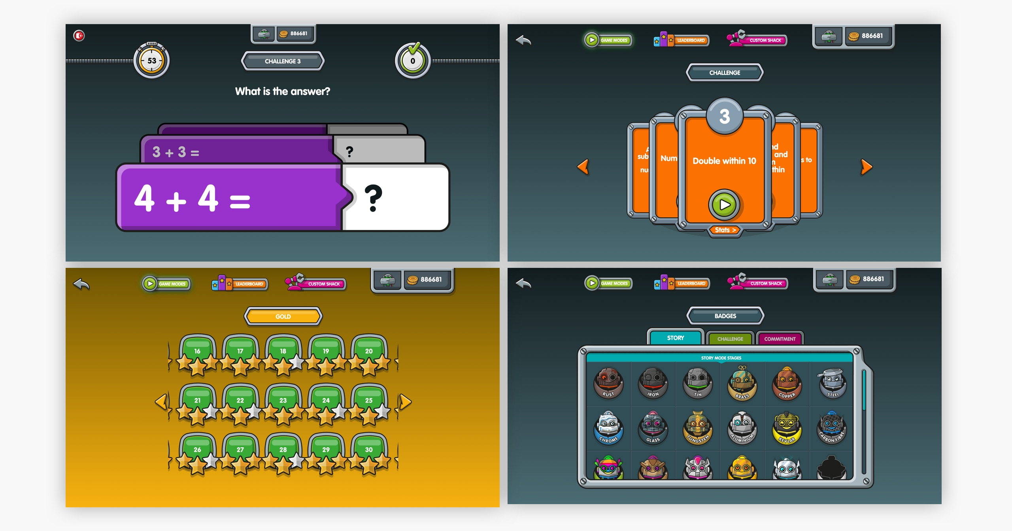
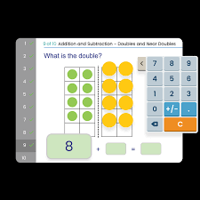

Extra learning at home
Numbots and Mathletics
Numbots is a maths app to help develop your child’s understanding of number.
Children will be able to use Numbots twice a week at school, however, still encourage your child to use this app at home.
Mathletics is another maths app that is more closely linked with the curriculum. Children will receive certificates in Celebration Assembly every Friday as they move through the levels.

Slide 15
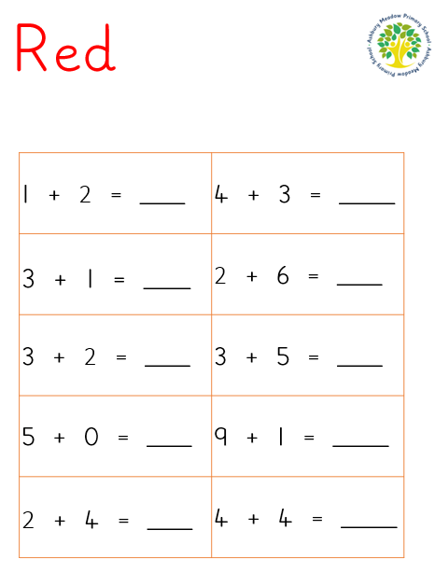
Extra learning at home
Maths Fluency
Maths fluency gives children the secure foundations they need for all future mathematics. Fluency means children can recall and use key facts and procedures quickly, accurately and confidently, without having to work everything out from the beginning each time.
Why is maths fluency important in Year 1?
Builds strong foundations – Children develop secure understanding of numbers, counting, addition and subtraction, which are essential for later learning.
Reduces cognitive load – When basic number facts are automatic, children can focus their thinking on solving problems and explaining their reasoning.
Develops confidence – Regular opportunities to practise and succeed help children develop positive attitudes towards mathematics.
Every Friday your child will take part in Fluency Fridays and move up the levels. These sheets will be sent home and are available on the Year 1 class page.

Slide 16
questions

Slide 17
Useful links
Phonics- Little Wandle Parent area https://www.littlewandlelettersandsounds.org.uk/resources/for-parents/
Numbots Log in
https://play.numbots.com/#/intro
Mathletics Log in
https://login.mathletics.com/
- Ashbury Meadow – Year 1 page link - https://www.ashburymeadow.co.uk/class/year-1

