Slide 1
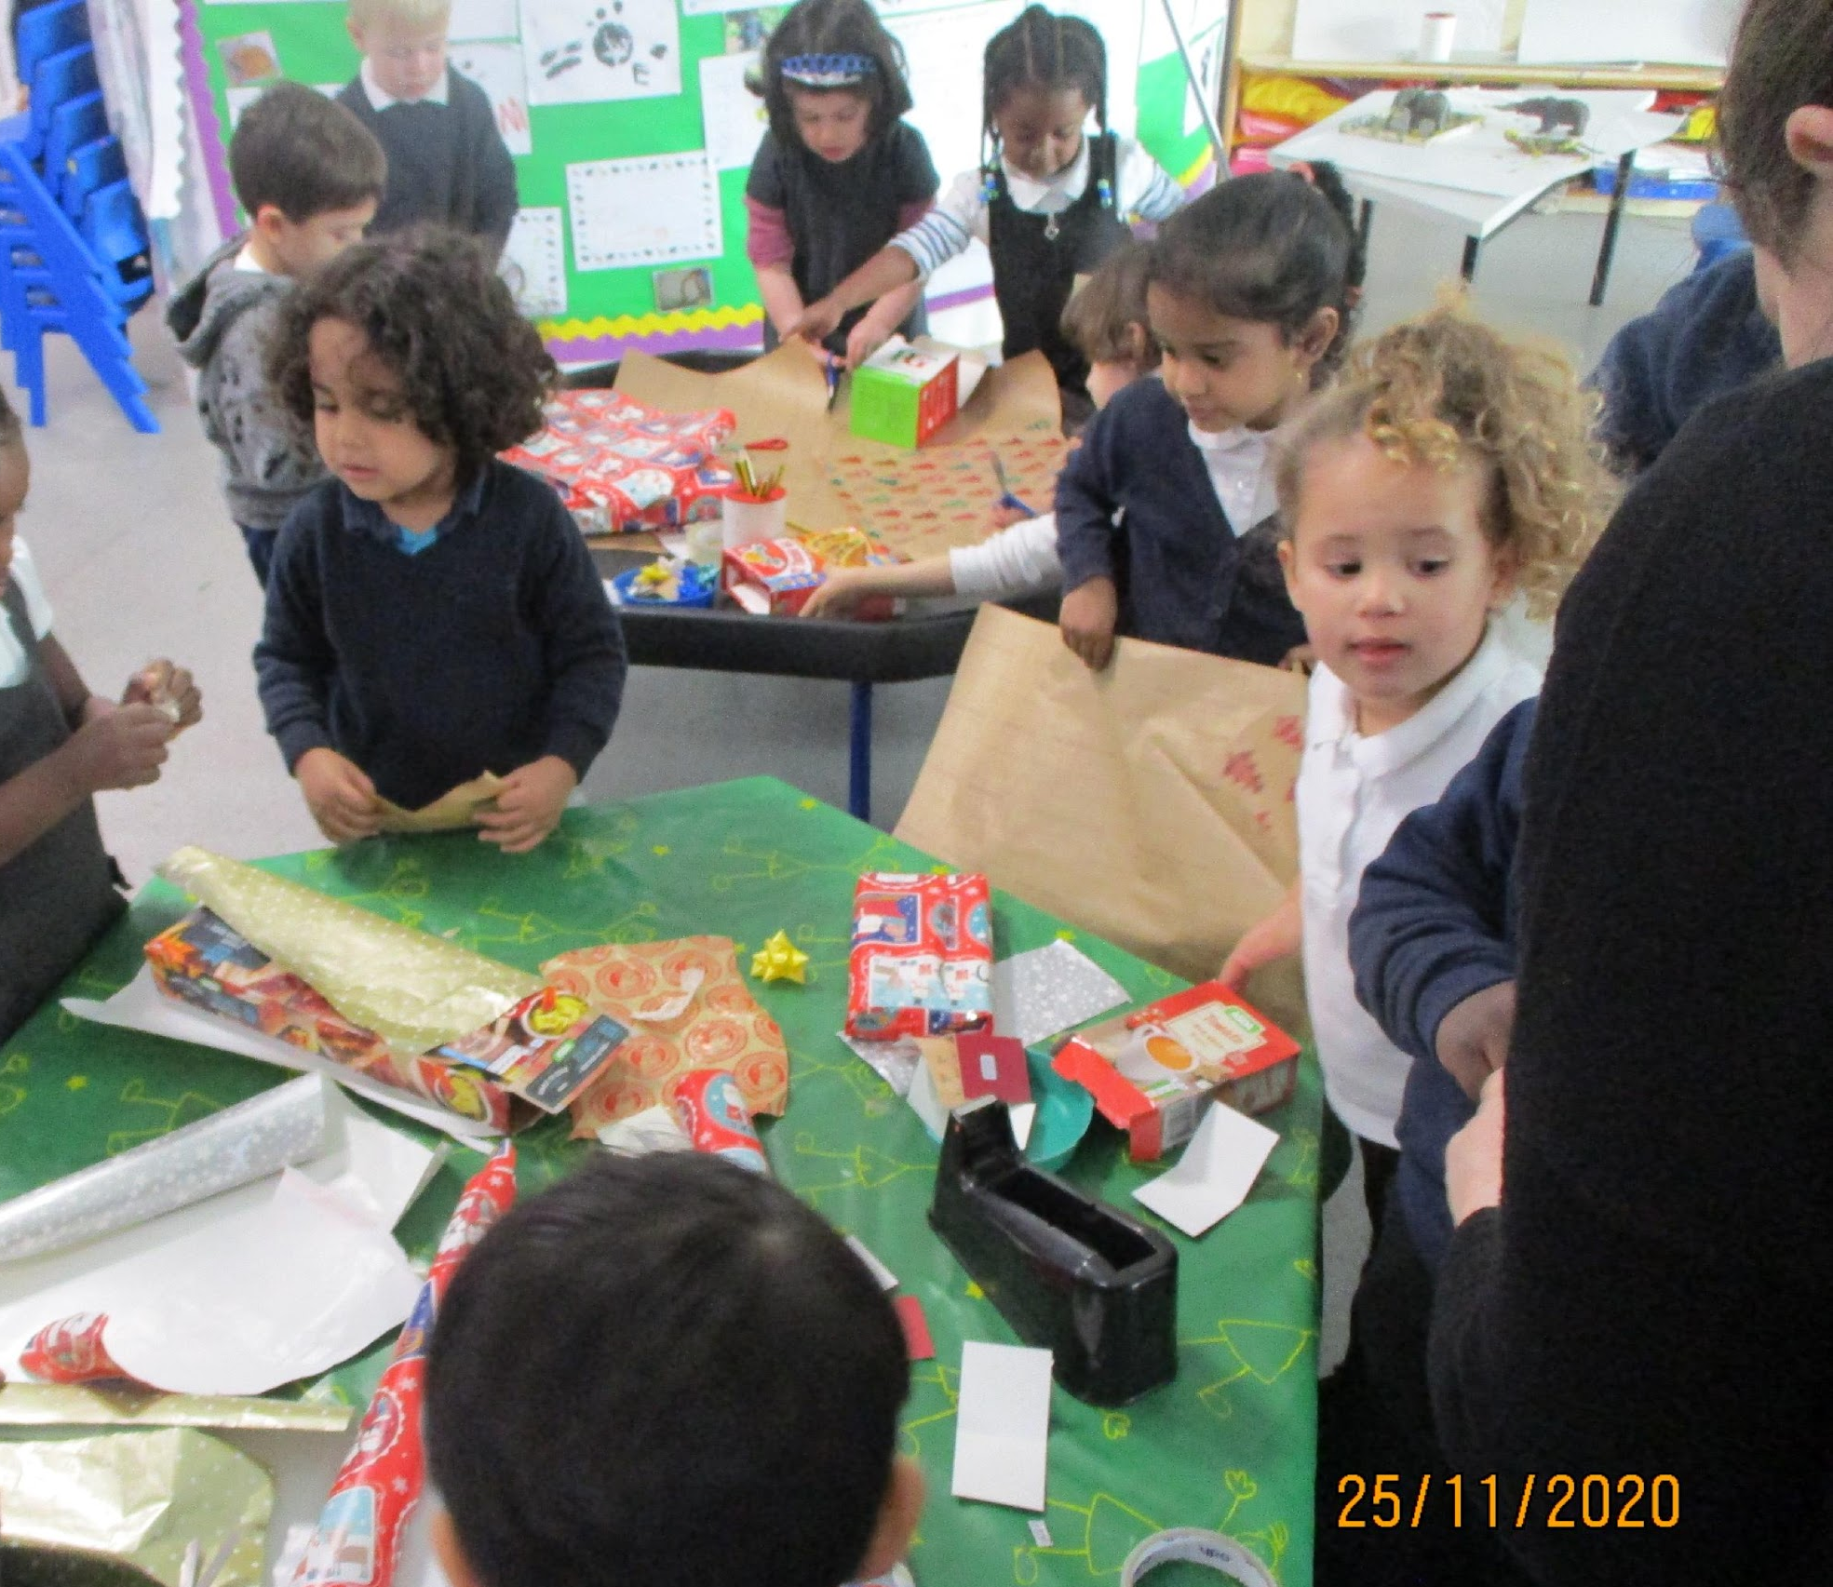
What to expect this year…

Slide 2
Aims of this workshop:
Familiarise with the staff and get a feel for the daily routines.
Be aware of Expectations (safeguarding, homework including reading, parents meetings, clothing)
Know about resources and platforms to help; school website, Tapestry, Collins
Phonics

Slide 3
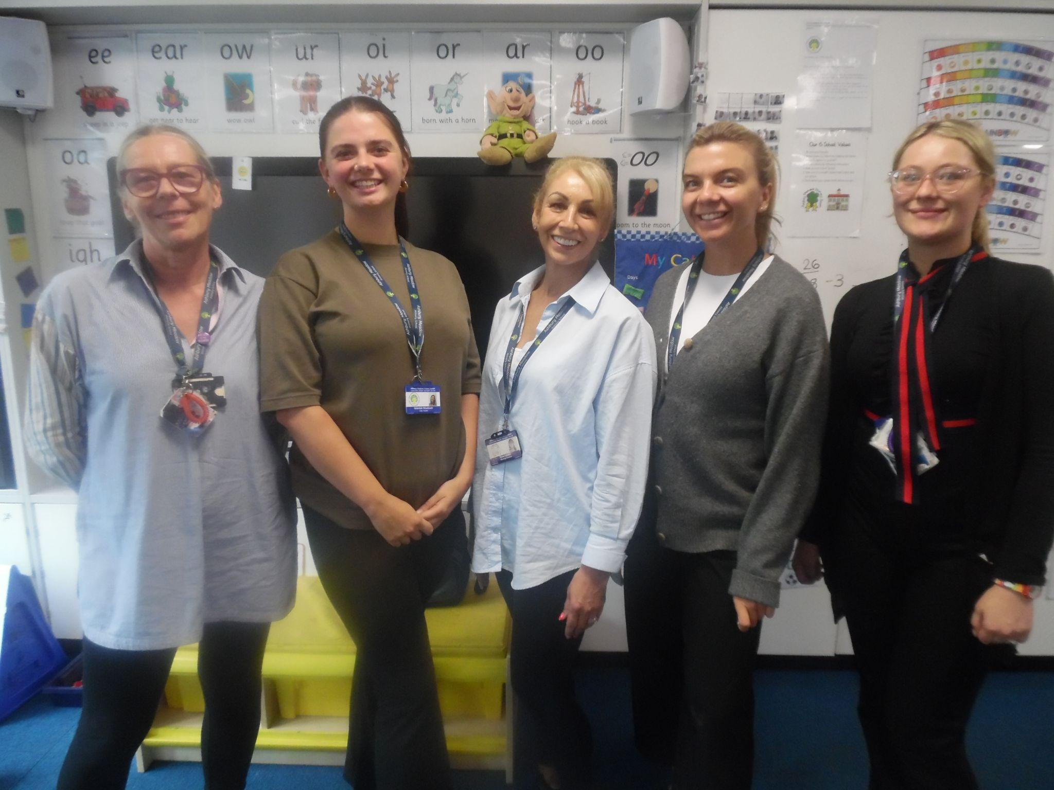
Welcome/Welcome back to a new school year at Ashbury Meadow Primary School!
We are looking forward to working together to support your children over the coming year!
Reception teachers

Slide 4
Our Amazing Team
In Early years at Ashbury Meadow we have 2 Nursery classes and 2 Reception classes some of you may have had children who have come through our Nursery!
RM Class teacher/EYFS lead/Early reading lead Mrs Millington- Stubbs and and teaching assistant Mrs Landell
RW Class teacher Miss Woodcock and class teaching assistant Miss Ward
We also have Miss Davies working in Reception, finalising her teacher training and Mrs Pople who covers teacher PPA.

Slide 5
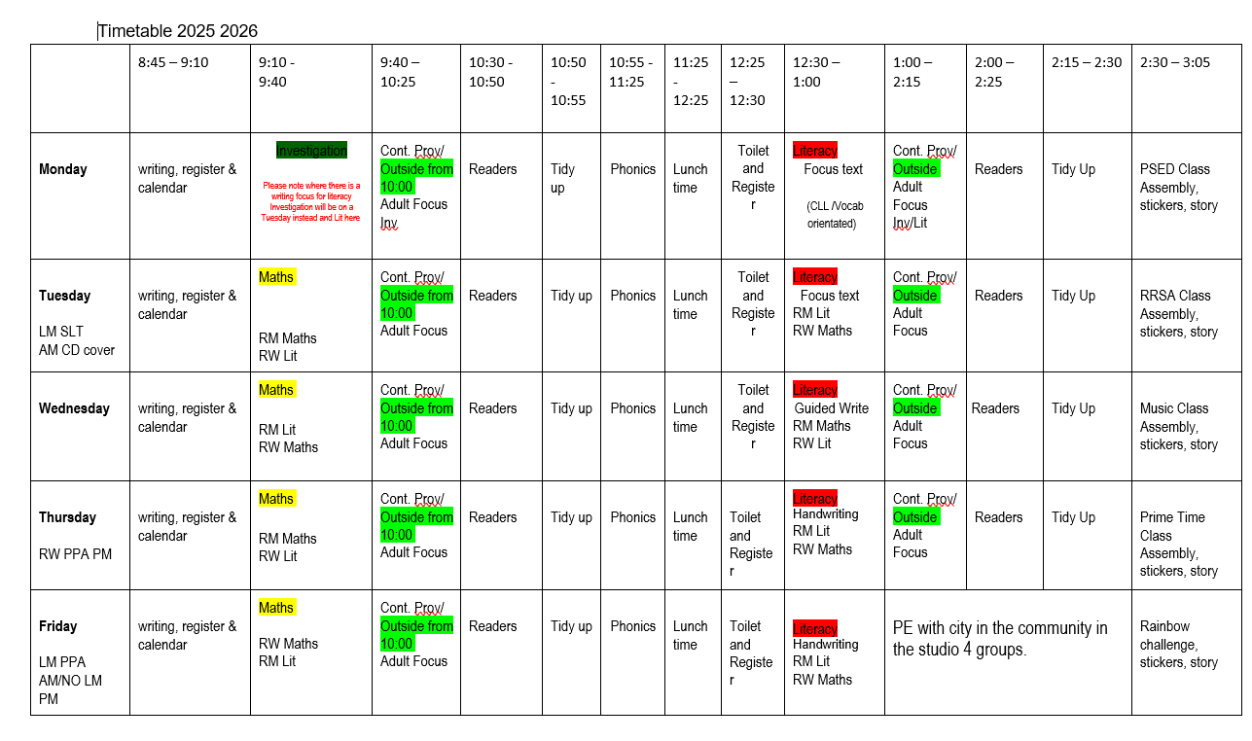
A day in Reception

Slide 6
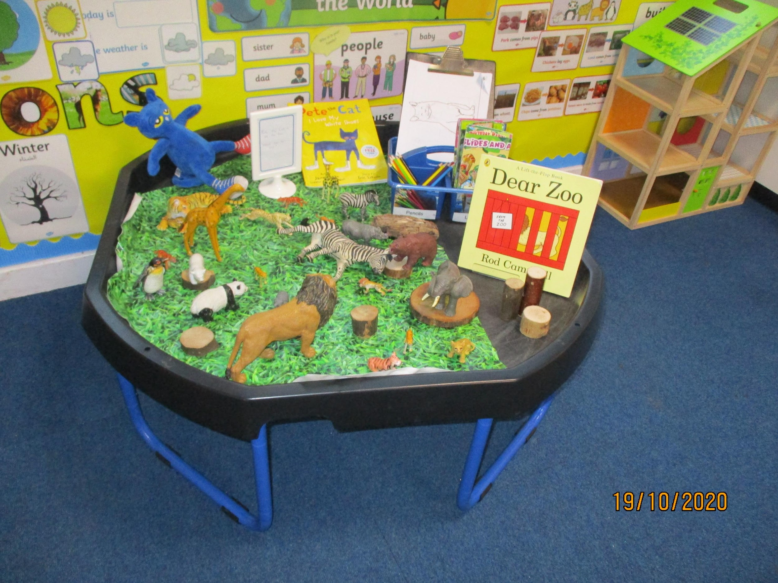
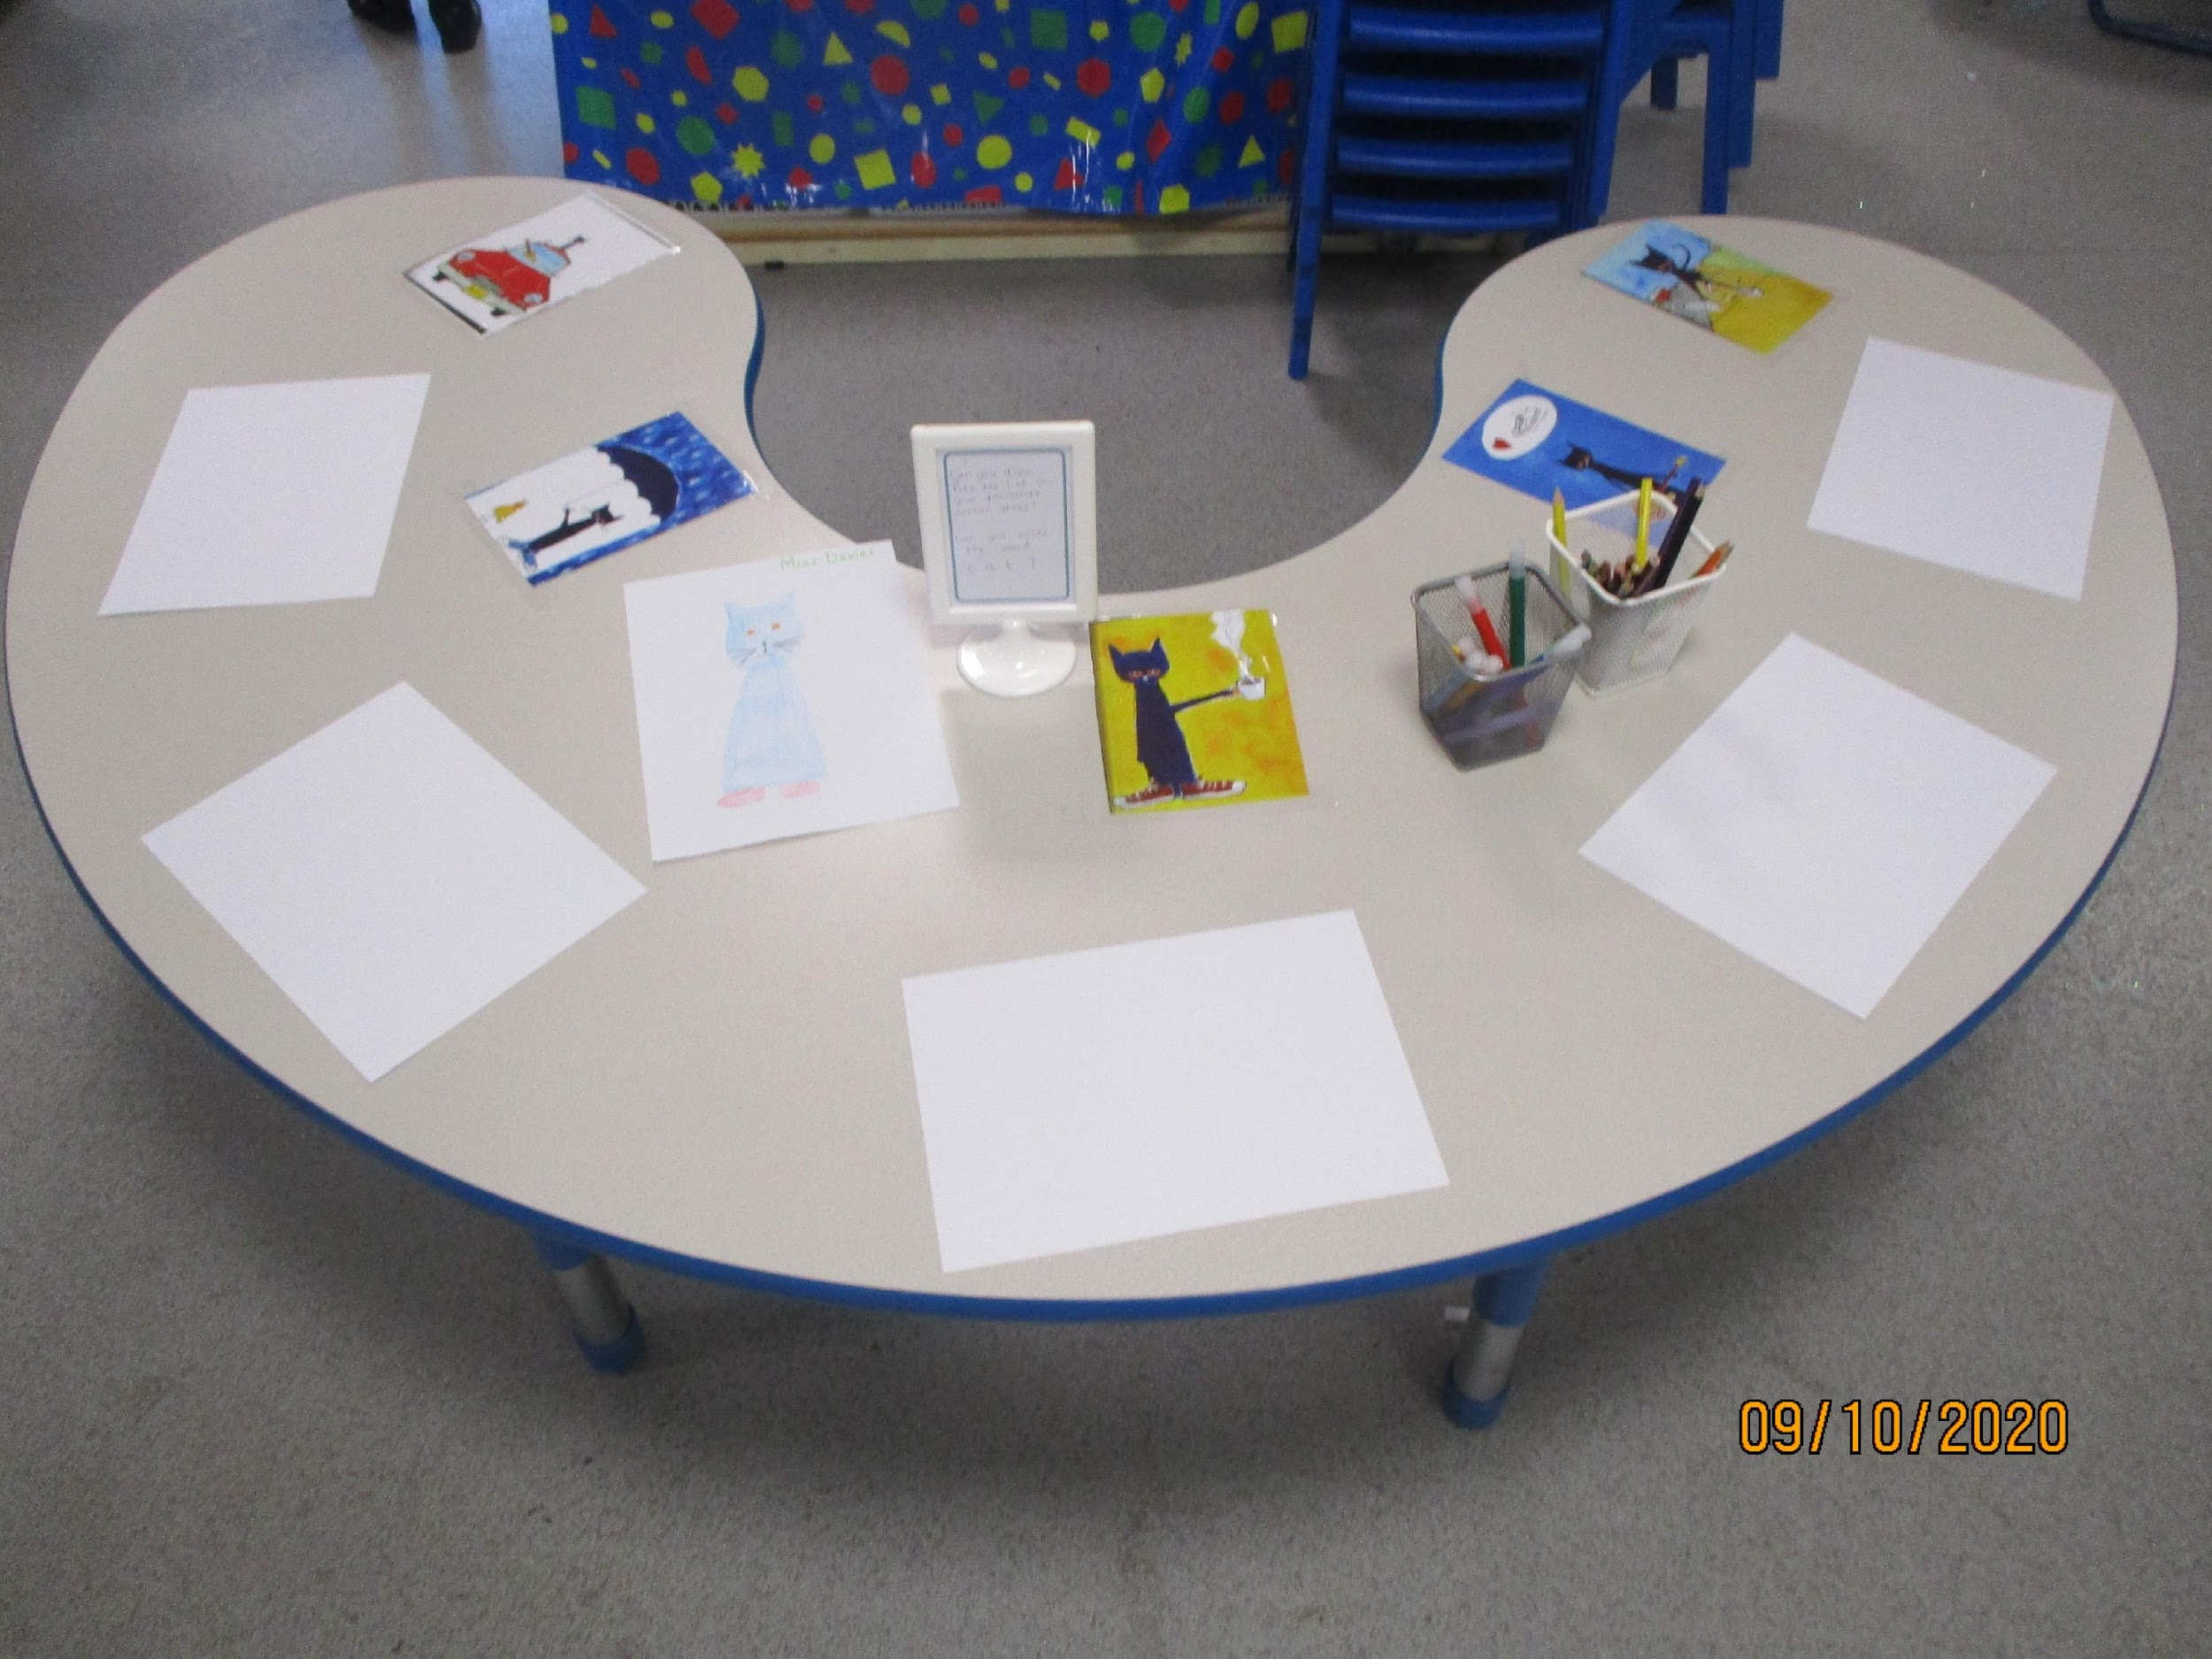
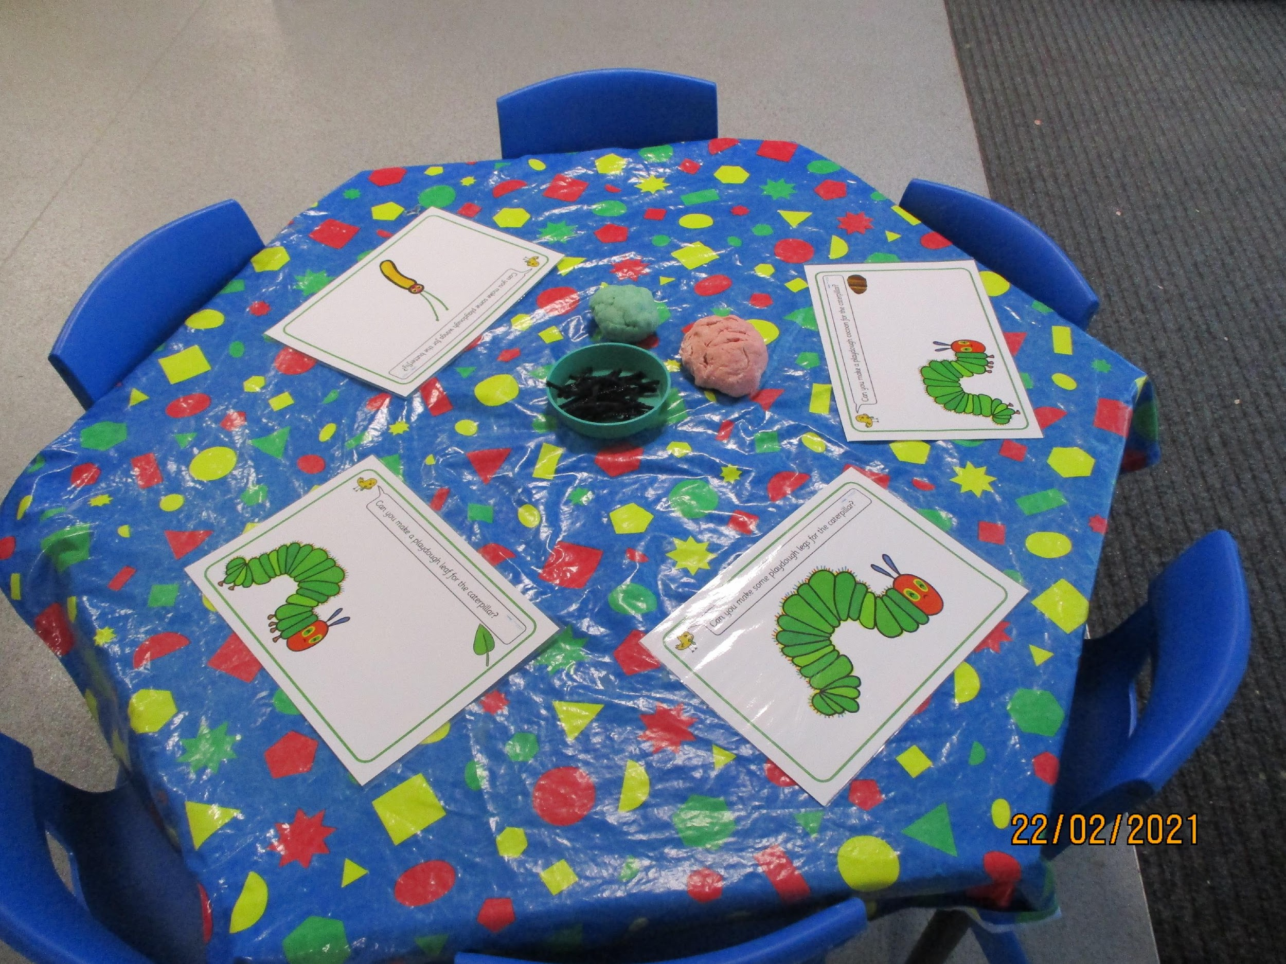
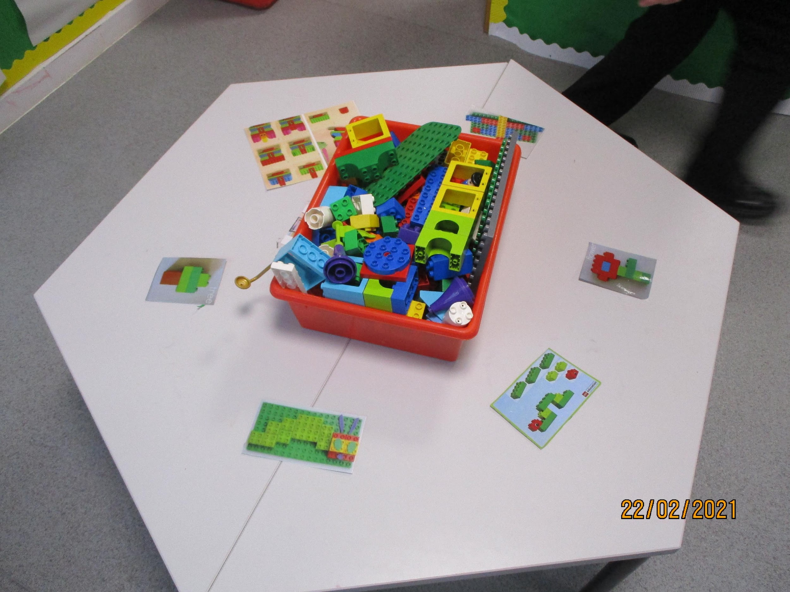
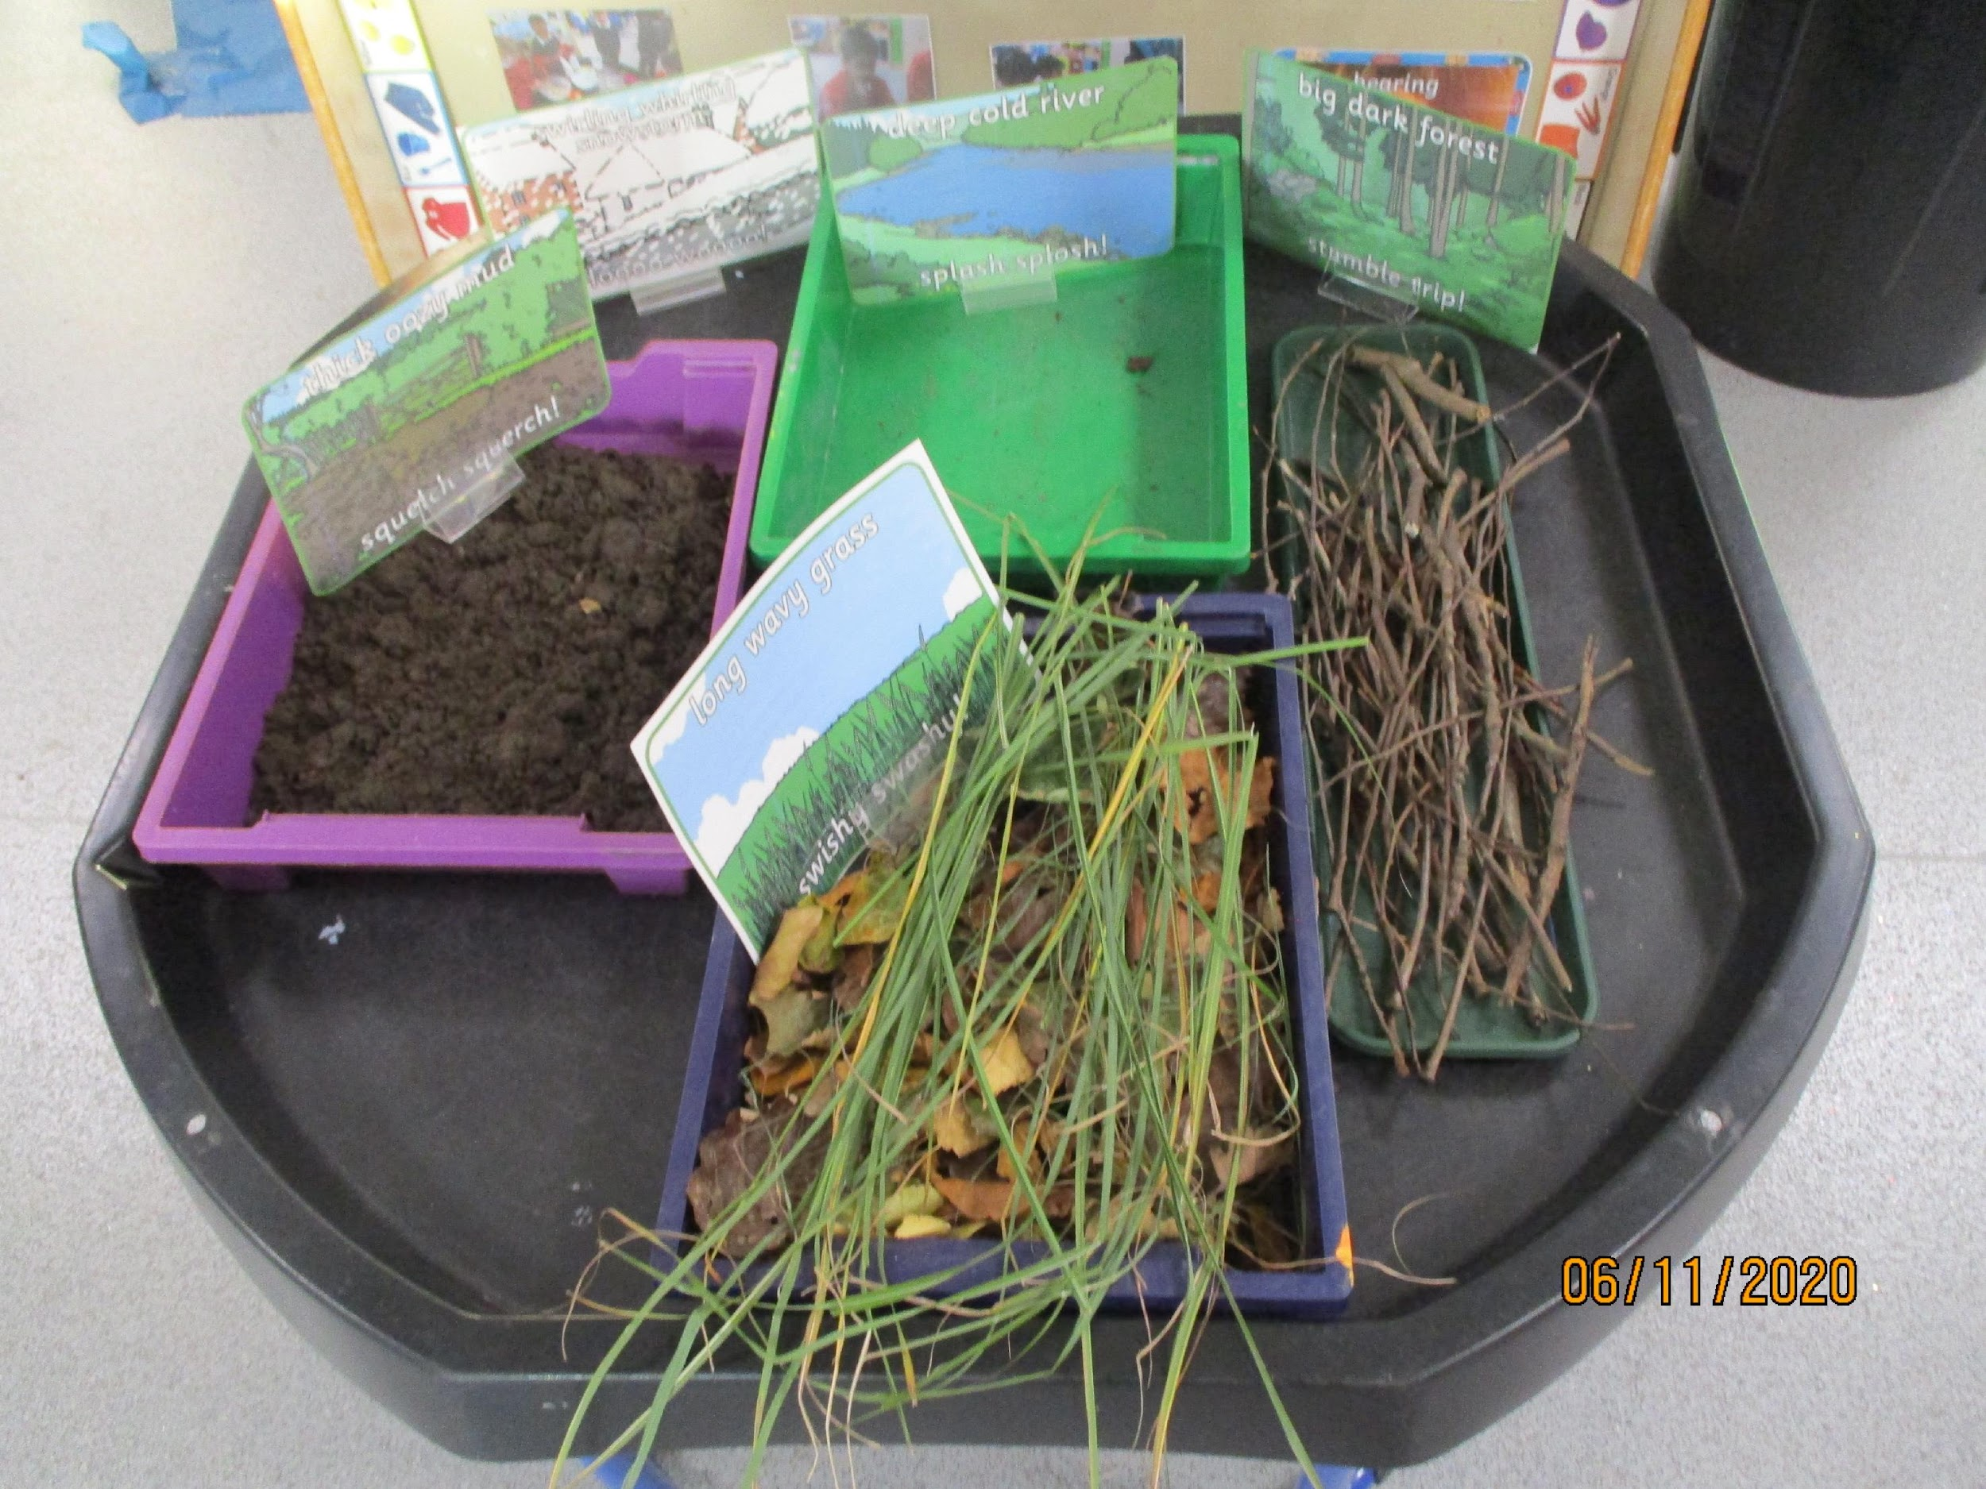
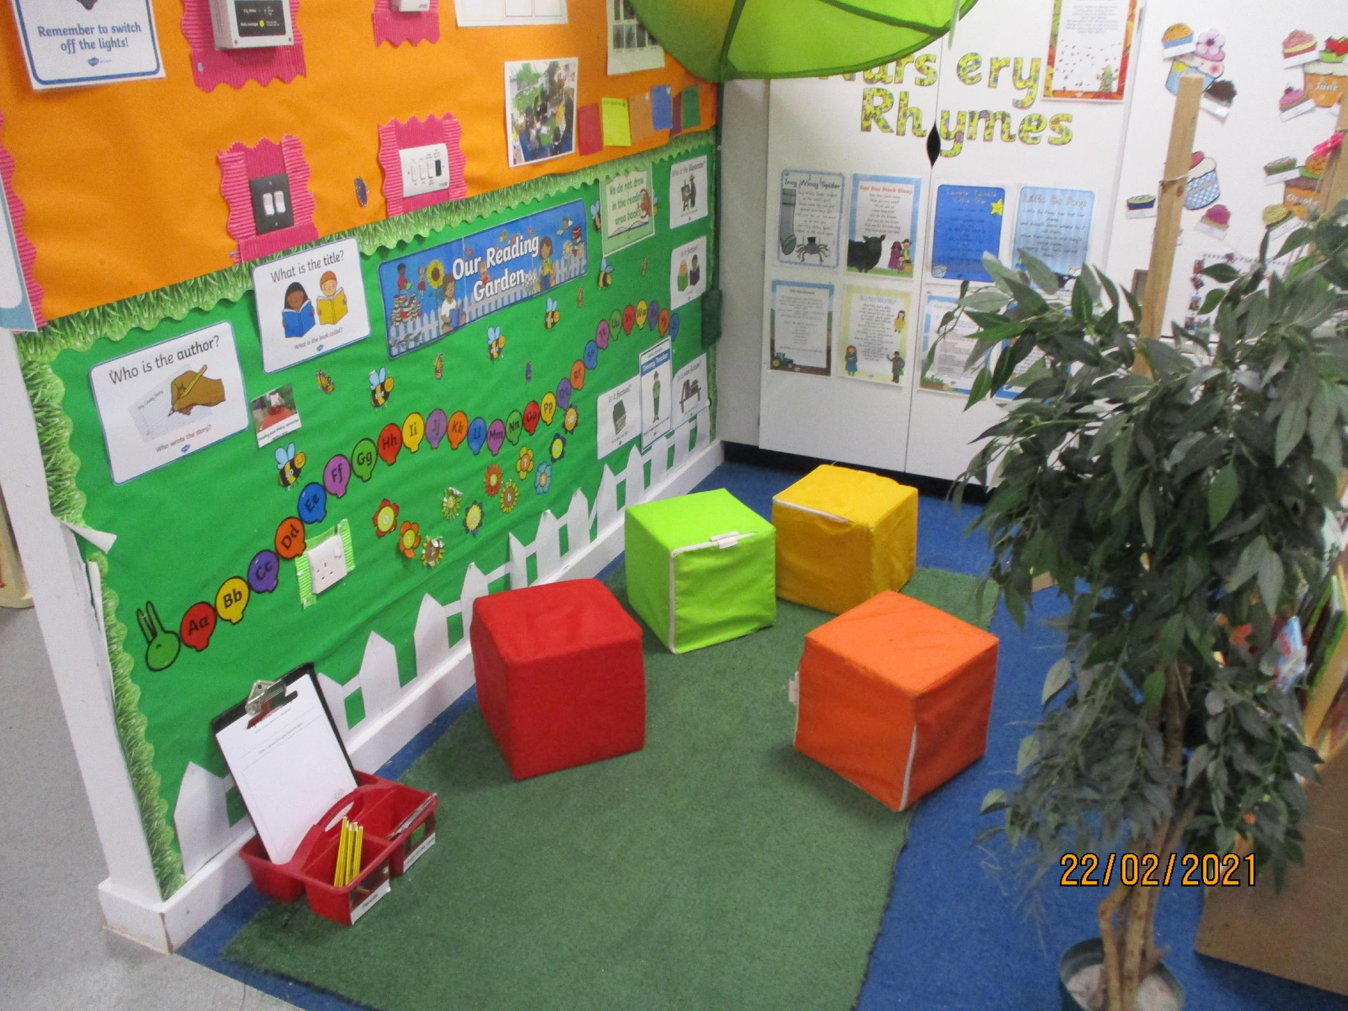
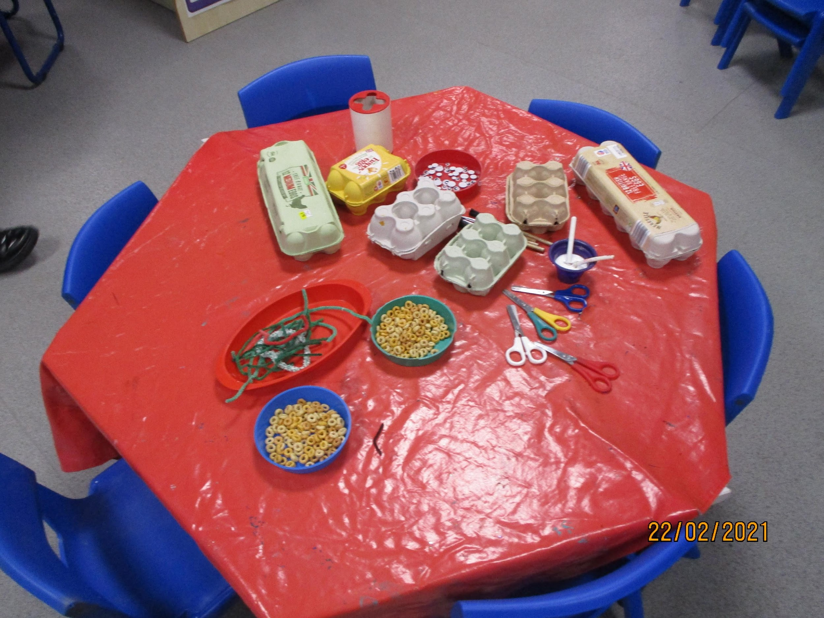
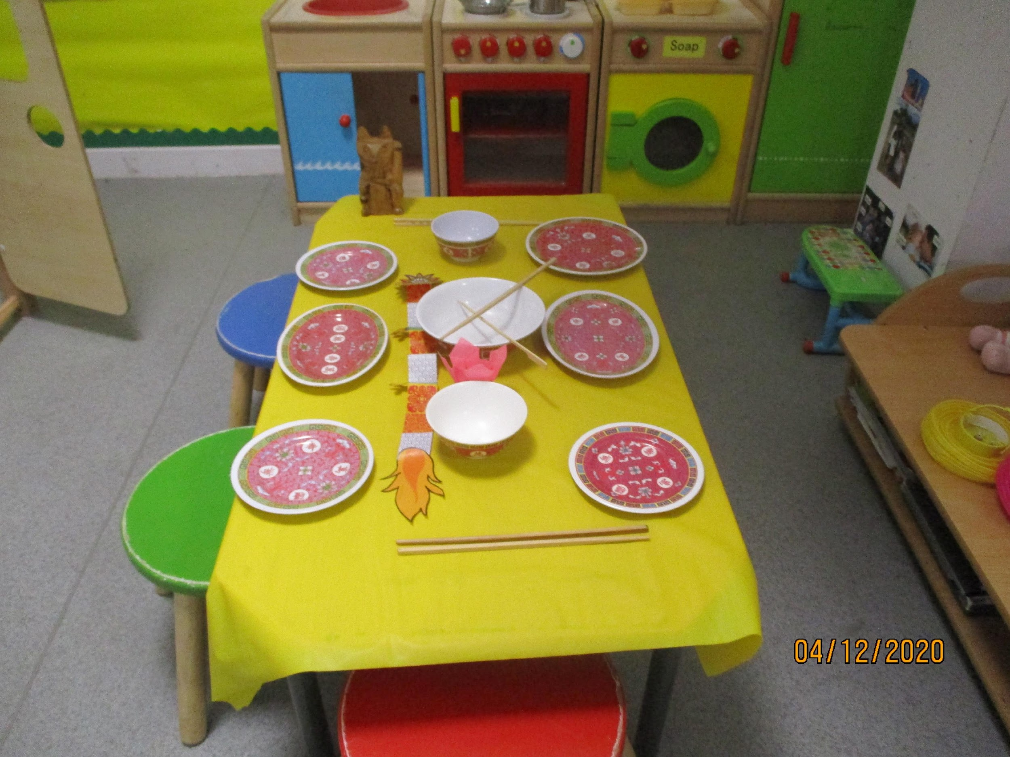
Continuous provision
Creative
Writing
Maths
Small world/Construction
Reading and phonics
Fine motor/Investigation
Role play
(The colours reflect the
rainbow)
Outside - this has sand and water in addition

Slide 7

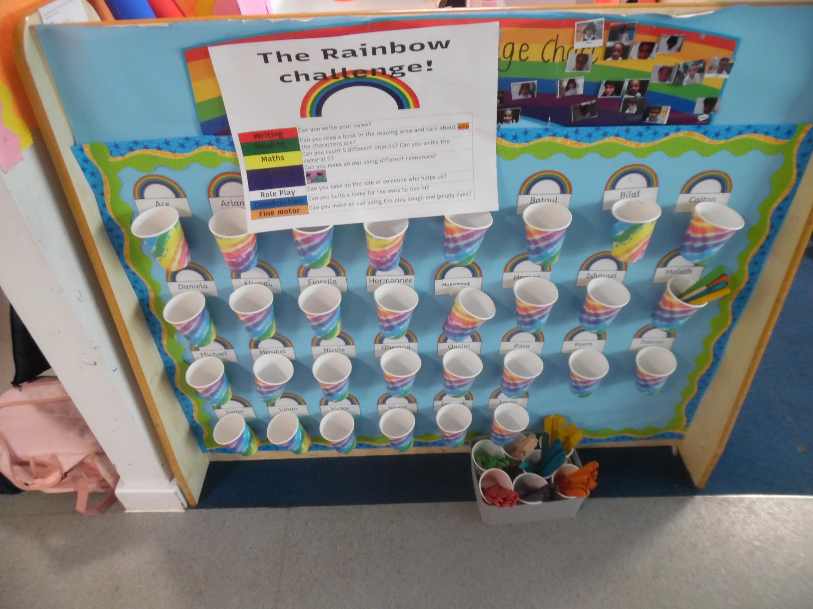
The Rainbow Challenge
Writing | Can you write your name?
Reading | Can read a story and tell the teacher WHO the characters are?
Maths | Can you find different ways of making 5 with the numicon tiles?
Creative | Can you make a boat that will float in the water tray?
Role Play | Can you role-play different people who help us?
Construction | Can you design and then build a bridge?

Slide 8
Expectations
Attendance - we expect 100% attendance unless there is a illness/medical reason, the school gates open at 8:40 in the morning and we send children out at 3:10pm
What your child needs to bring; bag, coat, spare clothes, water bottle, homework bag (when they have it) LABEL EVERYTHING
Safeguarding – children will only be sent home by staff with adults we recognise, if you know you can’t pick up your child and someone else will be collecting them for you, you must notify us and share the password with them as we have to ask for it and cannot send them home without it.
If your child has any known allergies we should have been notified of this and a health care plan filled in and signed. Meds should be kept in school and in date. Epi pens x2
Homework;
Reception - 1 piece of maths and phonics/literacy a week alongside a book for enjoyment and a e-book on www.collinshub.co.uk which matches the book from their reading practice sessions

Slide 9

Expectations cont…
https://tapestryjournal.com/
Staff will occasionally post observations of learning moments that your child has in school – observations will have Next steps and we would love for you to work with your child on these! You can also add your own learning moments for your child from home, but there is no expectation for this to happen!
Homeworks may occasionally be sent to you via a Tapestry memo, this is to make it easier for you you to share information e.g. where we have requested family photos etc.
Please speak to your child’s class teacher if you have not received a link to register or have forgotten your details

Slide 10
Other useful websites
The school website
http://www.ashburymeadow.co.uk/
Collins Hub
www.collinshub.co.uk
Little wandle letters and sounds
For parents | Letters and Sounds

Slide 11

Phonics
Little wandle letters and sounds
Phonics is a way of teaching children how to read and write. It helps children hear, identify and use different sounds that distinguish one word from another in the English language.
Phonics begins in Nursery - foundation for phonics - phase 1 tuning into sounds, early alliteration and blending practice
Reception - Phase 2, 3 and 4
Year 1 phase 5 - phonics screening check
Overview - Programme Overview_Reception and Year 1.indd (schoolspider.co.uk)
Support with sounds 28005045_grade_file.docx (live.com)
Focus this stage in the year - recognising phonemes segmenting and blending to read.
Promote a love for reading
Look out for future workshops.

Slide 12
Early Learning Goals
7 Areas of Learning
3 prime C&L, PD, PSED,
4 Specific Literacy, Maths, UTW, EAAD
17 ELGS, 14 to get Good Level of Development
(excludes UTW and EAAD)
29633703_grade_file.pdf (schoolspider.co.uk)

