Slide 2
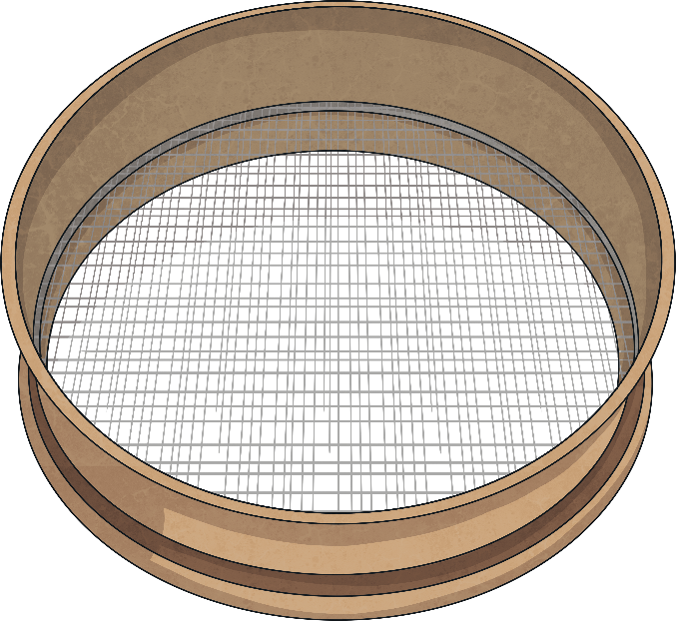
Processes to Separate Mixtures
When some materials are mixed together, it is possible to separate the mixture and get the original materials back again.
There are several different ways of separating mixtures.
The best process to use depends on the type of mixture you are separating.
Evaporation and Condensation
Magnetism
Filtering
Sieving
Decanting

Slide 3
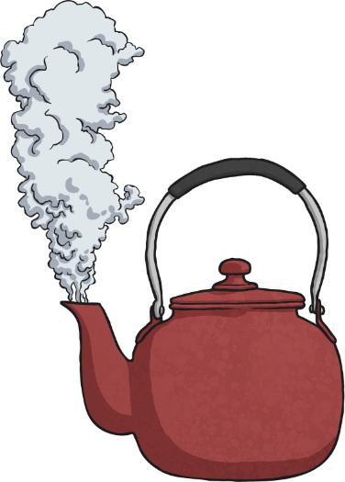
Evaporation and Condensation
1
2
This process is best used to separate solutions - mixtures in which a solid has dissolved in a liquid.
As the solid has dissolved in the liquid, filtering would not separate the two materials. The solid particles would go through the filter paper along with the liquid.
4
If the gas is then condensed
on a cool surface, the liquid can be recovered and collected too. Examples of mixtures to separate with this process include salt and water or sugar and water
3
When the solution is evaporated, either through boiling or by being left in a warm place, the liquid will turn into gas and leave the solid behind.
Processes

Slide 4
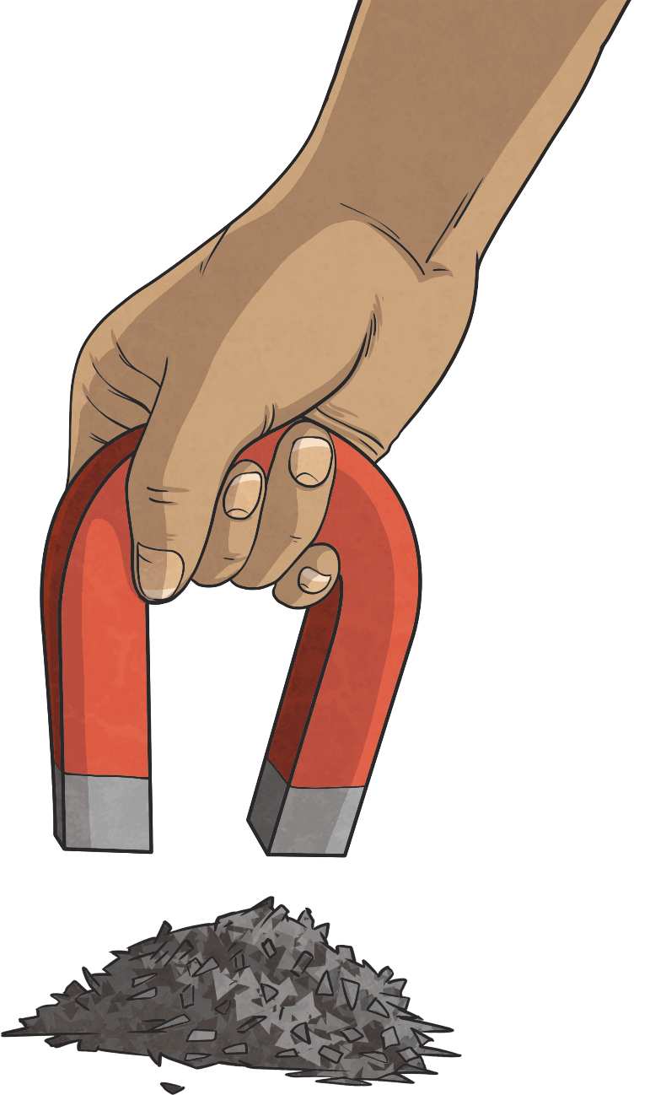
Magnetism
Use this process to separate magnetic materials
from non-magnetic materials.
A magnet is used to attract any magnetic materials and remove them from the mixture.
You could separate a mixture of copper nails and iron nails using this process.
Processes

Slide 5
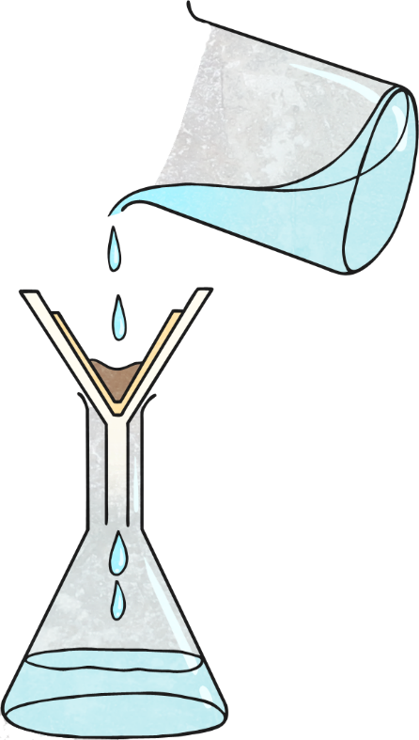
Filtering
This process should be used to separate a
mixture of an insoluble solid and a liquid.
A funnel is lined with filter paper and placed over a beaker.
The mixture is poured slowly into the filter paper.
Insoluble solids will not have dissolved in the liquid. The solid particles will not be able to get through the tiny holes in the filter paper, and will be caught in it.
The liquid particles will go through the filter paper into the beaker below.
This process could be used to separate a mixture of sand and water
Processes

Slide 6
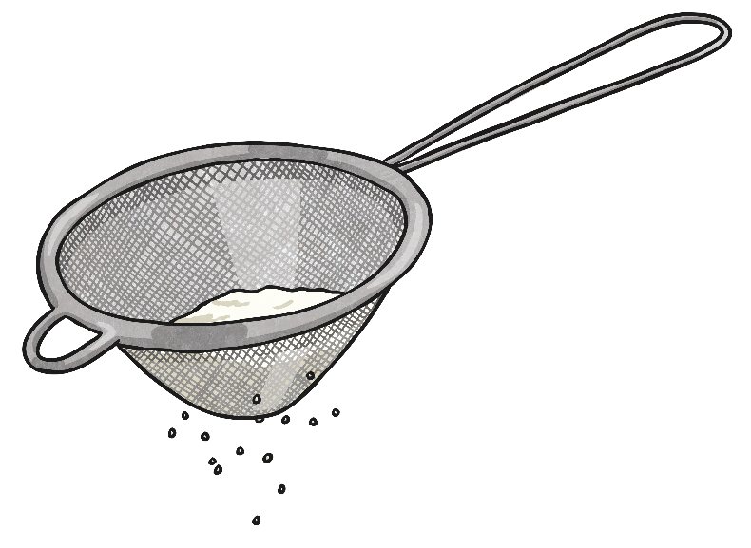
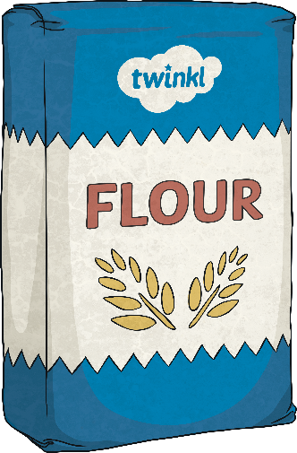
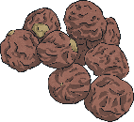
Sieving
Use this process to separate a mixture of different sized solids.
The mixture is poured into a sieve held over a bowl.
The smaller particles will get through it into the bowl and the larger particles
will be caught in the sieve.
Mixtures you could
separate using this
process include
raisins and flour,
or rice and pasta.
Processes

Slide 7
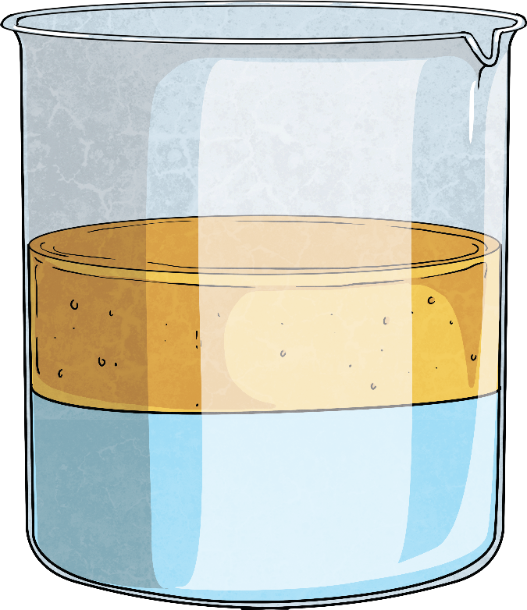
Decanting
This process can be used to separate two
liquids that have different densities.
The mixture of liquids is left to settle, so the two liquids are visible as two different layers.
The less dense liquid will be the top layer, and this can be decanted, or slowly poured off.
oil
This process could be used to separate a mixture of oil and water.
water
Processes

