Slide 1
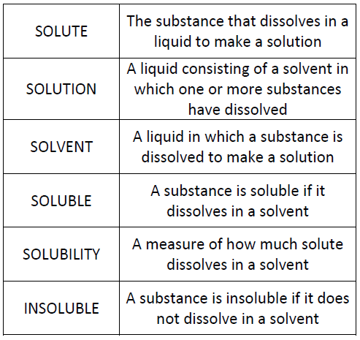
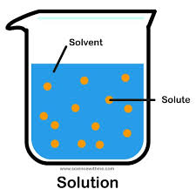
Soluble Solutions Investigation

Slide 2
Solutions – What are these?
SOLUTION: This is when a substance is dissolved in a liquid. For an explanation of what ‘dissolved’ means, click here to go to the BBC Bitesize website.
Not all substances dissolve, we say that those that do are called SOLUBLE, and those that don’t are called INSOLUBLE.
The liquid that the substance dissolves in is called the SOLVENT.
The soluble substance that dissolves in the liquid is called the SOLUTE.
SOLUTE + SOLVENT = SOLUTION e.g. salt + hot water = salty water

Slide 3
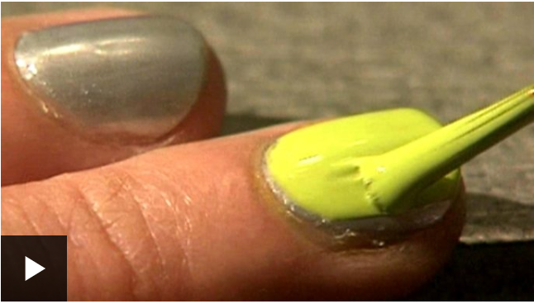
What investigation could you carry out to test solubility?
Click here to watch a video about testing materials for solubility.
Notes:
The experiment we could design

Slide 4
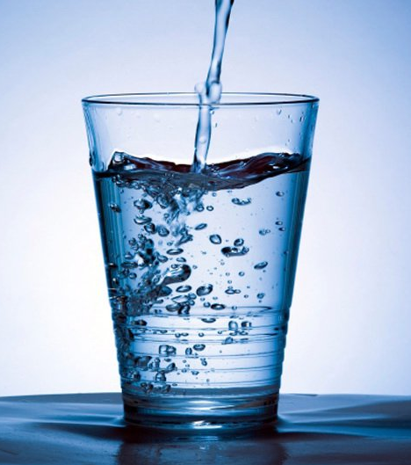
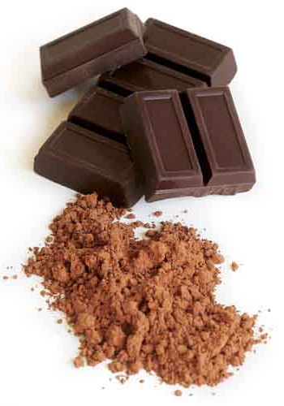
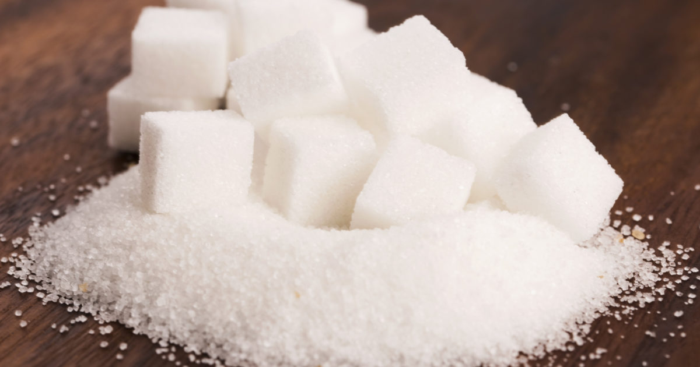
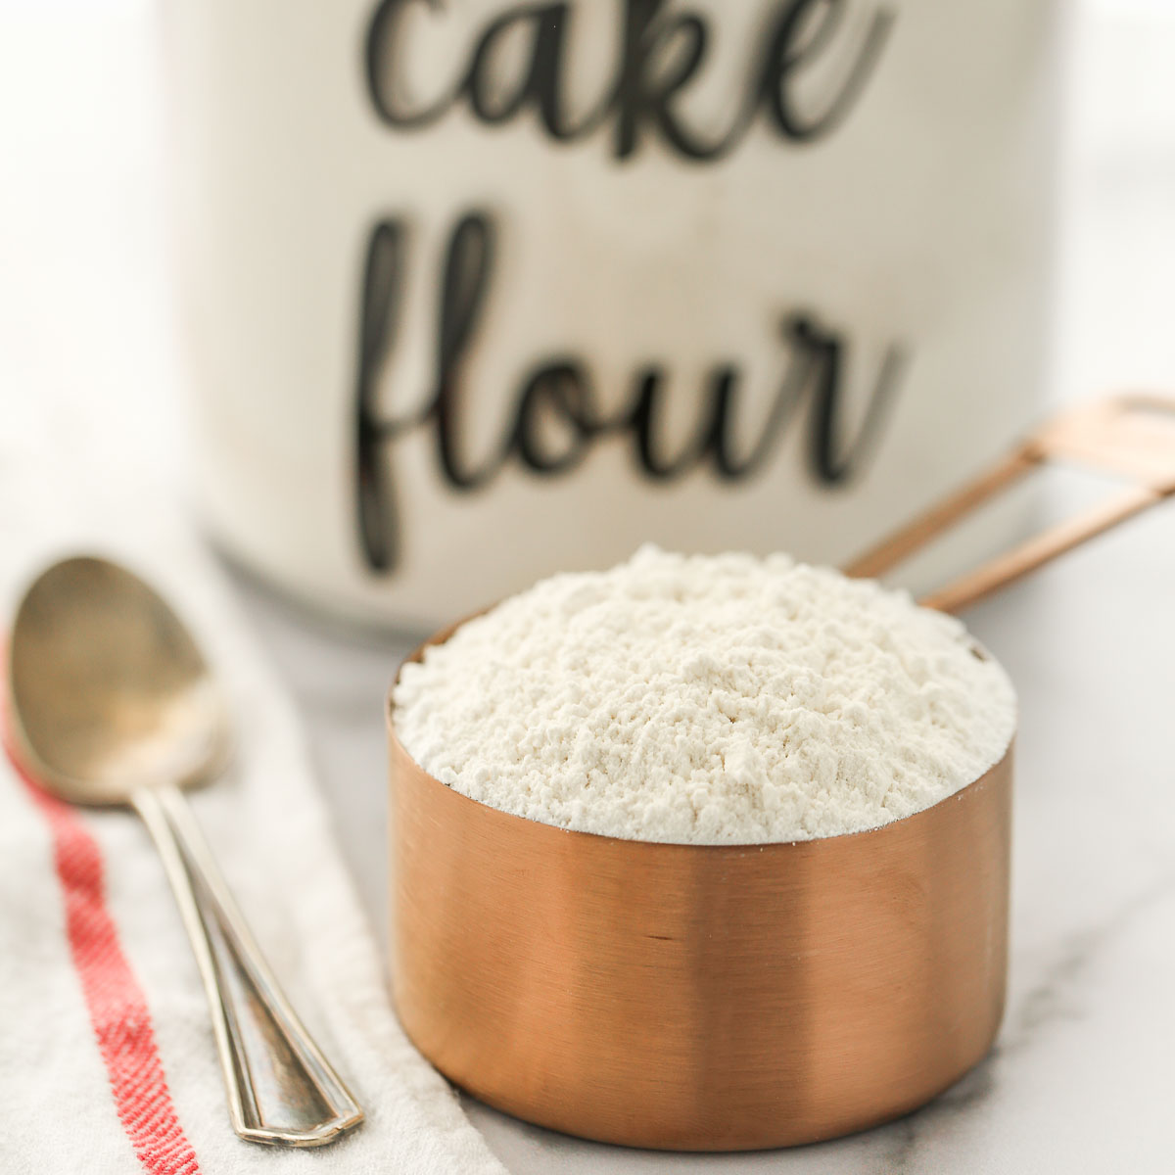

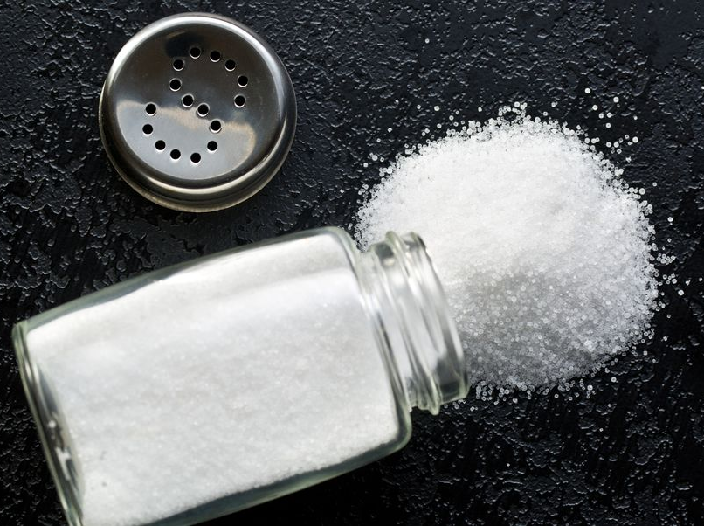
What will your investigation measure or observe?
Dependent Variable
In my investigation I will observe what happens when different solids are mixed with water.

Slide 5
What will you ensure stays the same during the tests? How will it be a fair test? Controlled variable
To make sure the test is fair, I will keep these variables the same:
the amount of water that is mixed with each material/solid
the amount of material/solid put in the water
the amount of time the material/solid is left in the water before an observation is made

Slide 6
What do you think will happen when the material/solid is mixed with water? Make a prediction
Before each material/solid is mixed with water, you will need to predict what you think will happen on the table:
Will the material/solid dissolve?
Will the material/solid still be seen in the water?
Will there be some sort of change to form a new substance?

Slide 7

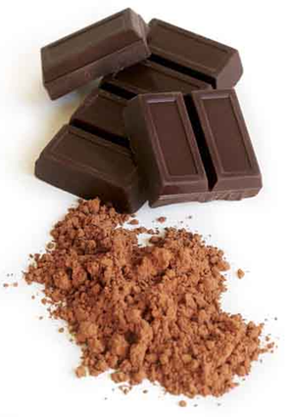
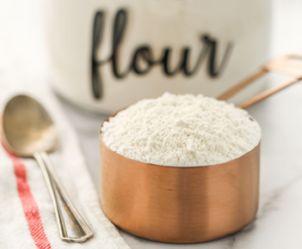
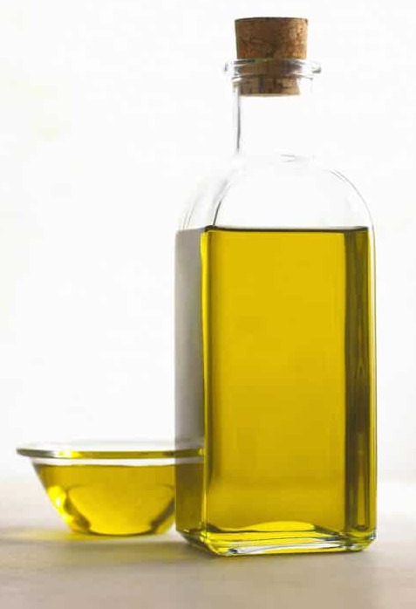
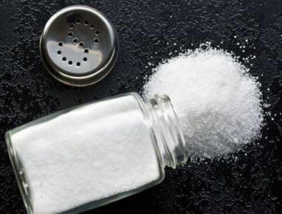
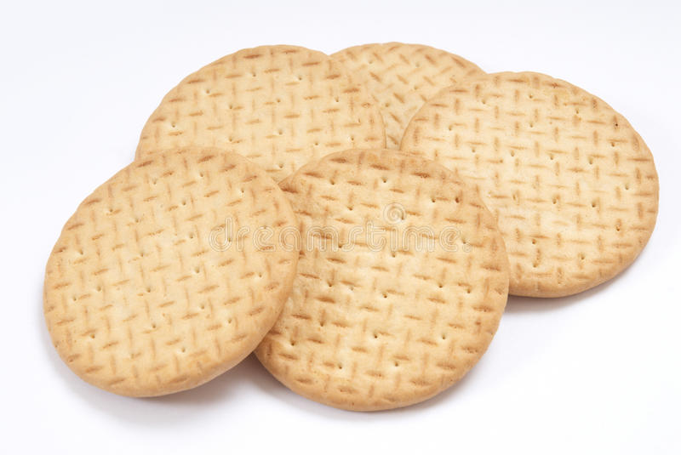
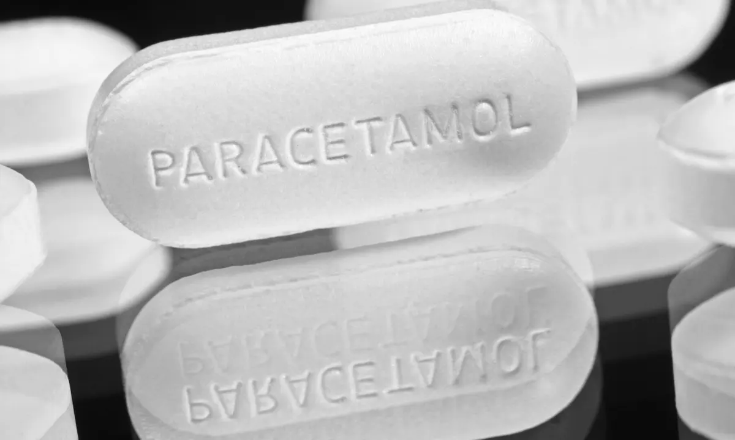

Investigation
You will need:
the materials – sugar, biscuits, salt, cooking oil, cocoa powder, flour, paracetamol, coffee
a timer or stopwatch
glasses for the water and materials
a teaspoon

Slide 8
Investigation
Suggested process:
Fill beakers with a given amount of tap water.
Put a set amount of substance in (e.g. 1tsp, or 5g) and stir for 1 minute.
Inspect with a magnifying glass (if you have one).
Leave for 5 minutes to see if any sediment settles on the bottom.
Classify as soluble or not.

Slide 9
Results
Material/ solid | Prediction | Results
 |  | Dissolved | Did not dissolve | Reacted with water to form new substance | Observations/ explanation
Flour
Crushed biscuits
Cocoa powder
Salt
Sugar
Paracetamol
Coffee
Cooking oil
Record your results in the grid on your sheet.

Slide 10
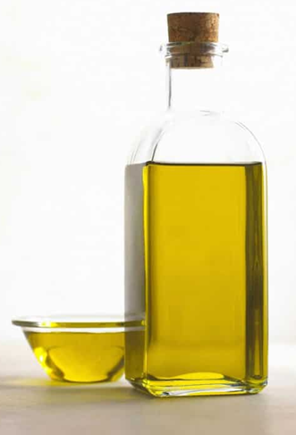




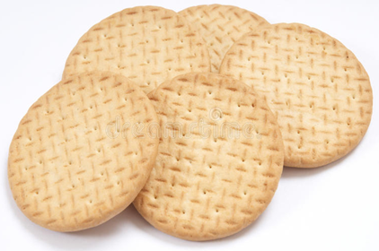
Conclusion
What do the results show?
Were your predictions correct?
Complete the conclusion part on your sheet, making sure that you refer back to the enquiry question.

