Slide 1
Week 1
What can we learn about the Ancient Maya from the lives of the Maya today?

Slide 2
Learning objective
To use evidence to reach conclusions about the lives of the Maya in the past and the present

Slide 3
Success criteria
I know where and how the Maya live today
I can relate evidence about the Maya today to the Maya in the past
I can generate further questions to check my findings and deepen my understanding

Slide 4
Key vocabulary
Can you create definitions for these words as you learn about the Maya civilisation?
Word | Definition
Religious
Social
Economic
Cultural
Political
Civilisation
Pyramid
Temple
Conclusion
Evidence

Slide 5
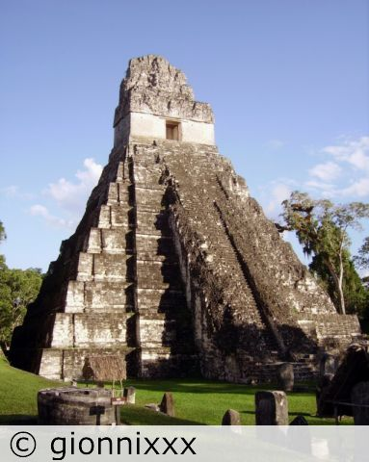
Tikal Pyramid I in Guatemala
What might you hear?
What might you see?
What might you smell?
How might you feel?
Who do you think lived here?
Does this remind you of anything?

Slide 6
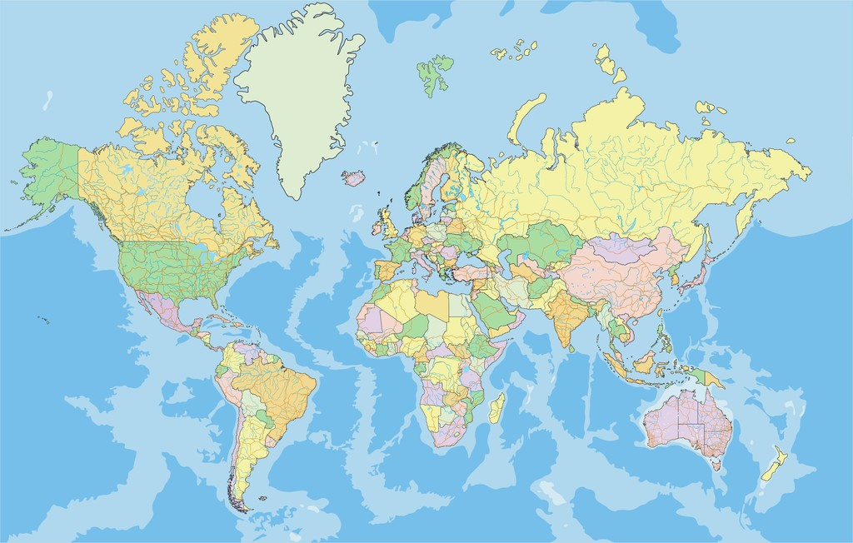
Where is the Maya Civilisation?
Which continent is the civilisation located in?

Slide 7
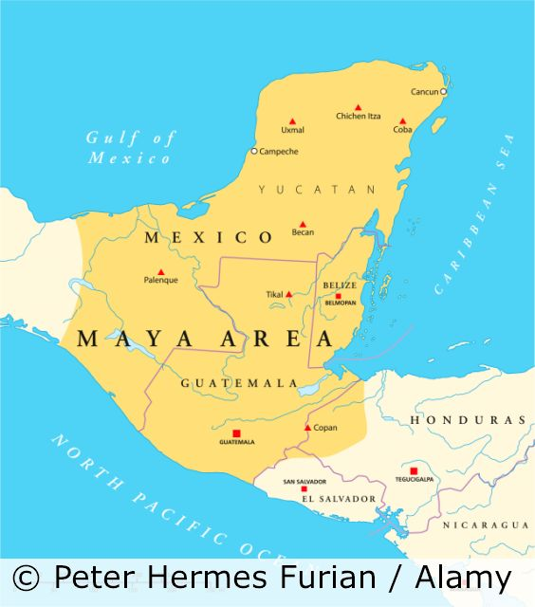
Where is the Maya Civilisation?
Which modern day countries is it located in?

Slide 8
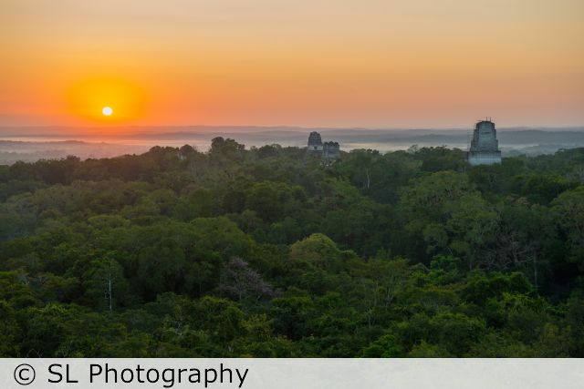
The Rainforest
What do you already know about the rainforest?
What vegetation would you find there?
What animals live there?
What is the climate like?
What is life like for the people that live in the area?

Slide 9
Maya Timeline
Task:
Sequence the dates chronologically.
Calculate approximately how many years are between each event and create a scale to show the intervals between them.
700 BC
The Maya begin to develop their writing
c. 1800 BC
First Maya settlements

Slide 10
Where does this fit in with
what we’ve already studied?
BC
AD
3000 | 2500 | 2000 | 1500 | 1000 | 500 | 0 | 500 | 1000 | 1500 | 2000
Key:
Stone Age to Iron Age
The Romans
The Maya

Slide 11
What do we want to know about the Maya today to help us answer our key question?

Slide 12
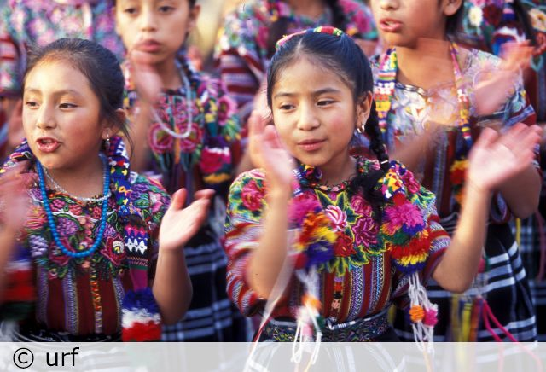
Maya people in the modern day
What I definitely know… What I probably know… What I still need to know…

Slide 13
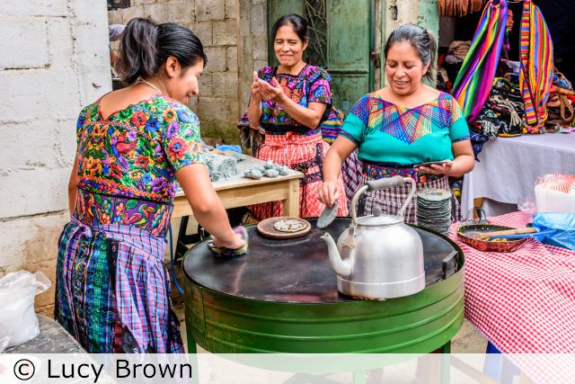
Maya people in the modern day
What I definitely know… What I probably know… What I still need to know…

Slide 14
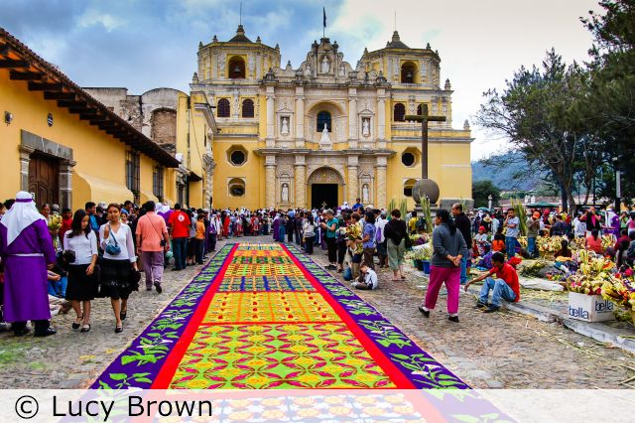
Maya people in the modern day
What I definitely know… What I probably know… What I still need to know…

Slide 15
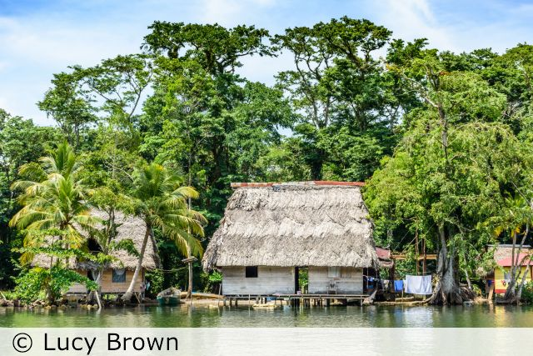
Maya people in the modern day
What I definitely know… What I probably know… What I still need to know…

Slide 16
What does life in the region look like today?
What I still need to know
What I probably know
What I definitely know
What does it tell us about the region in the past?

Slide 17
Do you think Maya life today is the same or different to Maya life 1000 years ago?

Slide 18
In what ways was life similar between the Maya today and the Maya of the ‘lost city’?

Slide 19
In what way was life similar for the Maya today and the Maya of the ‘lost city’?
Similarities | Differences
Task:
Compile a table of similarities/differences using the template, recording brief descriptions in each column before writing a short conclusion that answers the question. Make sure your thoughts are clear so we can use this information again in future lessons.

