Slide 1
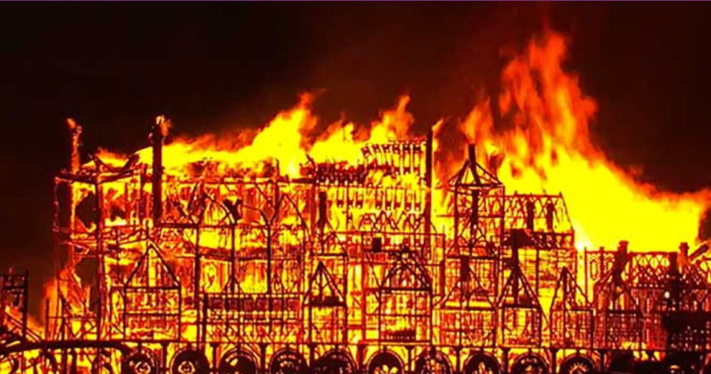
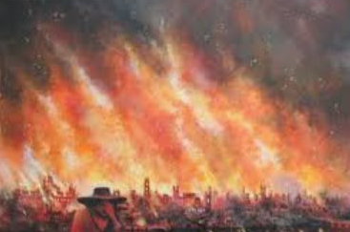
Unit 3: History
Interesting facts about the great fire of London
 | 1 | The fire burned out of control for 3 days.
 | 2 | The fire spread quickly because most of the houses were made of wood.
 | 3 | The fire happened more than 300 years ago (in 1666).
 | 4 | The fire started on Sunday, September 2nd.
 | 5 | Over 1300 houses were destroyed.
 | 6 | Amazingly, only 6 people were believed to have died.
 | 7 | The fire started at a baker’s shop

Slide 2
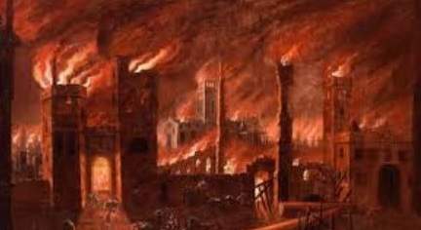
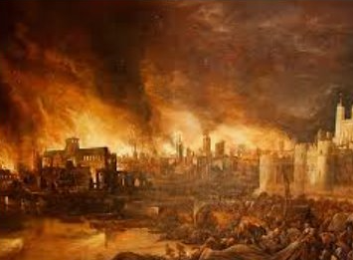
Unit 3: History
Interesting facts about the great fire of London: 2
 | 8 | The baker’s name was Thomas Farriner.
 | 9 | The street was called Pudding Lane.
 | 10 | It took 50 years to rebuild the area destroyed by the fire.
 | 11 | 68 churches were destroyed.
 | 12 | The original St Paul’s Cathedral was destroyed’
 | 13 | Building the new St Paul’s cathedral started in 1675, almost 9 years after the fire.
 | 14 | There was no fire brigade in London at the time so people has to fight the fire themselves.
 | 15 | They got the water from the river Thames.

Slide 3
Unit 2: History
The great fire of London: Why did the fire spread so quickly?
Look at the 2 internet clip below and let pupils watch them twice.
https://www.bing.com/videos/search?q=video+of+great+fire+of+London+for+children&view=detail&mid=7C557F14A78FBBA36AB77C557F14A78FBBA36AB7&FORM=VIRE
http://www.fireoflondon.org.uk/game/
Look at the internet link at least twice and work out why the fire spread so quickly.
Talk to your partner about the reasons why the fire spread so quickly.
On the next page write down five reasons why the fire spread so quickly and what could have been done to stop it spreading
© Focus Education UK Ltd.

Slide 4
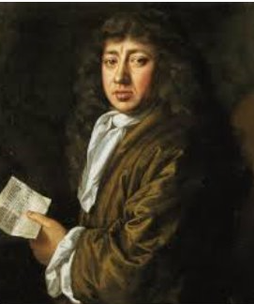
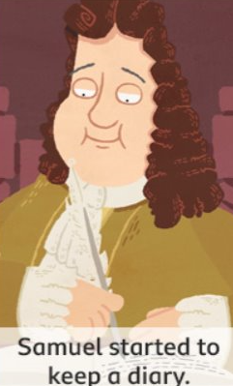
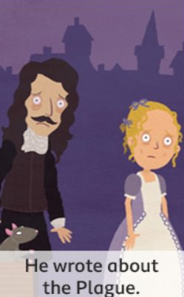
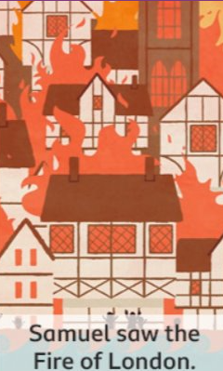
Unit 3: History
Who was Samuel Pepys
 | You say his name like ‘Peeps’. He played musical instruments including a violin and recorder. He lived in London during the time of the plague. | Samuel Pepys lived over 300 years ago and wrote about two of the most important events in English history.
 |  | Watch the internet link below to learn more about him:
 |  | https://www.bbc.co.uk/bitesize/topics/z7d7gwx/articles/zhgxcqt
Key facts Samuel Pepys survived the Great Plague of 1665. He also saw the Great Fire of London in 1666. It destroyed 13,000 houses. We know lots about these two events from his diary.

Slide 5
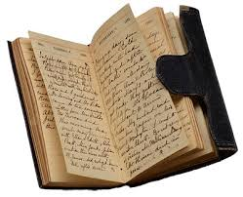
Unit 3: History
If you kept a diary what would you put in it for today or yesterday?
 | My diary entry for today:
 | Date:

Slide 6
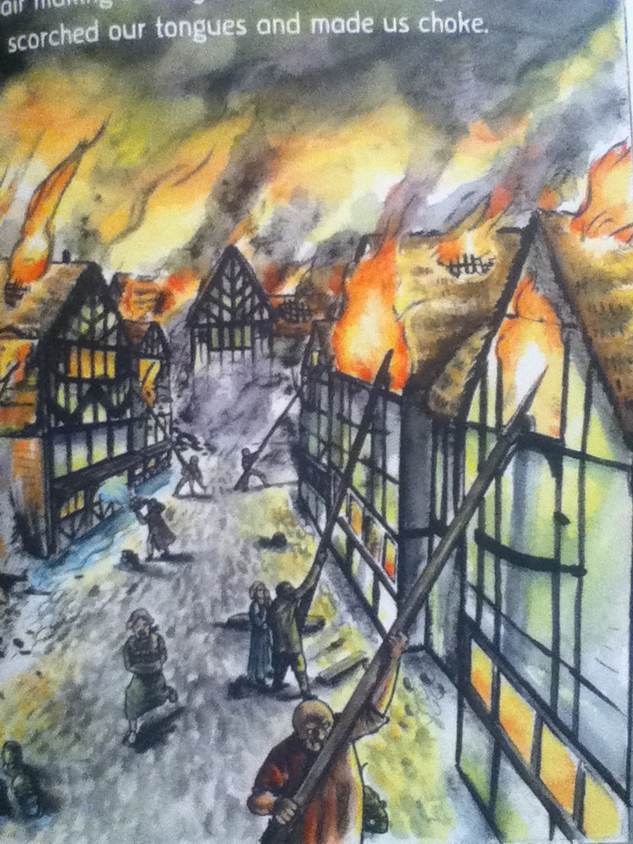
Unit 5: English
What do you think ‘fanning the inferno’ means?
Why is the sky so dark?
© Focus Education UK Ltd.

