Slide 1
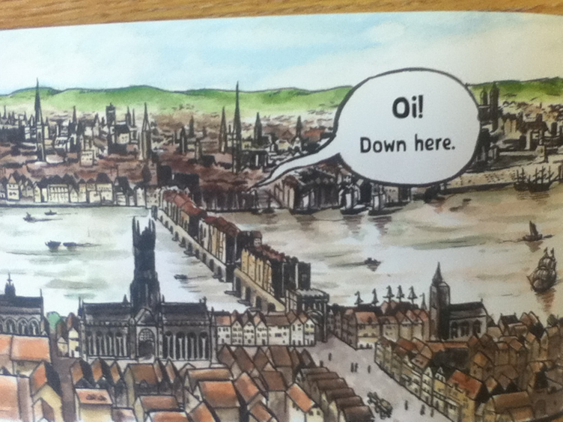


Slide 2
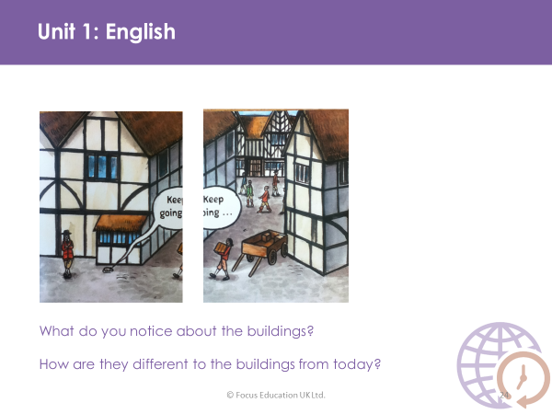

Slide 3
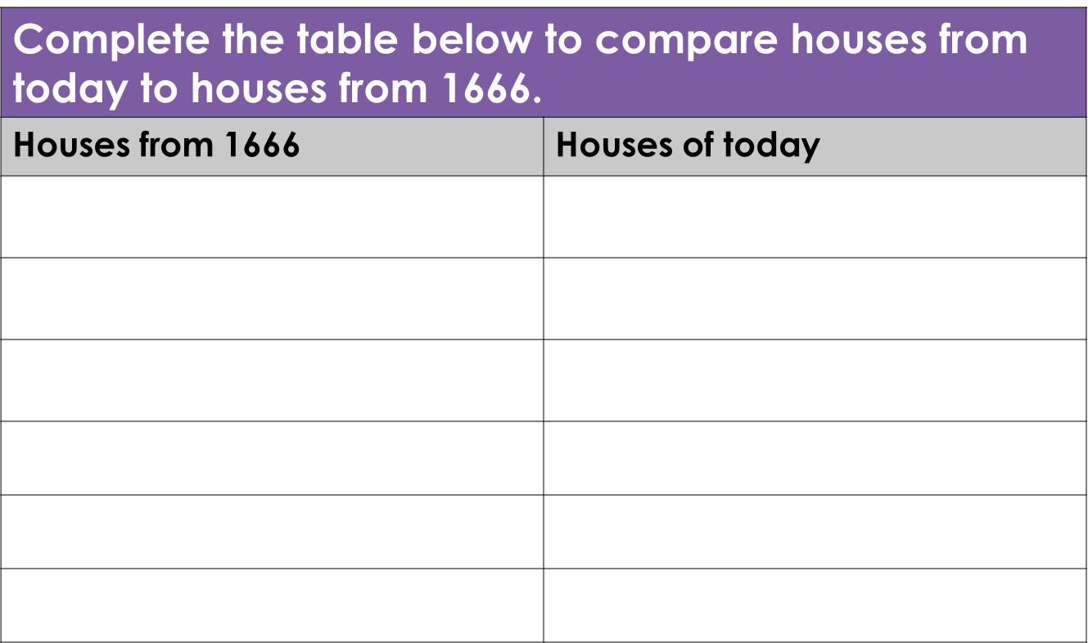
Go for a walk and look carefully at the houses near where you live. What do you notice about the houses today? Think about what they are made from, are they all built very close together or are there spaces between them? What are the roofs made from?

