Slide 1
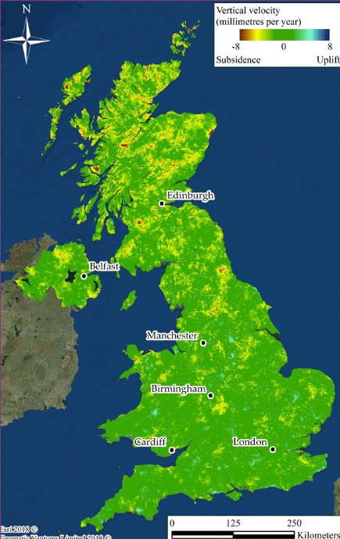
Unit 1: History/Geography: Where is London?
Use a map of the United Kingdom to locate London in relation to other major cities and where they live
Take the opportunity to explain to children where Wales, Scotland and Northern Ireland are. (this should re-inforce the learning in geography)
Name the three main seas that surround the United Kingdom: Irish sea; North Sea and the English Chanel.
Ensure children know where Manchester, Birmingham, Cardiff, Edinburgh and Belfast are.
Locate where they live on the map.
Talk about the nearest city to where they live and how they would travel to get to London from where they live.
Children could use the map to locate places they have visited in the United Kingdom.

Slide 2
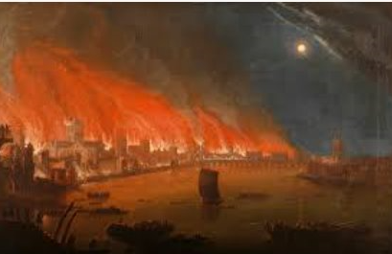
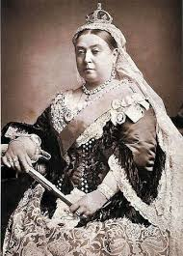
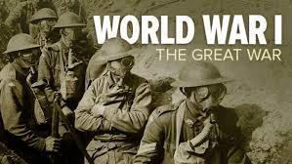
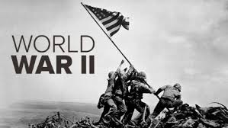
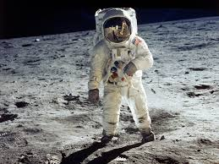
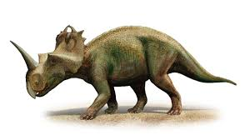
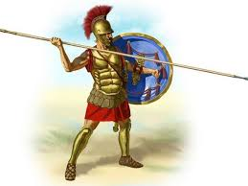
When did the Great Fire of London happen?
Unit 1: History
Draw this icon in the correct place on the timeline and write the key dates underneath each period. We have included some of the key periods: Dinosaurs, Romans, Birth of Jesus, Victorians, World War 1, World War 2, 1960s. Draw an icon for today; what would you draw to represent the present time?
Today
Jesus
born
0
2000

Slide 3
