Slide 1
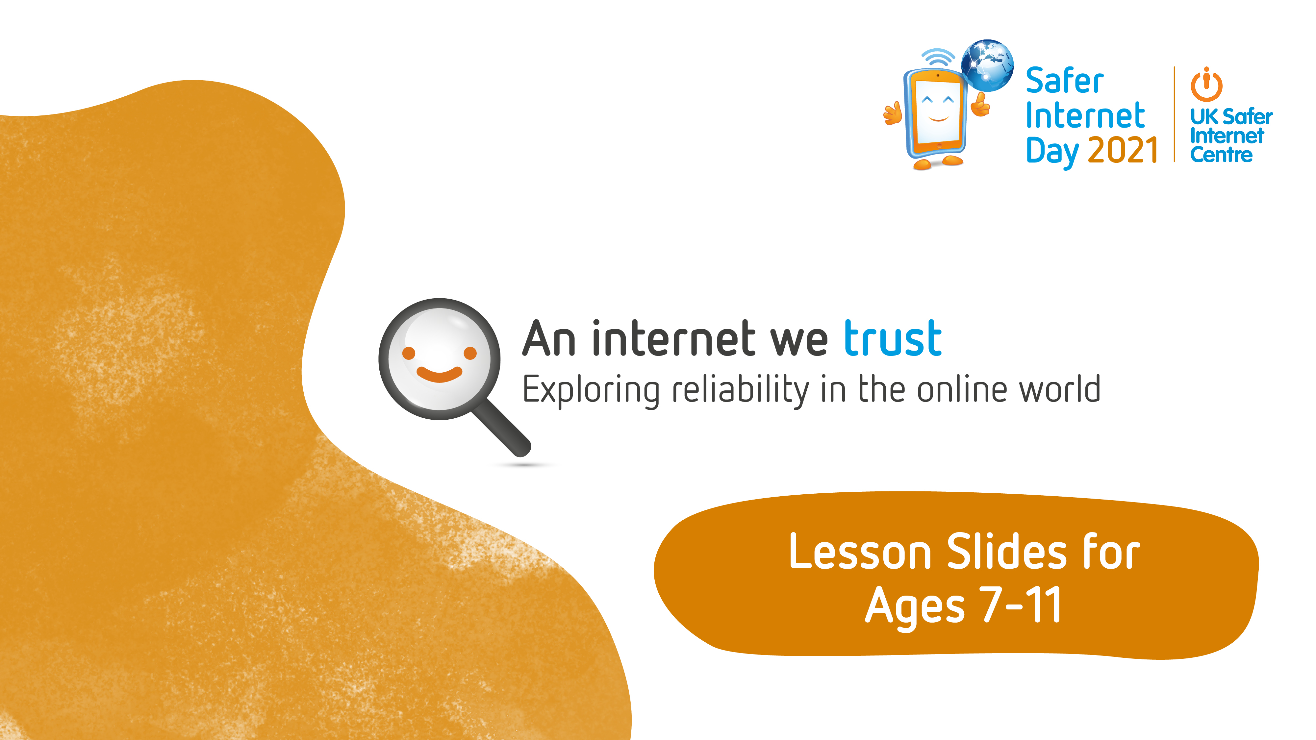

Slide 2

Lesson Aim
You will use and develop your critical thinking skills to question the motives behind what
you see. By focusing first on commercial influences (e.g. advertising) it will help you explore
trust online and challenge your personal responses when engaging with the wider digital world.
Lesson Outcomes
You will be able to:
• Describe and recognise some methods used to encourage people to buy things online.
• Give examples of when and why it is important to understand the motive behind online content.
• Use questions to help decide what can and cannot be trusted online.
Key vocabulary
Advert, profit, motive, unboxing, giveaway, merch, collab, affiliate link

Slide 3

Let’s play…
Scattergories!
You have 2 minutes to think of an answer for each category beginning with ‘t’.
Hint:
If more than one person puts an answer it’s worth 2 points.
If only one person puts an answer it’s worth 5 points.

Slide 4

Think of answers beginning with ‘t’:
Something you enjoy doing online?
The name of a game or app?
A YouTuber, online show or channel?
A topic you could research online?

Slide 5

Activity 1: All the adverts
Where have you seen adverts before?
Was it online or offline?
What did they look like?

Slide 6
Activity 1: All the adverts
You might have seen adverts on TV (commercial channels, not the BBC), at the beginning of a video on YouTube, at the side of a webpage, at the cinema, on the side of a bus or in a magazine or newspaper.
An advert is a notice or announcement in a public medium promoting a product, service or event.
Watch the video from the link on the next slide. Keep a tally of how many adverts are included.

Slide 7
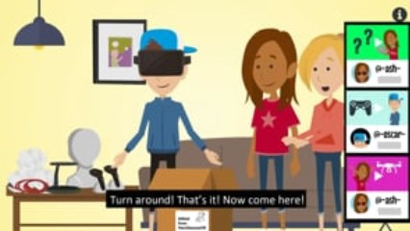
Notes:
The video on this slide is hosted online on Vimeo. You may be given the option to ‘Enable Content’ and will need to click this to allow it to play. Alternatively you can access the video by going to this URL: https://vimeo.com/481316945

Slide 8
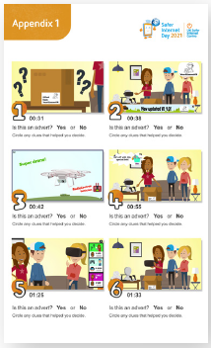
Activity 1: All the adverts
Watch the video for a second time, pausing at the times specified in Appendix 1. You need to decide whether each picture is showing an advert or not. You need to circle any clues that made you decide if it is an advert.
Technically, every picture is showing an advert! Hopefully you circled lots of clues to show this.

Slide 9



Activity 2: Quick quiz – video terms
People can profit from the things they do online…
Get something they didn’t have before
New likes, views, subscribers or followers
Money paid to advertise or promote things
Things that cost money given for free

Slide 10





Activity 2: Quick quiz – video terms
On the next five slides are different video terms. Your task is to decide whether the creator will profit or not from having these things online.

Slide 11









Unboxing
Will the creator profit?
They might
A video where someone unpacks a parcel on camera

Slide 12
Unboxing
Will the creator profit?
They might
A video where someone unpacks a parcel on camera
Some video creators may film an ‘unboxing’ using products or parcels they have purchased themselves. This is not an advert and they do not profit directly from it. However, some creators may be given items for free or paid to film an unboxing style video, in return for reviewing the products favourably. This is an advert and the audience should be told this.

Slide 13

Giveaway
Will the creator profit?
They might
A competition where a
free prize can be won

Slide 14
Giveaway
Will the creator profit?
They might
A competition where a free prize can be won
Some creators run an independent giveaway where they pay for, or source the prize themselves. This could gain them subscribers, likes or comments. Some creators may also be paid by a company to run a giveaway. This is an advert and the audience should be told this.

Slide 15

Collab
Will the creator profit?
They might
Collaboration – where two or more people or companies work together

Slide 16
Collab
Will the creator profit?
They might
Collaboration – where two or more people or companies work together
Some creators collaborate because they are friends or make similar content, and do not directly profit. However, some creators may use the term ‘collab’ to describe a partnership, sponsorship, or other paid opportunity with a company. This is an advert and the audience should be told this.

Slide 17

Merch
Will the creator profit?
Yes
Merchandise – products available to buy, connected with a popular person or brand

Slide 18
Merch
Will the creator profit?
Yes
Merchandise – products available to buy, connected with a popular person or brand
Many creators sell merchandise promoting their personal brand and earn additional money. Merch is nearly always sold to the audience with the intention of making a profit.

Slide 19

Affiliate link
Will the creator profit?
Yes
A link to another website (often a shop) where the creator earns money every time someone clicks on it

Slide 20
Affiliate link
Will the creator profit?
Yes
A link to another website (often a shop) where the creator earns money every time someone clicks on it
Many creators will link directly to products or companies they have mentioned online. An affiliate link means the creator will be rewarded (normally through payment) for every click on the link. Affiliate links are a form of advertising and the audience should be told this.

Slide 21
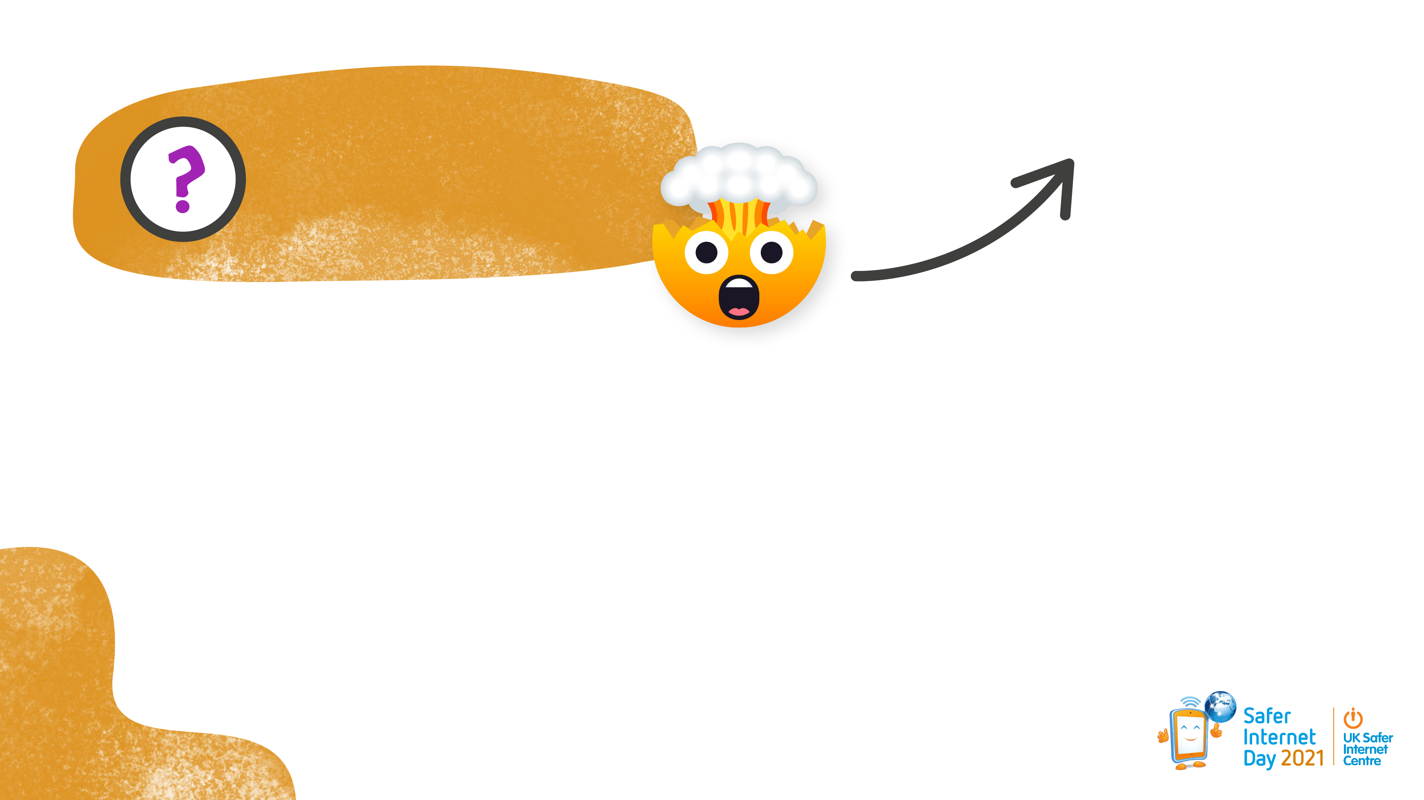

Did you know?
It’s the law!
People posting things like videos online must tell you if they’ve been paid to advertise or promote something.
Gifted
Advert
Sponsored Content
Ad

Slide 22

Activity 3: Spot the motive
So there could be more to your favourite YouTuber than you thought...
It’s always helpful to think about motive
A motive is why someone does something.

Slide 23

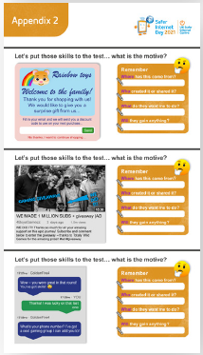
Activity 3: Spot the motive
On the following three slides are examples of what you could post online. You need to decide their motive for doing this.
You will also need to use Appendix 2 to record your ideas for the next activity.

Slide 24
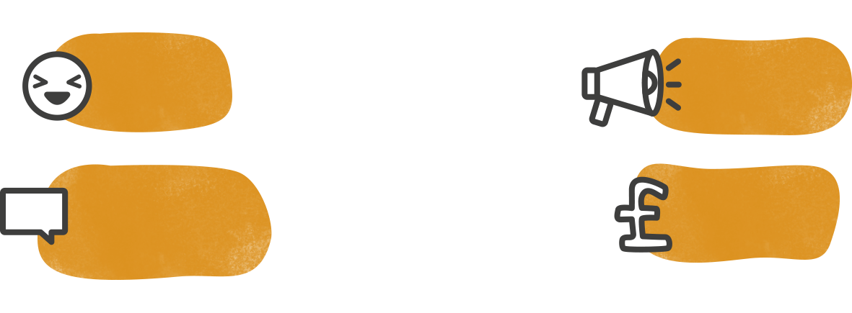
Post a video on YouTube
Why would someone do this? What is their motive?
To make people laugh
To advertise a product
To make money
To share their opinion about something
It could be more than one!

Slide 25

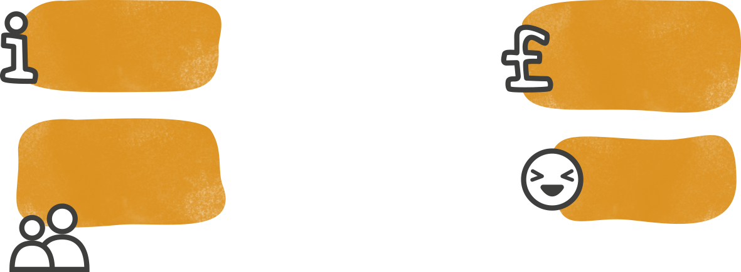
Share a photo online
Why would someone do this? What is their motive?
To support an article or some information
Because they want to sell something shown in the picture
Because they want their family or friends to see it
Because they find it funny
It could be more than one!

Slide 26


Run a giveaway
Why would someone do this? What is their motive?
To get more likes or subscribers
To reward their followers
Because they’re being paid to advertise a product
To celebrate a big achievement
It could be more than one!

Slide 27
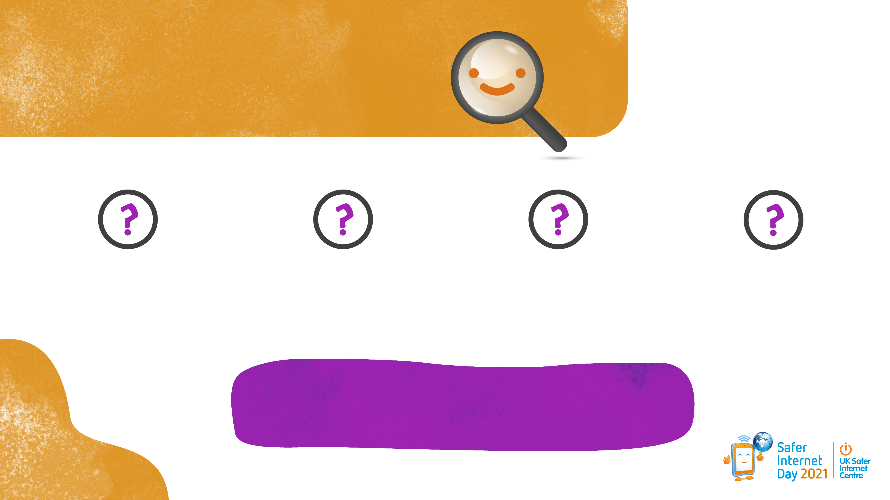
When you see something online
Ask…
Where has this come from?
Who created or shared it?
What do they want me to do?
Will they gain anything?
This will help you find the motive
(The reason why)

Slide 28
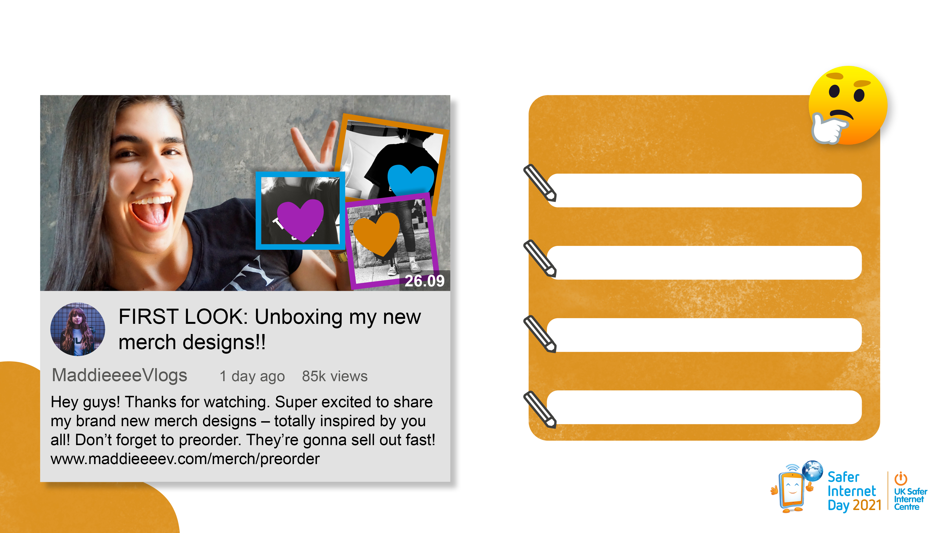
Activity 3: Spot the motive
What is the motive?
Remember:
Where has this come from?
Who created or shared it?
What do they want me to do?
Will they gain anything?
Notes:
Photo by Gabriel Porras on Unsplash
Photo by Patrick Beznoska on Unsplash
Photo by Scott Webb on Unsplash
Photo by kylie De Guia on Unsplash
Photo by Max Felner on Unsplash

Slide 29
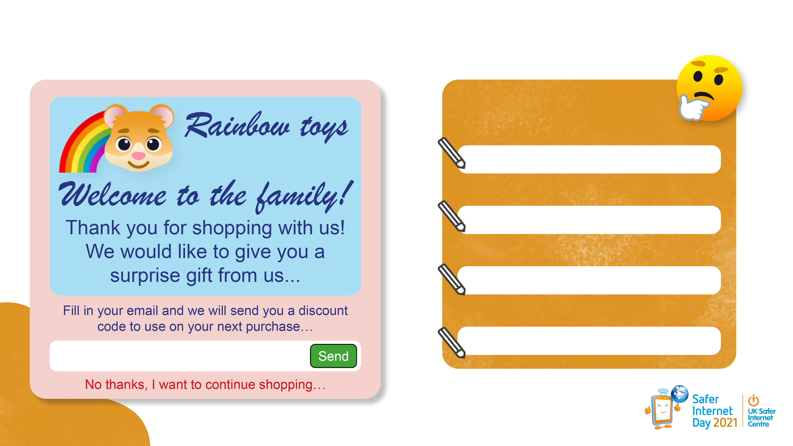
What is the motive? Record your ideas on Appendix 2.
Remember:
Where has this come from?
Who created or shared it?
What do they want me to do?
Will they gain anything?

Slide 30
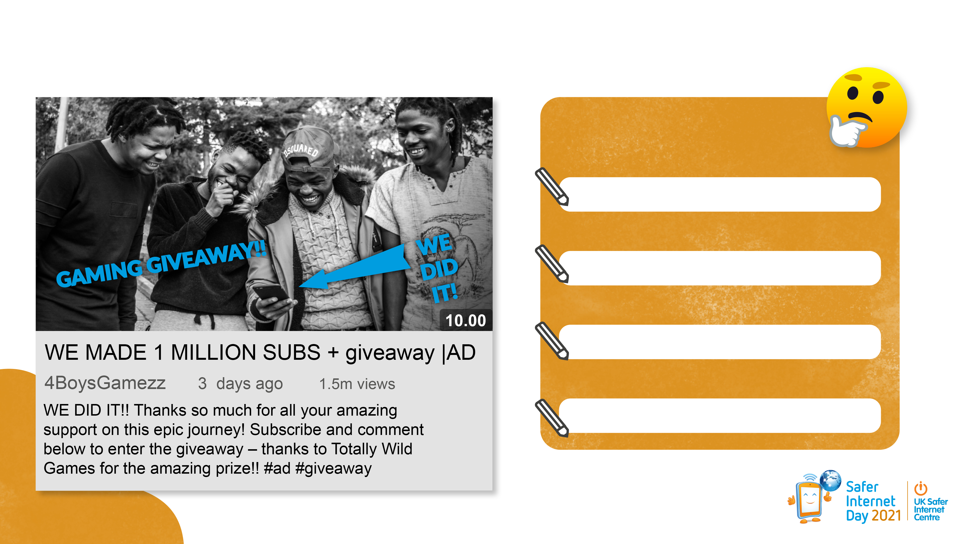
What is the motive? Record your ideas on Appendix 2.
Remember:
Where has this come from?
Who created or shared it?
What do they want me to do?
Will they gain anything?
Notes:
Photo by Alex Haney on Unsplash

Slide 31
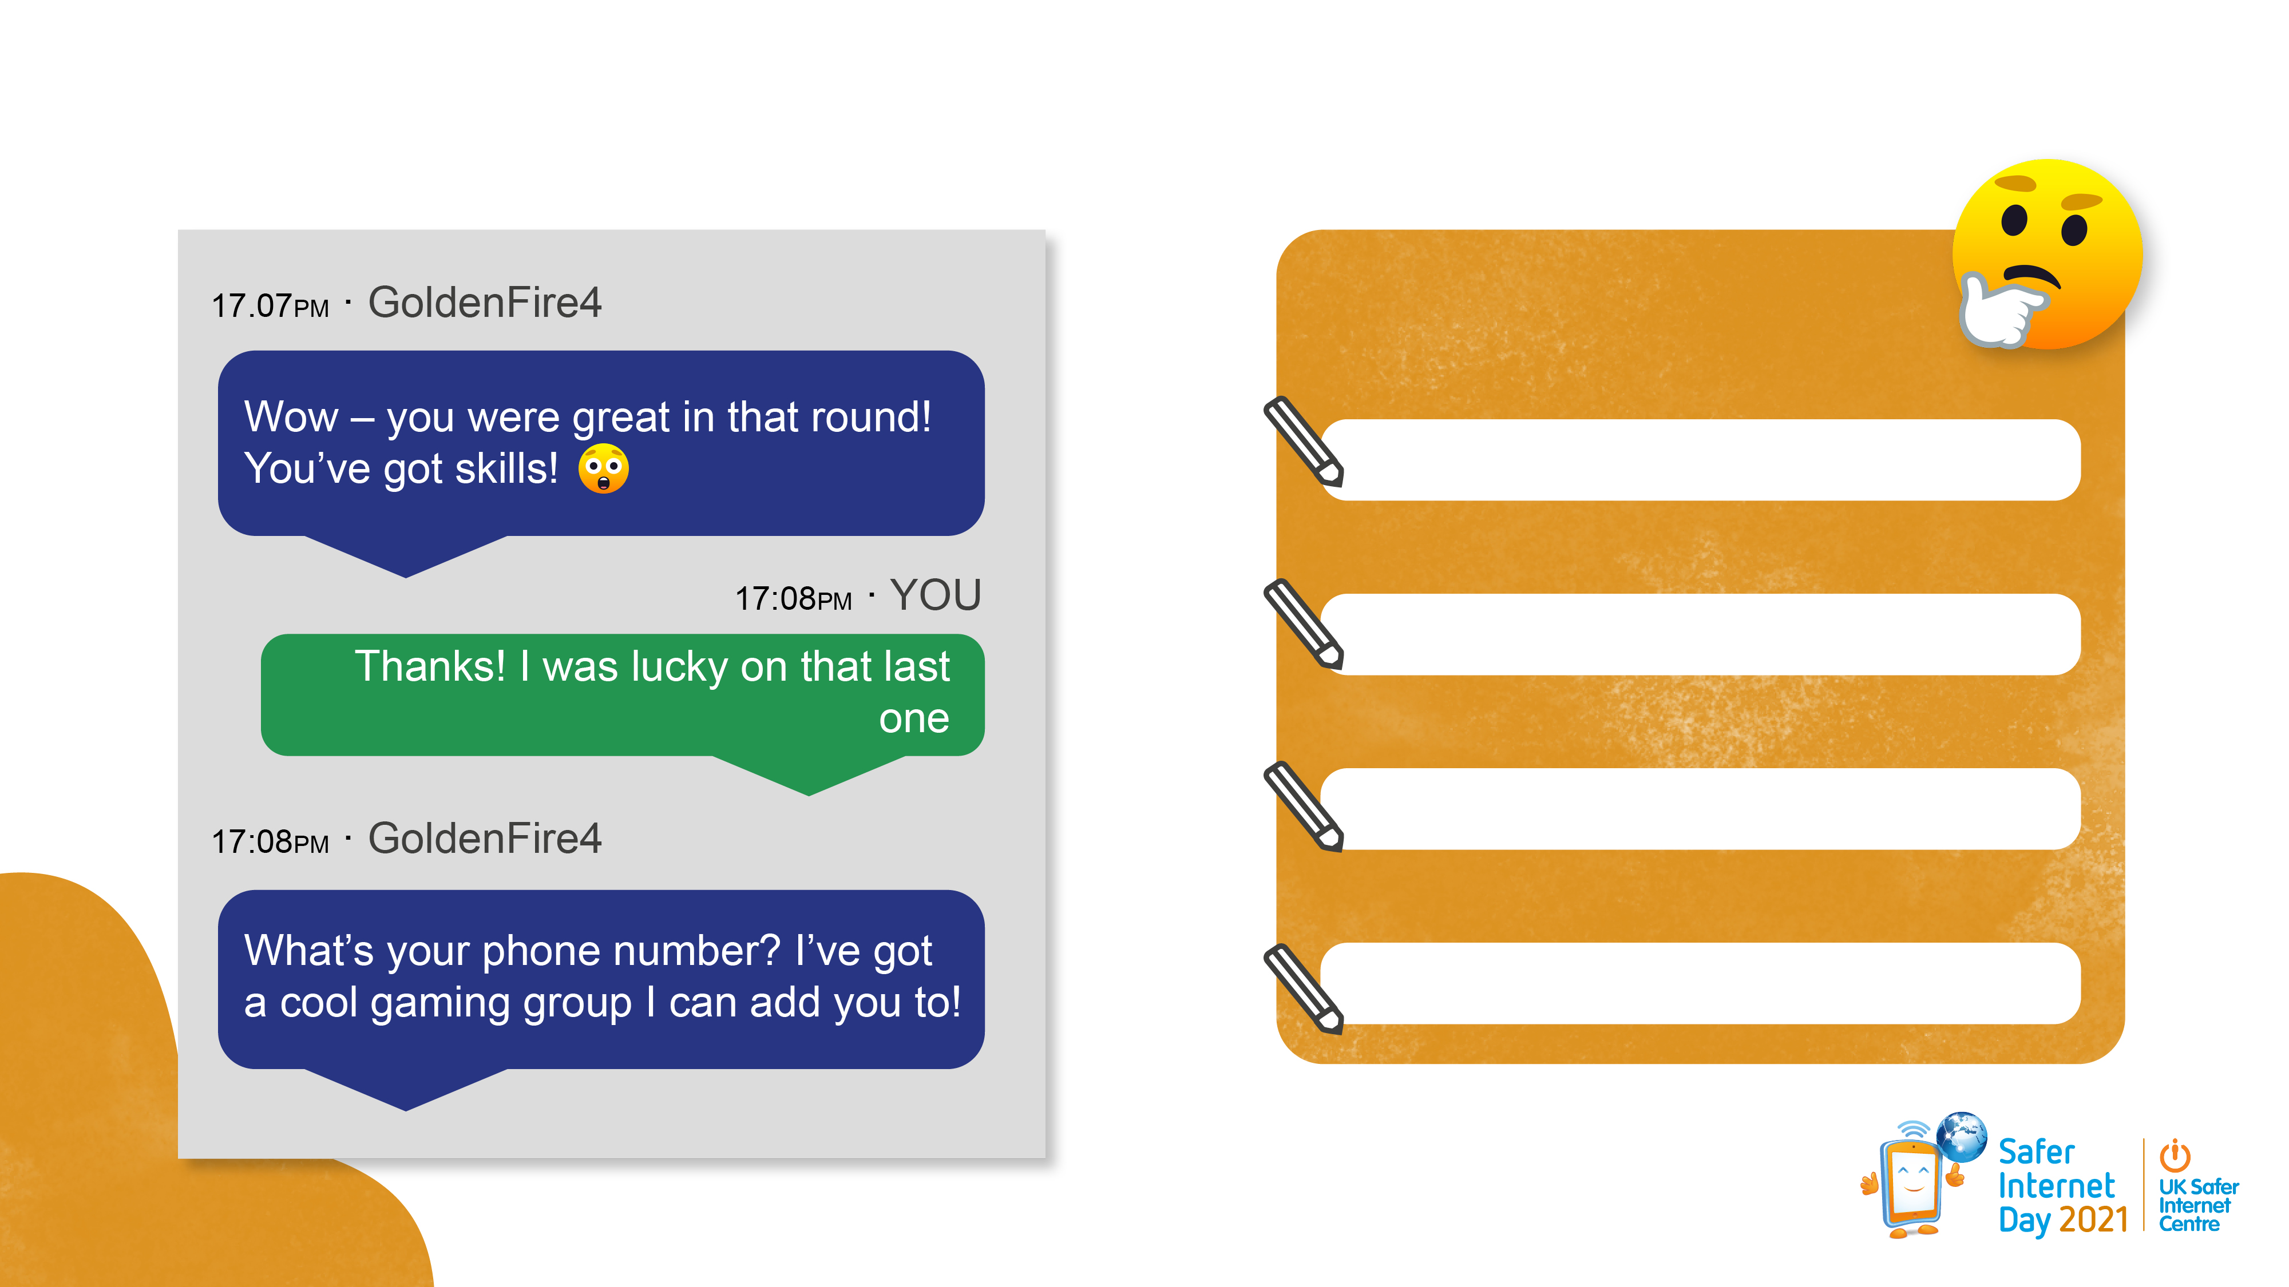
What is the motive? Record your ideas on Appendix 2.
Remember:
Where has this come from?
Who created or shared it?
What do they want me to do?
Will they gain anything?

Slide 32
Summing up
Today, you have been focussing on motives behind advertising, but you can use the skills you have learnt for any kind of content online. For example, although a message might have a different content, it still has a motive. There may even be times online when a motive may not be immediately obvious. It is really important that you remember this when you are either posting or watching anything online.

