Slide 1


Introduction
Which is the odd one out?
1,530 ÷ 6
1,354 ÷ 2
1,020 ÷ 4
© Classroom Secrets Limited 2018

Slide 2
Introduction
Which is the odd one out?
1,530 ÷ 6 = 255
1,020 ÷ 4 = 255
1,354 ÷ 2 = 677
© Classroom Secrets Limited 2018

Slide 3
Varied Fluency 1
Match the question to the correct answer.
2,165 | ÷ | 6
Thousands | Hundreds | Tens | Ones
1,000
1,000
100
10
10
1
1
10
10
1
1
10
10
1
361 r2
360 r5
321 r2
© Classroom Secrets Limited 2018

Slide 4
Varied Fluency 1
Match the question to the correct answer.
2,165 | ÷ | 6
Thousands | Hundreds | Tens | Ones
1,000
1,000
100
10
10
1
1
10
10
1
1
10
10
1
 | 0 | 3 | 6 | 0 | r5
6 | 2 | ²1 | ³6 | 5
361 r2
360 r5
321 r2
© Classroom Secrets Limited 2018

Slide 5
Varied Fluency 2
True or false?
The answer to the calculation below has a remainder.
3,527 | ÷ | 4
Thousands | Hundreds | Tens | Ones
1,000
1,000
100
100
10
10
1
1
1,000
100
100
1
1
100
1
1
1
© Classroom Secrets Limited 2018

Slide 6
Varied Fluency 2
True or false?
The answer to the calculation below has a remainder.
True. The answer is 881 r3
3,527 | ÷ | 4
Thousands | Hundreds | Tens | Ones
1,000
1,000
100
100
10
10
1
1
1,000
100
100
1
1
100
1
1
1
 | 0 | 8 | 8 | 1 | r3
4 | 3 | ³5 | ³2 | 7
© Classroom Secrets Limited 2018

Slide 7
Varied Fluency 3
Calculate the value of A.
1,267
A | A | A | 1
3
© Classroom Secrets Limited 2018

Slide 8
Varied Fluency 3
Calculate the value of A.
A = 422
1,267
422 | 422 | 422 | 1
 | 0 | 4 | 2 | 2 | r1
3 | 1 | ¹2 | 6 | 7
NOW COMPLETE THE VARIED FLUENCY ACTIVITY, CHOOSING EITHER DEVELOPING, EXPECTED OR GREATER DEPTH.
© Classroom Secrets Limited 2018

Slide 9
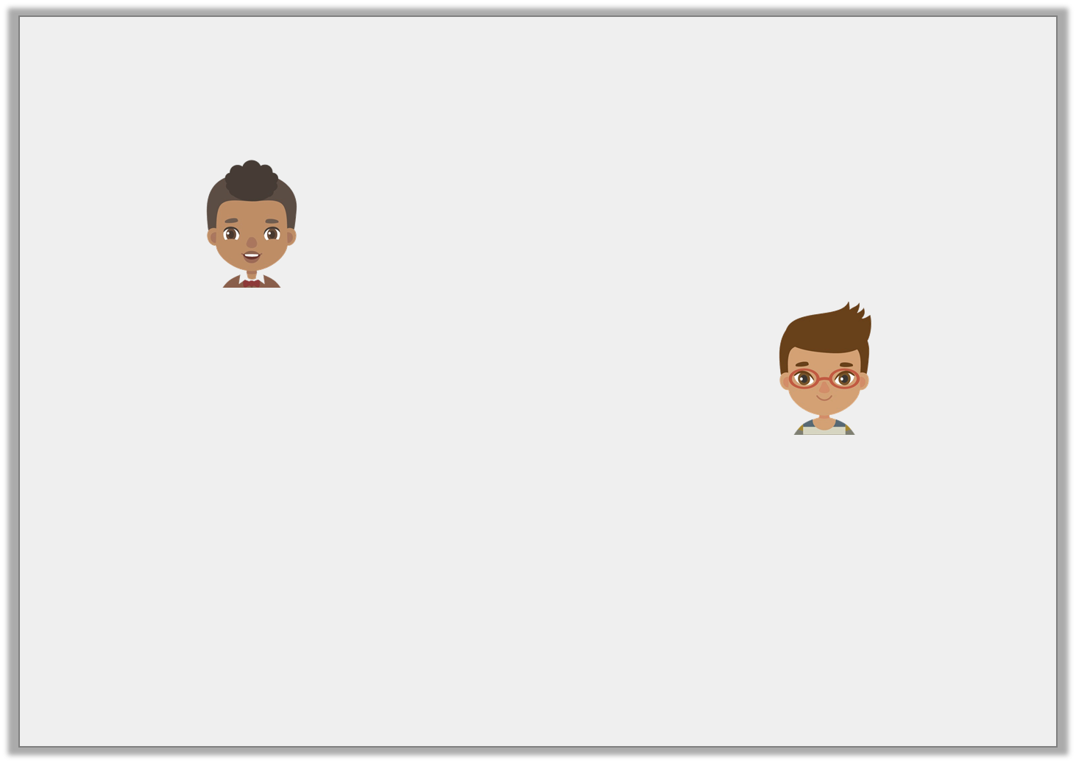
Reasoning 1
Ben and Josh are calculating 6,657 ÷ 5.
Who is correct?
Explain your reasoning.
The answer is
1,331 r2.
Ben
The answer is
1,331 r5.
Josh
© Classroom Secrets Limited 2018

Slide 10
Reasoning 1
Ben and Josh are calculating 6,657 ÷ 5.
Who is correct?
Explain your reasoning.
Ben is correct because…
The answer is
1,331 r2.
Ben
The answer is
1,331 r5.
Josh
© Classroom Secrets Limited 2018

Slide 11
Reasoning 1
Ben and Josh are calculating 6,657 ÷ 5.
Who is correct?
Explain your reasoning.
Ben is correct because Josh’s remainder is the same as the divisor.
The answer is
1,331 r2.
Ben
The answer is
1,331 r5.
Josh
© Classroom Secrets Limited 2018

Slide 12
Problem Solving 1
Apples are packed into crates. One crate holds 8 apples.
There are 2,487 apples.
How many crates are needed to hold all the apples?
© Classroom Secrets Limited 2018

Slide 13
Problem Solving 1
Apples are packed into crates. One crate holds 8 apples.
There are 2,487 apples.
How many crates are needed to hold all the apples?
311 crates will be needed.
 | 0 | 3 | 1 | 0 | r7
8 | 2 | ²4 | 8 | 7
© Classroom Secrets Limited 2018

Slide 14
Problem Solving 2
Arrange the number cards below to create a calculation
which has a remainder of 1.
Complete the calculation.
4
7
6
 |  |  |  |  |  | r1
 | 6 | 2
© Classroom Secrets Limited 2018

Slide 15
Problem Solving 2
Arrange the number cards below to create a calculation
which has a remainder of 1.
Complete the calculation.
Various answers, for example: 2,647 ÷ 6 = 441 r1
4
7
6
 |  | 0 | 4 | 4 | 1 | r1
 | 6 | 2
2
2
6
4
7
© Classroom Secrets Limited 2018

Slide 16
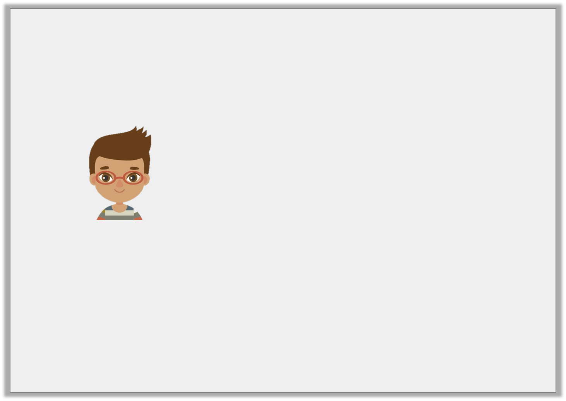
NOW COMPLETE REASONING + PROBLEM SOLVING ACTIVITY, CHOOSING EITHER DEVELOPING, EXPECTED OR GREATER DEPTH.
IF YOU HAVE TIME, COMPLETE THE HOMEWORK/EXTENSION ACTIVITY, CHOOSING EITHER DEVELOPING, EXPECTED OR GREATER DEPTH.
DON’T FORGET TO MARK YOUR ANSWERS!
© Classroom Secrets Limited 2018

