Slide 1

Delivery notes
You can find delivery instructions for these resources in the Education Pack for 3-7s.
Before delivering the lesson or activities, you could skip or hide any slides you do not need, including this one.

Slide 2


Slide 3

True
Correct
False
Wrong
Untrustworthy
Real
Fiction
Untrue
Pretend
Imaginary
Make-believe
Fake
Incorrect
Unreal
Right
Genuine
Trustworthy
Fact
Notes:
Resource for Activity 2 – ‘Word Sorting’

Slide 4

Geese have wings and feathers.
Geese eat sweets and ice cream.
Notes:
Example for Activity 7 - ‘Fact Detectives!’ Left side is true, right side is false.
Photo by PowerPoint Stock Images

Slide 5

XXXXX
XXXXX
Notes:
Blank templates for Activity 7 - ‘Fact Detectives!’
Use one side for your true statement and the other for false. Put the same picture in both.

Slide 6

Notes:
TRUE sign for sorting the cards in Activity 7 - ‘Fact Detectives!’
Image by Childnet

Slide 7

Notes:
FALSE sign for sorting the cards in Activity 7 - ‘Fact Detectives!’
Image by Childnet

Slide 8
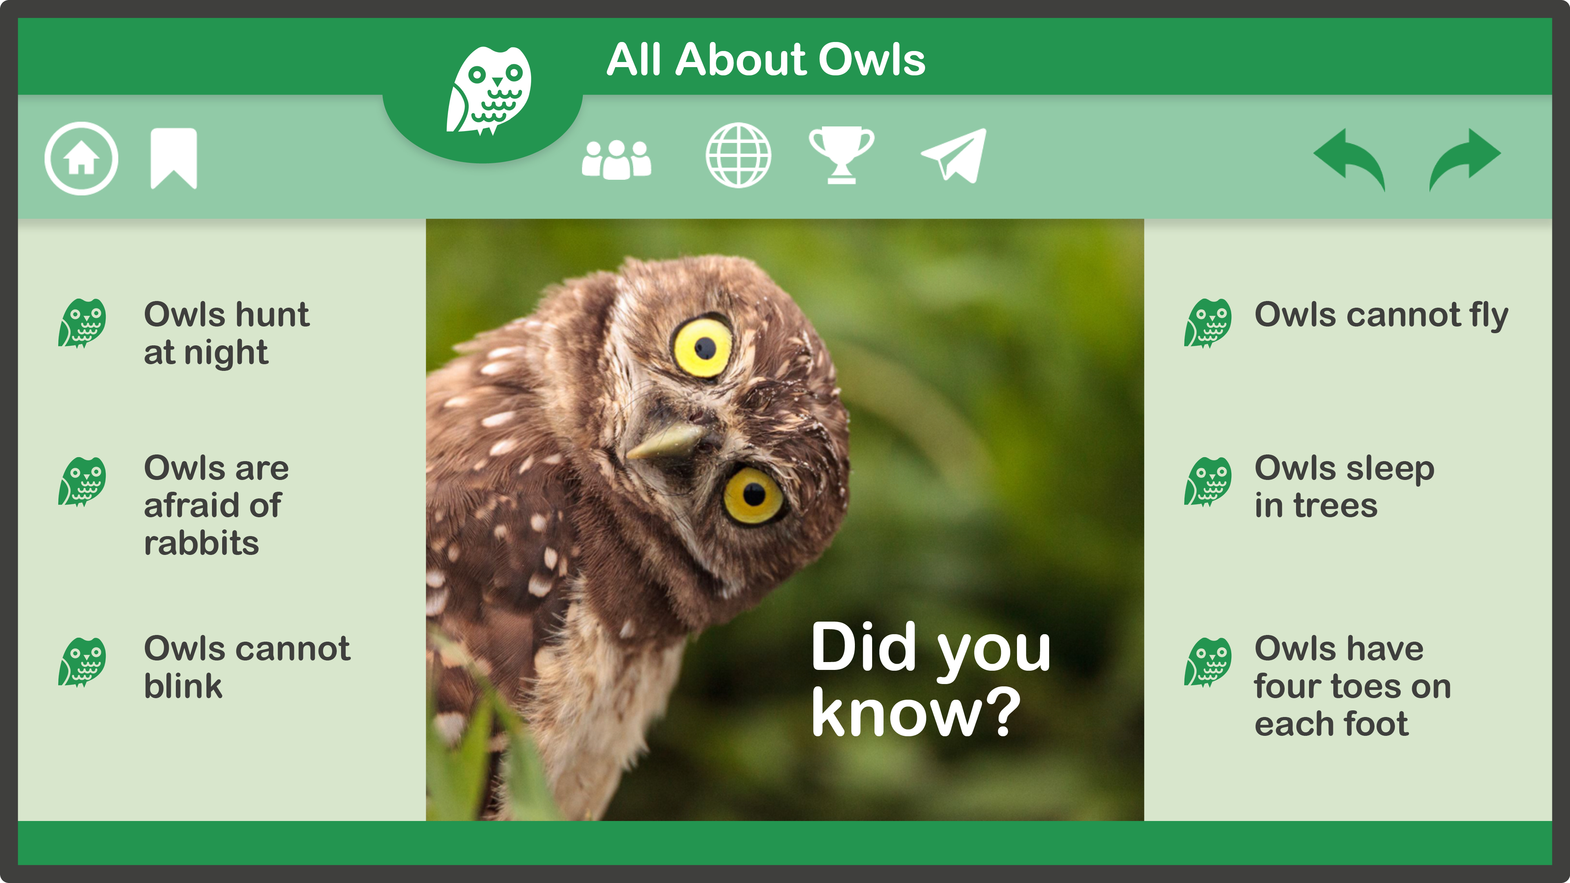
Notes:
Resource for Activity 8 – ‘All about owls!’ Standard version.
Photo by PowerPoint Stock Images

Slide 9
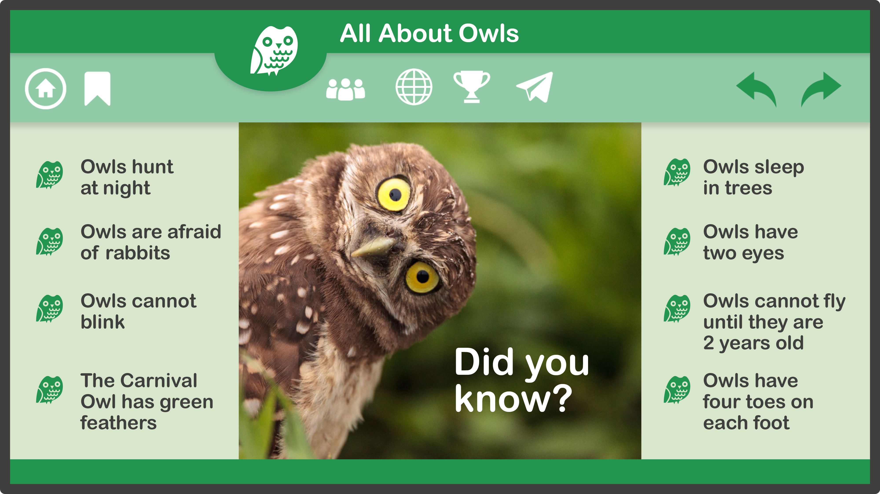
Notes:
Resource for Activity 8 - ‘All about owls!’ Extended version.
Photo by PowerPoint Stock Images

Slide 10




