Slide 1



LIFE/work balance
We have started a #LIFEworkbalance campaign and we need your help to complete our LIFE/work balance survey.
We hope to publish the results soon, so please give 15 minutes of your time to help us get a true picture of school life.
Want to be a part of this campaign? Take the survey on our website and share it with your colleagues!
© Classroom Secrets Limited 2019

Slide 2
Year 2 – Summer Block 4 – Mass, Capacity and Temperature – Litres
About This Resource:
This PowerPoint has been designed to support your teaching of this small step. It includes a starter activity and an example of each question from the Varied Fluency and Reasoning and Problem Solving resources also provided in this pack. You can choose to work through all examples provided or a selection of them depending on the needs of your class.
National Curriculum Objectives:
Mathematics Year 2: (2M1) Compare and order lengths, mass, volume/capacity and record the results using >, < and =
Mathematics Year 2: (2M2) Choose and use appropriate standard units to estimate and measure length/height in any direction (m/cm); mass (kg/g); temperature (°C); capacity (litres/ml) to the nearest appropriate unit, using rulers, scales, thermometers and measuring vessels
More Year 2 Mass Capacity and Temperature resources.
Did you like this resource? Don’t forget to review it on our website.
© Classroom Secrets Limited 2018

Slide 3
Year 2 – Summer Block 4 – Mass, Capacity and Temperature
Step 6: Litres
© Classroom Secrets Limited 2018

Slide 4
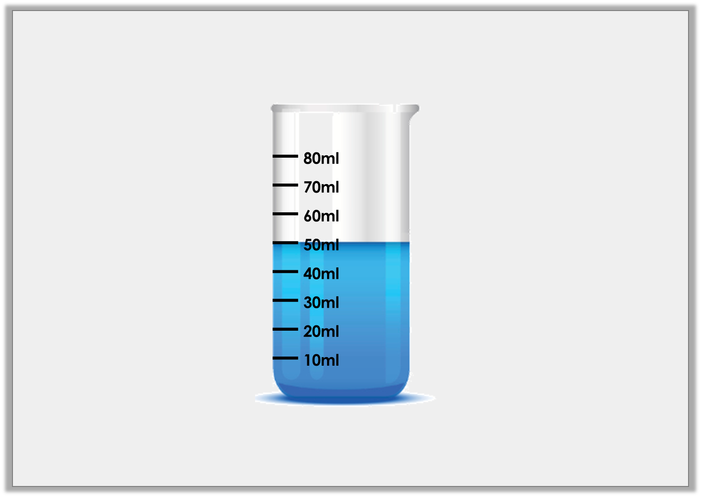
Introduction
How many millilitres of liquid are in this container?
What is the greatest volume of liquid that could be measured in this container?
© Classroom Secrets Limited 2018

Slide 5
Introduction
How many millilitres of liquid are in this container? 50ml
What is the greatest volume of liquid that could be measured in this container? 80ml
© Classroom Secrets Limited 2018

Slide 6
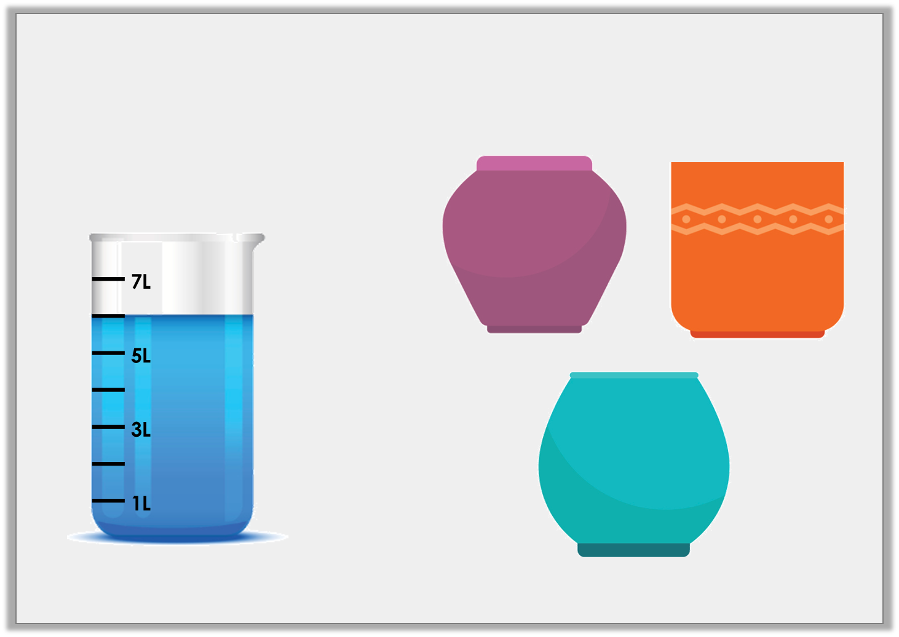
Varied Fluency 1
Which pot holds the same amount of liquid as the container?
A
B
5L
6L
C
7L
© Classroom Secrets Limited 2018

Slide 7
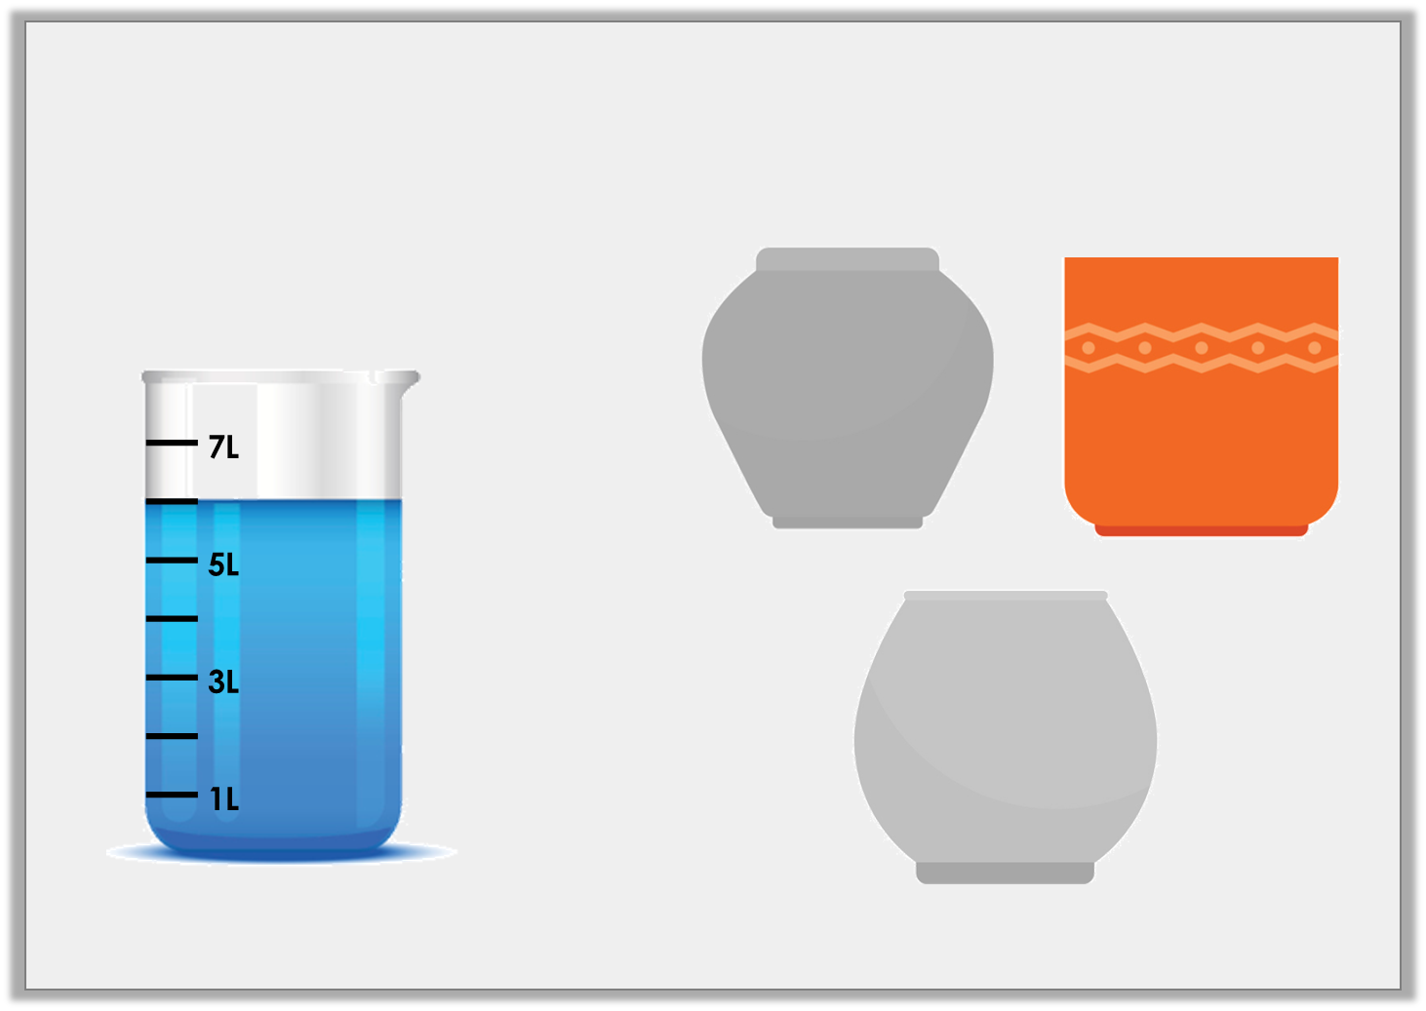
Varied Fluency 1
Which pot holds the same amount of liquid as the container?
A
B
5L
6L
C
7L
© Classroom Secrets Limited 2018

Slide 8
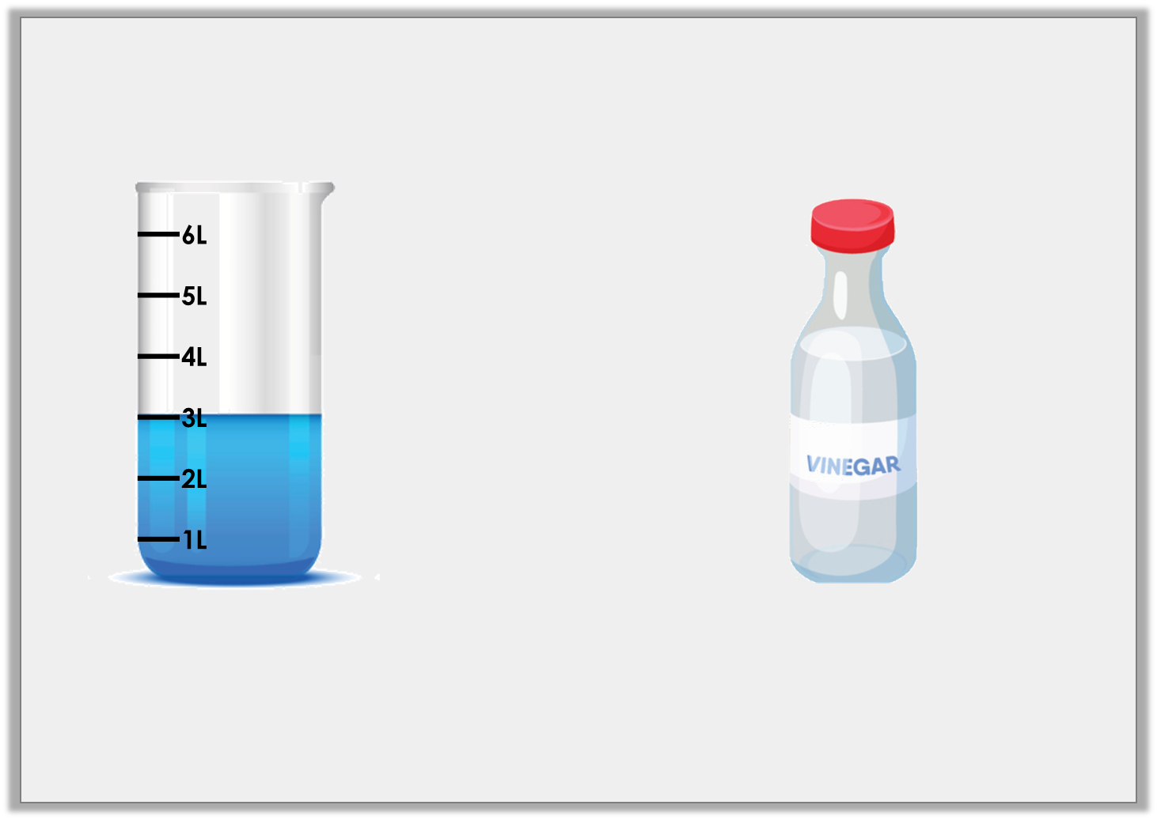
Varied Fluency 2
Complete the comparison by using the correct symbol from below.
2L
<
>
=
© Classroom Secrets Limited 2018

Slide 9
Varied Fluency 2
Complete the comparison by using the correct symbol from below.
>
2L
<
>
=
© Classroom Secrets Limited 2018

Slide 10
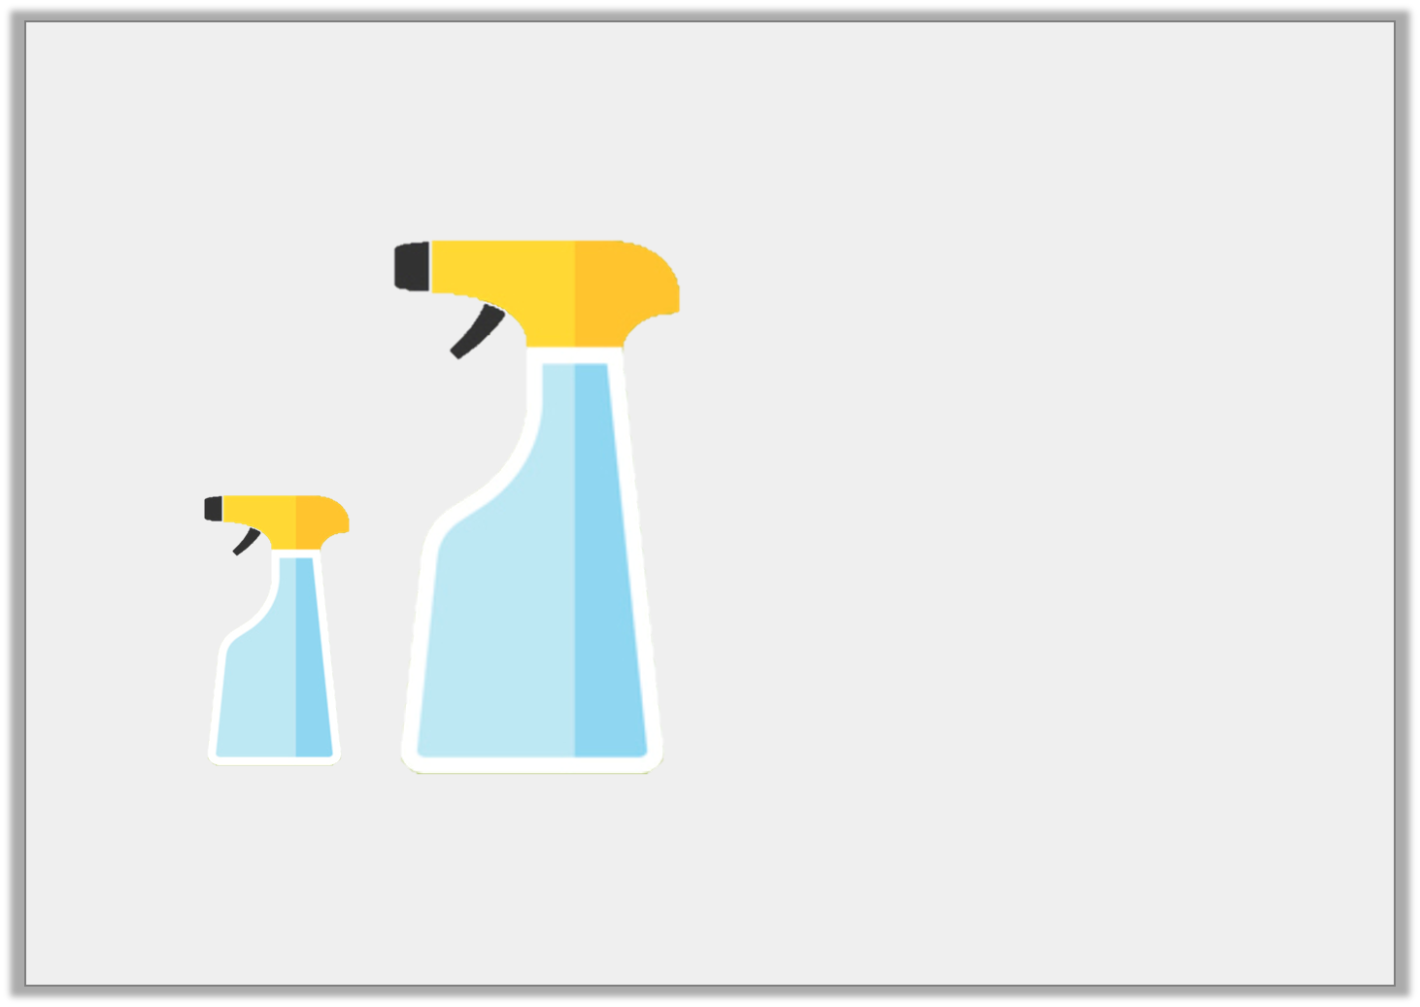
Varied Fluency 3
Estimate how much liquid is in container B.
1L
20L
2L
8L
A
B
© Classroom Secrets Limited 2018

Slide 11
Varied Fluency 3
Estimate how much liquid is in container B.
1L
20L
2L
8L
A
B
© Classroom Secrets Limited 2018

Slide 12
Varied Fluency 4
Colour the containers up to the correct level.
L
10L
8L
6L
4L
2L
L
10L
8L
6L
4L
2L
L
9L
7L
5L
3L
1L
9L
10L
4L
© Classroom Secrets Limited 2018

Slide 13
Varied Fluency 4
Colour the containers up to the correct level.
L
10L
8L
6L
4L
2L
L
10L
8L
6L
4L
2L
L
9L
7L
5L
3L
1L
9L
10L
4L
© Classroom Secrets Limited 2018

Slide 14
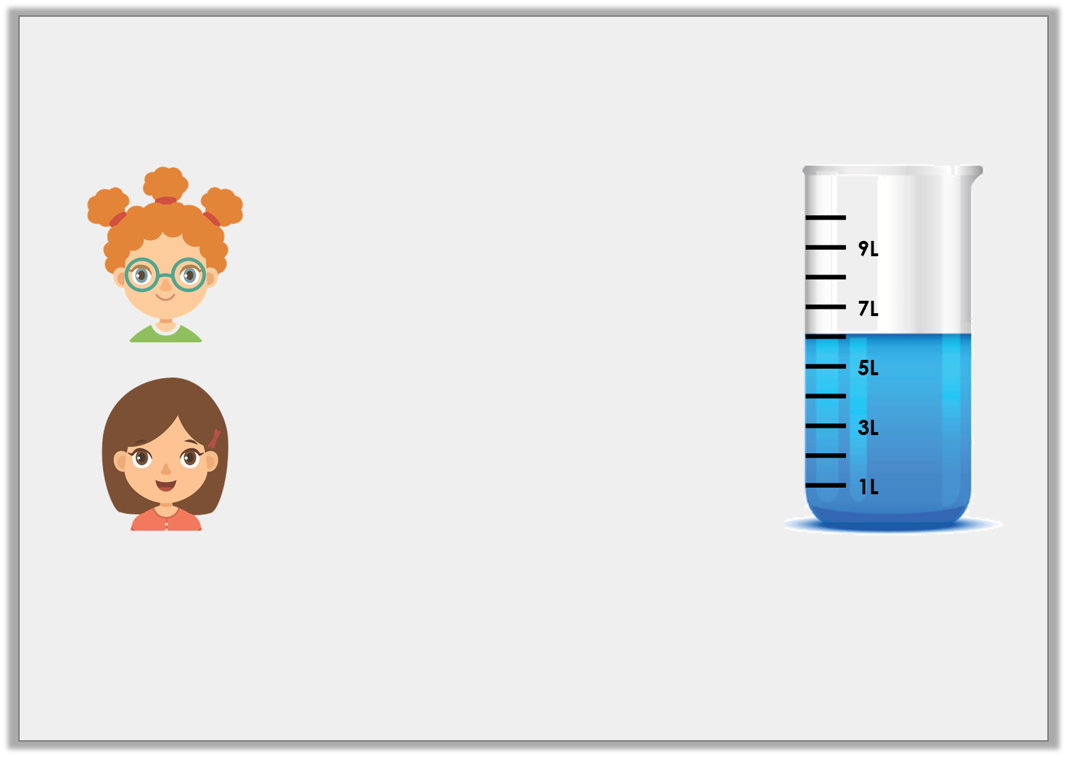
Reasoning 1
Kate and Freya are discussing capacity.
Who is correct? Explain your answer.
The volume of liquid in this container is 7L.
Kate
The volume of liquid in this container is 6L.
Freya
© Classroom Secrets Limited 2018

Slide 15
Reasoning 1
Kate and Freya are discussing capacity.
Who is correct? Explain your answer.
Freya is correct because…
The volume of liquid in this container is 7L.
Kate
The volume of liquid in this container is 6L.
Freya
© Classroom Secrets Limited 2018

Slide 16
Reasoning 1
Kate and Freya are discussing capacity.
Who is correct? Explain your answer.
Freya is correct because the liquid reaches the increment between 5L and 7L on the container so the volume of liquid is 6 litres.
The volume of liquid in this container is 7L.
Kate
The volume of liquid in this container is 6L.
Freya
© Classroom Secrets Limited 2018

Slide 17
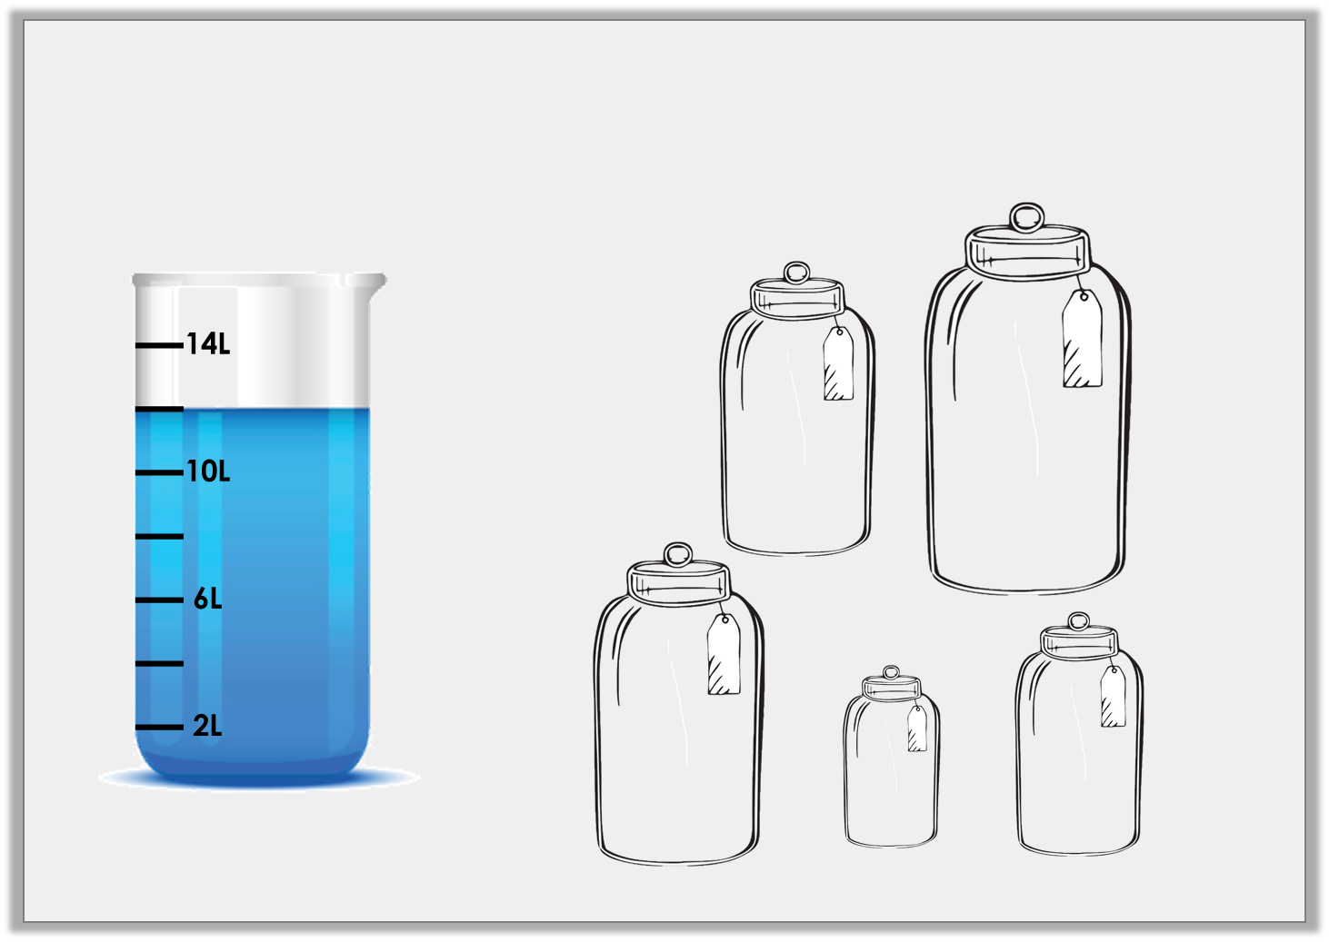
Problem Solving 1
Which combination of jars could be filled using the amount of liquid shown in the container below?
A
B
3L
5L
C
E
D
4L
1L
2L
© Classroom Secrets Limited 2018

Slide 18
Problem Solving 1
Which combination of jars could be filled using the amount of liquid shown in the container below?
A, B and C
A
B
3L
5L
C
E
D
4L
1L
2L
© Classroom Secrets Limited 2018

Slide 19
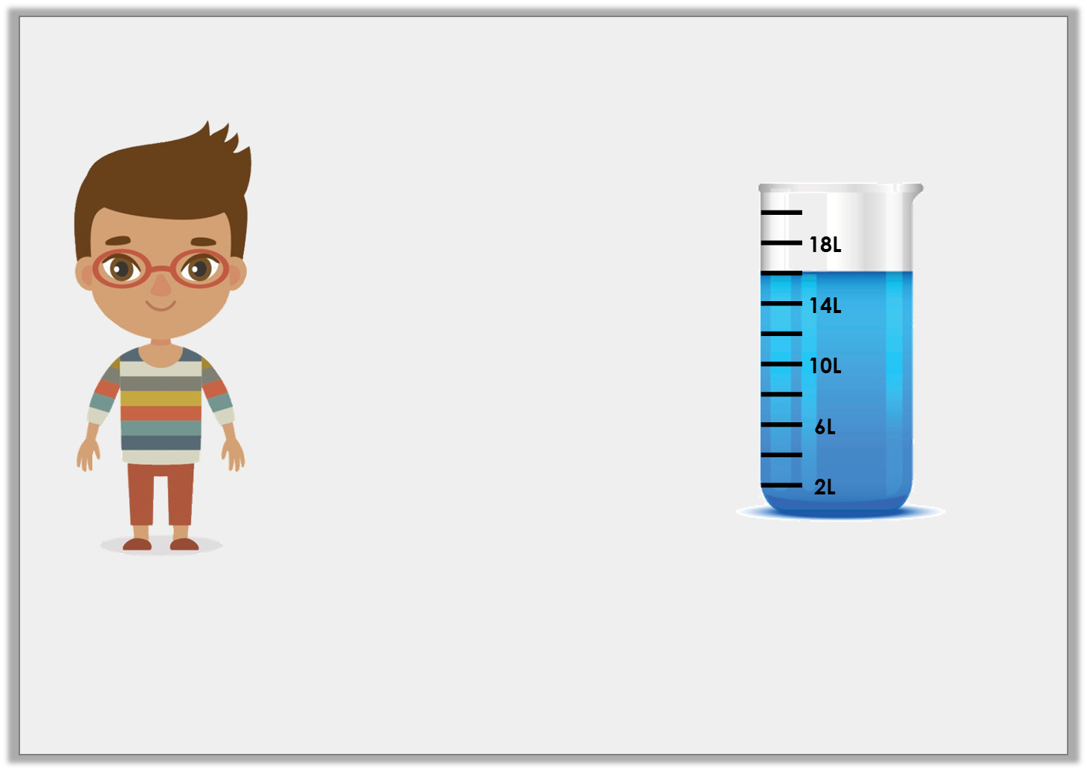
Reasoning 2
Tim wants to fill his paddling pool.
Does he have enough water? Explain your answer.
I need 18 litres of water to fill my paddling pool.
© Classroom Secrets Limited 2018

Slide 20
Reasoning 2
Tim wants to fill his paddling pool.
Does he have enough water? Explain your answer.
Tim does not have enough water because…
I need 18 litres of water to fill my paddling pool.
© Classroom Secrets Limited 2018

Slide 21
Reasoning 2
Tim wants to fill his paddling pool.
Does he have enough water? Explain your answer.
Tim does not have enough water because the liquid only reaches 16L on the container which is 2 litres less than what he needs.
I need 18 litres of water to fill my paddling pool.
© Classroom Secrets Limited 2018

