Slide 2
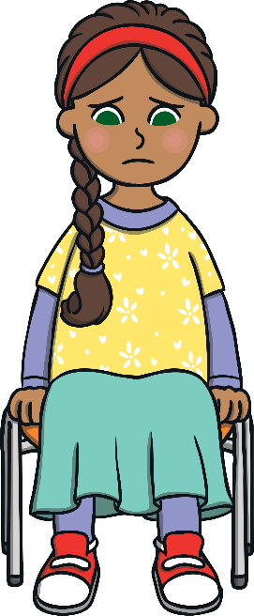
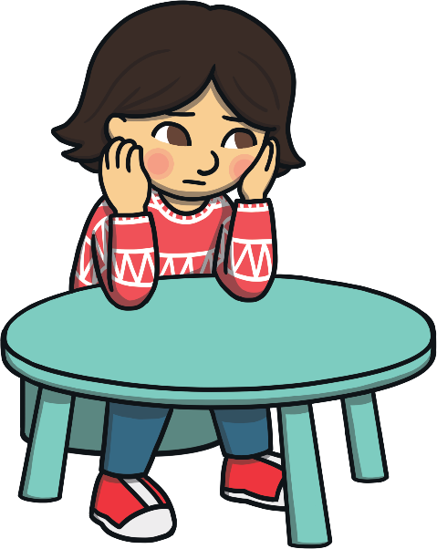
What is Mental Health?
Mental health is about how you feel, think and sometimes behave. Lots of children have mental health problems and it means they can feel sad, angry or anxious.

Slide 3
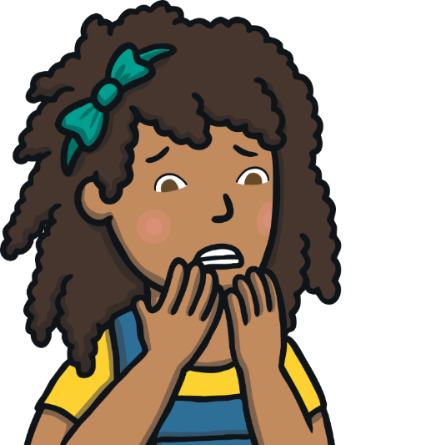
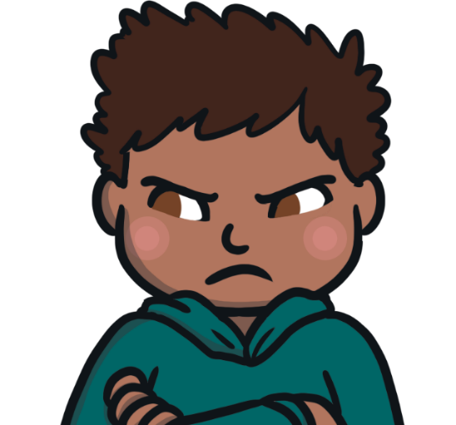
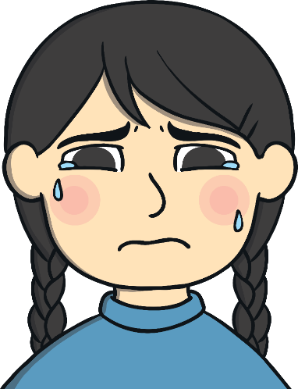
Can You Think of any Mental Health Problems?
next
These are some of the ways that you can feel if you have a mental
health problem. Click on a mental health problem to learn more about it.
sad
anxious
angry

Slide 4
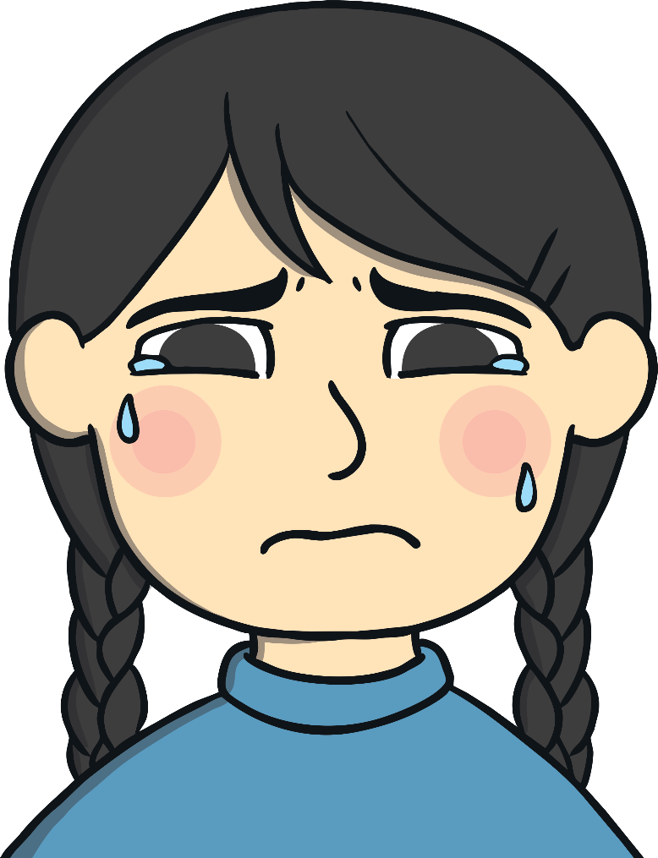
I Feel Sad
I sometimes feel like crying, being on my own or not wanting to come to school.
back

Slide 5

I Feel Anxious
When you feel anxious your heart beats fast and you might feel sweaty
and sick.
back

Slide 6

I Feel Angry
It’s normal to sometimes feel angry but sometimes it becomes too much and you feel angry all the time.
back

Slide 7
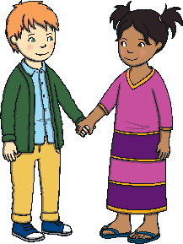
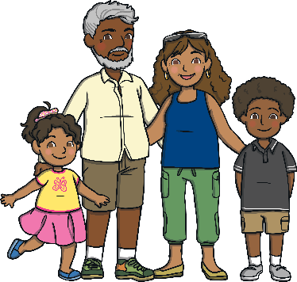



Plenary
There are lots of people to help you if you feel sad, angry or anxious.
friends
family
Here are some of them:
Phone a friend or family member
doctor
Teacher

