Slide 2
Teachers’ notes
Activity summary
Pupils apply their knowledge of materials and their properties to select the best materials to protect Humpty Dumpty from being broken by his fall, and write a letter explaining to him how he can protect himself.
Learning aims
Describe the simple physical properties of everyday materials.
Decide on the best material to use for a given purpose and explain my reason using scientific vocabulary.
STEM clubs
This resource could be used in a STEM or Science club, as well as in class. See slide 29 for ideas on how it could be adapted.
Curriculum links
England
Science; Everyday materials, Year 1
Identify and name a variety of everyday materials.
Describe the simple physical properties of everyday materials.
Science; Everyday materials, Year 2
Identify and compare the suitability of a variety of everyday materials.
Scotland
Science; Materials; Properties and uses of substances
Through creative play, I explore different materials and can share my reasoning for selecting materials for different purposes. SCN 0-15a
Wales
Science; Myself and non-living things; Foundation phase
Explore and investigate the properties of materials from which everyday objects are made, and to acquire relevant vocabulary to describe them and begin to link the materials with their uses.
Northern Ireland
Science and Technology; The world around us; Strand 3: Place
Learning about the properties of everyday materials and their uses

Slide 3
Teachers’ notes
What you’ll need:
Per pair:
‘Practice egg’ to test with (see slide 4 for options)
1 real egg per pair, ideally boiled (optional)
Freezer / sandwich bags
Variety of materials with different properties – see slides 16 and 20 for our suggestions. You may wish to adapt these slides if you prefer to use different materials.
Timing:
1 hour +
Key science vocab:
Material, object, properties, protect
Material names, e.g. wood, plastic, glass, water, rock, paper, metal, brick
Properties of materials, e.g. hard / soft, stretchy / stiff, shiny/ dull, thick / thin, flexible / inflexible, bendy / not bendy, rough/ smooth, transparent / opaque, see through / not see through
Prior Learning
Use slide 12 to assess pupils’ ability to:
distinguish between an object and the material from which it is made
identify and name a variety of everyday materials
If pupils need to recap this, visit bpes.bp.com/introducing-materials.
About this resource:
BP Educational Services activities are developed in partnership with practising teachers. This resource has also been informed by the Enterprising Science research partnership of BP, the Science Museum Group and King’s College London, who collaborated to create, measure and test science capital – a new concept that gets to the heart of how people engage with science.
www.enterprisingscience.com
Related activities:
This activity is part of a collection called Science in stories, which uses well known stories to explore the science curriculum.

Slide 4
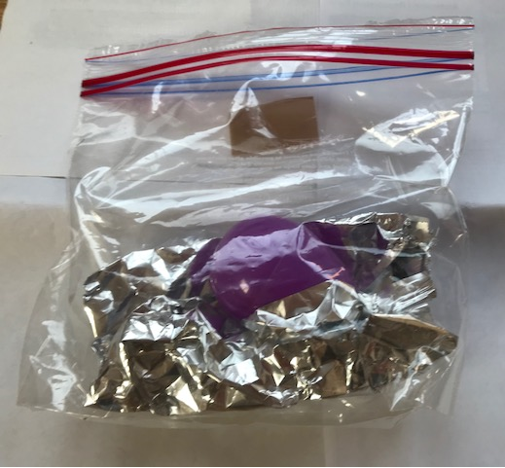
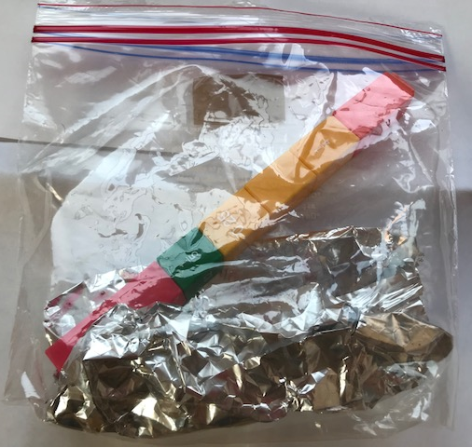
Teachers’ notes
Pupils can use a ‘practice egg’ to test their materials.
These test eggs are reusable, minimising waste and mess.
Once pupils have chosen the best protective material, they can use it to protect the ‘real’ Humpty – observing what happens when they drop a real egg!
We advise you test your chosen practice egg on your classroom floor to make sure it will break / show damage when dropped.
Options for a practice egg include the following:
1. A chain of unifix cubes
A long chain will break apart when dropped. After dropping, pupils can observe whether the cubes have moved, begun to break apart or actually broken apart.
Cubes works best if you:
use a longer chain of at least 10cm
use longer / larger cubes which have a single join (e.g. Early Years cubes)
encourage pupils to raise their arms up high when they perform the drop.
2. Plastic hinged eggs
These reusable plastic eggs open if dropped.
Plastic eggs work best if you:
encourage pupils to raise their arms up high when they perform the drop.
Note, for both of these options, a hard floor surface and a thin plastic bag work best. If you are using freezer bags, ensure pupils leave the bag open to minimise air resistance.
Using a real egg:
Alternatively, use a real egg. A real egg will break much more easily than the practice eggs, so this works best if you:
encourage pupils to drop the egg from less than a metre (e.g. their waist height)
use a softer surface, such as carpet
boil the eggs first to minimise mess.

Slide 5
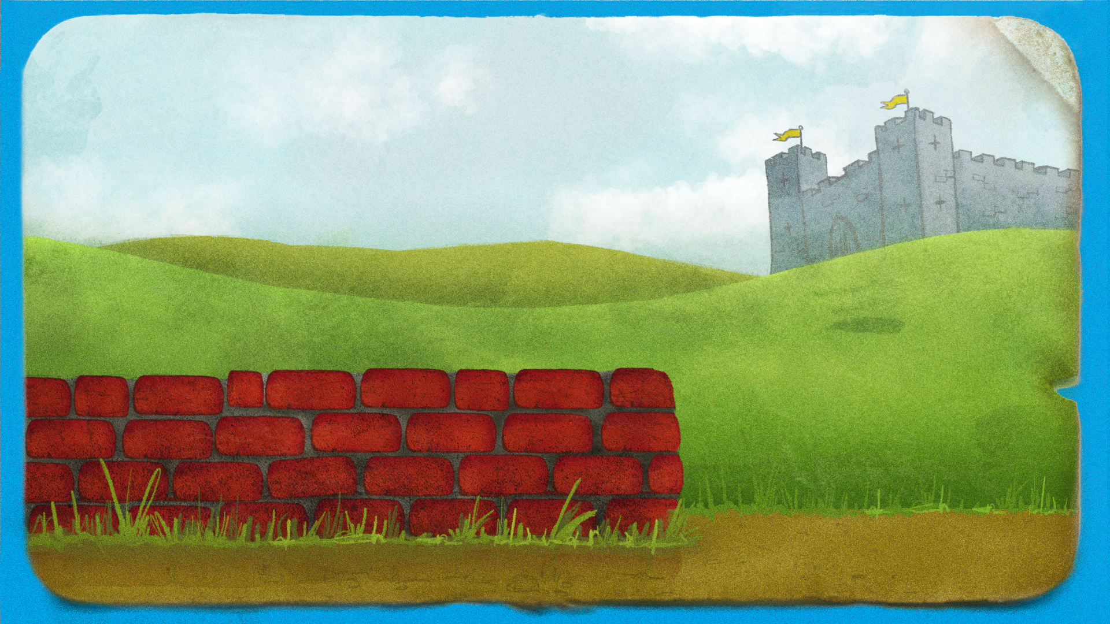
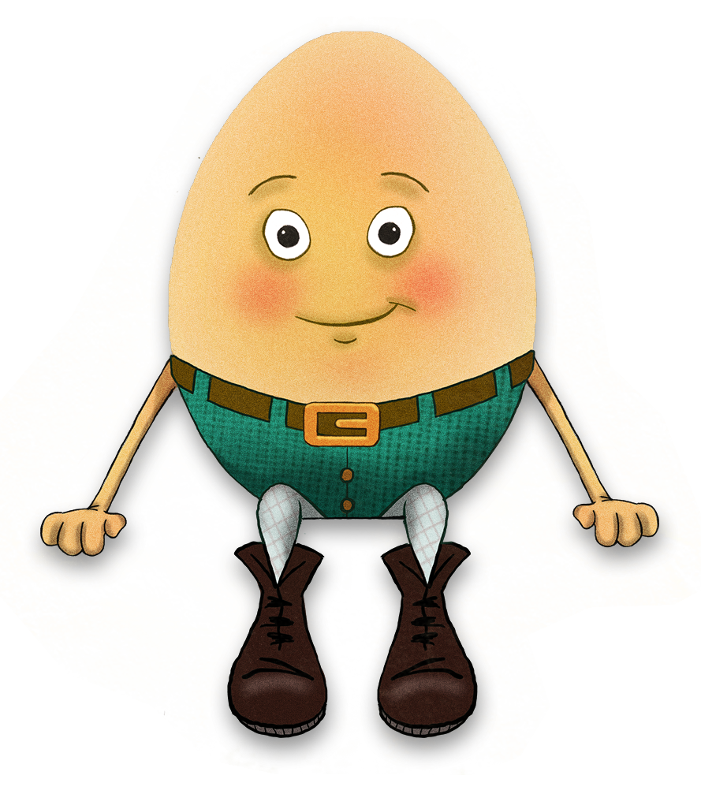
Notes:
Teachers’ notes:
Q. Does anyone know who this character is?
See if pupils recognise Humpty Dumpty and then begin to read through the nursery rhyme.

Slide 6
Humpty Dumpty sat on a wall.
Notes:
Teachers’ notes:
Read through the nursery rhyme with pupils.

Slide 7
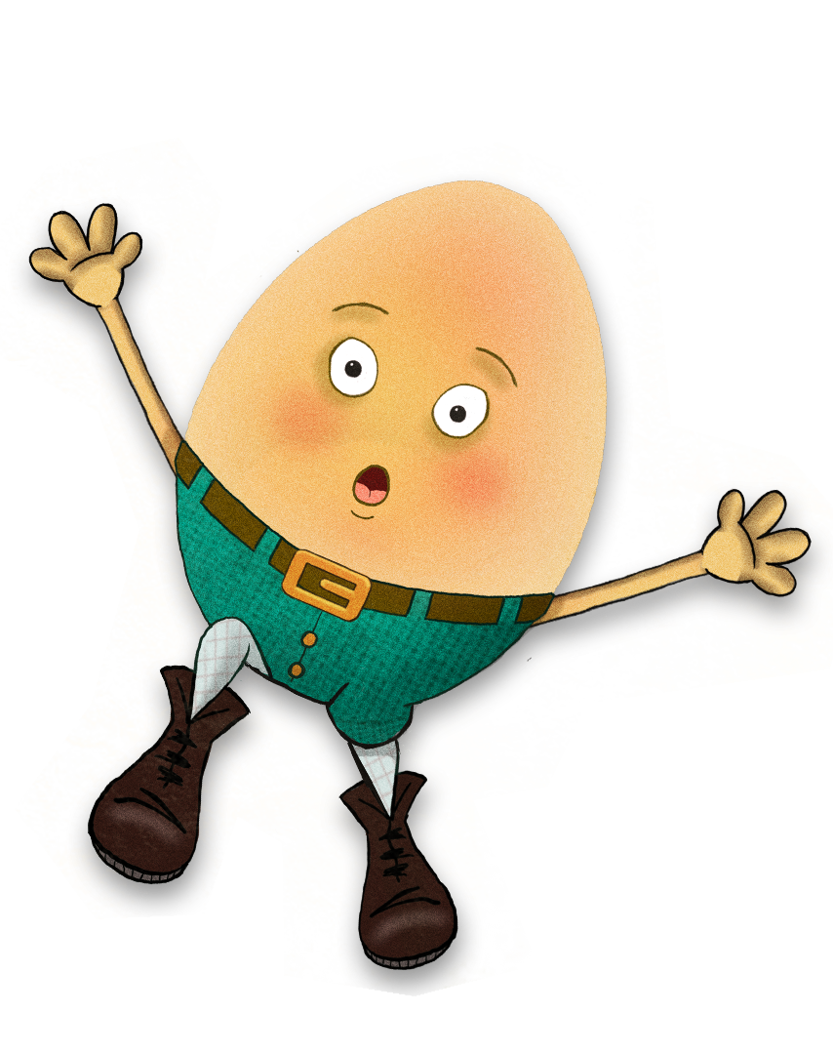
Humpty Dumpty had a great fall.
Notes:
Teachers’ notes:
Read through the nursery rhyme with pupils.

Slide 8
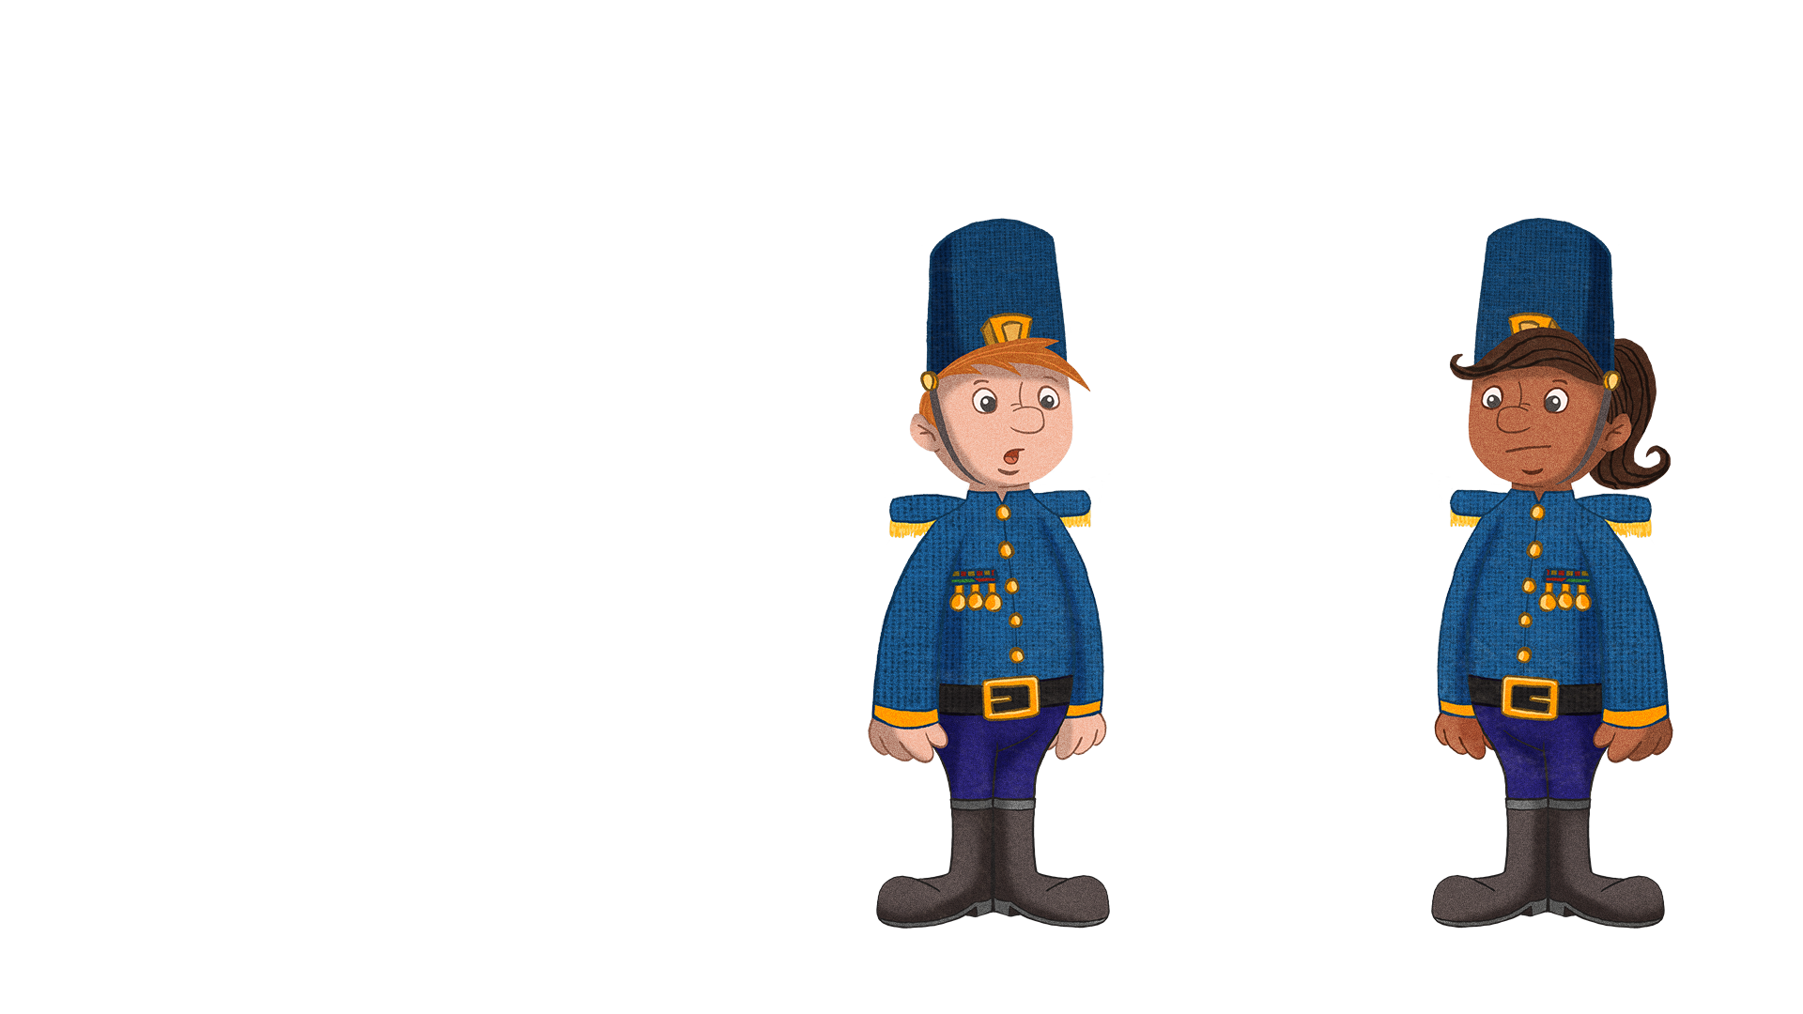
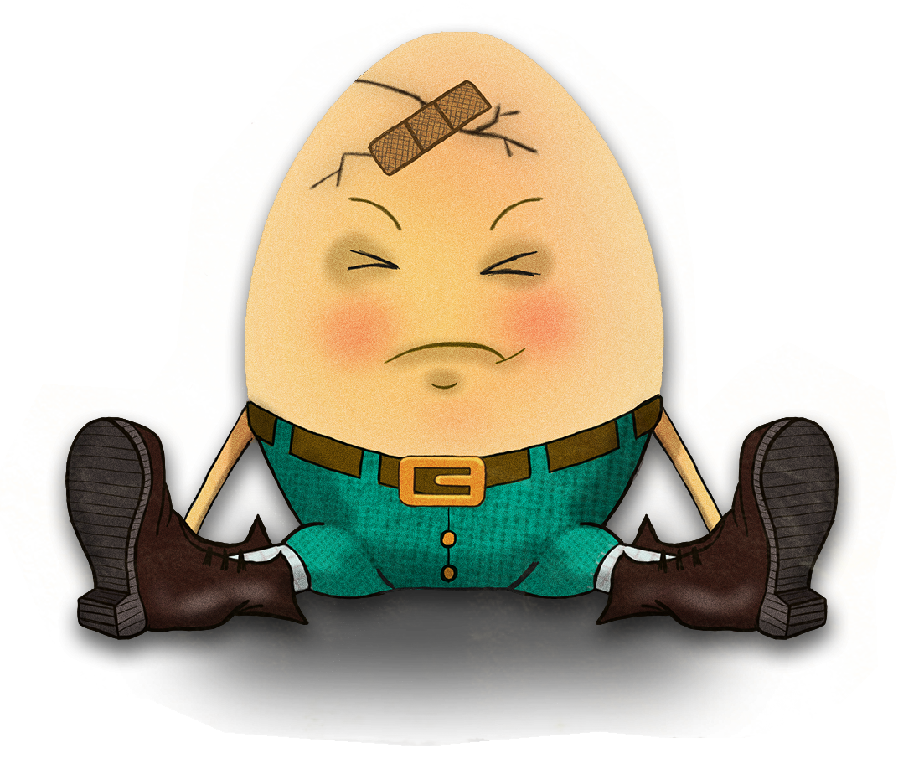
All the King’s horses and all the King’s men
Couldn’t put Humpty together again!
Notes:
Teachers’ notes:
Once you have read through the nursery rhyme, ask pupils:
Q. Can you explain what happened to Humpty Dumpty? Why did he break?
Eggs usually break if you drop them on a hard surface.
Q. Would he have broken if he fell onto a carpet or a duvet? Why / why not?
He might not have broken because a carpet or a duvet is softer than the floor.
Q. Would he have broken if the wall was lower?
Maybe not! If we drop an object from a lower height it will be travelling more slowly when it hits the ground.
This is because it doesn’t fall for as long – so it has less time to pick up its speed.
If the wall Humpty fell from were lower, he would be falling at a slower speed. That means he might not break!
Q. Have you ever dropped something and broken it? What was it made of? What surface did it land on? How high up was it when you dropped it?
Allow children time to share their experiences with one another.

Slide 9


Dear Children,
You can see, I’ve had enough!
Being an egg can be tough.
Falls are big and floors are hard too
Can you help me enjoy the view?
All I want is to sit on a wall,
And stay safe, even if I fall!
Yours hopefully,
Notes:
Teachers’ notes:
You could print this slide and leave it on the teacher’s desk as though Humpty has sent the pupils a letter asking for their help.

Slide 10

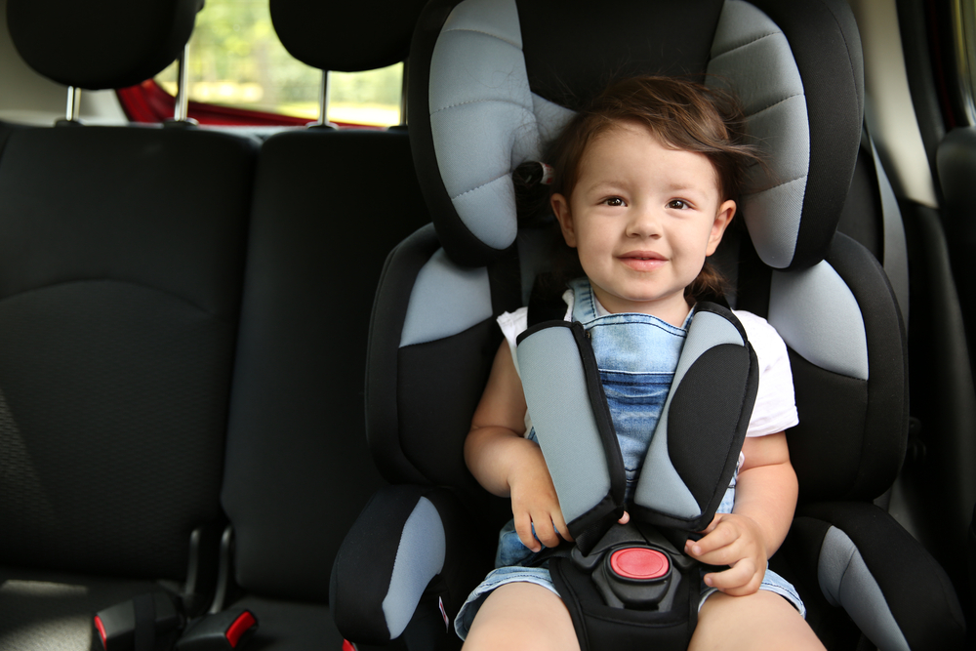
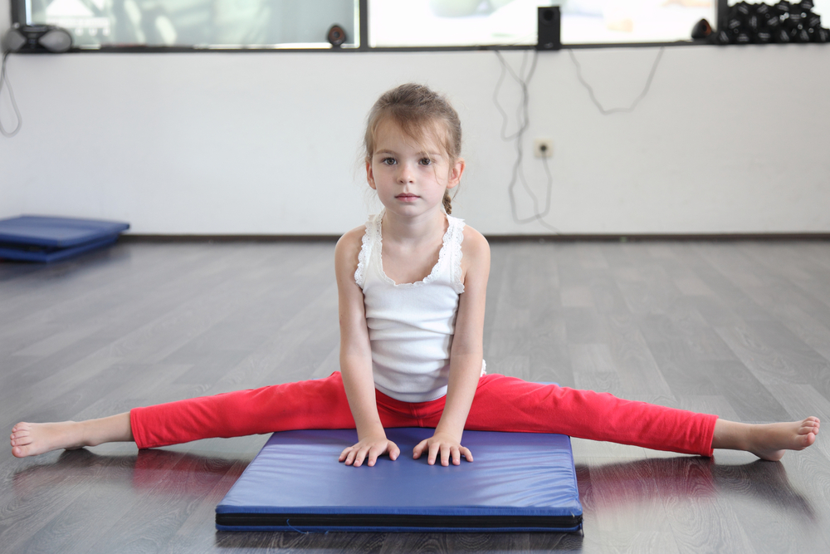

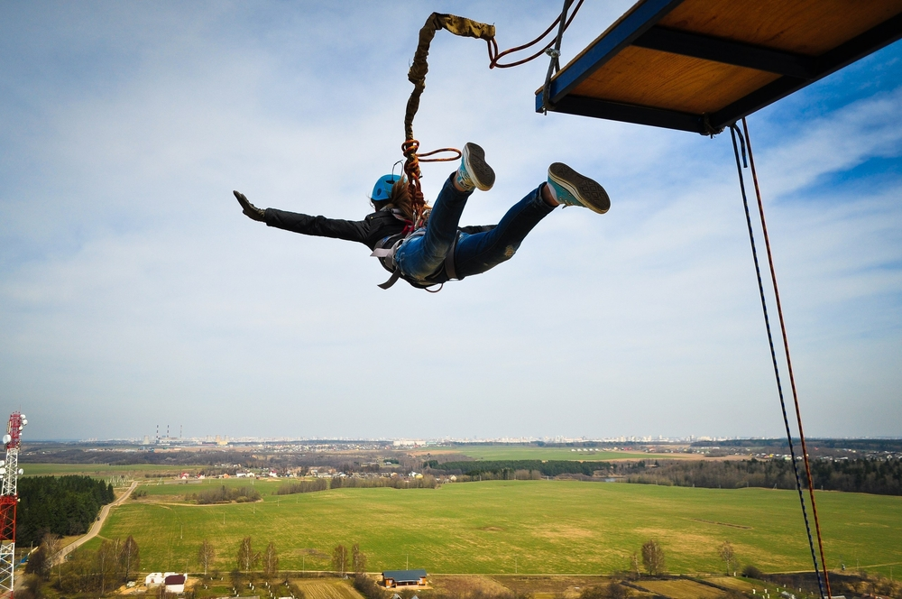
Help save Humpty!
Notes:
Teachers’ notes:
Q. How could we stop Humpty from breaking?
To get pupils up and moving, they could act out or freeze frame what would have happened to Humpty if he had one of the items shown in the pictures above to protect him.
Q. How would the story change if Humpty had had one of the things shown above?
For example, Humpty wouldn’t have broken if he were wearing a parachute
Q. What are the problems with each? For instance if Humpty wants to sit on different walls he won’t want to carry a crash mat with him. How would he attach his parachute to himself? What would he attach his bungee jumping cord to? If he wore a helmet on his head, how would this protect the rest of him?

Slide 11
Learning aim: Can I choose the best materials to protect Humpty?
Success criteria:
Recognise the properties of different materials.
Explain my choices of material by describing their properties.
Make a conclusion about which properties a material needs to protect a falling egg.
Notes:
Teachers’ notes:
Note that the success criteria above get progressively more difficult.

Slide 12
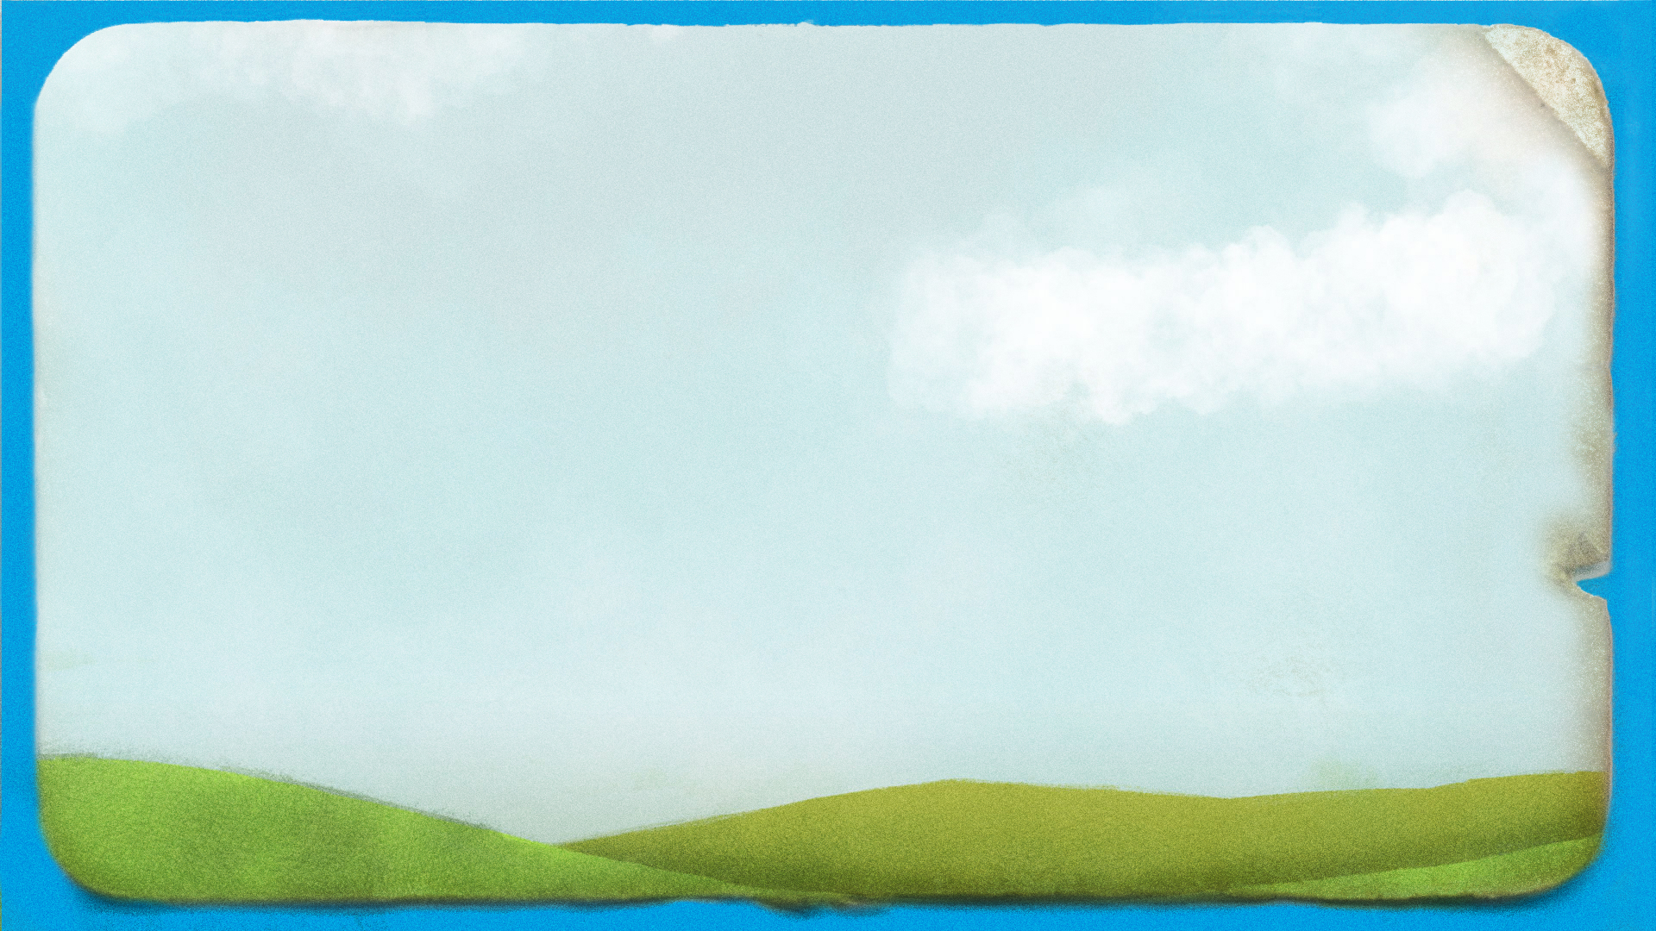

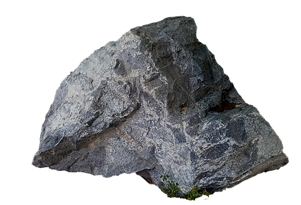
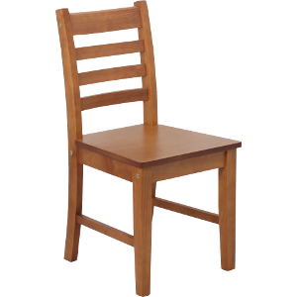
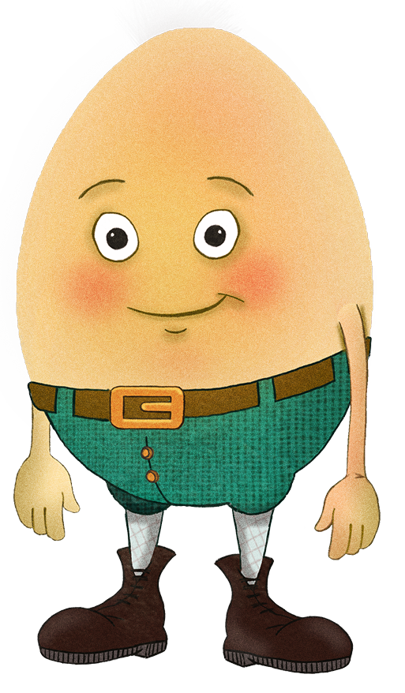
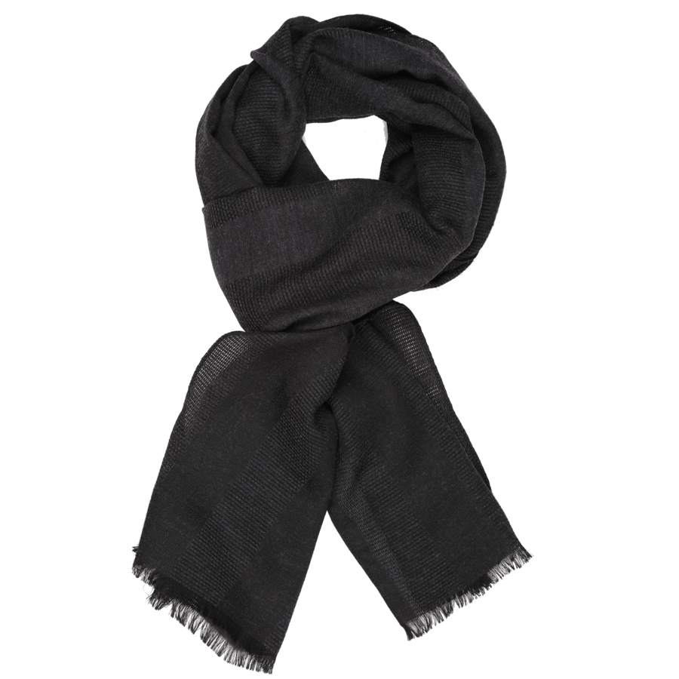
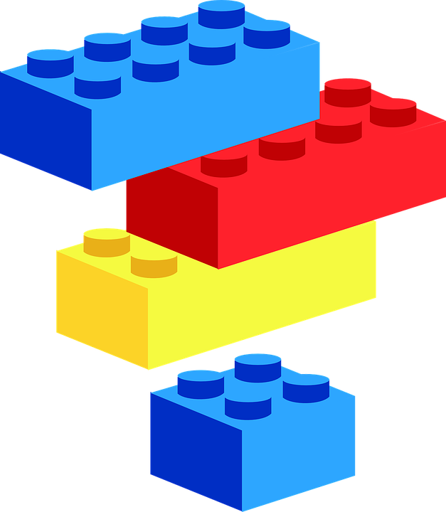
flexible
inflexible
waterproof
hard
smooth
rough
soft
transparent
Notes:
Teachers’ notes:
Q. What objects can you see around Humpty?
- Chair
- Toy building bricks
- Scarf
- Magnifying glass
- Rock
Explain that a material is what an object is made from.
Q. What material is each object made from?
- Wooden chair
- Plastic toy building bricks
- Cotton/fabric/wool scarf
- Glass magnifying glass.
- The rock is made from rock! Rock is different because it is natural rather than manmade.
Q. What other materials can you see around you?
Answers might include brick, leather, stone, paper.
Q. Now, look at these describing words on the board. Can you spot something in the picture that we could describe with each word?
NB: Remind pupils that flexible means bendy and inflexible means not bendy, and that transparent means see through!
Answers might include that:
wood is hard and inflexible (and smooth when made into a chair)
plastic is smooth and waterproof
cotton/fabric/wool is flexible and soft
glass is transparent, waterproof, hard and smooth
rock is hard, waterproof, inflexible and rough.
Explain that the describing words that they have chosen for each material are its properties. We can use our senses – touch and sight – to find the properties of each material.
Q. Could you make the objects out of other materials? Would cotton make a good window? Would wood make a good piece of jewellery? Not always – cotton isn’t hard, so it wouldn’t make a good chair. Rock is rough, so it wouldn’t make a comfortable scarf.
Q. Feel your school jumper – what are its properties? It is soft, flexible/bendy, and dull not shiny.
Explain that to help Humpty, they will need to know about the properties of materials.

Slide 13
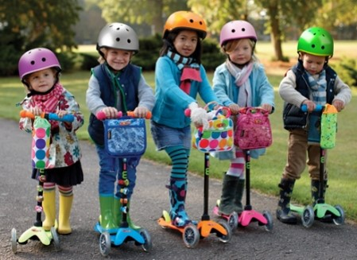

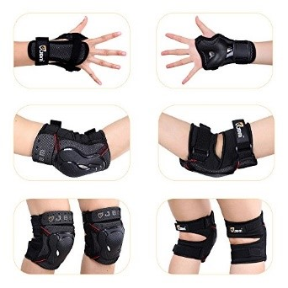

Protective clothing
Notes:
Teachers’ notes:
Q. Have you ever worn clothing like this to protect yourself?
Allow pupils time to share their experiences with one another.
Q. Which materials do you think they use?
- Helmets and knee pads use hard plastic.
- Sun hats use flexible, breathable fabric
- Sunglasses use dark plastic or glass that is translucent/see through and dark
- Raincoats and wellies use flexible, waterproof fabric.
Q. Why do you think we wear protective clothing on these parts of our bodies and not others?
- Helmets protect our heads, as brain injuries can be very serious.
- Knee and elbow pads are useful as these parts of us stick out, so they’re more likely to get scraped.
- Sun hats protect the backs of our necks from the sun so our skin doesn’t get burnt. We can get sunstroke if our heads get too hot.
- Sunglasses protect our eyes, as they can get damaged by bright light.
- Raincoats and wellies protect most of us, but not our faces, as we need to be able to see and breathe easily, and not hands, as it is useful to have them free to do things.

Slide 14
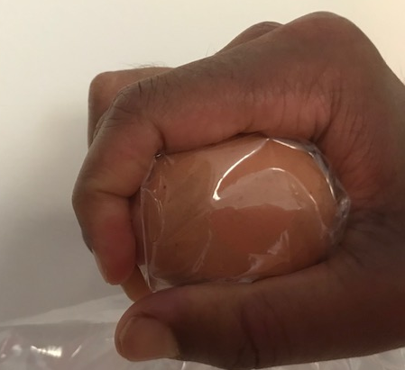
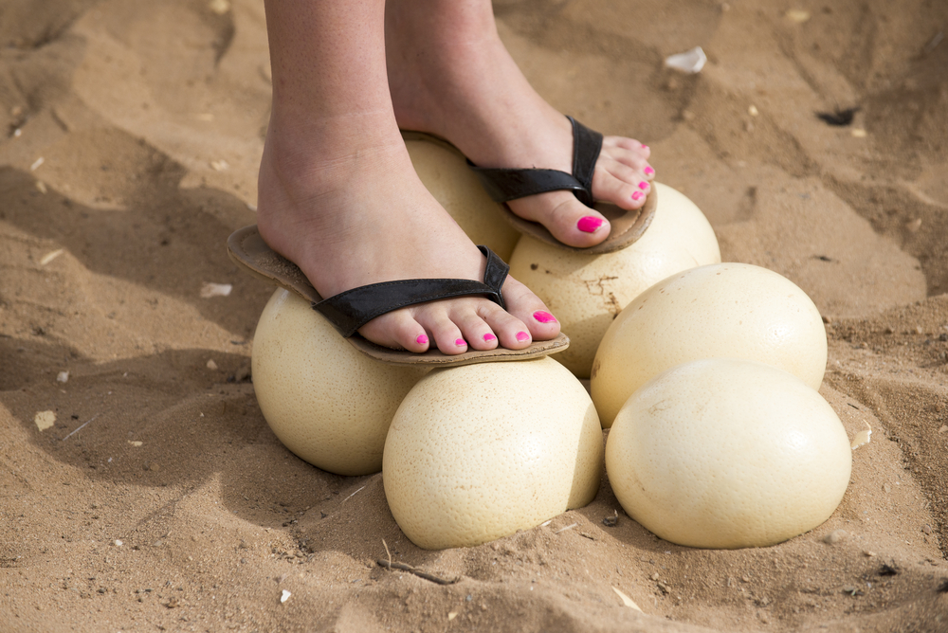
Is Humpty strong?
Notes:
Teachers’ notes:
Q. Are eggs like Humpty strong?
Pupils may say no, as he breaks when he falls. But actually eggs are stronger than you’d think – they are designed for birds to sit on them after all!
Q. What will happen to this egg if I squeeze it hard in my palm?
Pupils share their ideas.
Demonstration
Seal an egg in a plastic sandwich bag. Demonstrate squeezing it with the palm of your hand (or get a pupil to demonstrate this). Just make sure you apply pressure to the entire egg. Explain that it is difficult to break an egg by squeezing it in this way!

Slide 15
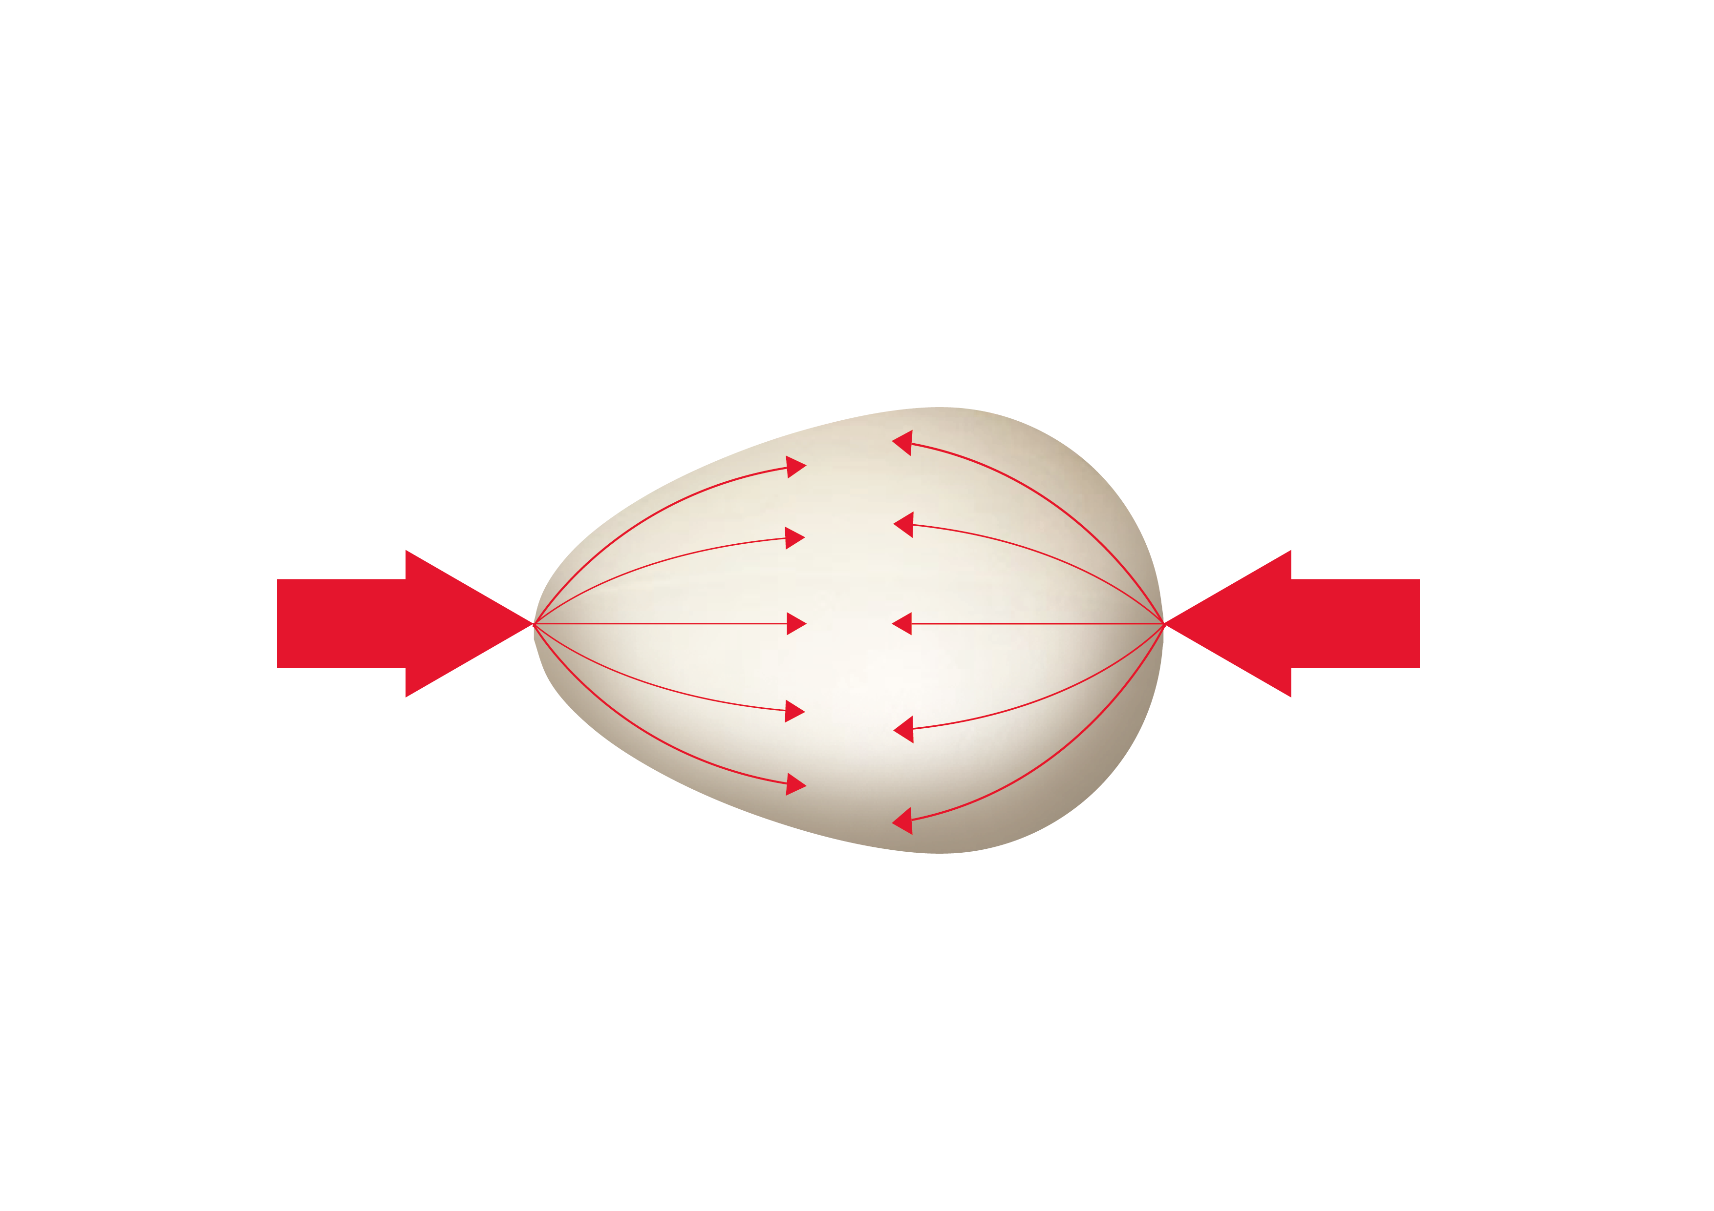

A strong shape
Notes:
Teachers’ notes:
Q. Why didn’t the egg break?
Eggs have a strong shape – they need to have this special strong shape because mother birds sit on them to keep them warm! Even if you stand on a box of eggs, they won’t break!
Arches have a similar shape – you can put a lot of weight on top of them, but it all spreads out evenly along the arch and the arch does not collapse.
Q. Why does Humpty break when he falls off the wall then?
If the weight is spread out across the whole egg shell it won’t break. However if there’s lots of weight or force on one bit of the egg, then it can break easily.
Demonstration
Seal an egg in a plastic sandwich bag. If you drop it from a height of at least 1 metre, it will usually break – a little bit of the egg hits the ground really hard.

Slide 16
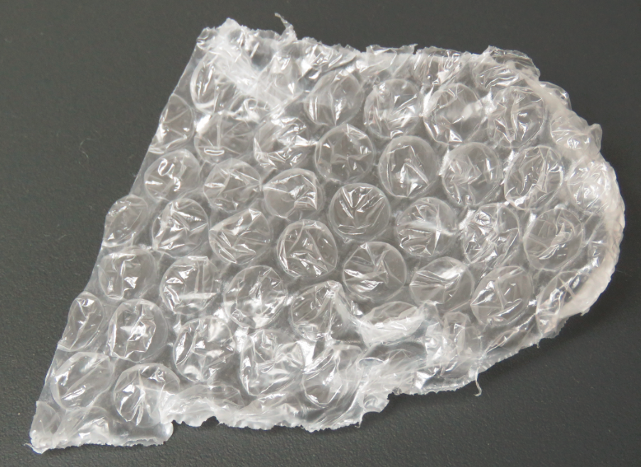
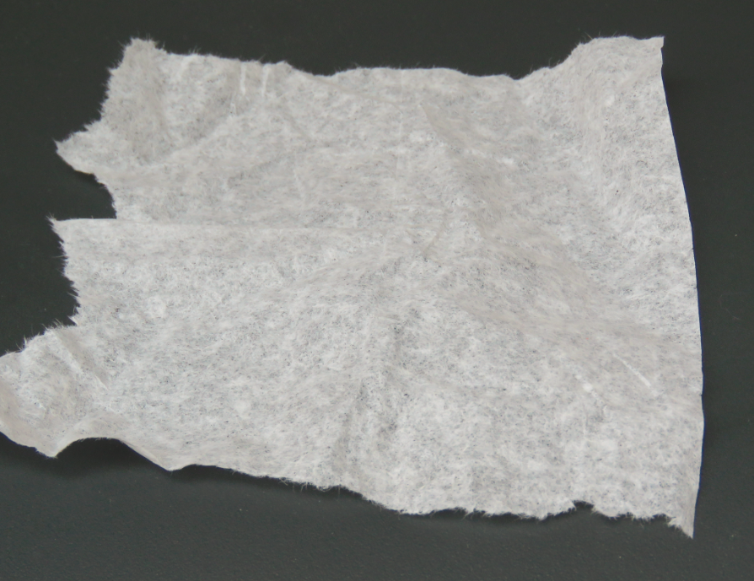
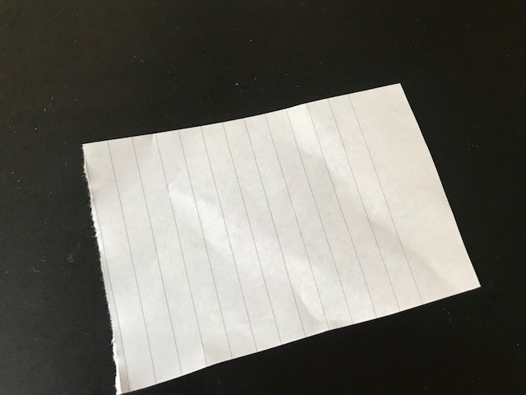
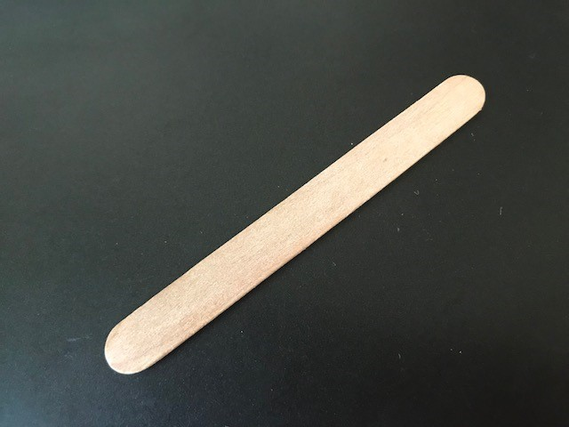
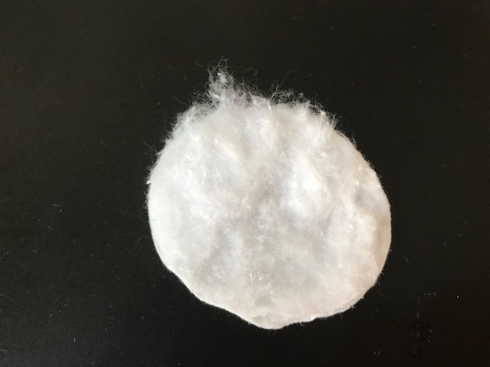
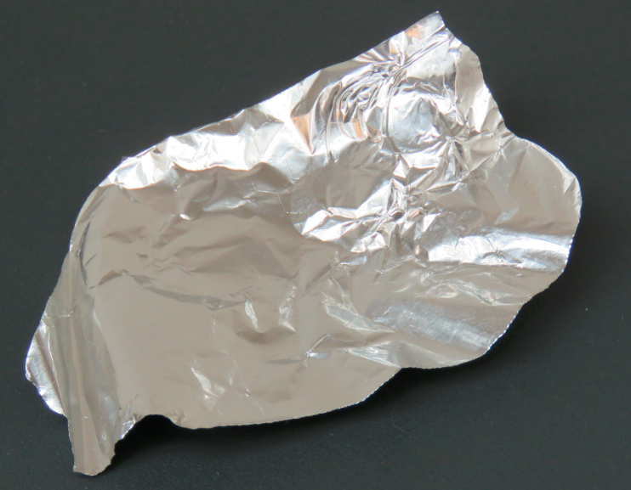
Which material will protect Humpty best?
Notes:
Teachers’ notes:
Q. Which material do you predict will protect Humpty best when he falls?
Pupils share their ideas.
Extension Q: How could pupils change the materials to make them work better?
Answers might include screwing up tissue paper or silver foil to make it thicker instead of using thin layers, or sticking the lolly sticks into a different shape.

Slide 17
Prediction
I predict that the ----- will protect Humpty best, because it is -----, ----- and -----.
Materials
Properties
tissue paper
cotton wool
bubble wrap
wooden lolly stick
paper
silver
soft
thick
smooth
hard
rough
flexible
inflexible
waterproof
transparent
thin
Notes:
Teachers’ notes:
Q. Why do you think that material will help protect Humpty from his fall?
Encourage pupils to describe the properties of their chosen material in their answer e.g. I predict the bubble wrap will be best because it is soft, thick and smooth.
Pupils can write a sentence explaining their prediction.

Slide 18
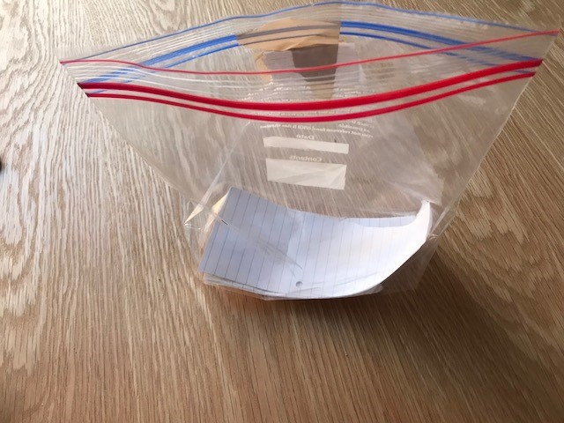
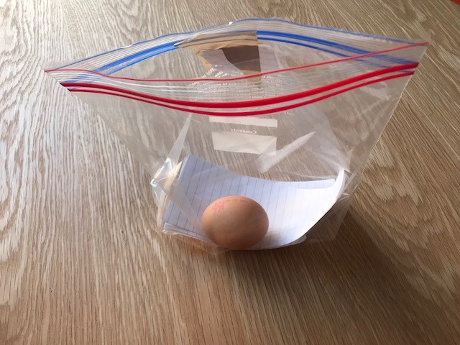
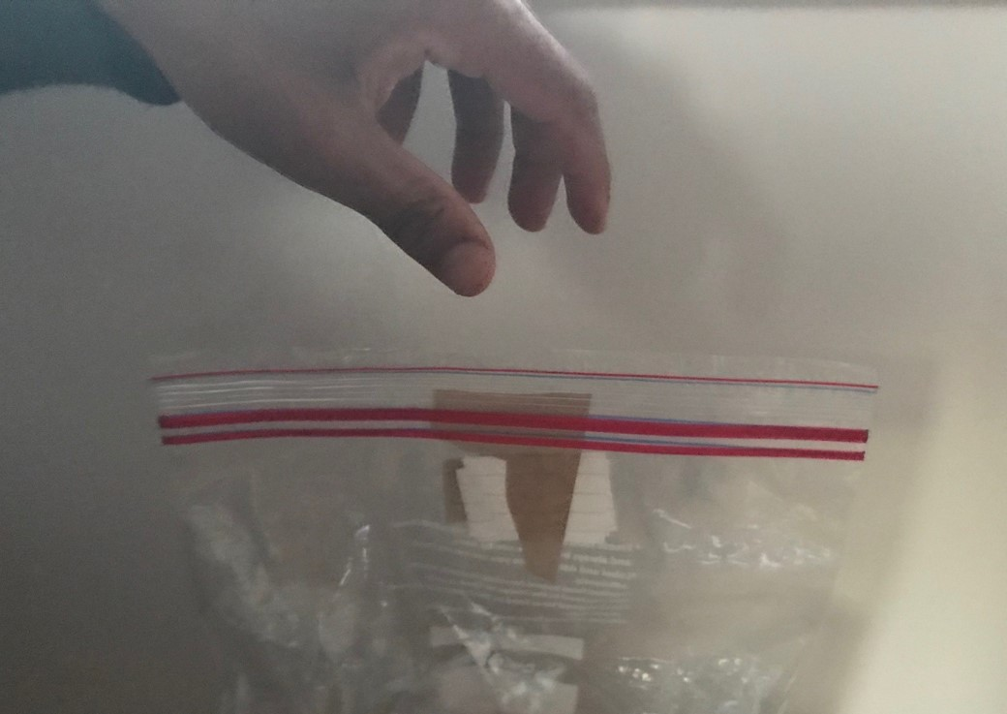
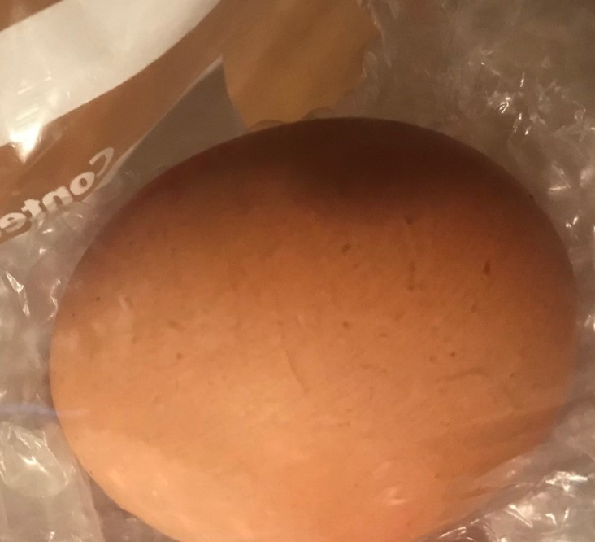
Method
1
2
3
4
Notes:
Teachers’ notes:
Explain that to avoid wasting eggs (or hurting Humpty!) we are going to use practice eggs before we use a real one (see slide 4 for practice egg options).
Demonstration
Show pupils what will happen to their practice egg if it has no protection, by dropping it onto the floor. The practice egg will break apart.
Instructions:
Run through how to do an egg drop experiment, working in pairs:
1. Place four layers of the test material in the bottom of an open sandwich bag.
2. Put a practice egg in the bag.
3. Drop the bag.
4. Observe what has happened to the practice egg.
Q. What will need to stay the same to make sure our test is fair?
Explain to pupils that before we start our test, we need to make sure it is ‘fair’.
A fair test means we only change one thing – the material we use!
Answers on next slide.

Slide 19
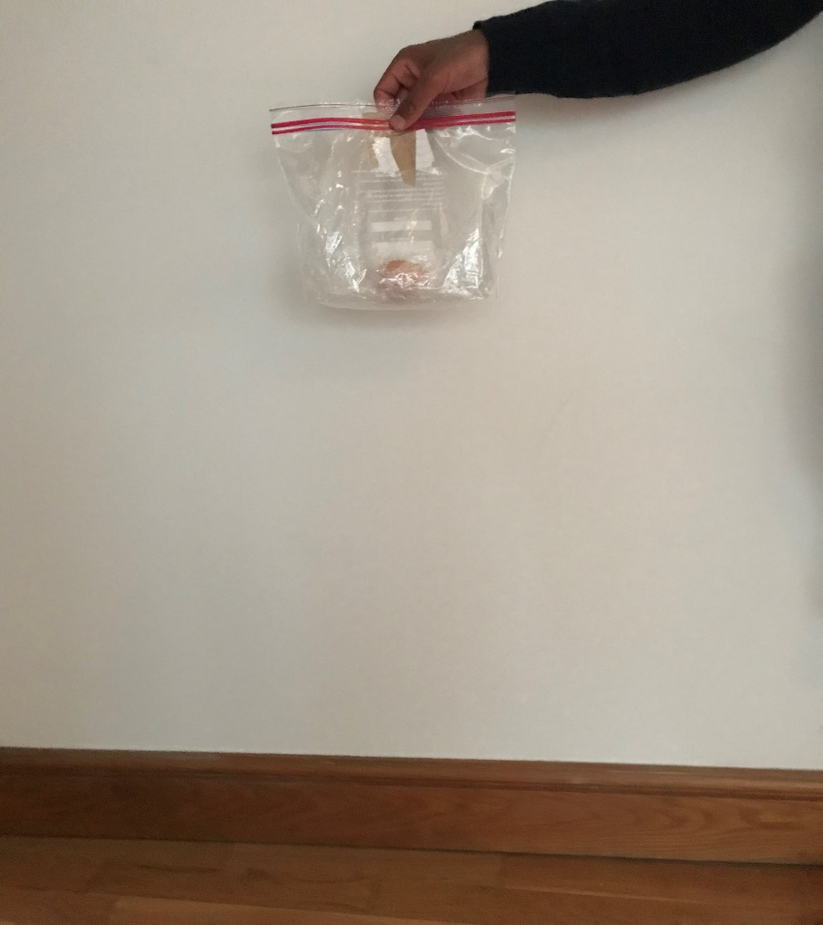
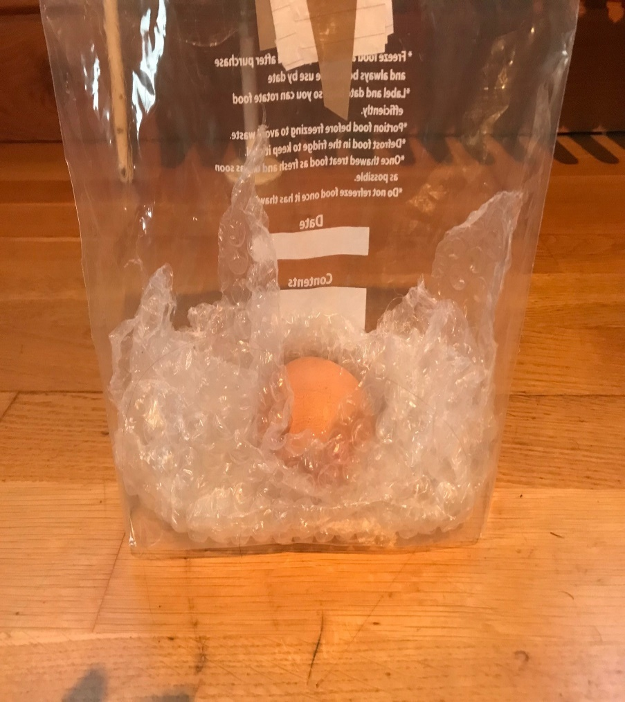
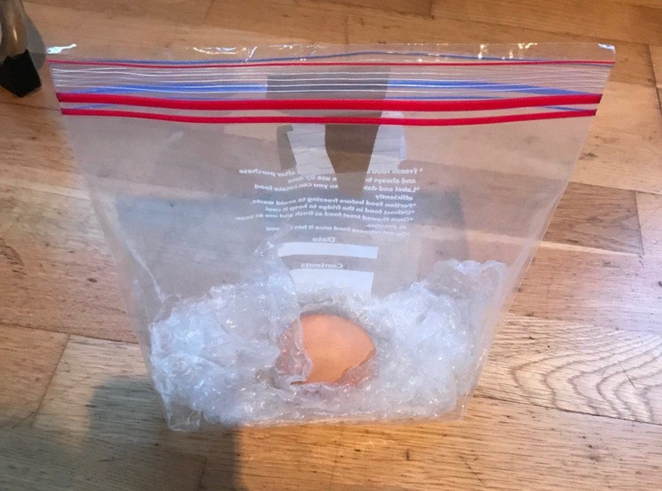
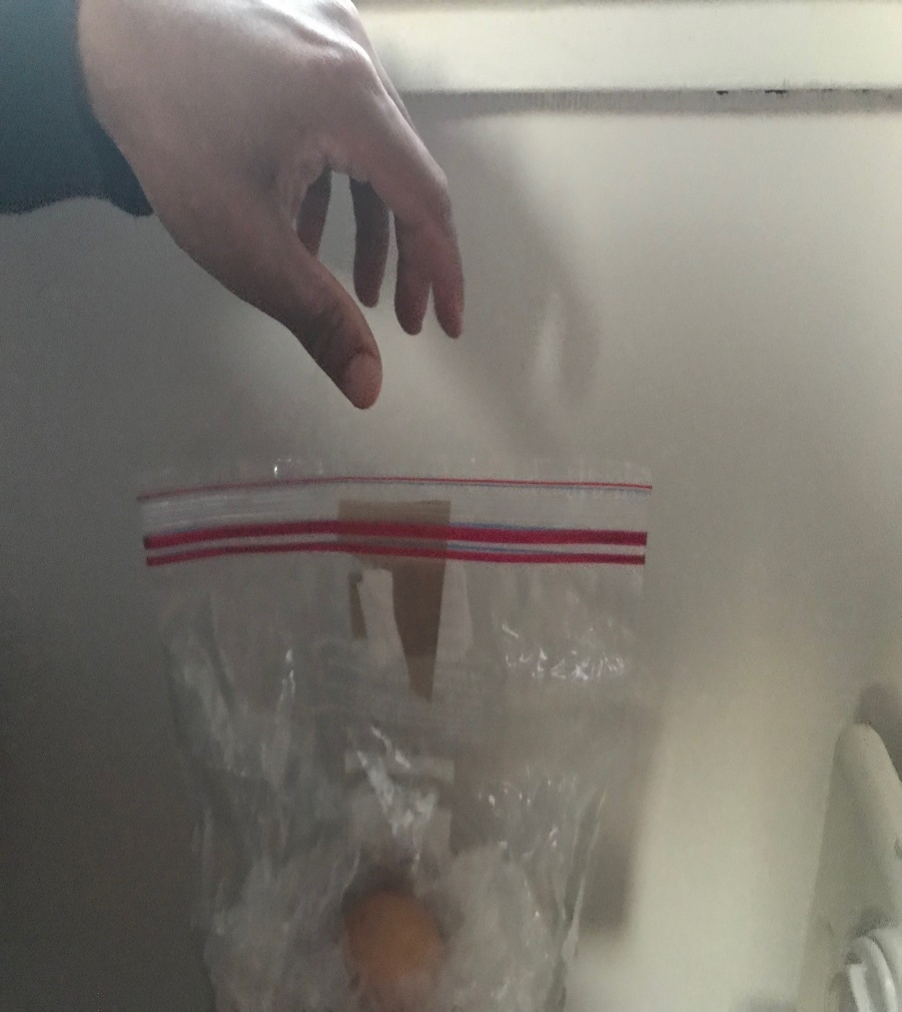
Fair test
Drop the bag from the same height
Make sure you use the same amount of materials
Check your egg is facing the same way
Use the same force on each drop
Notes:
Teachers’ notes:
Q. How can you make a fair test?
Take answers from pupils and then run through the points on the board.
Practical experiment – practice eggs
Allow pupils time to complete the experiment for each different material they are testing using the practice egg.
Practical experiment – real eggs
Once they have made a decision about the best material, they will use this material with a real egg.
Explain to pupils that Humpty Dumpty (the real egg) is more delicate than our practice egg, so we are going to need to help him by using more of our chosen material and dropping him from a lower height.
1. Pupils should fill a sandwich bag halfway with their chosen material.
2. Place a real egg on the topmost layer (they may want to draw Humpty’s smiling face on before the drop).
3. This time, make sure they seal the sandwich bag and drop the egg from a slightly lower height that with the practice egg (less than 1 metre).
Q. What happens to their egg? Did they choose the right material?
Pupils share their findings.
SAFETY: Make sure that pupils don’t touch any raw egg if it spills out of their bag. If they do come into contact with raw egg, make sure that they wash their hands immediately.

Slide 20
Which materials protected Humpty?
Notes:
Teachers’ notes:
Q. Can you list the materials you used?
Pupils share their findings.
Q. Which of them were good for protection?
Pupils share their findings. The softer, thicker materials will have worked best.
Q. Were their predictions correct?
Pupils share their findings.

Slide 21
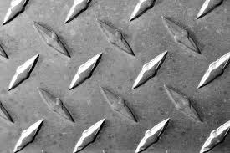
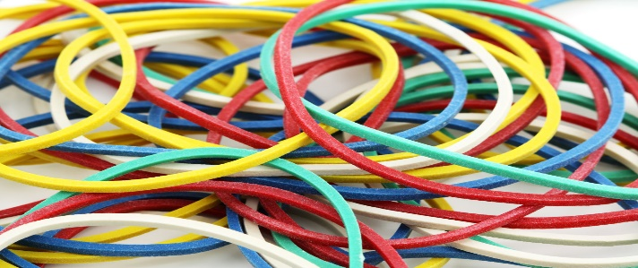
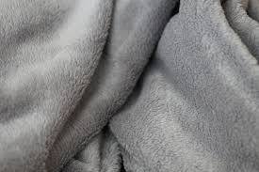
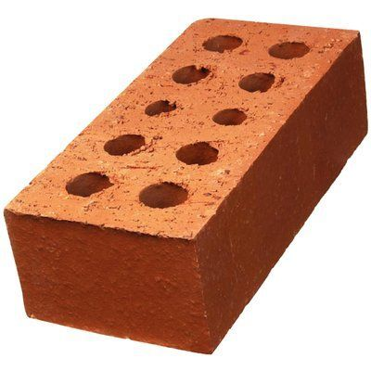
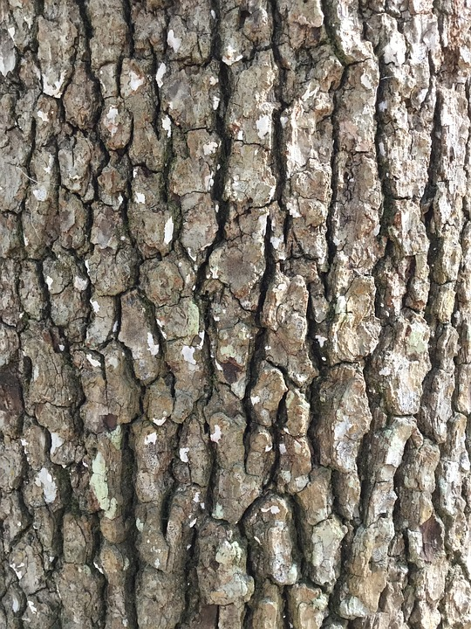
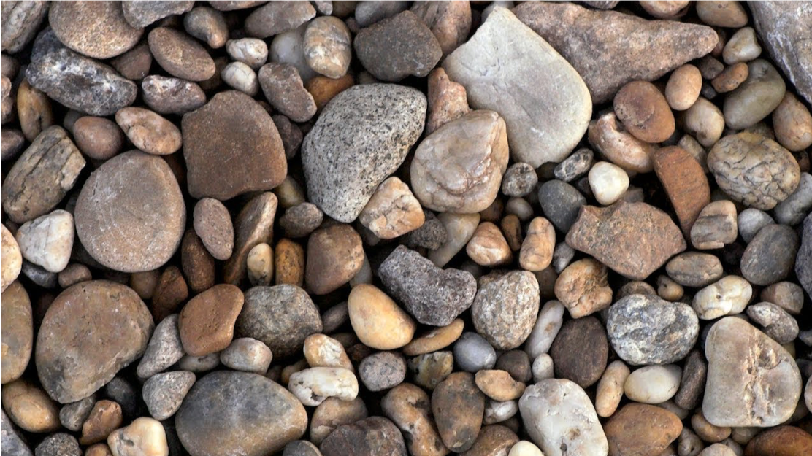
Can you explain why these materials worked best?
hard
flexible
soft
inflexible
thick
rough
thin
smooth
Notes:
Teachers’ notes:
Encourage pupils to discuss why they think certain materials gave the best protection – prompting them to use the key words of the board to describe its properties.
For example, you might ask:
Q. Which of these words could we use to describe that material?
Q. Do you think flexible or inflexible / hard or smooth / thick or thin / rough or smooth materials give better protection?

Slide 22
Reply to Humpty
Draw your idea
Dear Humpty Dumpty,
-------------------------------------------------------------------------------------------------------------------------------------------------------------------------------------------------------------------------------------------
Word bank smooth
flexible hard
inflexible
soft
rough thick
thin
Notes:
Teachers’ notes:
You may wish to print this slide for pupils. Pupils can draw their chosen protective material and write a sentence to explain which material they chose and why.

Slide 23
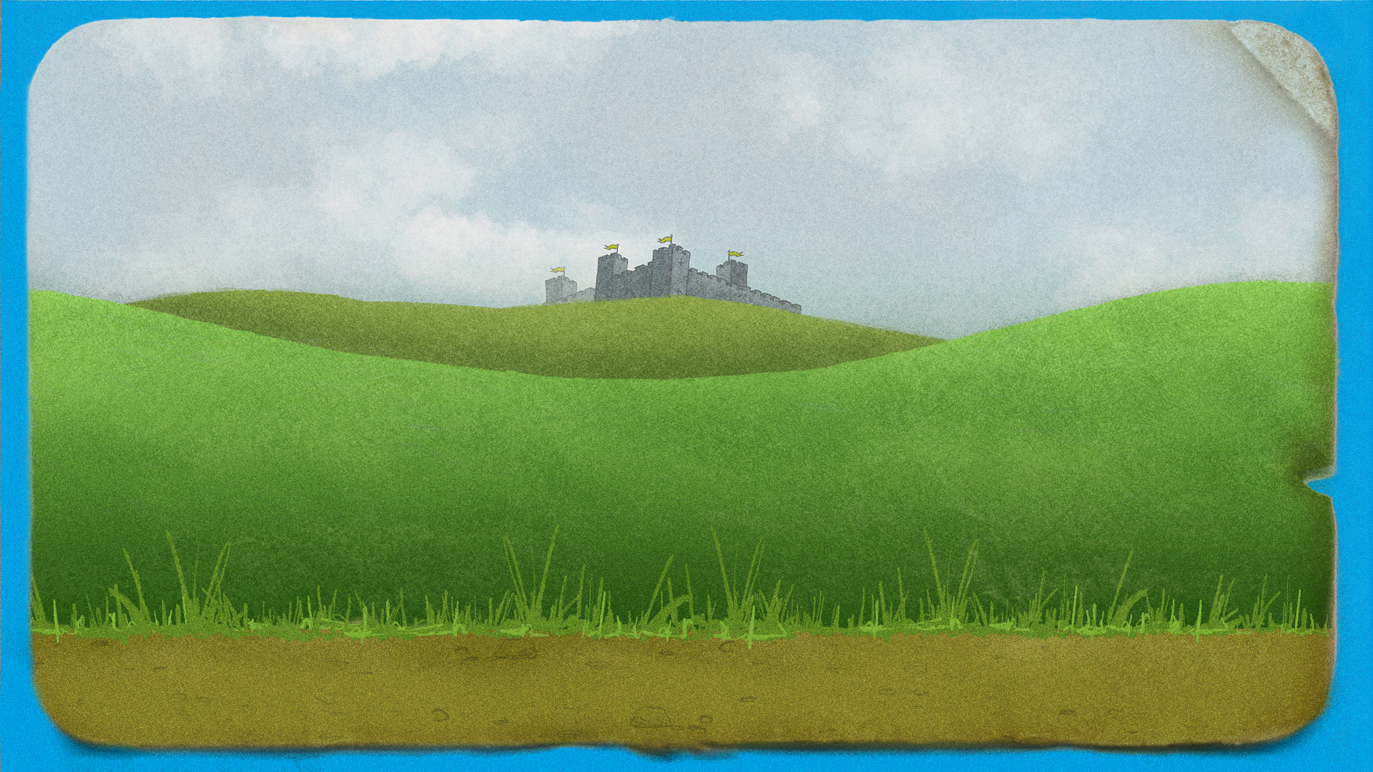
Finishing thinker!
Which material could they be offering to make a suit for Humpty?
I have a smooth, soft material
I have a hard, inflexible material
Notes:
Teachers’ notes:
Q. Which material could each of the King’s men be offering to make a suit for Humpty?
There will be a number of correct answers. A hard inflexible material could be glass, metal, wood or hard plastic. A smooth, soft material could be fabric, foam, bubble wrap or a duvet.
Q. Which of the king’s men has the best material to protect Humpty? Why?
Again, there is more than one correct answer, but a smooth soft material would be more flexible, so would probably work better for a suit, and be better at absorbing the impact.

Slide 24
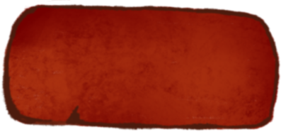
Finishing thinker!
Metal
is
?
and
?
rough
dull
soft
shiny
hard
Notes:
Teachers’ notes:
Q. Which bricks make the sentence correct?
The answers could be shiny and hard.
Q. What other words, not on the board, could complete our sentence?
e.g. opaque, waterproof, inflexible.

Slide 25
Finishing thinker!
?
is
smooth
and
flexible.
glass
plastic
cotton
fabric
wood
Notes:
Teachers’ notes:
Q. Which brick makes the sentence correct?
Answers could be cotton, fabric or plastic.
Q. What other words, not on the board, could complete our sentence?
Answers could include paper or rubber.

Slide 26
Extension ideas
Notes:
Teachers’ notes:
The following 3 slides contain possible extension activities to be used with pupils in the classroom or in a STEM club.

Slide 27
Can you make Humpty bounce?
Notes:
Teachers’ notes:
By soaking eggs in vinegar for a couple of days, pupils will be able to remove the eggs’ brittle shells. However, the membrane will remain. This membrane will keep the egg together and make it so that it ‘bounces’ when dropped from a low height. At what height can these shell-less eggs be dropped from without breaking?
Equipment
Eggs
Vinegar
Bowls
Height chart
Measuring stick
Cleaning materials (at least some eggs will break).
Time
2 days to soak the eggs, 45-60 mins to do the activity.
Curriculum link (England)
Science – Everyday materials
- Find out how the shapes of solid objects made from some materials can be changed.

Slide 28
Build a wall
Can you build the tallest wall possible for me to sit on?
Notes:
Teachers’ notes:
Build the tallest wall possible for Humpty to sit on.
See the BP Educational Service Design a tower activity: bpes.bp.com/design-a-tower-activity

Slide 29
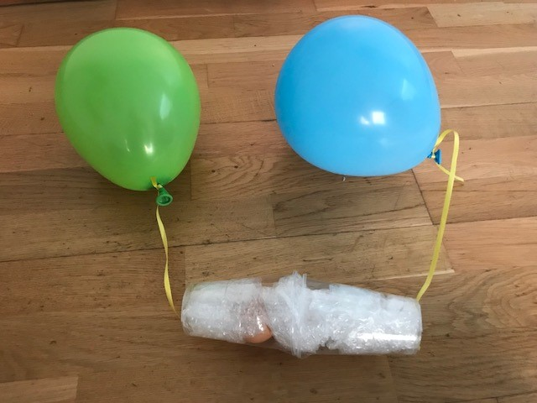
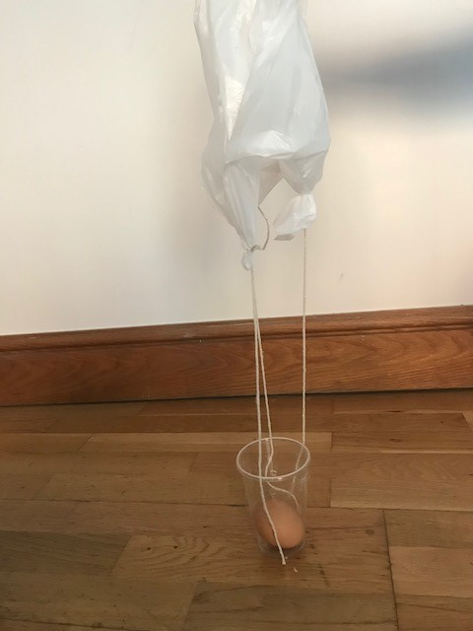
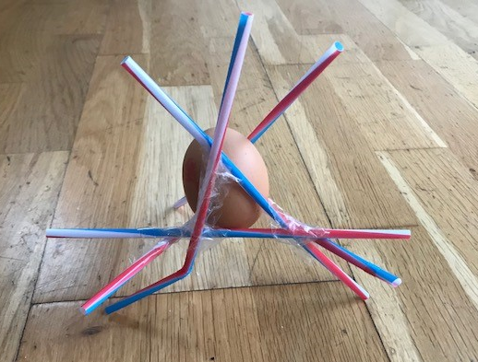
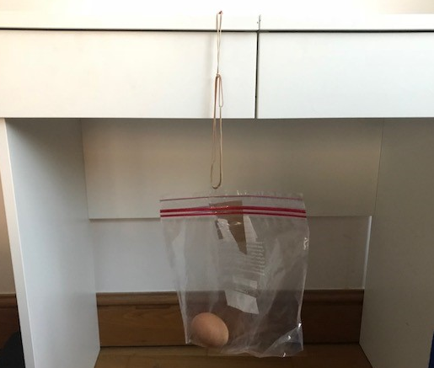
Protect Humpty!
Notes:
Teachers’ notes:
For a STEM club version of the activity:
Focus on a more broad approach to protecting Humpty using the ideas on this slide 10 for creative inspiration.
Which method will pupils choose to protect Humpty?
The photographs on this slide could also serve as a starting point for pupils. For example, they could use air resistance to create an egg parachute (top right) or use elastic materials like tights of elastic bands to create a bungee jump (bottom right).
Pupils could compete to see whose egg best survives the drop with their chosen method of protection.
Tips
‘Test’ eggs can be used prior to the actual egg drop – options for ‘test’ eggs can be found on slide 4.

