Slide 1
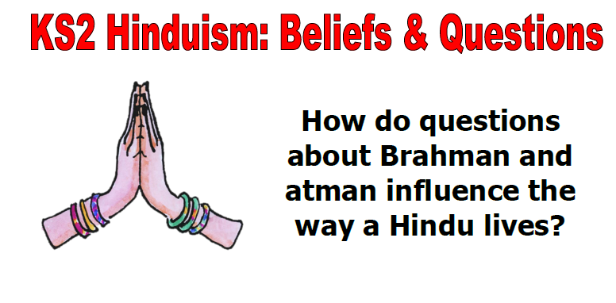
EXPLORE different ideas about Brahman / Atman in Hindu Narrative

Slide 2
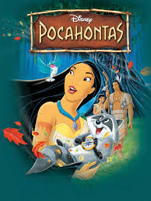
What ideas underlie the song ‘Colours of the Wind’ from ‘Pocahontas’?
Click HERE to watch the song.
Using the lyrics on the next slide, answer the questions at the bottom. You might need to watch the video again.

Slide 3
‘Colours of the Wind’ lyrics
You think I'm an ignorant savage
And you've been so many places
I guess it must be so
But still I cannot see
If the savage one is me
How can there be so much that you don't know
You don't know
You think you own whatever land you land on
The Earth is just a dead thing you can claim
But I know every rock and tree and creature
Has a life, has a spirit, has a name
You think the only people who are people
Are the people who look and think like you
But if you walk the footsteps of a stranger
You'll learn things you never knew, you never knew
Have you ever heard the wolf cry to the blue corn moon
Or asked the grinning bobcat why he grinned
Can you sing with all the voices of the mountains
Can you paint with all the colours of the wind
Can you paint with all the colours of the wind
Come run the hidden pine trails of the forest
Come taste the sun sweet berries of the Earth
Come roll in all the riches all around you
And for once, never wonder what they're worth
The rainstorm and the river are my brothers
The heron and the otter are my friends
And we are all connected to each other
In a circle, in a hoop that never ends
How high will the sycamore grow
If you cut it down, then you'll never know
And you'll never hear the wolf cry to the blue corn moon
For whether we are white or copper skinned
We need to sing with all the voices of the mountains
We need to paint with all the colours of the wind
You can own the Earth and still
All you'll own is Earth until
You can paint with all the colours of the wind
Which lessons is Pocahontas trying to teach John Smith?
Why is Pocahontas trying to show John Smith these ideas?

Slide 4
Which lessons is Pocahontas trying to teach John Smith?
There is life in everything
All things are connected
The world isn’t just about humans
We must care about the world
All creatures are important
Why is Pocahontas trying to show John Smith these ideas?
Pocahontas wants to teach him about the wonders of the earth and nature, including the spirit within all living things, encouraging him not to think of them as things he can conquer or own, but rather as beings to respect and live with in harmony. She also urges him to accept humans who are different in appearance and culture and to learn from them.

Slide 5
What lessons do Hindu children learn about God from their scriptures?
The Upanishads, also Hindu scriptures, explore the idea that everything is connected to Brahman – the divine essence of everything, including humans.
The stories of Svetaketu are found in the Upanishads. Svetaketu had been away to be educated and when he came home, his father, a wise man, was horrified to see how conceited his son had become. Svetaketu thought he knew everything but when his father asked about the essence of everything, Brahman, Svetaketu could not answer.
His father called for a glass of water – read the first story on the next slide to find out what happens.
In another story, the father asks his son to cut open a fig – read the story about the fig on the next slide to find out what happens.
The final story involves a pot of honey – read the story on the next slide.

Slide 6
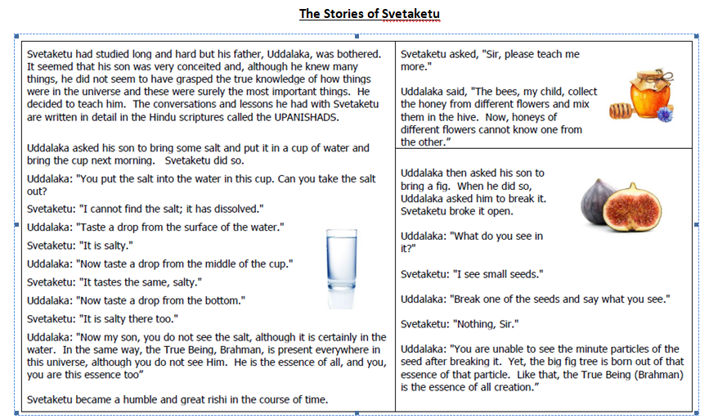
The Stories of Svetaketu

Slide 7

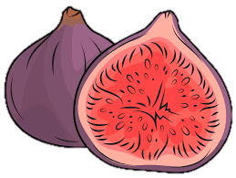

What do these stories teach us about Brahman?
When Svetaketu’s father had demonstrated how Brahman pervades everything (i.e. is in everything), he said “Tat tvam asi” which means ‘you are that too’. Svetaketu had to realise that Brahman is in him too – in fact, this is his real self (the atman).
When the fig is cut in half, Svetaketu sees nothing; his father says that from this nothingness a great tree has grown. That nothingness, the mystery that lies at the heart of all life is Brahman, the invisible reality pervading everything.
Many parts of creation combine to make honey – flowers, bees, humans – and its sweetness becomes part of us too. This reflects how all things are joined together as part of Brahman, the interlocking network of all life.

Slide 8
What does this text from a Hindu scripture make you think about?
Brahman (God)
I am the taste in the water
I am the radiance in the sun and moon
I am the sound in space
I am the strength in humanity
I am the sweet fragrance of the earth
I am the brilliance in the fire
I am the life in all beings
The text on the left is from the Bhagavad Gita and also describes God.
Do you like these ideas?
Do they have any similarity with the Pocahontas song?
Task: Write your own description of God using the structure above and metaphors. Each line begins: I am the… then you need to choose an abstract noun and then a concrete noun. For example: I am the love in every person’s heart
YOU WILL NEED TO UPLOAD A PHOTO OF YOUR DESCRIPTION TO TODAY’S DISCUSSION

Slide 9



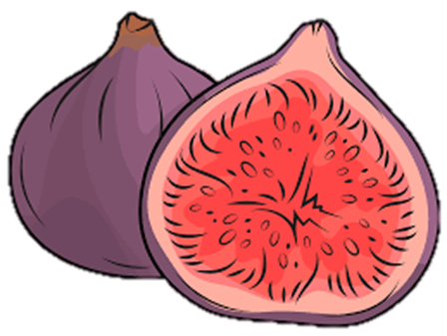
Would we see the world differently if God was in everything?
How do you think people might see the world differently if they thought God was in everything?
BRAHMAN
Consider:
How would you treat other people?
Would you eat meat?
Would you have a higher opinion of your friends and your parents?
What else might you do differently?

