Slide 1
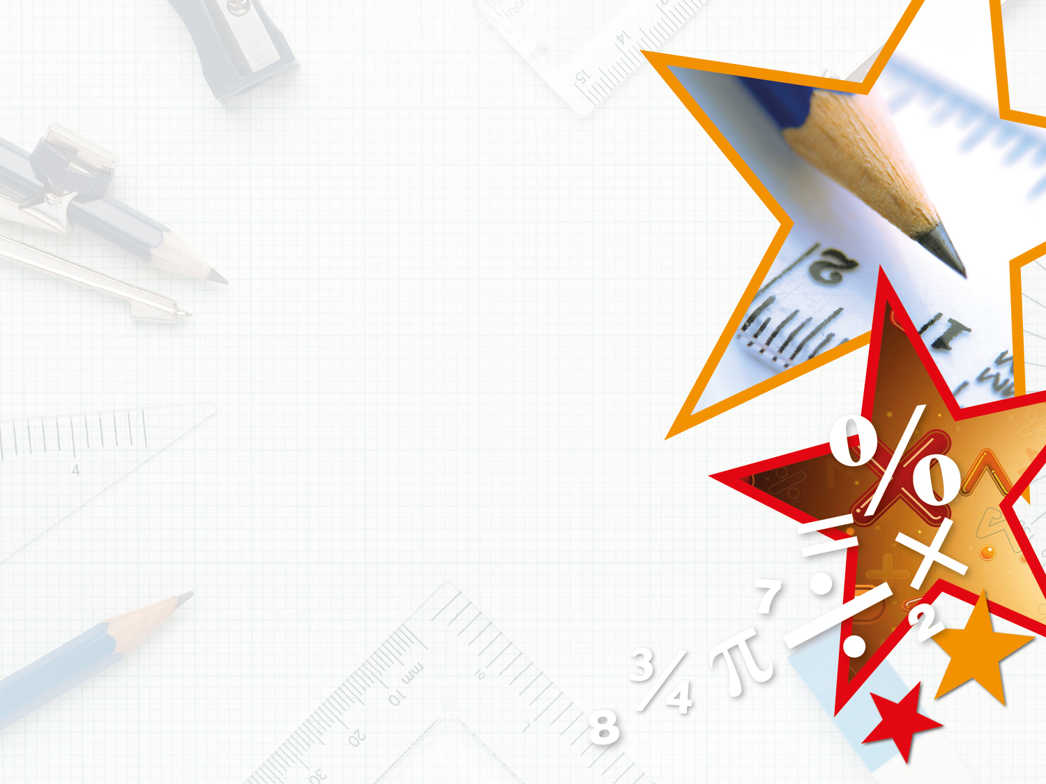
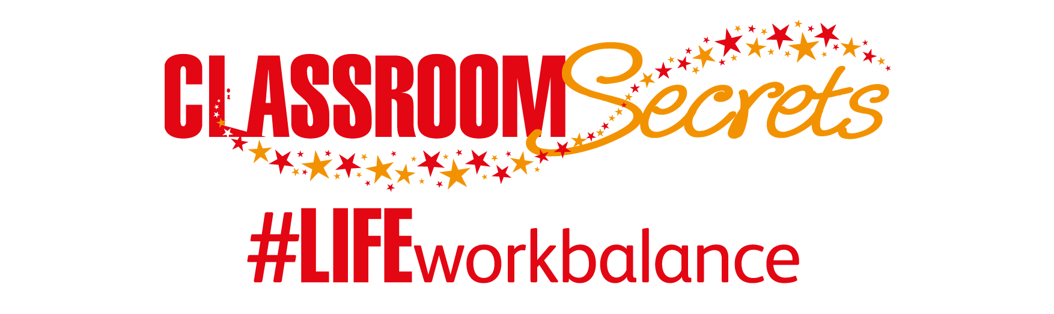

LIFE/work balance
We have started a #LIFEworkbalance campaign and we need your help to complete our LIFE/work balance survey.
We hope to publish the results soon, so please give 15 minutes of your time to help us get a true picture of school life.
Want to be a part of this campaign? Take the survey on our website and share it with your colleagues!
© Classroom Secrets Limited 2020

Slide 2
Year 1 – Spring Block 3 – Length and Height – Measure Length 1
About This Resource:
This PowerPoint has been designed to support your teaching of this small step. It includes a starter activity and an example of each question from the Varied Fluency and Reasoning and Problem Solving resources also provided in this pack. You can choose to work through all examples provided or a selection of them depending on the needs of your class.
National Curriculum Objectives:
Mathematics Year 1: (1M2) Measure and begin to record: lengths and heights
More Year 1 Length and Height resources.
Did you like this resource? Don’t forget to review it on our website.
© Classroom Secrets Limited 2019

Slide 3
Year 1 – Spring Block 3 – Length and Height
Step 2: Measure Length 1
© Classroom Secrets Limited 2019

Slide 4
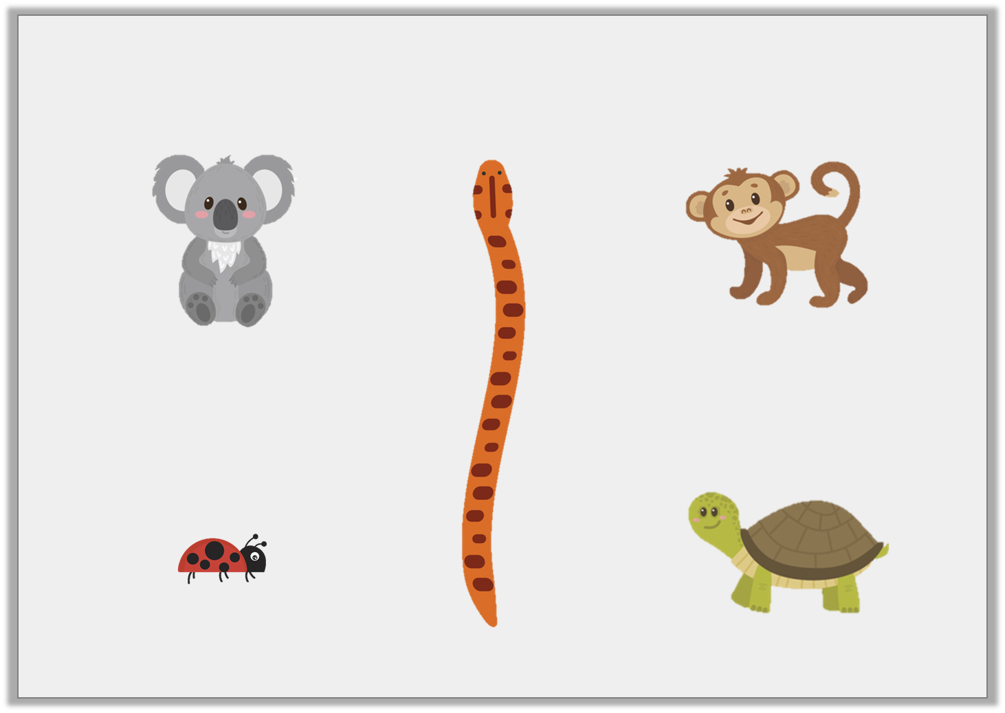
Introduction
Circle the shortest animal.
© Classroom Secrets Limited 2019

Slide 5
Introduction
Circle the shortest animal.
© Classroom Secrets Limited 2019

Slide 6
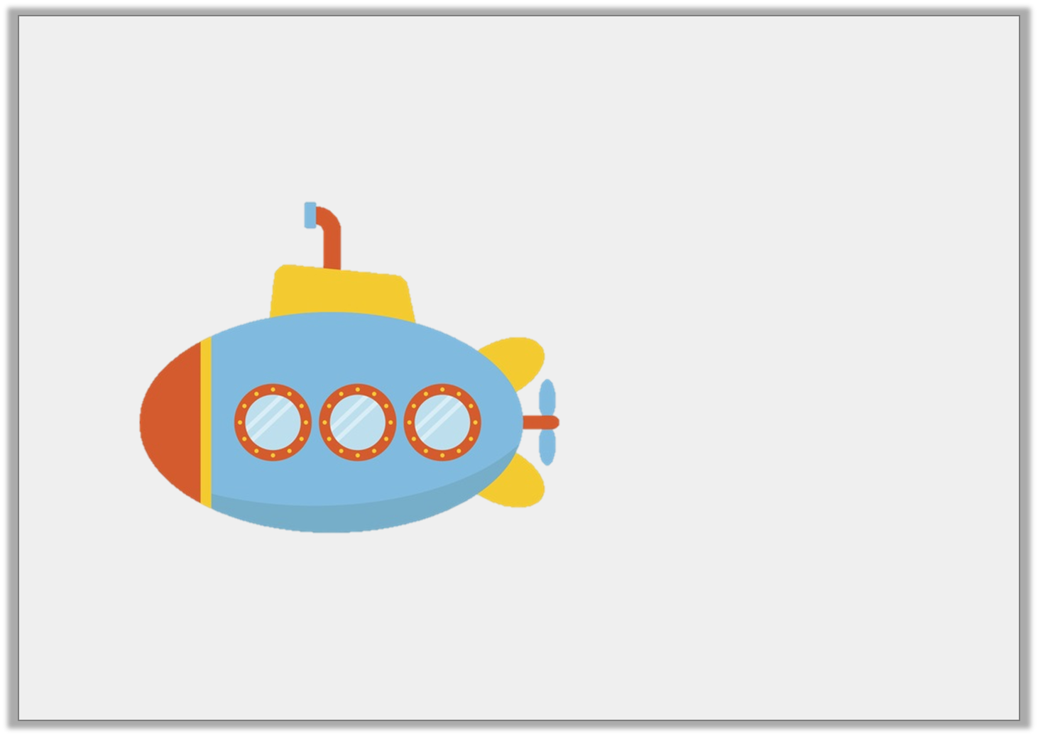
Varied Fluency 1
How many cubes long is the submarine?
© Classroom Secrets Limited 2019

Slide 7
Varied Fluency 1
How many cubes long is the submarine?
5
© Classroom Secrets Limited 2019

Slide 8
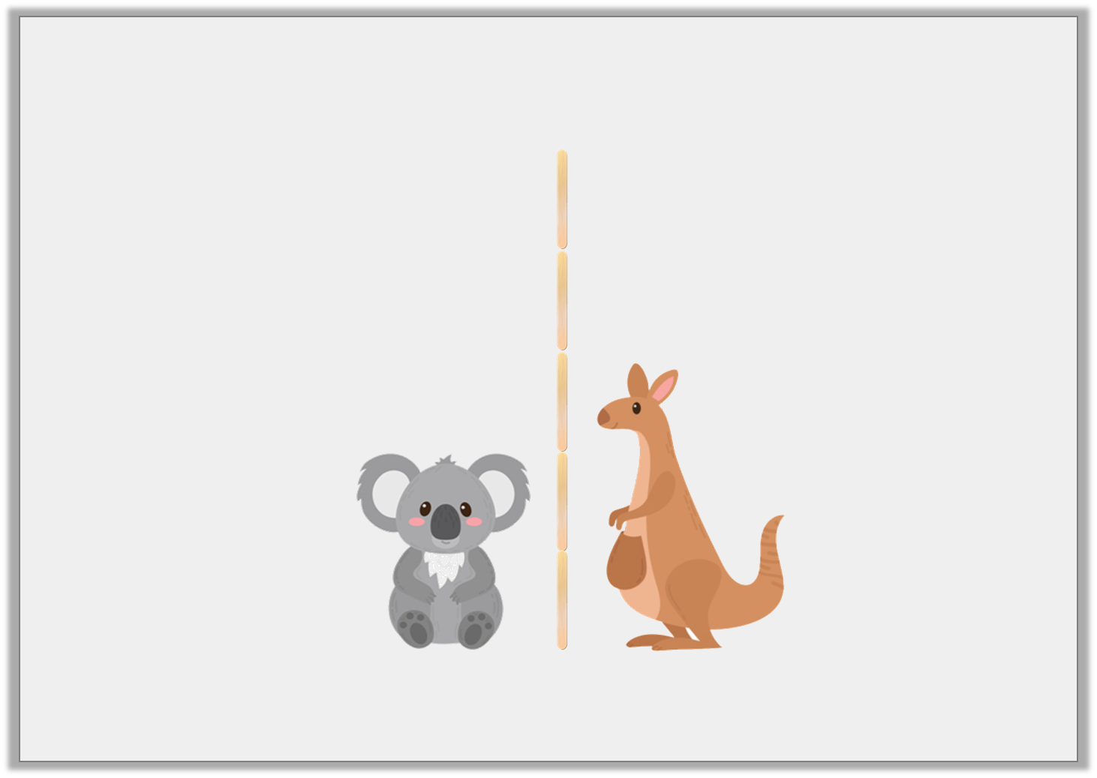
Varied Fluency 2
How many lolly sticks does the tallest animal measure?
© Classroom Secrets Limited 2019

Slide 9
Varied Fluency 2
How many lolly sticks does the tallest animal measure?
3 lolly sticks
© Classroom Secrets Limited 2019

Slide 10
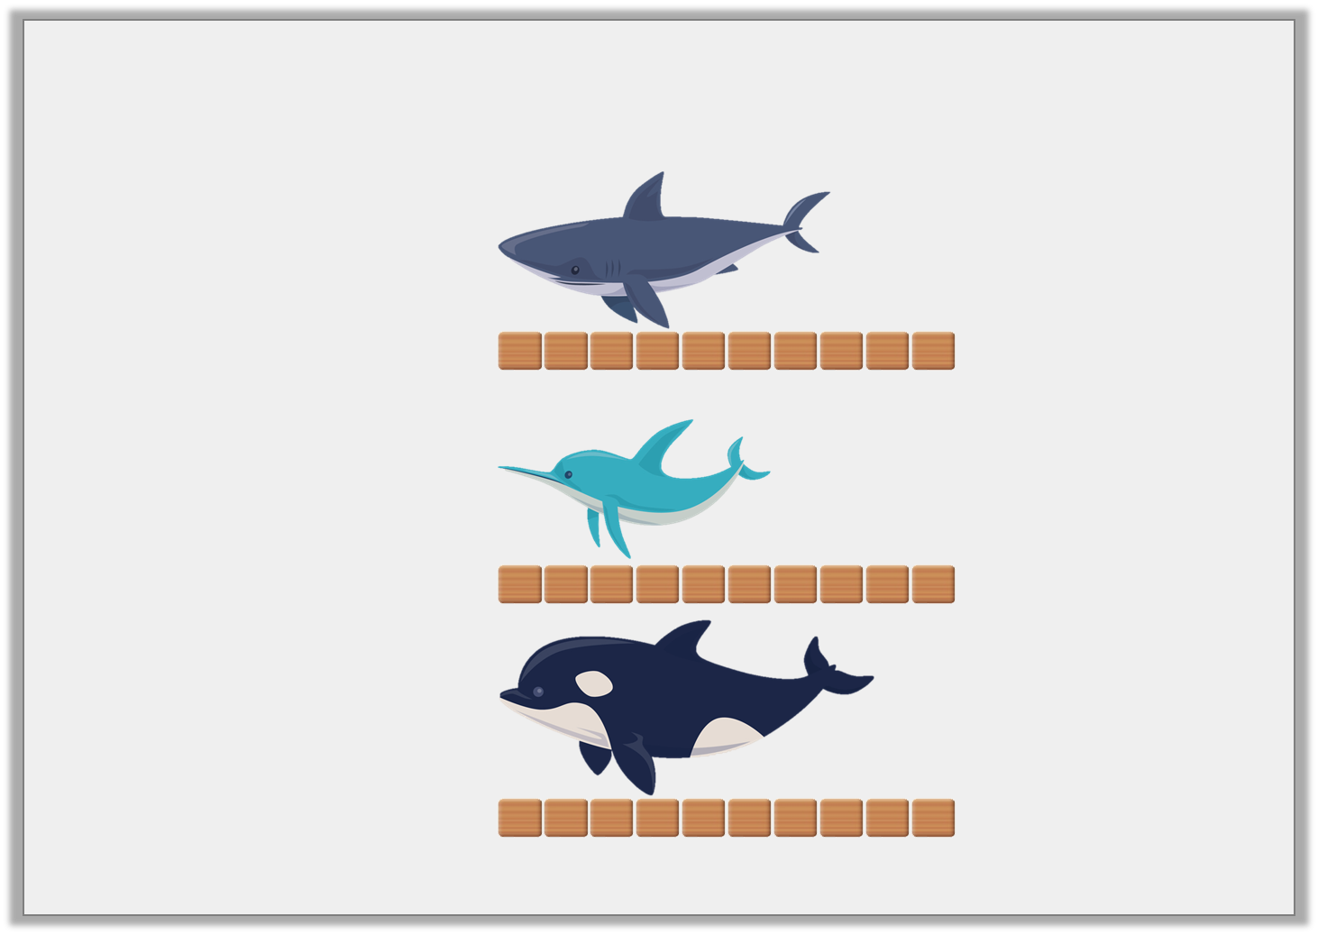
Varied Fluency 3
Tick the sea creature that is 6 blocks long.
A.
B.
C.
© Classroom Secrets Limited 2019

Slide 11
Varied Fluency 3
Tick the sea creature that is 6 blocks long.
A.
✓
B.
C.
© Classroom Secrets Limited 2019

Slide 12
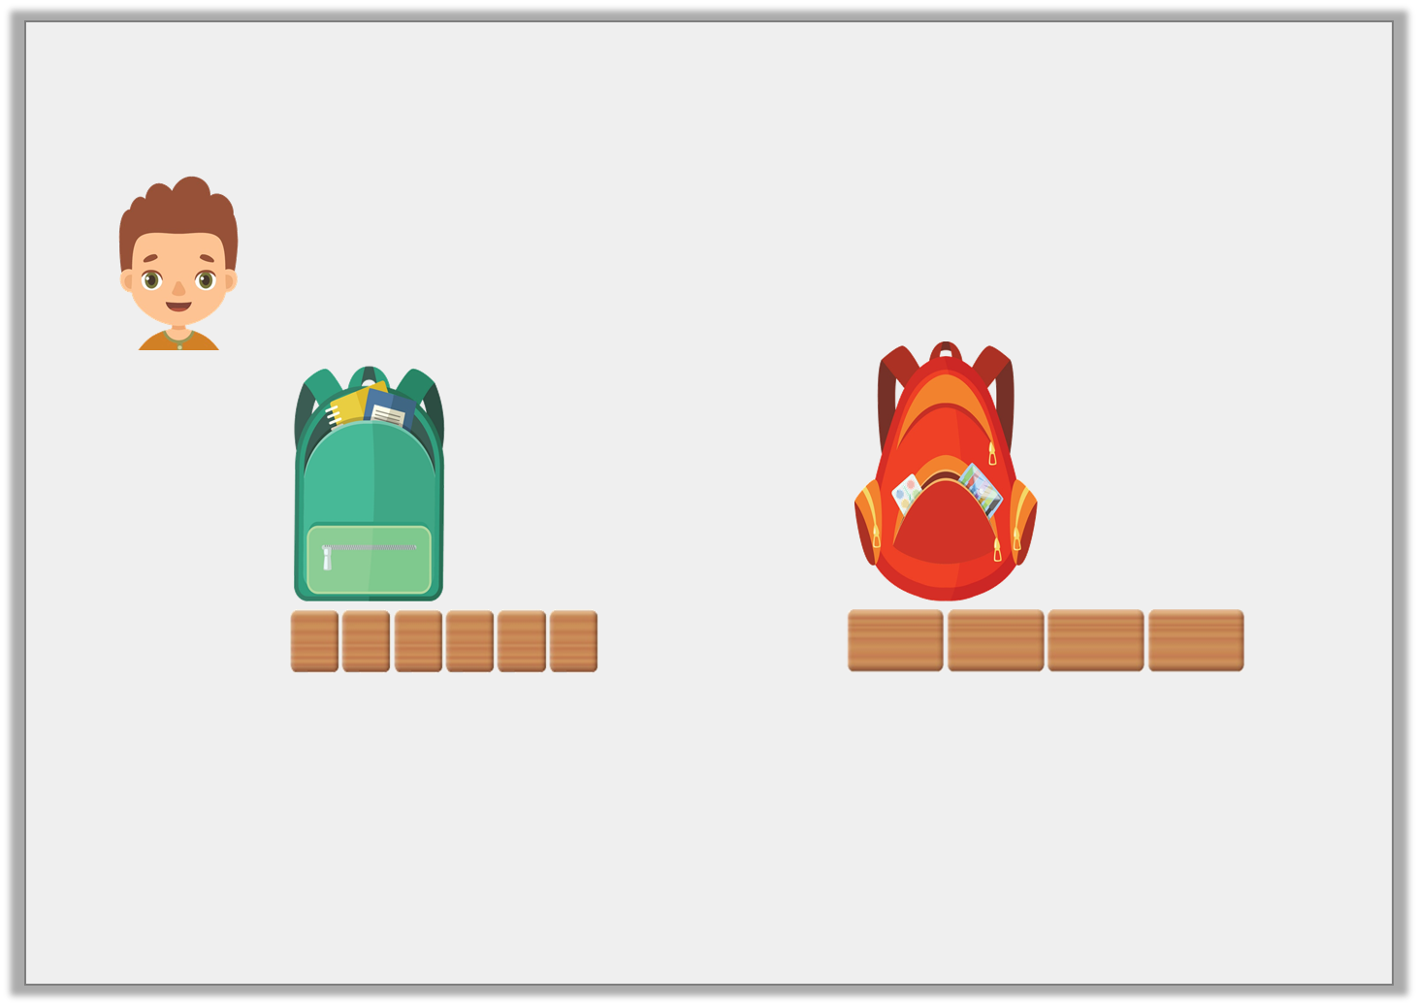
Reasoning 1
Pete has been measuring bags.
Is Pete correct? Explain your answer.
The green bag is longer than the red bag.
© Classroom Secrets Limited 2019

Slide 13
Reasoning 1
Pete has been measuring bags.
Is Pete correct? Explain your answer.
Pete is incorrect because…
The green bag is longer than the red bag.
© Classroom Secrets Limited 2019

Slide 14
Reasoning 1
Pete has been measuring bags.
Is Pete correct? Explain your answer.
Pete is incorrect because the non-standard units he has used are different. The green bag is 3 small blocks but the red bag is 2 large blocks. He cannot compare them unless he uses the same non-standard units to measure.
The green bag is longer than the red bag.
© Classroom Secrets Limited 2019

Slide 15
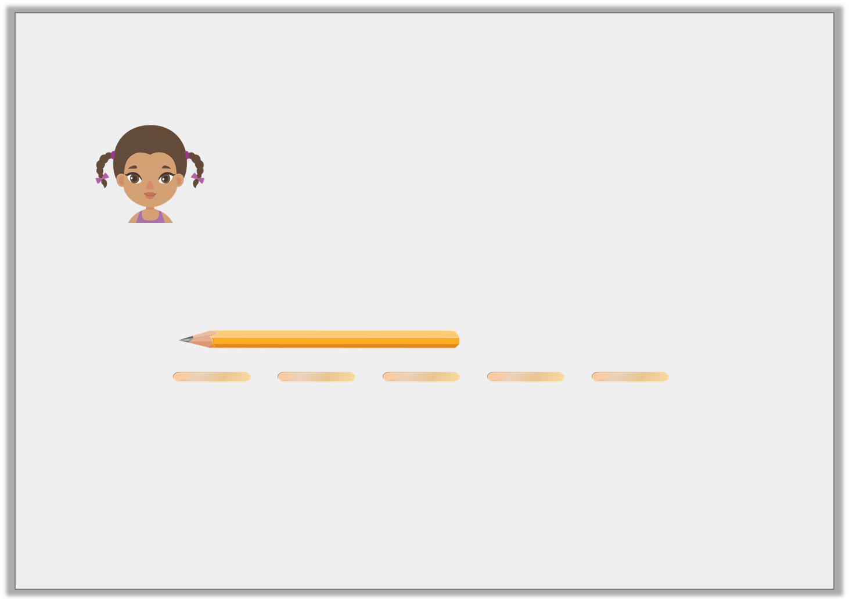
Reasoning 2
Alex measured a pencil in her classroom.
Explain the mistake she has made.
I think it is 3 lolly sticks long.
© Classroom Secrets Limited 2019

Slide 16
Reasoning 2
Alex measured a pencil in her classroom.
Explain the mistake she has made.
Alex is incorrect because…
I think it is 3 lolly sticks long.
© Classroom Secrets Limited 2019

Slide 17
Reasoning 2
Alex measured a pencil in her classroom.
Explain the mistake she has made.
Alex is incorrect because she has not correctly lined up the lolly sticks with their ends touching.
I think it is 3 lolly sticks long.
© Classroom Secrets Limited 2019

Slide 18
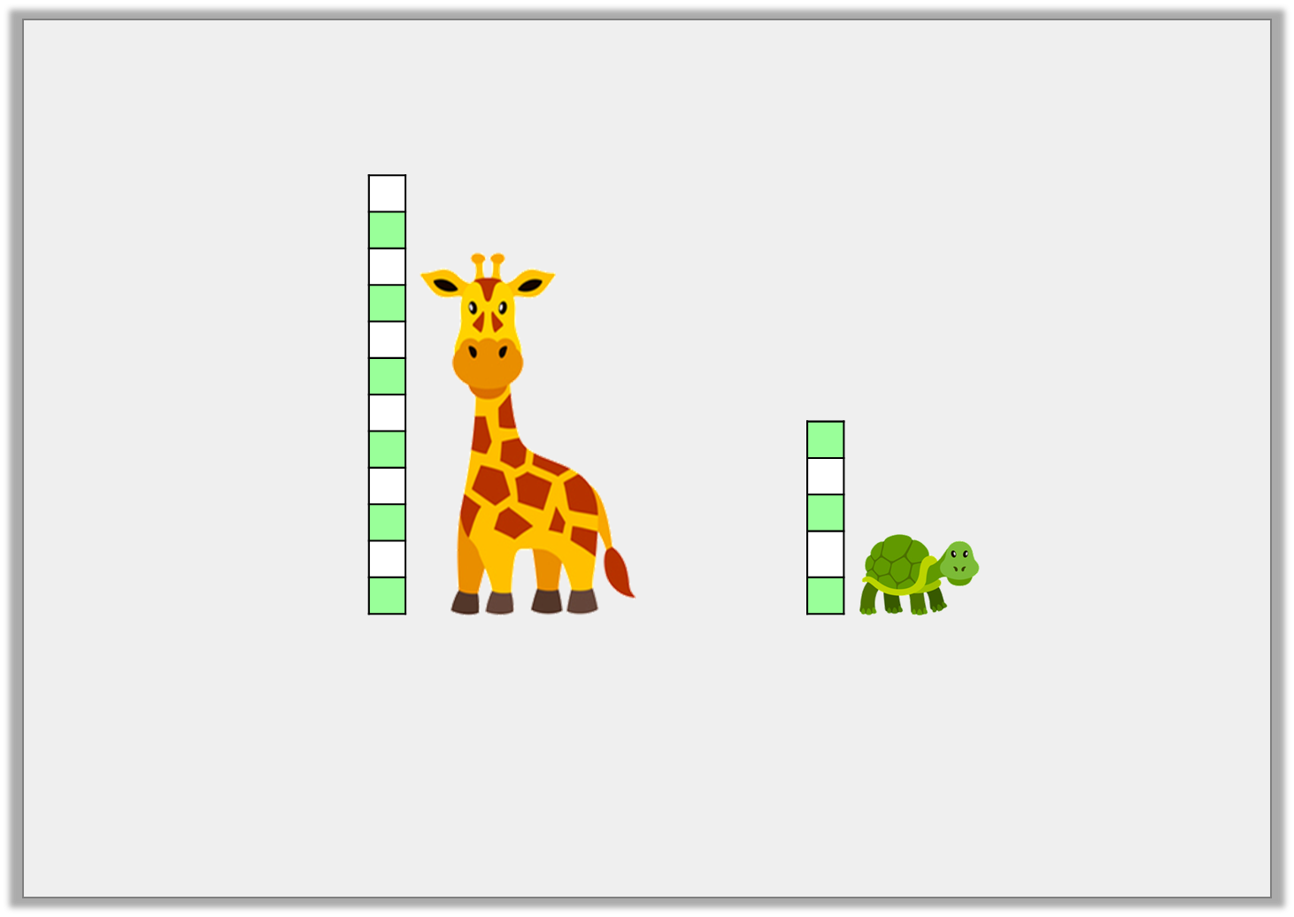
Problem Solving 1
A flamingo is shorter than the giraffe but taller than the tortoise.
How many cubes could the flamingo measure?
Find two possibilities.
© Classroom Secrets Limited 2019

Slide 19
Problem Solving 1
A flamingo is shorter than the giraffe but taller than the tortoise.
How many cubes could the flamingo measure?
Find two possibilities.
Various answers, for example: 5, 6, 7
© Classroom Secrets Limited 2019

