Slide 1
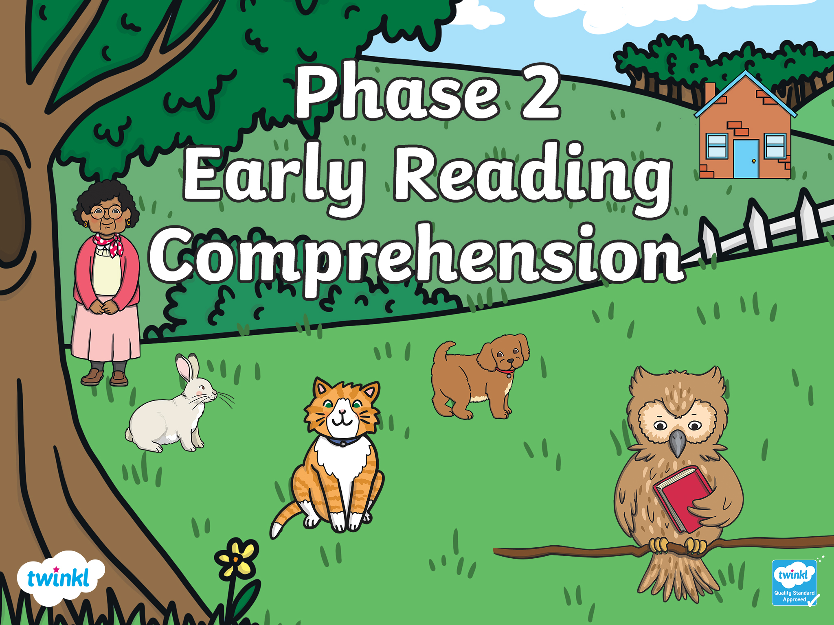

Slide 2
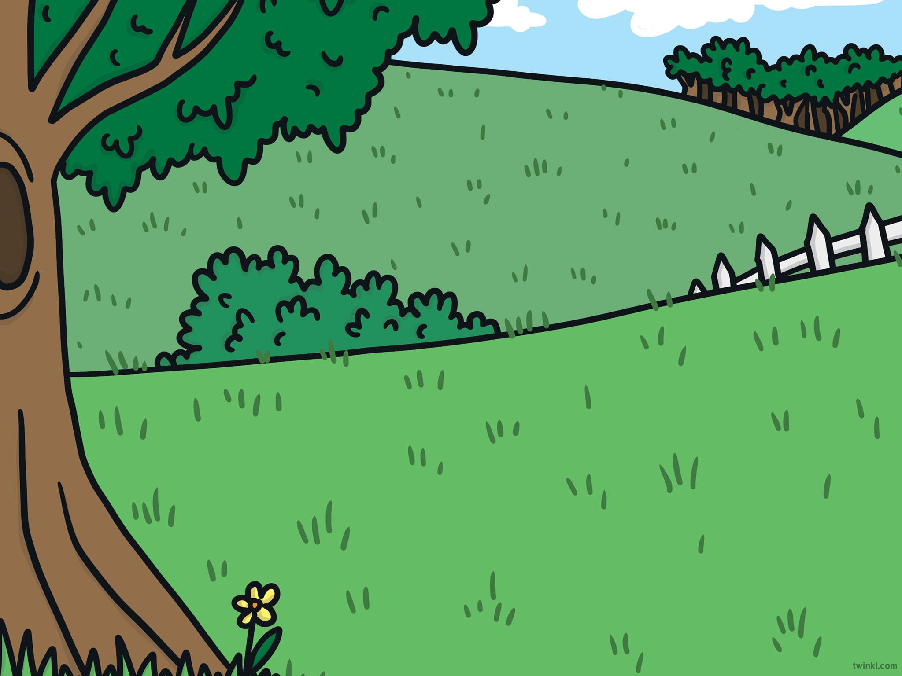
Can you read the sentences and choose the matching picture?
Which option would you like?
Read the sentence. Then,
click on the matching picture.
with sound buttons
without sound buttons

Slide 3
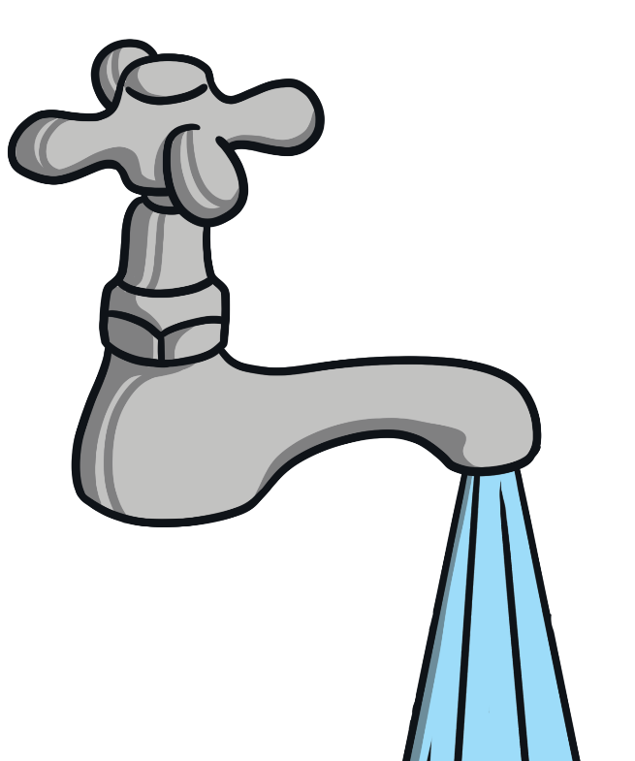

The tap is on.

Slide 4
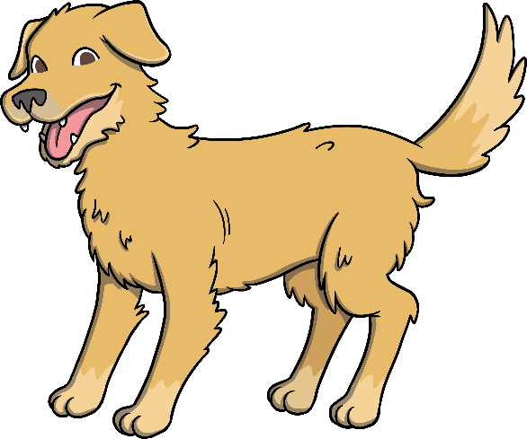

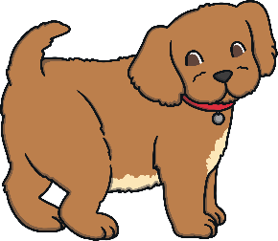
The dog has a pup.

Slide 5

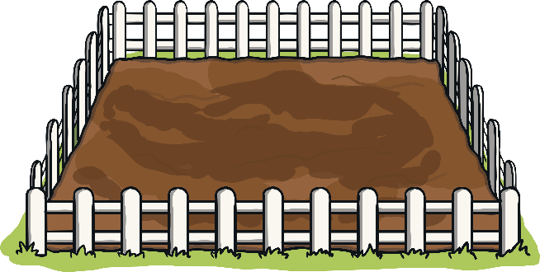
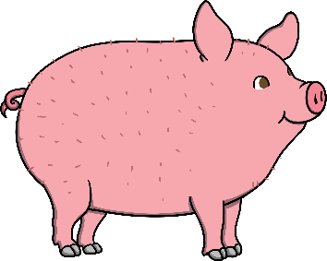

The pig can go in the pen.

Slide 6
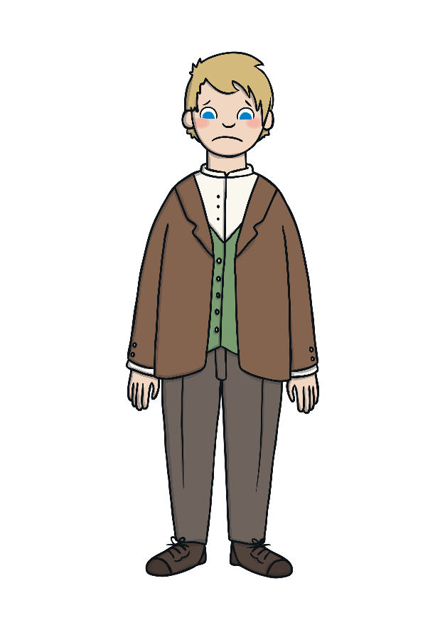

The man is sad.

Slide 7
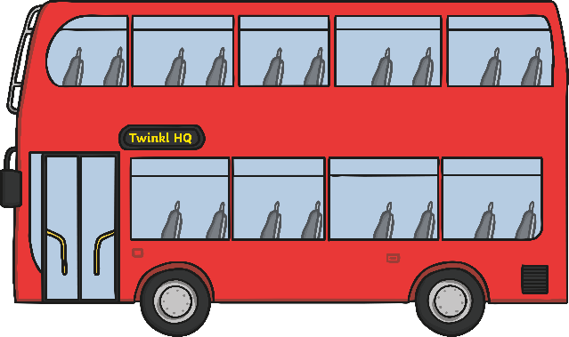
Nan is on the bus.

Slide 8
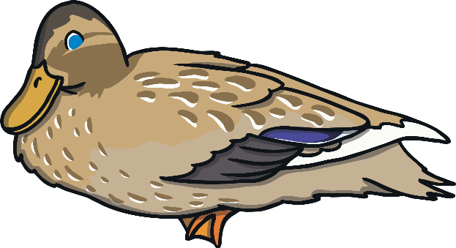


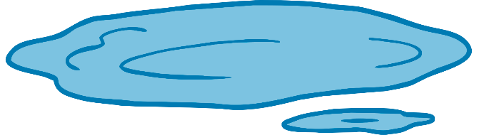
The fat duck is in the mud.

Slide 9
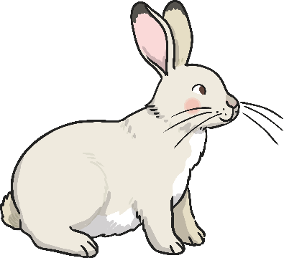


The rabbit is on the hill.

Slide 10

The cat has a big bell.

Slide 11
The tap is on.

Slide 12
The dog has a pup.

Slide 13
The pig can go in the pen.

Slide 14
The man is sad.

Slide 15
Nan is on the bus.

Slide 16
The fat duck is in the mud.

Slide 17
The rabbit is on the hill.

Slide 18
The cat has a big bell.

