Slide 1
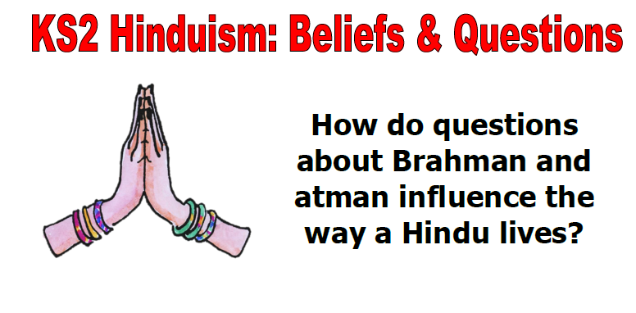
ENQUIRE into Hindu ideas about God, the world and living beings

Slide 2
What different ideas are there about God?
In the Hindu religion, there are many ideas about God and they are not all the same; it depends who you ask and what aspect of the religion you look at.
Using the activity sheet on the blog, match up these words and their definitions.
Monotheism | Atheism | Pantheism
Polytheism | Henotheism | Theism

Slide 3
What different ideas are there about God?
ANSWERS
Word | Definition
Monotheism | A person who believes that there is only one God.
Atheism | A person who believes that there is no God or gods.
Pantheism | A belief which identifies God with the universe, or regards the universe as a version of God. It is also the worship or tolerance of many gods.
Polytheism | The belief in or worship of more than one god.
Henotheism | Attachment or commitment to one particular god out of several, especially by a family, tribe, or other group.
Theism | A belief in the existence of a god or gods, specifically of a creator who intervenes in the universe.

Slide 4
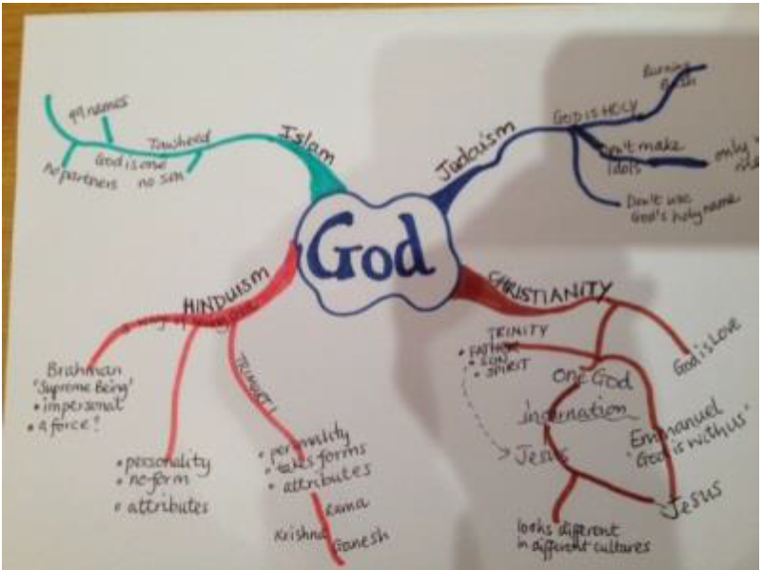
What ideas do you know about God in other religions?
The mind map shows that Christianity and Islam are both ‘monotheistic’ (they believe in one God), but in Islam, God never takes any ‘form’ whereas in Christianity, God is incarnated as Jesus.
Most people in a faith agree what their religion says about God; Hinduism is different. It had no single founder and has many holy books. Many Hindus today follow spiritual teachers or gurus who help them think about God in different ways.

Slide 5
What ideas do you know about God in other religions?
Watch this video about Hindus up to 6.25 minutes (the whole programme is 30 minutes)
After watching the programme, discuss with your adult at home which ‘theism’ word fits best for Hinduism and complete the sentence:
We think Hindus are xxxxxx-eist because Vraj and Simran said ….
Each word COULD apply to Hindus because their beliefs about God vary. The word ‘PLURALIST’ could describe how Hindus approach the idea of God. It means: a person who believes that the existence of different types of people, beliefs, and opinions within a society is a good thing.
How do you think this term ‘pluralist’ can relate to the Blind Men and the Elephant story?

