Slide 1


Year 5 – Spring Block 2 – Fractions
Step 13: Subtract Mixed Numbers 1
© Classroom Secrets Limited 2019

Slide 2
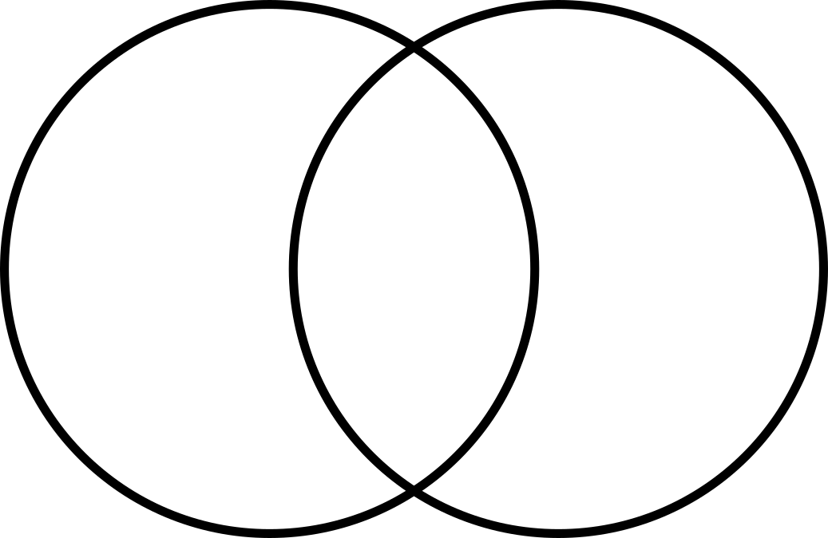
Subtract Mixed Numbers
Introduction
Sort the fractions into the Venn diagram.
Greater than 1 | Can be simplified
1 | 3
 | 4
3 | 7
 | 8
4
8
2 | 2
 | 8
3
5
© Classroom Secrets Limited 2019

Slide 3
Introduction
Sort the fractions into the Venn diagram.
Greater than 1 | Can be simplified
1 | 3
 | 4
3
5
2 | 2
 | 8
4
8
3 | 7
 | 8
© Classroom Secrets Limited 2019

Slide 4
Varied Fluency 1
Which calculation is being shown in the model below?
Solve the calculation.
Step 1
Step 2
A. | B. | C.
4 | 1 | – | 3
 | 5 |  | 10
4 | 4 | – | 6
 | 5 |  | 10
4 | 4 | – | 2
 | 5 |  | 10
© Classroom Secrets Limited 2019

Slide 5
Varied Fluency 1
Which calculation is being shown in the model below?
Solve the calculation.
Step 1
Step 2
A. | B. | C.
4 | 1 | – | 3
 | 5 |  | 10
4 | 4 | – | 6
 | 5 |  | 10
4 | 4 | – | 2
 | 5 |  | 10
4 | 4 | – | 6 | = | 4 | 2 | or | 4 | 1
 | 5 |  | 10 |  |  | 10 |  |  | 10
© Classroom Secrets Limited 2019

Slide 6
Varied Fluency 2
Find the difference between the fractions using the number line to help you.
Write your answer in its simplest form.
2 | 6 |  | 1
 | 8 |  | 2
+?
+?
4
8
4
8
2 | 6
 | 8
2
© Classroom Secrets Limited 2019

Slide 7
Varied Fluency 2
Find the difference between the fractions using the number line to help you.
Write your answer in its simplest form.
2 | 6 |  | 1
 | 8 |  | 2
+?
+?
4
8
4
8
2 | 6
 | 8
2
2 | 6 | – | 1 | = | 2 | 1
 | 8 |  | 2 |  |  | 4
© Classroom Secrets Limited 2019

Slide 8
Varied Fluency 3
Tick the calculation where the answer is a whole number.
4 | 8 | – | 2
 | 18 |  | 6
A.
B.
3 | 1 | – | 3
 | 6 |  | 18
© Classroom Secrets Limited 2019

Slide 9
Varied Fluency 3
Tick the calculation where the answer is a whole number.
4 | 8 | – | 2
 | 18 |  | 6
A.
B.
3 | 1 | – | 3 |  | ✓
 | 6 |  | 18
© Classroom Secrets Limited 2019

Slide 10
Reasoning 1
Will has used the following model to solve the calculation below.
Is he correct? Explain any errors he has made.
5 | 6 | – | 1 | = | 5 | 5
 | 10 |  | 5 |  |  | 10
Step 1
Step 2
© Classroom Secrets Limited 2019

Slide 11
Reasoning 1
Will has used the following model to solve the calculation below.
Is he correct? Explain any errors he has made.
No, he is incorrect because…
5 | 6 | – | 1 | = | 5 | 5
 | 10 |  | 5 |  |  | 10
Step 1
Step 2
© Classroom Secrets Limited 2019

Slide 12
Reasoning 1
Will has used the following model to solve the calculation below.
Is he correct? Explain any errors he has made.
No, he is incorrect because he has taken away the numerator before finding the common denominator. He should have taken away . The answer should be 5 or 5 .
5 | 6 | – | 1 | = | 5 | 5
 | 10 |  | 5 |  |  | 10
Step 1
Step 2
2
10
4
10
2
5
© Classroom Secrets Limited 2019

Slide 13
Problem Solving 1
Lucie has a jug which contains litres of milk.
The recipe for her cake needs of a litre of milk.
What fraction of the milk is left over?
3 | 3
 | 4
7
12
© Classroom Secrets Limited 2019

Slide 14
Problem Solving 1
Lucie has a jug which contains litres of milk.
The recipe for her cake needs of a litre of milk.
What fraction of the milk is left over? or
3 | 3
 | 4
7
12
3 | 2
 | 12
3 | 1
 | 6
© Classroom Secrets Limited 2019

Slide 15

Problem Solving 2
Daniel has a fraction on his number card.
Find the route across the grid subtracting each time to reach the card at the other end of the grid.
1
7
4 | 7
 | 9
4 | 5
 | 21
4 | 5
 | 7
4 | 6
 | 21
4 | 10
 | 14
4 | 6
 | 7
4 | 6
 | 14
4 | 2
 | 35
4 | 6
 | 7
4 | 1
 | 7
4 | 4
 | 7
4 | 16
 | 28
4 | 5
 | 14
4 | 3
 | 7
© Classroom Secrets Limited 2019

Slide 16
Problem Solving 2
Daniel has a fraction on his number card.
Find the route across the grid subtracting each time to reach the card at the other end of the grid.
1
7
4 | 7
 | 9
4 | 5
 | 21
4 | 5
 | 7
4 | 6
 | 21
4 | 10
 | 14
4 | 6
 | 7
4 | 6
 | 14
4 | 2
 | 35
4 | 6
 | 7
4 | 1
 | 7
4 | 4
 | 7
4 | 16
 | 28
4 | 5
 | 14
4 | 3
 | 7
© Classroom Secrets Limited 2019

