Slide 1


Subtract Fractions
Introduction
Choose two fractions and add them together.
14
20
1 | 4
 | 5
9
10
© Classroom Secrets Limited 2019

Slide 2
Introduction
Choose two fractions and add them together.
Various answers, for example:
14
20
1 | 4
 | 5
9
10
14 | + | 9 | = | 32
20 |  | 10 |  | 20
= | 1 | 12 | = | 1 | 3
 |  | 20 |  |  | 5
© Classroom Secrets Limited 2019

Slide 3
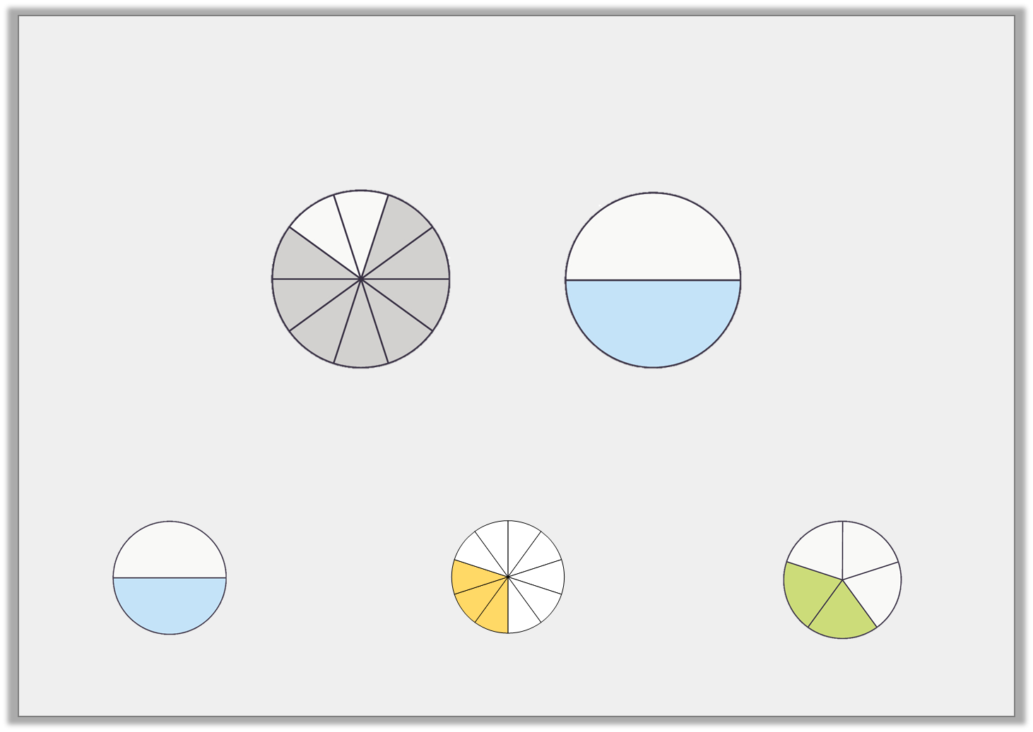
Varied Fluency 1
Circle the correct answer to the subtraction below.
–
A
B
C
© Classroom Secrets Limited 2019

Slide 4
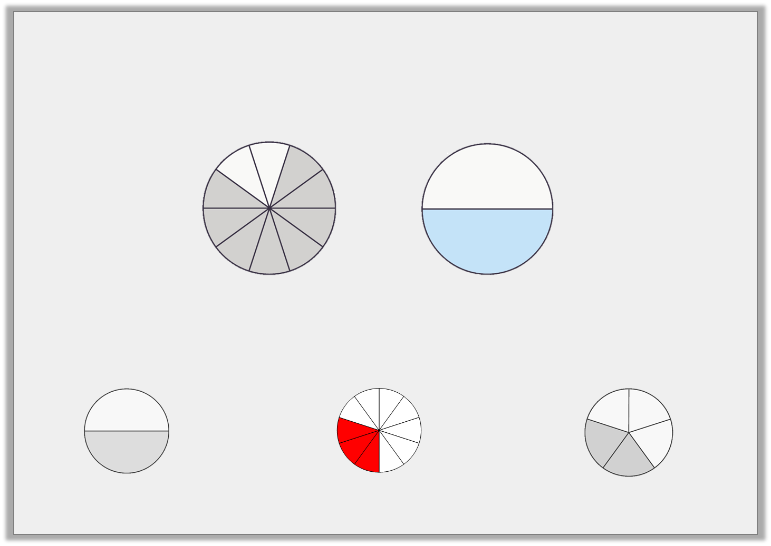
Varied Fluency 1
Circle the correct answer to the subtraction below.
–
A
B
C
© Classroom Secrets Limited 2019

Slide 5
Varied Fluency 2
Complete the calculation below.
–
=
© Classroom Secrets Limited 2019

Slide 6
Varied Fluency 2
Complete the calculation below.
, or
–
=
9
18
3
6
1
2
© Classroom Secrets Limited 2019

Slide 7
Varied Fluency 3
Find the difference between the pairs of fractions below.
A. | 7 |  | 3
 | 16 |  | 4
B. | 9 |  | 23
 | 8 |  | 24
© Classroom Secrets Limited 2019

Slide 8
Varied Fluency 3
Find the difference between the pairs of fractions below.
A. | 7 |  | 3
 | 16 |  | 4
5
16
B. | 9 |  | 23
 | 8 |  | 24
4 | or | 1
24 |  | 6
© Classroom Secrets Limited 2019

Slide 9
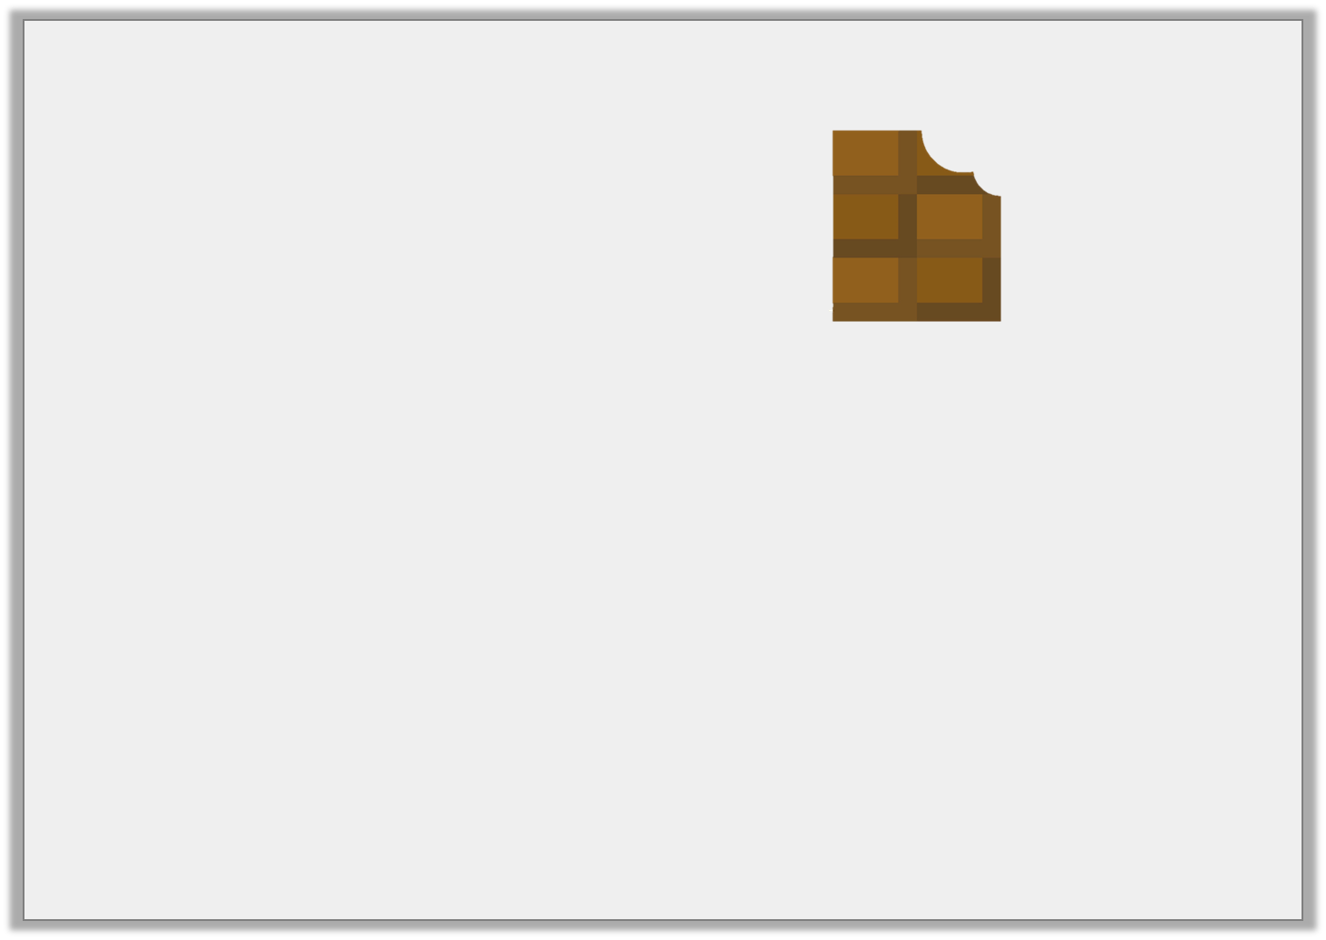
Varied Fluency 4
Sarah has of a chocolate bar.
She gives to her brother.
How much does she have left?
6
7
15
21
© Classroom Secrets Limited 2019

Slide 10
Varied Fluency 4
Sarah has of a chocolate bar.
She gives to her brother.
How much does she have left?
6
7
15
21
3 | or | 1
21 |  | 7
© Classroom Secrets Limited 2019

Slide 11
Problem Solving 1
Arrange the number cards to make the calculation below correct.
8
4
32
16
7
 | – |  | = | 3
 |  |  |  | 8
© Classroom Secrets Limited 2019

Slide 12
Problem Solving 1
Arrange the number cards to make the calculation below correct.
8
4
32
16
7
7 | – | 16 | = | 3
8 |  | 32 |  | 8
© Classroom Secrets Limited 2019

Slide 13

Reasoning 1
Mrs Hill shows Class 5 two fractions:
Jayden says,
Explain the mistake that he has made.
20 |  | 6
25 |  | 5
The difference between them is .
14
25
© Classroom Secrets Limited 2019

Slide 14
Reasoning 1
Mrs Hill shows Class 5 two fractions:
Jayden says,
Explain the mistake that he has made.
Jayden has…
20 |  | 6
25 |  | 5
The difference between them is .
14
25
© Classroom Secrets Limited 2019

Slide 15
Reasoning 1
Mrs Hill shows Class 5 two fractions:
Jayden says,
Explain the mistake that he has made.
Jayden has not converted the fraction into twenty fifths. He has just subtracted the numerators. The correct answer is .
20 |  | 6
25 |  | 5
The difference between them is .
14
25
10 | or | 2
25 |  | 5
© Classroom Secrets Limited 2019

Slide 16
Problem Solving 2
Two children took their leftover sweets home from the cinema.
Mia had left and gave her mum .
Seth took home and gave his dad .
Who is left with the most sweets?
7
10
14
30
15
30
2
6
© Classroom Secrets Limited 2019

Slide 17
Problem Solving 2
Two children took their leftover sweets home from the cinema.
Mia had left and gave her mum .
Seth took home and gave his dad .
Who is left with the most sweets?
Mia has the most sweets left because she has and Seth has
.
7
10
14
30
15
30
2
6
7
30
5 | or | 1
30 |  | 6
© Classroom Secrets Limited 2019

