Slide 1
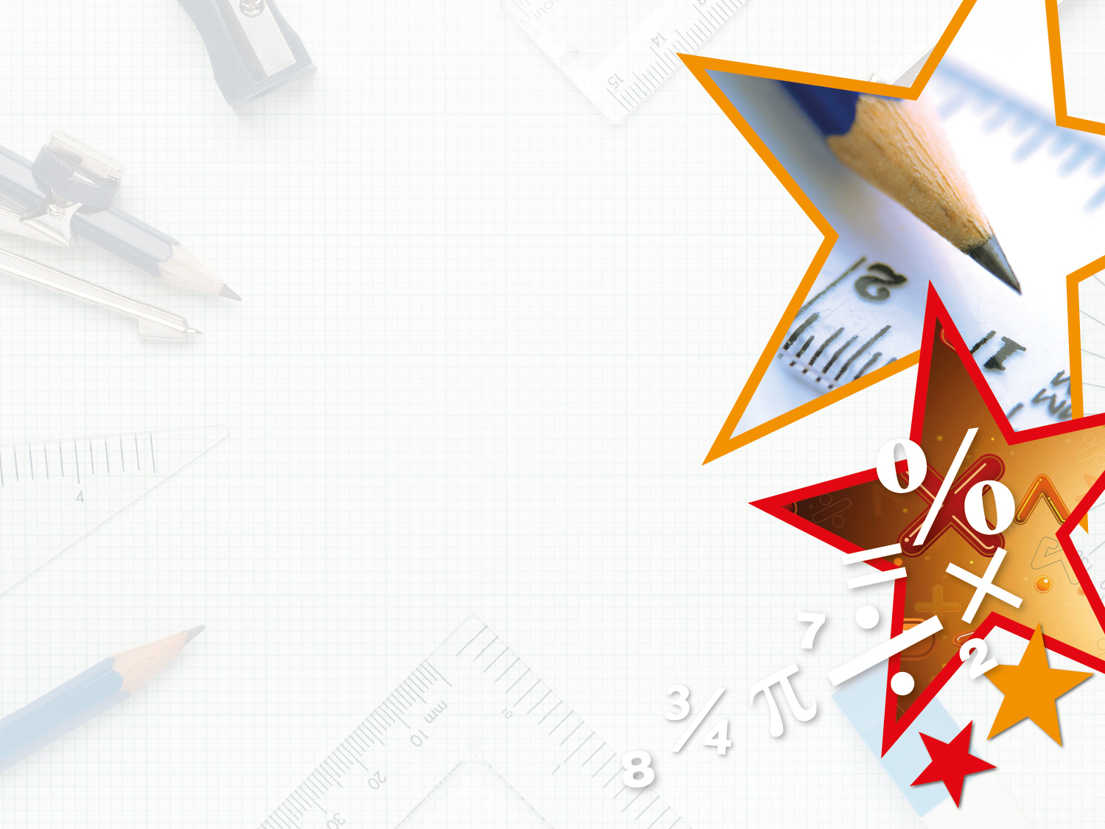

Year 3/4 – Summer Block 5 – Mass and Capacity
Measure Mass 1
© Classroom Secrets Limited 2018

Slide 2
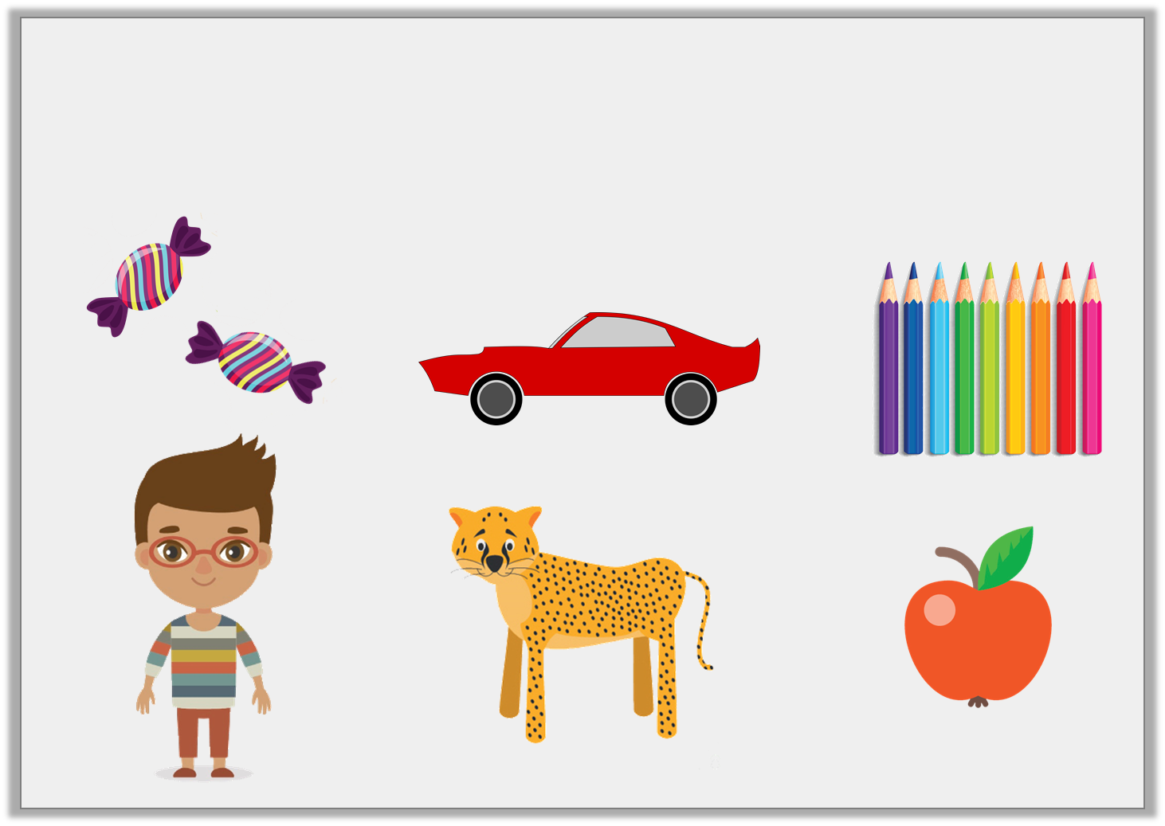
Introduction
Which items would you measure in kilograms?
Which items would you measure in grams?
Y3
© Classroom Secrets Limited 2018

Slide 3
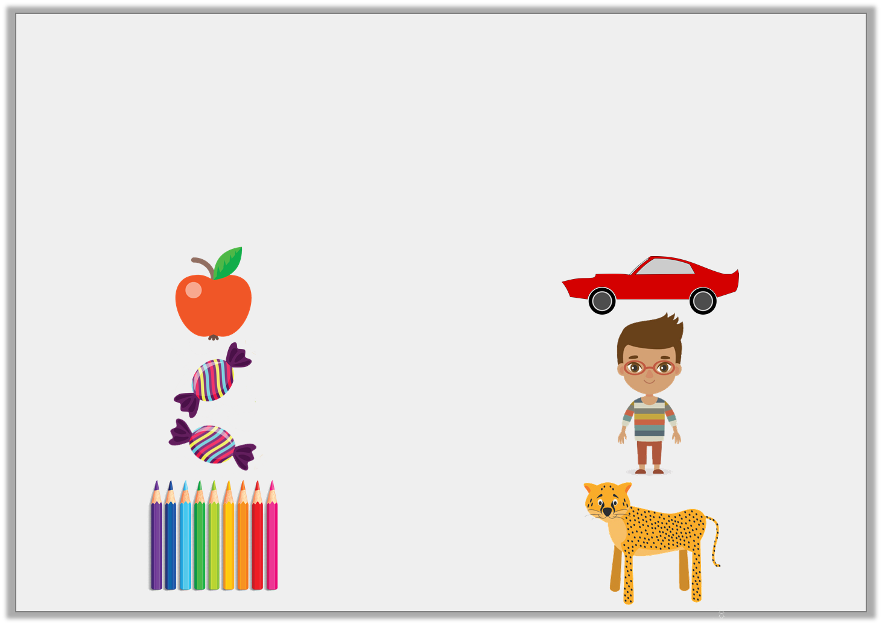
Introduction
Which items would you measure in kilograms?
Which items would you measure in grams?
Grams: Kilograms:
Y3
© Classroom Secrets Limited 2018

Slide 4
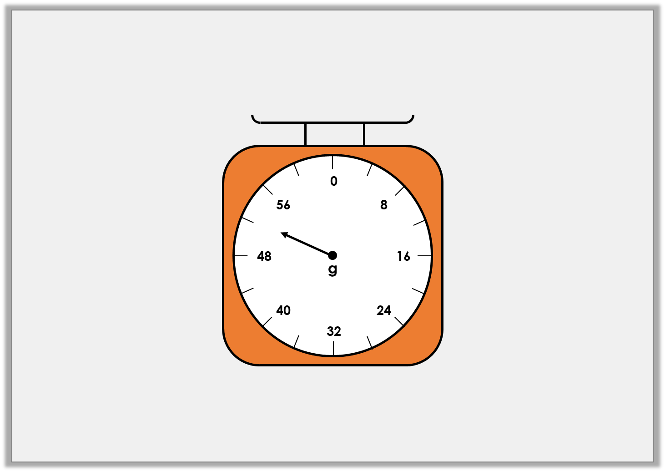
Varied Fluency 1
What mass is the arrow showing on this scale?
Y3
© Classroom Secrets Limited 2018

Slide 5
Varied Fluency 1
What mass is the arrow showing on this scale?
52g
Y3
© Classroom Secrets Limited 2018

Slide 6
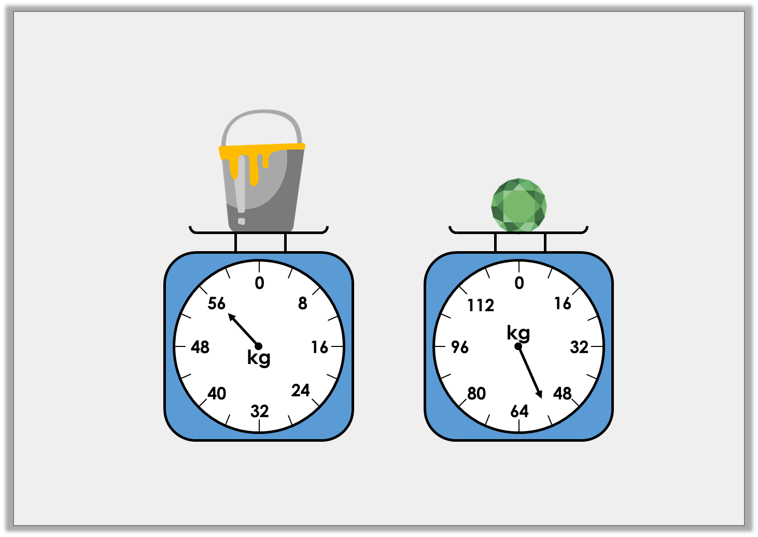
Varied Fluency 2
Which object is the heaviest?
A
B
Y3
© Classroom Secrets Limited 2018

Slide 7
Varied Fluency 2
Which object is the heaviest?
A = 56kg B = 56kg
Neither because they weigh exactly the same.
A
B
Y3
© Classroom Secrets Limited 2018

Slide 8
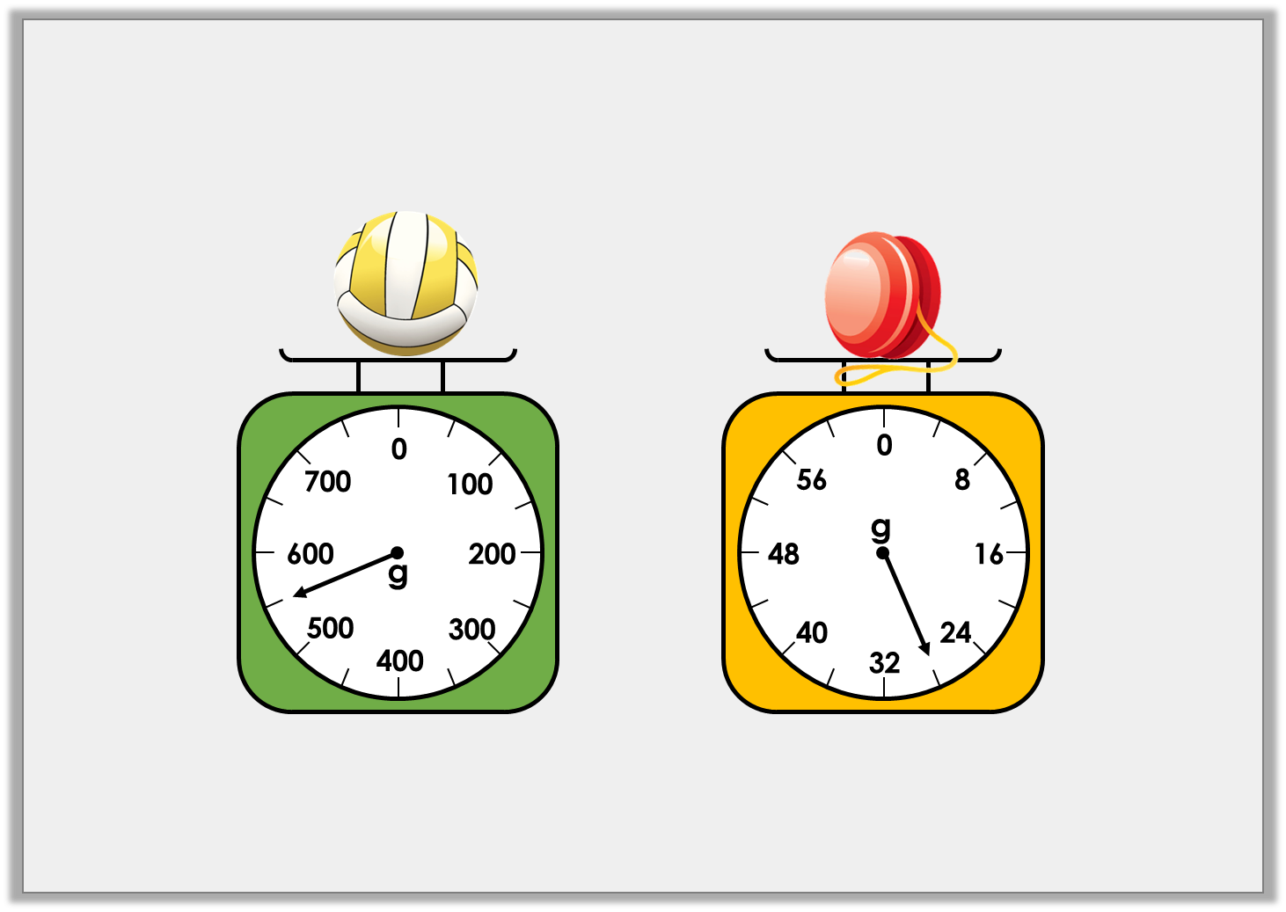
Varied Fluency 3
How much does each object weigh?
A
B
Y3
© Classroom Secrets Limited 2018

Slide 9
Varied Fluency 3
How much does each object weigh?
550g 28g
A
B
Y3
© Classroom Secrets Limited 2018

Slide 10
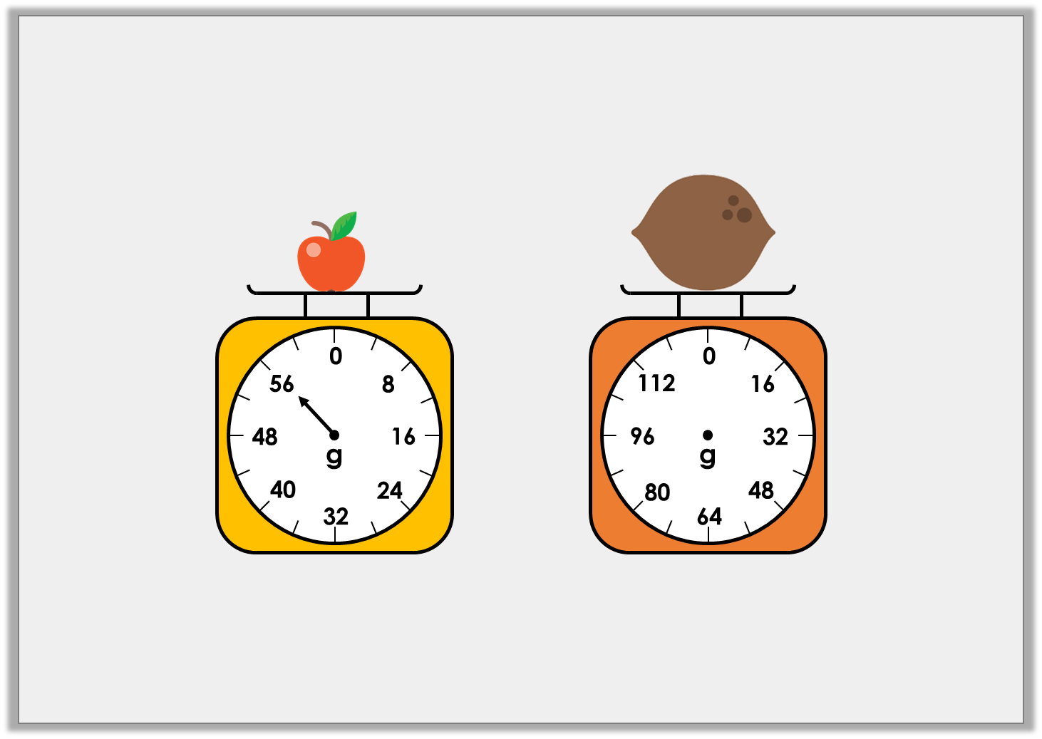
Problem Solving 1
If two apples weigh the same as one coconut,
draw an arrow on the scale to show the weight of the coconut.
Y3
© Classroom Secrets Limited 2018

Slide 11
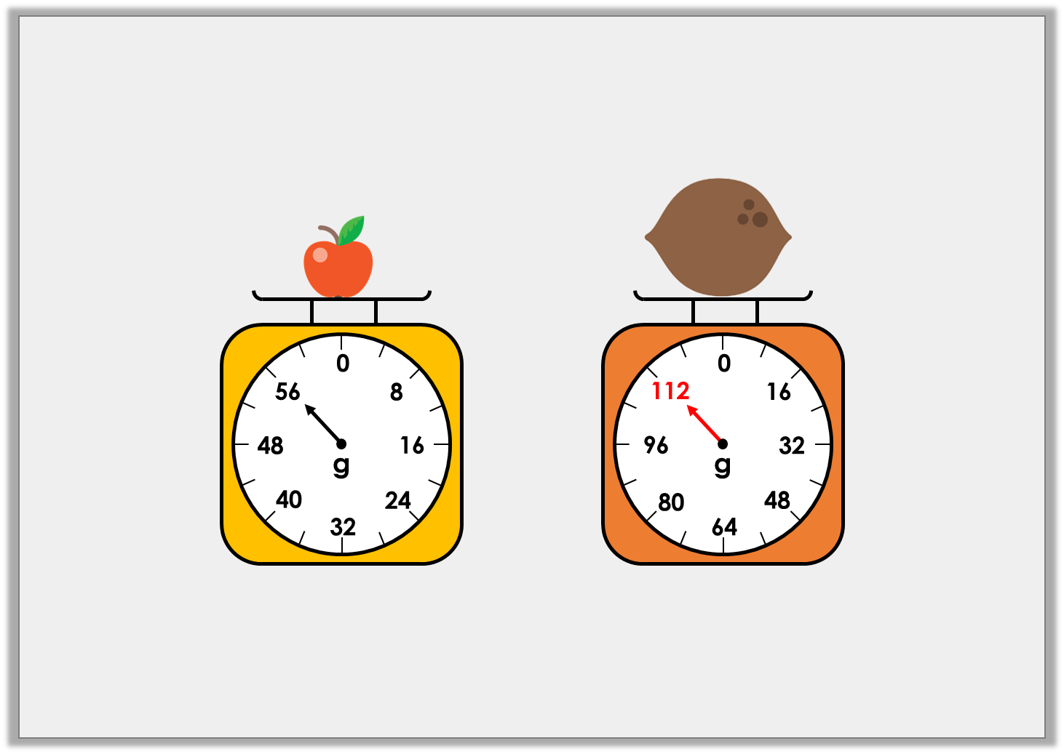
Problem Solving 1
If two apples weigh the same as one coconut,
draw an arrow on the scale to show the weight of the coconut.
Y3
© Classroom Secrets Limited 2018

Slide 12
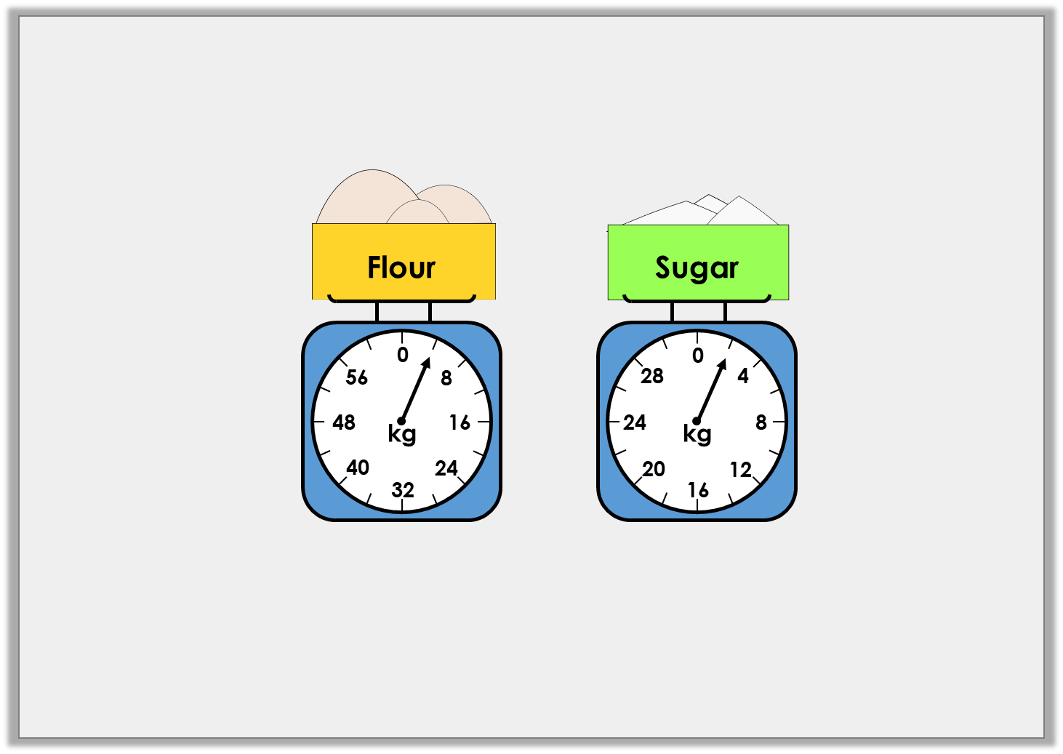
Problem Solving 2
Lizzie is making cakes. She needs 6kg of flour and 6kg of sugar.
How much more of each ingredient does she need?
Y3
© Classroom Secrets Limited 2018

Slide 13
Problem Solving 2
Lizzie is making cakes. She needs 6kg of flour and 6kg of sugar.
How much more of each ingredient does she need?
2kg of flour
4kg of sugar
Y3
© Classroom Secrets Limited 2018

Slide 14
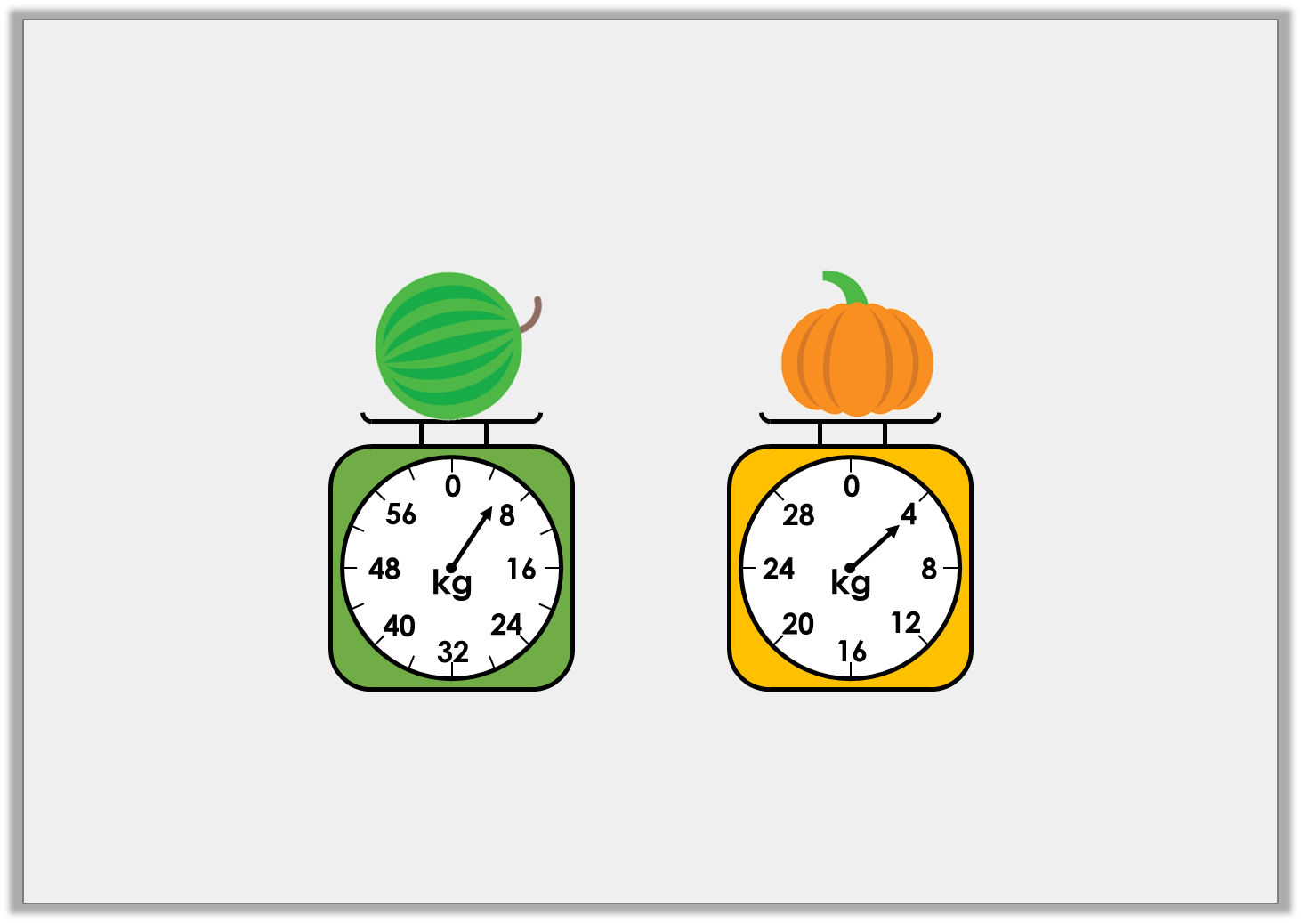
Reasoning 1
Joanne is weighing different items.
She says the watermelon is heavier because the arrow
on the scale is further away from zero.
Is she correct? Explain how you know.
Y3
© Classroom Secrets Limited 2018

Slide 15
Reasoning 1
Joanne is weighing different items.
She says the watermelon is heavier because the arrow
on the scale is further away from zero.
Is she correct? Explain how you know.
Joanne is incorrect because…
Y3
© Classroom Secrets Limited 2018

Slide 16
Reasoning 1
Joanne is weighing different items.
She says the watermelon is heavier because the arrow
on the scale is further away from zero.
Is she correct? Explain how you know.
Joanne is incorrect because the watermelon weighs 6kg and the pumpkin weighs 4kg. The scales increase in different increments.
Y3
© Classroom Secrets Limited 2018

