Slide 1


Year 3 – Spring Block 3 –Statistics
Tables
© Classroom Secrets Limited 2019

Slide 2
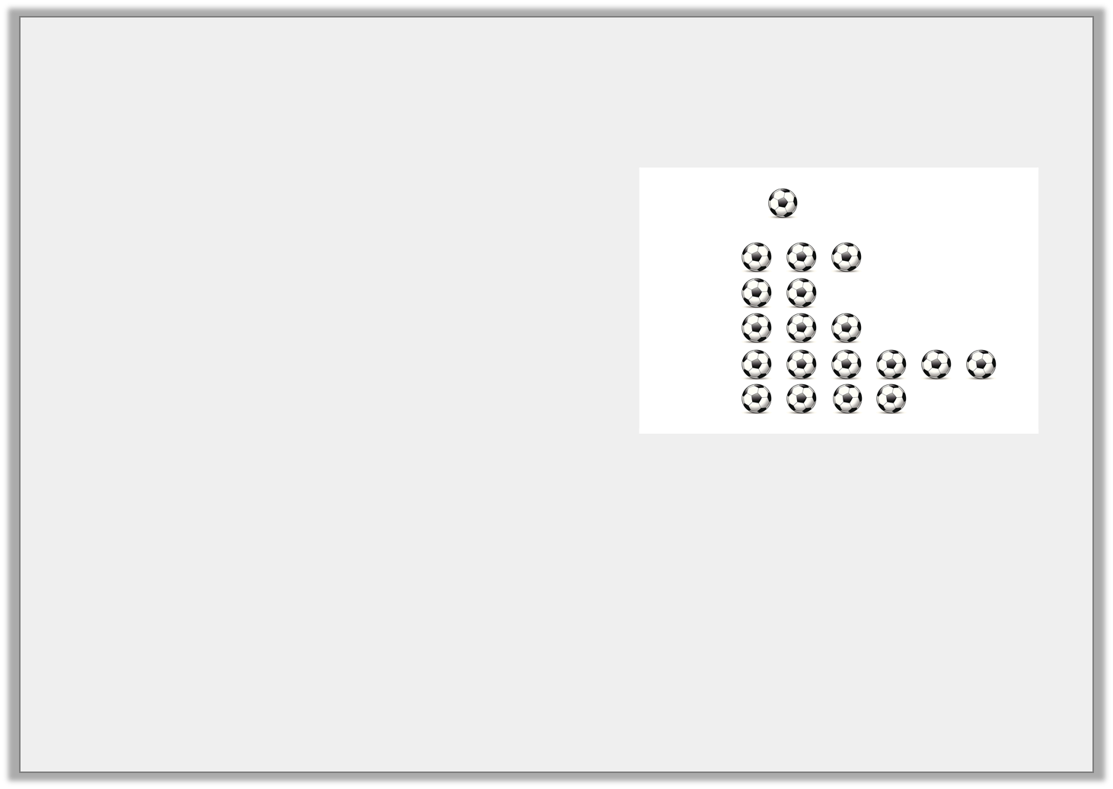
Introduction
Which two show the same data?
12
10
8
6
4
2
0
= 2 people
netball
hockey
rugby
swimming
tennis
tennis | swimming | rugby | hockey | netball
 | Men | Women | Total
Running | 11 | 42 | 53
Gym | 48 | 55 | 103
Swimming | 16 | 32 | 48
No exercise | 25 | 12 | 37
Y3
© Classroom Secrets Limited 2019

Slide 3
Introduction
Which two show the same data?
12
10
8
6
4
2
0
= 2 people
netball
hockey
rugby
swimming
tennis
tennis | swimming | rugby | hockey | netball
tennis | swimming | rugby | hockey | netball
 | Men | Women | Total
Running | 11 | 42 | 53
Gym | 48 | 55 | 103
Swimming | 16 | 32 | 48
No exercise | 25 | 12 | 37
Y3
© Classroom Secrets Limited 2019

Slide 4
Varied Fluency 1
Use the table to answer the questions about favourite colours.
a. Which was the most popular colour?
b. Which colours do the girls prefer?
c. Is purple a boy’s favourite?
d. Which is the most unpopular colour?
 | Green | Red | Yellow | Blue | Purple
Jane | ●
Mark |  |  |  | ●
Michael |  |  |  | ●
Charlotte |  | ●
Emily |  |  |  |  | ●
Y3
© Classroom Secrets Limited 2019

Slide 5
Varied Fluency 1
Use the table to answer the questions about favourite colours.
a. Which was the most popular colour?
Blue
b. Which colours do the girls prefer?
Green, red and purple
c. Is purple a boy’s favourite?
No
d. Which is the most unpopular colour?
yellow
 | Green | Red | Yellow | Blue | Purple
Jane | ●
Mark |  |  |  | ●
Michael |  |  |  | ●
Charlotte |  | ●
Emily |  |  |  |  | ●
Y3
© Classroom Secrets Limited 2019

Slide 6
Varied Fluency 2
The table below shows the results of football matches.
a. Which two teams have won the most matches?
b. Which team is the least successful?
c. What is the most common result of the matches?
 | win | draw | lose
Northfield AFC | 6 | 2 | 1
Wetherton Juniors | 4 | 1 | 4
Jumpleby Town | 3 | 2 | 4
Y3
© Classroom Secrets Limited 2019

Slide 7
Varied Fluency 2
The table below shows the results of football matches.
a. Which two teams have won the most matches?
Northfield AFC and Wetherton Juniors
b. Which team is the least successful?
Jumpleby Town
c. What is the most common result of the matches?
Win
 | win | draw | lose
Northfield AFC | 6 | 2 | 1
Wetherton Juniors | 4 | 1 | 4
Jumpleby Town | 3 | 2 | 4
Y3
© Classroom Secrets Limited 2019

Slide 8
Varied Fluency 3
The table shows the results of a breakfast survey.
a. How many males eat toast?
b. Which was the second least popular breakfast amongst females?
c. How many people have nothing for breakfast?
d. What was the most popular breakfast for both boys and girls?
 | toast | cereal | porridge | fruit | nothing
Boys | 3 | 13 | 6 | 4 | 6
Girls | 2 | 14 | 8 | 6 | 2
Men | 12 | 5 | 7 | 3 | 10
Women | 3 | 9 | 17 | 11 | 0
Y3
© Classroom Secrets Limited 2019

Slide 9
Varied Fluency 3
The table shows the results of a breakfast survey.
a. How many males eat toast?
15
b. Which was the second least popular breakfast amongst females?
Toast
c. How many people have nothing for breakfast?
18
d. What was the most popular breakfast for both boys and girls?
Cereal
 | toast | cereal | porridge | fruit | nothing
Boys | 3 | 13 | 6 | 4 | 6
Girls | 2 | 14 | 8 | 6 | 2
Men | 12 | 5 | 7 | 3 | 10
Women | 3 | 9 | 17 | 11 | 0
Y3
© Classroom Secrets Limited 2019

Slide 10
Problem Solving 1
The table shows how many house points each pupil receives each time they do well at school. The number of points increase each time by 4 each time. They have a maximum of ten rewards.
Complete the table and answer the questions.
a. How many house points will a child have if they get the reward 5 times?
b. The maximum number of house points a child could receive is higher than 200. True or false?
Rewards | 1 | 2 | 3 | 4 | 5 | 6 | 7 | 8 | 9 | 10
Number of House points | 1 | 5
Y3
© Classroom Secrets Limited 2019

Slide 11
Problem Solving 1
The table shows how many house points each pupil receives each time they do well at school. The number of points increase each time by 4 each time. They have a maximum of ten rewards.
Complete the table and answer the questions.
a. How many house points will a child have if they get the reward 5 times? 45
b. The maximum number of house points a child could receive is higher than 200. True or false? False.
Rewards | 1 | 2 | 3 | 4 | 5 | 6 | 7 | 8 | 9 | 10
Number of House points | 1 | 5 | 9 | 13 | 17 | 21 | 25 | 29 | 33 | 37
Y3
© Classroom Secrets Limited 2019

Slide 12
Problem Solving 2
Liberty writes the following statements using the information in the table, spot three mistakes she has made.
There are 80 animals in the two addresses.
There is an even number of cats in both addresses.
There are more dogs than cats.
There is one even and one odd number of dogs.
 | Lowdale Avenue | Sunnyvale Drive | Total animals
Dogs | 13 | 31 | 44
Cats | 23 | 15 | 38
Y3
© Classroom Secrets Limited 2019

Slide 13
Problem Solving 2
Liberty writes the following statements using the information in the table, spot three mistakes she has made.
There are 80 animals in the two addresses.
There is an even number of cats in both addresses.
There are more dogs than cats.
There is one even and one odd number of dogs.
Error 1: There are 82 animals in total.
Error 2: There are an odd number of cats at both addresses.
Error 3: There are two odd numbers of dogs.
 | Lowdale Avenue | Sunnyvale Drive | Total animals
Dogs | 13 | 31 | 44
Cats | 23 | 15 | 38
Y3
© Classroom Secrets Limited 2019

Slide 14
Reasoning 1
Olly creates some questions about the table below.
How many people support Eastlee?
How many supporters go to every game?
How many more people support Northend than Southam?
Which of Olly’s questions cannot be answered using the table? Explain why not.
 | Eastlee | Southham | Westprom | Northend
Children | 19 | 12 | 28 | 30
Adults | 20 | 45 | 52 | 54
Y3
© Classroom Secrets Limited 2019

Slide 15
Reasoning 1
Olly creates some questions about the table below.
How many people support Eastlee?
How many supporters go to every game?
How many more people support Northend than Southam?
Which of Olly’s questions cannot be answered using the table? Explain why not.
This cannot be answered because...
 | Eastlee | Southham | Westprom | Northend
Children | 19 | 12 | 28 | 30
Adults | 20 | 45 | 52 | 54
Y3
© Classroom Secrets Limited 2019

Slide 16
Reasoning 1
Olly creates some questions about the table below.
How many people support Eastlee?
How many supporters go to every game?
How many more people support Northend than Southam?
Which of Olly’s questions cannot be answered using the table? Explain why not.
This cannot be answered because the table does not include that information.
 | Eastlee | Southham | Westprom | Northend
Children | 19 | 12 | 28 | 30
Adults | 20 | 45 | 52 | 54
Y3
© Classroom Secrets Limited 2019

