Slide 1



LIFE/work balance
We have started a #LIFEworkbalance campaign and we need your help to complete our LIFE/work balance survey.
We hope to publish the results soon, so please give 15 minutes of your time to help us get a true picture of school life.
Want to be a part of this campaign? Take the survey on our website and share it with your colleagues!
© Classroom Secrets Limited 2019

Slide 2
Year 3/4 – Summer Block 2 – Statistics
About This Resource:
This PowerPoint has been designed to support your teaching of this small step from the Mixed Age planning. It includes a starter activity suitable for each year group and an example of each question from the Varied Fluency and Reasoning and Problem Solving resources also provided in this pack (separate for each year group). Each slide has the year group identified in the bottom right-hand corner. We recommend that you look through this PowerPoint in advance and decide whether to work through all examples provided or a selection of them depending on the needs of your class.
National Curriculum Objectives:
Mathematics Year 3: (3S1) Interpret and present data using bar charts, pictograms and tables
Mathematics Year 3: (3S2) Solve one-step and two-step questions [for example, ‘How many more?’ and ‘How many fewer?’] using information presented in scaled bar charts and pictograms and tables
Mathematics Year 4: (4S1) Interpret and present discrete and continuous data using appropriate graphical methods, including bar charts and time graphs
Mathematics Year 4: (4S2) Solve comparison, sum and difference problems using information presented in bar charts, pictograms, tables and other graphs
More Year 3 and Year 4 Statistics resources.
Did you like this resource? Don’t forget to review it on our website.
© Classroom Secrets Limited 2019

Slide 3
Year 3/4 – Summer Block 2 – Statistics – Step 2
Step 2
Year 3: Bar Charts
Year 4: Interpret Charts
© Classroom Secrets Limited 2019

Slide 4
Introduction
How many blocks should be coloured on the bar chart for each house?
Key: = 10 points House Points
50
45
40
35
30
25
20
15
10
5
0
Red | Blue | Green | Yellow | Orange
 | House Points
Red House
Blue House
Green House
Yellow House
Orange House
Y3
© Classroom Secrets Limited 2019

Slide 5
Introduction
How many blocks should be coloured on the bar chart for each house?
Key: = 10 points House Points
50
45
40
35
30
25
20
15
10
5
0
Red | Blue | Green | Yellow | Orange
 | House Points
Red House
Blue House
Green House
Yellow House
Orange House
Y3
© Classroom Secrets Limited 2019

Slide 6
Introduction
What is each increment worth on these scales?
0 |  |  |  |  | 10 |  |  |  |  | 20
0 |  |  |  |  |  |  |  |  |  | 100
0 |  |  |  |  | 25 |  |  |  |  | 50
0 |  |  |  |  | 20 |  |  |  |  | 40
Y4
© Classroom Secrets Limited 2019

Slide 7
Introduction
What is each increment worth on these scales?
0 | 2 | 4 | 6 | 8 | 10 | 12 | 14 | 16 | 18 | 20
0 | 10 | 20 | 30 | 40 | 50 | 60 | 70 | 80 | 90 | 100
0 | 5 | 10 | 15 | 20 | 25 | 30 | 35 | 40 | 45 | 50
0 | 4 | 8 | 12 | 16 | 20 | 24 | 28 | 32 | 36 | 40
Y4
© Classroom Secrets Limited 2019

Slide 8
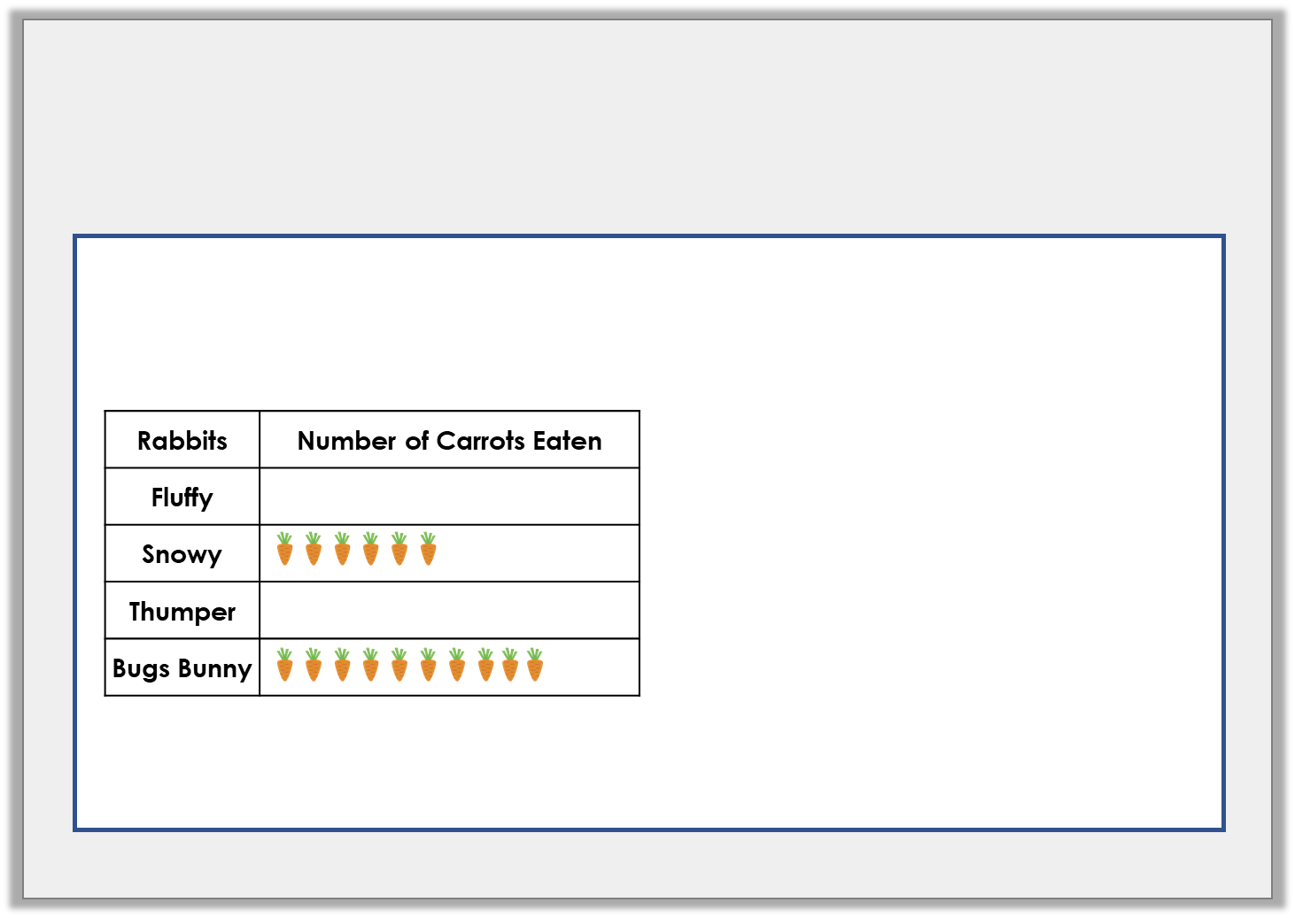
Varied Fluency 1
Use the information to complete the pictogram and the bar chart.
80
70
60
50
40
30
20
10
0
Fluffy | Snowy | Thumper | Bugs Bunny
1 picture = 5 carrots
Y3
© Classroom Secrets Limited 2019

Slide 9
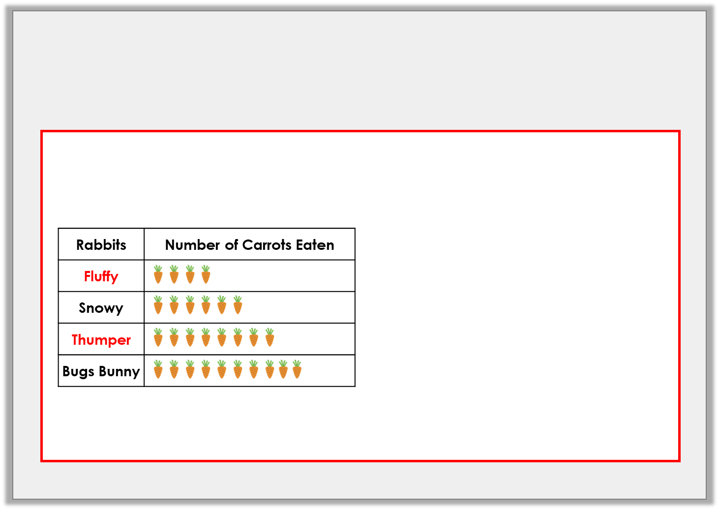
Varied Fluency 1
Use the information to complete the pictogram and the bar chart.
80
70
60
50
40
30
20
10
0
Fluffy | Snowy | Thumper | Bugs Bunny
1 picture = 5 carrots
Y3
© Classroom Secrets Limited 2019

Slide 10
Varied Fluency 2
Use this bar chart to answer the questions about goals scored in a tournament.
Which team scored the most goals?
B. How many more goals did Team A score than Team D?
C. How many goals did Teams C and E score altogether?
D. How many goals were scored in total?
35
30
25
20
15
10
5
0
Team A | Team B | Team C | Team D | Team E
Y3
© Classroom Secrets Limited 2019

Slide 11
Varied Fluency 2
Use this bar chart to answer the questions about goals scored in a tournament.
Which team scored the most goals?
B. How many more goals did Team A score than Team D?
C. How many goals did Teams C and E score altogether?
D. How many goals were scored in total?
35
30
25
20
15
10
5
0
Team A | Team B | Team C | Team D | Team E
Team E
15
45
85
Y3
© Classroom Secrets Limited 2019

Slide 12

Varied Fluency 3
Create a bar chart using this tally chart.
Write on the correct scale and labels.
Favourite Dinosaur | Number of Children
T-Rex
Triceratops
Raptor
Diplodocus
Y3
© Classroom Secrets Limited 2019

Slide 13
Varied Fluency 3
Create a bar chart using this tally chart.
Write on the correct scale and labels.
35
30
25
20
15
10
5
0
T-Rex | Tri | Raptor | Dip
Favourite Dinosaur | Number of Children
T-Rex
Triceratops
Raptor
Diplodocus
Y3
© Classroom Secrets Limited 2019

Slide 14
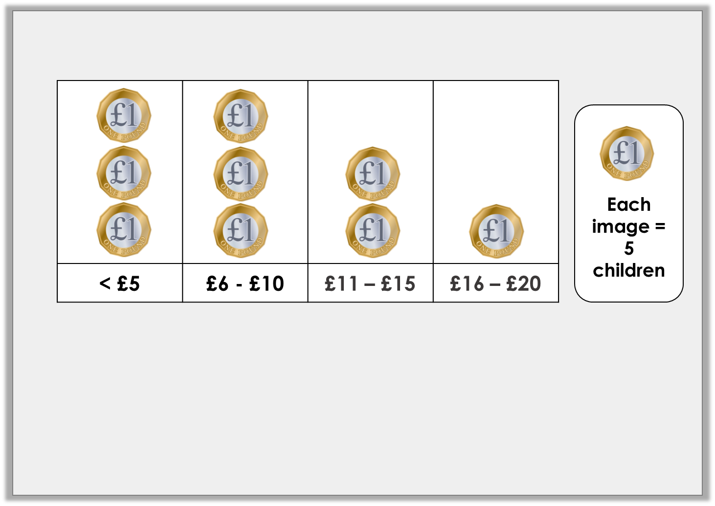
Varied Fluency 1
Look at this pictogram.
Complete the missing information in the table.
Pocket Money
< £5 | £6 – £10 | £11 – £15 | £16 – £20
 |  | 10
Y4
© Classroom Secrets Limited 2019

Slide 15
Varied Fluency 1
Look at this pictogram.
Complete the missing information in the table.
Pocket Money
< £5 | £6 – £10 | £11 – £15 | £16 – £20
15 | 15 | 10 | 5
Y4
© Classroom Secrets Limited 2019

Slide 16
Varied Fluency 2
Think of one question to ask about the information in this tally chart:
Holiday Destinations
UK
Europe
Rest of the World
Y4
© Classroom Secrets Limited 2019

Slide 17
Varied Fluency 2
Think of one question to ask about the information in this tally chart:
Example answers:
How many people stayed in the UK for their holiday?
Which is the least popular destination?
How many people were asked in total?
How many more people stayed in the UK than travelled to Europe?
Holiday Destinations
UK
Europe
Rest of the World
Y4
© Classroom Secrets Limited 2019

Slide 18
Varied Fluency 3
Use the information in the table to create a bar chart.
Colour of Cars Passing the School
Silver | 35
Red | 40
Blue | 55
 | Silver |  | Red |  | Blue
Y4
© Classroom Secrets Limited 2019

Slide 19
Varied Fluency 3
Use the information in the table to create a bar chart.
Colour of Cars Passing the School
Silver | 35
Red | 40
Blue | 55
 | Silver |  | Red |  | Blue
Discuss which scale to use: 1s, 2s, 5s, 10s, 20s
How will you
show 35? 55?
Y4
© Classroom Secrets Limited 2019

Slide 20
Varied Fluency 3
Use the information in the table to create a bar chart.
Silver | 35
Red | 40
Blue | 55
Colour of Cars Passing the School
60
40
20
0
 | Silver |  | Red |  | Blue
Number of Trains
Time
Y4
© Classroom Secrets Limited 2019

Slide 21
Varied Fluency 4
Use the bar chart to answer the questions.
60
45
30
15
0
Cake Sales
How many cakes were sold on Monday?
What is the most cakes sold in one day?
On which day were the least amount of cakes sold?
Mon | Tues | Wed | Thurs | Fri
Y4
© Classroom Secrets Limited 2019

Slide 22
Varied Fluency 4
Use the bar chart to answer the questions.
60
45
30
15
0
Cake Sales
How many cakes were sold on Monday? 45
What is the most cakes sold in one day? 60 on Wednesday
On which day were the least amount of cakes sold? Tuesday and Thursday
Mon | Tues | Wed | Thurs | Fri
Y4
© Classroom Secrets Limited 2019

Slide 23
Problem Solving 1
Here is a bar chart to show Year 3’s favourite drinks.
More children like juice than tea, but fewer like juice than milk. Complete the bar chart showing how many children could like tea and juice?
14
12
10
8
6
4
2
0
Water | Milk | Tea | Juice | Cola
Y3
© Classroom Secrets Limited 2019

Slide 24
Problem Solving 1
Here is a bar chart to show Year 3’s favourite drinks.
More children like juice than tea, but fewer like juice than milk. Complete the bar chart showing how many children could like tea and juice?
Various answers, for example:
2-10 children could like juice and tea must be fewer than juice.
14
12
10
8
6
4
2
0
Water | Milk | Tea | Juice | Cola
Y3
© Classroom Secrets Limited 2019

Slide 25

Reasoning 1
Ben draws a bar chart to show the Year 3 children's favourite type of PE lesson.
Ben says,
Is he correct? Explain your answer.
14
12
10
8
6
4
2
0
Gym | Dance | Games | Athletics
2 children like athletics.
Y3
© Classroom Secrets Limited 2019

Slide 26
Reasoning 1
Ben draws a bar chart to show the Year 3 children's favourite type of PE lesson.
Ben says,
Is he correct? Explain your answer.
Ben is not correct because…
14
12
10
8
6
4
2
0
Gym | Dance | Games | Athletics
2 children like athletics.
Y3
© Classroom Secrets Limited 2019

Slide 27
Reasoning 1
Ben draws a bar chart to show the Year 3 children's favourite type of PE lesson.
Ben says,
Is he correct? Explain your answer.
Ben is not correct because the scale goes up in 2s. 4 children like athletics.
14
12
10
8
6
4
2
0
Gym | Dance | Games | Athletics
2 children like athletics.
Y3
© Classroom Secrets Limited 2019

Slide 28

Problem Solving 2
A class collects data about houses.
Draw a bar chart to display this information. Choose a suitable scale.
5 more children live in a flat than in a terraced house.
5 children live in a detached house.
10 fewer children live in a terraced house than a semi.
20 children live in a semi-detached house.
Y3
© Classroom Secrets Limited 2019

Slide 29
Problem Solving 2
An accurate bar chart. The scale should go up in 5s.
35
30
25
20
15
10
5
0
Flat | Terraced | Semi | Detached
Y3
© Classroom Secrets Limited 2019

Slide 30

Reasoning 1
The school kitchen are collecting ideas for recipes by asking the children their favourite food.
Who do you agree with and why?
I want to use a pictogram to draw each meal.
Jayden
I think a choice of 4 meals and a bar chart would work best.
Hakeem
Y4
© Classroom Secrets Limited 2019

Slide 31
Reasoning 1
The school kitchen are collecting ideas for recipes by asking the children their favourite food.
Who do you agree with and why?
Hakeem has the best idea because…
I want to use a pictogram to draw each meal.
Jayden
I think a choice of 4 meals and a bar chart would work best.
Hakeem
Y4
© Classroom Secrets Limited 2019

Slide 32
Reasoning 1
The school kitchen are collecting ideas for recipes by asking the children their favourite food.
Who do you agree with and why?
Hakeem has the best idea; it will be quick and simple to collect the data and make people’s decision making much easier.
I want to use a pictogram to draw each meal.
Jayden
I think a choice of 4 meals and a bar chart would work best.
Hakeem
Y4
© Classroom Secrets Limited 2019

Slide 33
Reasoning 2
True or false?
Explain your answer.
The lines on a chart are called axels.
Y4
© Classroom Secrets Limited 2019

Slide 34
Reasoning 2
True or false?
Explain your answer.
False, the lines are called the y-axis and the x-axis
(or axes).
The lines on a chart are called axels.
Y4
© Classroom Secrets Limited 2019

Slide 35
Problem Solving 1
Mr Thompson says this tally chart is not easy to interpret.
Find 2 ways in which you could make the chart easier to interpret.
Height of Pupils in Oak Class
< 1 metre
> 1 metre
Y4
© Classroom Secrets Limited 2019

Slide 36
Problem Solving 1
Mr Thompson says this tally chart is not easy to interpret.
Find 2 ways in which you could make the chart easier to interpret.
The tally should be 5 strokes so counting is easier.
The options could be broken into smaller steps e.g. 90cm to 1m, 1m to 1.5m, 1.5 to 2m as the data is not very useful with such a large range.
Height of Pupils in Oak Class
< 1 metre
> 1 metre
Y4
© Classroom Secrets Limited 2019

