Slide 2



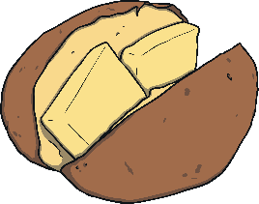


Where Does Food Come From?
What is your favourite food?
Do you know where it comes from?

Slide 3
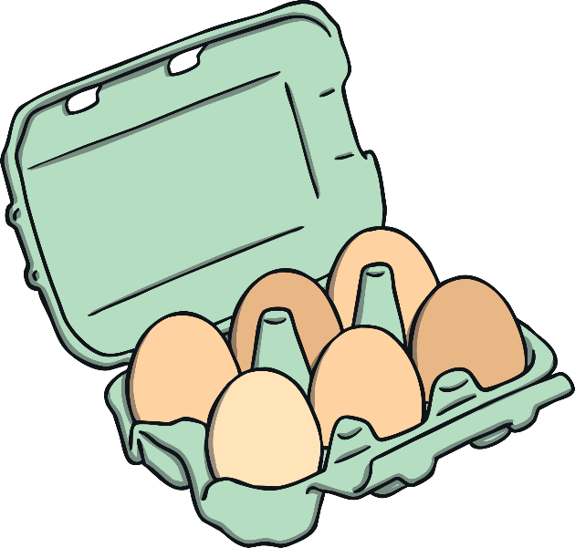
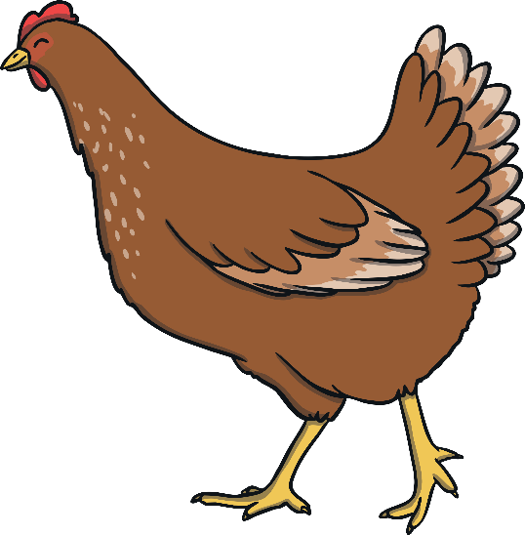
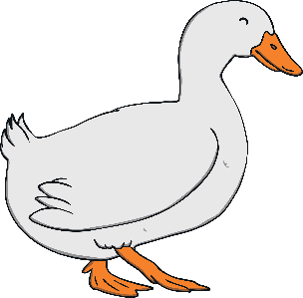
Eggs
Where do eggs come from?
Eggs come from hens.
Hens often live on farms or in barns. They lay eggs and farmers collect them. We sometimes eat eggs on their own but we can also mix them into other foods, such as cakes and yorkshire puddings.
Fun Fact!
Hens are not the only birds that lay eggs that we can eat.
You might find duck or quail eggs in a shop too!

Slide 4
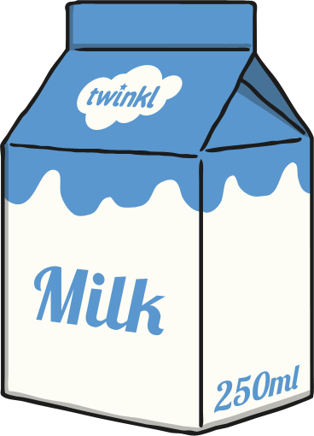
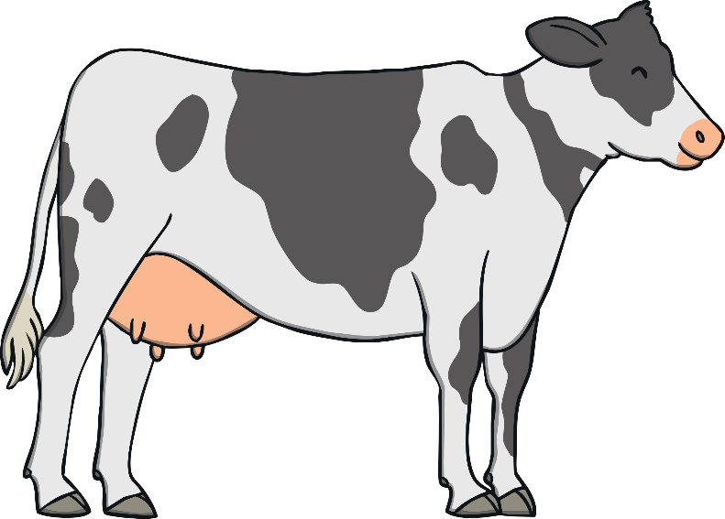

Milk
Where does milk come from?
Milk comes from cows.
Cows often live on dairy farms. The farmer milks the cows with a special machine and stores the milk in a big tank. Then, a tanker lorry comes and takes it to a factory to treat it and put it into bottles.
Fun Fact!
Milk is used as the main ingredient in other foods we use too,
like butter, yoghurt and cheese!

Slide 5





Bread
Where does bread come from?
Bread is made from wheat.
Farmers grow wheat in their fields. In the summer, they harvest the wheat using a combine harvester. The farmers mill the grain by grinding it between two stones. This then makes flour. Flour is the main ingredient in bread.
Fun Fact!
To make bread, you also need water, yeast and salt.

Slide 6

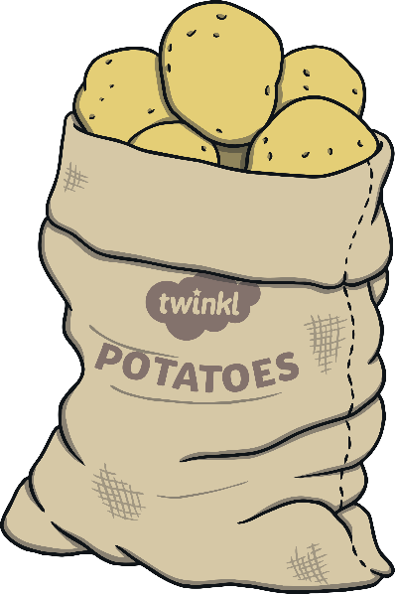
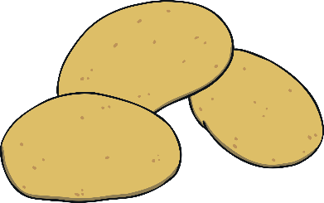
Chips
Where do chips come from?
Chips are made from potatoes.
Farmers grow potatoes in their fields. Potatoes grow underground. In summer, the farmers dig the potatoes up and store them in big sacks. We can cook potatoes in different ways, such as roast potatoes, jacket potatoes, mashed potatoes and chips!
Fun Fact!
Potatoes are one of the vegetables that can be grown in space.

Slide 7
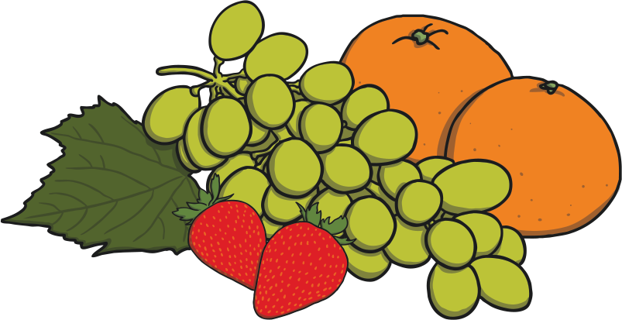



Fruit
Where does fruit come from?
Fruit grows on trees, bushes and plants. Some fruits need hot weather to grow, such as mangoes, oranges and pineapples. So, they grow in hot countries. Other fruits, such as apples, pears and plums, do not need hot weather. These are fruits that can be grown in the UK.
Fun Fact!
There are over 7,000 different types of apple.

Slide 8
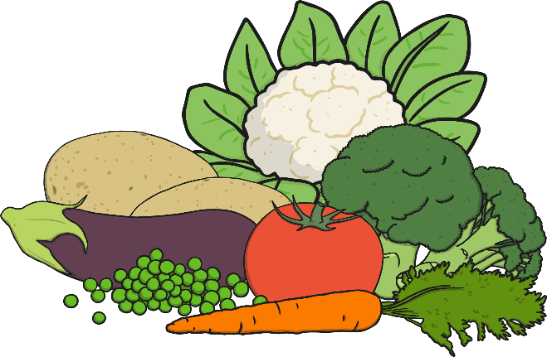
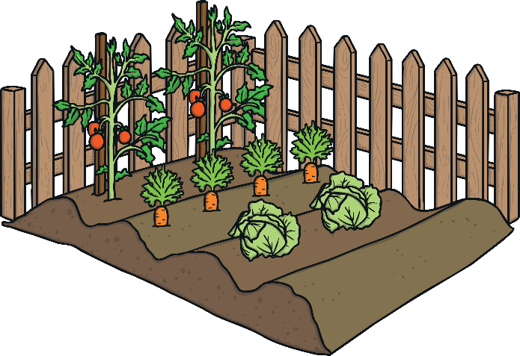
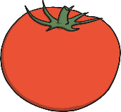
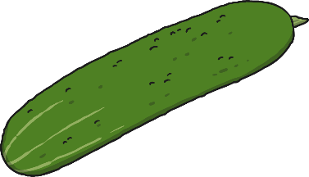
Vegetables
Where do vegetables come from?
Vegetables grow on plants and underground.
Some vegetables grow above ground and others grow underground.
Potatoes, beetroots, carrots and turnips all grow underground.
Beans, cabbages, lettuces, cauliflower and broccoli all grow above ground.
Fun Fact!
Tomatoes and cucumbers are fruits, not vegetables.

Slide 9


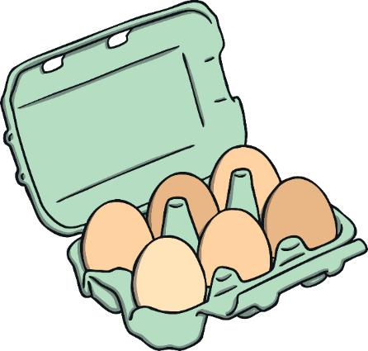

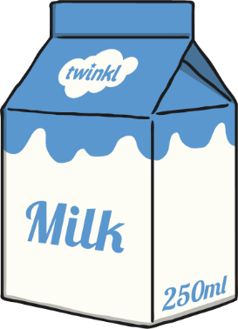


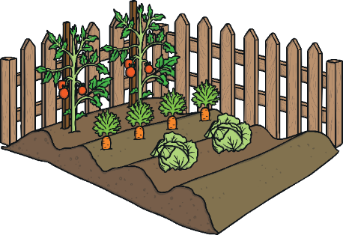

Can You Remember Where These Foods Come From?

