Slide 1
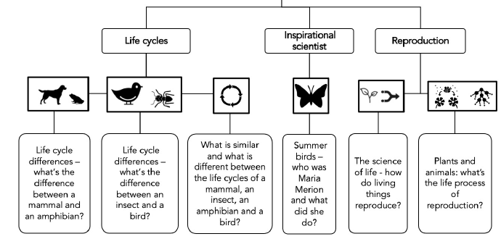
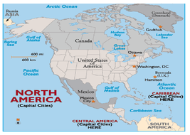
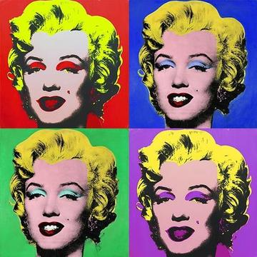
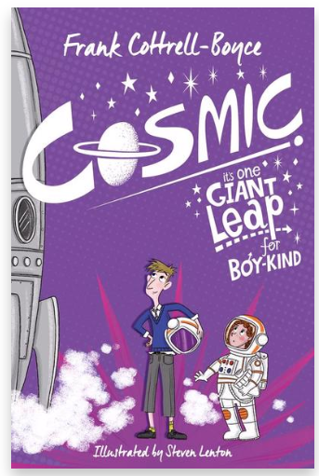


In Science, we will be looking at Living Things and Habitats
Foxes Class Spring 1 – 2022
What’s so Special about the USA?
As geographers, we will be looking at the countries in North America, focusing particularly on the USA. We will locate the states of the USA, describe key aspects of physical and human geography and focus on researching one particular state, comparing facts.
In English, we will be writing a narrative based on ‘Cosmic’
As authors, we will be looking at the sci-fi story ‘Cosmic’ by Frank Cottrell-Boyce. Liam is too big for his boots. And his football strip. And his school blazer. But being super-sized height-wise has its advantages: he's the only eleven-year-old to ever ride the G-force-defying Cosmic rollercoaster - or to be offered the chance to drive a Porsche. Long-legged Liam makes a giant leap for boy-kind by competing with a group of adults for the chance to go into space. Is Liam the best boy for the job? Sometimes being big isn't all about being a grown-up.
In PSHE, we will be looking at Diversity and Communities. We will be looking at our sense of personal identity and self-worth as well as considering and respecting the needs and views of others. We will be looking at the ethnic make up of our communities and the benefits of living in a diverse society.
Andy Warhol (1928-87) was an American artist, director, and producer who was a leading figure in the visual art movement known as pop art.
In art we will look at the pop art scene and produce our own pictures based on the work of Andy Warhol.

Slide 2
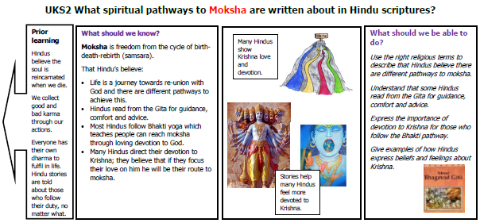
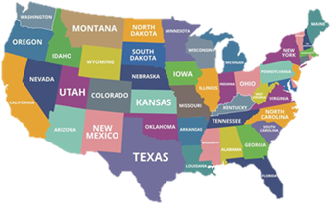
Key Vocabulary | Definition | Key Vocabulary | Definition
immigration | The action of coming to live permanently in a foreign country. | economic | Making enough money; profitable.
metamorphosis | The process of transformation from an immature form to an adult form in two or more distinct stages. | density | How thick or tightly packed something is; population density is the measurement of the total number of people in the area.
pollination | The transfer of pollen to a stigma, ovule, flower, or plant to allow fertilisation. | governance | The action or manner of governing a state or organisation.
specification | A detailed description of the design and materials used to make something. | prairie | A large area of grassland.
proportion | A part, share, or number considered in relation to a whole. | embryo | An unborn or unhatched offspring in the process of development.
significance | Importance. | principle | A rule or belief about what a person thinks is right.
Physical development, Health and Well-being
Curriculum drivers: Knowledge of Community in the World
PE: Gymnastics & basketball
Value: Courage

