Slide 1


Maths
Addition and Subtraction
Year One
Maths | Addition and Subtraction | Solve Problems | Lesson 4 of 4: Addition and Subtraction Problems Crossing 10

Slide 2
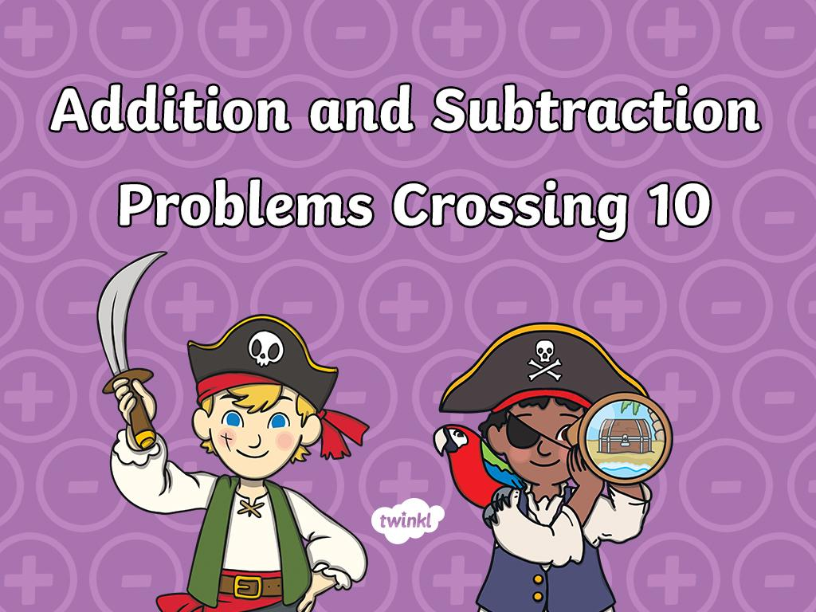

Slide 3
Aim
To solve addition and subtraction problems crossing ten.
Success Criteria
I can solve addition problems crossing ten.
I can solve subtraction problems crossing ten.
I can select strategies to solve addition and subtraction problems crossing ten.

Slide 4

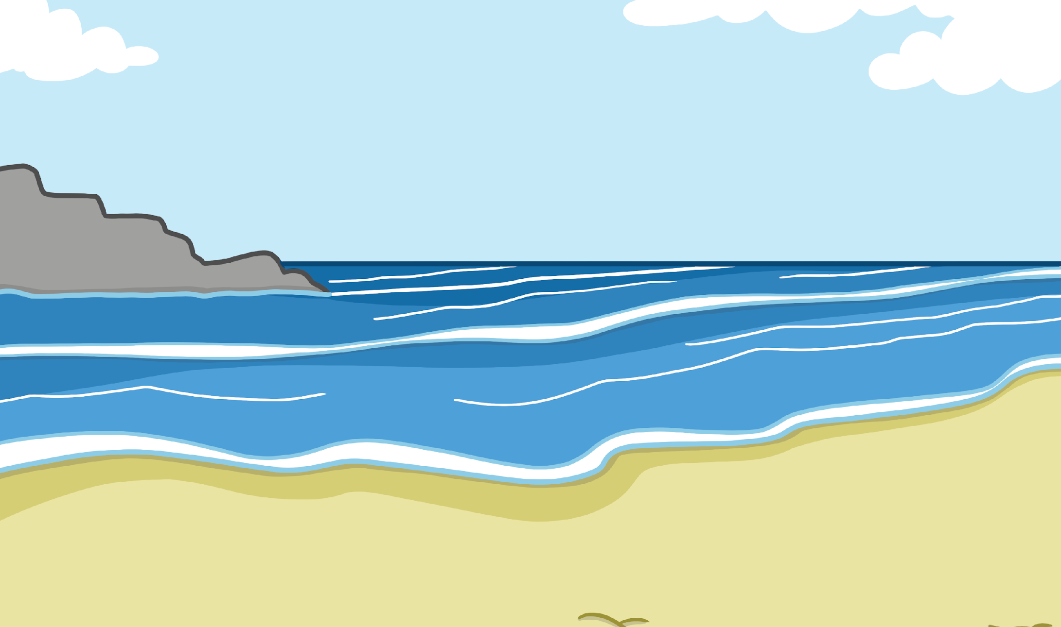
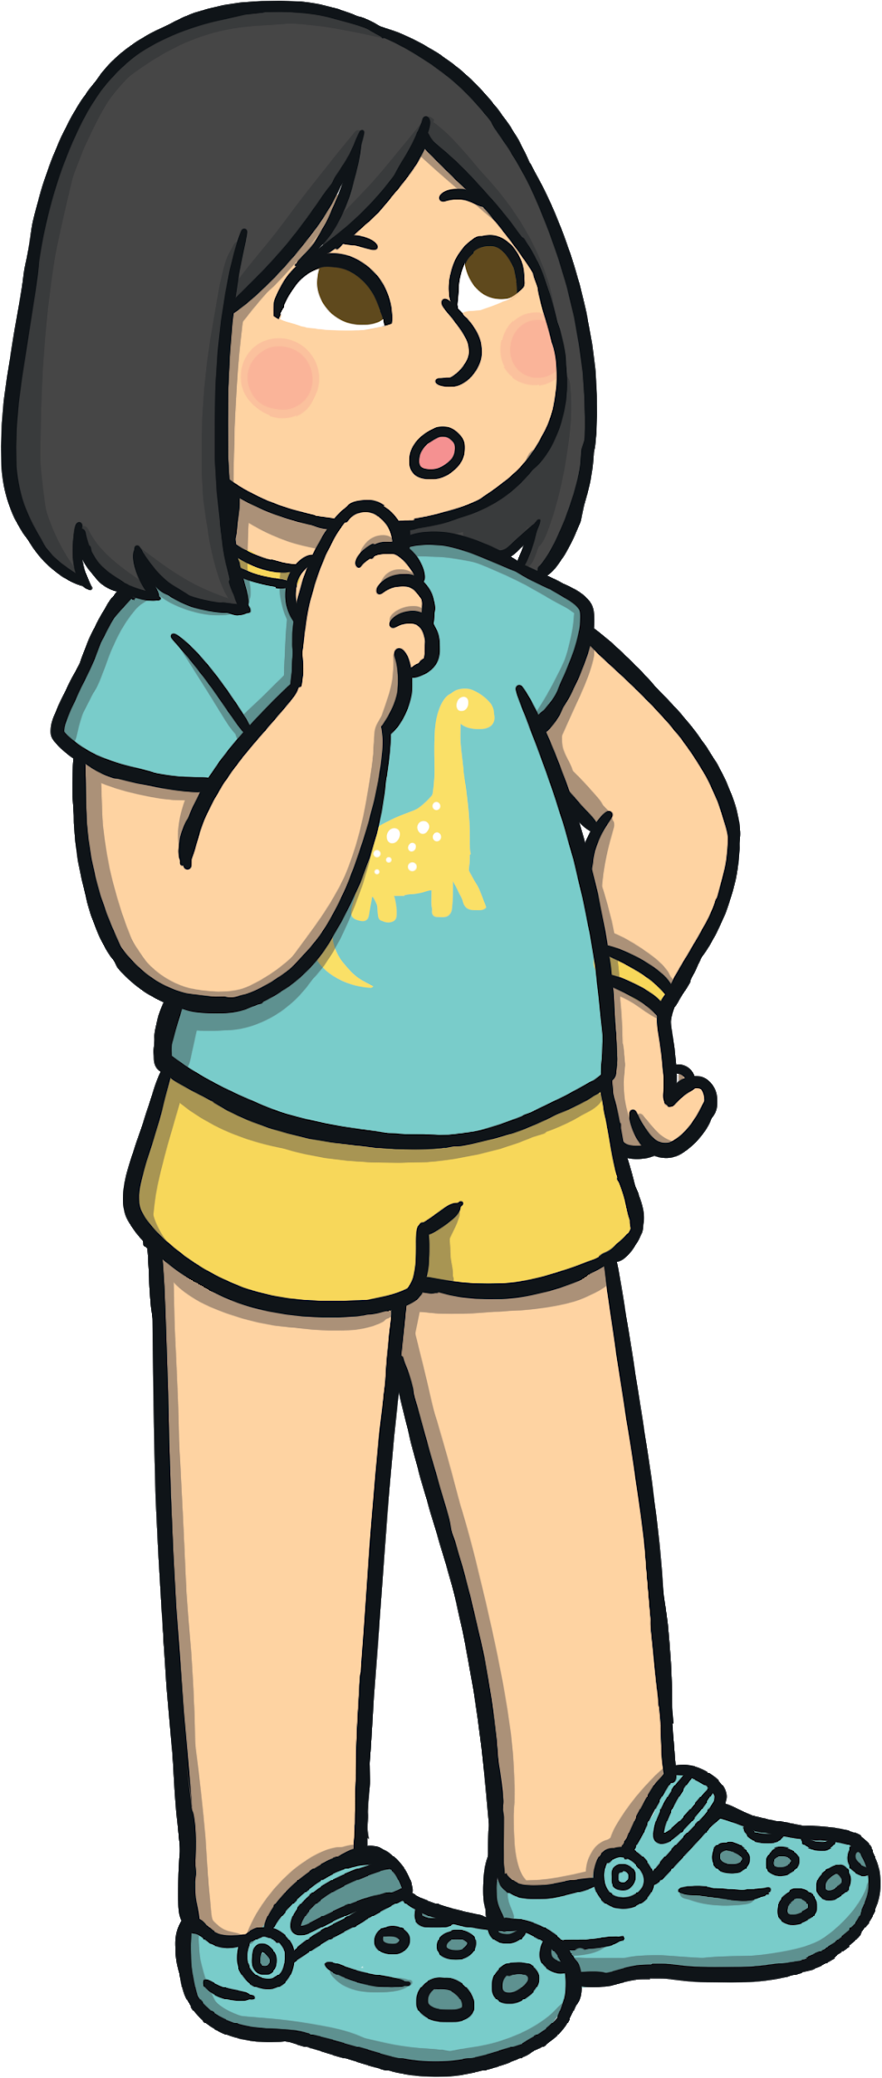
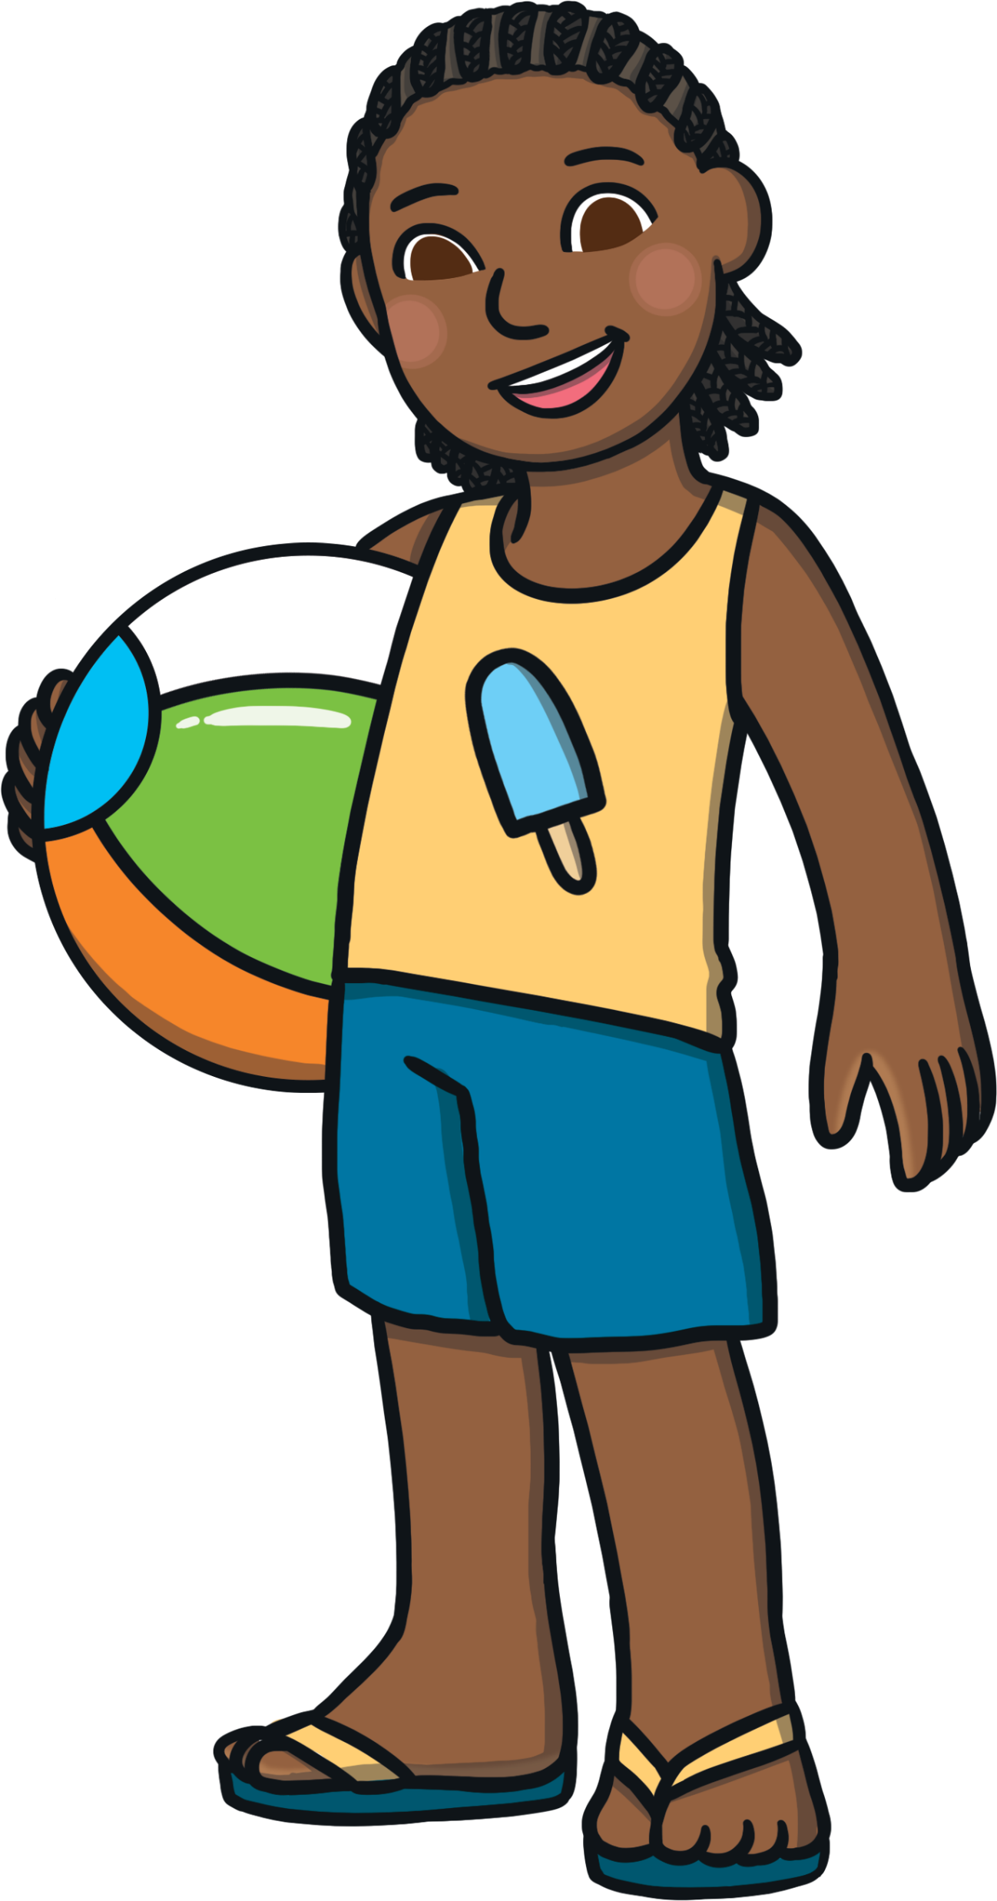
Remember It
27 + 1 5
= 42
+3
+2
+10
3
2
27
30
32
42
How can we use a number line to find
the answer?
We found the nearest ten by partitioning
the ones that we were adding.
Then we added the rest of the ones and the tens.

Slide 5

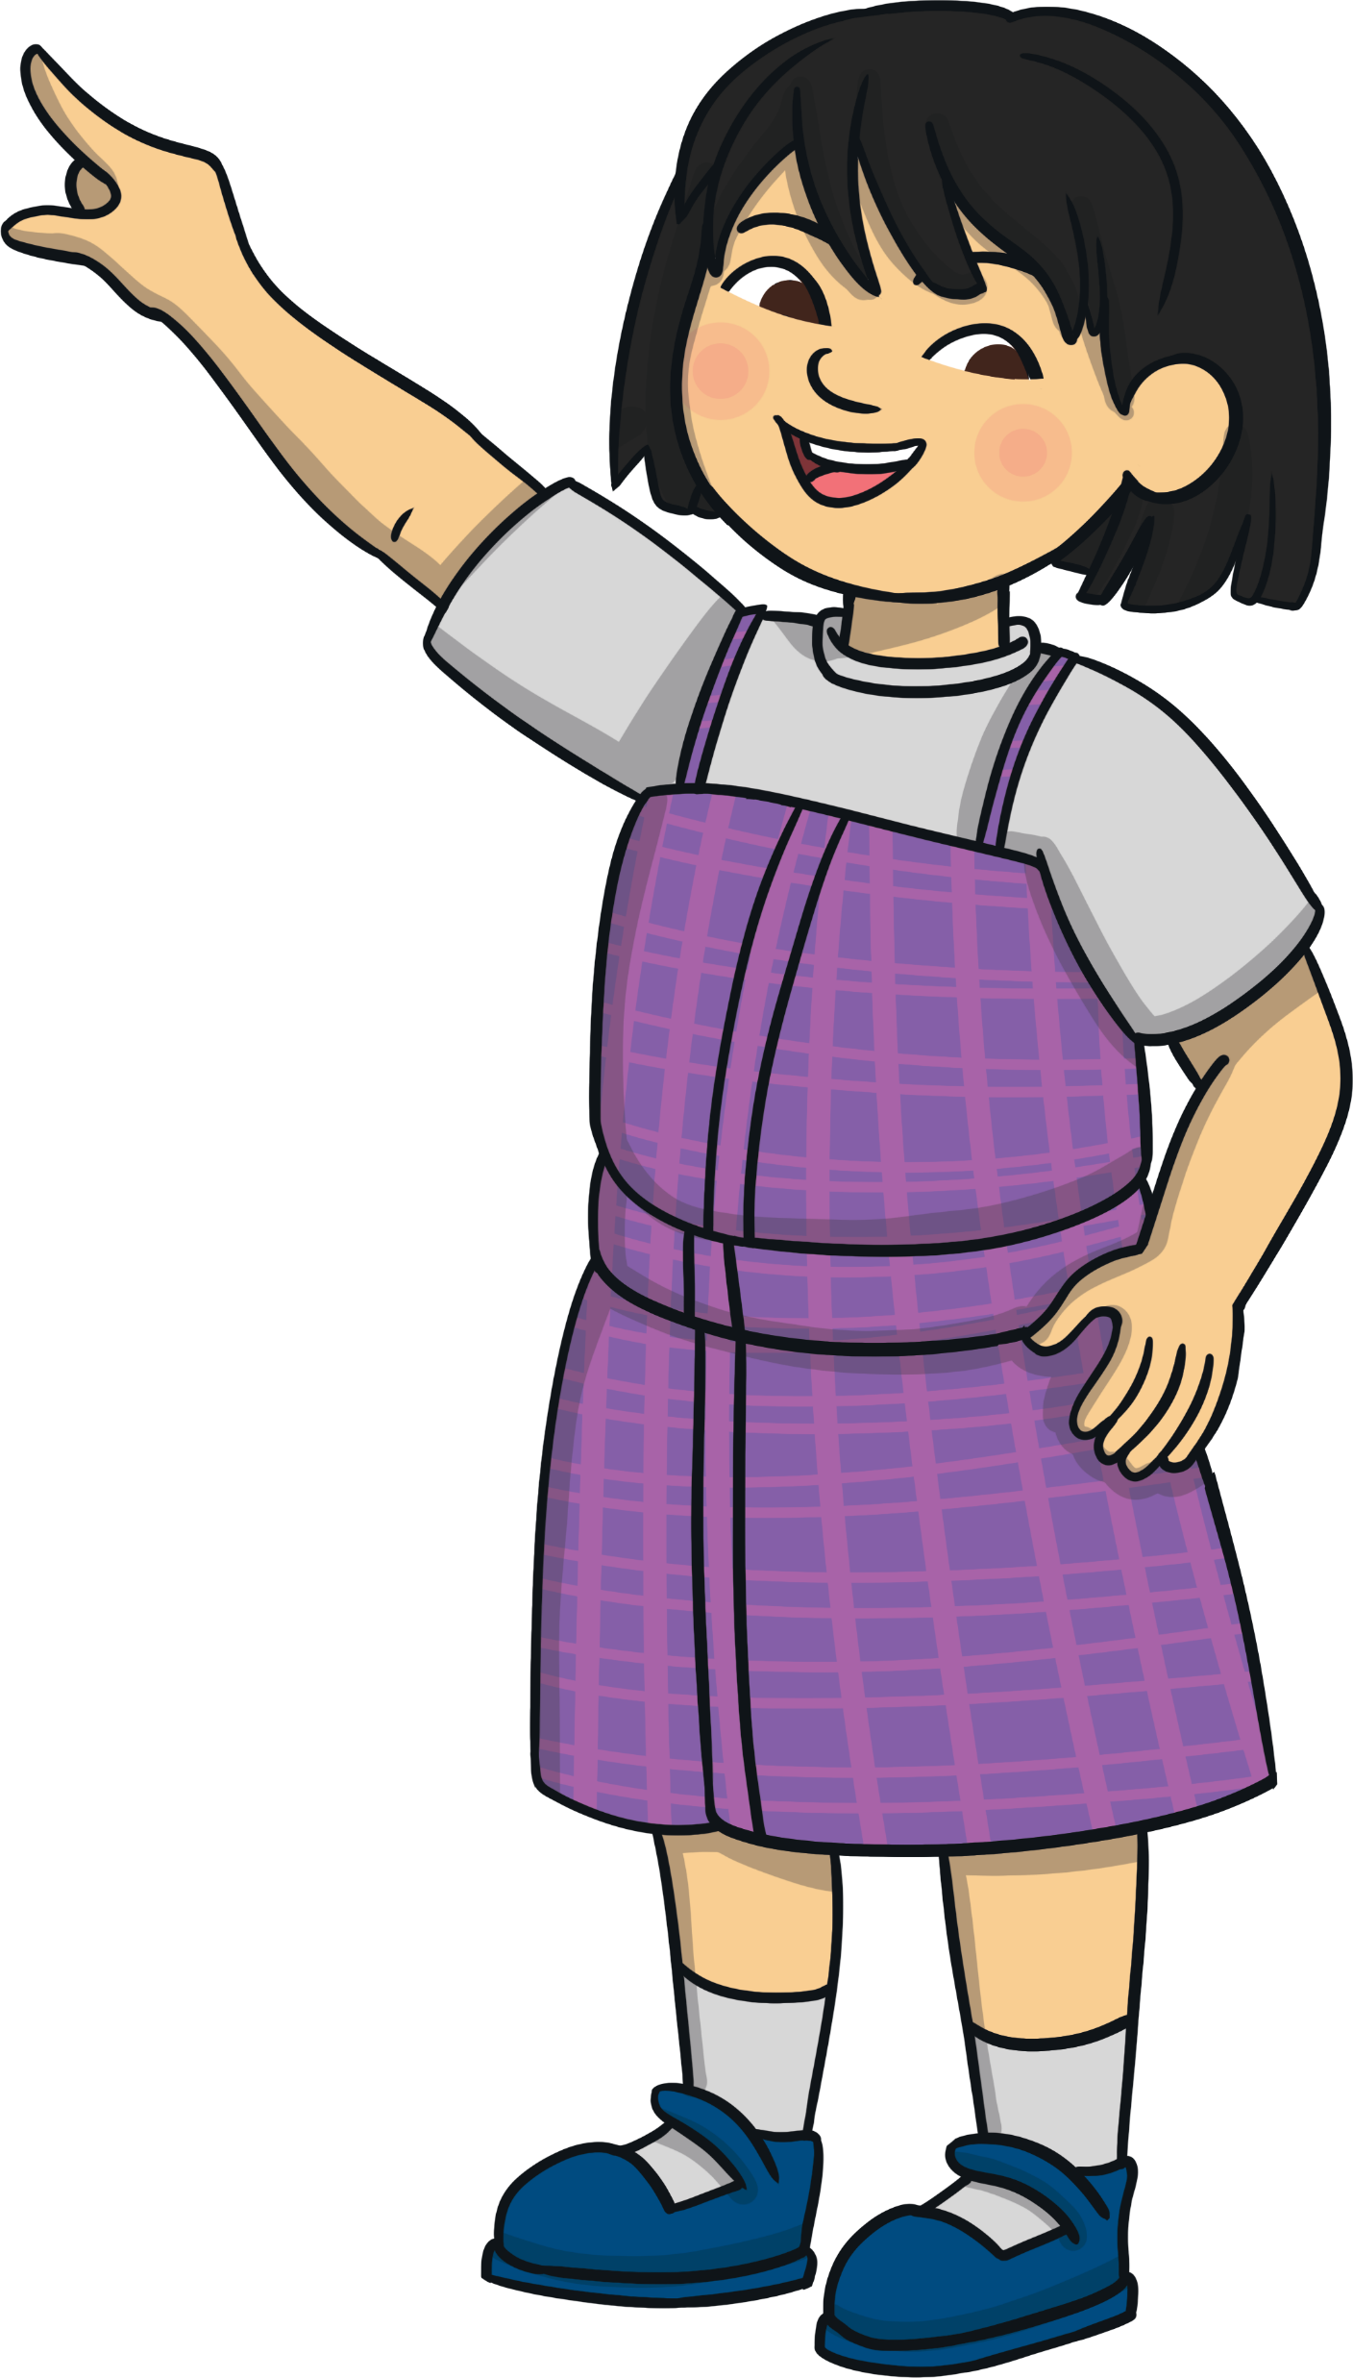
Remember It
38 + 23
= 61
Tens
Ones
10
10
10
1
1
1
1
1
1
1
1
30
8
20
3
10
10
1
1
1
30 + 20 = 50
8 + 3 = 11
50 + 11 = 61
How can we use place value counters to find the answer?
We partitioned the numbers into
ones and tens then added them.

Slide 6
Remember It
49 + 34
= 83
Tens
Ones
40 + 30 = 70
10
10
10
10
1
1
1
1
1
1
1
1
1
9 + 4 = 13
10
10
10
1
1
1
1
70 + 13 = 83
+1
+3
+30
49
50
53
83
Pick your favourite
strategy to find the answer.
Do you know another way to find the answer?

Slide 7
Remember It
52 - 14
= 38
38
48
50
52
2
2
-10
-2
-2
How can we use a number line to find the answer?
We found the nearest ten by partitioning the ones that we were subtracting.
Then, we subtracted the rest of the ones and the tens.

Slide 8

Remember It
35 - 1 7
= 18
5
2
We subtracted 7 ones by crossing out 5 counters on the incomplete ten-frame, then we crossed out the next 2. We crossed out a set of 10 to subtract 17 altogether.
How can we use ten-frames to find the answer?

Slide 9
Remember It
63 - 25
= 38
38
58
60
63
-20
-2
-3
Do you know another way to find the answer?
Pick your favourite
strategy to find the answer.

Slide 10

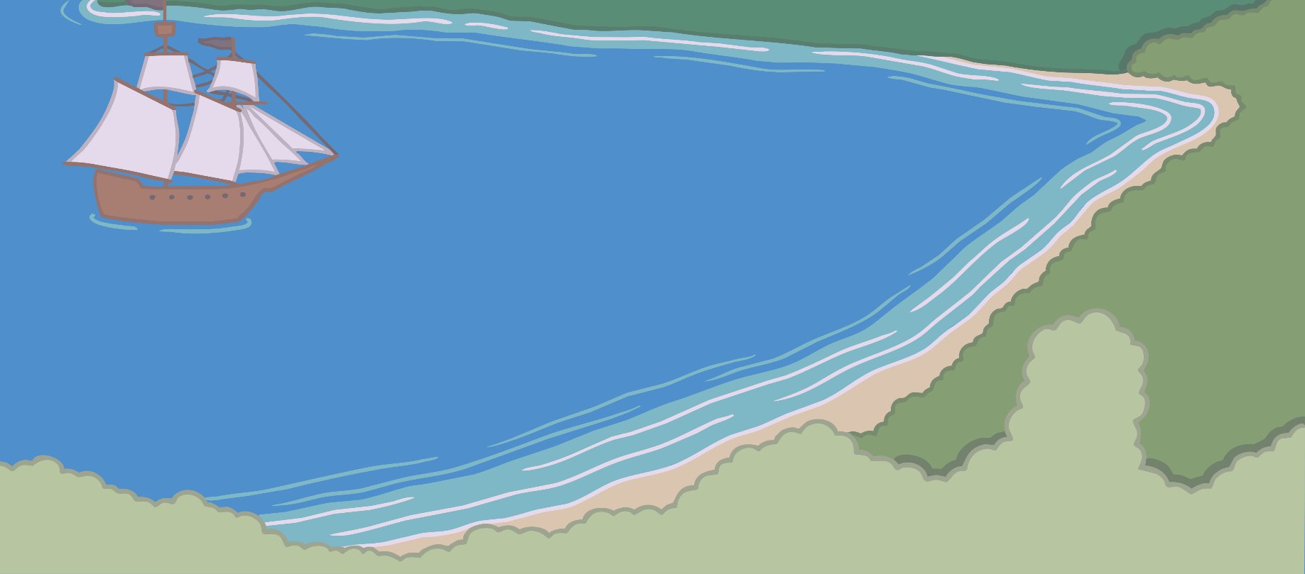
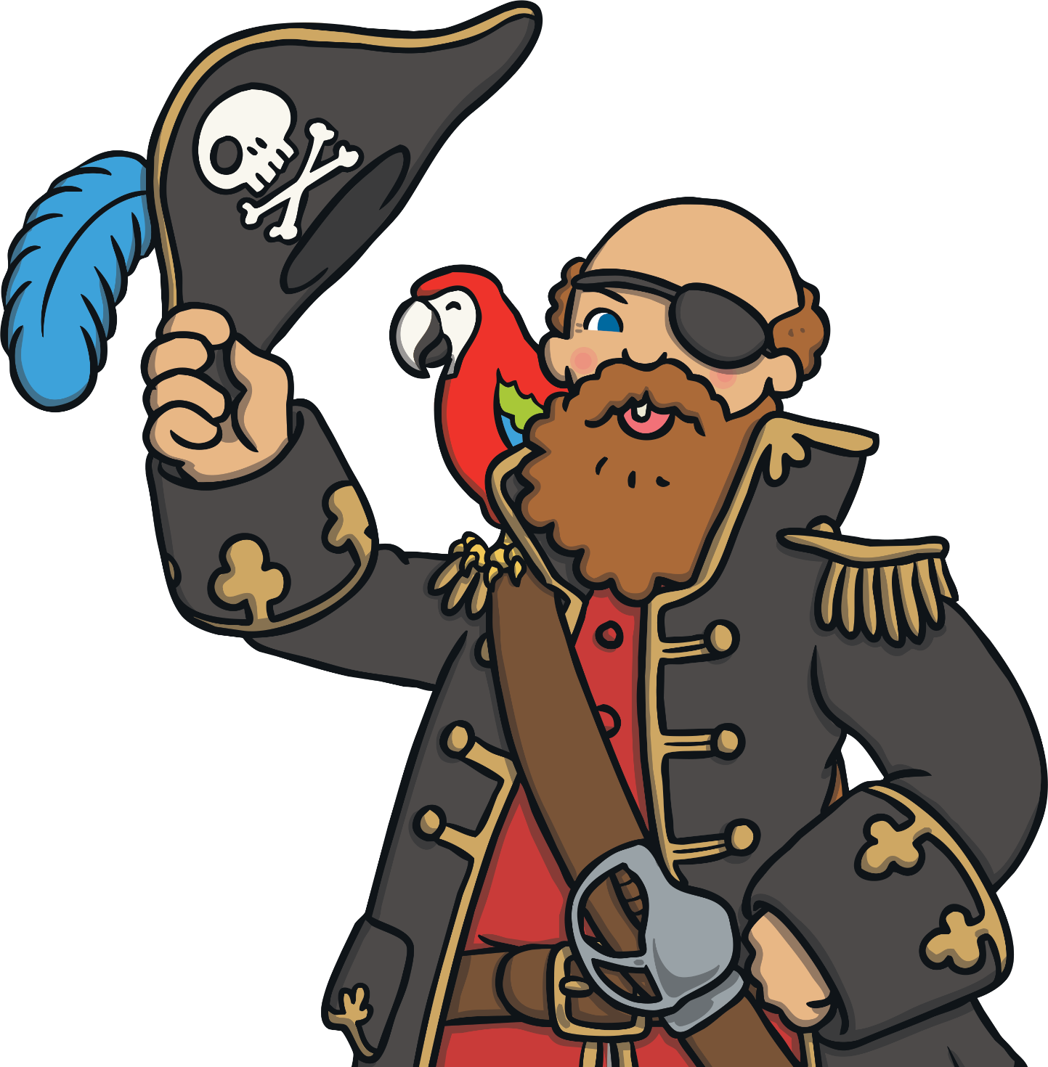
Where Is Captain Jack?
Choose a square and solve the puzzle on the scroll.
Click on the scroll to reveal the answer once you have solved the puzzle. Click on the answer square to look for what is hidden there.
Who can find Captain Jack’s hiding place?

Slide 11



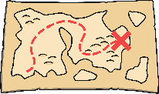
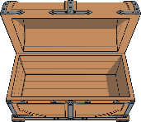
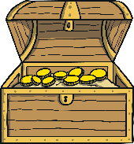

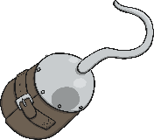
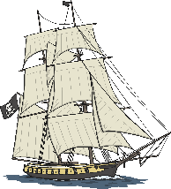


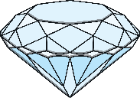

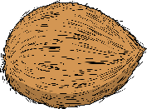
Where Is Captain Jack?
?
?
?
?
9
33
17
28
There are 24 pirates in the crew. 18 are on the ship. How many are left on the island?
I counted 16 gold and 15 silver rings in the treasure chest. How many rings did I count altogether?
I started with 31 coins in my bag, now I only have 19. How many coins fell out
my bag?
I counted 31 seashells. A wave swept 16 away. How many are left?
There was £31 in the treasure chest. The captain took £18. How much money is still in the treasure chest?
We found a necklace. It had 19 blue beads and 14 white beads. What was the total number of beads?
We found a crown with 17 red gems and 14 yellow gems. How many gems did it have altogether?
We took turns to dig for treasure. I dug for 18 minutes. My friend dug for 17 minutes. What is the total amount of time that we spent digging?
33 coconuts were growing on the tree. We picked 15, how many are still on the tree?
We dug up 45 gold and silver coins. 17 were silver. How many were gold?
We picked 26 bananas. We ate 9. How many are left?
15 pirates are searching for treasure and 8 are looking for
food. How many pirates are in our crew?
I did 17 steps to the tree then 16 steps to the rock. How many steps did I do altogether?
We saw 23 parrots in the trees. 14 flew away. How many are left?
We picked some mangos. We ate 18 and put 14 in a bag. How many mangos did we pick altogether?
We counted 42 crabs on the beach. 25 scuttled away. How many were left?
?
?
?
?
18
£13
15
23
?
?
?
?
31
33
32
17
?
?
?
?
35 minutes
12
31
6

Slide 12
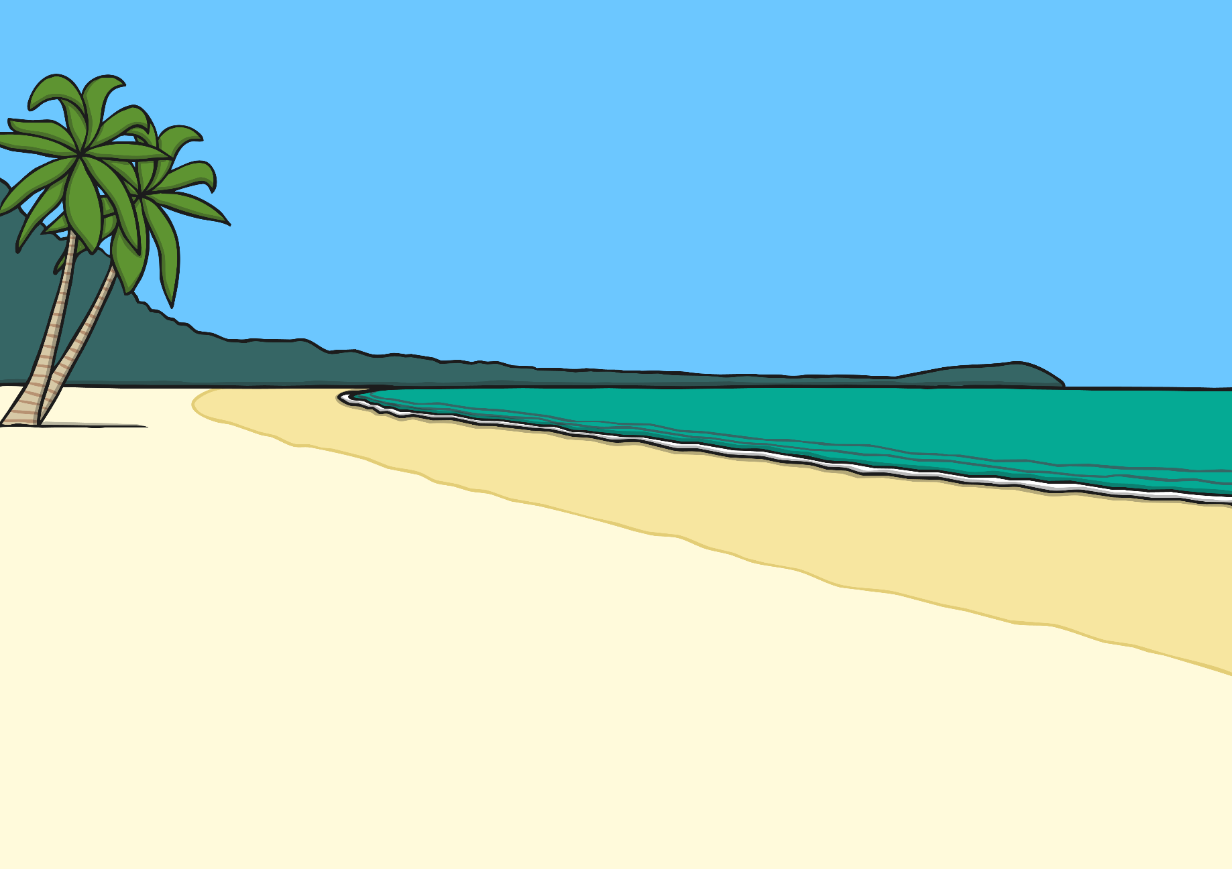
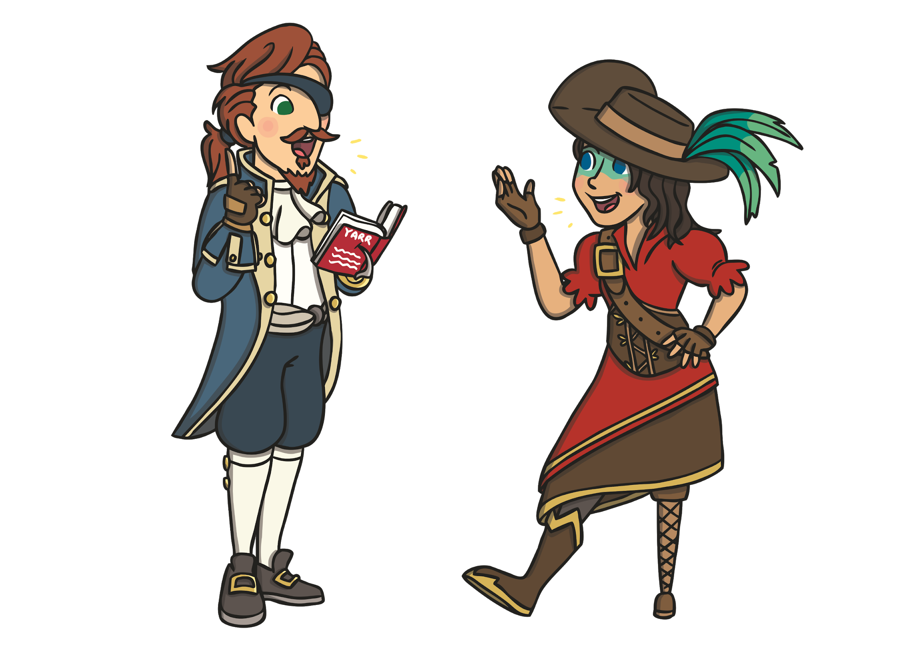
Mutiny!
There’s been a mutiny on the Black Sails.
Redbeard has run off with all the treasure and buried it
somewhere on the island!

Slide 13

Mutiny!
The pirates have captured him but he’s refusing to tell them where the treasure is. All they can find is a map and some clues.
Ha ha ha! I’m the only pirate that went to school – you’ll never solve my clues! You will never find the treasure!
We might not, but I bet the children can! Will you help us recover our lost treasure?

Slide 14
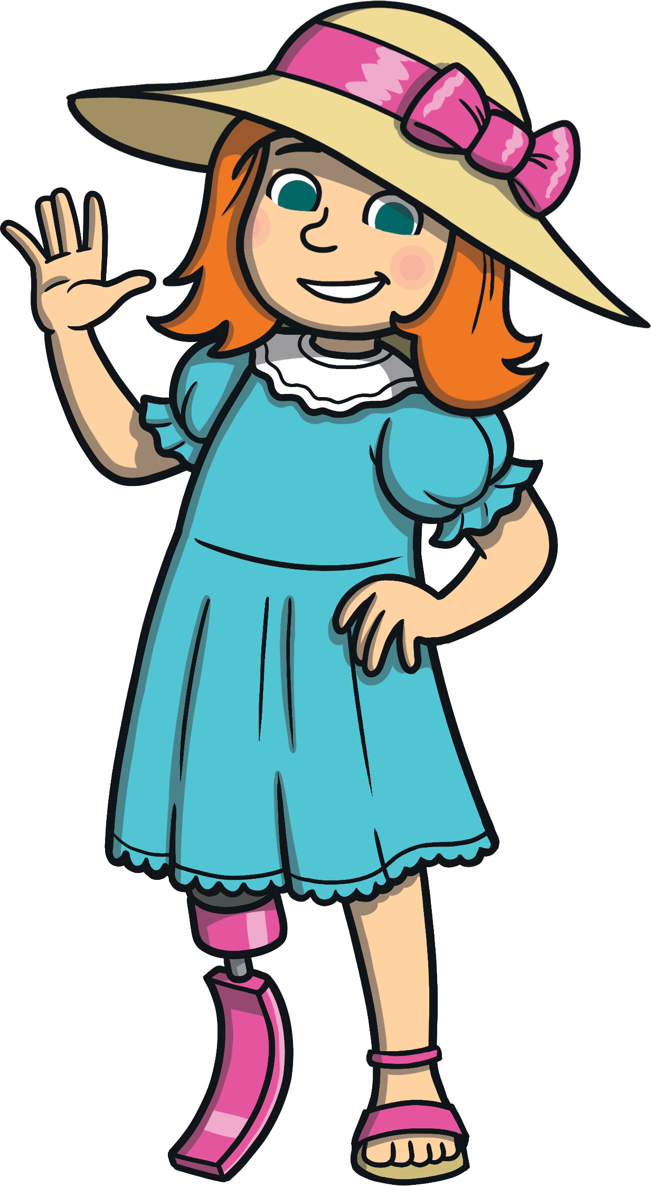
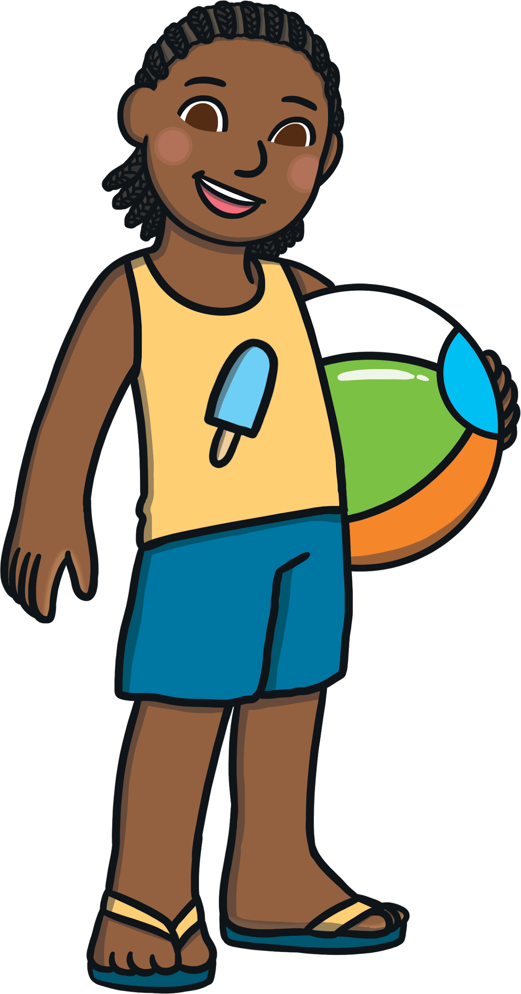
Mutiny!
Hi there, we’ve come to help you. These are tricky clues. It looks as though we’ll have to use all of our problem-solving skills!
It looks like we have to solve every challenge to find the treasure.

Slide 15

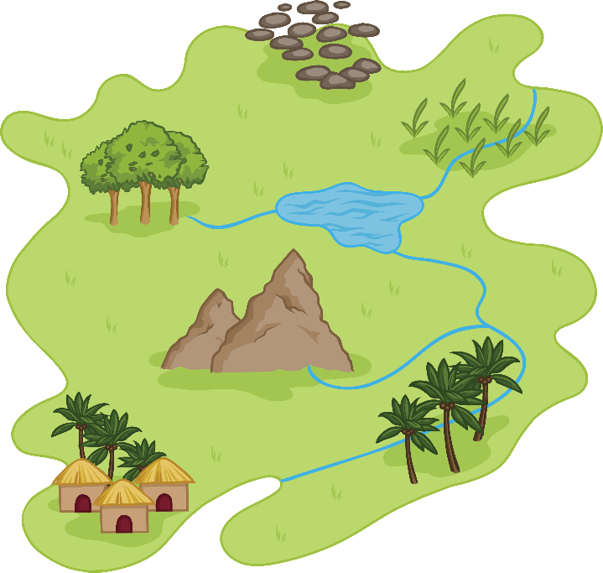
To the Rescue!
Here’s the treasure map!
Let’s try the first clue.

Slide 16
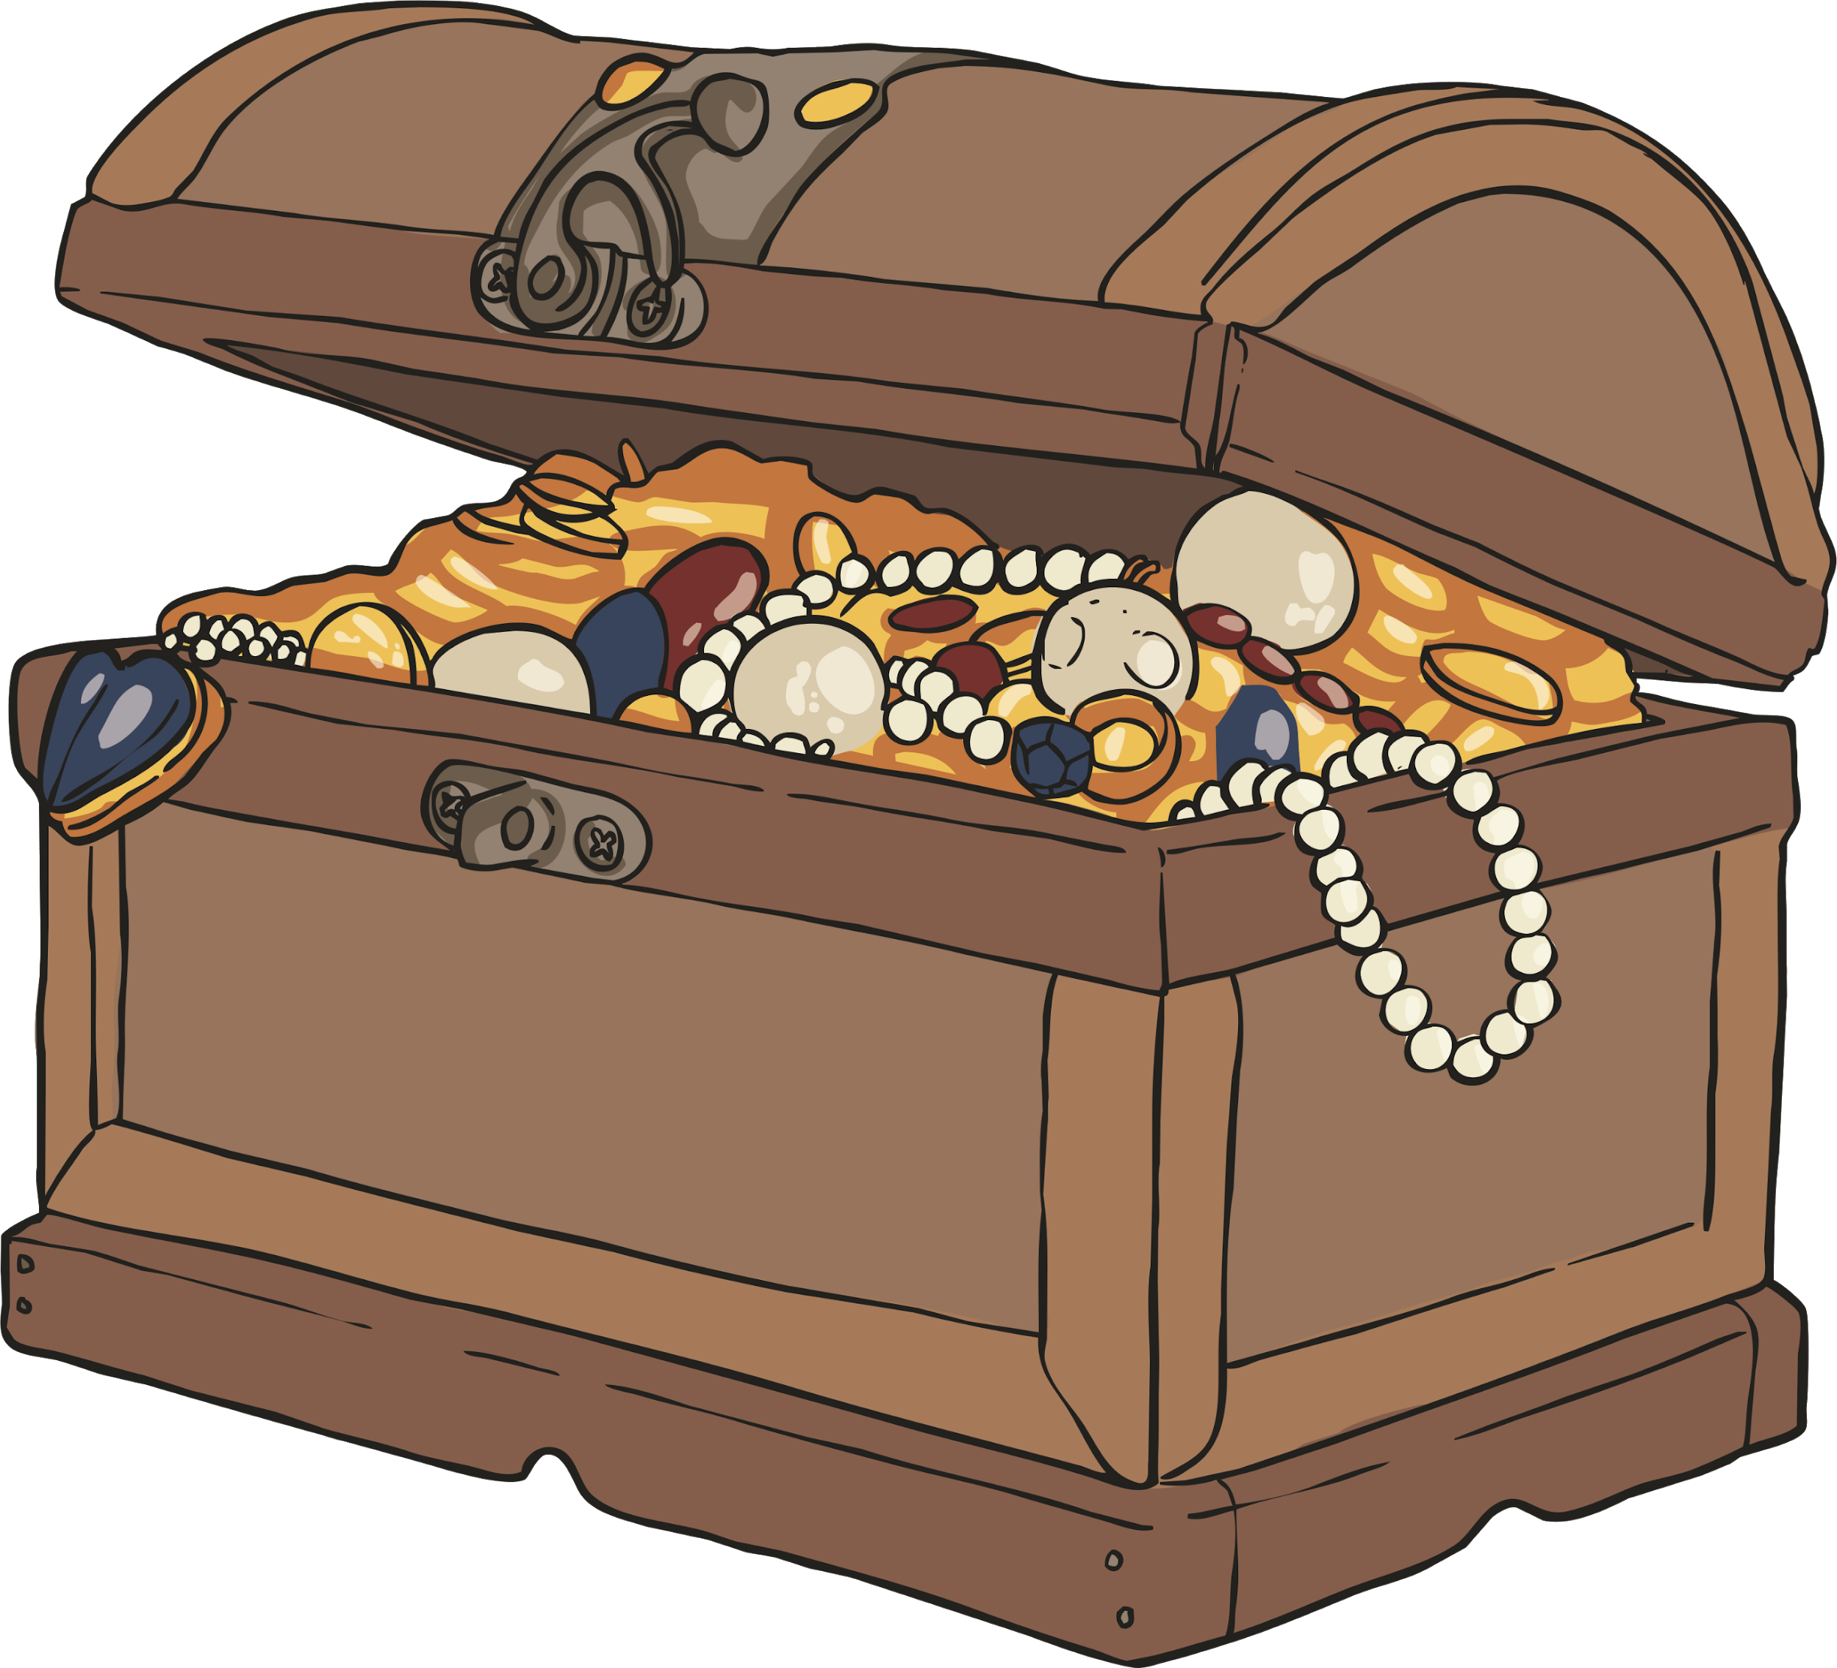
To the Rescue!
The first clue.
I had 31 jewels in my treasure chest. I took 14 out and hid them somewhere else.
How many coins are left in Redbeard’s treasure chest?

Slide 17
To the Rescue!
31 - 14
= 17
The pirates could use different
strategies to solve different challenges.
They could solve this with ten-frames.

Slide 18
To the Rescue!
31 - 14
= 17
17
27
30
31
-10
-3
-1
Or number lines.
Which strategy would you choose?

Slide 19
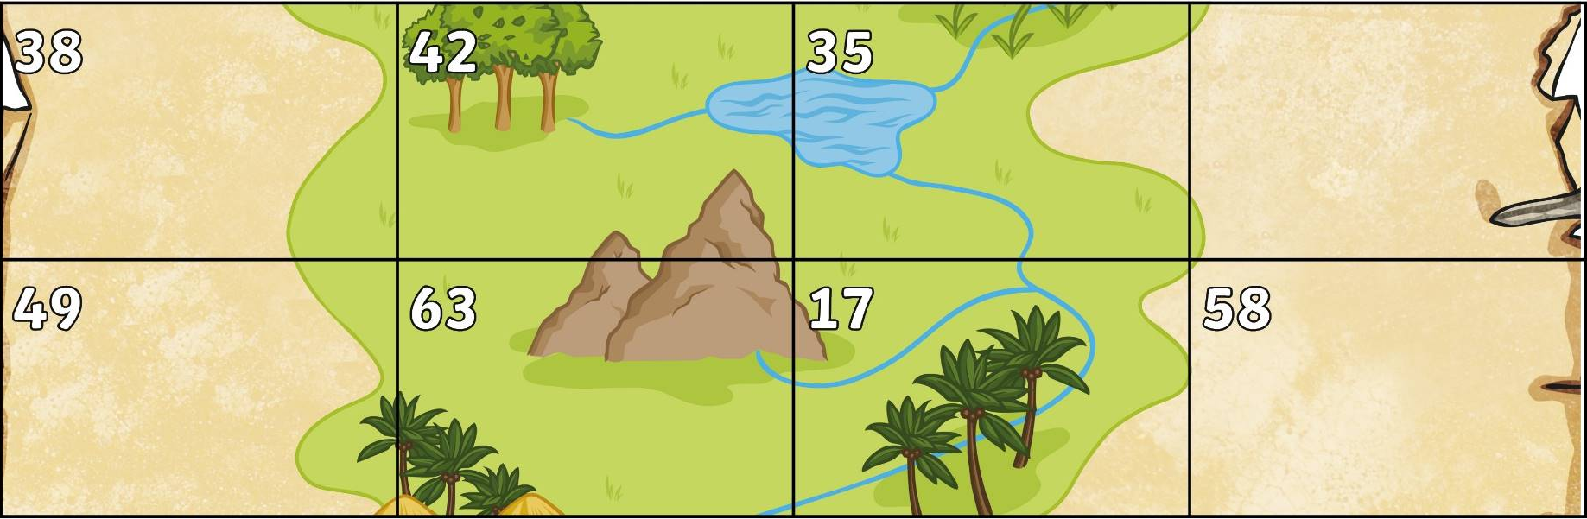

To the Rescue!
We know the treasure is not in square 17, so we can cross it out.
When we have solved all the puzzles, we will know where to dig!

Slide 20

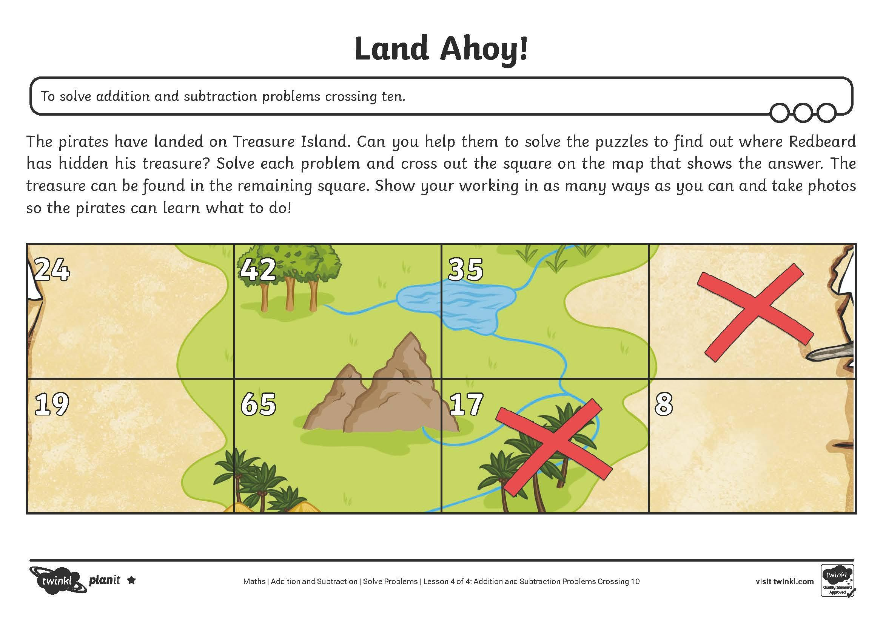
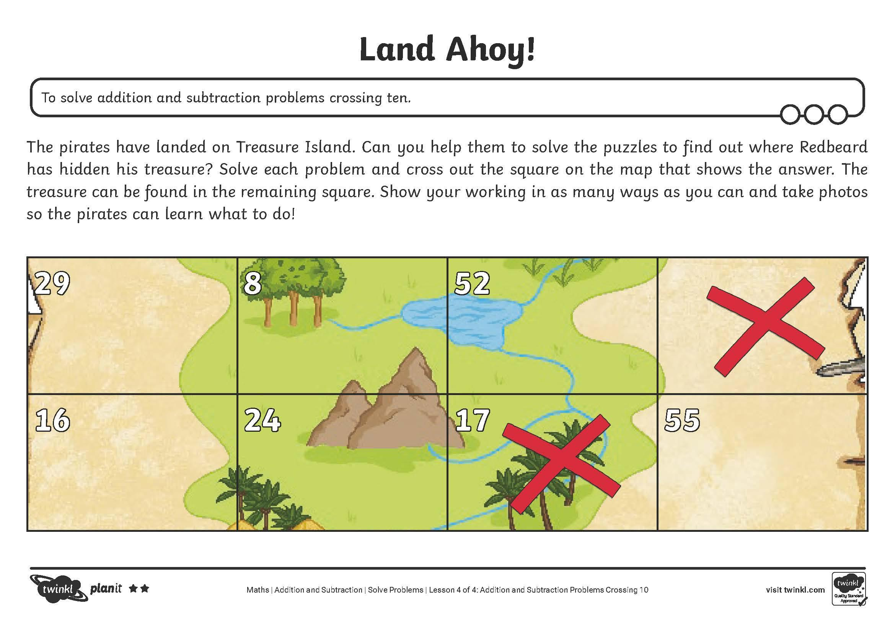
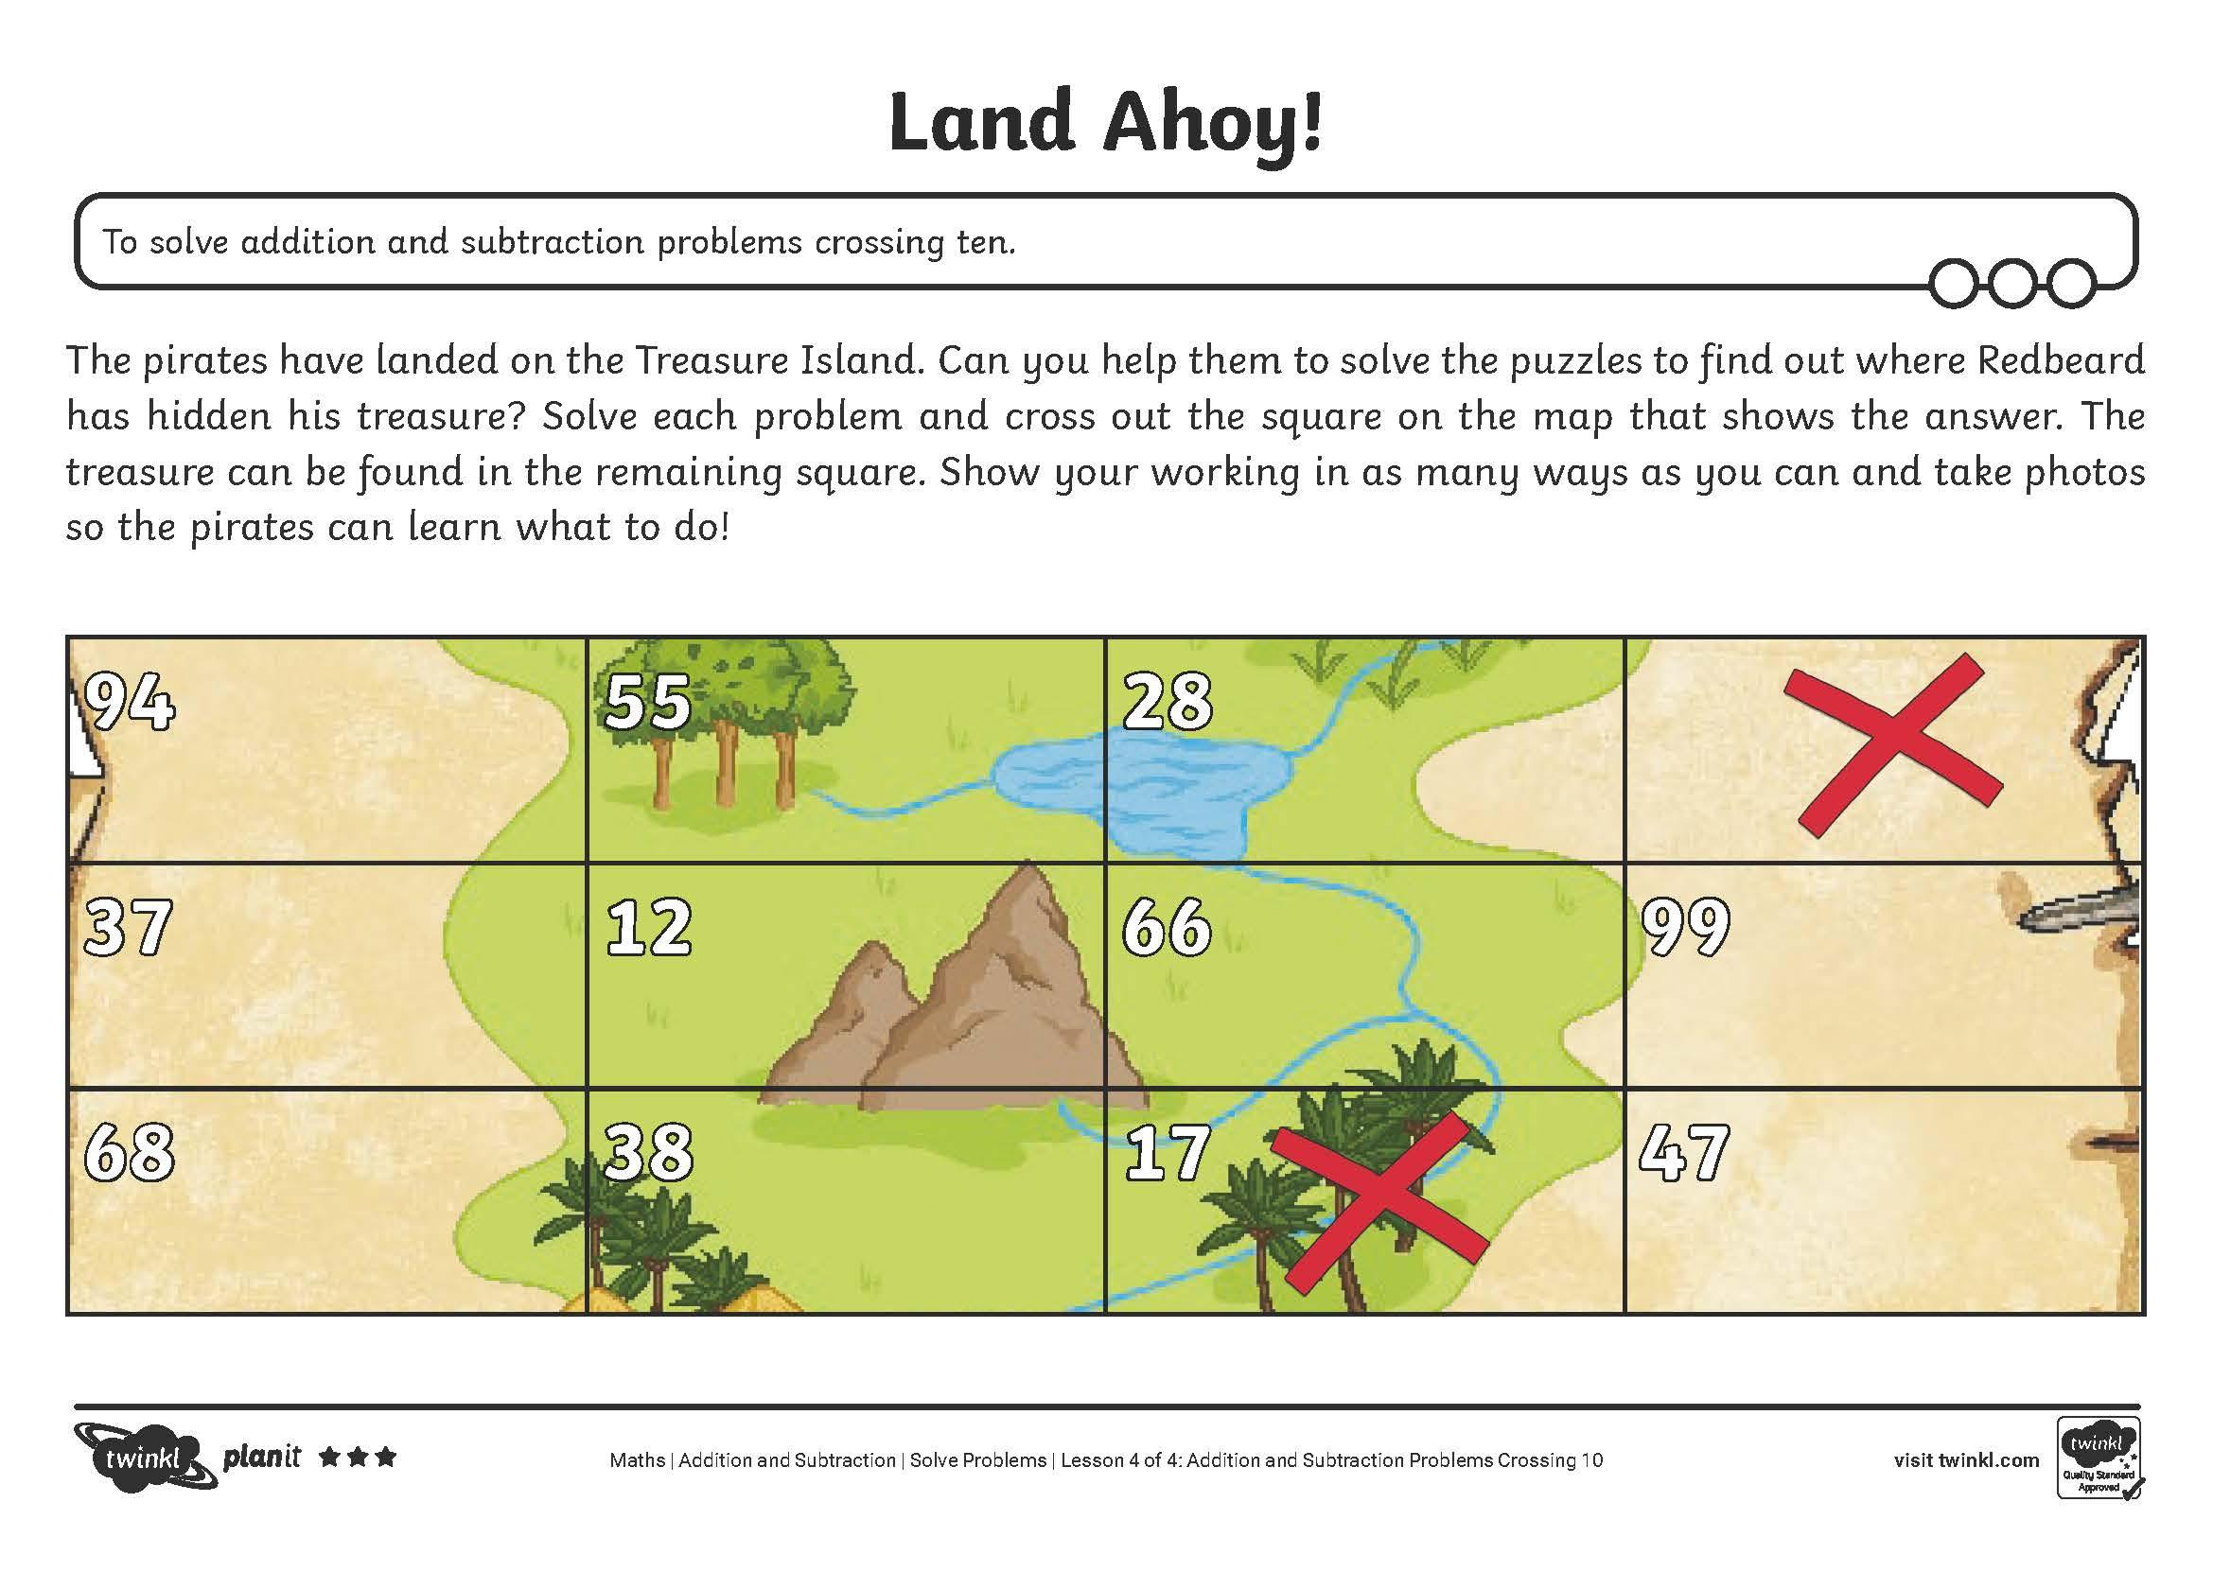
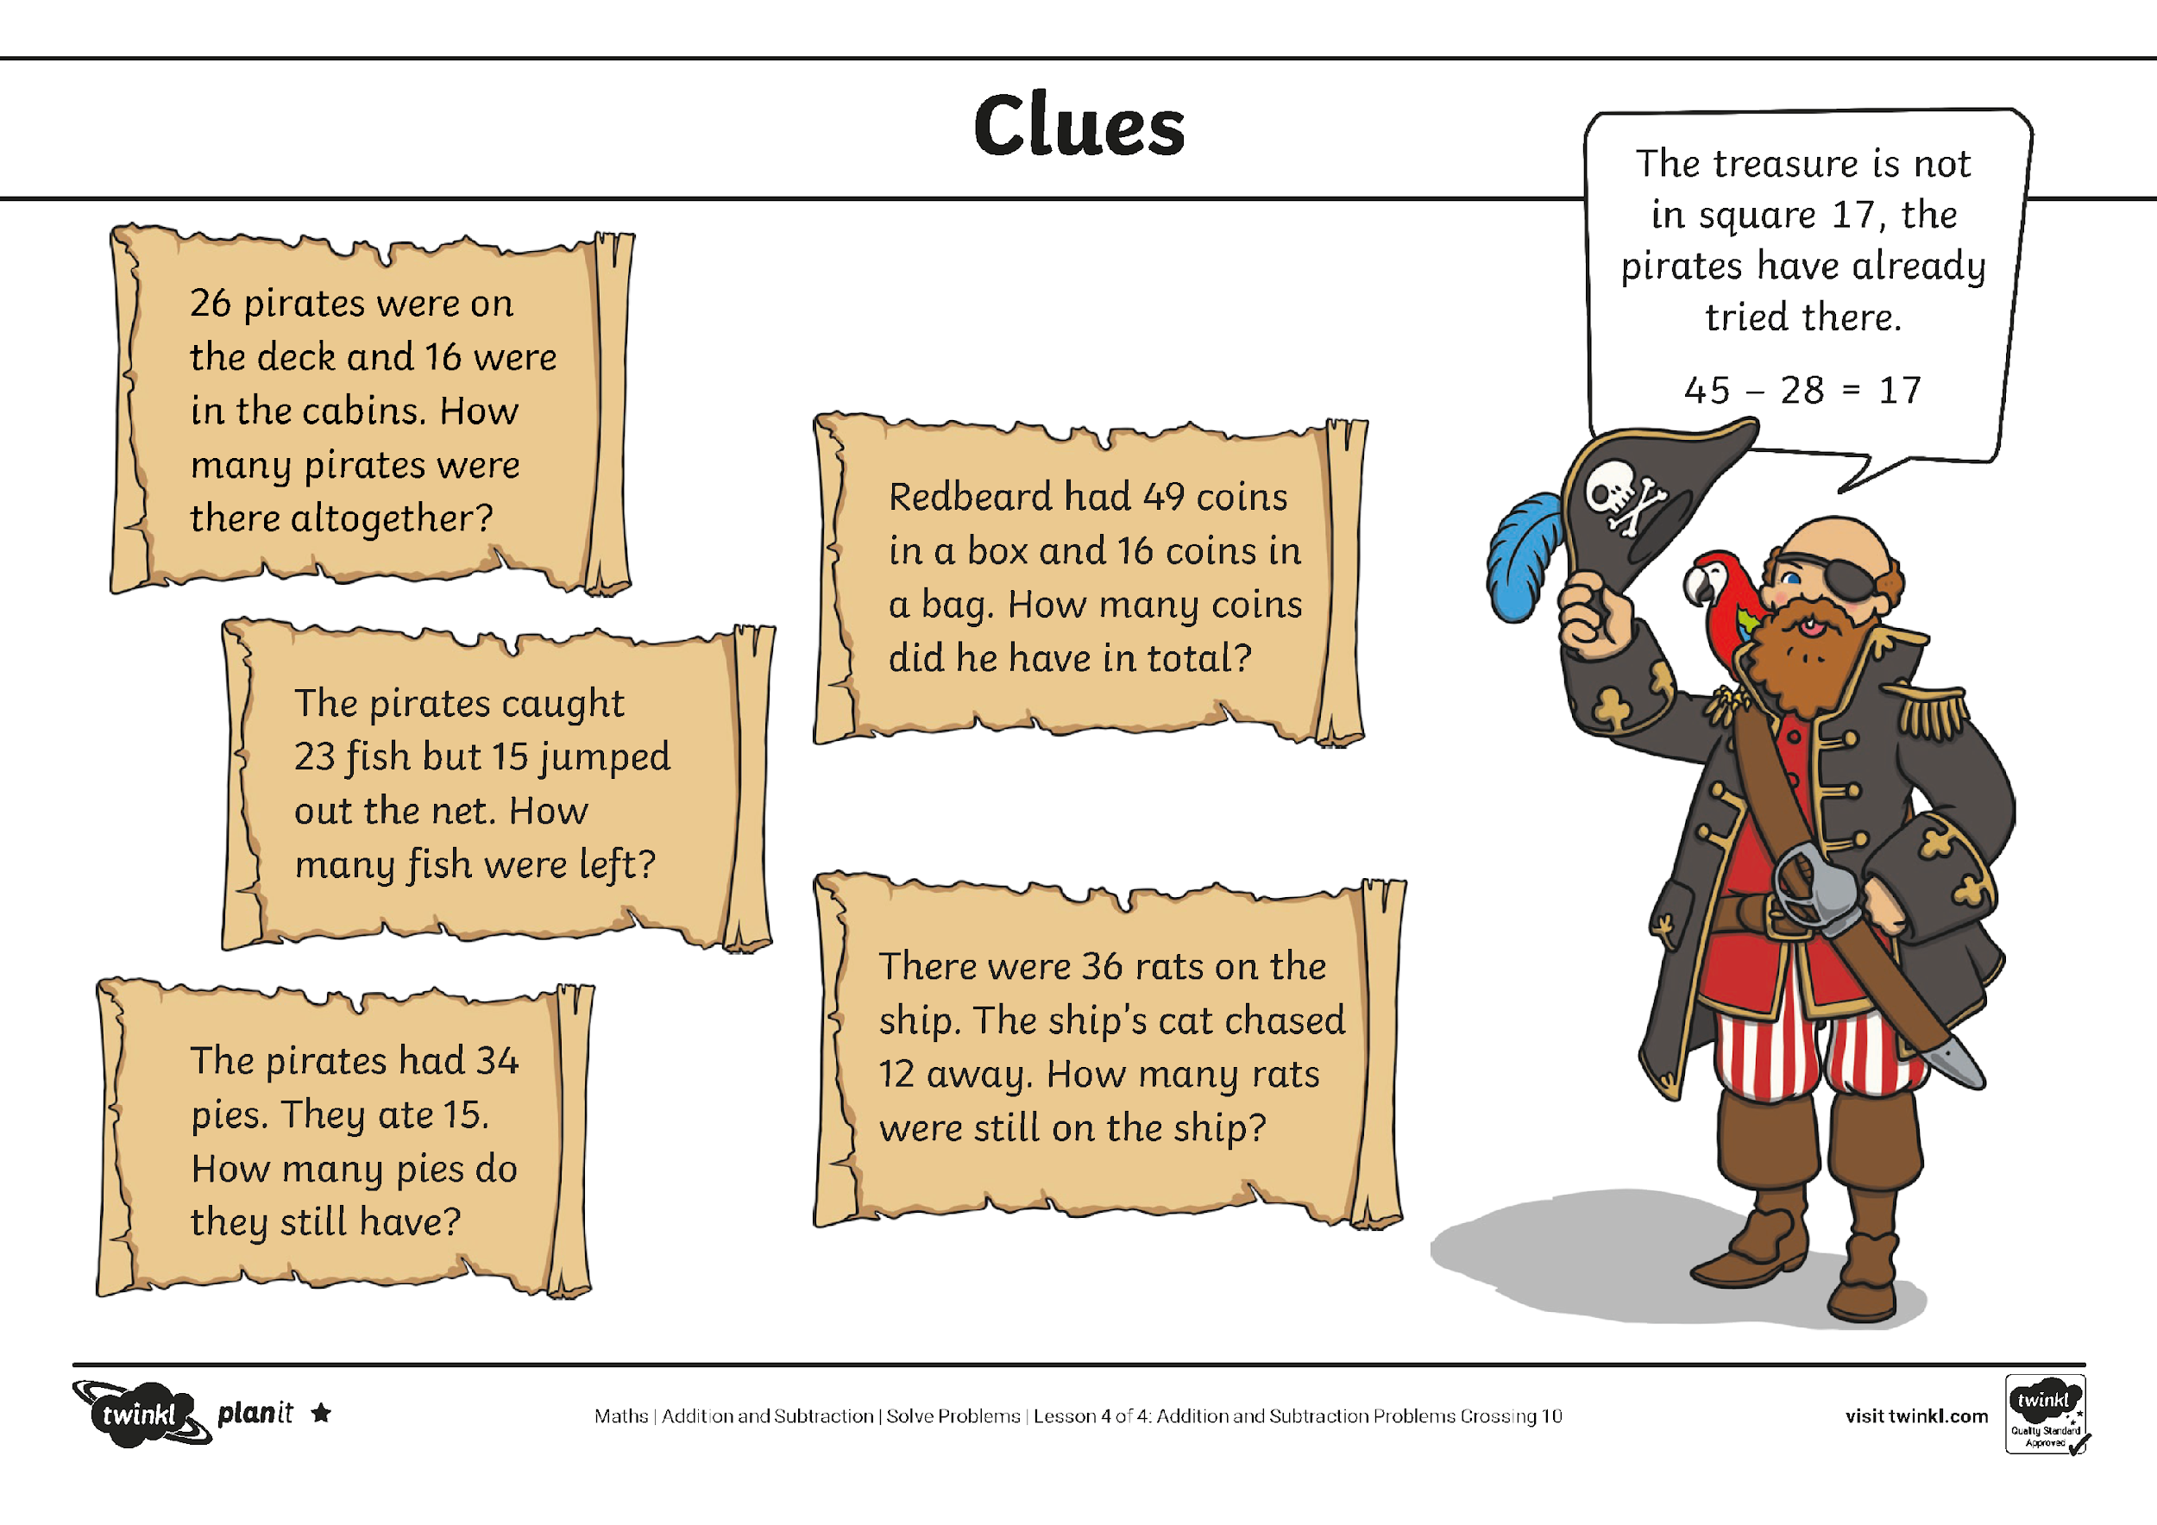
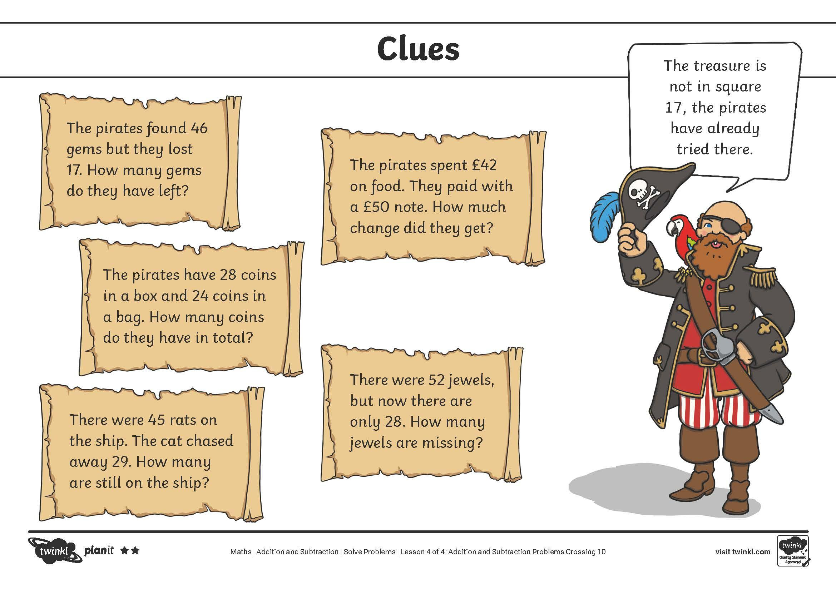
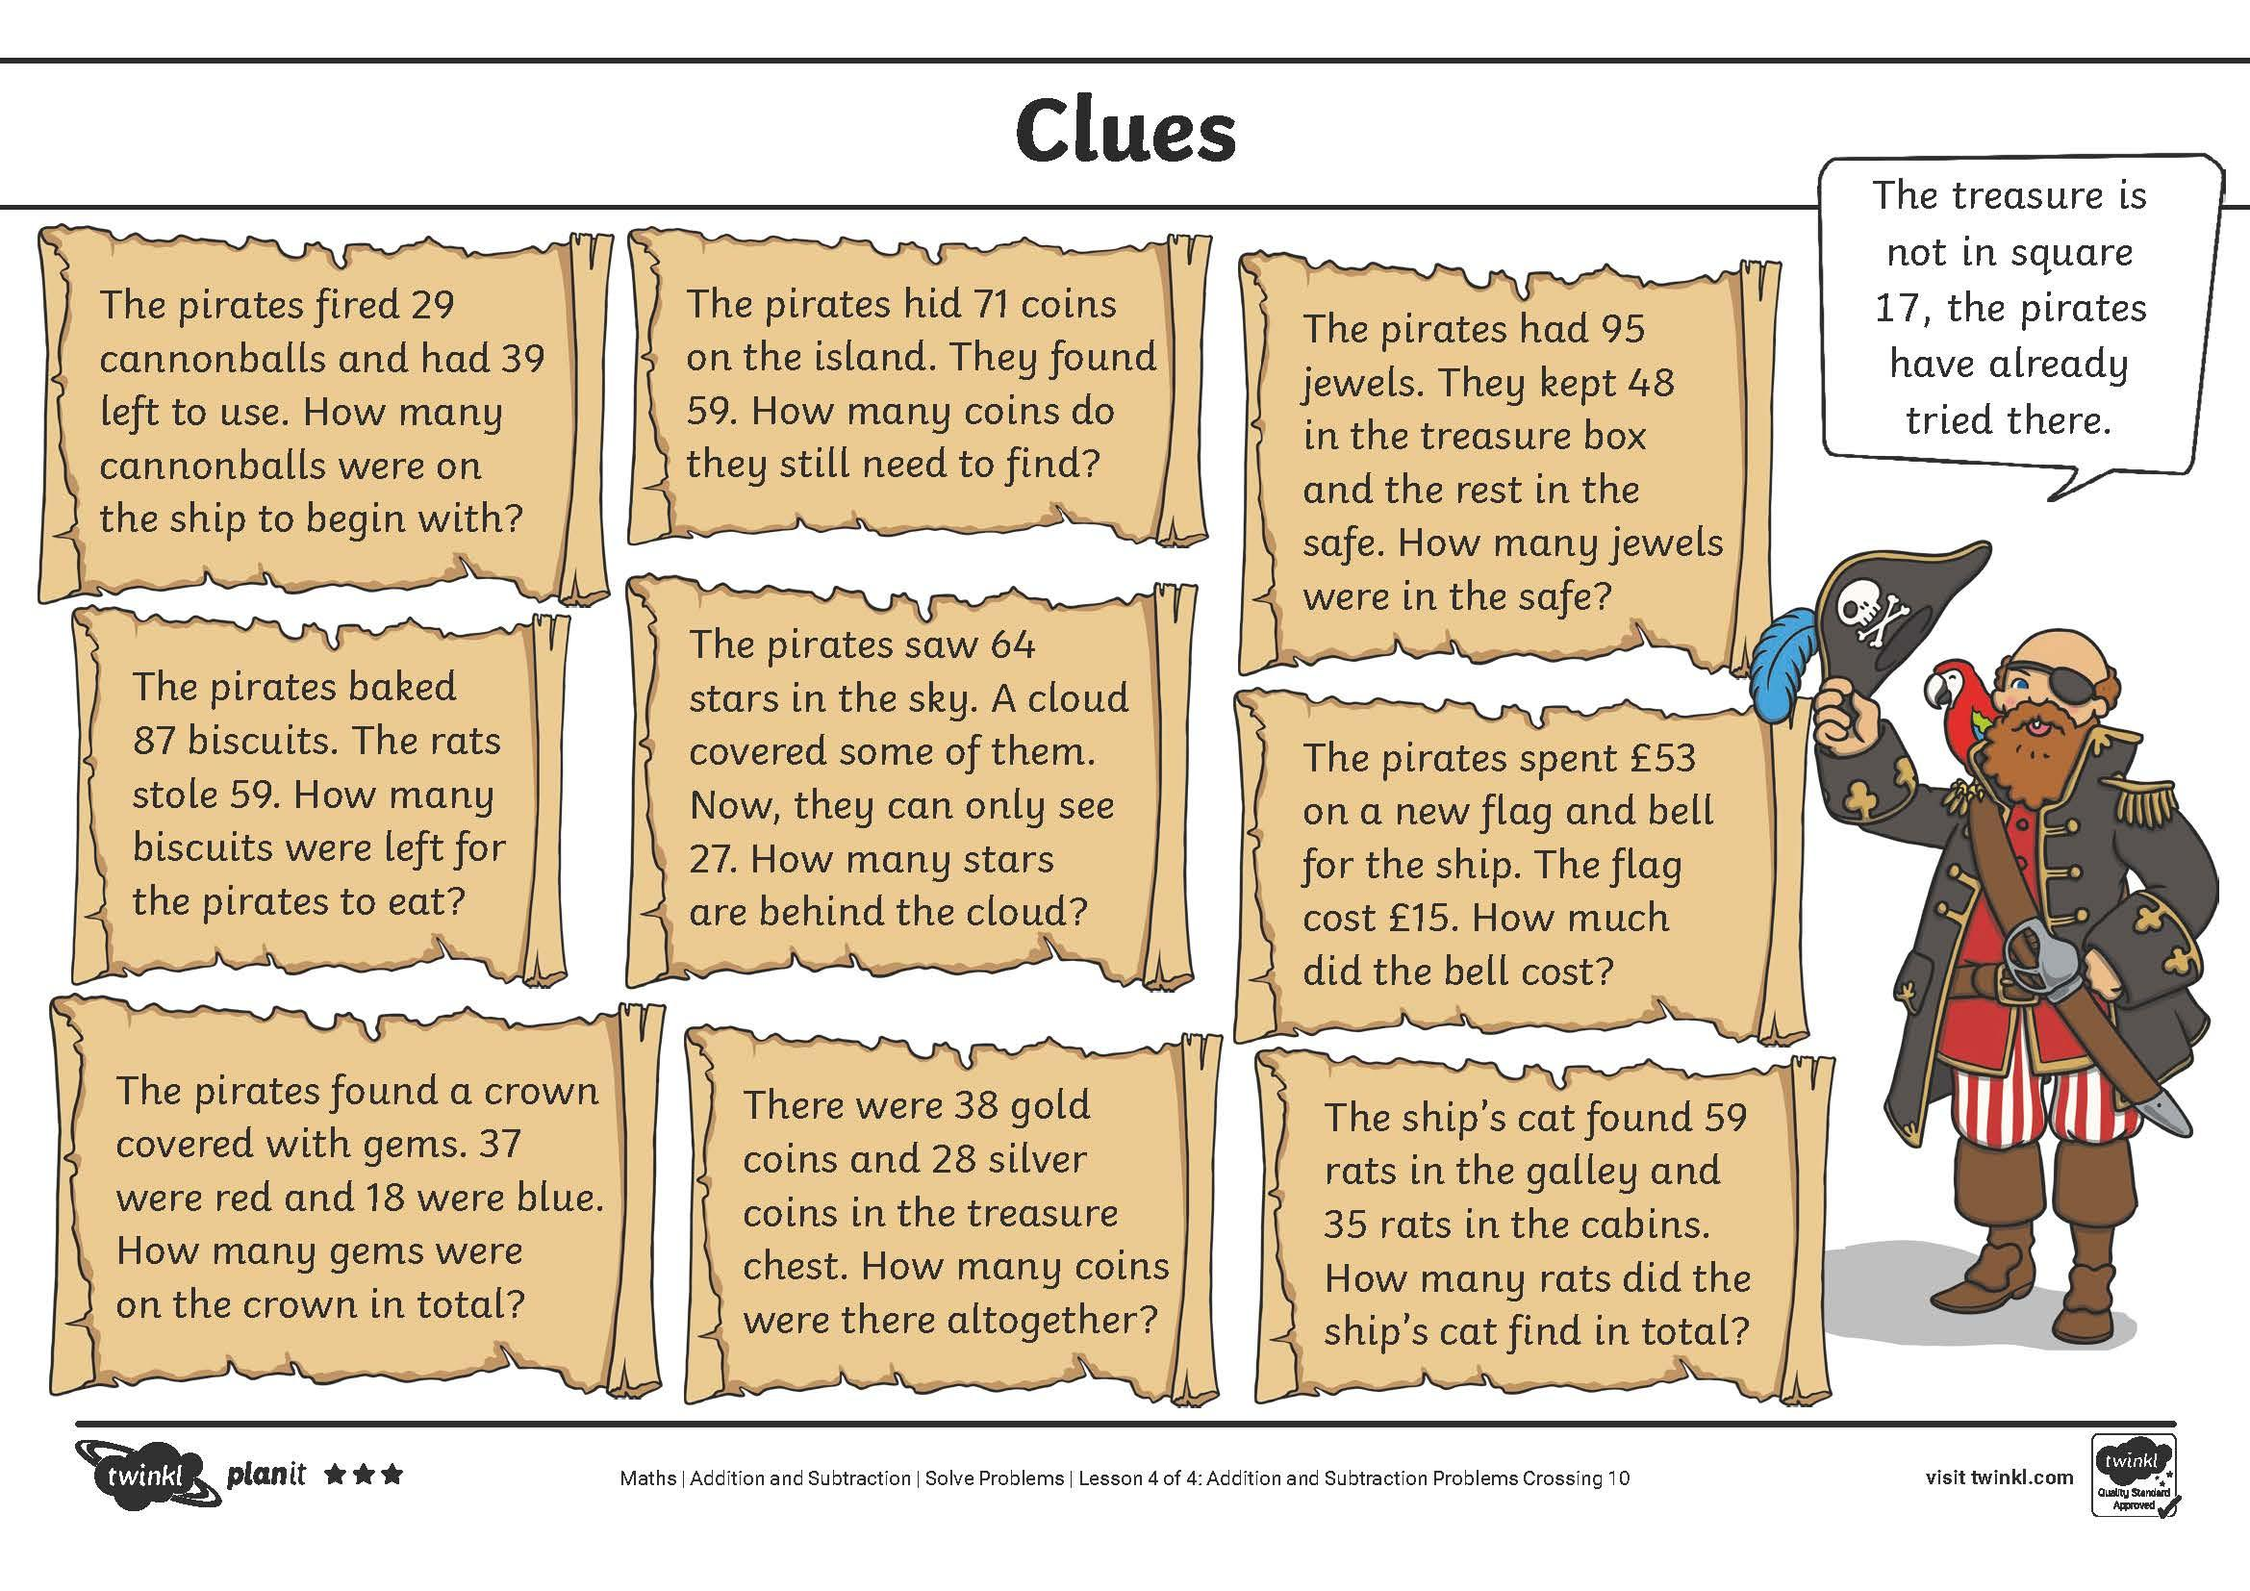
Land Ahoy
Can you solve all the puzzles to find where the treasure is hidden?
Think about which strategies will help you.

Slide 21
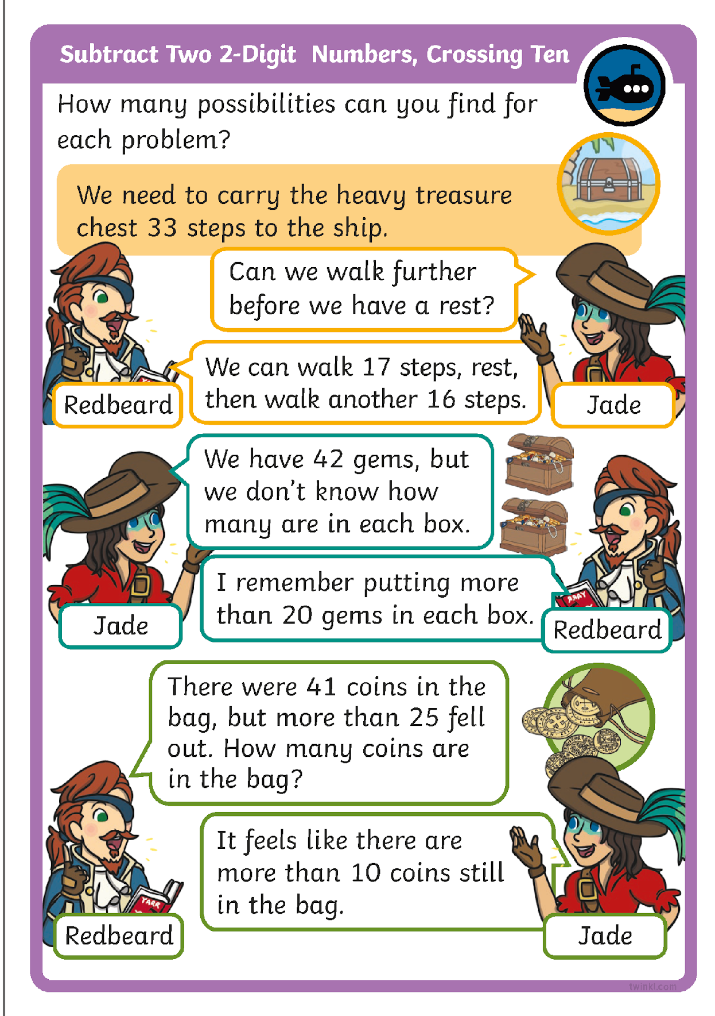
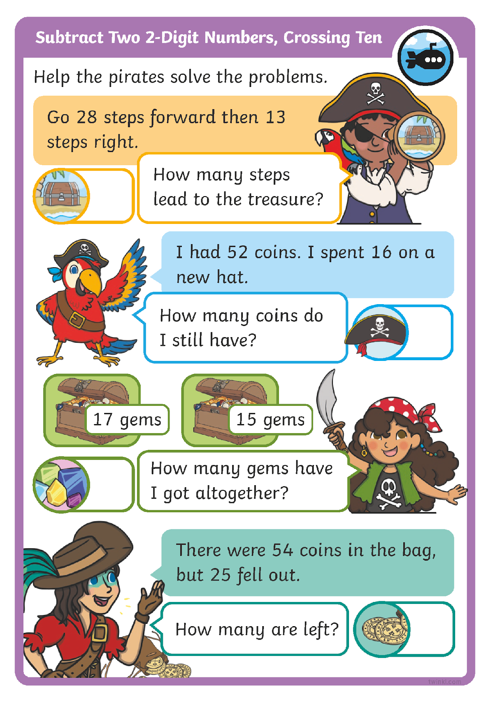
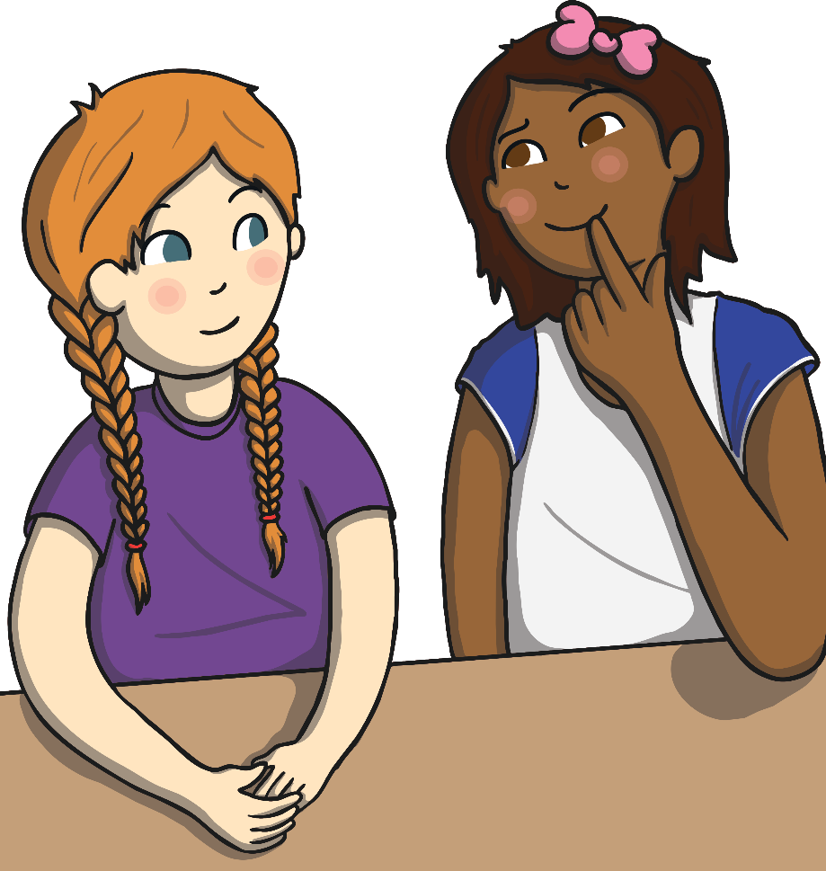
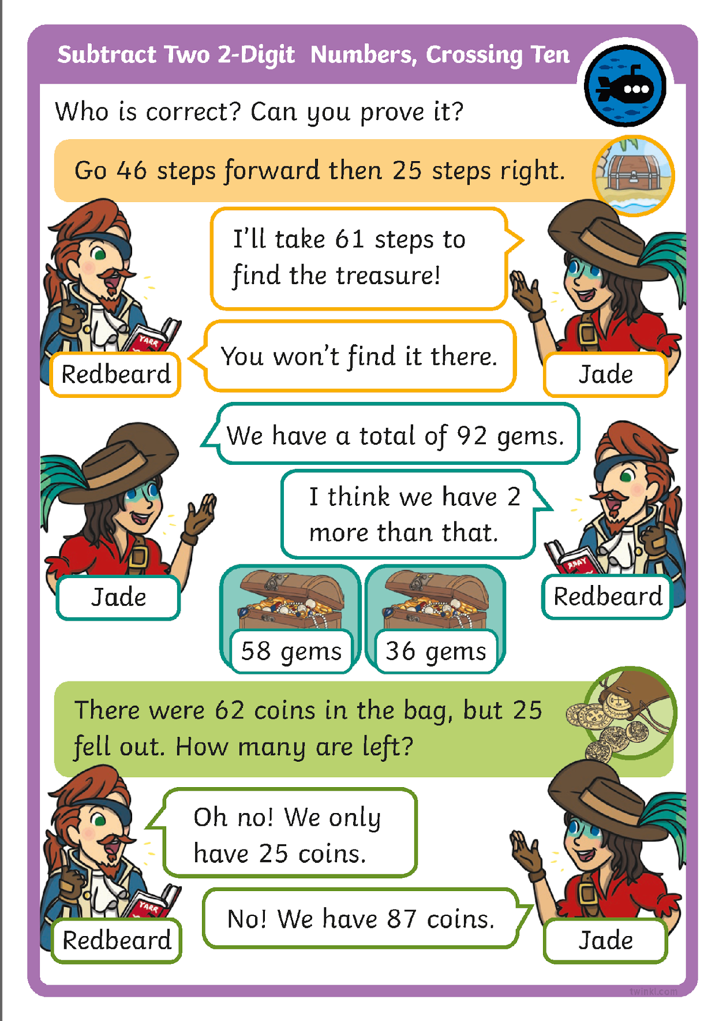
Diving into Mastery
Dive in by completing your own activity!

Slide 22
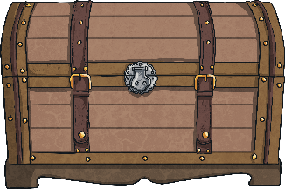
Redbeard’s Last Challenge
There are 27 coins in this treasure chest,
but I have 24 more in a hiding place!
How many coins does Redbeard have altogether?

Slide 23
Redbeard’s Last Challenge
27 + 24
= 51
Tens
Ones
20 + 20 = 40
10
10
1
1
1
1
1
1
1
7 + 4 = 11
10
10
1
1
1
1
40 + 11 = 51
We could use place value counters to solve this.

Slide 24
Redbeard’s Last Challenge
27 + 24
= 51
+3
+1
+20
27
30
31
51
We could use place value counters or number lines to solve this.
Which strategy did you choose?
Or did you find another way to reach the answer?

Slide 25

Aim
I can solve addition and subtraction problems crossing ten.
Success Criteria
I can solve addition problems crossing ten.
I can solve subtraction problems crossing ten.
I can select strategies to solve addition and subtraction problems crossing ten.

