Slide 1


Maths
Addition and Subtraction
Year One
Maths | Year 2 | Addition and Subtraction | Strategies | Lesson 3 of 13: Add Across 10

Slide 2
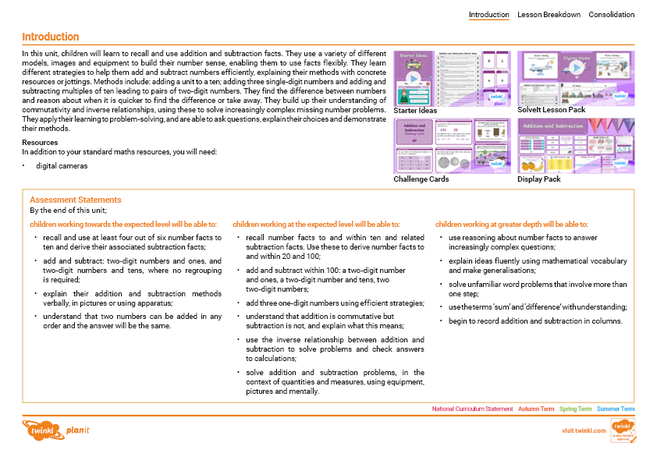
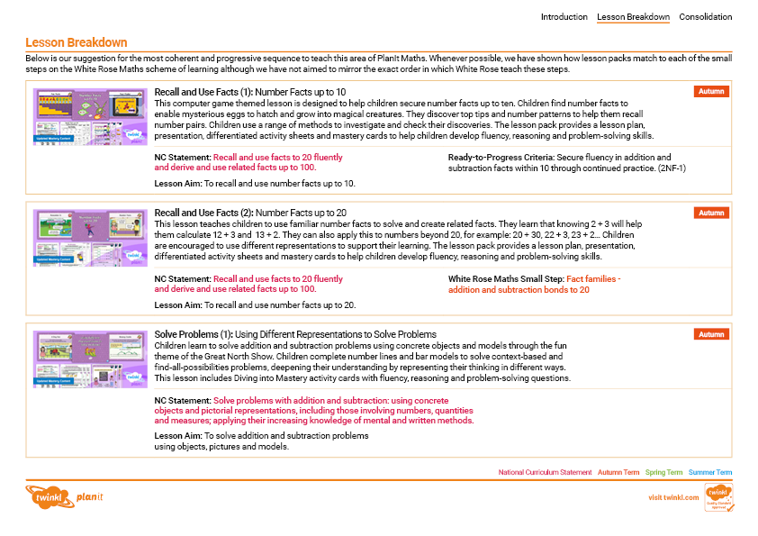
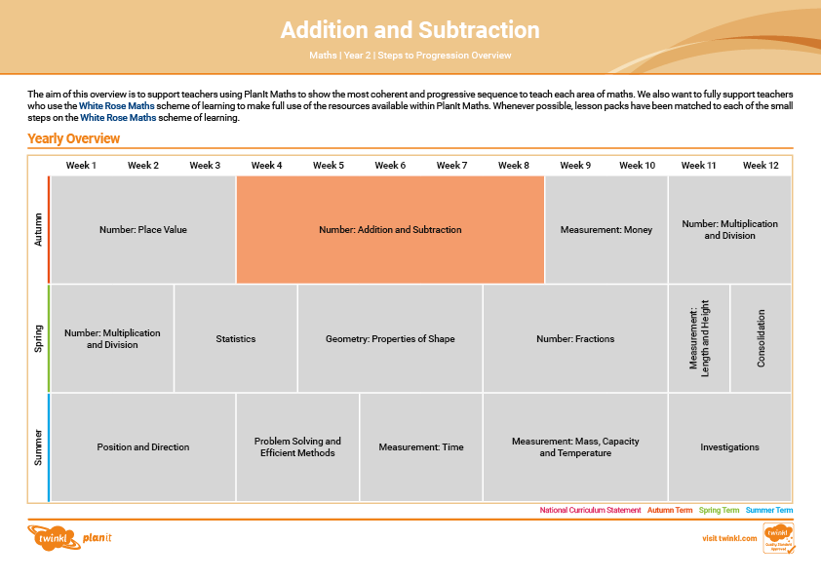

Need a coherently planned sequence of lessons to complement this resource?
See our Addition and Subtraction Steps to Progression document.
Twinkl PlanIt is our award-winning scheme of work with
over 4000 resources.

Slide 3
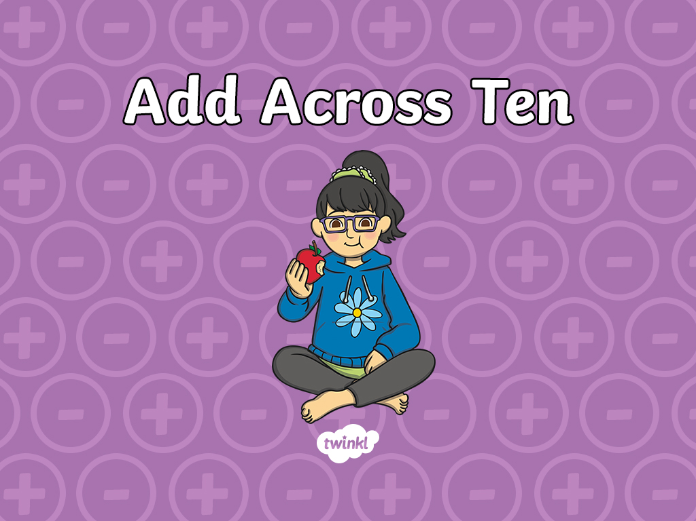

Slide 4
Aim
To add across 10.
Success Criteria
I can recall number facts of 10.
I can use ten-frames to add across 10.
I can use part-whole models to add across 10.

Slide 5


Remember It
Do you remember number facts of ten?
Pick an apple and hold up your fingers to show the missing part.
2 +
8
5 +
5
9 +
1
8 +
2
10
1 +
9
7 +
3
3 +
7
6 +
4
0 +
10
4 +
6
Click on the apple to reveal the answer.

Slide 6

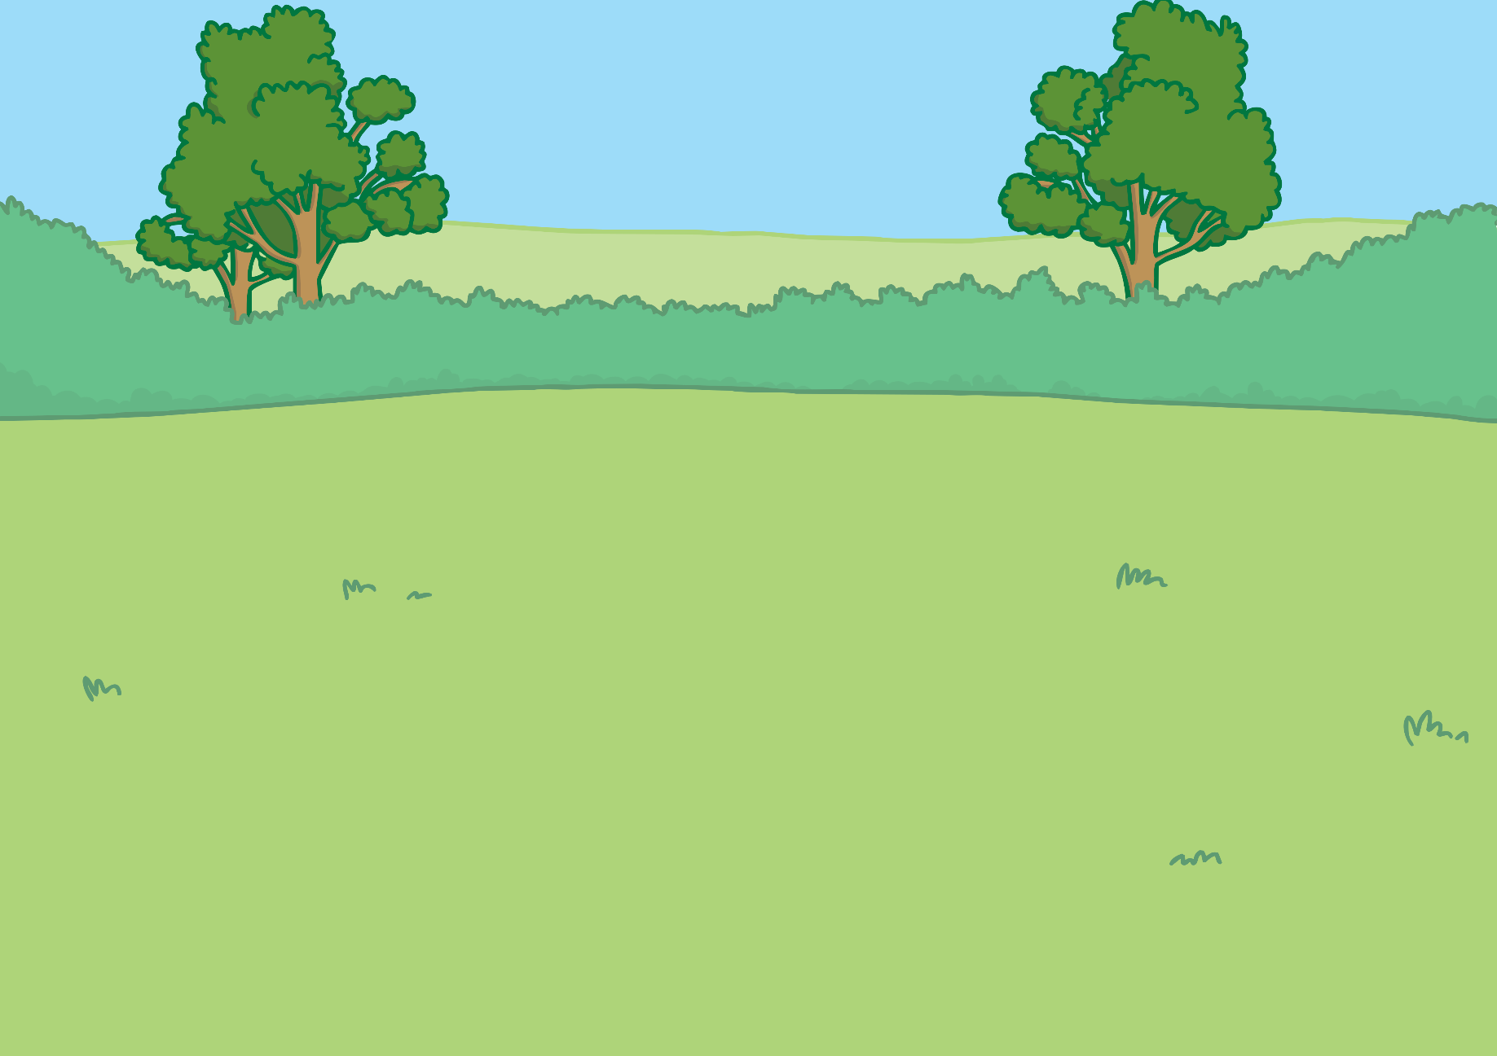
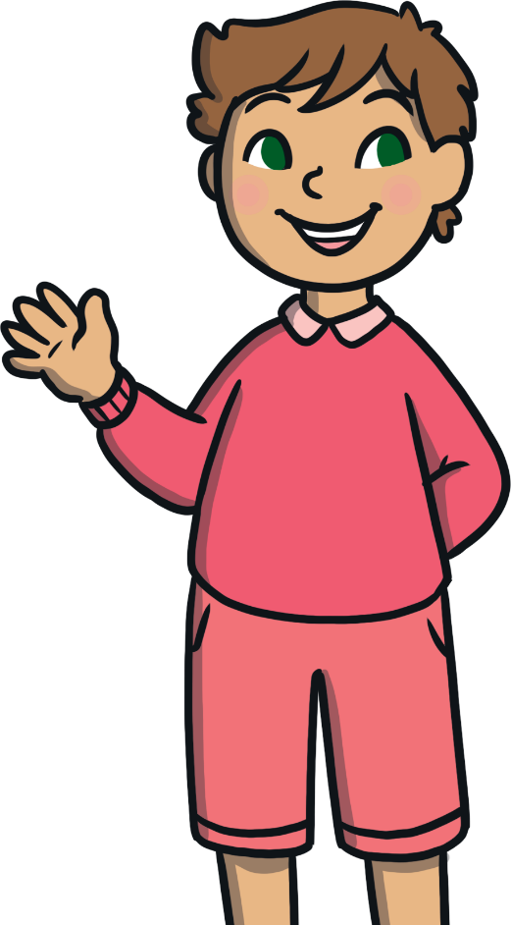
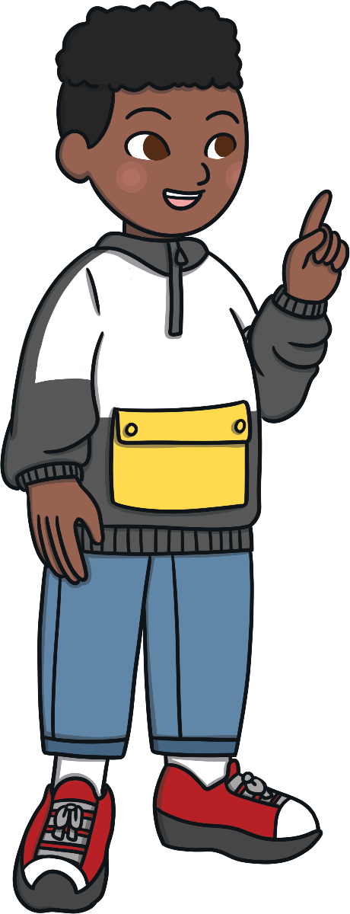
Pack It
We’re becoming experts at recalling number facts of 10.
We can still use number facts of 10 to help us find the total.
But what if we add 2 numbers and the total is more than 10?
Let’s use ten-frames and part-whole models to help us.
Frank
Theo

Slide 7




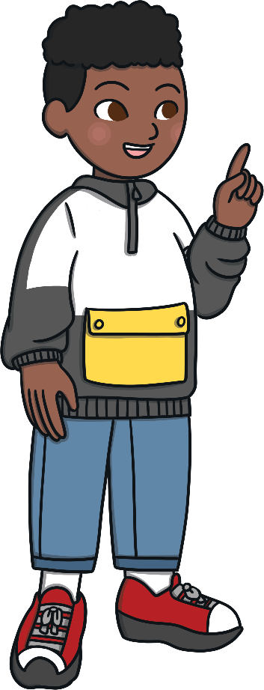
Pack It
They made a number fact of ten, then added the other part.
Frank and Theo are picking apples. Each box can hold ten apples.
8
+
3
=
11
I’ll put my apples in this box.
There’s room for more.
OK, I’ll finish filling it,
then I’ll put the rest in the next box.
Frank
8 + 2 = 10
Theo
10 + 1

Slide 8
Pack It
Frank and Theo made a number fact of ten.
Then they added the other part.
8 + 3 =
11
2
1
8 + 2 = 10
10 + 1

Slide 9
Pack It
Find the total by making a number fact of ten. Then add the other part.
They added across ten by making a number fact of ten
then added the other part.
=
12
7 + 5
3
2
Frank
Theo
7 + 3 = 10
10 +
2

Slide 10
Pick It
Find the total by making a number fact of ten. Then add the other part.
They added across ten by making a number fact of ten.
Then they added the other part.
=
13
9 + 4
1
3
Frank
Theo
9 + 1 = 10
10 +
3

Slide 11
Pack It
Find the total by making a number fact of ten. Then add the other part.
They added across ten by making a number fact of
ten and then added the other part.
14
=
8 + 6
2
4
Frank
Theo
8 + 2 = 10
4
10 +

Slide 12

Try It
Find 6 counters in one colour and 5 counters in another colour.
6 + 5 =
11
4
1
Fill the spaces with counters from your set of 5.
Put the other counter in the next ten-frame.
Add 10 and 1 to find the total.
Is this a number fact that you know?
Put 6 counters in the ten-frame.
10 + 1

Slide 13
Try It
Pick 8 counters in one colour and 7 counters in another colour.
8 + 7 =
15
2
5
How many more will you need to make 10?
Fill the spaces with counters from your set of 7.
Put 8 counters in the ten-frame.
Put the rest of the counters in the next ten-frame.
Add 10 and 5 to find the total.
10 + 5

Slide 14
Try It
Pick 9 counters in one colour and 5 counters in another colour.
9 + 5 =
14
1
4
Put the remaining counters here.
Put 9 counters in the ten-frame.
What parts of 5 do you need?

Slide 15
Try It
Pick 7 counters in one colour and 4 counters in another colour.
7 + 4 =
11
3
1
Add the ten with the ones to find the total.
Put 7 counters in the ten-frame.
Make 10 with a number fact you know.
Put the remaining counters here.

Slide 16





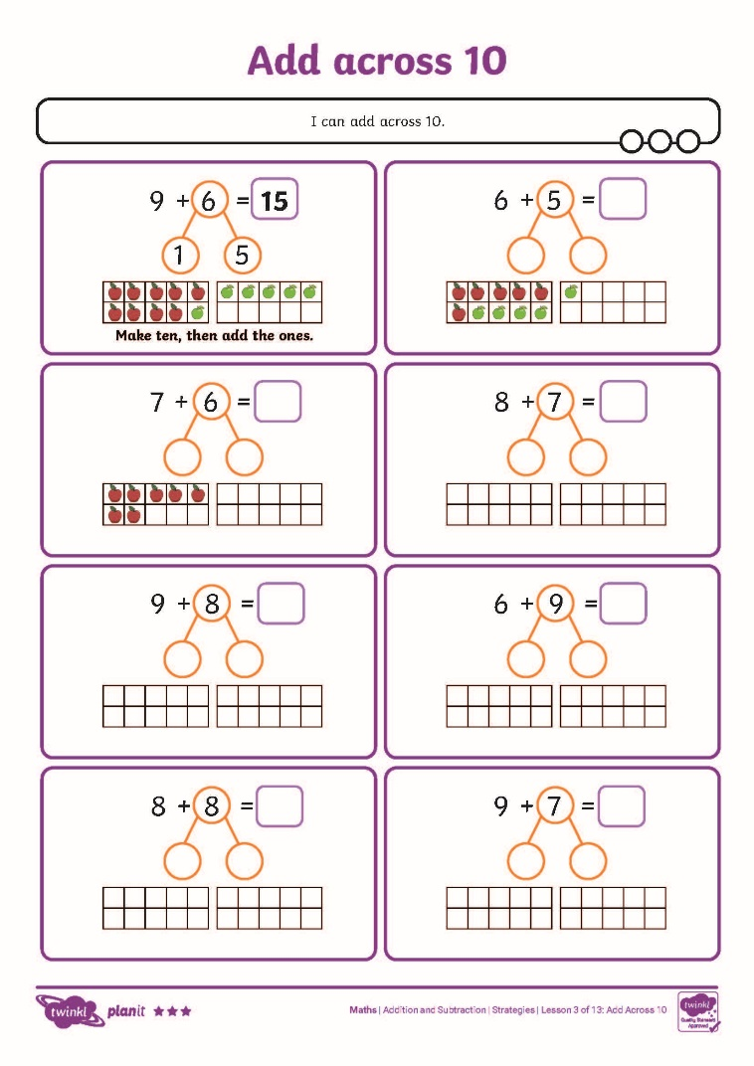
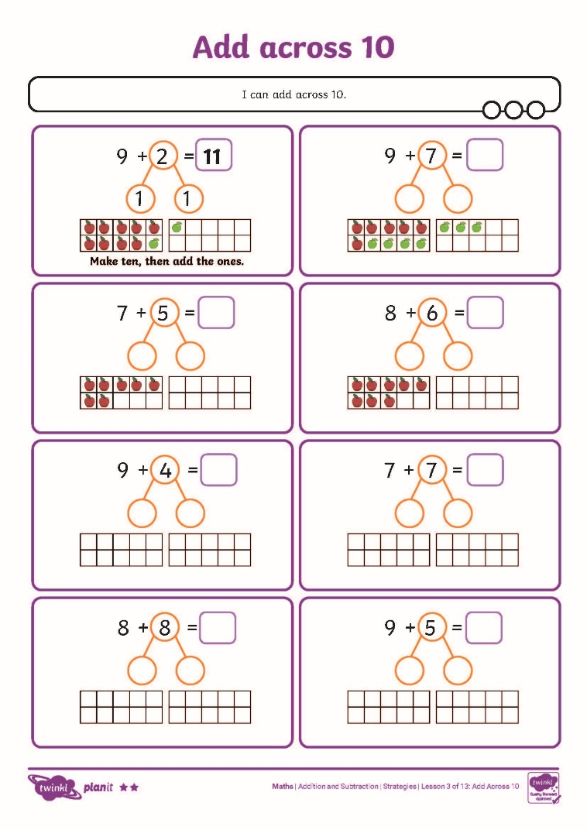
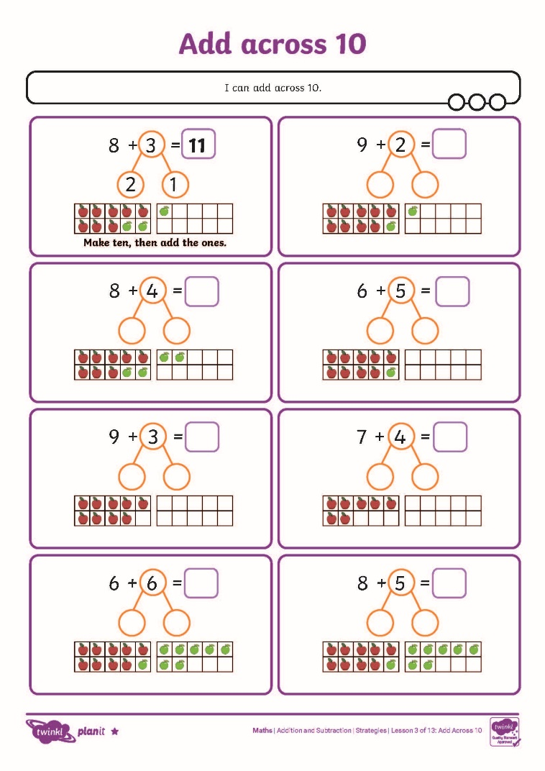
Add Across 10 Activity Sheets

Slide 17
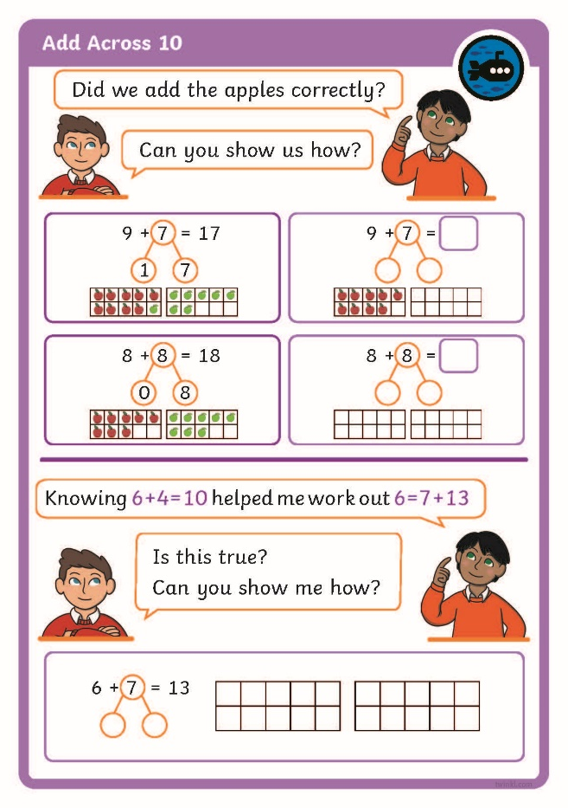
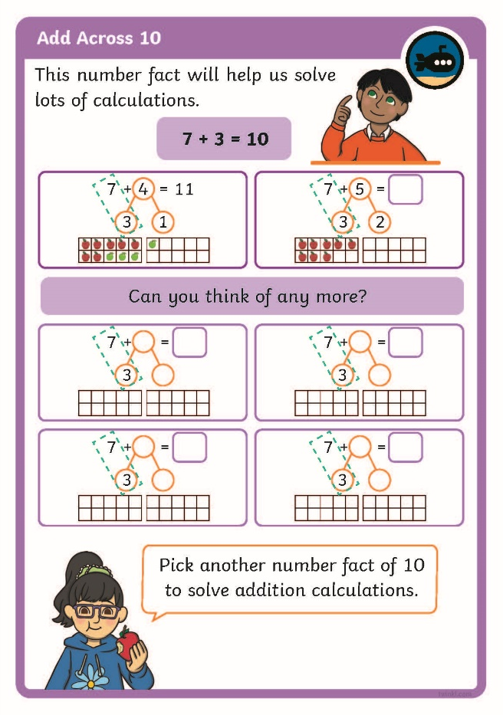
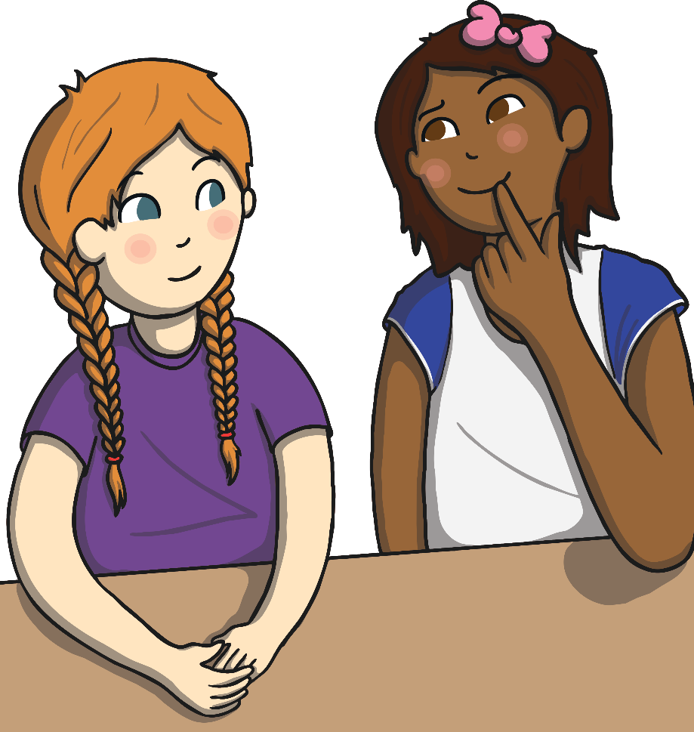
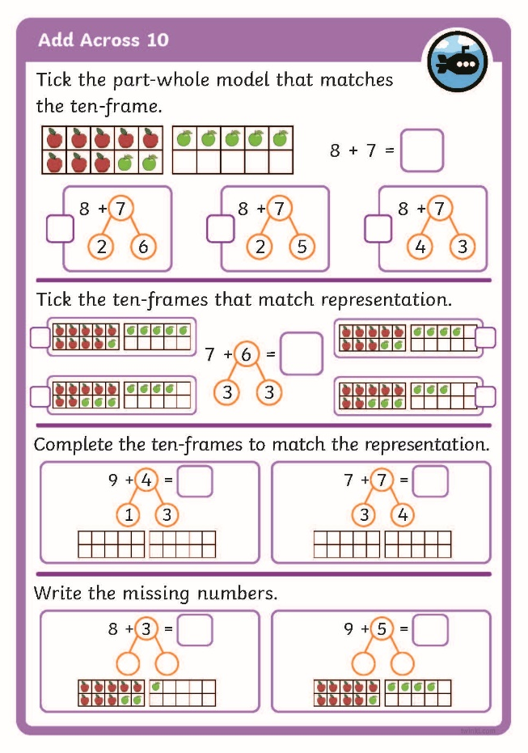
Diving into Mastery
Dive in by completing your own activity!

Slide 18
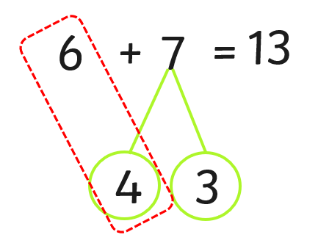
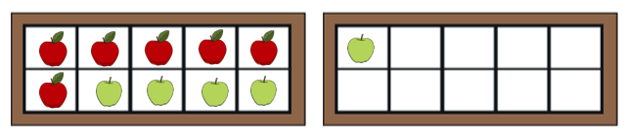
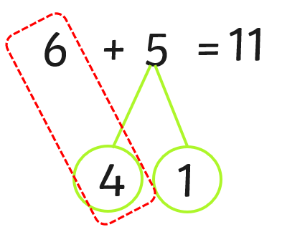
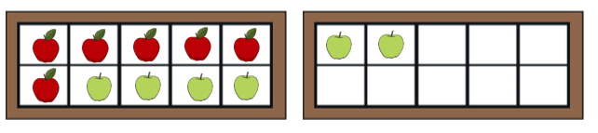
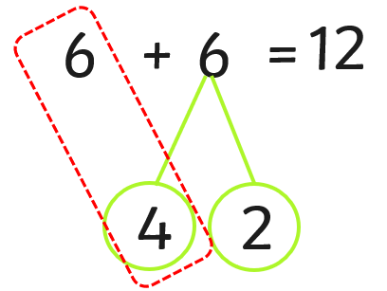
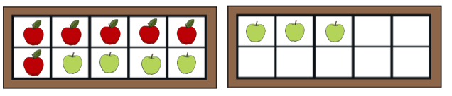
Try It
Match the calculations with the ten-frames.

Slide 19
Aim
To add across 10.
Success Criteria
I can recall number facts of 10.
I can use ten-frames to add across ten.
I can use part-whole models to add across ten.

