Slide 1
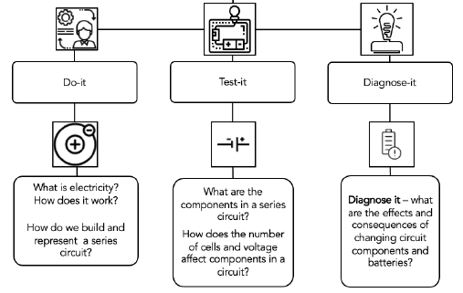
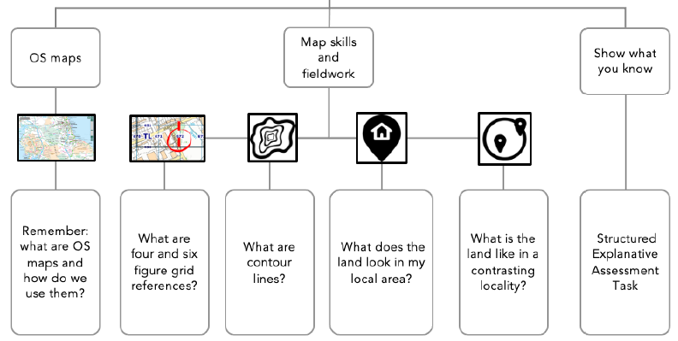
Foxes Class: Summer 1 – 2025
In English, we will be:
Writing – extended third person adventure narratives; Shakespeare Sonnets.
Reading – extracts from ‘Oliver Twist’ by Charles Dickens.
In PSHE we will be focusing on Risk Taking and Personal Safety
We will explore the positive and negative aspects of risk and learn strategies to deal with risky situations. We will look at safety contexts and how to keep ourselves safe.
In Science, we will be studying Electricity
In Art, we will be looking at 3D Art
As artists, we will create 3D forms using a variety of techniques. We will need to consider our use of colour, pattern and texture as we combine pieces to form 3D structures.
In Geography, we will be studying map skills + fieldwork
Dale Chihuly

Slide 2
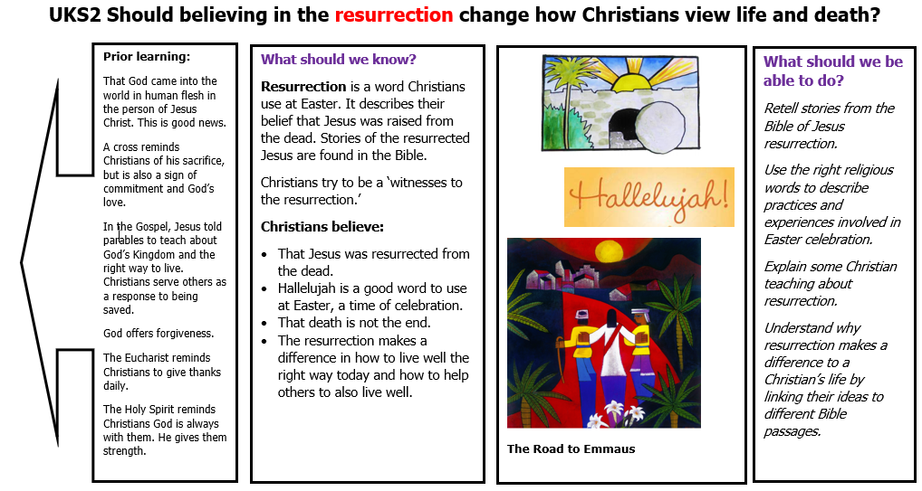
Key Vocabulary​ | Definition​ | Key Vocabulary​ | Definition​
proton | A subatomic particle with a positive electric charge. | contour line | Line on a map joining points of equal height.
neutron | A subatomic particle with no electric charge. | plateau | An area of fairly level high ground.
electron | A subatomic particle with a negative electric charge. | terrain | The physical features of an area of land.
terminal | One end of a battery. | intersect | (of lines or roads) To cross each other.
voltage | The push from a power source. | undulating | Having a smooth, wave-like shape or outline.
source | The origin of something. | resurrection | The raising to life of those who have died. It is a key belief of the Christian faith.
Physical development, Health, Well-being + Curriculum Enrichment
Curriculum drivers: Outdoor Learning and Environment
PE: Cricket and athletics
Value: Service
French: The Natural World
Computing: Creating Media: Vector Drawing
Music: Clarinet tuition
Follow the Ship visit – 30.4.25; netball + football tournaments – 22.5.25 + 23.5.25

