Slide 1


Maths
Addition and Subtraction
Year One
Maths | Addition and Subtraction | Derive, Recall and Use Facts | Lesson 3 of 5: Number Facts of 100.

Slide 2
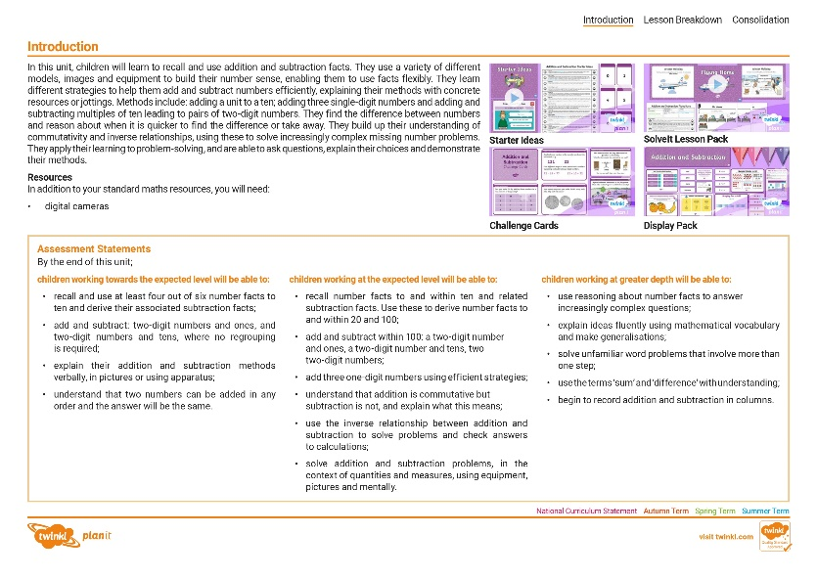
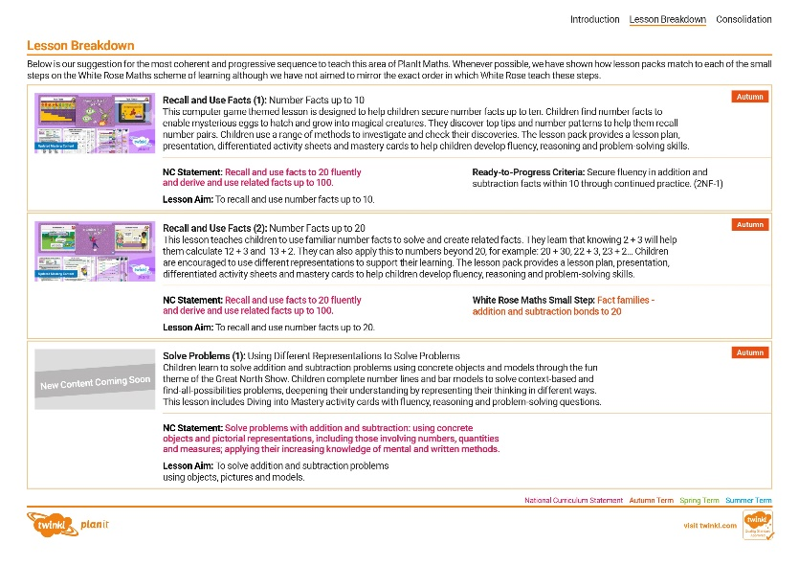
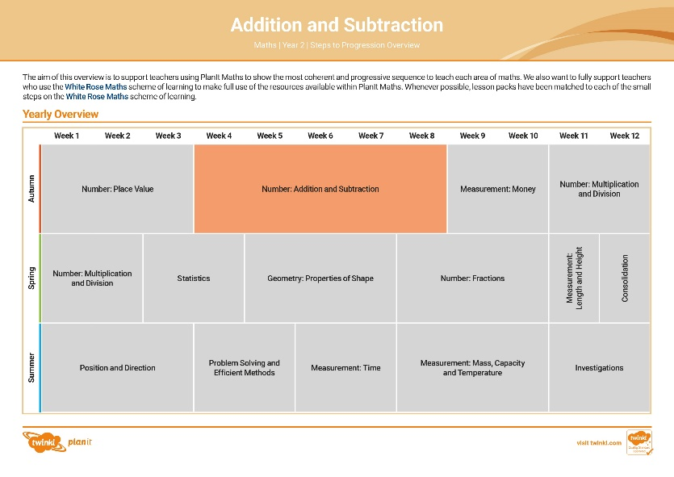

Need a coherently planned sequence of lessons to complement this resource?
See our Addition and Subtraction Steps to Progression document.
Twinkl PlanIt is our award-winning scheme of work with
over 4000 resources.

Slide 4
Aim
To derive and use addition and subtraction facts of 100
(multiples of 10).
Success Criteria
I can derive addition and subtraction facts of 100 (multiples of 10).
I can use these addition and subtraction facts in a context.

Slide 5







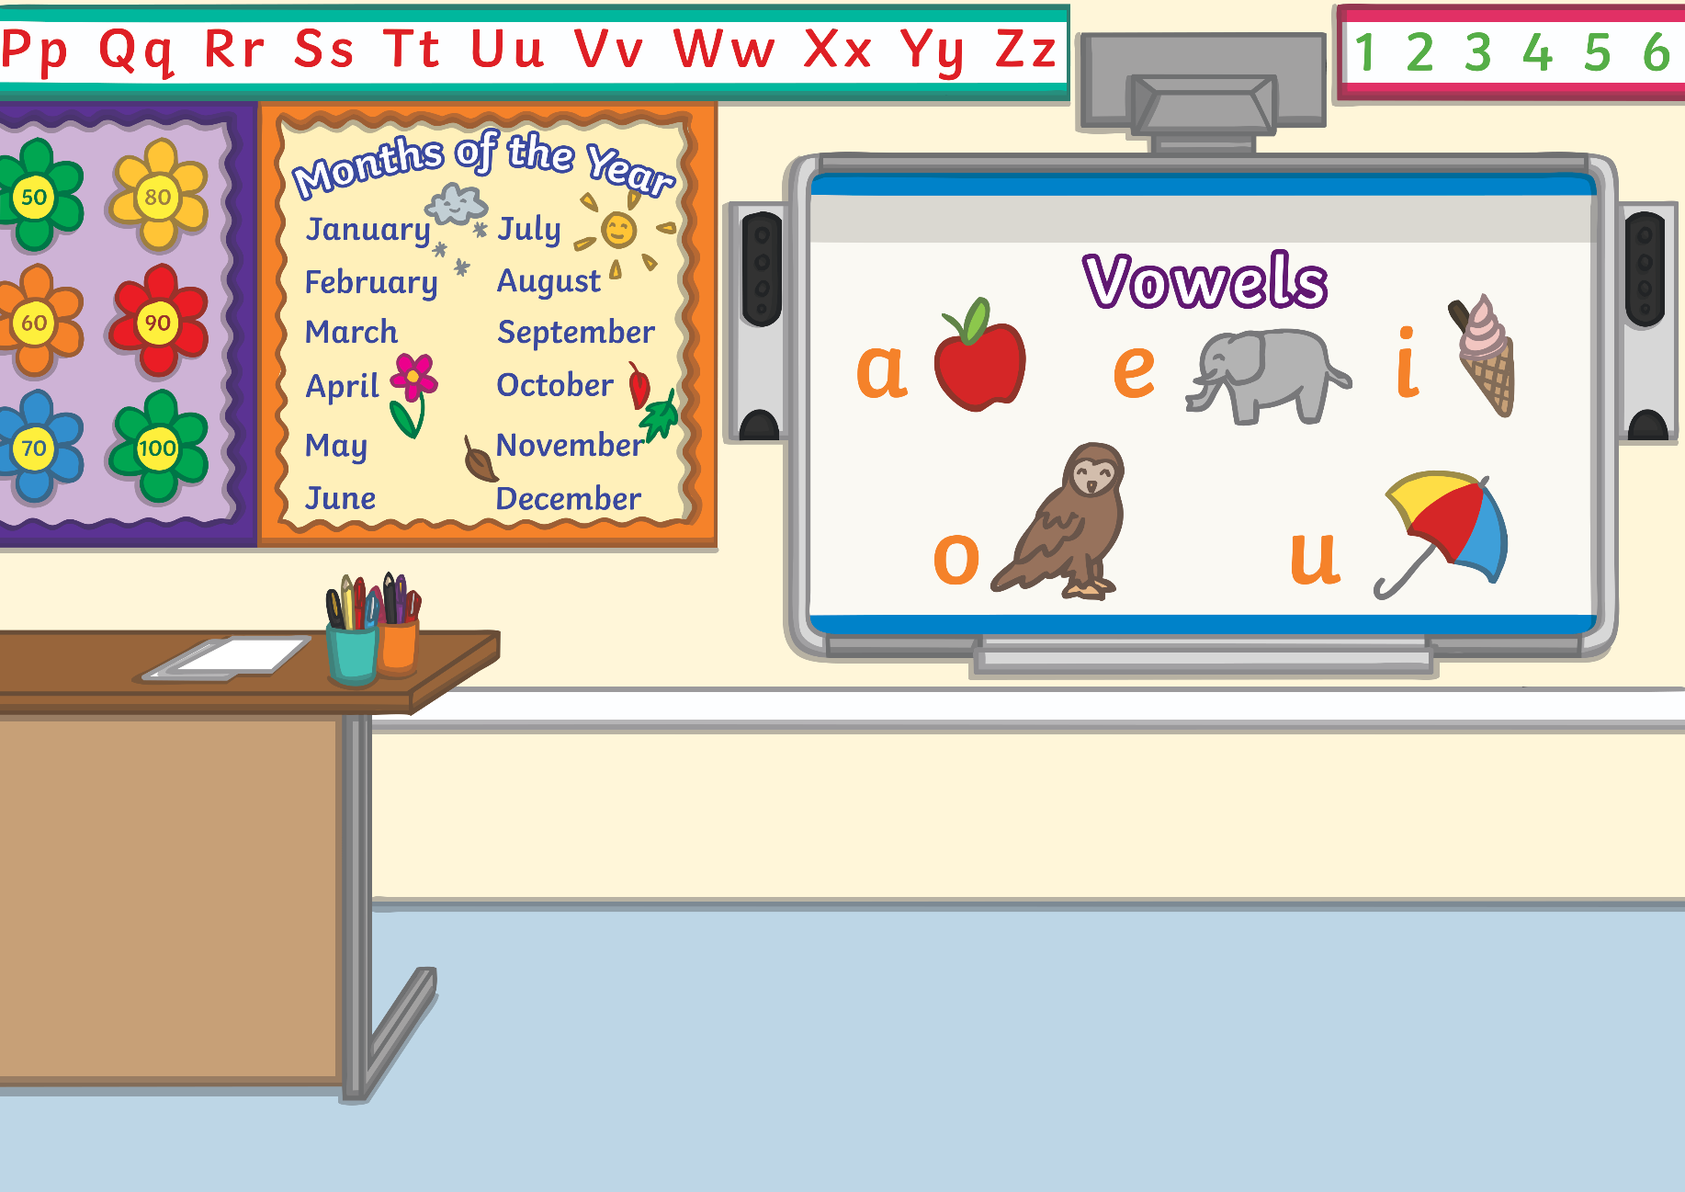

Remember It
Your teacher will throw a beanbag to someone in the class.
They will say a number from 0 – 10.
How quickly can you say the number that adds to this to make 10?
Can you say the answer if your teacher subtracts a number from 10?

Slide 6

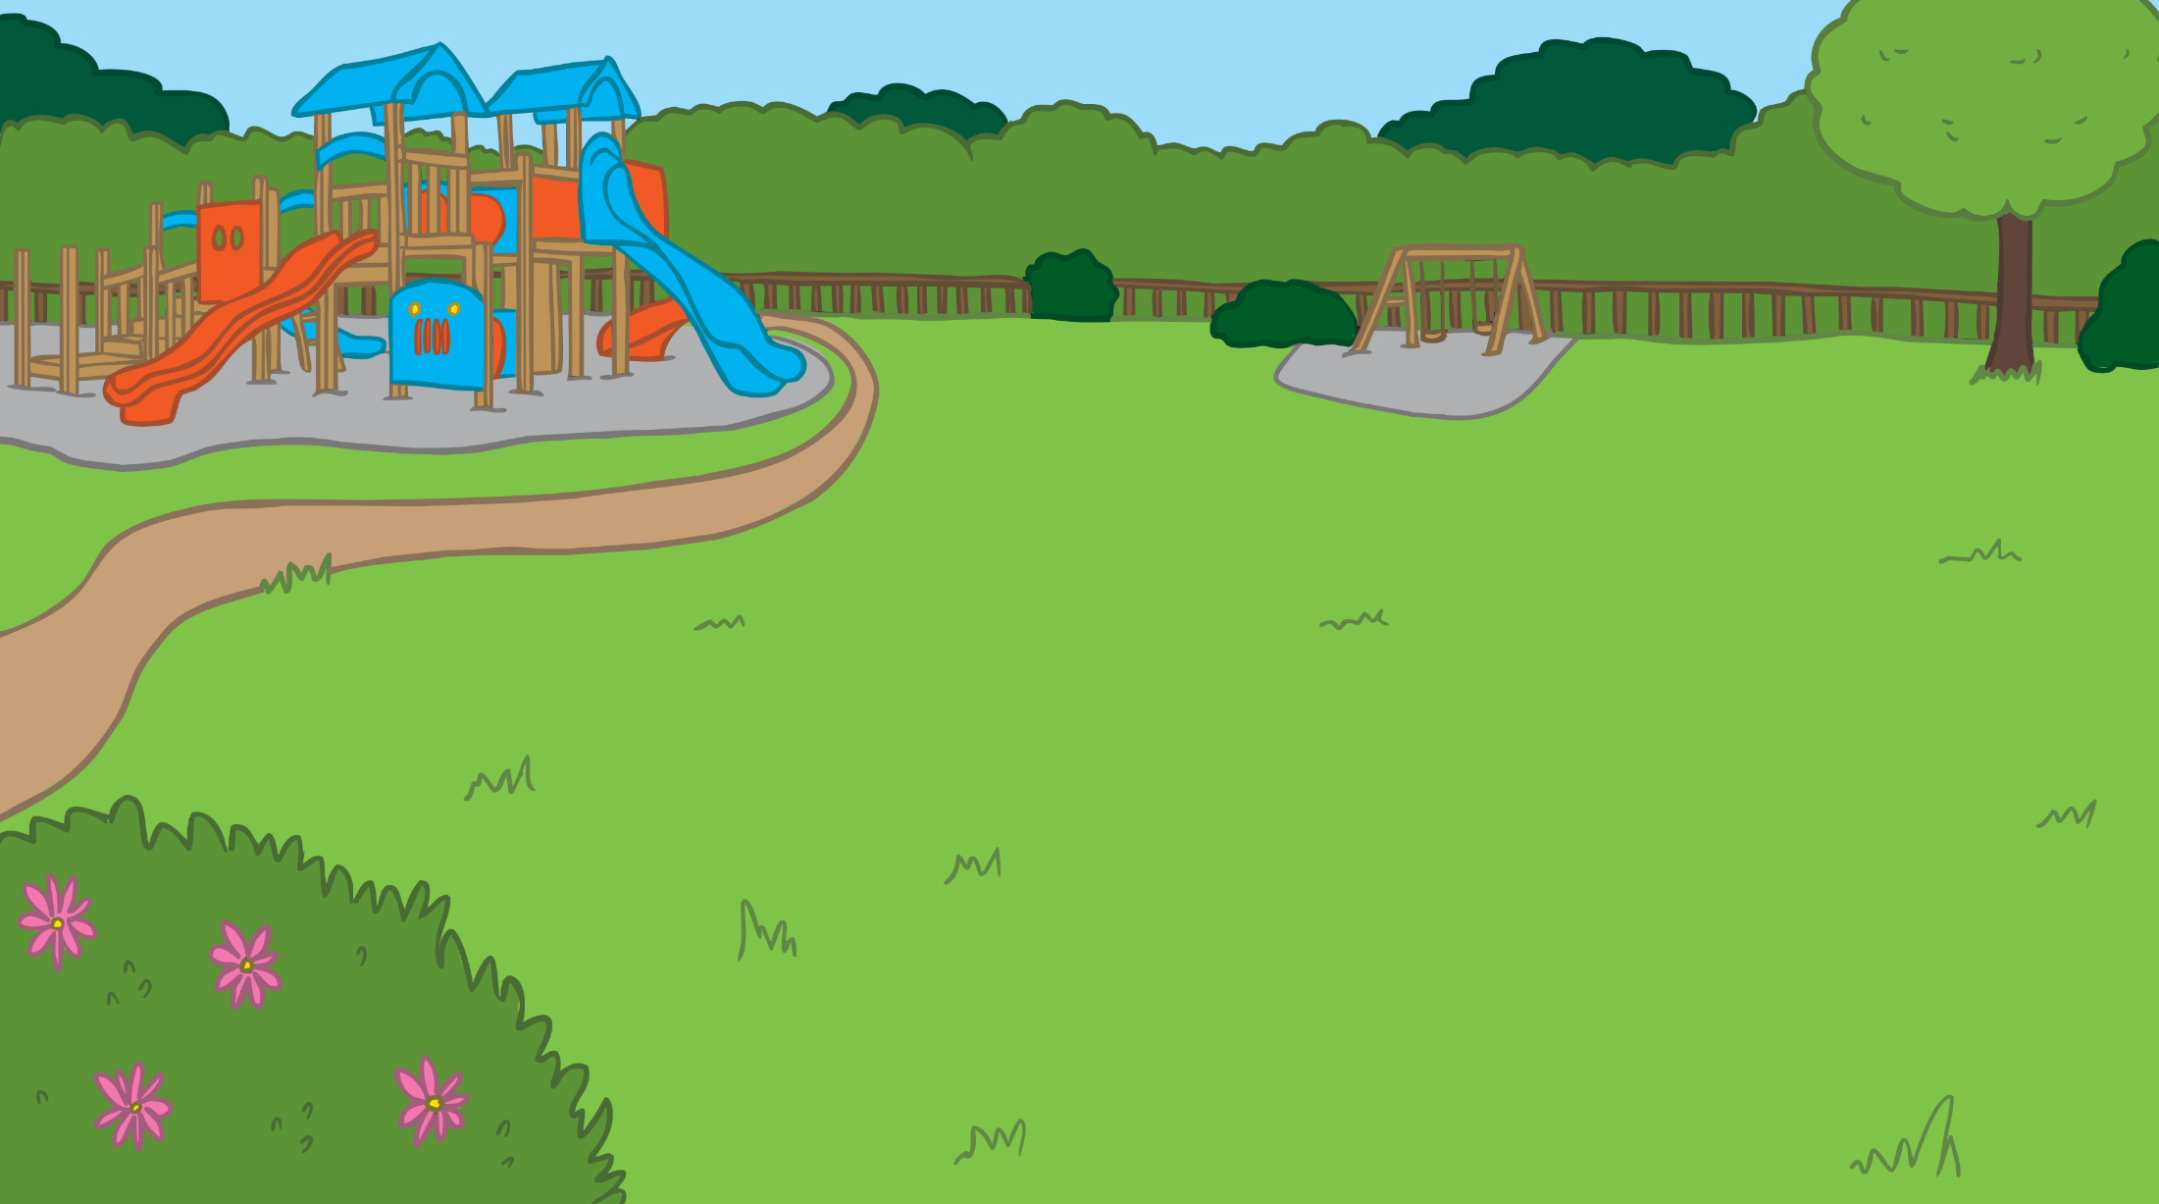
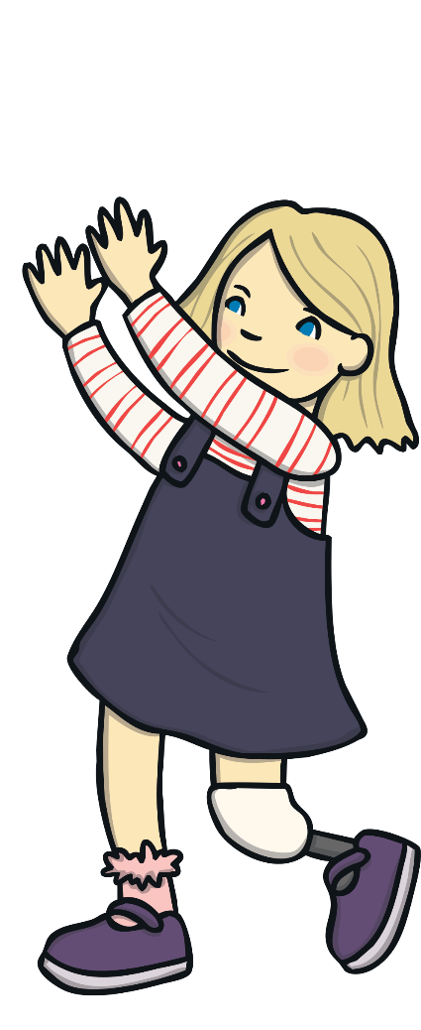


Remember It
Try playing the game with a partner. You could throw a bean bag
or start with 10 cubes and hide some.

Slide 7


Number Bonds
You will already know lots of facts.
We can use these to make new facts.
7 + 3 = 10
10 - 7 = 3
3 + 7 = 10
10 – 3 = 7

Slide 8
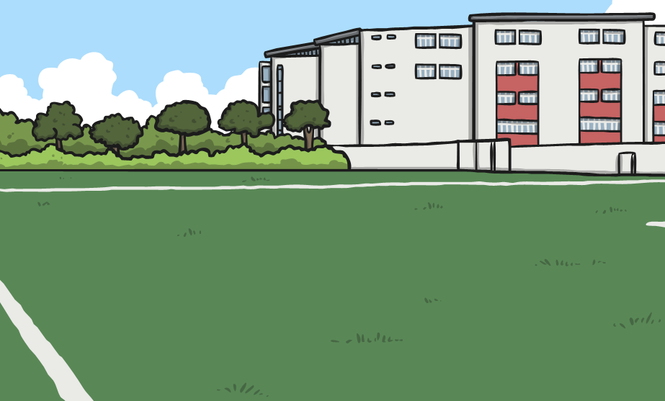


Number Bonds
4 + 6 = 10
so I know that…
40 + 60 = 100
Is this right?
Can you prove your thinking with equipment?

Slide 9


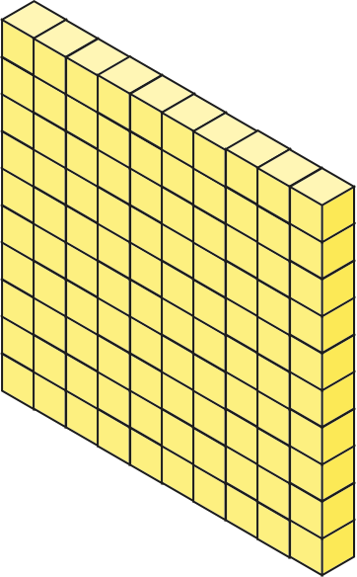
Number Bonds
4 + 6 = 10
+
=
40 + 60 = 100
+
=

Slide 10
Number Bonds
7 + 3 = 10
so I know that…
70 + 30 = 100
Is this right?
Can you prove your thinking with equipment?

Slide 11
Number Bonds
7 + 3 = 10
+
=
70 + 30 = 100
+
=

Slide 12

Make One Hundred
Explore number bonds of 10 with your partner and
make a similar bond of 100.
What do you notice?
Start with 100 and hide some tens. Can your partner say how many have
been hidden?

Slide 13
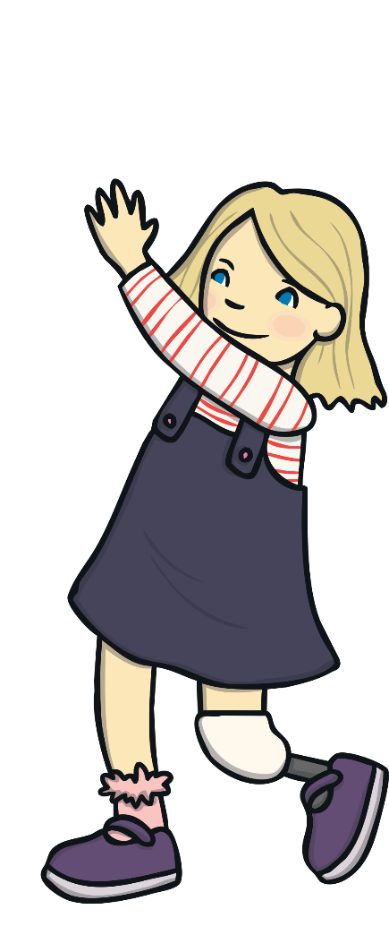
Make One Hundred
0 + 10 = 10
1 + 9 = 10
2 + 8 = 10
3 + 7 = 10
4 + 6 = 10
5 + 5 = 10
0 + 100 = 100
10 + 90 = 100
20 + 80 = 100
30 + 70 = 100
40 + 60 = 100
50 + 50 = 100
What do you notice?

Slide 14
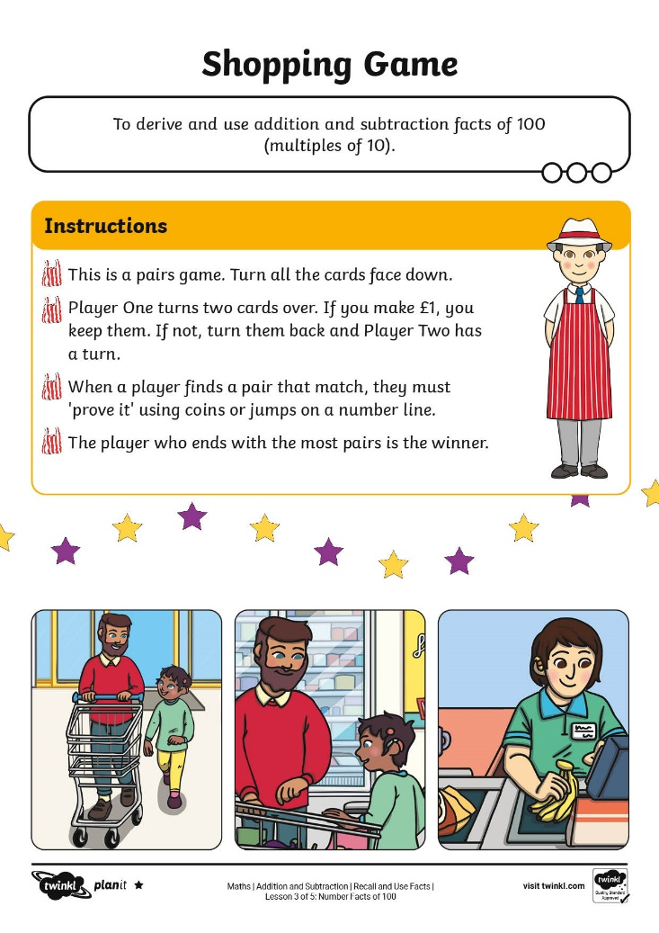
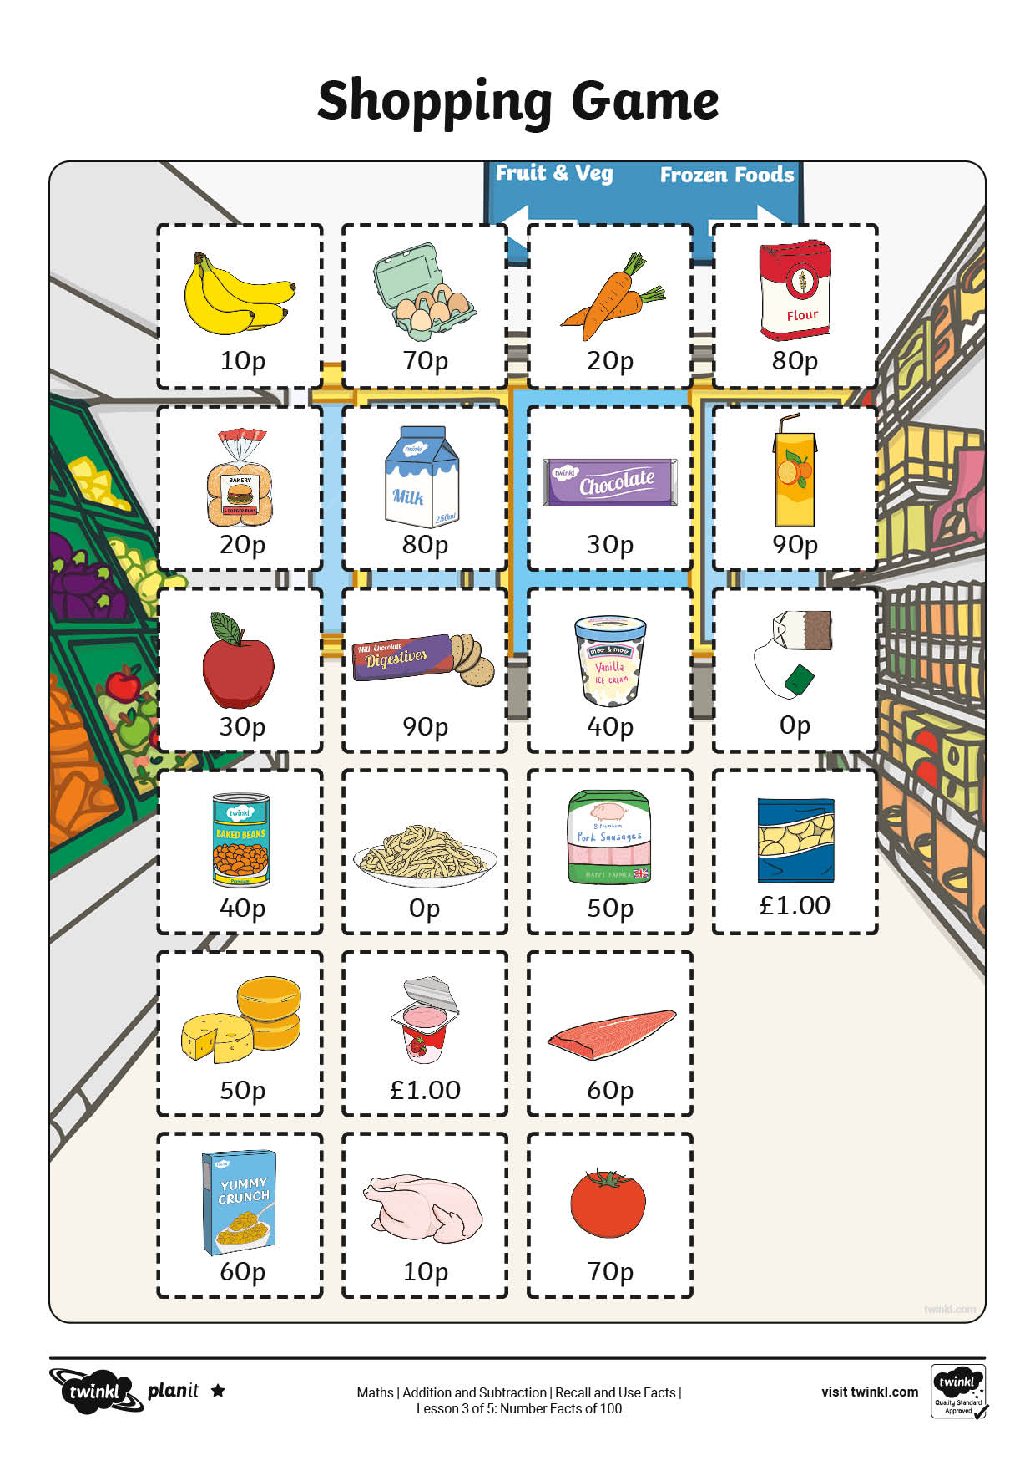
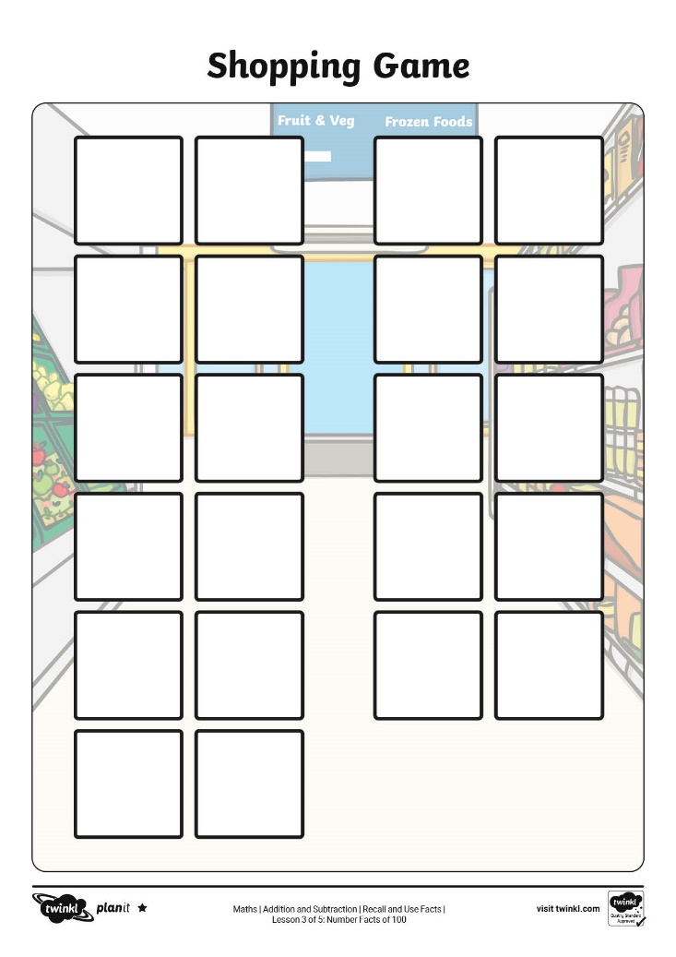
Shopping

Slide 15
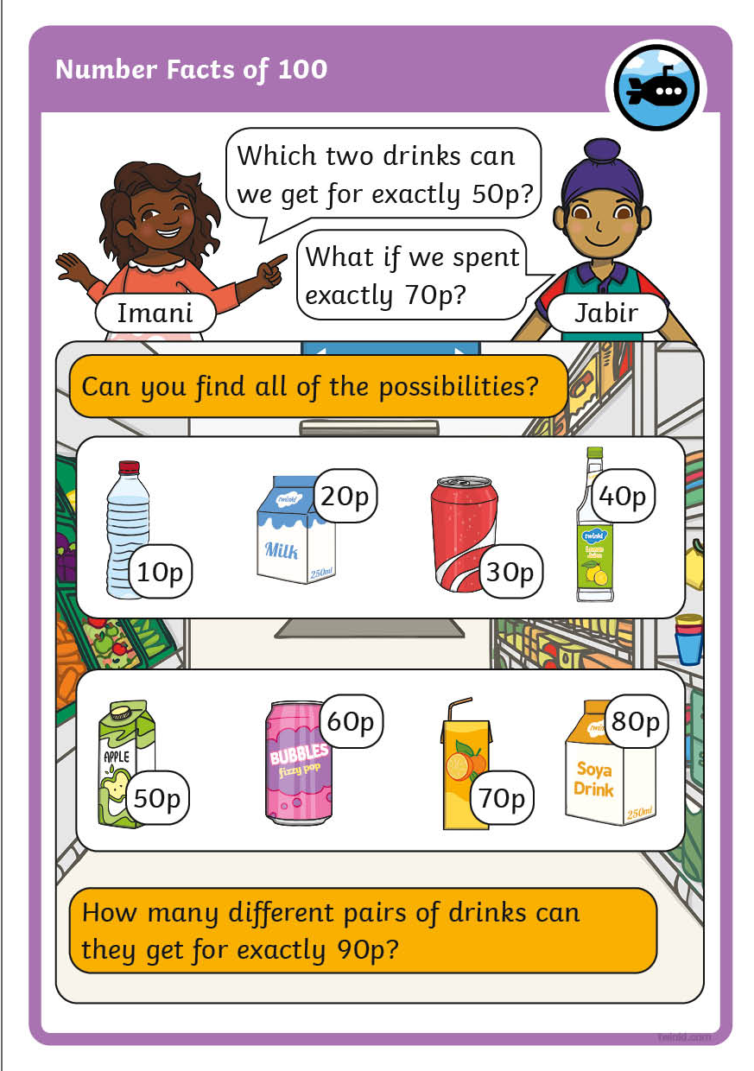
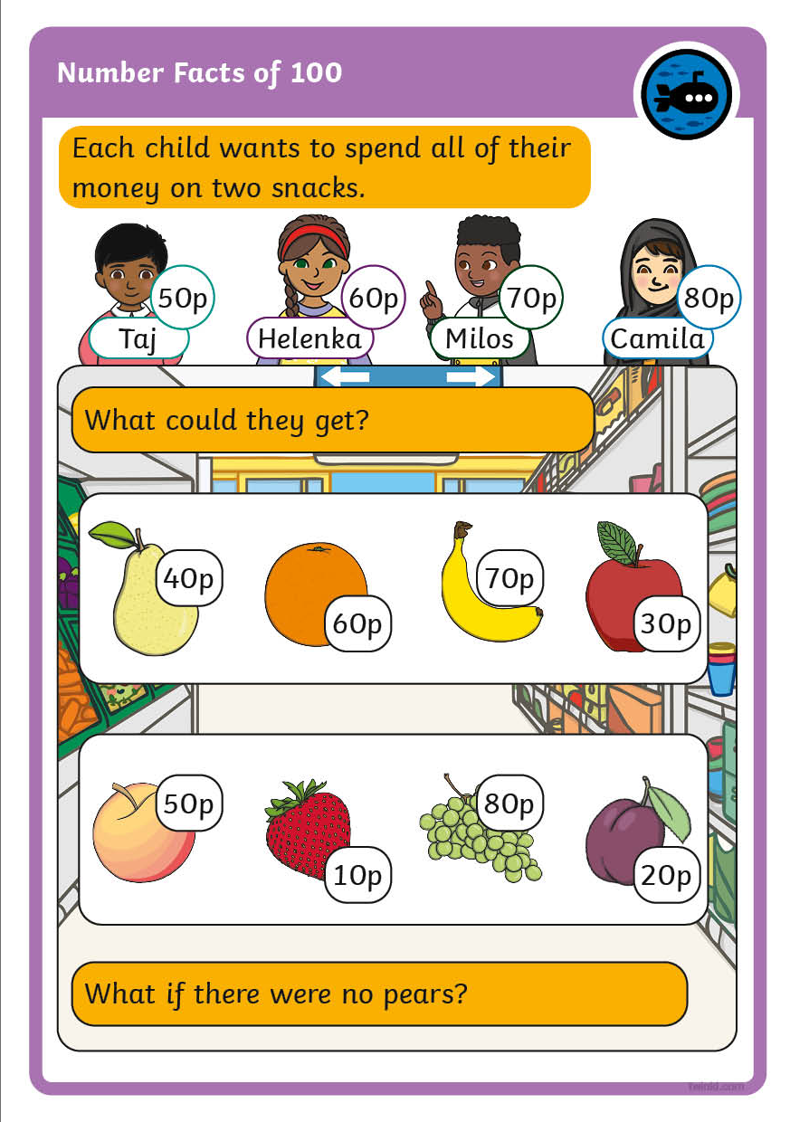
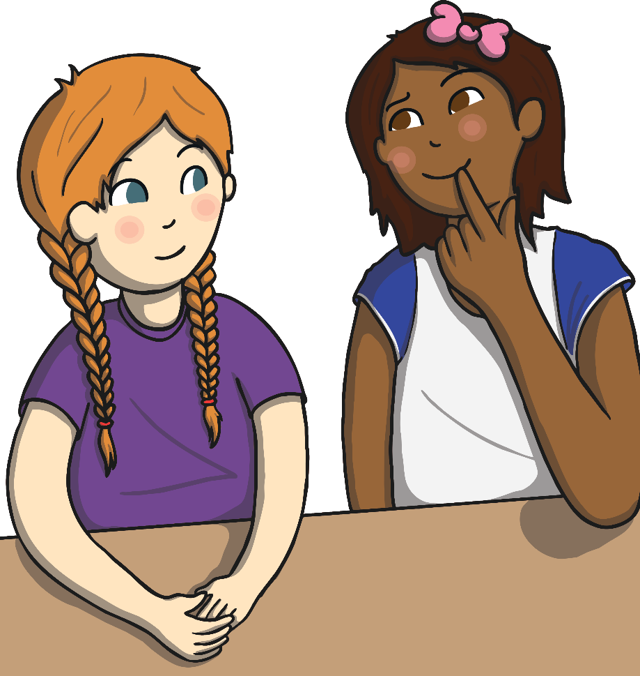
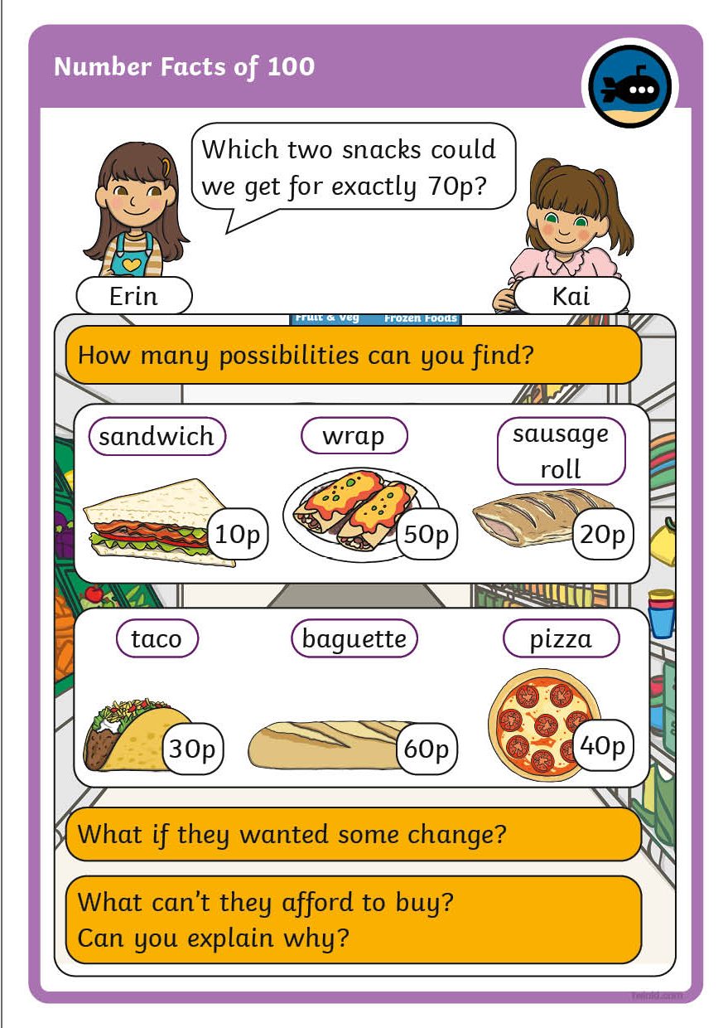
Diving into Mastery
Dive in by completing your own activity!

Slide 16
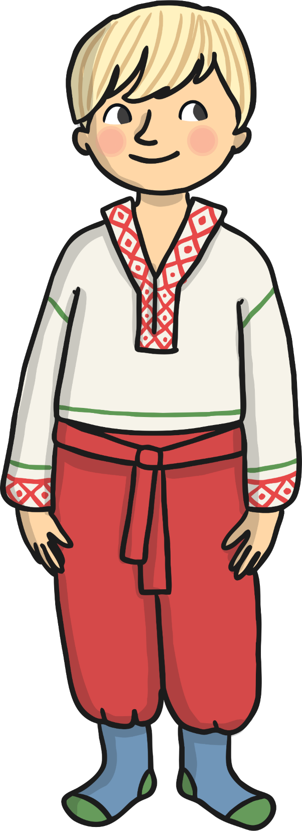

Reasoning
Hari asks the question:
If I start with 100 and subtract a multiple of 10, will my answer
always be a multiple
of 10?
Can you answer his question?
Can you give a reason
for your thinking?

Slide 17

Reasoning
If I add 5 to any number with 5 ones, I will always make the next ten.
55 + 5 = 60
15 + 5 = 20
75 + 5 = 80
Do you agree?
Can you think of any more numbers
that fit the pattern?

Slide 18
Aim
To derive and use addition and subtraction facts of 100
(multiples of 10).
Success Criteria
I can derive addition and subtraction facts of 100 (multiples of 10).
I can use these addition and subtraction facts in a context.

