Slide 1

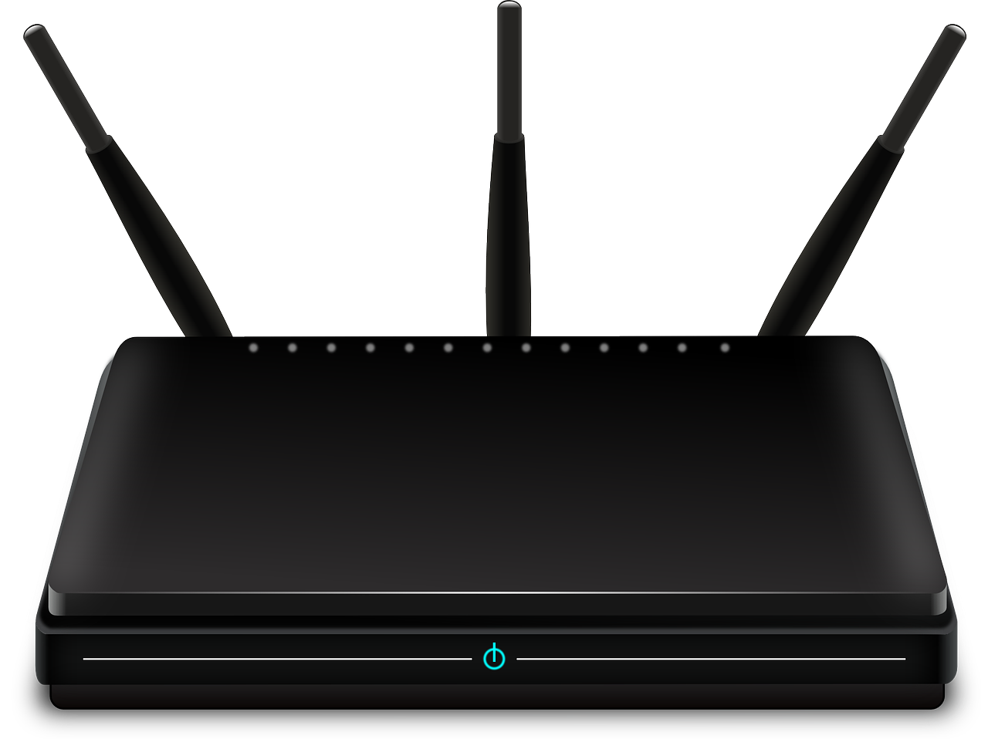



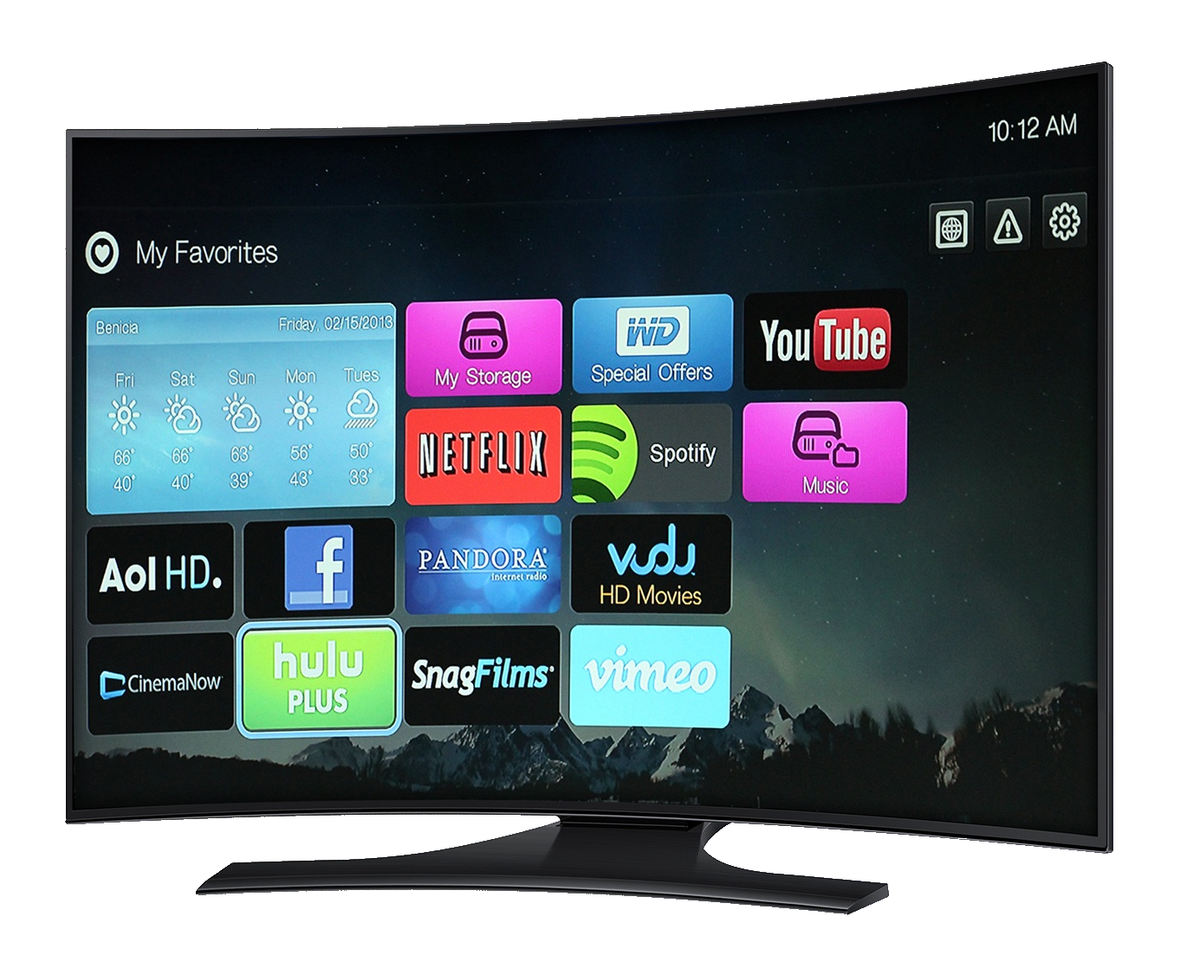
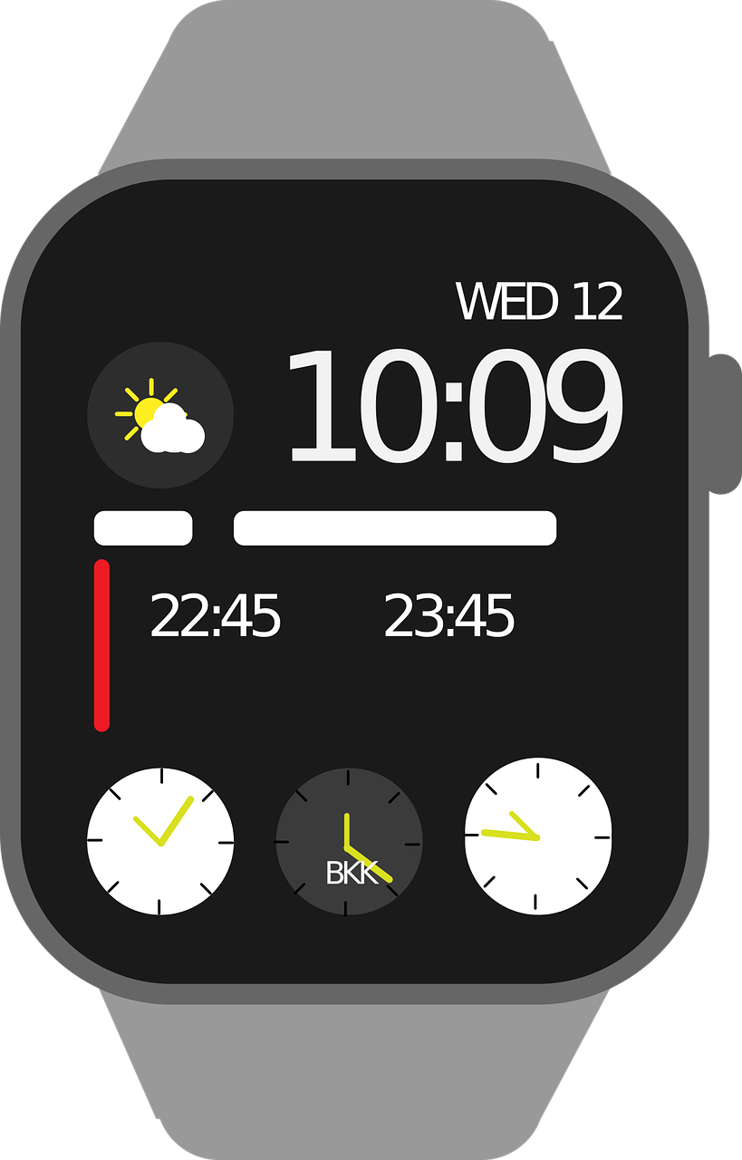
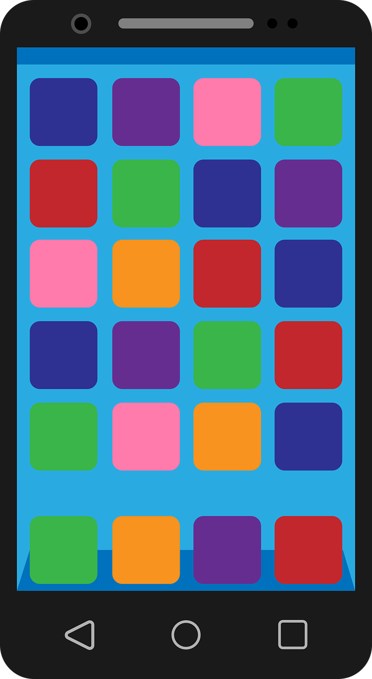
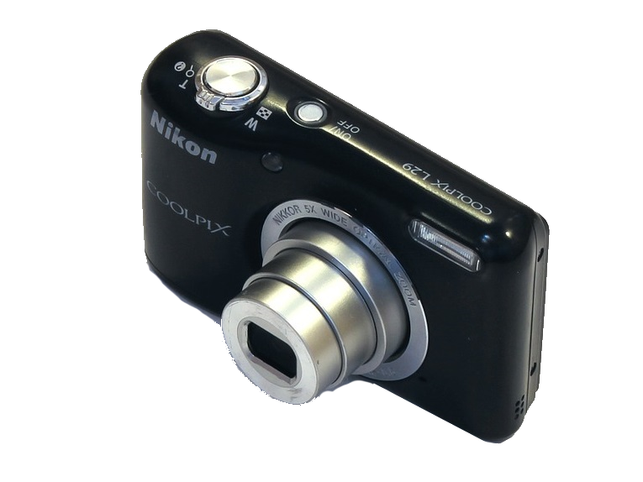



Notes:
Last updated: 01-07-20
Save a copy
This resource is available online at ncce.io/csn2-2-a2-ra. Resources are updated regularly — please check that you are using the latest version.
This resource is licensed under the Open Government Licence, version 3. For more information on this licence, see ncce.io/ogl.

