Slide 1
Lesson 2: Where have we seen information technology in the home?
Save a copy
Year 2 – Computing Systems and Networks – Information technology around us
Notes:
Last updated: 01-07-20
This resource is available online at ncce.io/csn2-2-s. Resources are updated regularly — please check that you are using the latest version.
This resource is licensed under the Open Government Licence, version 3. For more information on this licence, see ncce.io/ogl.

Slide 2
Lesson 2: Where have we seen information technology at home?
Objectives
Lesson objective: To identify information technology in the home
I can explain the purpose of information technology in the home
I can open a file
I can move and resize images

Slide 3
What is information technology?
What information technology
did we talk about
in the last lesson?
Introduction
Notes:
Ask learners to think back to the previous lesson. Ask them if they can remember what the term ‘information technology’ means or what it relates to. Discuss with learners the classroom IT that you looked at in the last lesson.

Slide 4


Is this information technology?
Introduction
Notes:
Show learners the images and ask them to put their thumbs up if the picture is of something which is IT, or thumbs down if it is not.
Image sources:
https://pixabay.com/illustrations/thumb-positive-finger-like-hand-3171760/
https://pixabay.com/vectors/computer-desktop-workstation-office-158675/

Slide 5

Is this information technology?
Introduction
Notes:
Show learners the images and ask them to put their thumbs up if the picture is of something which is IT, or thumbs down if it is not.
Image sources:
https://pixabay.com/illustrations/thumb-positive-finger-like-hand-3171760/
https://pixabay.com/photos/pencil-office-design-creative-1209528/

Slide 6
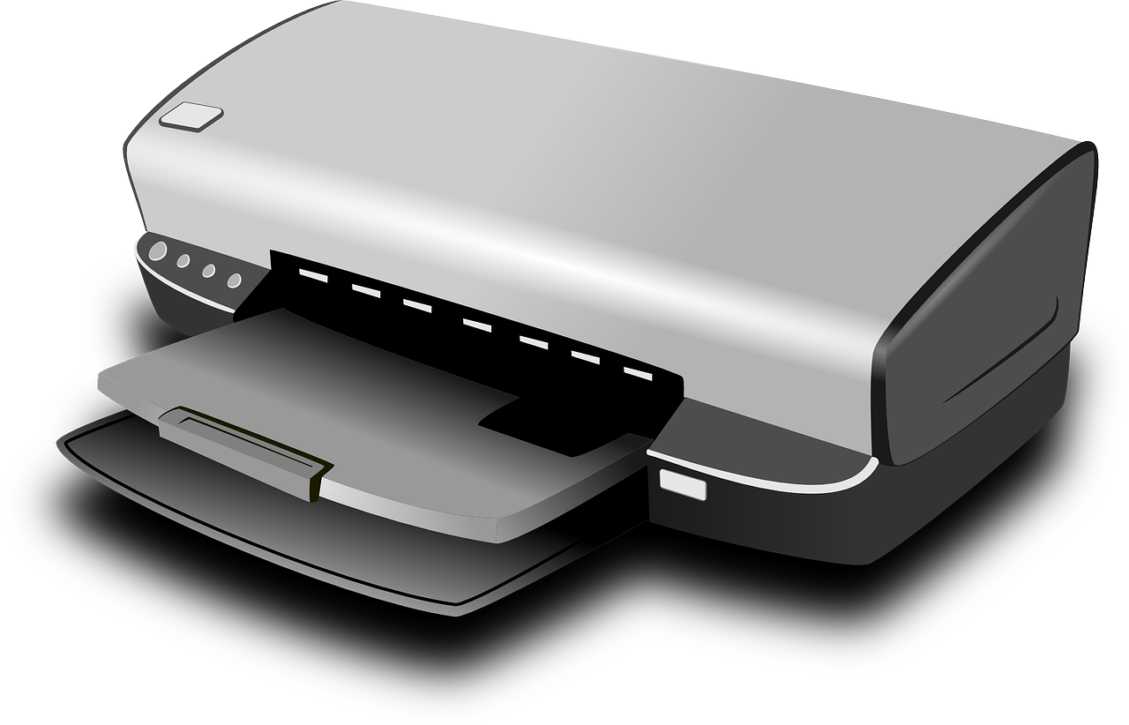
Is this information technology?
Introduction
Notes:
Show learners the images and ask them to put their thumbs up if the picture is of something which is IT, or thumbs down if it is not.
Image sources:
https://pixabay.com/illustrations/thumb-positive-finger-like-hand-3171760/
https://pixabay.com/vectors/printer-computer-hardware-inkjet-159612/

Slide 7
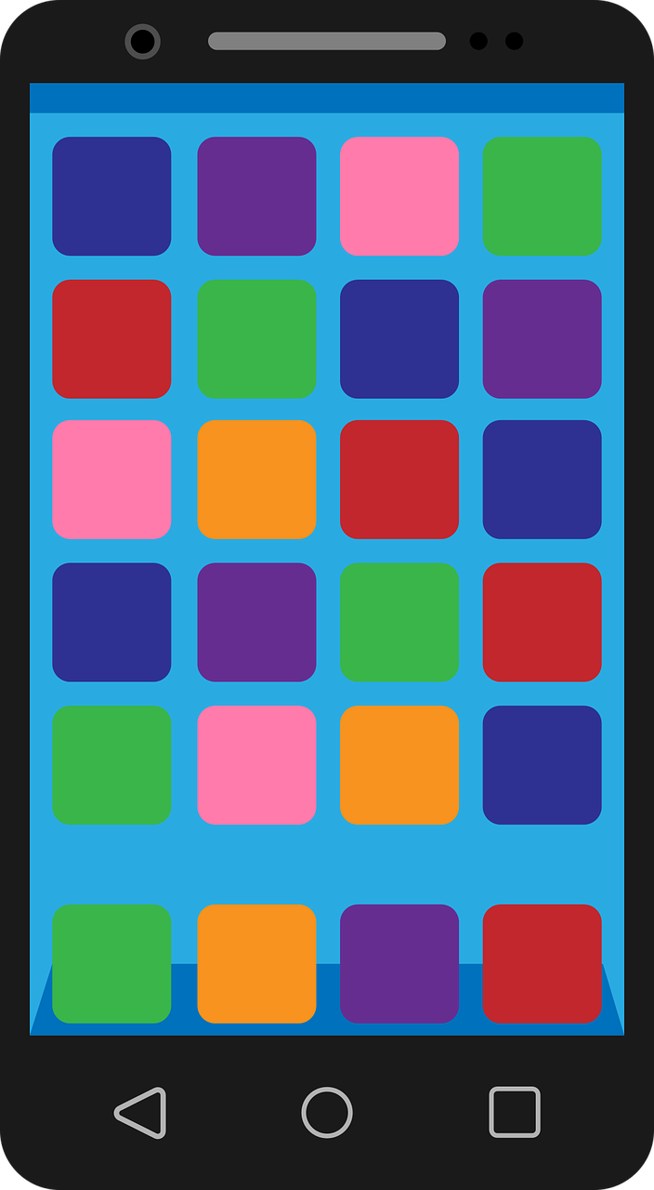
Is this information technology?
Introduction
Notes:
Show learners the images and ask them to put their thumbs up if the picture is of something which is IT, or thumbs down if it is not.
Image sources:
https://pixabay.com/illustrations/thumb-positive-finger-like-hand-3171760/
https://pixabay.com/vectors/smartphone-phone-mobile-technology-2821599/

Slide 8

Is this information technology?
Introduction
Notes:
Show learners the images and ask them to put their thumbs up if the picture is of something which is IT, or thumbs down if it is not.
Image sources:
https://pixabay.com/illustrations/thumb-positive-finger-like-hand-3171760/
https://pixabay.com/pt/vectors/violino-cl%C3%A1ssico-instrumento-33610/

Slide 9

Did you find any IT at home?
Activity 1
Notes:
Remind learners that they were asked to look around their homes for IT that they and/or their parents/guardians/carers may use. Write down a list of the devices that learners suggest and, if required, display images of devices often found in the home.
Image source: https://pixabay.com/vectors/house-svg-vector-2374925/

Slide 10
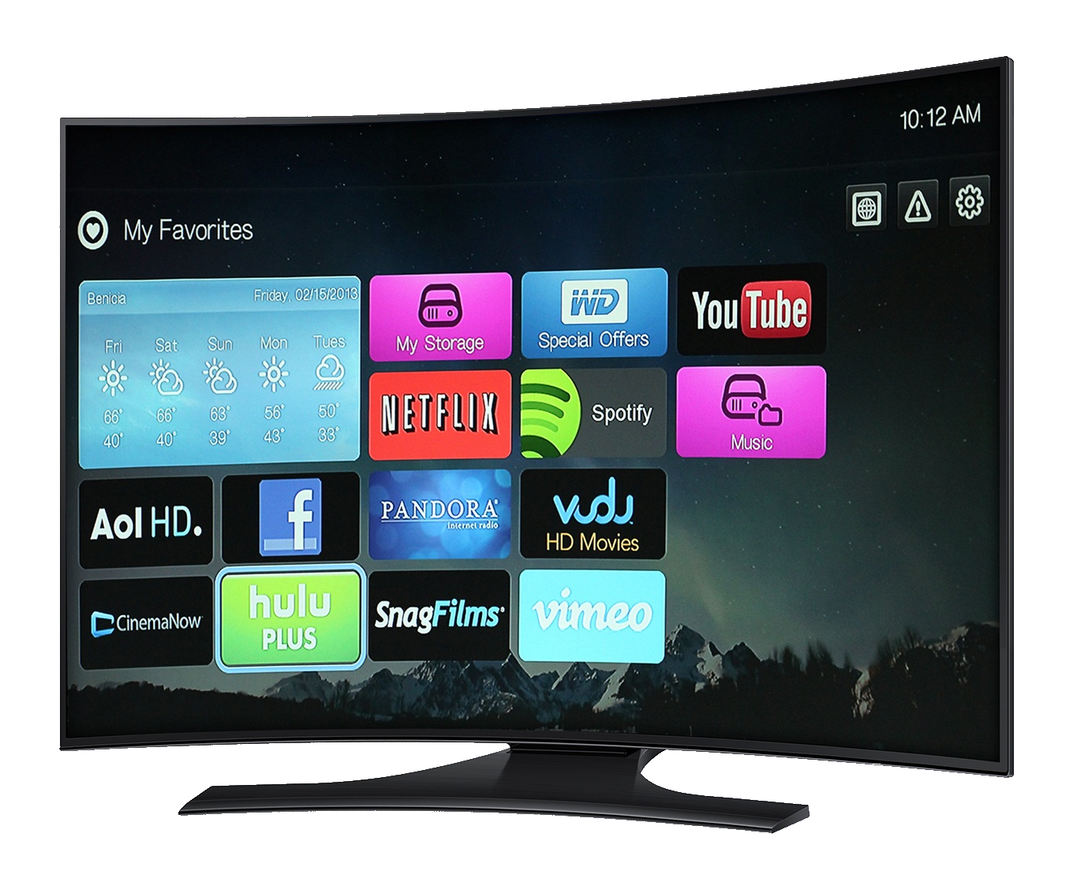
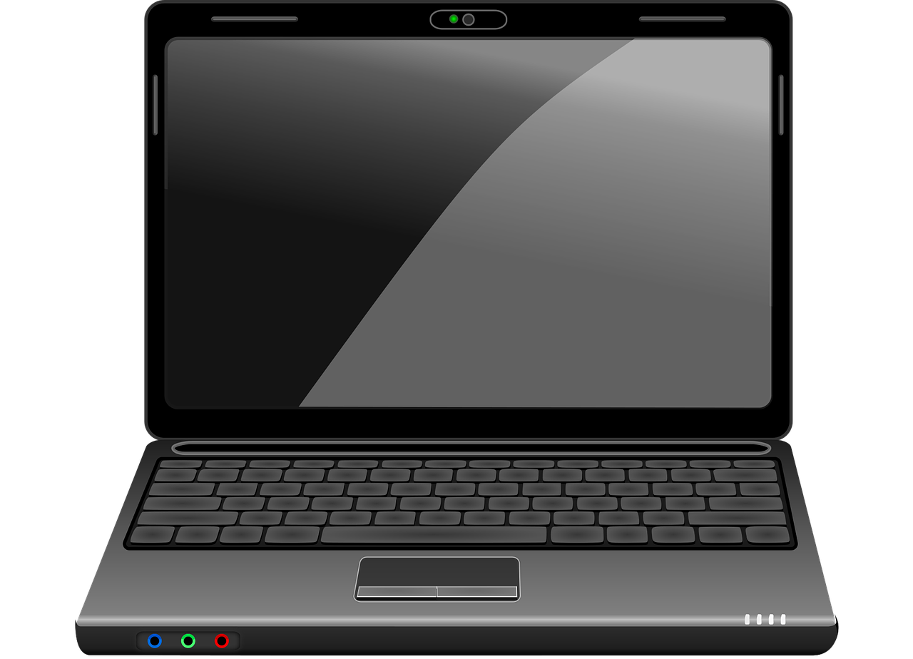


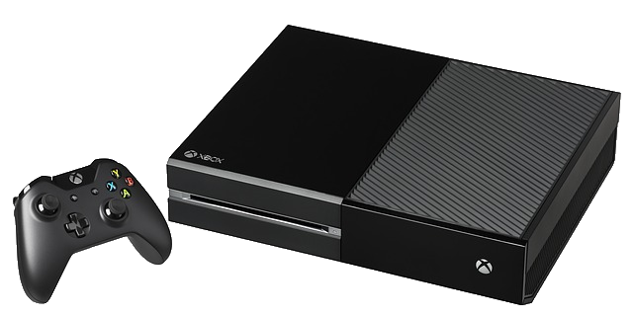
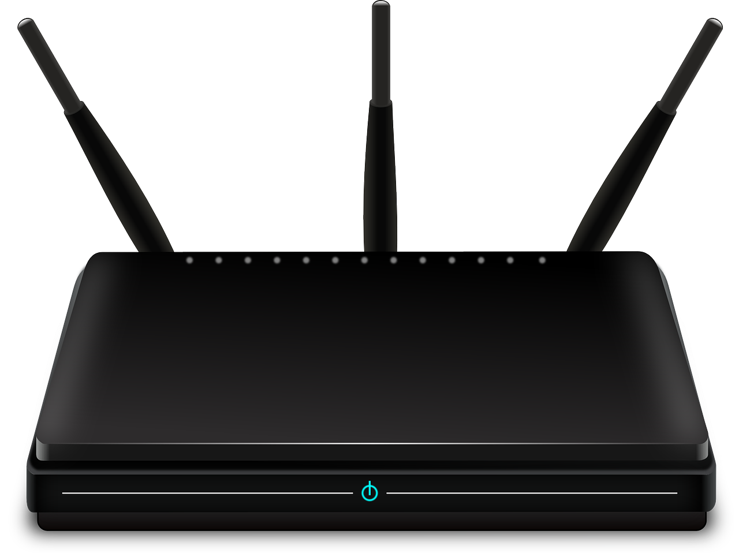

Did you find any IT at home?
Activity 1
Notes:
Image sources:
https://pixabay.com/vectors/smartphone-phone-mobile-technology-2821599/
https://pixabay.com/vectors/phone-handset-cordless-telephone-33870/
https://pixabay.com/vectors/router-wireless-network-connection-157597/
https://pixabay.com/photos/video-game-console-video-game-play-2202666/
https://pixabay.com/photos/ipad-tab-tablet-3d-2462599/
https://pixabay.com/vectors/laptop-computer-technology-business-1295373/
https://pixabay.com/photos/tv-android-tv-network-android-627876/
https://pixabay.com/illustrations/appliance-washing-machine-machine-2648080/

Slide 11
What do these devices let us do?
How do they help us?
Activity 1
Notes:
For the devices suggested, ask learners how we use the devices and how they help us.
Image source: https://pixabay.com/vectors/house-svg-vector-2374925/

Slide 12
Can you sort this home IT into groups?
Activity 2
Notes:
Explain to learners that they will be undertaking a sorting activity and they should sort the devices into groups based on what the device is used for. The images could be sorted into these categories:
To talk to people
To play on
To help us do a job
Not sure
Demonstrate to learners how to access the resources, and how to resize and move images.
Image sources:
https://pixabay.com/vectors/smartphone-phone-mobile-technology-2821599/
https://pixabay.com/vectors/phone-handset-cordless-telephone-33870/
https://pixabay.com/vectors/router-wireless-network-connection-157597/
https://pixabay.com/photos/video-game-console-video-game-play-2202666/
https://pixabay.com/photos/ipad-tab-tablet-3d-2462599/
https://pixabay.com/vectors/laptop-computer-technology-business-1295373/
https://pixabay.com/photos/tv-android-tv-network-android-627876/
https://pixabay.com/illustrations/appliance-washing-machine-machine-2648080/

Slide 13
Life without IT
Activity 3
Choose a device from home.
What would life be like without it?
Would you miss it?
What would you do instead?
Notes:
Explorer task: Ask learners to choose one device from the activity, and to think about life without that device. Learners should consider the above questions.
Image sources:
https://pixabay.com/vectors/smartphone-phone-mobile-technology-2821599/
https://pixabay.com/vectors/phone-handset-cordless-telephone-33870/
https://pixabay.com/vectors/router-wireless-network-connection-157597/
https://pixabay.com/photos/video-game-console-video-game-play-2202666/
https://pixabay.com/photos/ipad-tab-tablet-3d-2462599/
https://pixabay.com/vectors/laptop-computer-technology-business-1295373/
https://pixabay.com/photos/tv-android-tv-network-android-627876/
https://pixabay.com/illustrations/appliance-washing-machine-machine-2648080/

Slide 14
What device might you use to...
Communicate
Help you do a job
Play on
Conclusion
Notes:
Ask learners to give examples of IT that is used for communicating, playing on (entertainment), and to help us. Encourage learners to think about the devices that they sorted during the activity, as well as other devices.

Slide 15
Where else might you find
some of the IT that you have
at home?
Conclusion
Notes:
Ask learners whether they think that any of the devices discussed might be found somewhere other than at home, e.g. in school, shops, libraries, launderettes, cinemas, etc.

Slide 16

How confident are you? (1–3)
Assessment
I can explain the purpose of information technology in the home
I can open a file
I can move and resize images
3 - Very confident
2 - Unsure
1 - Not confident
Notes:
Image source: https://pixabay.com/vectors/thumb-up-hand-like-confirm-go-top-307176/

Slide 17
Lesson objective: To identify information technology in the home
Summary
In this lesson, you:
Looked at information technology that you use in your home
Thought about the different things that IT can help with and what life would be like without it
Next lesson, you will…
Look at information technology beyond school.
Before the next lesson, can you identify any examples of information technology away from school or the home?

