Slide 1


Maths
Addition and Subtraction
Year One
Maths | Addition and Subtraction | Solve Problems | Lesson 2 of 4: Using Number Facts to Solve 2-Step Problems

Slide 2
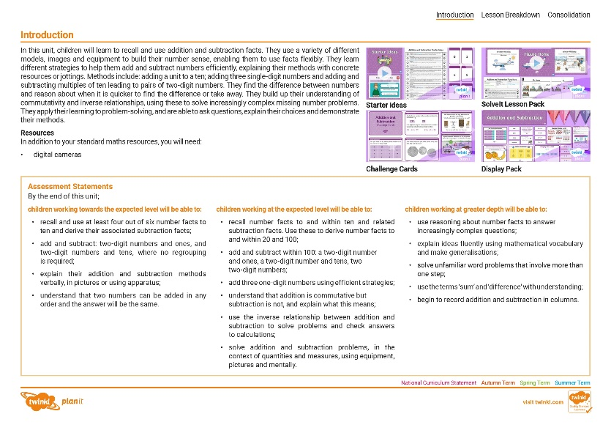
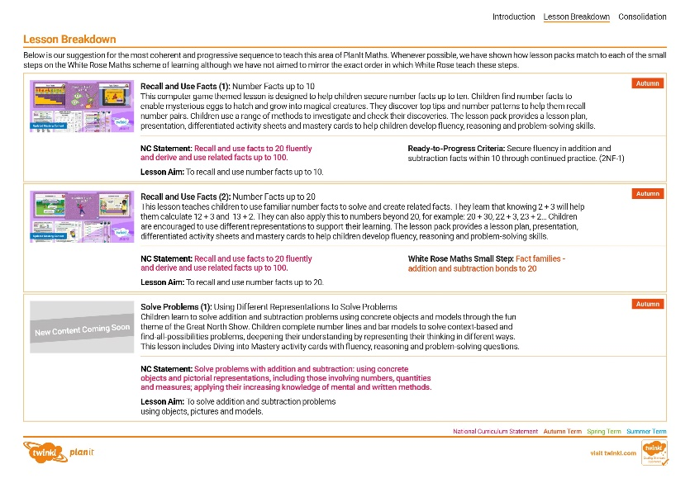
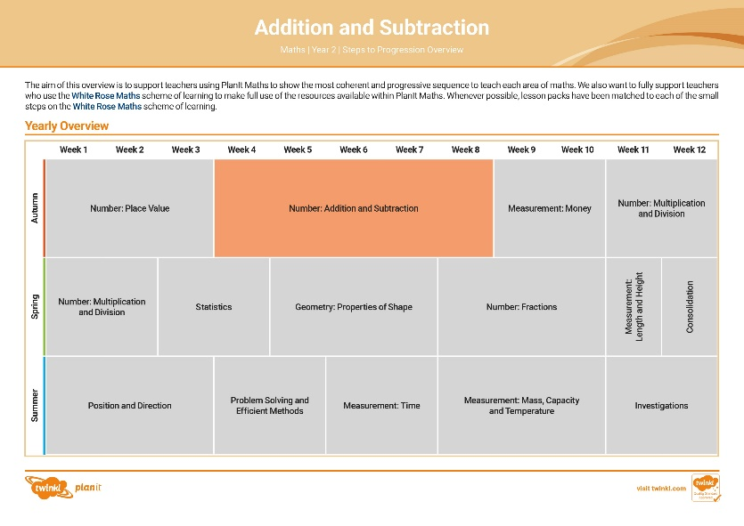

Need a coherently planned sequence of lessons to complement this resource?
See our Addition and Subtraction Steps to Progression document.
Twinkl PlanIt is our award-winning scheme of work with
over 4000 resources.

Slide 4
Aim
To solve two-step problems involving addition and subtraction.
Success Criteria
I can solve problems by adding.
I can solve problems by subtracting.
I can use objects, pictures and models to help me solve problems.
I can solve two-step problems by adding and subtracting.

Slide 5










Remember It
Choose 2 numbers on the grid that you could add or subtract from each other to make the target number. If it is correct, colour
them in your team colour.
The first team to connect 4 numbers in a row, column or diagonally wins the game.

Slide 6

Remember It
18 + 2 = 20 so
I can colour them in.
1
20
5
6
2
10
16
50
10
20
Click once in a square to turn it green, twice for yellow and a third time
to cancel.
15
18
0
12
13
17
7
14
40
30
19
4
3
60
70

Slide 7
Remember It
3 + 17 = 20 so I can colour them in.
20
18
5
12
19
80
10
16
23
50
37
24
70
44
0
99
13
42
Click once in a square to turn it green, twice for yellow and a third time
to cancel.
17
7
14
49
29
22
100
4
3
64
79
26
6
32
1
15
20
2

Slide 8





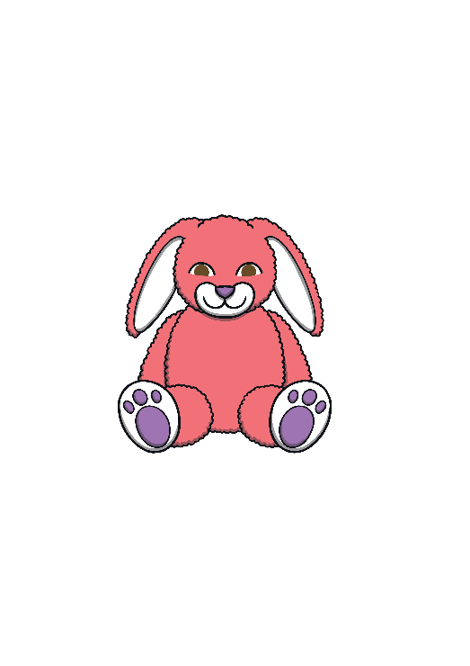




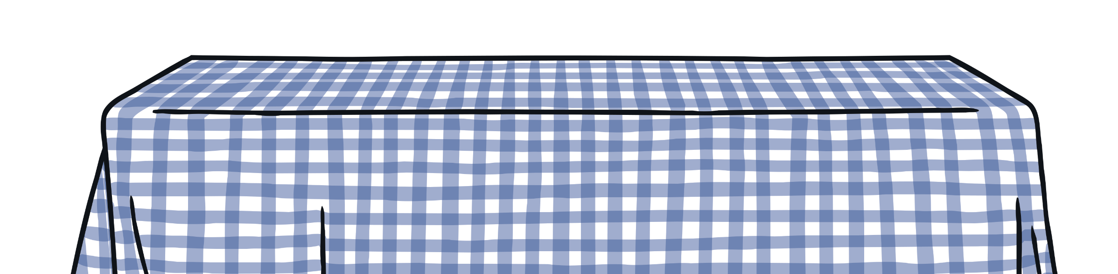


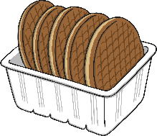



Buying Treats
Haleema and Erin are buying some treats from the stall at
the school fair. They buy 2 things each.
Can you work out how much change
they will get from 20p?
9p
5p
8p
3p
4p
12p
7p
2p
6p

Slide 9

Buying Treats
9p
Haleema bought the puppet and the bouncy ball.
How much change did she get?
8p
Next, we need to work out how much change she would get.
First, you need to find out how much she spent.
This is a 2-step problem. This means you have to do 2 things to answer the question. What do you think the 2 steps are?
9 + 8 = 17
change
+9
+8
0
1
2
3
4
5
6
7
8
9
10
11
12
13
14
15
16
17
18
19
20
We could count up from 17 – 20 or we could subtract 17 from 20.
Which do you think is easier?
20p
9p
8p
change
3p
She would get 3p change.

Slide 10

Buying Treats
Choose 2 things from the stall and find change from 20p.
Can you explain how you worked it out?
Can you show your working out in different ways?
9p
5p
8p
3p
4p
12p
7p
2p
6p

Slide 11
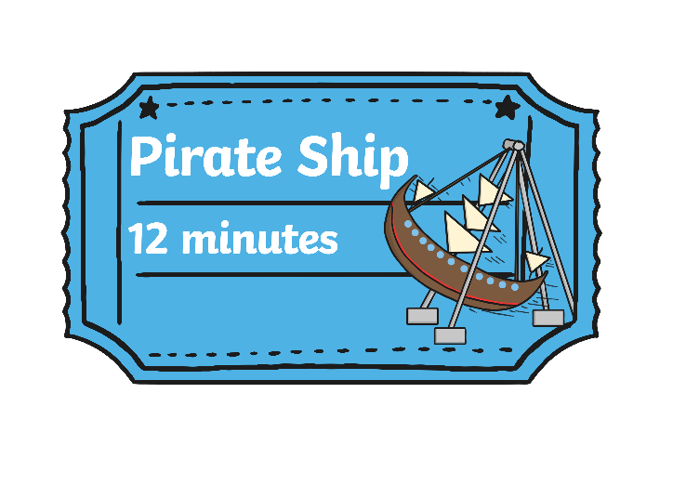
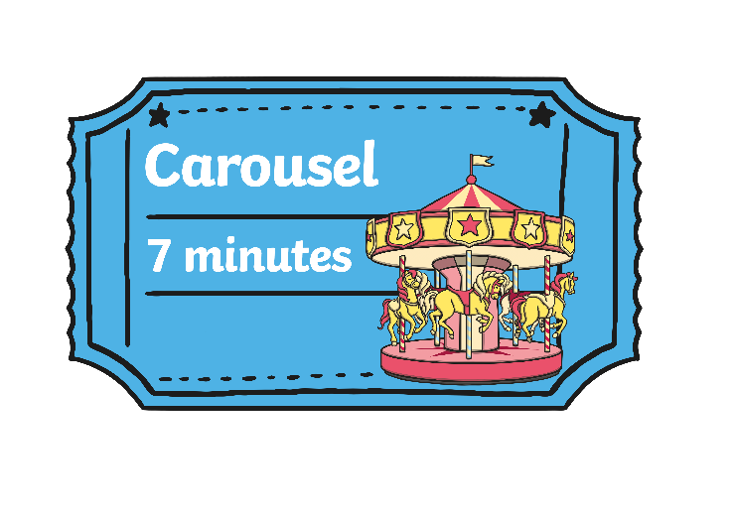

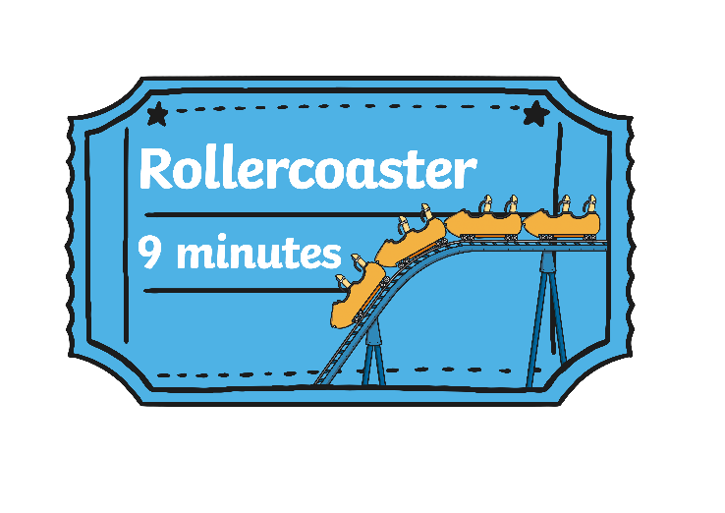
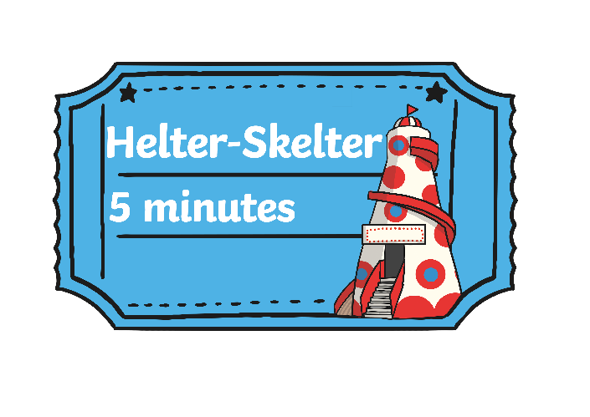




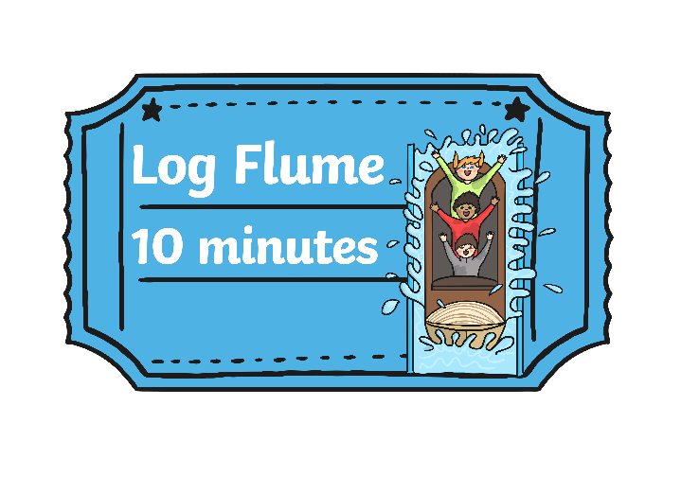

Choosing Rides
Haleema and Erin are allowed 20 minutes to choose which rides they'd like to go on. They can afford to go on 2 rides. What could they go on and how much
time will they have to spare?

Slide 12
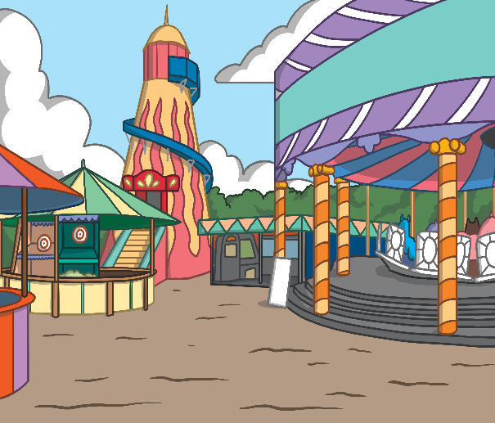

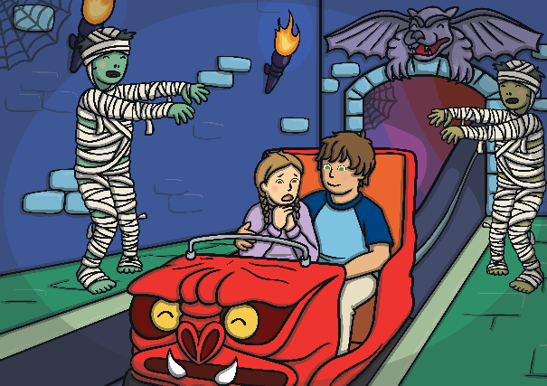
Choosing Rides
Haleema and Erin choose the Ghost Train and the Pirate Ship.
The Ghost Train takes 6 minutes. The Pirate Ship takes 12 minutes.
20 minutes
12 minutes
6 minutes
2
minutes
Pirate Ship
Ghost Train
Time to spare
What does the blue box represent?
12 + 6 = 18
It would take 18 minutes to go on the
Pirate Ship and Ghost Train.
20 – 18 = 2. They have 2 minutes to spare.

Slide 13

Choosing Rides
What other 2 rides could they go on and how long
would they have to spare?
Choose 2 rides and calculate the time to spare.
Use a bar model to help you.

Slide 14






A Day at the Fair
Work with a partner to solve the problems on your activity sheet.
Represent your work in as many ways as you can.
Here are some examples:
19
0
1
2
3
4
5
6
7
8
9
10
11
12
13
14
15
16
17
18
19
6
13
19
13
6
Click the models to hide them. Click here to show them all.

Slide 15
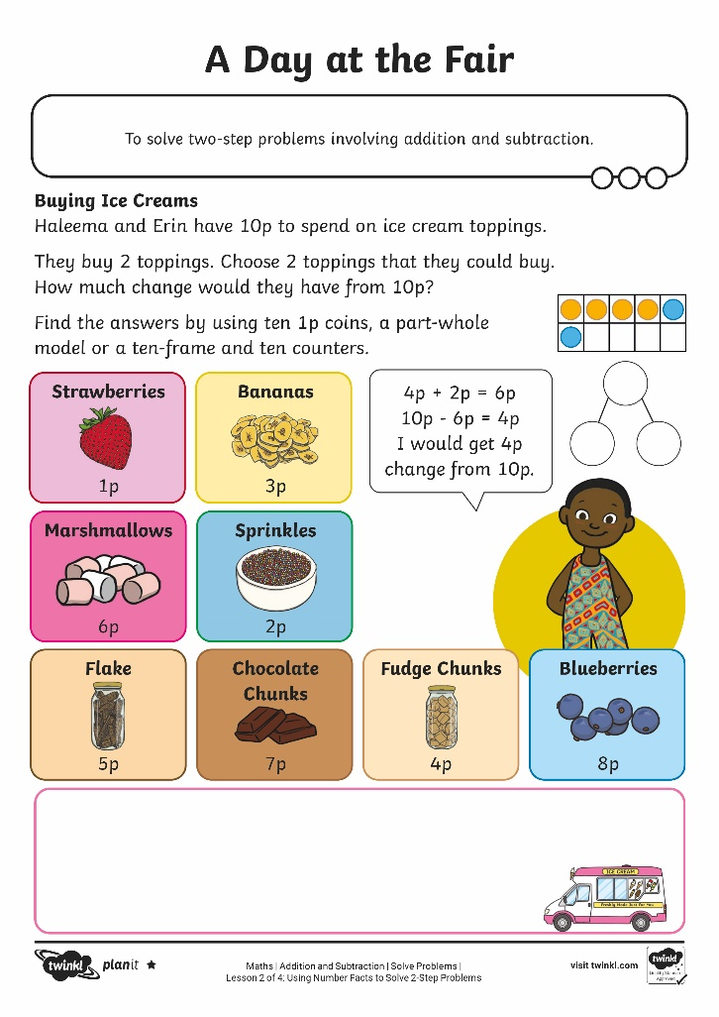
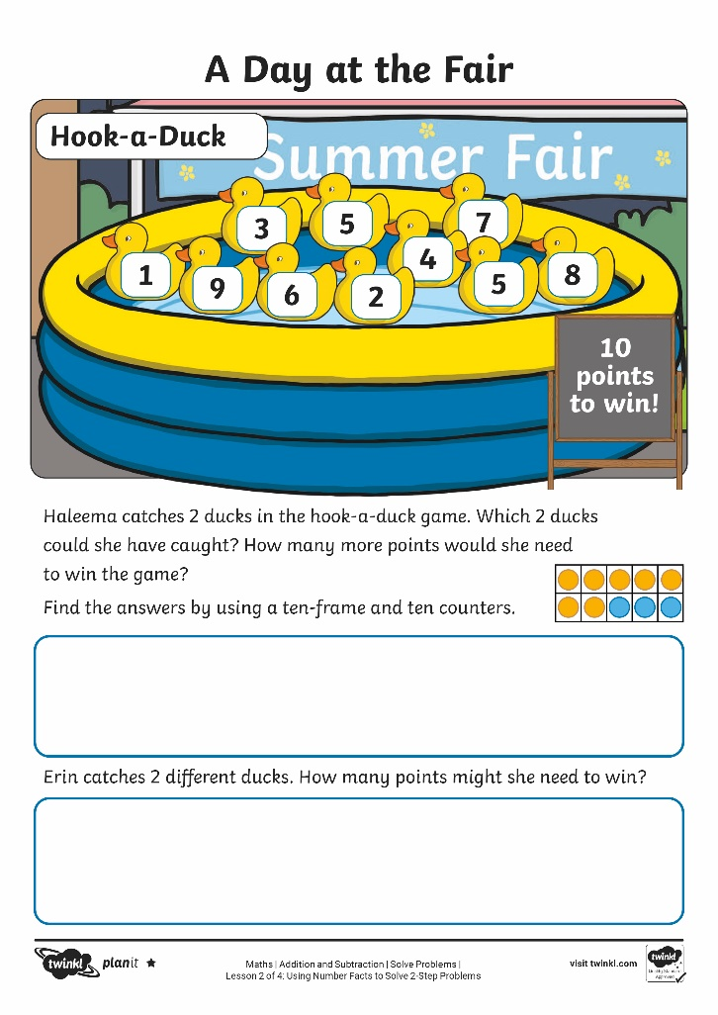
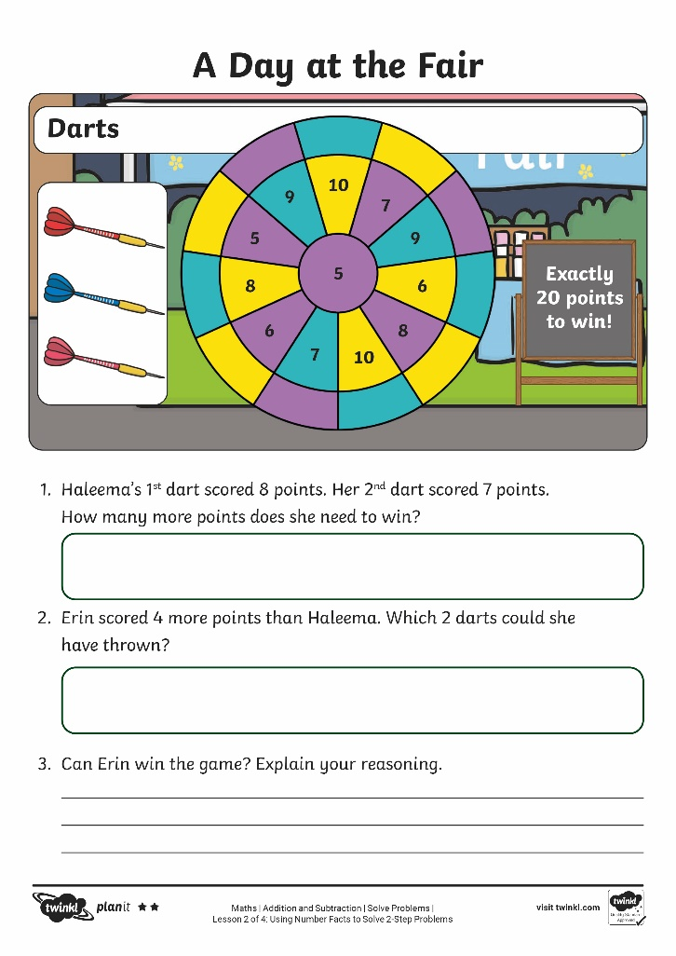
A Day at the Fair

Slide 16
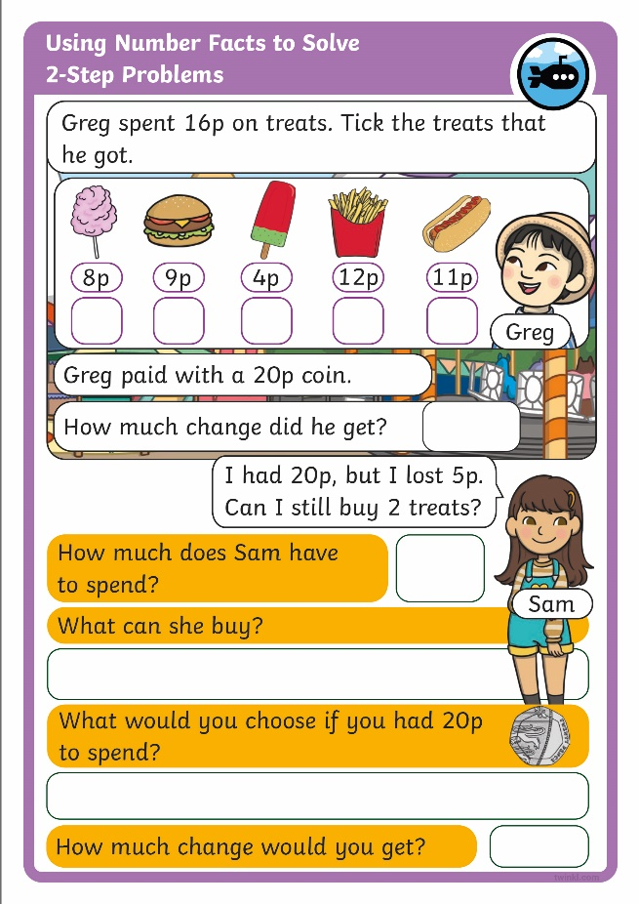
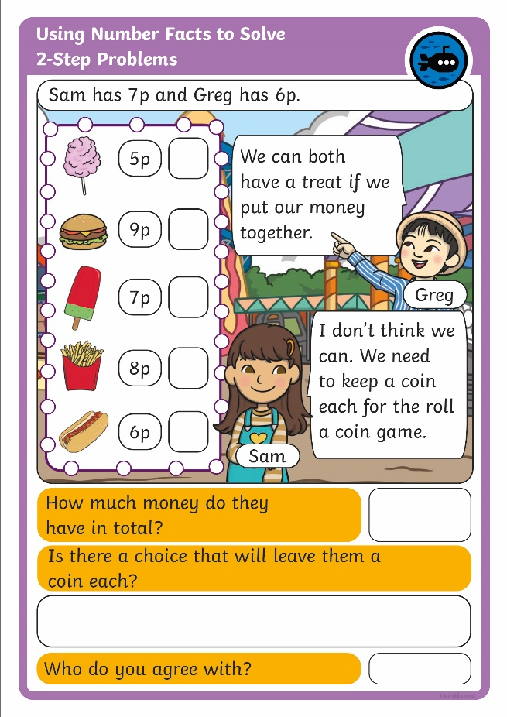
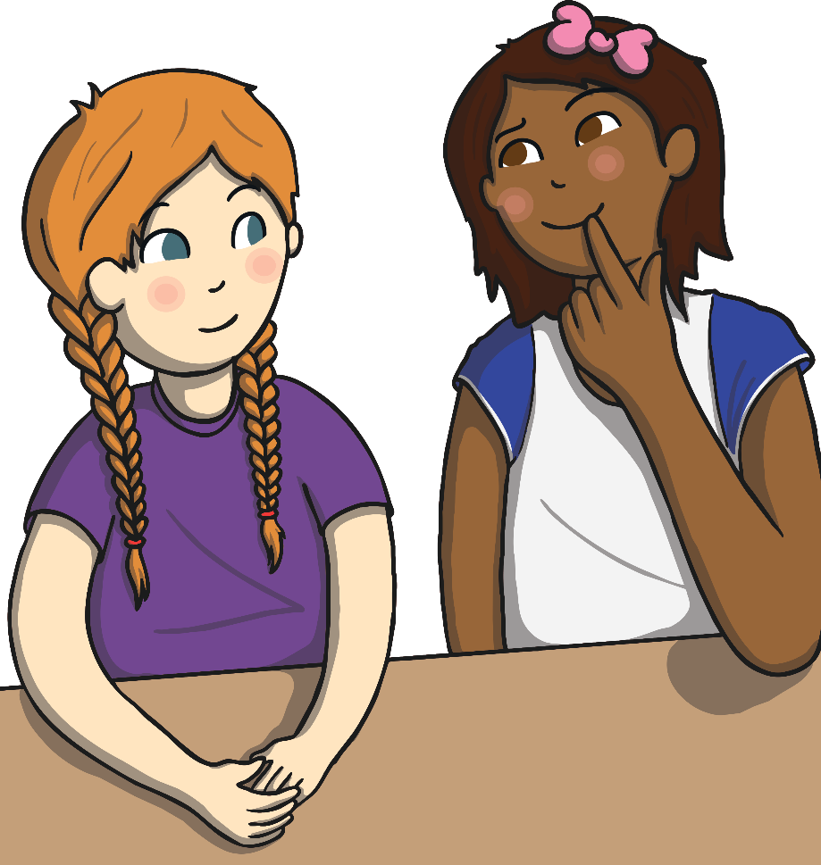
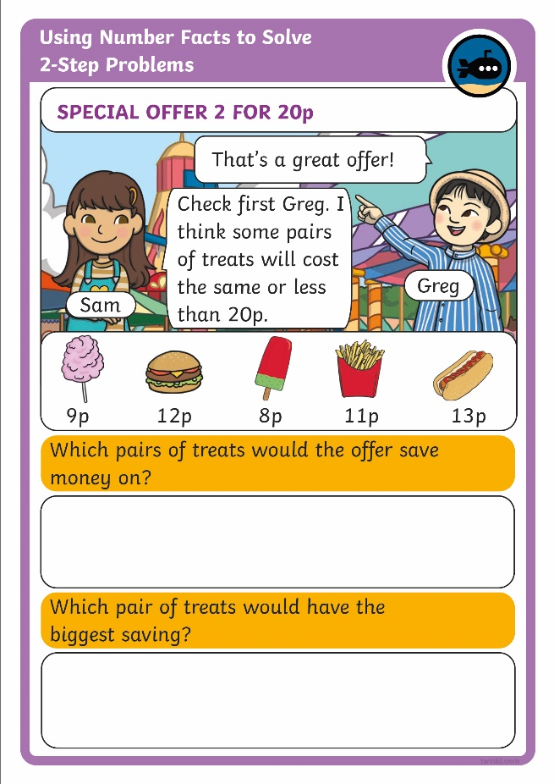
Diving into Mastery
Dive in by completing your own activity!

Slide 17

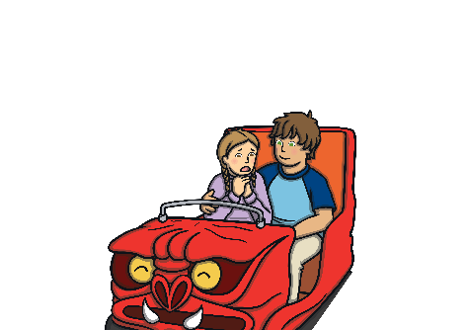






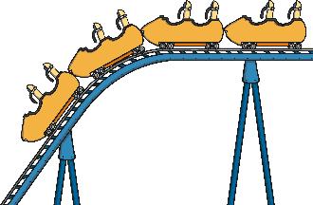
Ask a Question
Can you ask a 2-step question?
How much longer
does it take to ride the Pirate Ship and the Log Flume than the Ghost Train and the
Rollercoaster?
Helter-Skelter
Log Flume
10 minutes
Ghost Train
6 minutes
5 minutes
Carousel
7 minutes
Pirate Ship
12 minutes
Tea Cups
4 minutes
Rollercoaster
9 minutes
9 minutes
It takes 22 minutes to ride the Pirate Ship and the Log Flume.
It takes 15 minutes to ride the Ghost Train and the Rollercoaster.
It takes 7 minutes longer to ride the Pirate Ship and Log Flume.

Slide 18
Aim
To solve two-step problems involving addition and subtraction.
Success Criteria
I can solve problems by adding.
I can solve problems by subtracting.
I can use objects, pictures and models to help me solve problems.
I can solve two-step problems by adding and subtracting.

