Slide 1


Maths
Addition and Subtraction
Year One
Maths | Addition and Subtraction |Represent and Use Number Bonds within 10 | Lesson 1 of 2: Applying number Bonds within 10

Slide 2
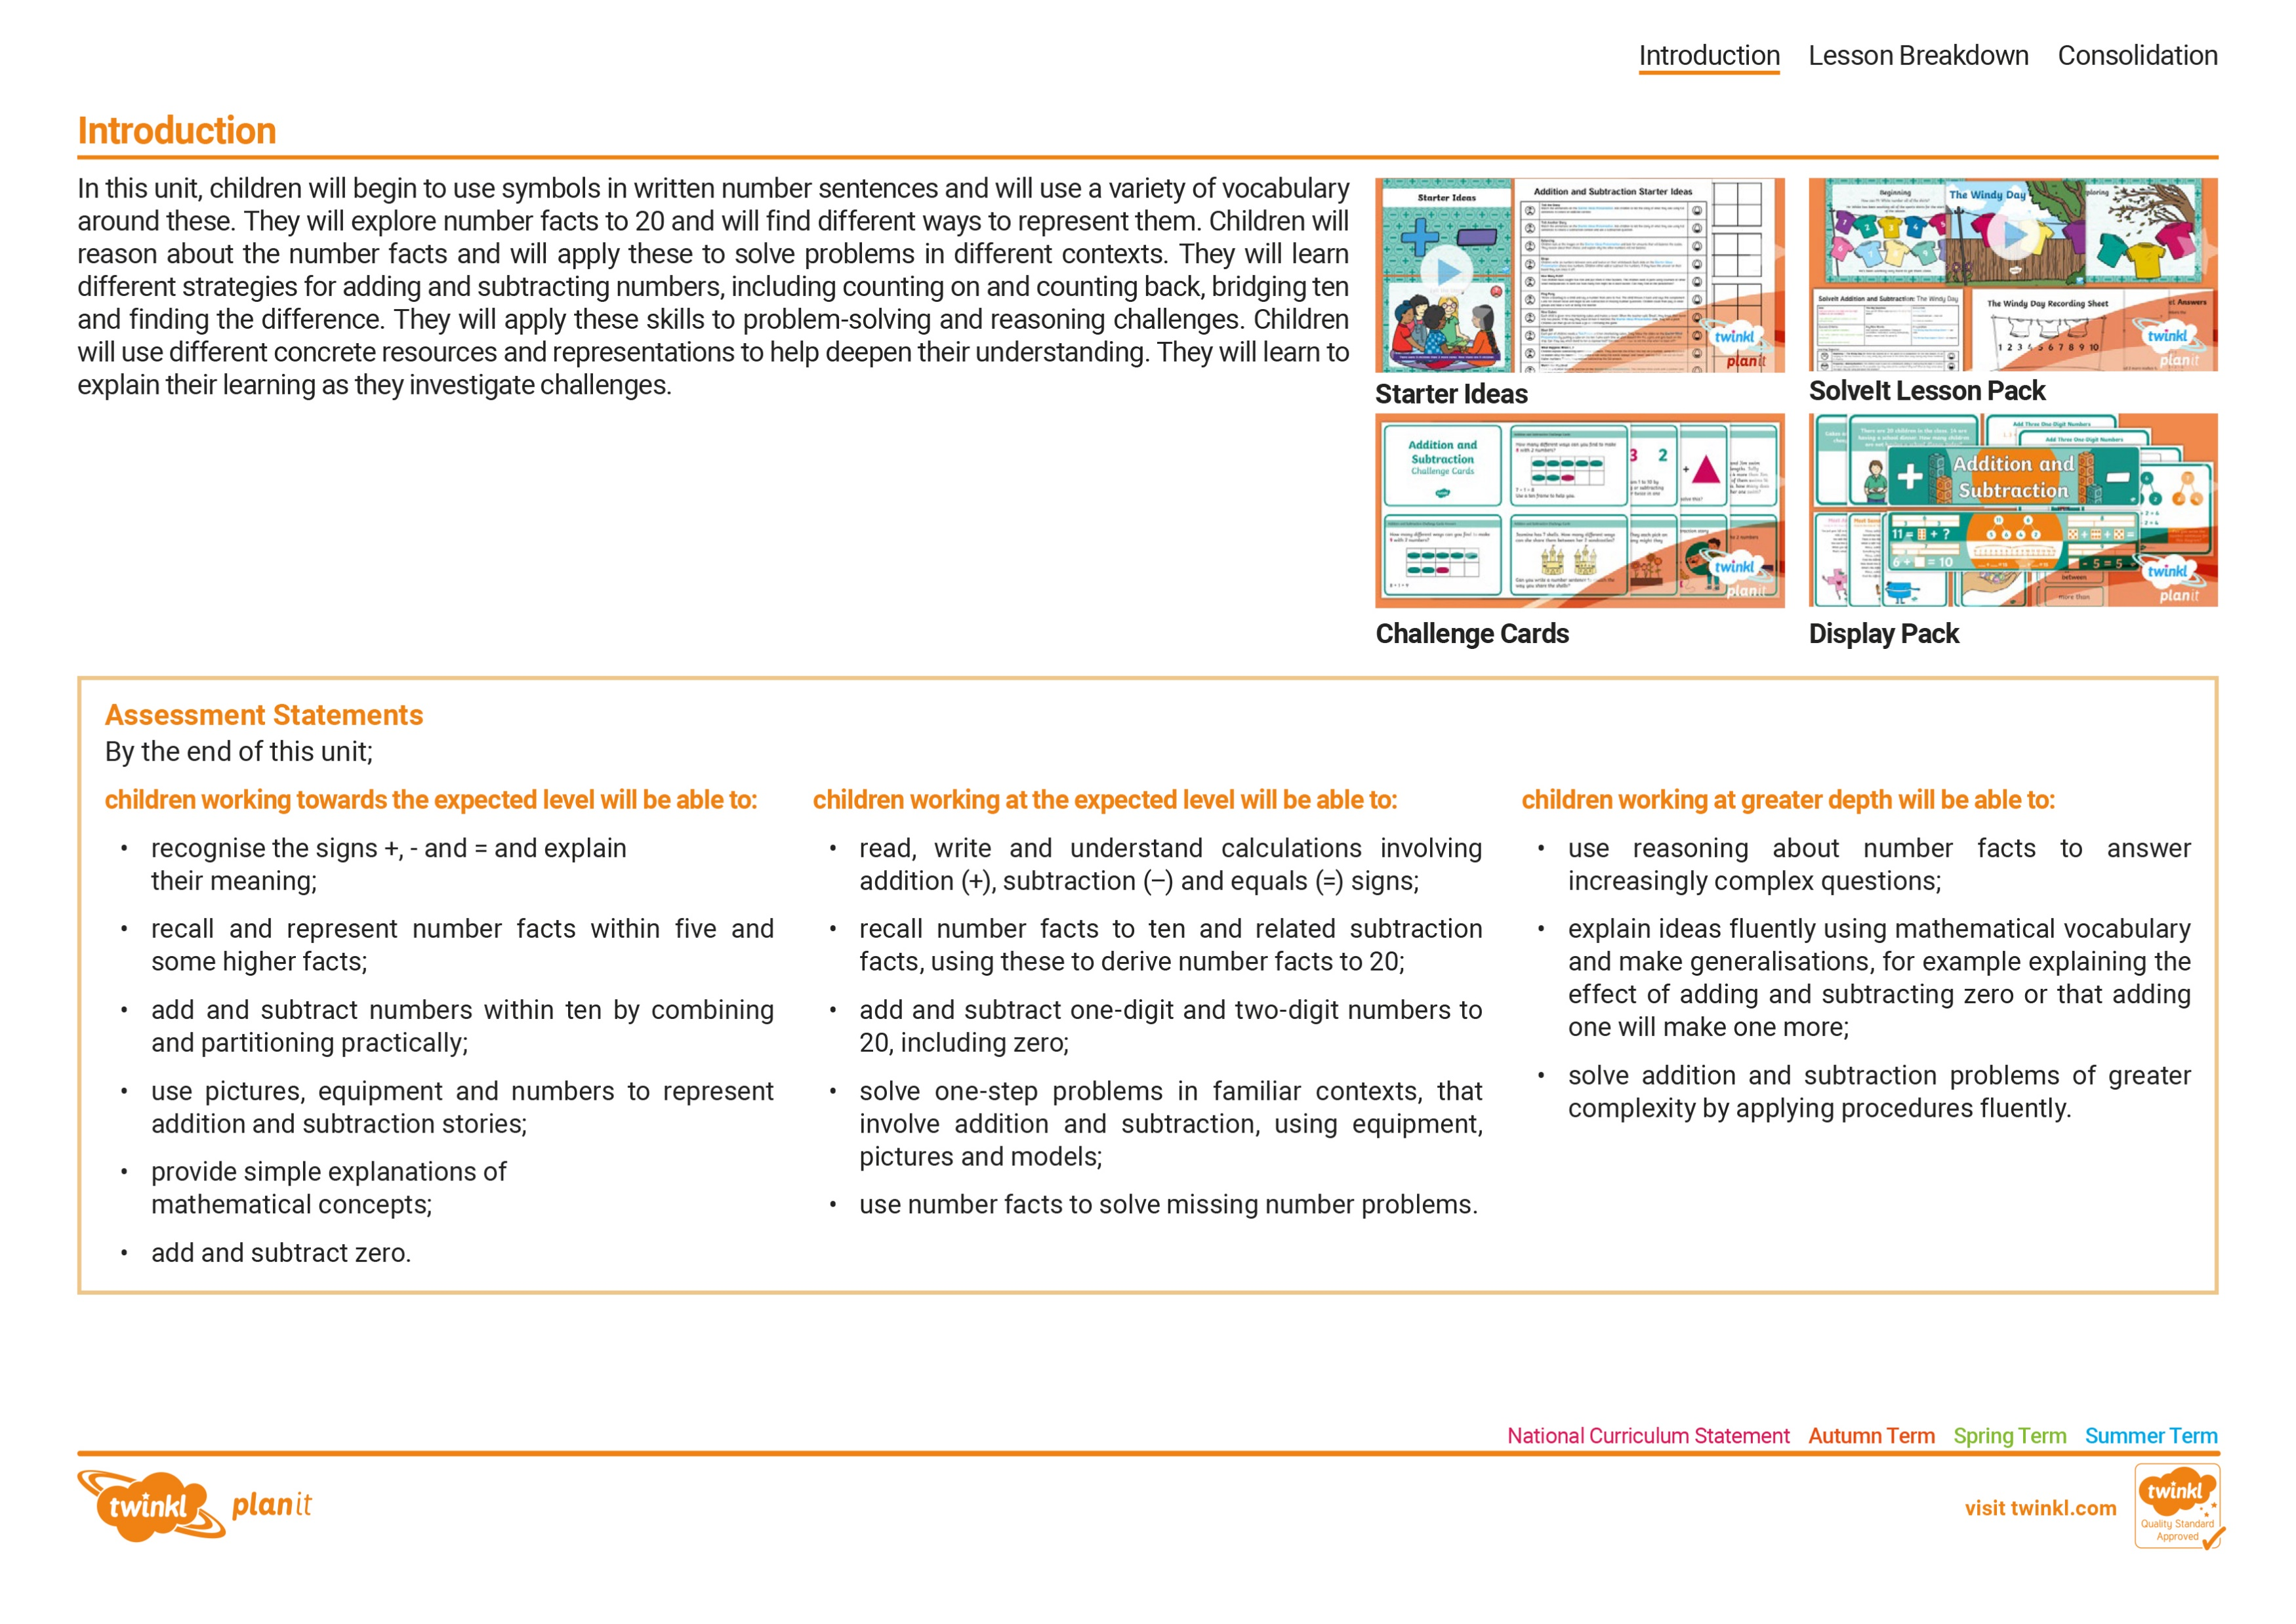
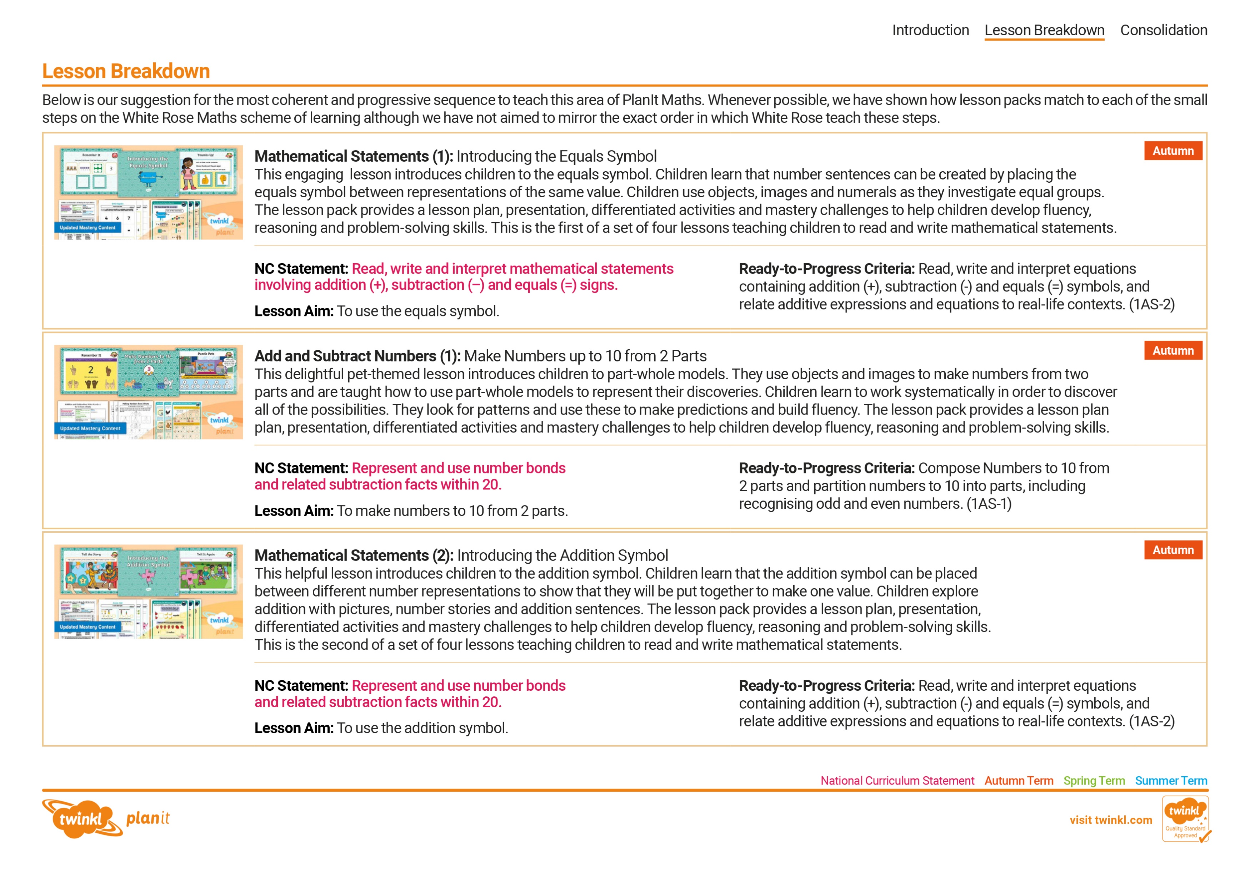
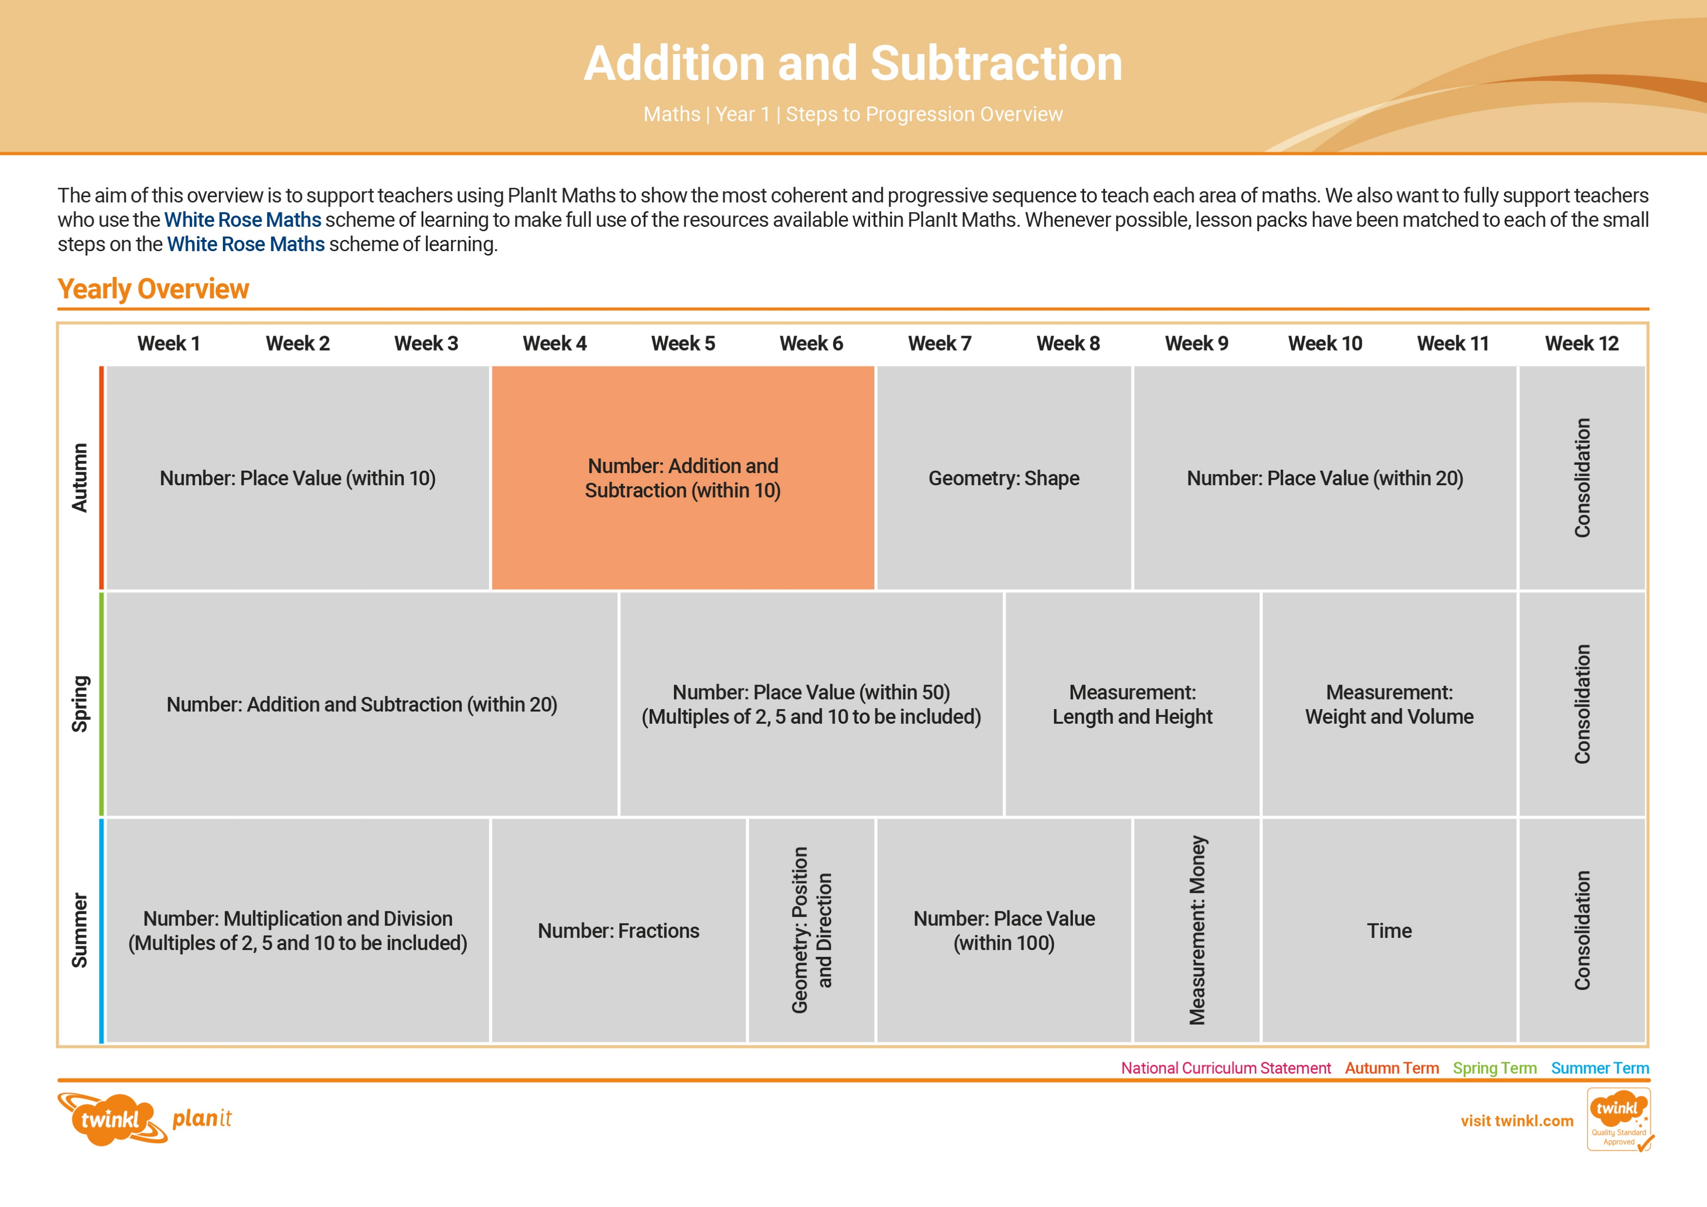

Need a coherently planned sequence of lessons to complement this resource?
See our Addition and Subtraction Steps to Progression document.
Twinkl PlanIt is our award-winning scheme of work with
over 4000 resources.

Slide 3
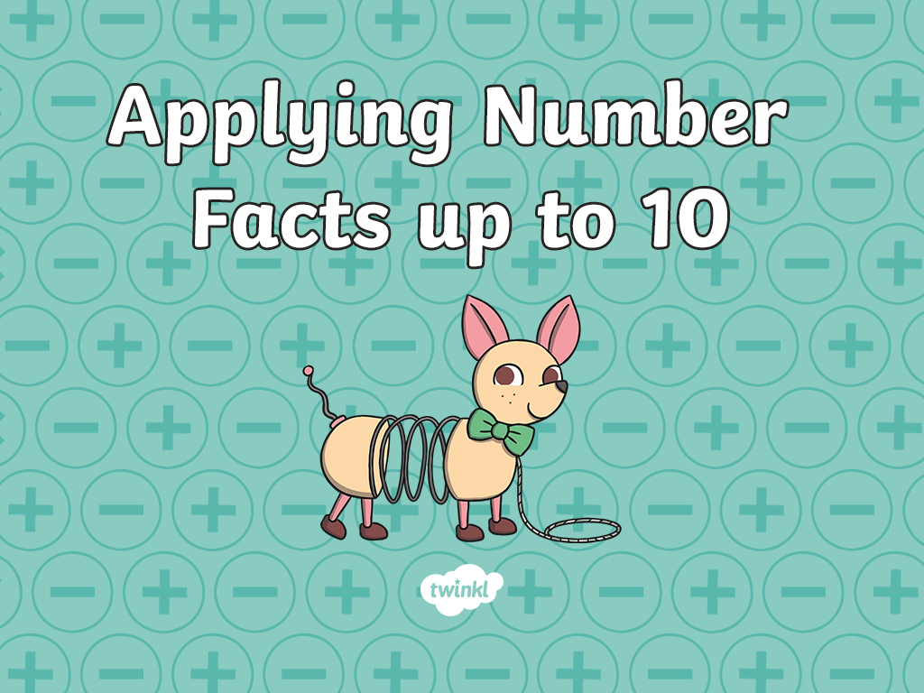

Slide 4

Aim
To use number bonds to solve problems.
Success Criteria
I can work out all number bonds within 10.
I can use number bonds to solve addition problems.
I can represent number bonds using part-whole models.
I can write number bonds as calculations.

Slide 5

Remember It
Fill in the gaps.
10
6
5
5
9
2
4
7
7
2
8
6
1
Are there any that have more than one answer? Why?
0 and 8, 1 and 7, 2 and 6, 3 and 5, 4 and 4

Slide 6

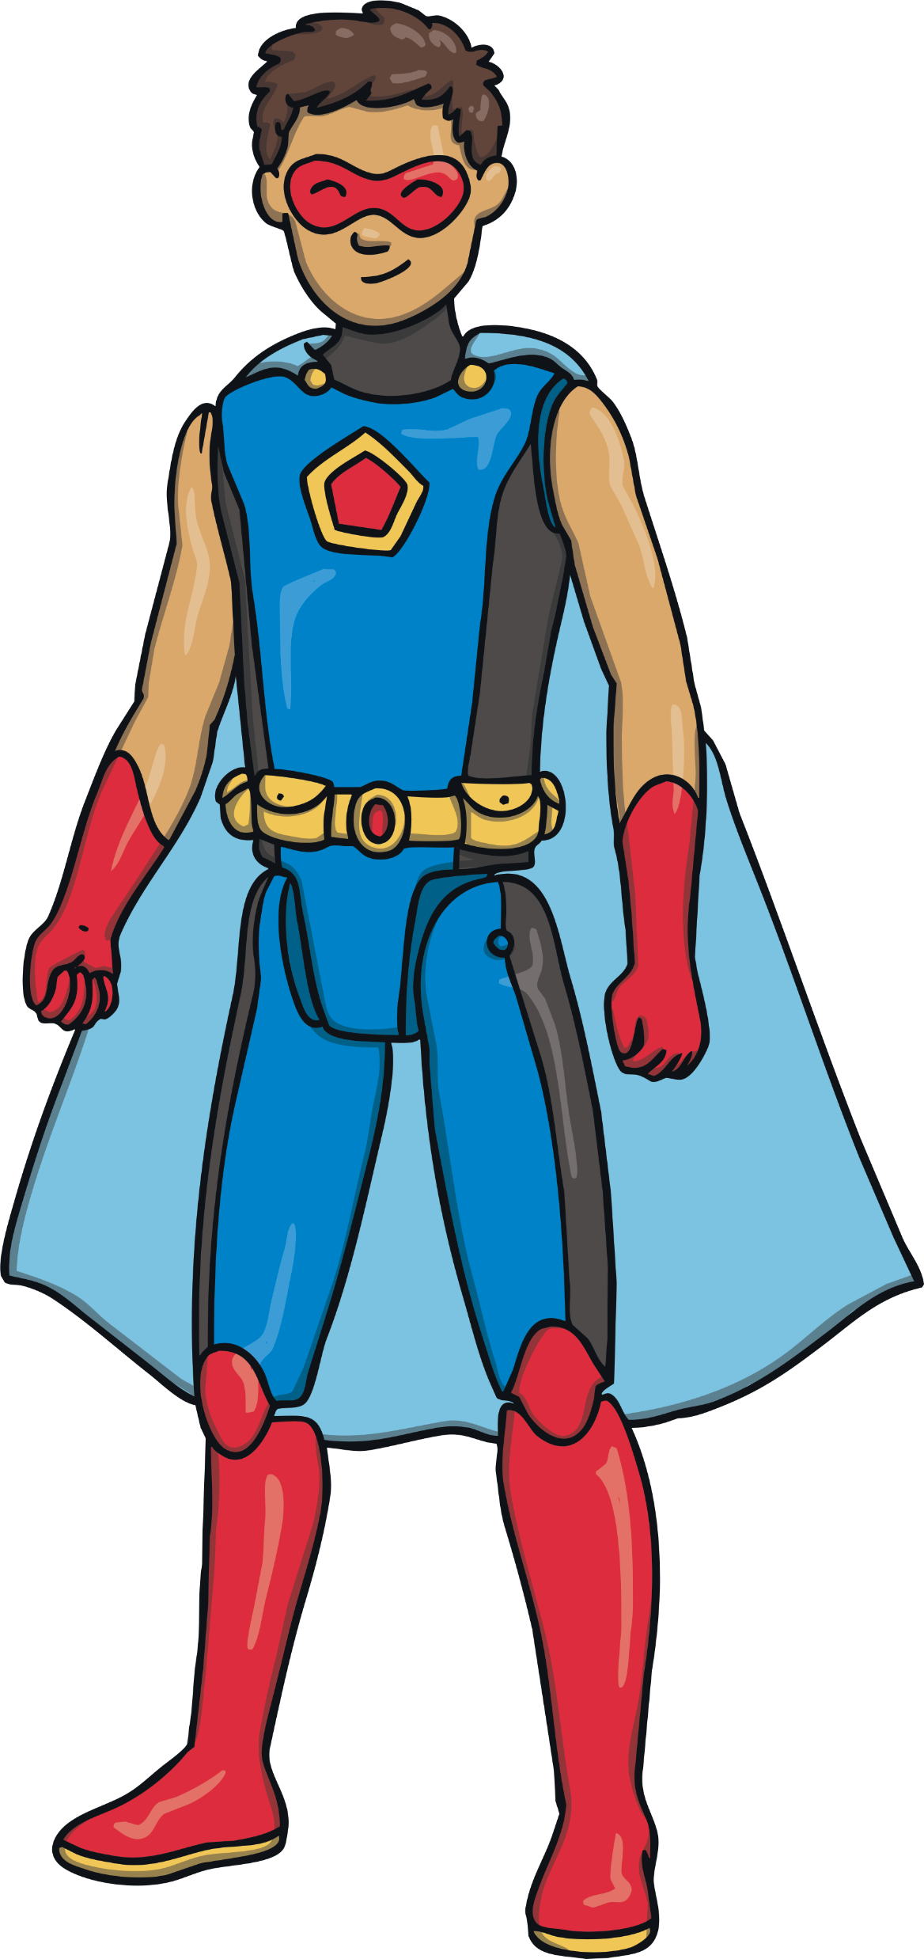

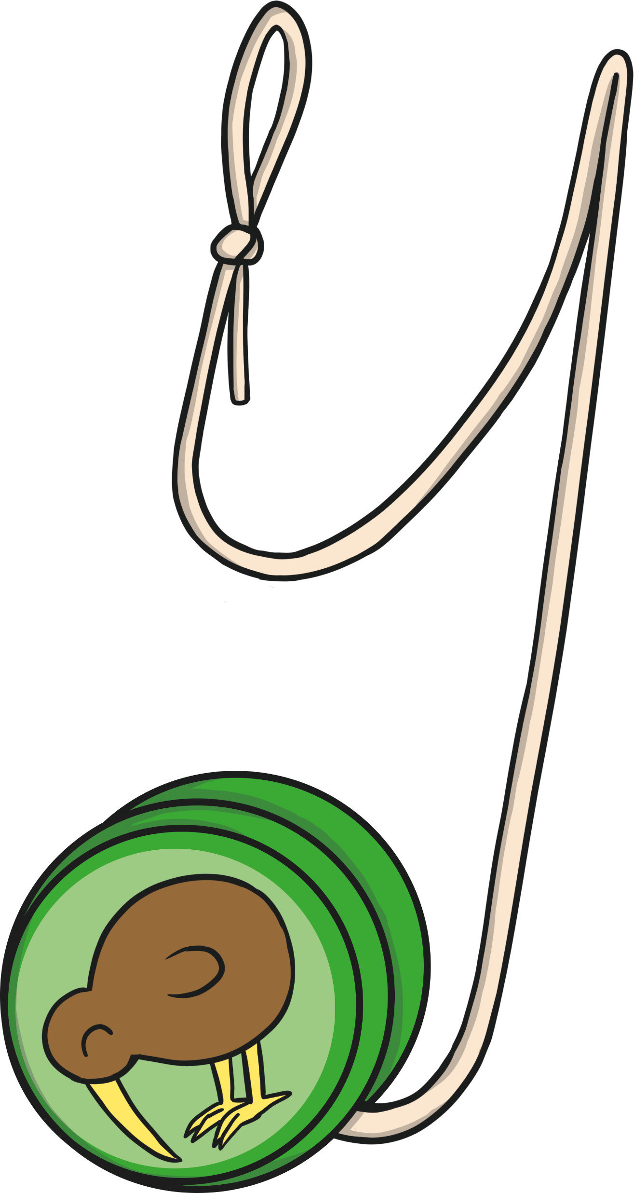
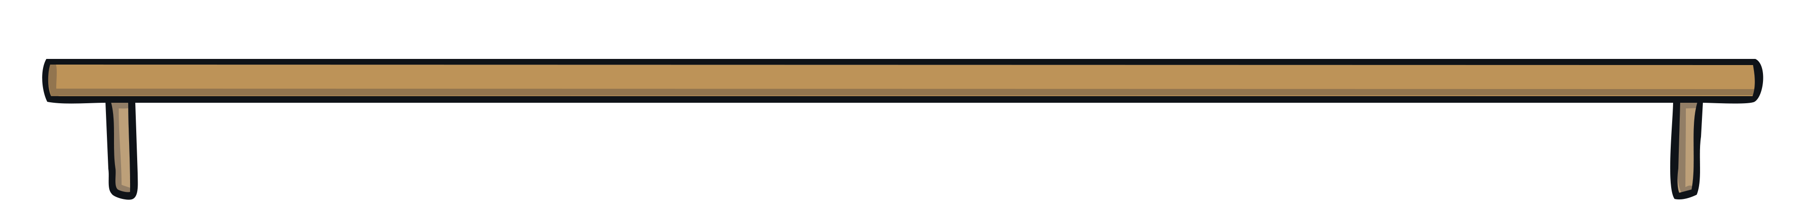
Spending Money
You’ve got £3 to spend. What two things could you buy?
Explain to your partner.
£1
£2
£1
£3 3 = 1 + 2
3
3
1
2

Slide 7
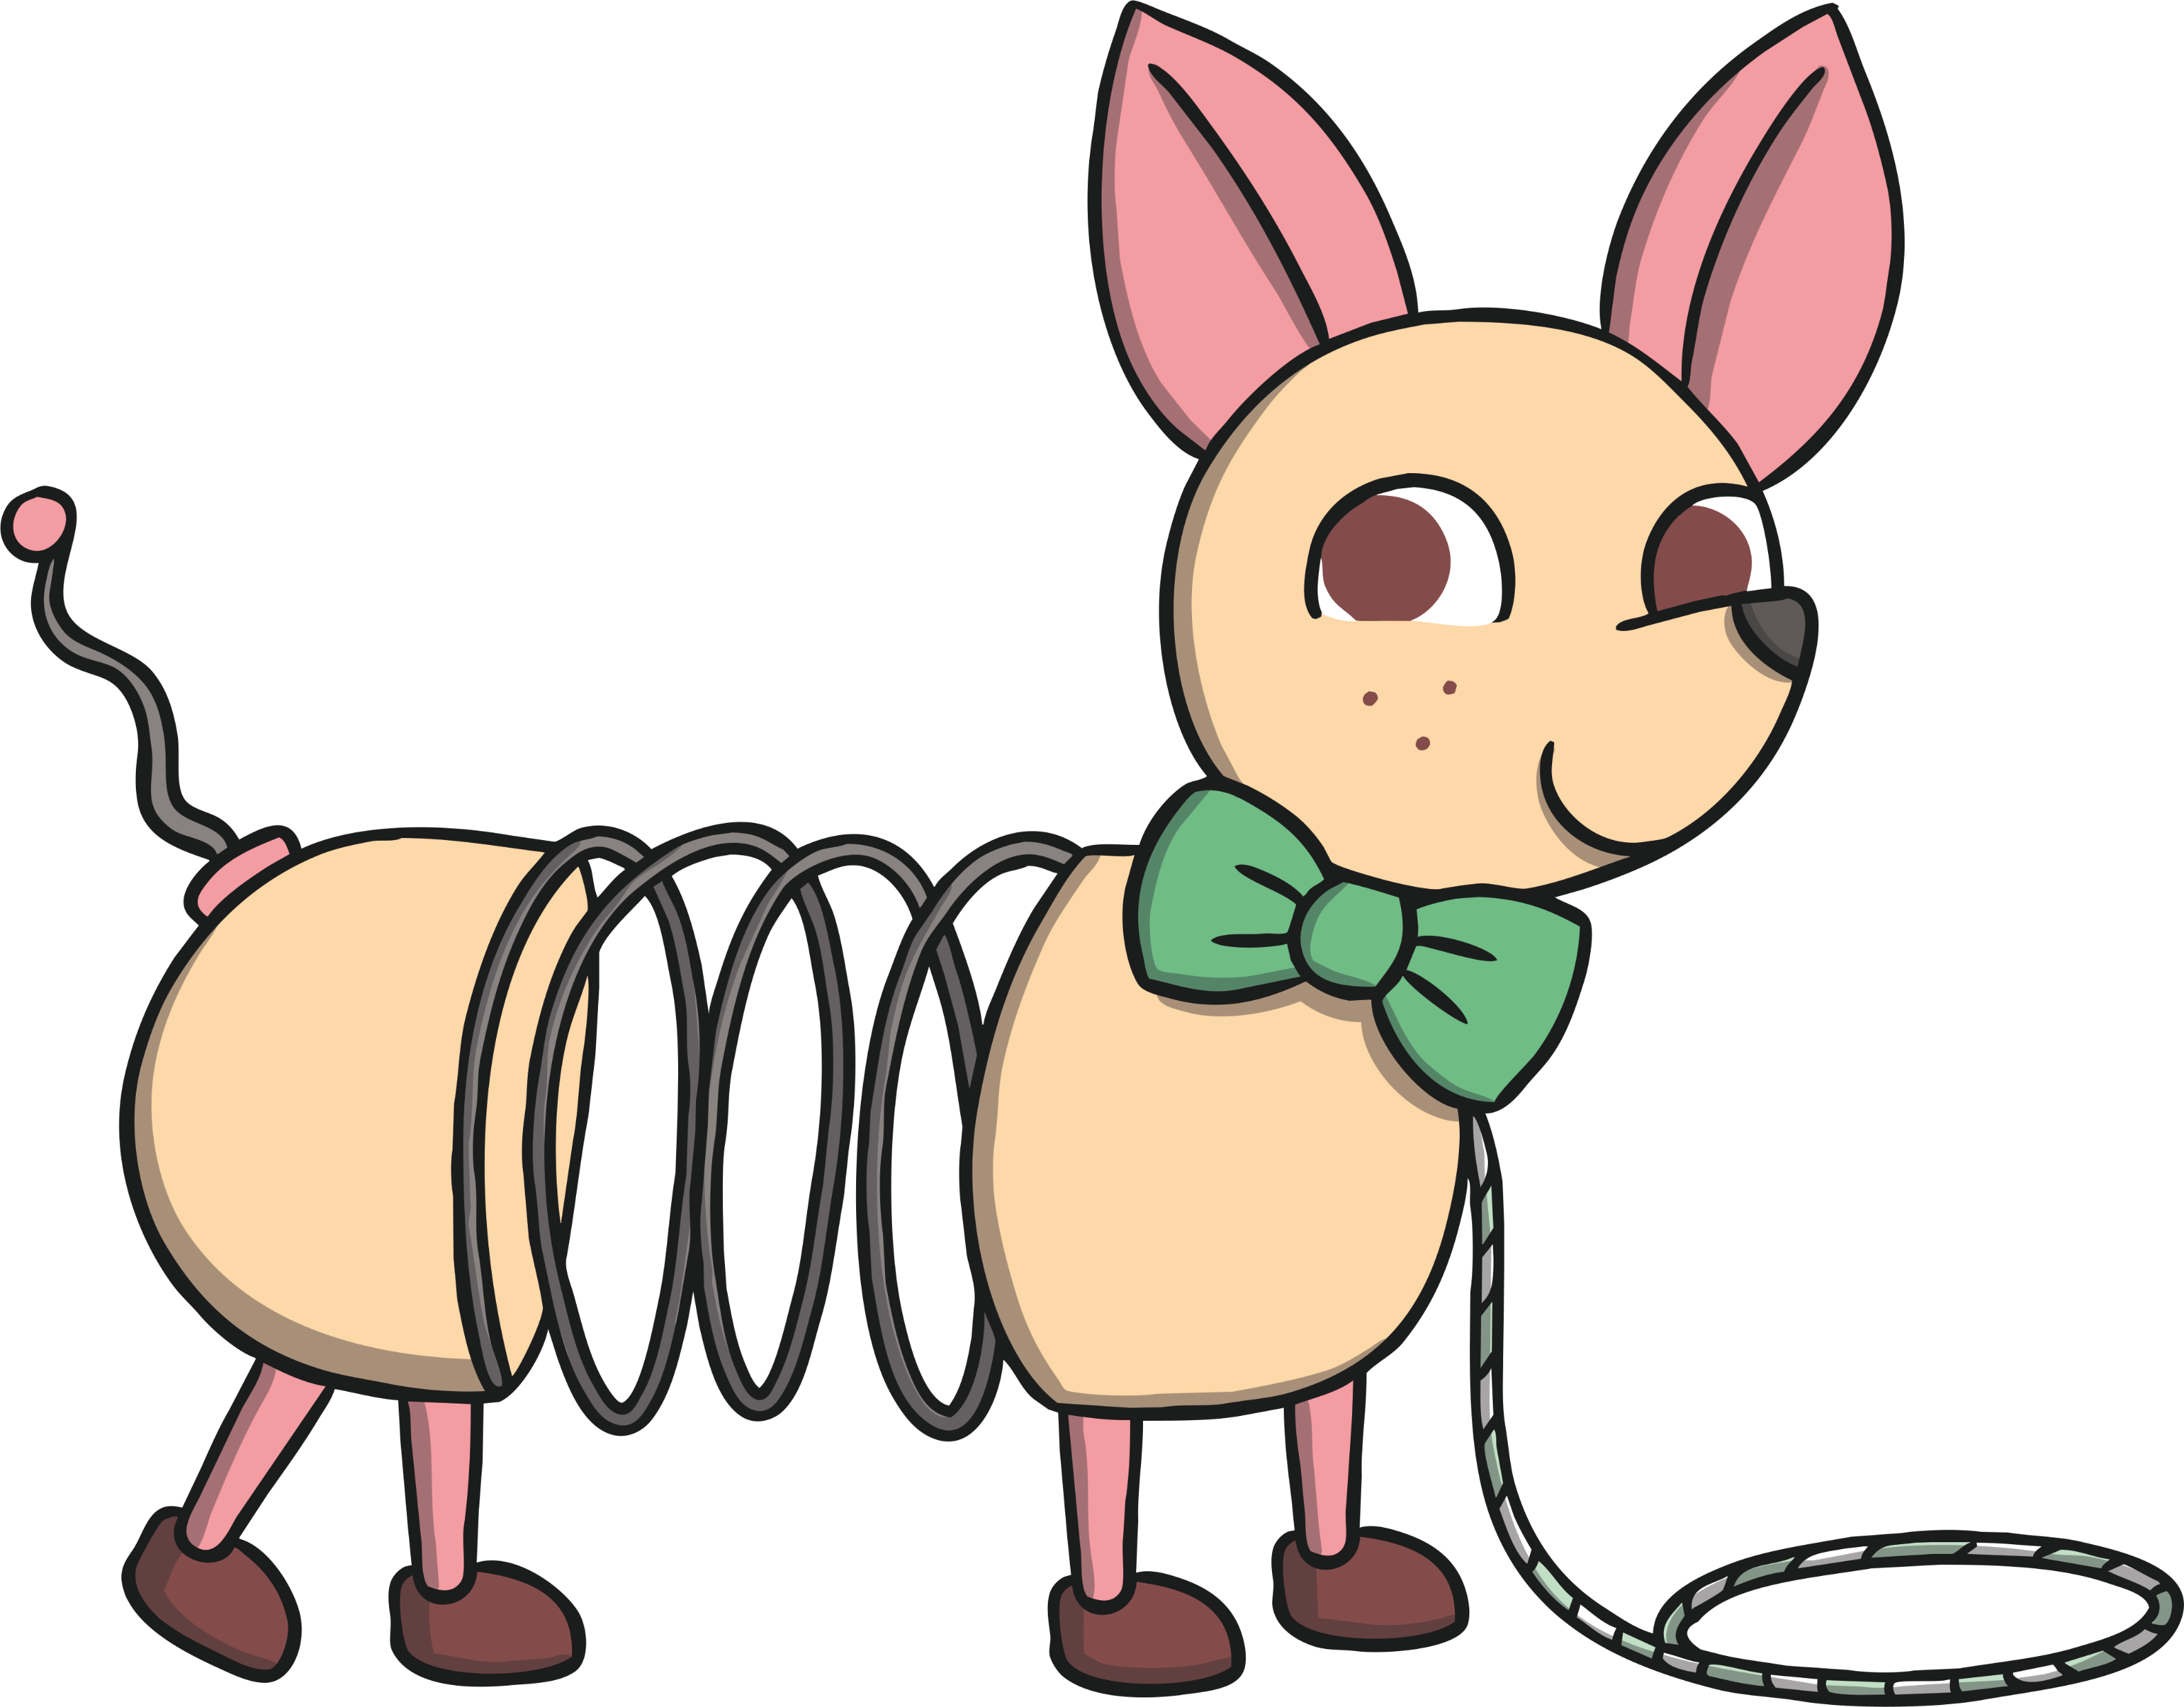
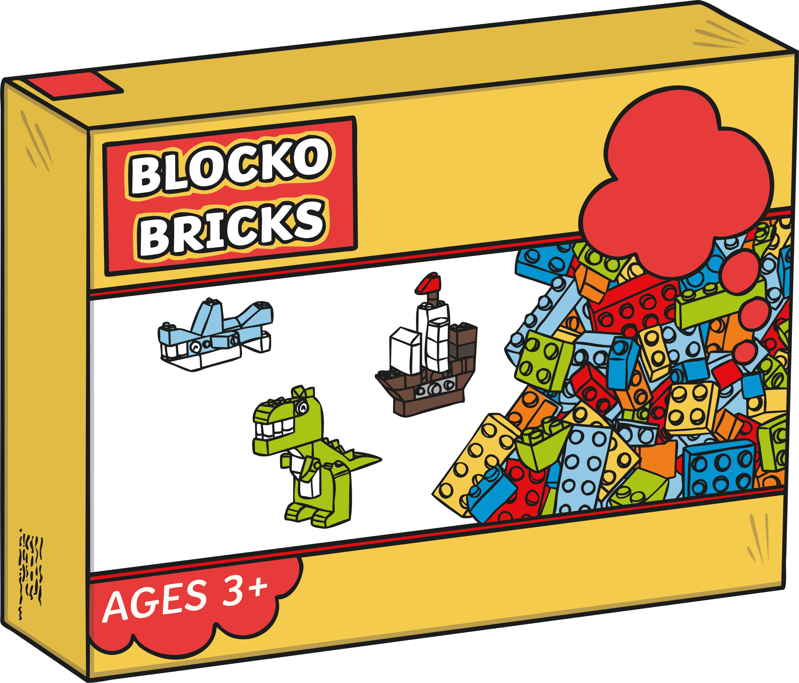

Spending Money
You’ve got £5 to spend. What two things could you buy?
Explain to your partner.
£4
£1
£5
£5 4 + 1 = 5
5
5
4
1

Slide 8

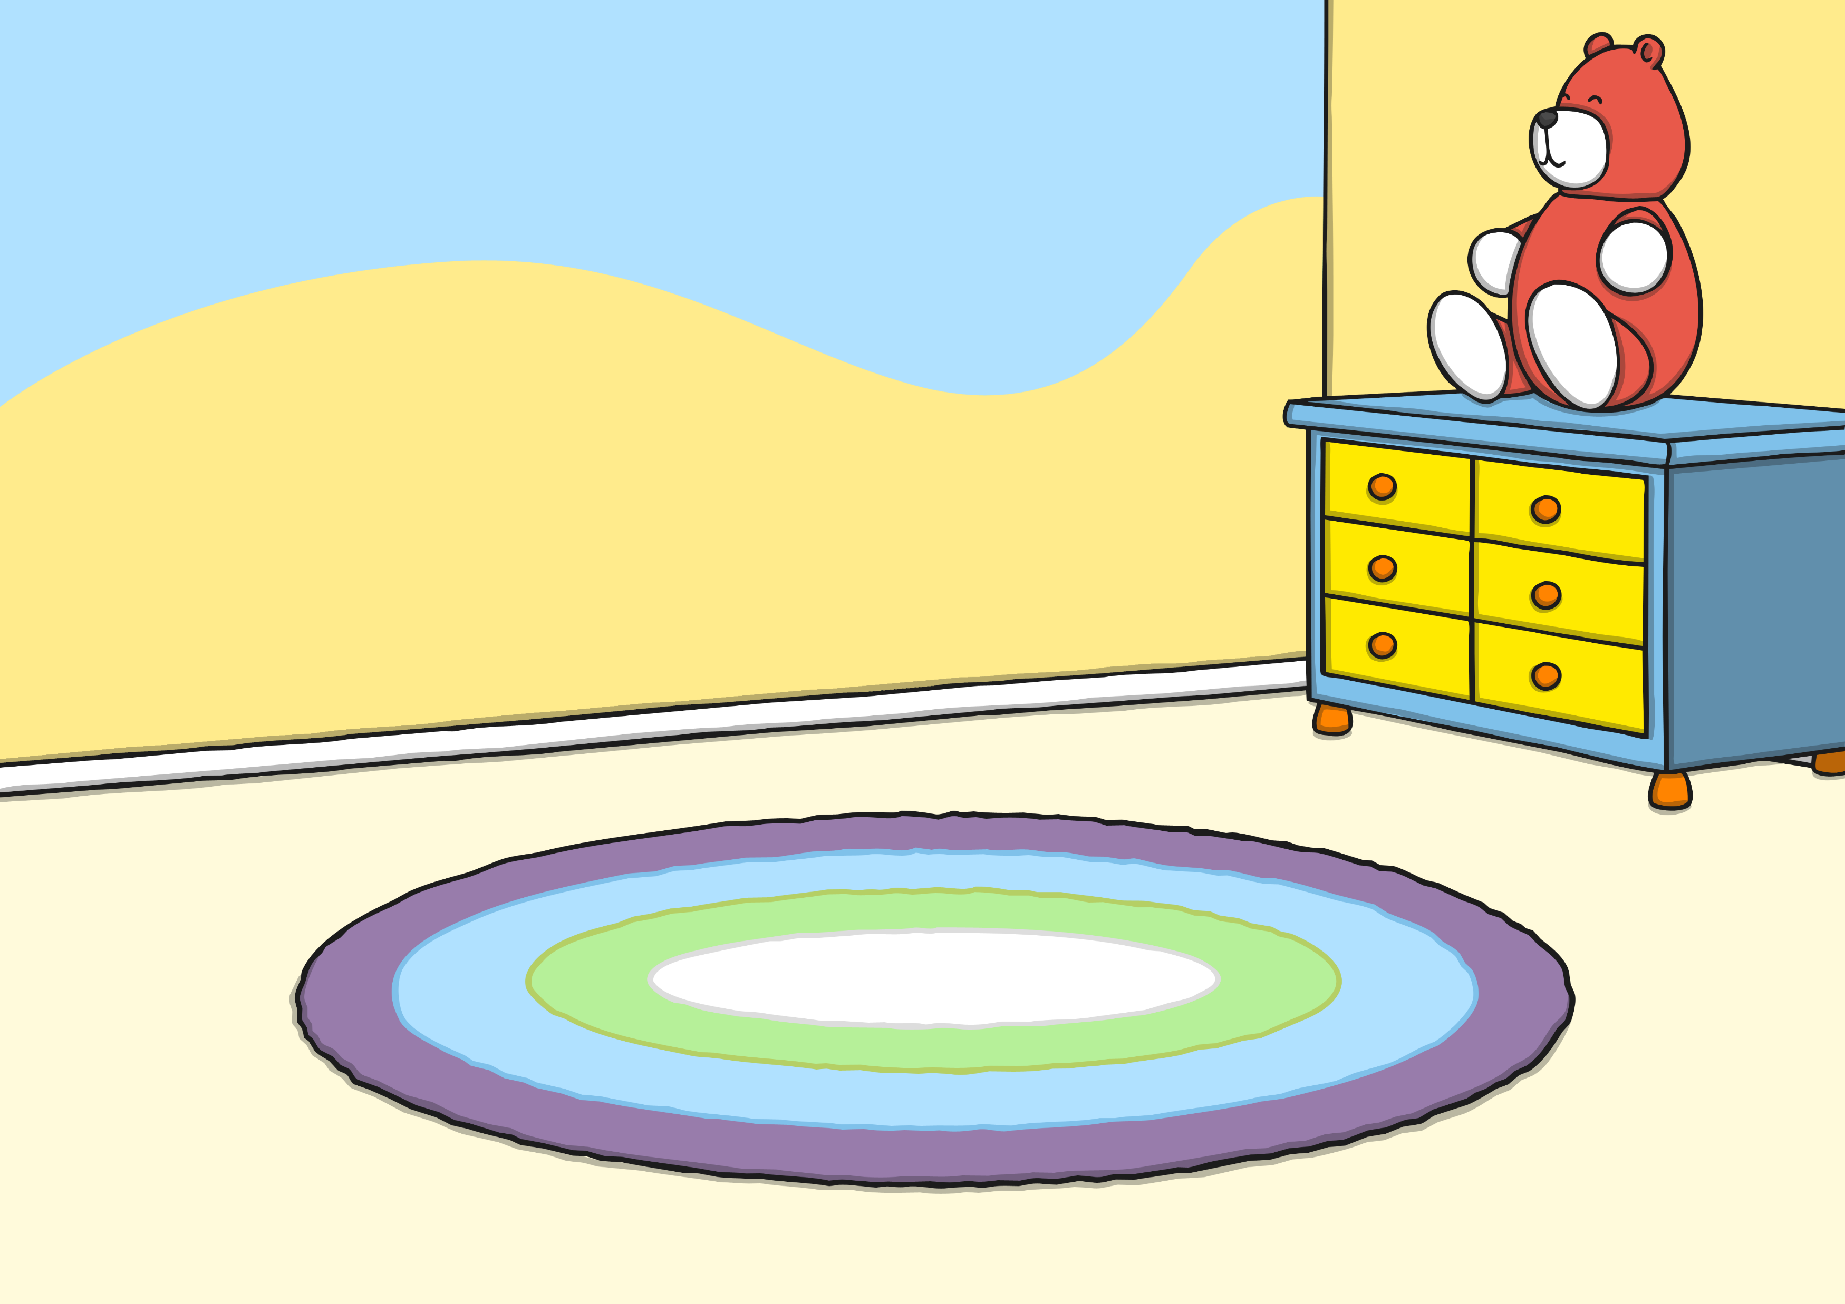
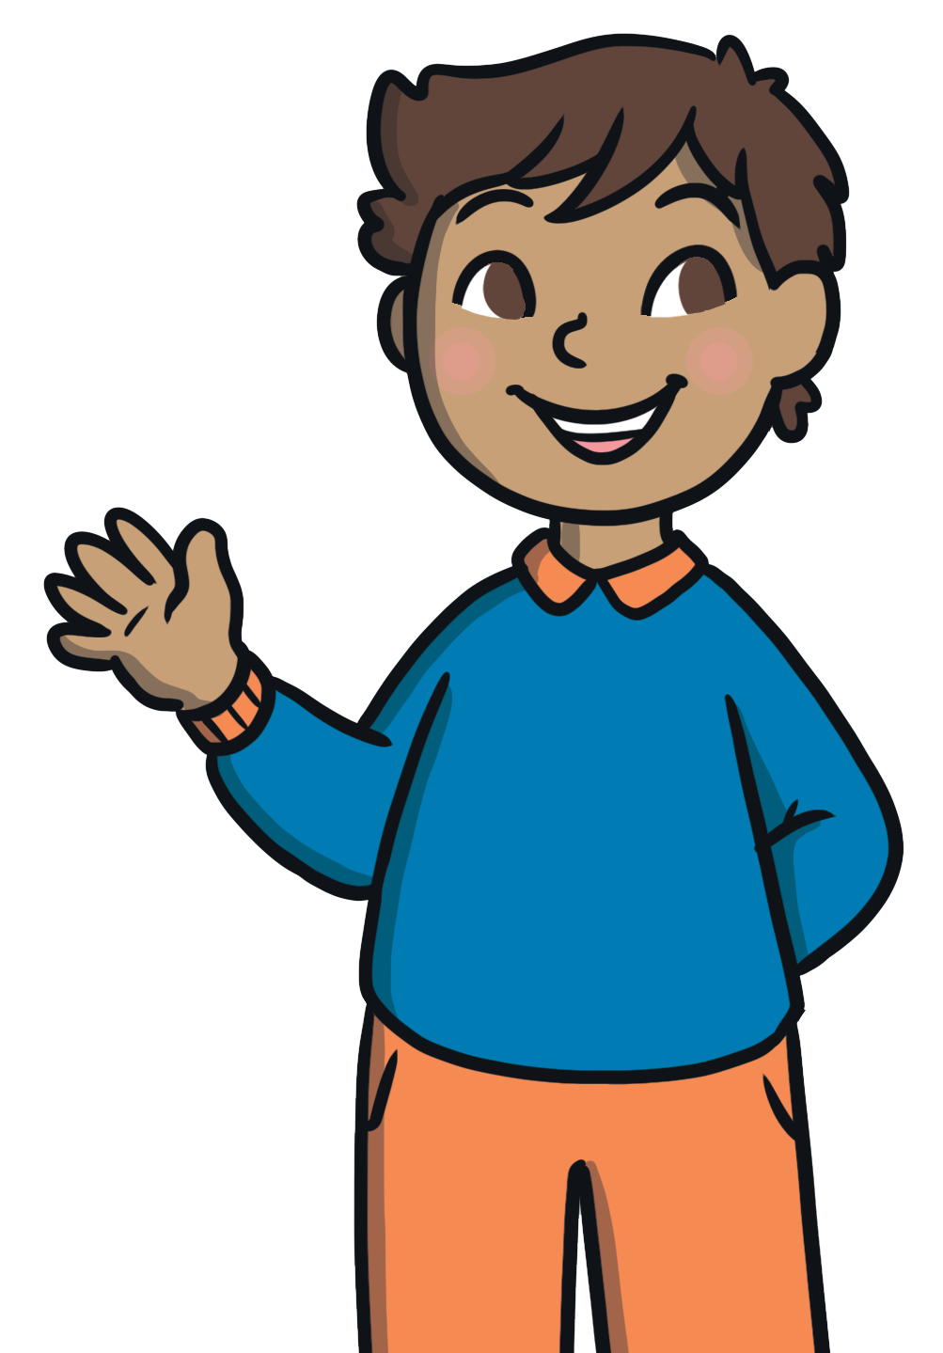
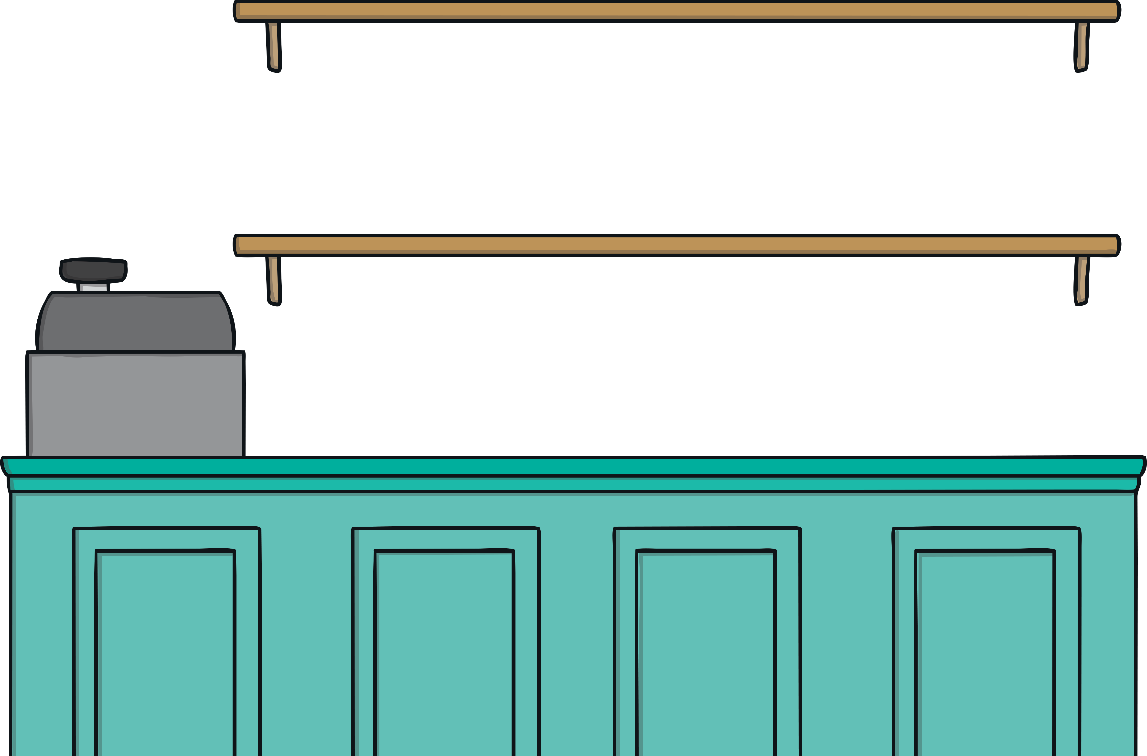

Kemal and
Olivia’s Birthday
Kemal and Olivia want to spend all their birthday money.
£7
£8
£9
£10
Click how much money
they have to spend.

Slide 9





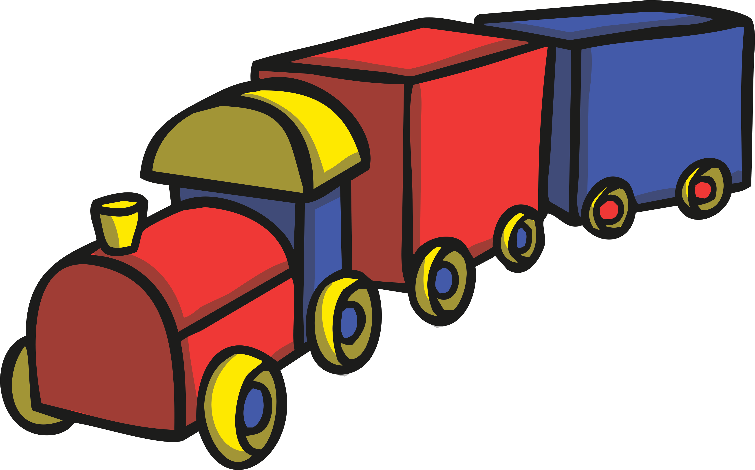
Kemal and
Olivia’s Birthday
£7
Kemal and Olivia have £7 to spend. What two things could they buy?
£5
£3
£5
£2
£3
£2
£1
£1
£4
£6
£4
£6

Slide 10
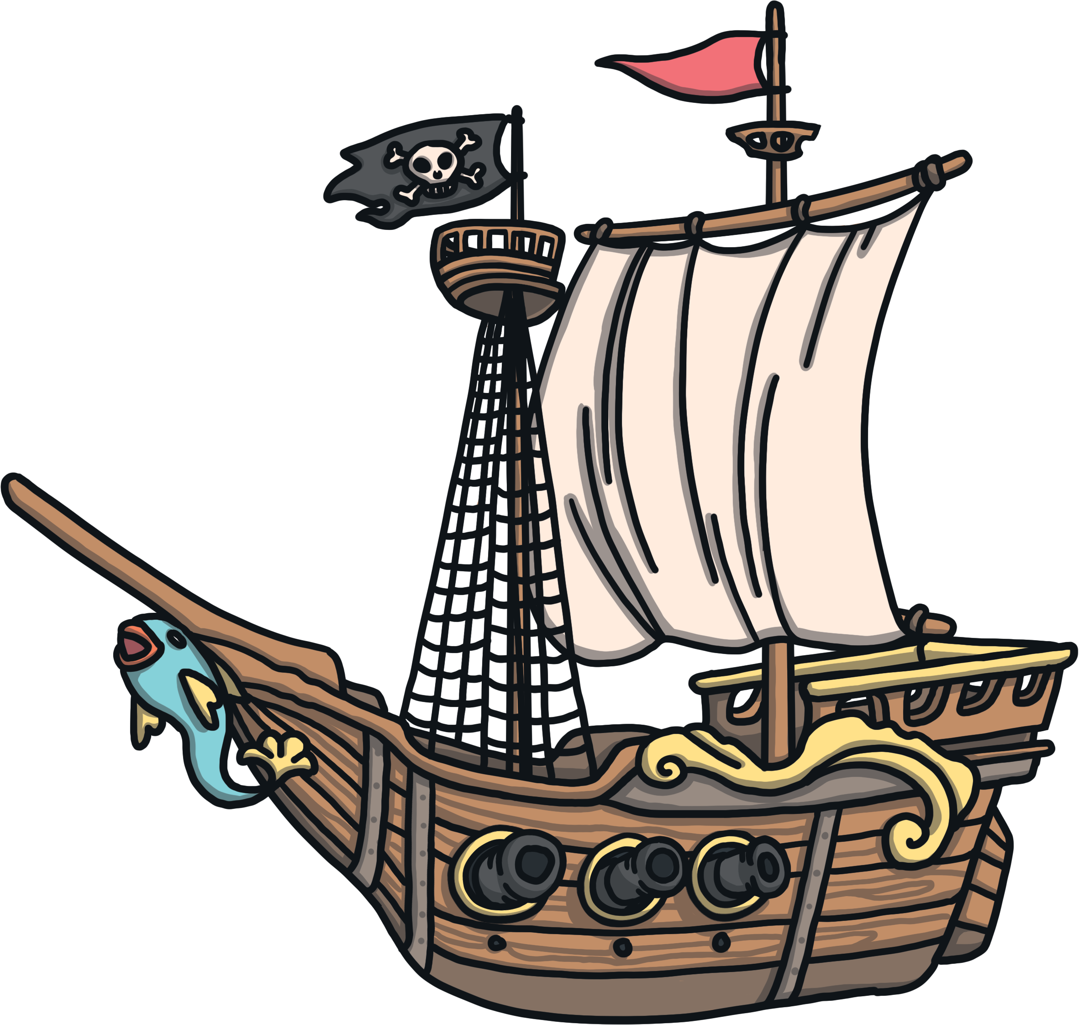
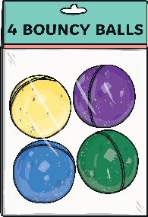
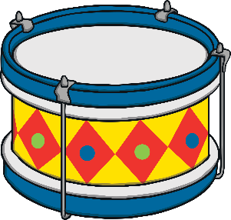

Kemal and
Olivia’s Birthday
£8
Kemal and Olivia have £8 to spend. What two things could they buy?
£6
£6
£5
£2
£5
£2
£7
£7
£3
£1
£3
£1

Slide 11
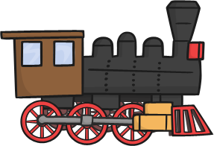

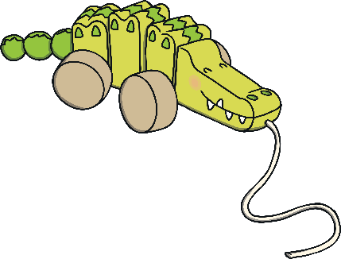

Kemal and
Olivia’s Birthday
£9
Kemal and Olivia have £9 to spend. What two things could they buy?
£1
£5
£8
£1
£5
£8
£2
£2
£9
£7
£4
£7
£4
Why can't they buy the action figure?
Even though it would be spending £9, they wouldn’t be buying two things.

Slide 12
Kemal and
Olivia’s Birthday
£10
Kemal and Olivia have £10 to spend. What two things could they buy?
£9
£9
£6
£4
£1
£6
£4
£1
£5
£5
£5
£2
£2
£8
£8
What if they wanted a train, how could they spend all their money?
They could buy 2 of them!

Slide 13


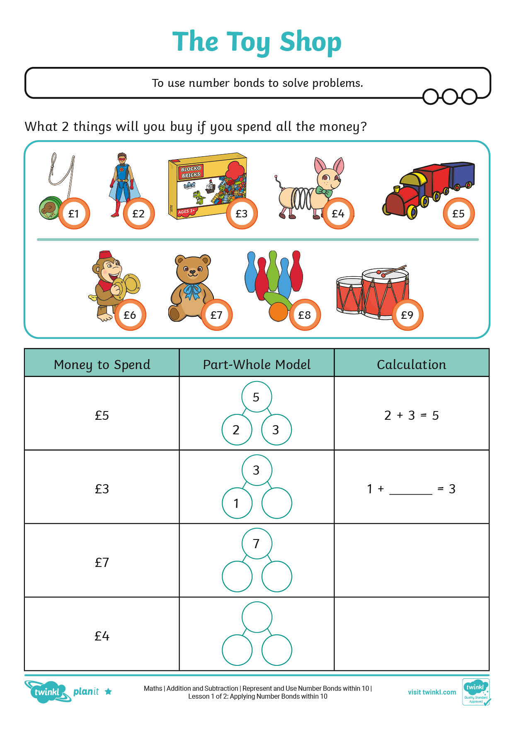


The Toy Shop

Slide 14
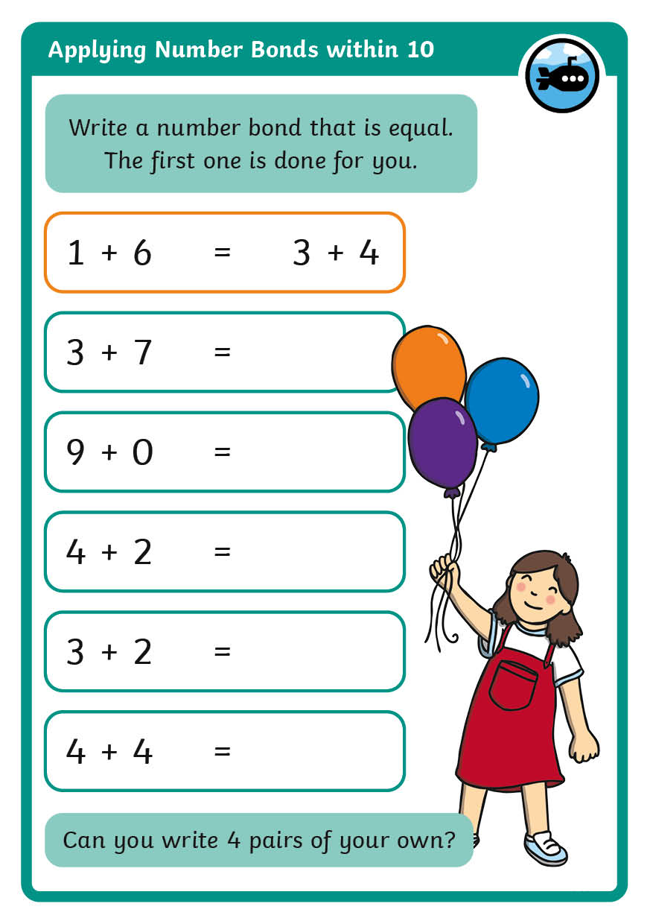
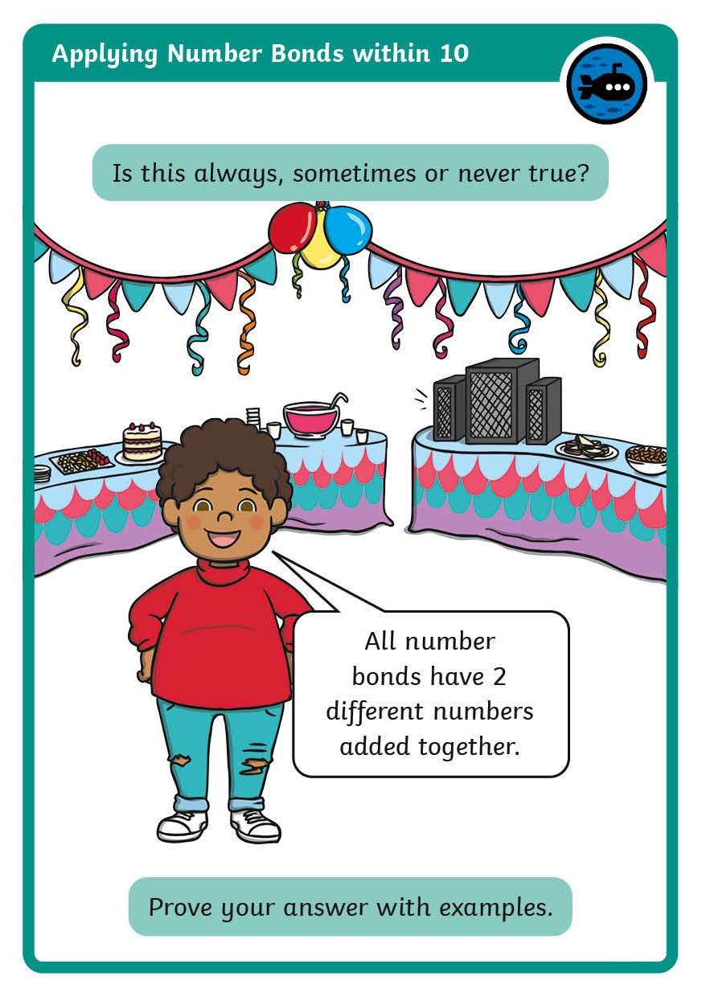
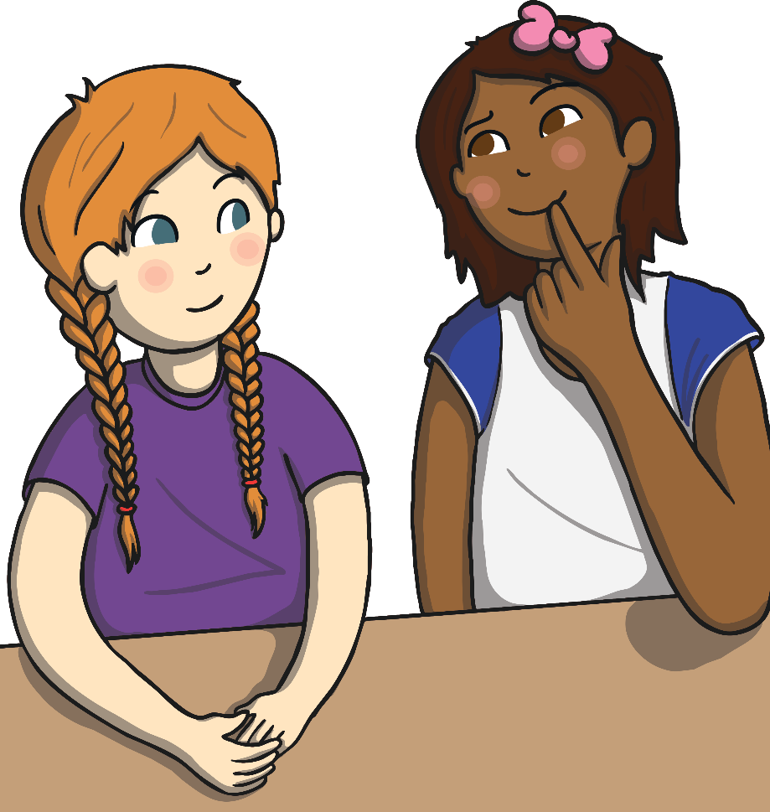
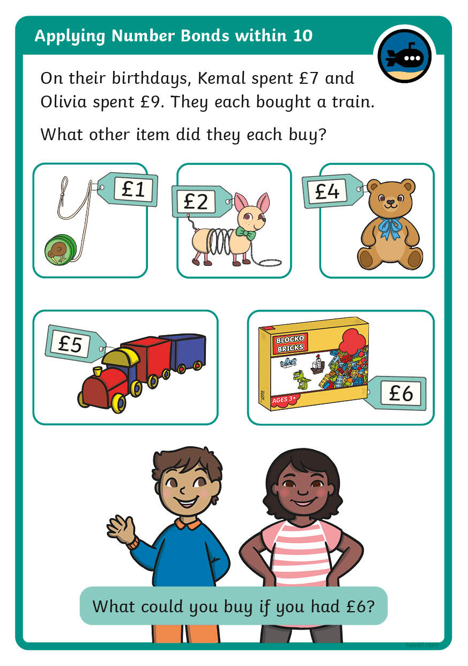
Diving into Mastery
Dive in by completing your own activity!

Slide 15

Olivia’s Puzzle
£2
£3
£5
How much could I have spent in total?
I bought a monkey and one other thing.
7
She could have bought a monkey and the bricks
5 + 2 = 7
so she could have had £7.
8
She could have bought the monkey and the crocodile
5 + 3 = 8
so she could have had £8.
5
5
5
2
3

Slide 16

Aim
To use number bonds to solve problems.
Success Criteria
I can work out all number bonds within 10.
I can use number bonds to solve addition problems.
I can represent number bonds using part-whole models.
I can write number bonds as calculations.

Slide 17


