Slide 1
Lesson 1: Exploring conditions
Save a copy
Year 5 – Programming – Selection in quizzes
Notes:
Last updated: 09-10-20
This resource is available online at ncce.io/pg5b-1-s. Resources are updated regularly — please check that you are using the latest version.
This resource is licensed under the Open Government Licence, version 3. For more information on this licence, see ncce.io/ogl.

Slide 2
Lesson 1: Exploring conditions
Objectives
To explain how selection is used in computer programs
I can recall how conditions are used in selection
I can identify conditions in a program
I can modify a condition in a program

Slide 3


True or false?
Introduction
On the next slide, several statements will appear.
Record whether the statement is true or false for you.
Notes:
Tick and cross: https://pixabay.com/vectors/tick-asterisk-cross-red-green-40678/

Slide 4
True or false?
Introduction
Today is Wednesday
My birthday is in March
I like carrots
My first name contains the letter ‘s’
I walked to school this morning
It is raining
Computing is my favourite lesson
I want extra homework this week
Notes:
This slide contains animation. Click to make the next statement appear.

Slide 5

True or false?
Introduction
If you recorded more than three ‘trues’
Then stand up and take a bow
Notes:
Image source: https://pixabay.com/illustrations/professions-music-conductor-2065278/

Slide 6
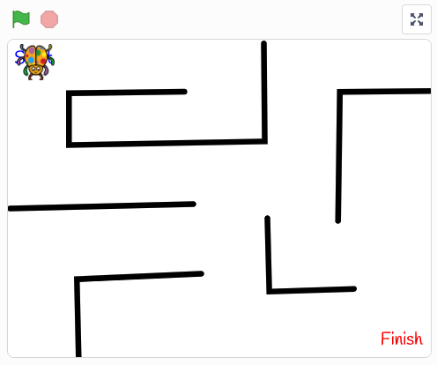
Selection
Activity 1
Play the program:
ncce.io/pg5b-1-a1-c
Look at the code snippets.
What selection is taking place?
What conditions are being used?
What actions are being carried out if the conditions are true?
Notes:
Screenshot from Scratch.

Slide 7
Using selection
Activity 1
If left arrow key is pressed
Then point in direction of -90
move ten steps
Condition must be either true or false
Action(s) to to be carried out when the condition is true
Notes:
Recap on previous learning on the construct of selection by identifying:
The use of the ‘if, then’ structure
The condition
The need for it to be either true or false
The action to carry out when the condition is true
The use of indentation to show the links between the condition and the action

Slide 8
Using selection
Activity 1
If touching the colour red
Then say ‘You completed the maze!’ for two seconds
Condition must be either true or false
Action(s) to to be carried out when the condition is true
Notes:
Recap on previous learning on the construct of selection by identifying:
The use of the ‘if, then’ structure
The condition
The need for it to be either true or false
The action to carry out when the condition is true
The use of indentation to show the links between the condition and the action

Slide 9

Condition in programs
Activity 2
This block can be used as a condition when writing programs in Scratch.
The condition block needs to be used with other blocks to control the flow of actions.
Condition blocks are all the same shape (a hexagon). The blocks they are used with have a hexagonal space in them.
Notes:
Screenshot from Scratch.

Slide 10
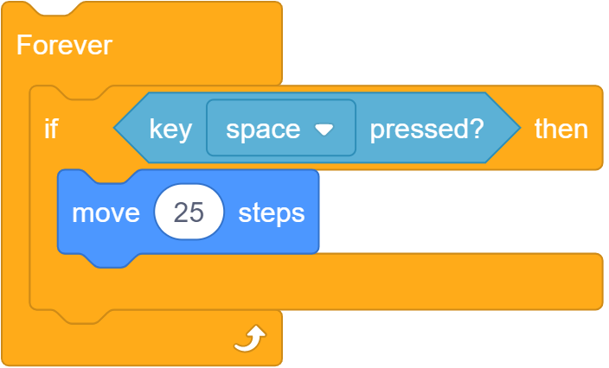
Condition in programs
Activity 2
Condition: if space bar is pressed
Action: to be carried out when the condition is true
Notes:
Screenshot from Scratch.

Slide 11
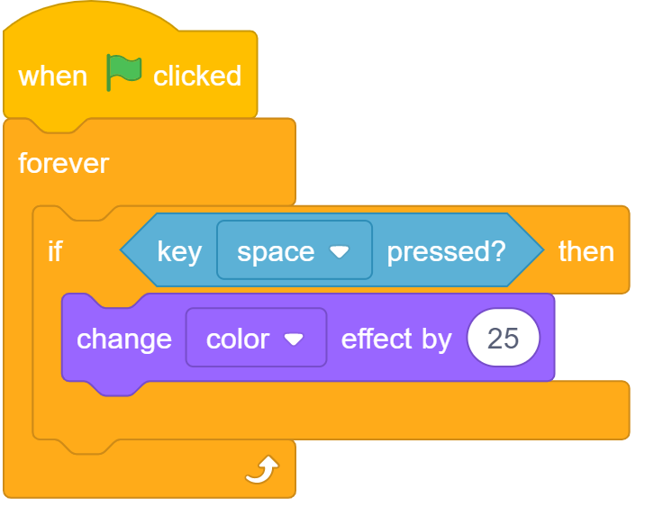
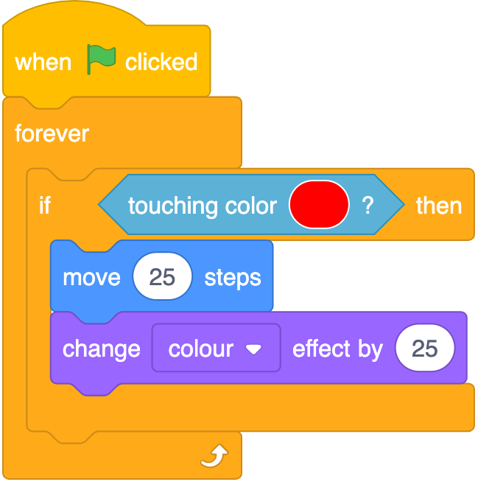
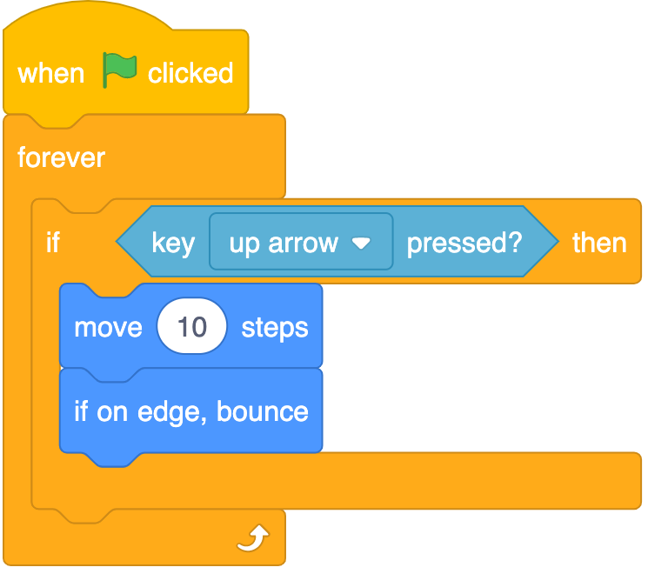
Condition in programs
Activity 2
Notes:
Screenshots from Scratch.

Slide 12
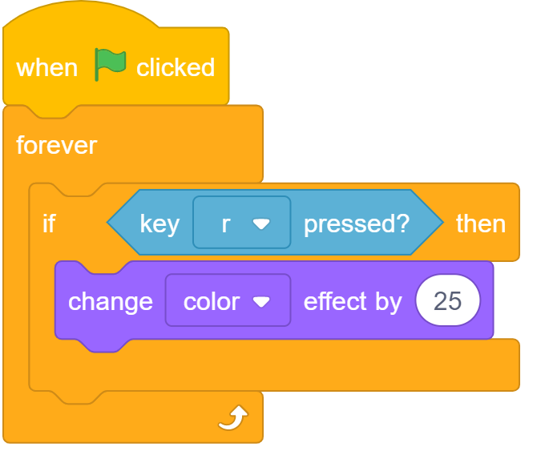
Modifying conditions
Activity 3
Notes:
Responses may include:
Both use a condition
Both use selection
Both will carry out the same action (change sprite’s colour) when the condition is true
Both use a infinite loop
Screenshots from Scratch.

Slide 13
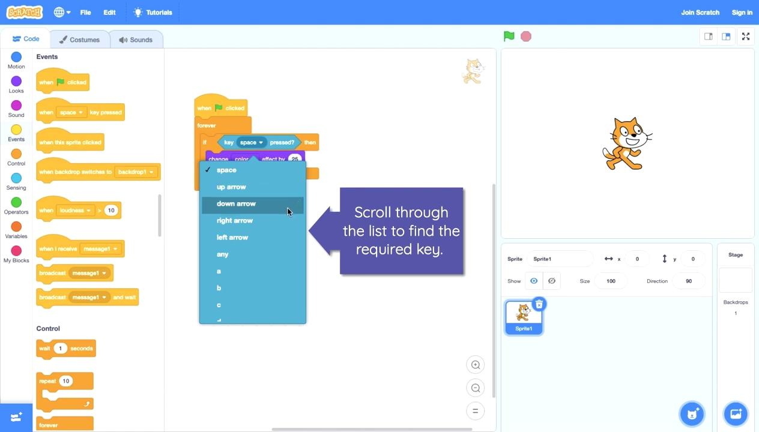
Modifying conditions
Activity 3
Notes:
Pedagogically, it is more beneficial to model the concepts to the learners in the Scratch programming environment, which allows for easier questioning and understanding. We recommend using the videos to see what needs to be modelled, but giving a live demonstration within the lesson. However, this video can be used to demonstrate the concept, if this is preferred.
Video from Scratch.

Slide 14
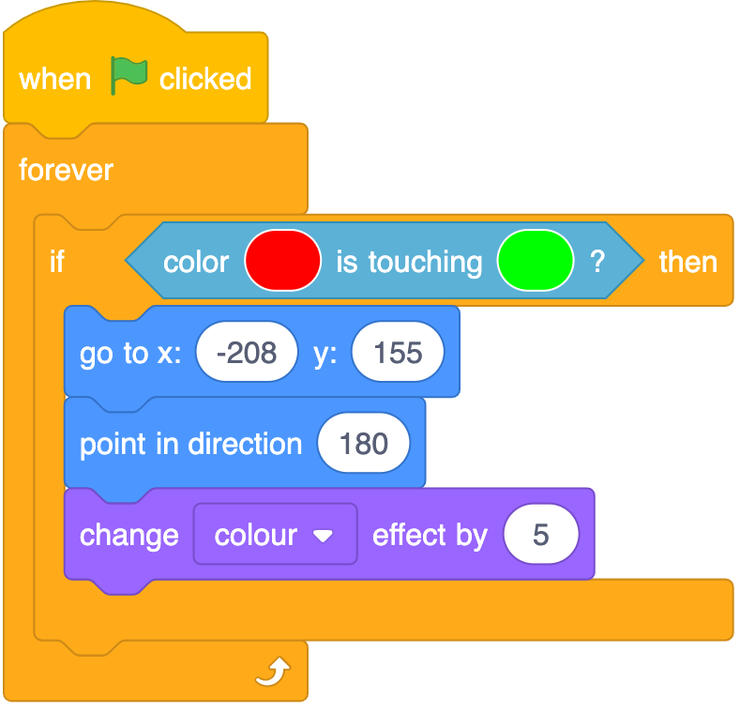
Think, pair, and share
Plenary
Is selection used?
Notes:
Answer: yes — the if, then structure demonstrates this.
Screenshot from Scratch.

Slide 15
Think, pair, and share
Plenary
What is the condition used?
Notes:
Answer: if the colour red is touching the colour green.
Screenshot from Scratch.

Slide 16
Think, pair, and share
Plenary
What actions will be carried out when the condition is true?
Notes:
Answer: go to the coordinates stated (x:-208 and y:155), point in the direction (90), and change the colour effect by 25.
Screenshot from Scratch.

Slide 17

Assessment
How confident are you? (1–3)
I can recall how conditions are used in selection
I can identify conditions in a program
I can modify a condition in a program
3 – Very confident
2 – Unsure
1 – Not confident
Notes:
Image source: https://pixabay.com/vectors/thumb-up-hand-like-confirm-go-top-307176

Slide 18
Next lesson
Summary
In this lesson, you…
Explored some of the ways that conditions can be used in programs, and modified the conditions that were used in programs
Next lesson, you will…
Recall how repetition is used in selection, develop your understanding of selection by using the ‘if, then, else’ structure, and identify and modify the outcomes of programs that use selection

