Slide 1
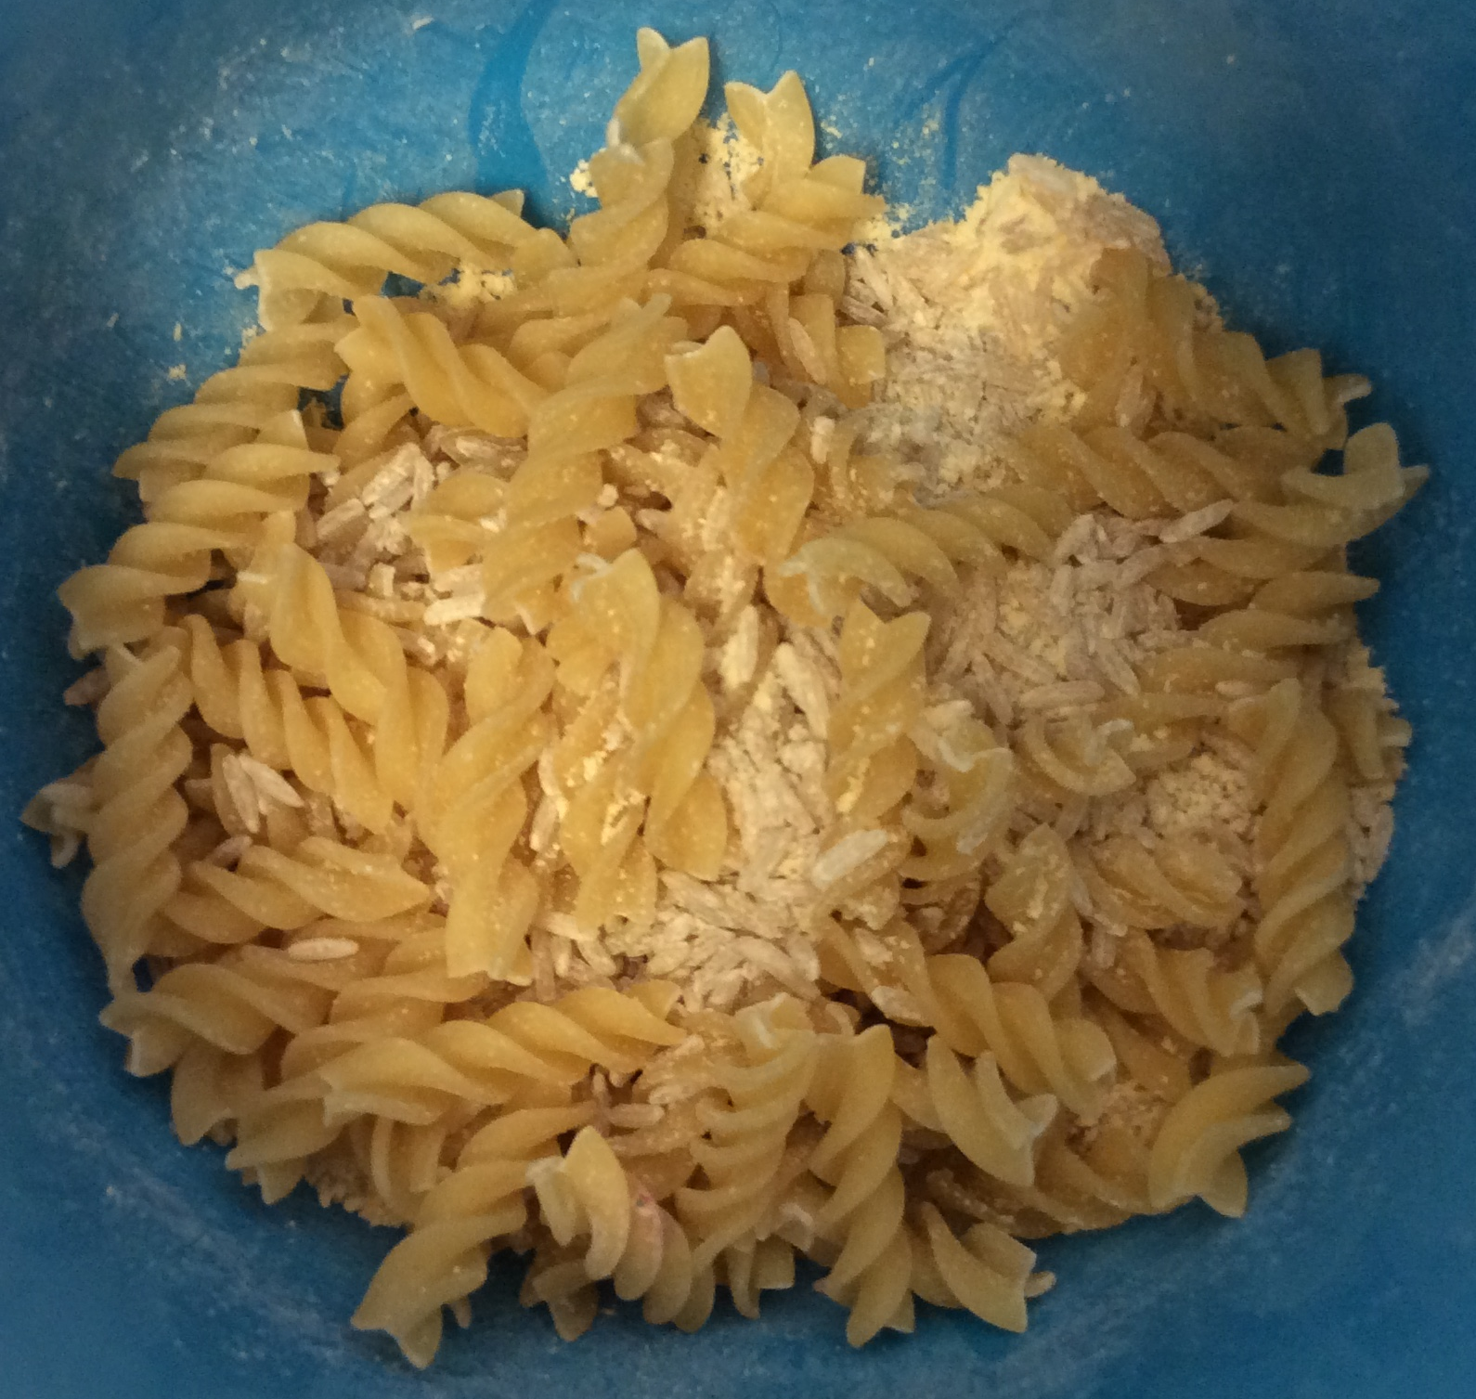
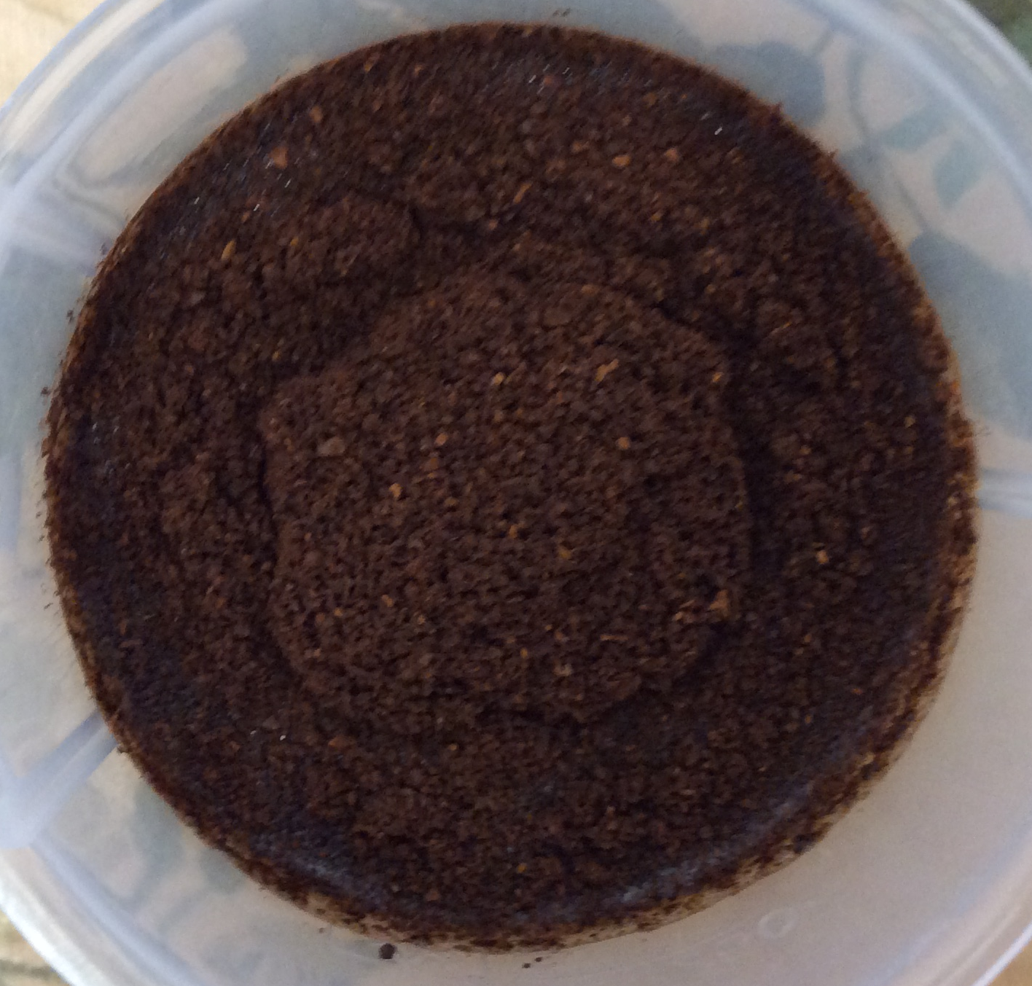
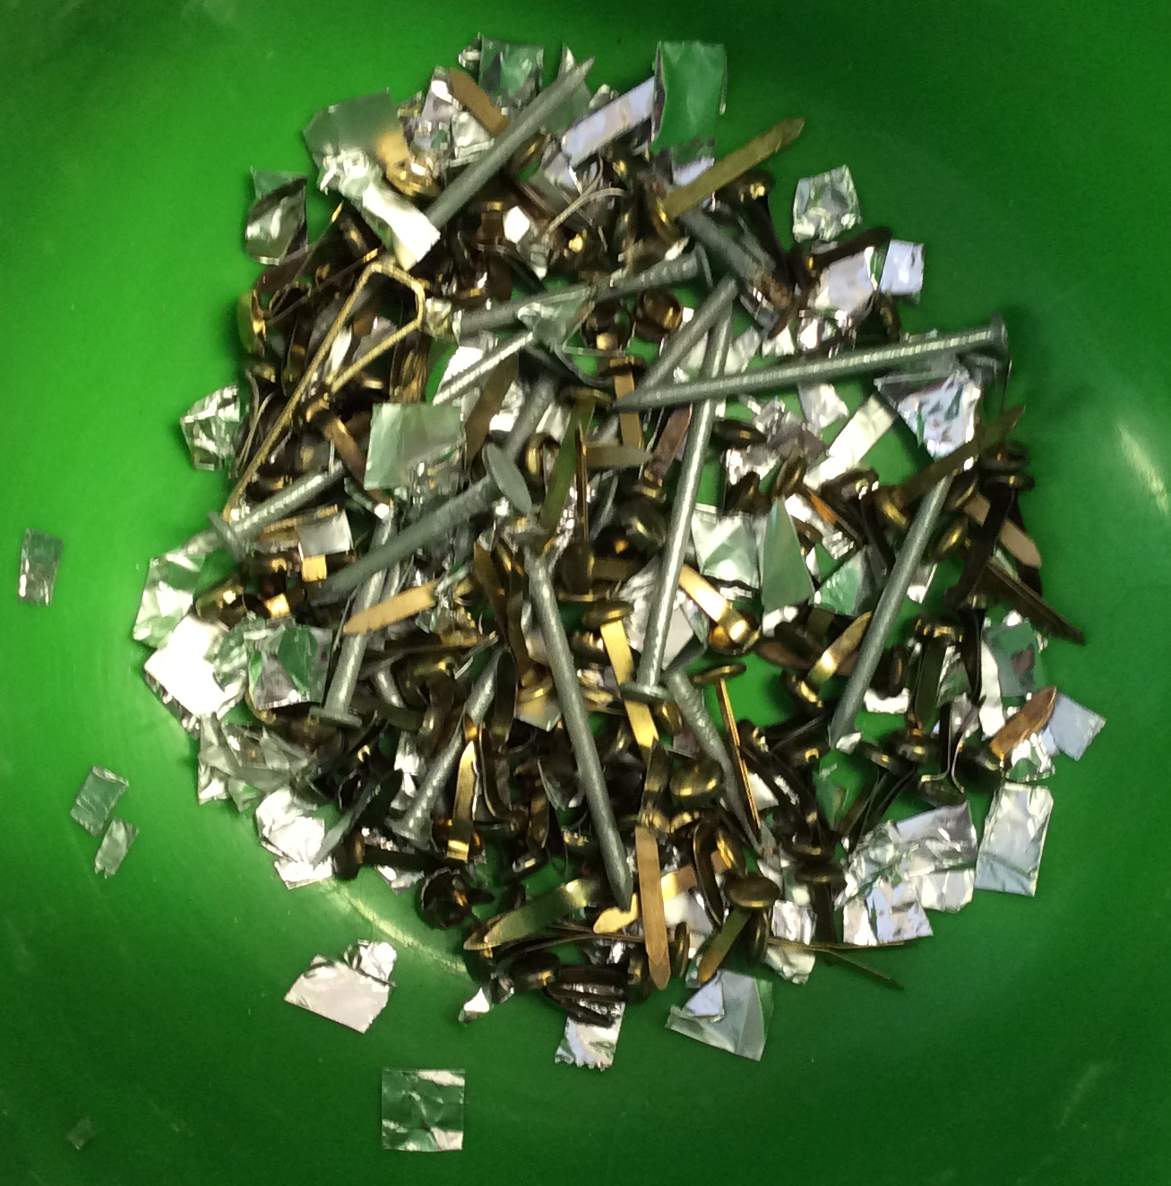
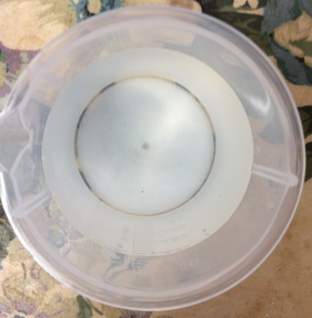
Separating Solutions Investigation

Slide 2
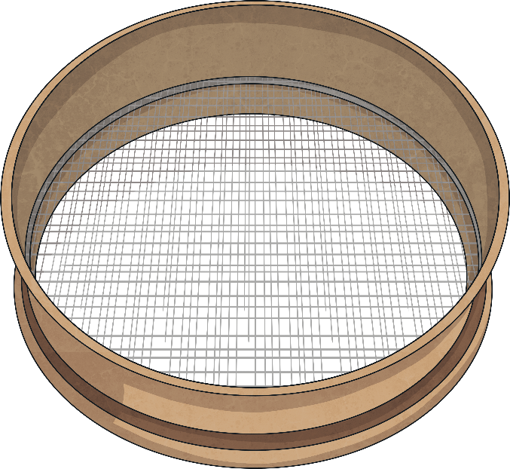
Processes to Separate Mixtures
When some materials are mixed together, it is possible to separate the mixture and get the original materials back again.
There are several different ways of separating mixtures.
The best process to use depends on the type of mixture you are separating.
Evaporation and Condensation
Magnetism
Filtering
Sieving
Decanting

Slide 3
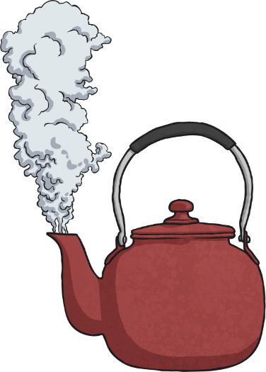
Evaporation and Condensation
This process is best used to separate solutions - mixtures in which a solid has dissolved in a liquid.
As the solid has dissolved in the liquid, filtering would not separate the two materials. The solid particles would go through the filter paper along with the liquid.
1
2
4
If the gas is then condensed
on a cool surface, the liquid can be recovered and collected too. Examples of mixtures to separate with this process include salt and water or sugar and water
When the solution is evaporated, either through boiling or by being left in a warm place, the liquid will turn into gas and leave the solid behind.
3
Processes

Slide 4
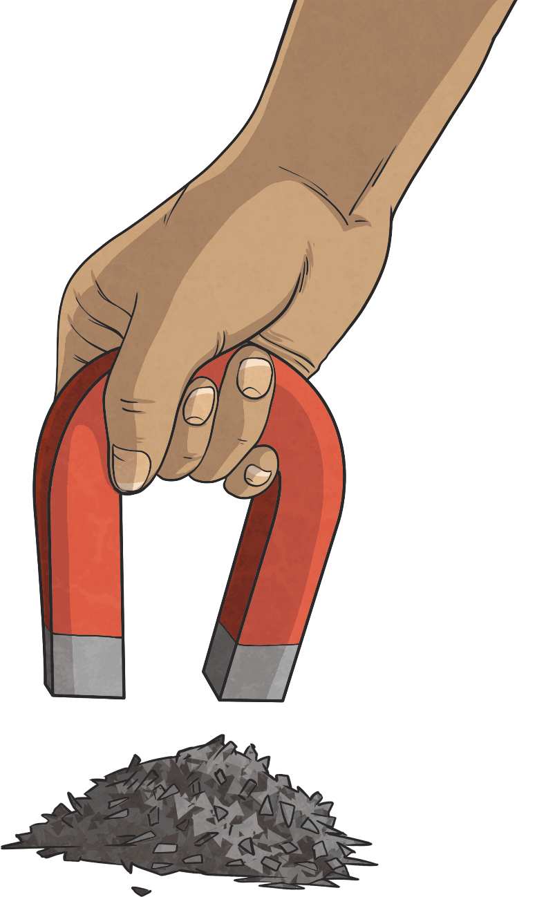
Magnetism
Use this process to separate magnetic materials
from non-magnetic materials.
A magnet is used to attract any magnetic materials and remove them from the mixture.
You could separate a mixture of copper nails and iron nails using this process.
Processes

Slide 5
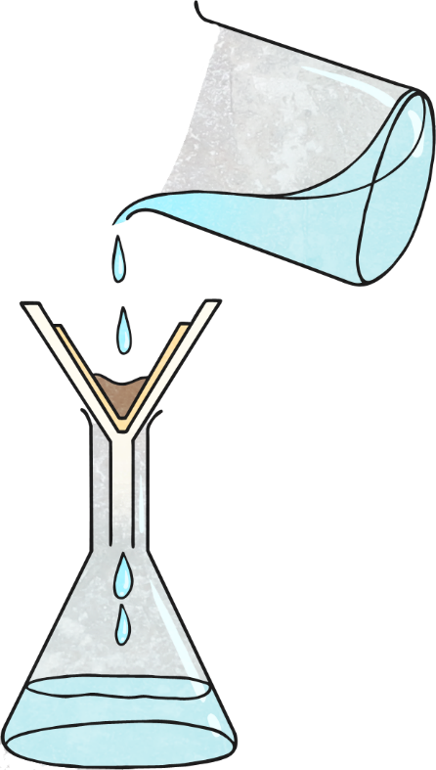
Filtering
This process should be used to separate a mixture of an insoluble solid and a liquid.
A funnel is lined with filter paper and placed over a beaker.
The mixture is poured slowly into the filter paper.
Insoluble solids will not have dissolved in the liquid. The solid particles will not be able to get through the tiny holes in the filter paper, and will be caught in it.
The liquid particles will go through the filter paper into the beaker below.
This process could be used to separate a mixture of sand and water.
Processes

Slide 6
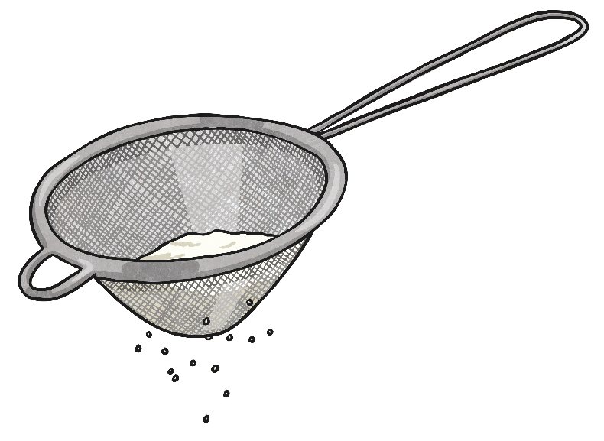
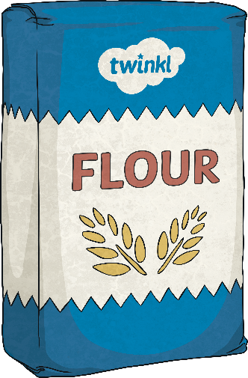
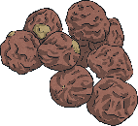
Sieving
Use this process to separate a mixture of different sized solids.
The mixture is poured into a sieve held over a bowl.
The smaller particles will get through it into the bowl and the larger particles will be caught in the sieve.
Mixtures you could separate using this process include raisins and flour, or rice and pasta.
Processes

Slide 7
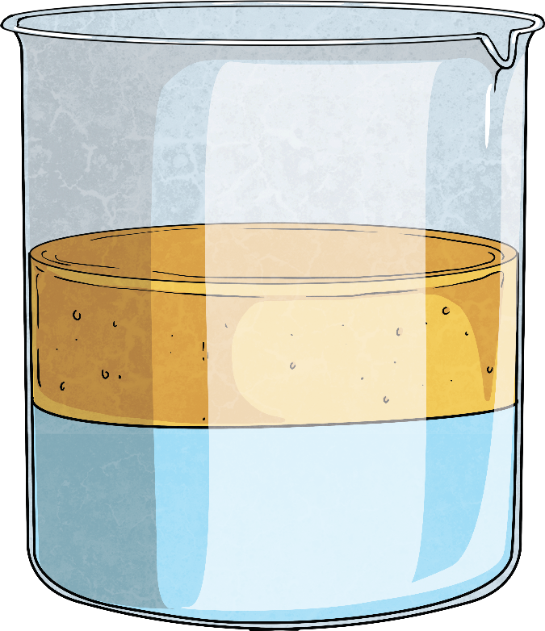
Decanting
This process can be used to separate two liquids that have different densities.
The mixture of liquids is left to settle, so the two liquids are visible as two different layers.
The less dense liquid will be the top layer, and this can be decanted, or slowly poured off.
oil
This process could be used to separate a mixture of oil and water.
water
Processes

Slide 8
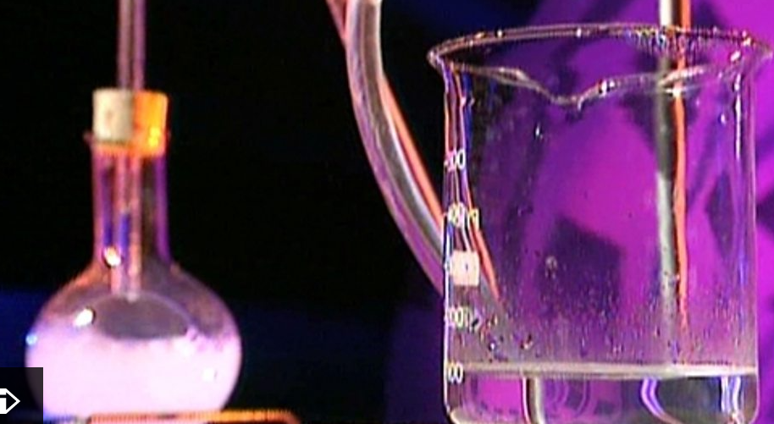
Investigation into Separating Solutions
Click here to watch a video about separating solutions.
Notes:
The experiment we could design

Slide 9
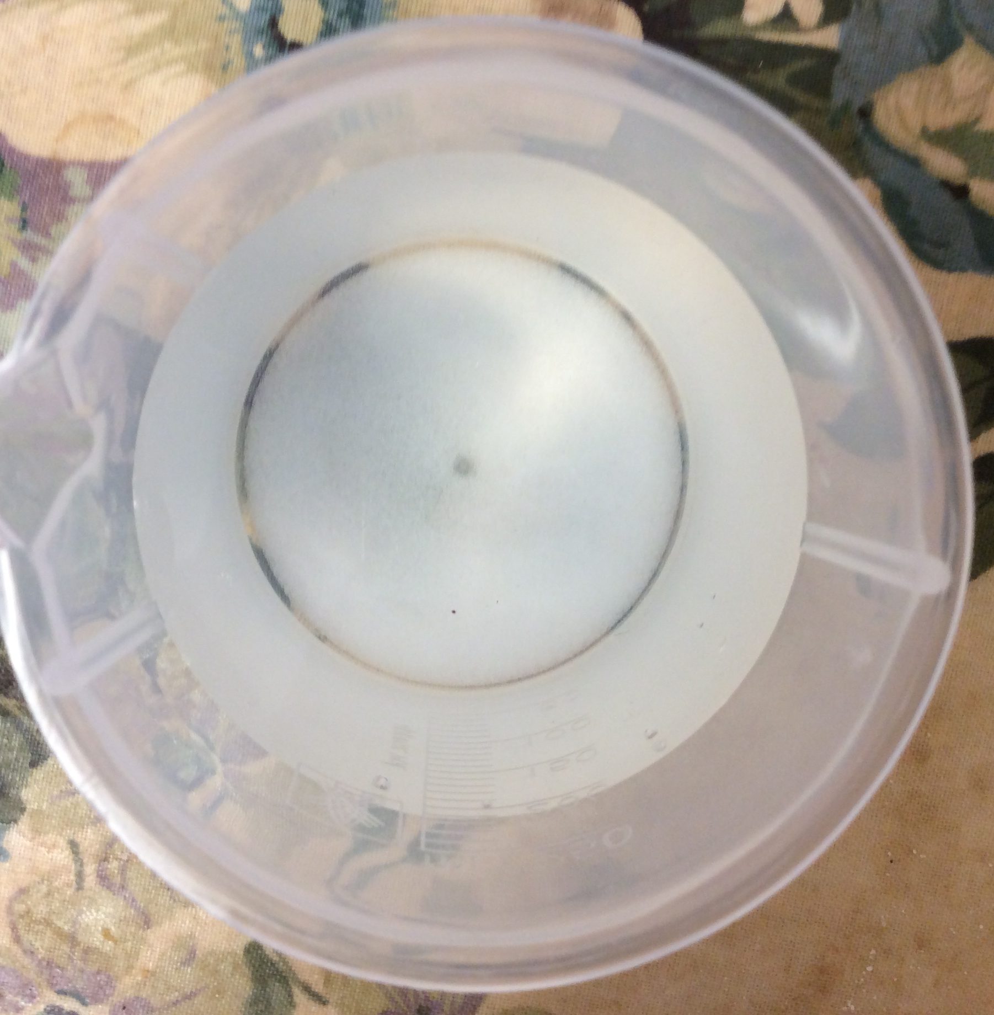
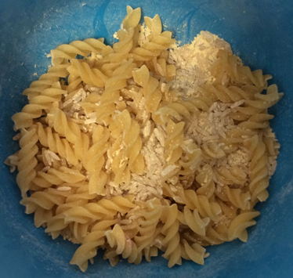
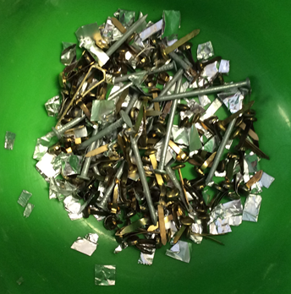
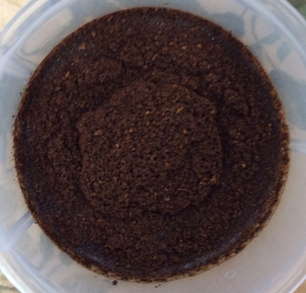
How would you separate the following?
Solutions to separate:
Salty water
Flour, rice and pasta
Filter coffee in water
Iron & brass paper clips

Slide 10
How would you separate the following?
Equipment to use:
Sieves
Filters – cotton wool, muslin, filter paper
Magnets
Hairdryer/candles
Water

Slide 11
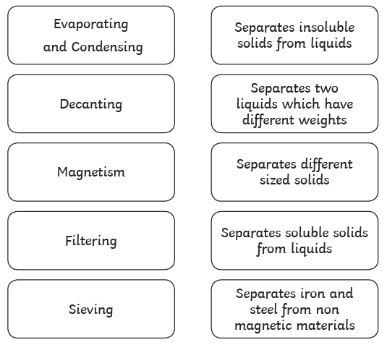



TASK: Match the process with its correct description.

Slide 12
TASK: Write in the process used to separate each material.
Mixture | Process
Salt + water
Sugar + water
Rice + pasta shapes
Sand + water
Flour + rice
Paperclips + sawdust

Slide 13
Investigation prompt questions
Sieving
• Think about the three solids - how many sieves and grades of sieve might you need?
• What order will you sieve the mixture in?
Using magnets
• How will a magnet separate two materials that are both metallic?
• Which metals attracted to magnets?
Filtering
• How many different types of filter could you use? (e.g. cotton wool, piece of muslin, filter paper)
• Which filter works the best (which water is the clearest)?
Evaporation
• Can you find a way to separate the salt from the water so the salt is in solid form again?
• Where could you leave liquids (it will need to be a warm place!) to create the best conditions for evaporation without using a hairdryer or candle?

