Slide 1
Year 1: Why did the great fire of London start and how did it affect London?
By the end of this unit what should pupils know?
 | Pupils should know where London is and why it is our capital city
 | Pupils should know that life was different for children a long time ago
 | Pupils should know how London’s housing was very different a long time ago than it is now
 | Pupils should know that the way fires were dealt with was very different a long time ago
 | Pupils should know that most children at the time of the great fire of London did not go school
 | Pupils should know that London was plagued with rats
 | Pupils should know that the lives of rich people at this time were very different to lives of poor people
 | Pupils should know about the paintings that showed London on fire

Slide 2
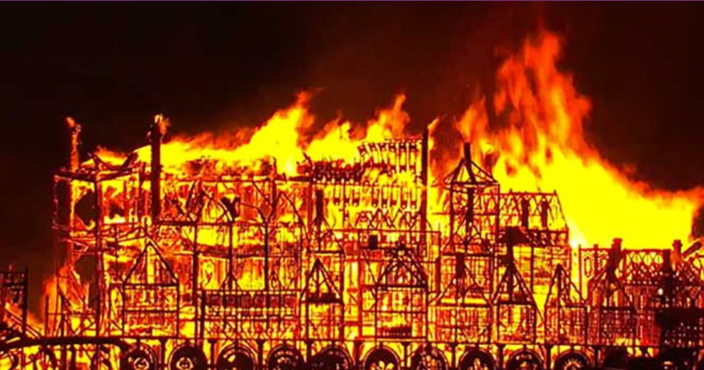
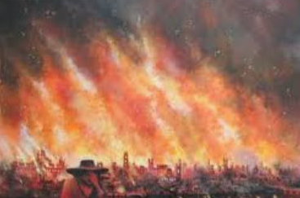
Unit 3: History
Interesting facts about the great fire of London
 | 1 | The fire burned out of control for 3 days.
 | 2 | The fire spread quickly because most of the houses were made of wood.
 | 3 | The fire happened more than 300 years ago (in 1666).
 | 4 | The fire started on Sunday, September 2nd.
 | 5 | Over 1300 houses were destroyed.
 | 6 | Amazingly, only 6 people were believed to have died.
 | 7 | The fire started at a baker’s shop

Slide 3
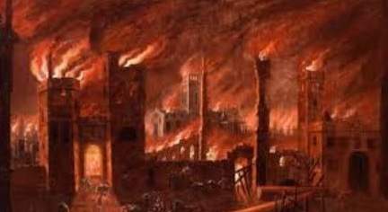
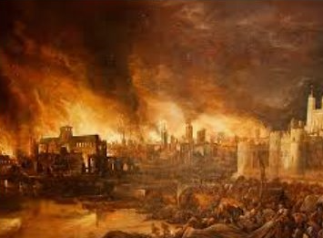
Unit 3: History
Interesting facts about the great fire of London: 2
 | 8 | The baker’s name was Thomas Farriner.
 | 9 | The street was called Pudding Lane.
 | 10 | It took 50 years to rebuild the area destroyed by the fire.
 | 11 | 68 churches were destroyed.
 | 12 | The original St Paul’s Cathedral was destroyed’
 | 13 | Building the new St Paul’s cathedral started in 1675, almost 9 years after the fire.
 | 14 | There was no fire brigade in London at the time so people has to fight the fire themselves.
 | 15 | They got the water from the river Thames.

Slide 4
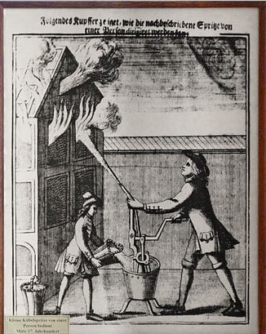
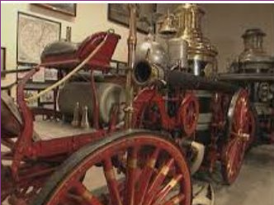
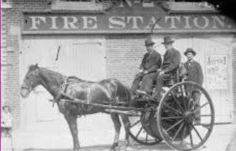
Unit 4: History
What did they use to try and put the fire out?
 | They would have used something as shown in the picture.
 | Water would be poured into the container.
 | The container had a simple pump.
 | The pump was attached to a hose.
 | The hose and pump allowed the water to be spayed much higher than they would otherwise have been able to do.

Slide 5
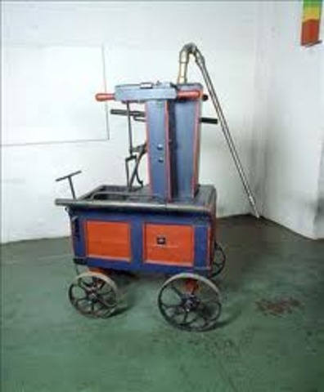

Unit 4: History
How did people try and put out the fire?
 | When the great fire of London happened there were no fire engines.
 | The first ‘fire engine’ didn’t appear until much later. Nearly 100 years later.
 | This is a picture of one of the first fire engines.
 | You would put water into the container and use a pump to spray the water out.
 | In this way the water could reach places that were high up.
 | That was not possible when throwing water from containers.
 | Use a water pump that you use in swimming pools to show how this really works.
 | Fill a bucket with water and then use the pump to spray water as high as you can.
 | Set up a competition.

Slide 6
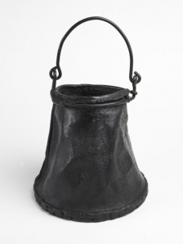
Unit 4: History/ Science
Leather bucket found 50 years ago
 | This leather bucket found 50 years ago is believed to have been used to tackle the great fire of London.
 | The bucket would have been filled with water from the river Thames and then thrown on the fire.
 | Find different materials that could carry water for a distance.
 | Pour water into different materials and carry the water for 10 metres.
 | Work out which is the best material to use
 | Record your outcomes. Consider the following materials
 | wood | plastic | Cotton shirt
 | Woollen jumper | glass | leather

Slide 7
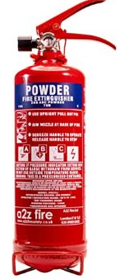
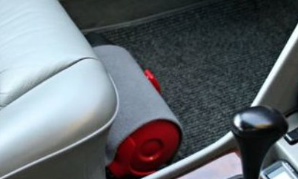
Unit 4: History
Fire Extinguishers
 | A Fire extinguisher is a device which can be used to control a fire. Fire extinguishers can help stop the fire, and may stop it from burning.
 | Depending on the size, some fire extinguishers can be carried around and operated by hand.
 | There are different kinds of fire extinguishers.
 | Find out where the fire extinguishers are in your school.
 | Where else would you find a fire extinguisher?

Slide 8
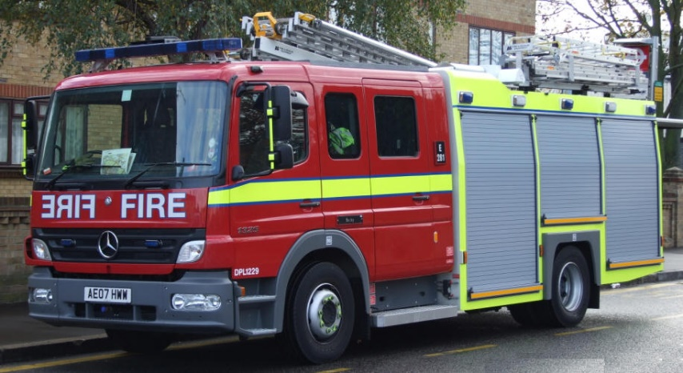
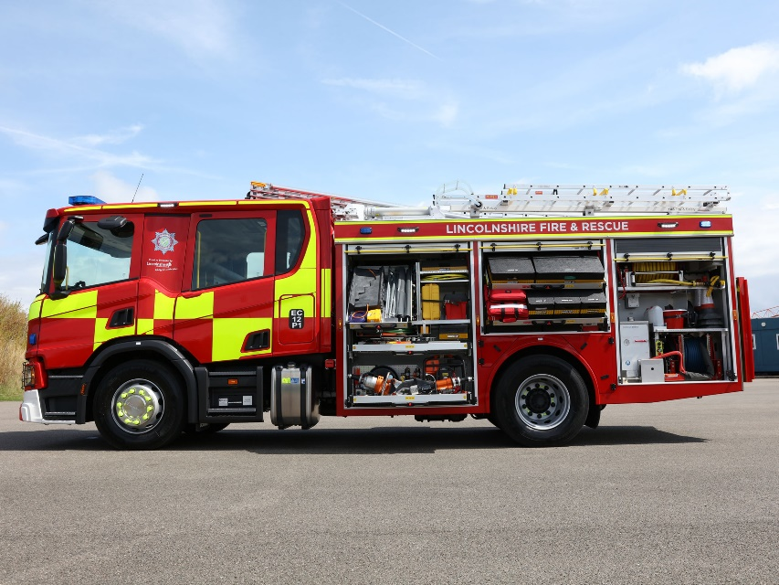
Unit 4: History
What does a modern fire engine look like?
 | Here are two pictures of a modern fire engine. What would you ask a fire fighter if you met one? Here is your chance to ask 8 questions.
 | 1
 | 2
 | 3
 | 4
 | 5

